Slide 1


Project Risk Management
Prepared by Dr. Usama Al-Fendi
PMG 510
Project Risk Management
Lecture 4

Slide 2

Lecture
Outcomes of the chapter:
4
Risk management context:
Components of the RM context
Designing a risk register
Project Risk Management Process
Project Risk Management Planning

Slide 3
Lecture
Risk management Standards
4
Risk management context:
There needs to be a clear understanding of the risk management process, followed by a clear definition of the framework that supports the process.
Because the risk management framework is a supportive structure.
it is shown in the next Figure as a series of components built around and supporting the risk management process.

Slide 4
Lecture
Risk management Standards
4
Risk management context:

Slide 5
Lecture
Risk management Standards
4
Components of the RM context:
Risk architecture: defines roles, responsibilities, communication and risk-reporting structure.
Risk strategy: Risk strategy, appetite, attitudes and philosophy are defined in the risk management policy
Risk protocols: are defined in the risk guidelines for the organization and include the rules and procedures, as well as the risk management methodologies, tools and techniques that should be used

Slide 6
Lecture
Establishing the Context
4
Scope of the context :
The components the context are the risk management context, internal context and external context. The relationship between the three contexts is illustrated in the Figure.

Slide 7
Lecture
Establishing the Context
4
The three components of context may be considered as follows:
1- Risk management context:
Has already been described as the risk architecture, strategy and protocols or the risk management framework within the organization.
This framework must fulfil two functions:
Provide support for the risk management process within the organization;
Ensure that the outputs from the risk management process are communicated to internal and external stakeholders.

Slide 8
Lecture
Establishing the Context
4
The three components of context may be considered as follows:
2- Internal context:
Internal context refers to the organization itself, the activities it undertakes, the range of skills and capabilities available within the organization, and how it is structured.
Internal stakeholders and their expectations are part of the internal context.
Internal context may be considered to be the strengths and weaknesses within the organization.

Slide 9
Lecture
Establishing the Context
4
The three components of context may be considered as follows:
2- Internal context:
The FIRM (Financial, Infrastructural, Reputational, Market Place) risk scorecard offers one mechanism for evaluating the internal and external context of an organization, but other approaches may be employed, including a SWOT analysis.
Many organizations use the political, economic, social, technological, legal and environmental/ethical (PESTLE) risk classification system. The PESTLE risk

Slide 10
Lecture
Establishing the Context
4
The three components of context may be considered as follows:
3- External context :
External context is the environment within which the organization exists.
This environment will include consideration of the business sector within which the organization operates, external stakeholders and their expectations and the external financial environment.
This may be considered to be the opportunities and threats facing the organization.

Slide 11
Lecture
Establishing the Context
4
Designing a risk register:
A risk register is defined as the ‘document used for recording risk Management process for identified risks’.
The guide adds that the purpose of the risk register is to facilitate ownership and management of each risk.
The risk register will cover the significant risks facing the organization or the project.

Slide 12
Lecture
Establishing the Context
4
Designing a risk register:
The purpose of the risk register:
is to form an agreed record (documentation) of the significant risks that have been identified.
Also, the risk register will serve as a record of the control activities that are currently undertaken.
It will also be a record of the additional actions that are proposed to improve the control of the particular risk.

Slide 13
Lecture
Establishing the Context
4
Designing a risk register:

Slide 14
Lecture
Establishing the Context
4
Designing a risk register:

Slide 15
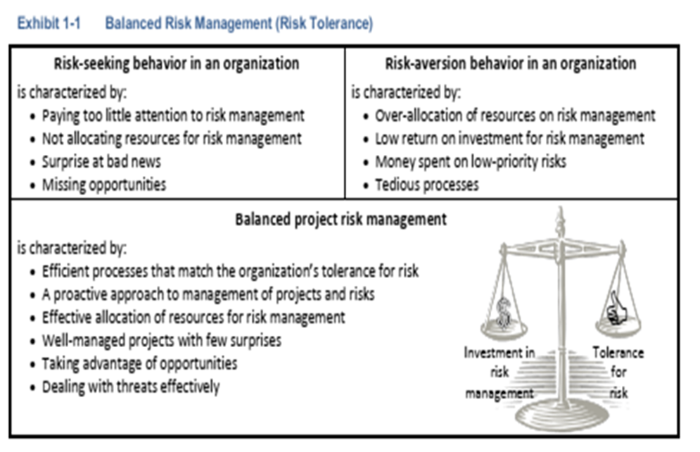
Lecture
Establishing the Context
4
Designing a risk register:

Slide 16
Lecture
Project Risk Management Guide
4
Project risk management delivers a number of values to the project, including:
Recognizes uncertainty and provides forecasts of possible outcomes.
Produces better business outcomes through more informed decision making.
Has a positive influence on creative thinking and innovation.
Creates opportunities for improved project monitoring and control.
Can aide in addressing concerns with respect to overhead and time.

Slide 17
Lecture
Project Risk Management Guide
4
Project Risk Management Process
Risk management, as an integral part of project management, occurs on a daily basis.
With proactive risk management, we look at projects in a comprehensive manner and assess an document risks and uncertainty.
The steps for risk management are provided below.

Slide 18
Lecture
Project Risk Management Guide
4
Project Risk Management Process
Risk Management Planning
Identify Risk Events
Qualitative Risk Analysis
Quantitative Risk Analysis
Risk Response
Risk Monitoring & Control

Slide 19
Lecture
Project Risk Management Guide
4
Project Risk Management Process
Risk Management Planning: Risk management planning is the systematic process of deciding how to approach, plan, and execute risk management activities throughout the life of a project. It is intended to maximize the beneficial outcome of the opportunities and minimize or eliminate the consequences of adverse risk events.

Slide 20
Lecture
Project Risk Management Guide
4
Project Risk Management Process
2. Identify Risk Events: Risk identification involves determining and documenting which risks can affect the project. It may be a simple risk assessment organized by the project team, or an outcome of a formal risk assessment process such as the Cost Estimate Validation Process, CEVP.

Slide 21
Lecture
Project Risk Management Guide
4
Project Risk Management Process
3. Qualitative Risk Analysis: Qualitative risk analysis involves Project teams assessing identified risks for probability of occurrence and impact on project objectives. Teams may elicit assistance from subject matter experts or functional units to assess the risks in their respective fields. Risks are measured by their “quality” in words rather than quantified in numbers.

Slide 22
Lecture
Project Risk Management Guide
4
Project Risk Management Process
4. Quantitative Risk Analysis: Quantitative risk analysis is a way of numerically estimating the probability that a project will meet its cost and time objectives. Quantitative analysis is based on a simultaneous evaluation of the impacts of all identified and quantified risks.

Slide 23
Lecture
Project Risk Management Guide
4
Project Risk Management Process
5. Risk Response : involves developing options and determining actions to reduce threats or enhance opportunities to project objectives. Actions are identified and assigned to parties that take responsibility for the risk response. This process ensures each risk requiring a response has an “owner.” The Project Manager and the project team identify a strategy that is best for each risk, and then select specific actions to implement that strategy.

Slide 24
Lecture
Project Risk Management Guide
4
Project Risk Management Process
6. Risk Monitoring & Control: Risk monitoring and control tracks identified risks, monitors residual risks, and identifies new risks—ensuring the execution of risk plans and evaluating their effectiveness in reducing risk. Risk monitoring and control is an ongoing process for the life of the project.
Much of project risk management relies on sound engineering judgment and knowing where to focus energy and resources. Knowing when to engage appropriate expertise is vital to good project risk management.
provides a helpful comparison between risk and objectives for various types of risk management. For this document we are interested in project risk management.

Slide 25
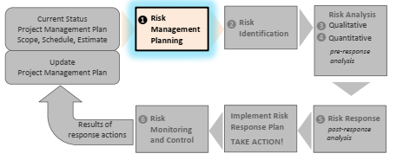
Lecture
Project Risk Management Guide
4
Project Risk Management Process

Slide 26
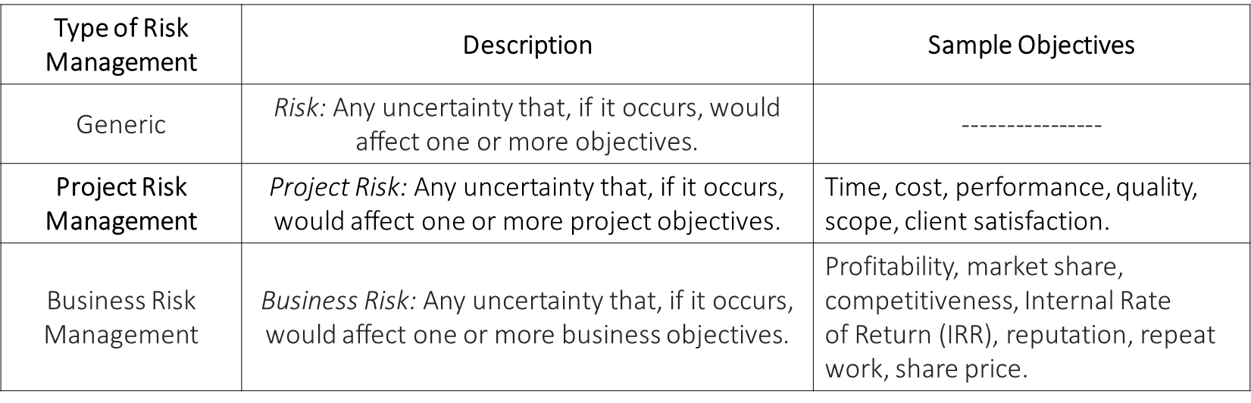
Lecture
Project Risk Management Guide
4
The following table provides a helpful comparison between risk and objectives for various types of risk management. we are interested in project risk management

Slide 27
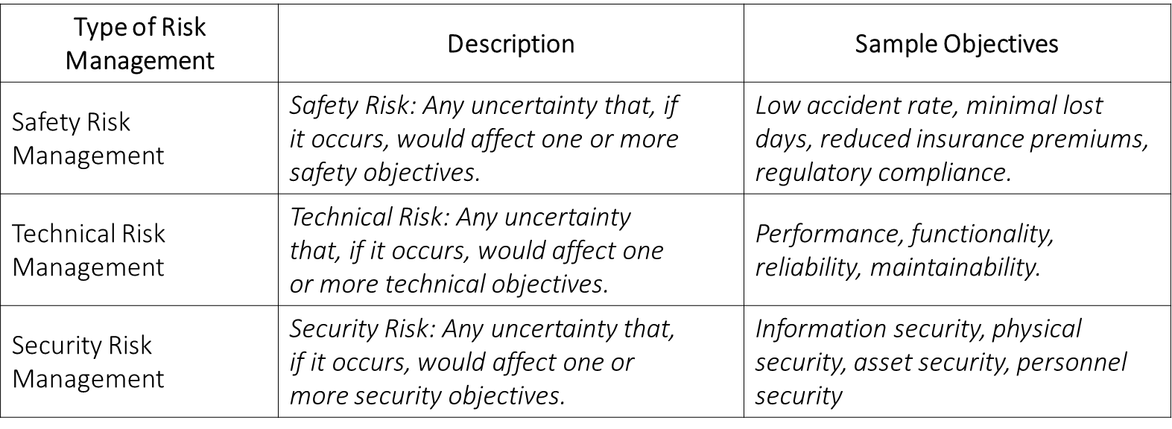
Lecture
Project Risk Management Guide
4

Slide 28
Lecture
Project Risk Management Guide
4
Great project risk management requires good planning.
Risk management must commence early in project development and proceed as the project evolves and project information increases in quantity and quality.

Slide 29
Lecture
Project Risk Management Guide
4
Aim of the project risk Plan :
Identify, assess/analyze, and respond to major risks
Continually monitor project risks and response actions.
Conduct an appropriate number and level of risk assessments to update the Risk Management Plan and evolving risk profile for the project.

Slide 30
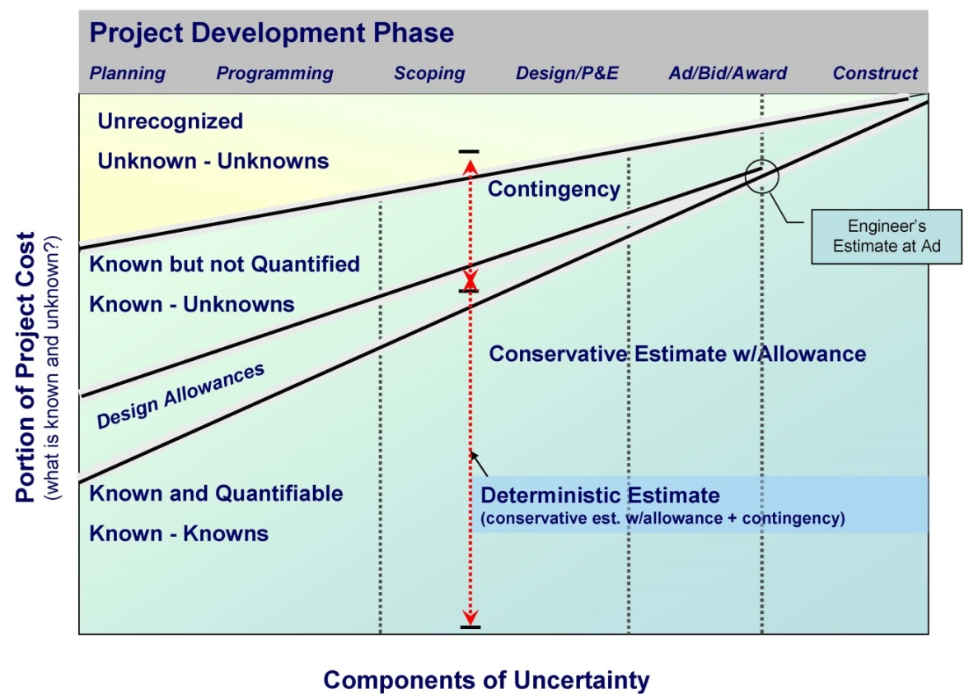
Lecture
Project Risk Management Guide
4
Evolution of Project Knowledge Through Project Development

Slide 31
Lecture
Project Risk Management Guide
4
Project Risk Management Planning:
The above figure illustrates how project information develops and evolves over time.
With rising project knowledge comes an understanding that contending with some elements of the project will require significant additional resources.
These elements could involve: scope; environmental mitigation and permitting; rising cost of right of way as corridors develop in advance of the project; utilities; seismic issues; and other elements.

Slide 32
Lecture
Project Risk Management Guide
4
Project Risk Management Planning:
How to Plan for Project Risk Management
Determine the level of risk assessment for your project .
2. Incorporate risk management activities into the project schedule.
3. Make risk management an agenda item for scheduled project meetings.
4. Communicate the importance of risk management to the entire project team.
5. Establish the expectation that risk will be managed, documented, and reported.

Slide 33
Lecture
Project Risk Management Guide
4
Project Risk Management Planning:
Tips for Risk Management Planning
Risk assessment planning should begin early. There is a minimum level of project knowledge needed to understand what is being assessed.
This varies depending on the point in project development at which the risk assessment is conducted (planning, scoping, design); hence, schedule risk assessments at appropriate times.

Slide 34
Lecture
Project Risk Management Guide
4
Project Risk Management Planning:
Tips for Risk Management Planning
At a minimum there must be an understood project scope of work, associated project cost estimate – with a basis of estimate complete, and an estimated project schedule.
Allow a budget and time in the schedule for risk assessment, risk management, and risk response activities.
Report on the status of project risk at regularly scheduled project meetings.

Slide 35
Lecture
Project Risk Management Guide
4
Project Risk Management Planning:
Tips for Risk Management Planning
Know the organization’s tolerance for risk. Are Project Managers (and upper management) risk averse or risk seeking? How much risk is the organization willing to accept? Knowing the answers to these questions will help with risk management and contribute to the decision-making process when determining risk response actions.
Contact the Strategic Analysis and Estimating Office (SAEO) and discuss the possibility of coordinating or integrating project risk assessment with value engineering

Slide 36
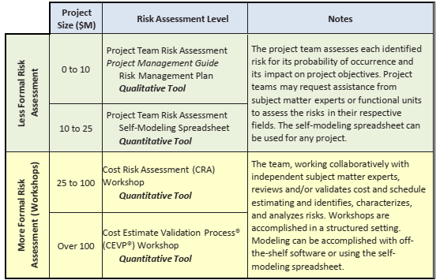
Lecture
Project Risk Management Guide
4
Project Risk Management Planning:

Slide 37


Thank You

