Slide 1

Problem Solving as Search & State Space Search
Dr. Mohamed Mostafa
AI 511
Foundations of Artificial Intelligence
Lecture 4

Slide 2


3.1 Solving problems by Searching
Solving Problems by Searching
Types of Agents (Reflex vs. Planning)
State Space Search
Example: Tic-Tac-Toe Game
Example: 8-Queens Problem
How human beings think?
Heuristic Search
3.2 State Space Search Graph & Strategies
Search Problem Components
Example: Romania
State Space & State Space Graph
Example: Vacuum World
Example: The 8-Puzzle
Example: Robot Motion Planning
Example: Tic-Tac-Toe
Example: Traveling Salesperson
State Space Search Strategies
Selecting Search Strategy
3.3 Basic Idea of Search & the Backtracking Search Algorithm
Search: Basic idea
Search Tree
Tree Search Algorithm Outline
Tree Search Example
Handling Repeated States
Backtracking Search
Backtracking Algorithm Data Structures
Backtracking Algorithm
3.4 Practice Exercises (Solved Problems)
01

Slide 3
Resources for this lecture
  Chapter 3 (Structures & Strategies for State Space Search; sections 3.2, and 3.3) and Chapter 4 (Heuristic Search) from George F. Luger, "Artificial Intelligence: Structures and strategies for complex problem solving, " Sixth edition (2009), Pearson Education Limited..
  .. AND ..
  Introduction to Artificial Intelligence Course,. Dr. Amr S. Ghoneim

Slide 4
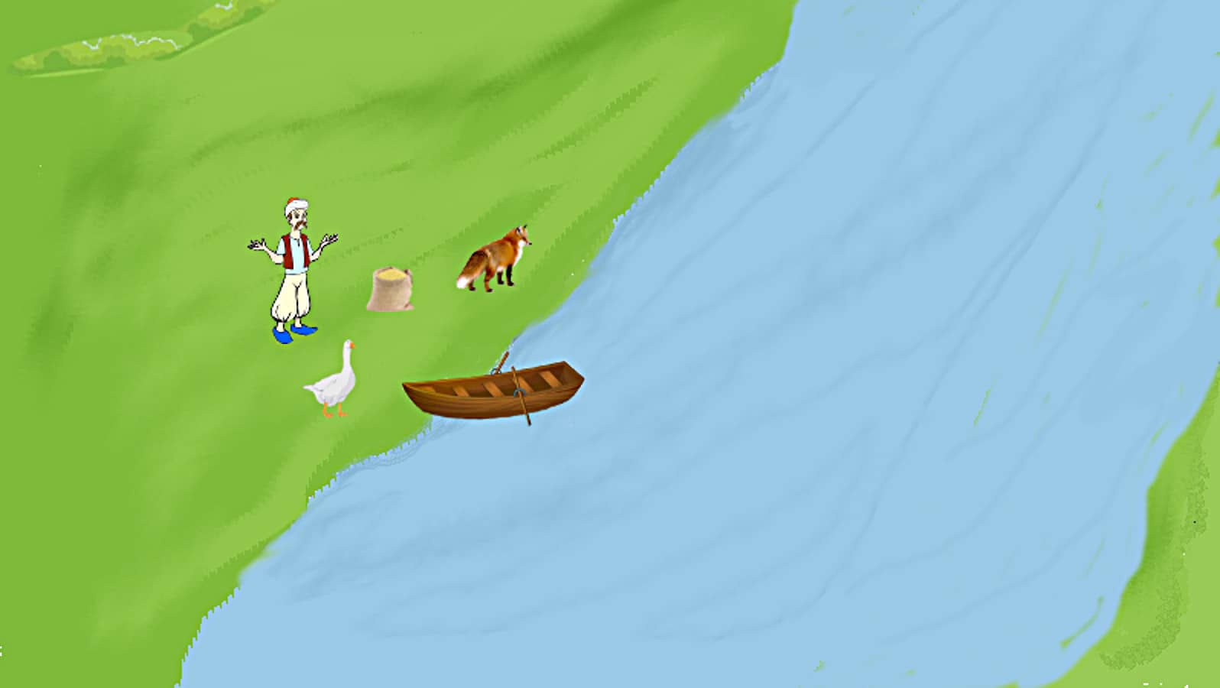
Recap with Example
Draw the graphical state space for the following Puzzle:
There are man, fox, goose, and cereals. If the man is not beside the fox, the fox will eat the goose. If the man is not beside the goose, the goose will eat the cereal. The man wants to bring them all to a land across river. Unfortunately there is only a small ship. The ship can contain only man and fox or man and goose or man and cereal.
Source: math.stackexchange.com

Slide 5
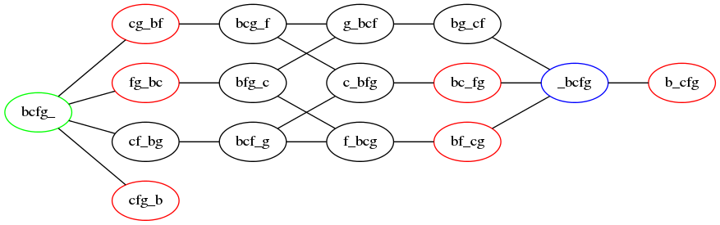
Recap with Example
Draw the graphical state space for the following Puzzle:
f: fox
b: boat + man
g: goose
c: cereal
A node labeled bg_cf means that the boat (and the man) and goose are on the left bank of the stream, the cereal and fox are on the right bank.
Source: math.stackexchange.com

Slide 6
Recap with Example
Draw the graphical state space for the following Puzzle:
  Initial state : bcfg_
  Actions: crossing the river
  State space: 16
  Transition model: one object to the other river bank
  Goal state : _bcfg
  Path cost: find the shorts & safest path
Source: math.stackexchange.com

Slide 7
Search: Basic idea
Start by identifying the initial state and list all potential successor states.
Maintain a frontier, which is a collection of unexpanded states.
Continuously select a state from the frontier to expand upon at each step.
Continue this process until you reach a state that satisfies the goal condition.
Aim to minimize the number of states expanded during the search process.

Slide 8
Search: Basic idea
start

Slide 9
Search: Basic idea

Slide 10
Search: Basic idea

Slide 11
Search: Basic idea

Slide 12
Search: Basic idea

Slide 13
Search: Basic idea

Slide 14
Search: Basic idea

Slide 15
Search: Basic idea

Slide 16
Search: Basic idea

Slide 17
Search: Basic idea

Slide 18
Search: Basic idea

Slide 19
Search: Basic idea

Slide 20
Search Example
Frontier
Source: math.stackexchange.com

Slide 21
Search Example
Frontier
Source: math.stackexchange.com

Slide 22
Search Example
Frontier
Source: math.stackexchange.com

Slide 23
Tree Search Algorithm Outline
Initialize the frontier using the starting state.
While the frontier is not empty:
  Choose a frontier node according to search strategy and take it off the frontier.
  If the node contains the goal state, return solution.
  Else expand the node and add its children to the frontier.

Slide 24
Uninformed vs. Informed Strategies
Various types of searches are employed across artificial intelligence, machine learning, deep reinforcement learning, and neural networks. These search methods are typically categorized into two groups:
Uninformed search is known as Blind, Exhaustive, or Brute-Force approaches, It doesn’t have any information about the goal, so it examines each node and consumes time in order to search for the goal.
Informed search is know as Heuristic, it exploits such information to assess that one node is “more promising” than another. The heuristic assigns the real number values to the nodes, and branches and the space provide the solution to the model in order to get the search on that particular area.

Slide 25
Blind Strategies
Breadth-First Search [BFS]
  Bidirectional Search
Depth-First Search [DFS]
  Depth-Limited Search
  Iterative Deepening Search
Uniform-Cost Search [UCS]

Slide 26
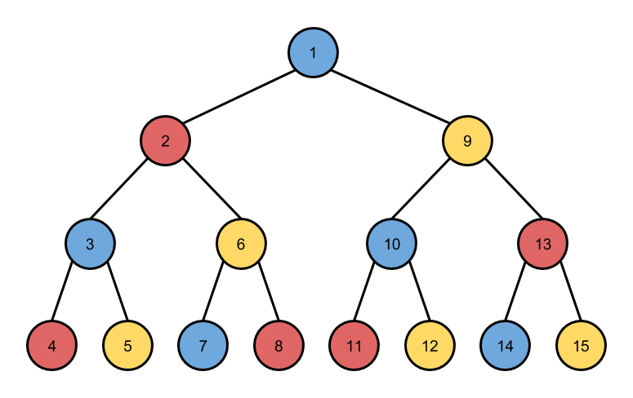
Depth-First Strategy
Initial
1
Frontier Stack
Goal

Slide 27
Depth-First Strategy
Initial
2
9
Frontier Stack
Goal

Slide 28
Depth-First Strategy
Initial
3
6
9
Frontier Stack
Goal

Slide 29
Depth-First Strategy
Initial
4
5
6
9
Frontier Stack
Goal

Slide 30
Depth-First Strategy
Initial
5
6
9
Frontier Stack
Goal

Slide 31
Depth-First Strategy
Initial
7
8
9
Frontier Stack
Goal

Slide 32
Depth-First Strategy
Initial
9
Frontier Stack
Goal

Slide 33
Depth-First Strategy
Initial
10
13
Frontier Stack
Goal

Slide 34
Depth-First Strategy
Initial
10
13
Frontier Stack
Goal

Slide 35
Depth-First Strategy
Initial
11
12
13
Frontier Stack
Goal

Slide 36

Depth-First Strategy
Initial
12
13
Frontier Stack
Goal

Slide 37
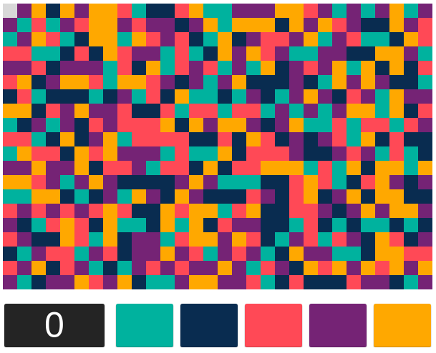
Exercise
Can you use the DFS to solve the Color Walk Game.
https://jenniferdewalt.com/color_walk/game

Slide 38
Depth-First Strategy
DFS(G, u)
u.visited = true
for each v ∈ G.Adj[u]
if v.visited == false
DFS(G,v)
init() {
For each u ∈ G
u.visited = false
For each u ∈ G
DFS(G, u) }

Slide 39
Depth-First Strategy
Time Complexity: Time complexity of DFS will be equivalent to the node traversed by the algorithm. It is given by:
T(n)= 1+ n²+ n³ +.........+ n^{m}=O(n^{m})
m= maximum depth of any node → this can be much larger than d (lowest solution depth)
Space Complexity: DFS algorithm needs to store only single path from the root node, hence space complexity of DFS is equivalent to the size of the fringe set, which is O(bm).
b= the branching factor

Slide 40
Breadth-First Strategy
Initial
1
Frontier Queue
Goal

Slide 41
Breadth-First Strategy
9
Initial
2
Frontier Queue
Goal

Slide 42
Breadth-First Strategy
3
Initial
9
6
Frontier Queue
Goal

Slide 43
Breadth-First Strategy
6
13
Initial
3
10
Frontier Queue
Goal

Slide 44
Breadth-First Strategy
13
4
6
5
Initial
10
Frontier Queue
Goal

Slide 45
Breadth-First Strategy
13
8
4
5
Initial
10
7
Frontier Queue
Goal

Slide 46
Breadth-First Strategy
8
12
13
11
4
5
Initial
7
Frontier Queue
Goal

Slide 47
Breadth-First Strategy
8
12
11
14
4
15
5
Initial
7
Frontier Queue
Goal

Slide 48
Breadth-First Strategy
8
12
11
14
5
15
Initial
7
Frontier Queue
Goal

Slide 49
Breadth-First Strategy
8
12
11
14
5
15
Initial
7
Frontier Queue
Goal

Slide 50
Breadth-First Strategy
8
12
11
14
Initial
7
15
Frontier Queue
Goal

Slide 51
Breadth-First Strategy
8
12
11
14
Initial
15
Frontier Queue
Goal

Slide 52
Breadth-First Strategy
12
11
14
Initial
15
Frontier Queue
Goal

Slide 53

Breadth-First Strategy
12
14
Initial
15
Frontier Queue
Goal

Slide 54
Breadth-First Strategy
create a queue Q
mark v as visited and put v into Q
while Q is non-empty
remove the head u of Q
mark and enqueue all (unvisited) neighbours of u

Slide 55
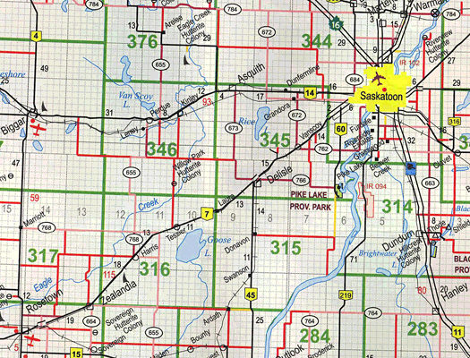
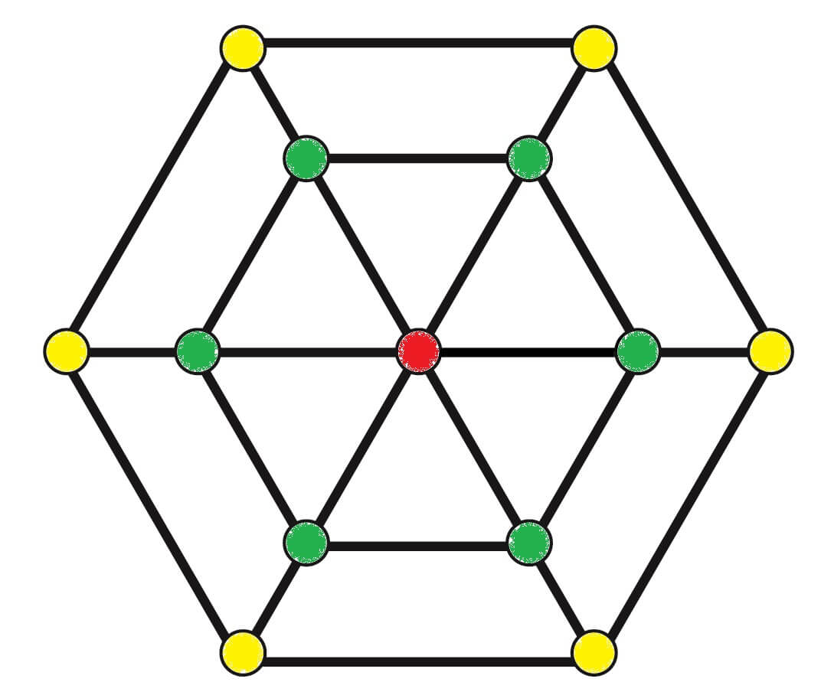
Breadth-First Strategy
Breadth First Search example (BFS) – How GPS navigation works
Source: hackerearth

Slide 56
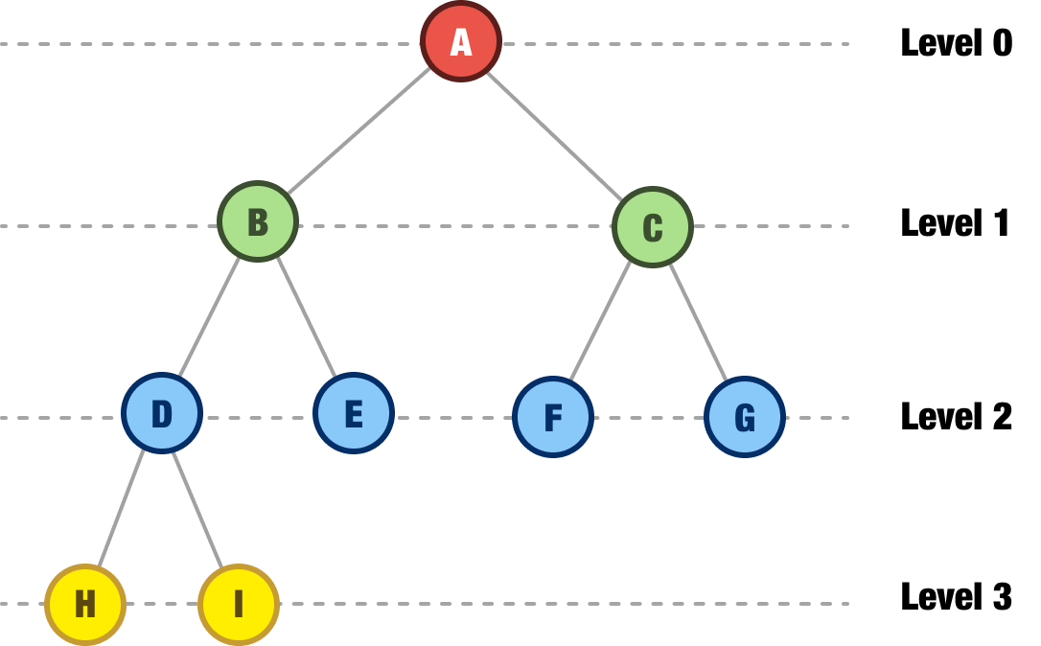
Breadth-First Strategy
Time Complexity: Time Complexity of BFS algorithm can be obtained by the number of nodes traversed in BFS until the lowest node. Where:
  O(V + E), where V is the number of nodes and E is the number of edges
Space Complexity: Space complexity of BFS algorithm is given by the Memory size of frontier which is O(b^{d}).

Slide 57
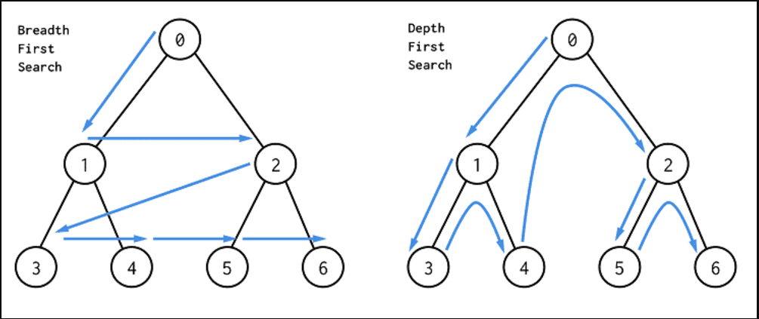
Depth-First Strategy vs. Breadth-First Strategy
Picture credit to https://res.cloudinary.com/practicaldev/image/fetch/s---f65OlYQ--/c_imagga_scale,f_auto,fl_progressive,h_420,q_auto,w_1000/https://dev-to-uploads.s3.amazonaws.com/i/e2ru41fjhqs4ombbcedf.png

Slide 58
Depth-Limited Strategy (DLS)
Same as Depth-first with depth cutoff k (maximal depth below which nodes are not successors)
Three possible outcomes:
  Solution.
  Failure (no solution).
  Cutoff (no solution within cutoff).
Iterative-Deepening Strategy (IDDFS)
The iterative deepening algorithm is a combination of DFS and BFS algorithms.
Repeat for k = 0, 1, 2, .. :
  - Perform depth-first with depth cutoff k

Slide 59
Depth-Limited Strategy
Initial
5
6
9
Frontier Stack
Goal

Slide 60
Iterative-Deepening Strategy (IDDFS)
1'st Iteration
Initial
2‘nd Iteration
3‘rd Iteration
Goal

Slide 61
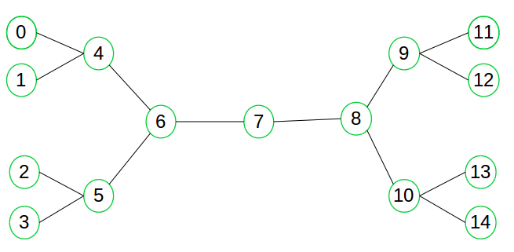
Bidirectional Search Strategy
The bidirectional search algorithm operates by conducting two concurrent searches.
One search, known as the forward-search, originates from the initial state.
The other search, referred to as the backward-search, originates from the goal node.
These searches progress independently towards the goal node.
The algorithm terminates when the paths from the initial state and the goal node intersect.
Initial
Goal
Intersection

Slide 62
Additional Resources
  Uninformed Search Algorithms
  https://www.javatpoint.com/ai-uninformed-search-algorithms
  Color walk problem algorithms
  https://sam-koblenski.blogspot.com/2017/09/exploring-simple-game-algorithms-with.html

Slide 63
Exercises
A
/ | \
B C D
/ \ / \
E F G H
/ \
I J
Consider the following complex tree structure:
Perform a Depth-First Search (DFS) traversal of the tree.
Perform a Breadth-First Search (BFS) traversal of the tree.

Slide 64
Exercises
There are man, fox, goose, and cereals. If the man is not beside the fox, the fox will eat the goose. If the man is not beside the goose, the goose will eat the cereal. The man wants to bring them all to a land across river. Unfortunately there is only a small ship. The ship can contain only man and fox or man and goose or man and cereal.
Source: math.stackexchange.com

Slide 65



Thank You

