Slide 1


College of Management
Project Communications
Lecturer: Dr. Raef Baraka
PMG 112
Lecture 08

Slide 2


Reference Book:
Ch1: Introduction.
Ch2: Exploring Communication Theories.
Ch3: Knowing Your Audience.
Ch4: Starting with the Basics.
Ch5: Planning Project Communications.
Ch6: Managing and Monitoring Project Communications.
Ch7: Using Project Communication Tools.
Ch8: Communicating Change.
Ch9: Managing Conflict through Communication.
Ch10: Closing.

Slide 3

Chapter 8: Communicating Change
The purpose of this chapter is to help you:
Understand change management, including three common models of managing change.
Describe how change management and project management work together.
Integrate change management into a project through communications.

Slide 4
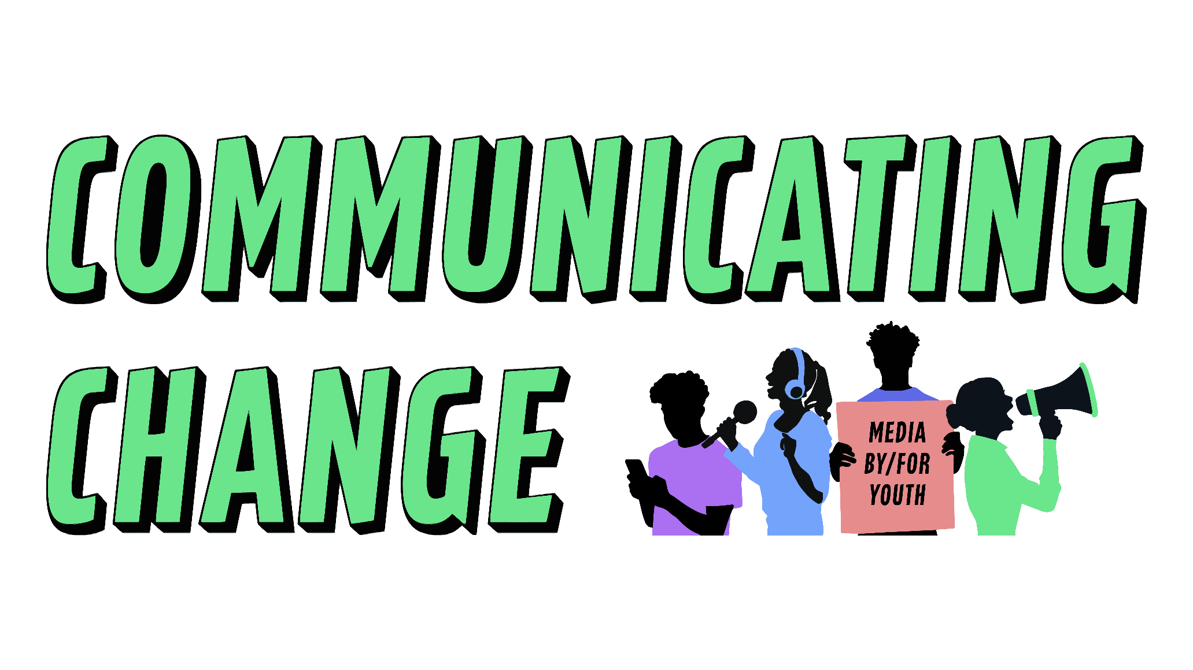
Communicating Change
You can’t build an adaptable organization without adaptable people—and individuals
change only when they have to or when they want to.
—Gary Hamel, American management consultant, professor, and author

Slide 5

Communicating Change
Communicating Change
What is a project if not an engine for change?
Whether the goal is to build a bridge, develop a new piece of software, transform an organization, or offer a new service or product to customers, the intent is that at the end of the project, something will be different than when it began.
Dr. Raef Baraka

Slide 6
Communicating Change
Communicating Change
At the same time, humans are naturally resistant to change. Employees can view change within an organization as a threat in many different ways —to their sense of control, to their feeling of competence in doing their job, to their expected workload and ability to complete everything asked of them, and even to their job security if the change could make what they do obsolete.
They are uncertain, and depending upon whether and how their uncertainty is addressed, they could resist the change.
Dr. Raef Baraka

Slide 7
Communicating Change
Communicating Change
Change initiatives have a high rate of failure. Research shows that anywhere from 46 to 70 percent of organizational change efforts fail.
Research also shows, however, that actively managing change positively impacts success in projects and organizational initiatives.
Organizations that excel at change management are five times more likely to integrate communication into their change management strategy, and are eight times more likely to implement and maintain changes.
Dr. Raef Baraka

Slide 8

Communicating Change
What Is Change Management?
Dr. Raef Baraka

Slide 9
Communicating Change
What Is Change Management?
The Association for Change Management Professionals (ACMP) defines change as:
“The transition from a current state to a future state.”
Current state and future state bookend the change—they are defined respectively as the conditions at the start when the change begins and at the end once the benefits of the change have been realized.
Change management is “the practice of applying a structured approach to the transition of an organization from a current state to a future state to achieve expected benefits.
Change management focuses on the people within the organization who are affected by the change (all stakeholders, including the project team), and how to support them in accepting the change and transitioning to the future state.
Dr. Raef Baraka

Slide 10
Communicating Change
How Do Change Management and Project Management Work Together?
Project management methodologies typically emphasize the organization and management of resources and activities required to complete projects (deliver the change) within the defined scope, budget, timeline, and quality standards.
Change management methodologies typically emphasize the people side of change and the activities required to prepare the organization for the delivered change, facilitate the transition from the old way of working to the future state, and embed the change as the new norm.
As you can see, change management and project management differ but overlap and are often interdependent. Integrating the two can help ensure that the objectives of the project (and the organization) are achieved.
Dr. Raef Baraka

Slide 11
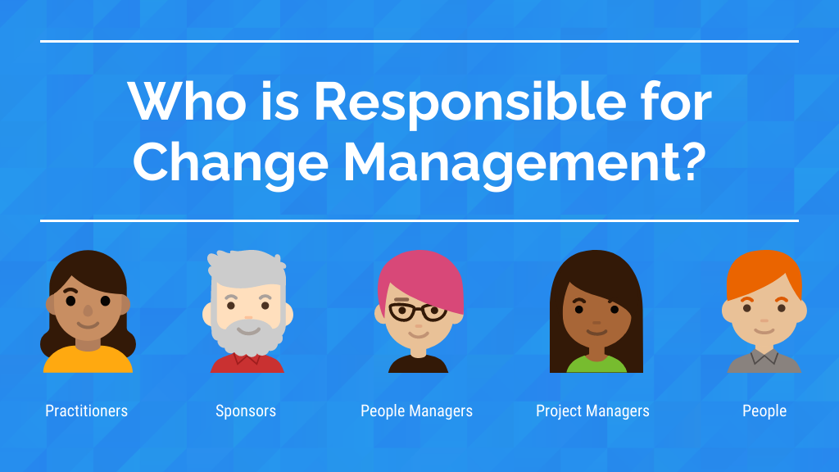
Communicating Change
Who is Responsible for Change Management?
Dr. Raef Baraka

Slide 12
Communicating Change
Who is Responsible for Change Management?
The responsibility for that integration varies depending on the context of the project:
Some organizations have change management offices, departments, and/or practitioners who specialize in this methodology. These practitioners are often part of the project team, and their role is to ensure the integration of change management principles into the life cycle of the project.
Other organizations expect communication professionals to address change management as part of their responsibilities within a project.
In many projects, change management or communication resources are not available to the project team. In these cases, it is the responsibility of the project team to ensure that change management principles are addressed.
Dr. Raef Baraka

Slide 13

Communicating Change
Change Management Models
Dr. Raef Baraka

Slide 14
Communicating Change
Change Management Models
There are a number of change management models available. Here is a brief overview of three of the most common: Kotter’s eight-step model, Lewin’s model, and the Prosci ADKAR model.
While these models have different components and approaches, you’ll see that they address similar concepts.
Models like these can be useful frameworks to help you integrate change management principles into your project.
Dr. Raef Baraka

Slide 15
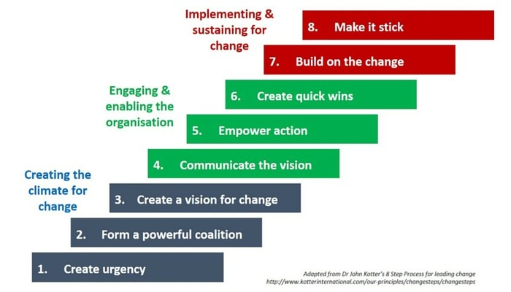
Communicating Change
Change Management Models
Kotter’s Eight Steps Model
John Kotter proposes an eight steps plan to help organizations change successfully.
He based his approach on his personal experience and research with dozens of organizational change initiatives.
Dr. Raef Baraka

Slide 16
Communicating Change
Change Management Models
Kotter’s Eight Steps Model
  Create a sense of urgency around identified crises or opportunities.
  Build a team to lead the change.
  Develop a vision for the change and a strategy to achieve the vision.
  Get everyone on board by communicating the change vision.
  Empower employees to action and remove barriers to change.
  Generate short-term wins to build momentum and positive reaction to the change.
  Continue the change momentum until the change vision is achieved.
  Anchor the change within the organization’s culture.
Dr. Raef Baraka

Slide 17
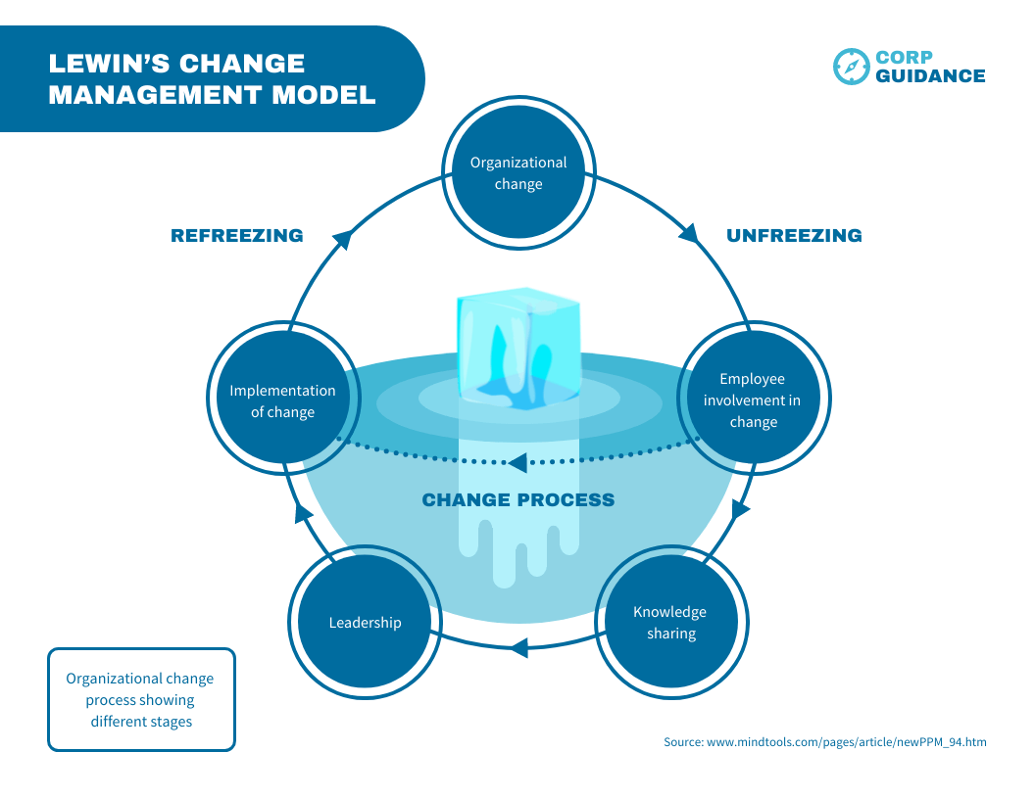
Communicating Change
Change Management Models
Lewin’s Model
Kurt Lewin’s model for change is one of the earliest (1951), and while it is simple, it is still widely used today.
He presented “Changing as Three Steps process.
Dr. Raef Baraka

Slide 18
Communicating Change
Change Management Models
Lewin’s Model
  Step 1: Unfreeze—People and organizations must prepare for change. One strategy to accomplish this is to demonstrate the discrepancy between the current state and the desired state.
  Step 2: Change—People must change behaviors and embrace new roles and responsibilities. This is where change is put into action through new structures and processes.
  Step 3: Refreeze—The new systems and behaviors are cemented into place. Support mechanisms like reward systems and reinforced cultural values can help accomplish this.
Dr. Raef Baraka

Slide 19
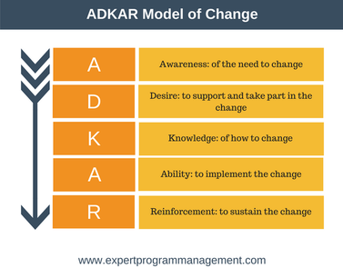
Communicating Change
Change Management Models
The Prosci ADKAR Model
Jeff Hiatt, founder of the change management consultancy and training organization Prosci, developed a model that can be a useful tool in understanding and facilitating the five outcomes that individuals need to achieve in order to make change “stick.”
Dr. Raef Baraka

Slide 20
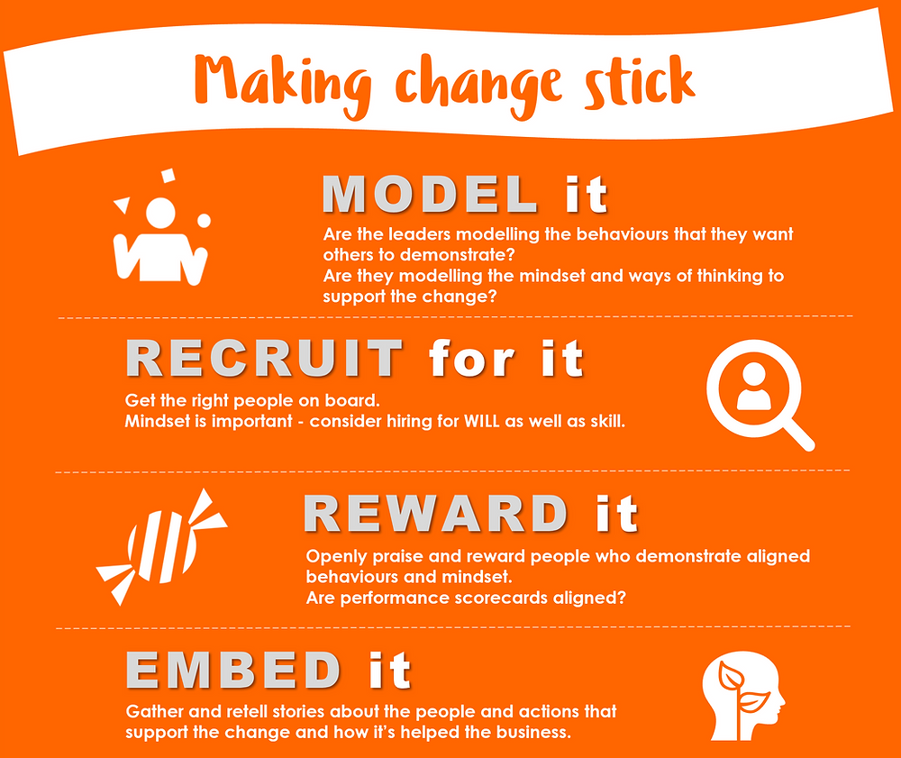
Communicating Change
Change Management Models
The Prosci ADKAR Model
Awareness of the reasons/need for change
Desire to participate in the change
Knowledge about how to change
Ability to implement the change
Reinforcement of the change11
Dr. Raef Baraka

Slide 21
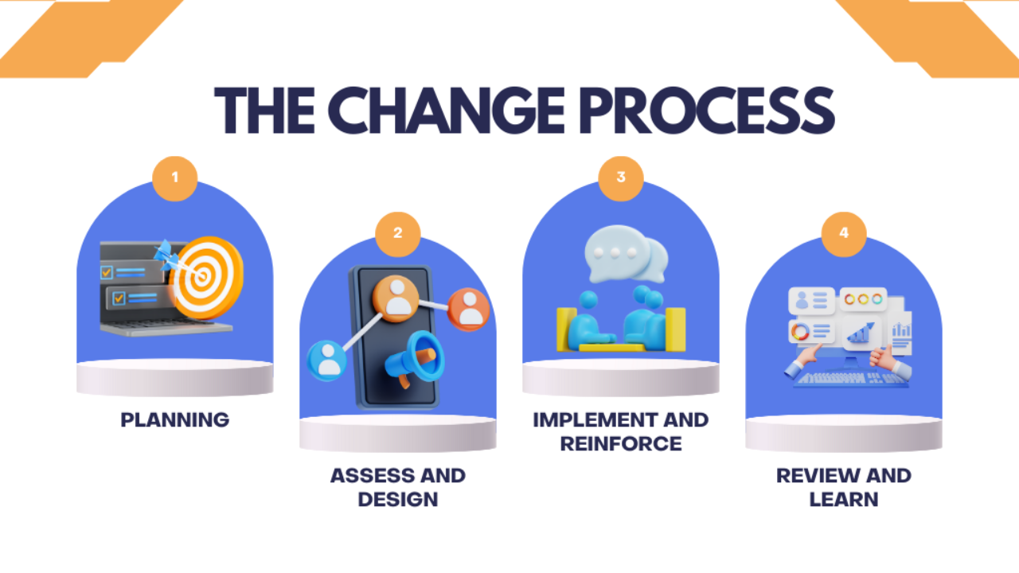
Communicating Change
Communicating Change
Dr. Raef Baraka

Slide 22
Communicating Change
Communicating Change
There are four change management concepts to build into your project communications:
  The need for change
  The effect of the change on stakeholders
  Stakeholder support through the change
  Change reinforcement
As you build your project communications management plan, use these four concepts to inform the content of your messages, timing, and other aspects of the plan.
Dr. Raef Baraka

Slide 23
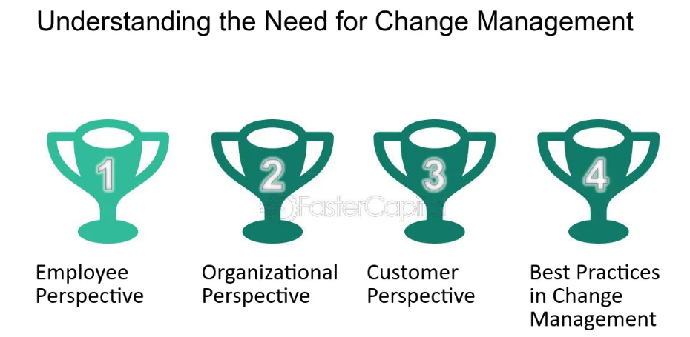
Communicating Change
Communicating Change
The Need for Change
Employees want to know that the change is coming and why it’s happening.
This includes explaining why the change is necessary, how it is tied to the
organization’s overall strategy, and what the risks are of not changing.
Dr. Raef Baraka

Slide 24
Communicating Change
Communicating Change
The Need for Change
Research shows that successful companies align their projects with their overall purpose and strategy.
This means explaining why the organization is undertaking the project and how the project will help achieve organizational goals.
Communications about the need for change should start early in the project life cycle and should clearly express the rationale for the project and relate it to the organization’s goals and/or purpose.
Much of this information can often be found in project documents like the project charter and business case, as well as organizational information like mission, vision, and/or values statements.
Dr. Raef Baraka

Slide 25
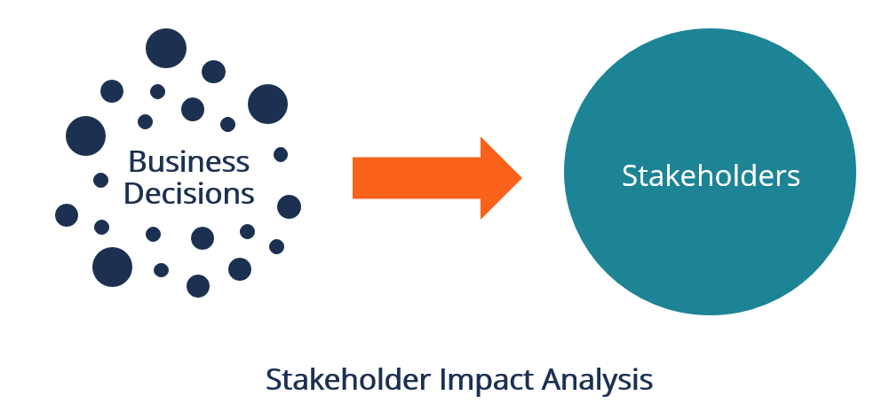
Communicating Change
Communicating Change
Stakeholder Impact
Communicating change means letting stakeholders know what to expect and when to expect it.
Reduce their uncertainty and increase their trust in the project by answering their big questions.
Dr. Raef Baraka

Slide 26
Communicating Change
Communicating Change
Stakeholder Impact
Communications about what to expect should also begin early in the project life cycle and continue throughout.
Don’t expect to know and be able to share every aspect of this information up front; tell stakeholders what you can and when you can.
Don’t wait until every detail is finalized before you begin communicating, or stakeholders will begin to speculate on their own
Dr. Raef Baraka

Slide 27
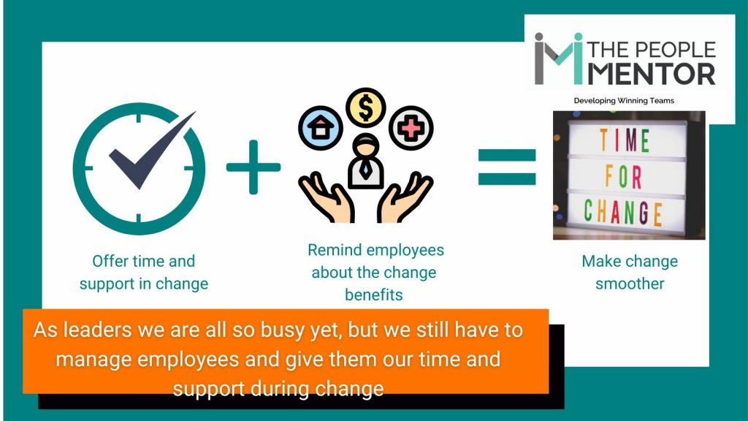
Communicating Change
Communicating Change
Support for Making the Change
Employees need to know how to make the change you are asking of them.
This includes communicating, educating, and training around roles and responsibilities, processes and tools, and desired behaviors.
Dr. Raef Baraka

Slide 28
Communicating Change
Communicating Change
Support for Making the Change
Initial communications should emphasize that support will be provided.
Once the project is underway, you can provide additional details to stakeholders as they become available, including what form the support will take and when stakeholders can expect it.
Change fatigue happens when employees face too many changes at once or in rapid succession. They’re often asked to do more but rarely given clear prioritization of the different change initiatives. They may have seen similar change efforts fail in the past. Change fatigue is a form of burnout and has many of the same consequences: increased absenteeism and presenteeism, lower engagement, and even increased turnover.
Dr. Raef Baraka

Slide 29
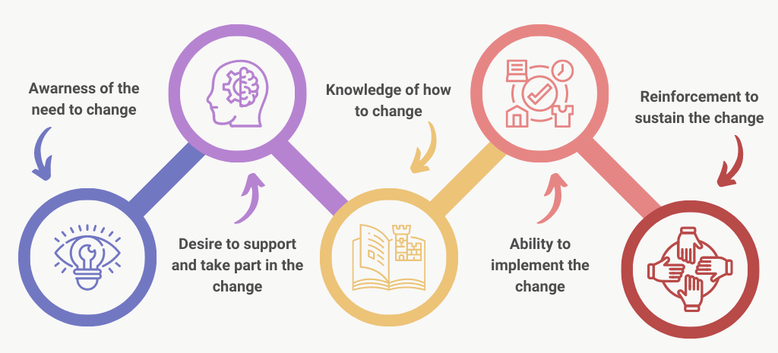
Communicating Change
Communicating Change
Change Reinforcement
Reinforcement means ensuring the change is sustained.
Human beings tend to revert back to old habits and patterns, so it’s important to keep the change and its purpose in front of stakeholders even after the project itself is complete.
Dr. Raef Baraka

Slide 30
Communicating Change
Communicating Change
Change Reinforcement
This is one notable area where project management and change management diverge. Projects generally come to an end when the objectives of the project are achieved.
Change management, however, continues after the end of the project to ensure that the outcomes are successfully adopted and integrated into the organization.
It is an ongoing process to continue to influence stakeholders’ engagement with and ability to implement the change.
Dr. Raef Baraka

Slide 31
Communicating Change
Communicating Change
Change Reinforcement
In cases where change management processes are the responsibility of the project team, you may have limited ability to reinforce the change.
Once the project is completed, team members move on to another project and/or return to their functional roles.
However, you can include ongoing communications in your project close-out process.
Dr. Raef Baraka

Slide 32
Communicating Change
Communicating Change
Change Reinforcement
Recommend to the sponsor or other stakeholders who will manage the outcomes of the project that they continue communicating to keep stakeholders engaged and inhibit regression back to the former state.
You can even provide recommendations of what those communications should look like and include a transition management plan in your project.
Dr. Raef Baraka

Slide 33

Communicating Change
Integrating Change Management into Your Communications Plan
Dr. Raef Baraka

Slide 34
Communicating Change
Integrating Change Management into Your Communications Plan
Depending on the degree of change, the number of stakeholders, and the size and complexity of your project, it may be helpful to map your stakeholders to each of these four concepts and use the results to help you build your project communications management plan.
The template shown in next table can serve as a guide
Dr. Raef Baraka

Slide 35
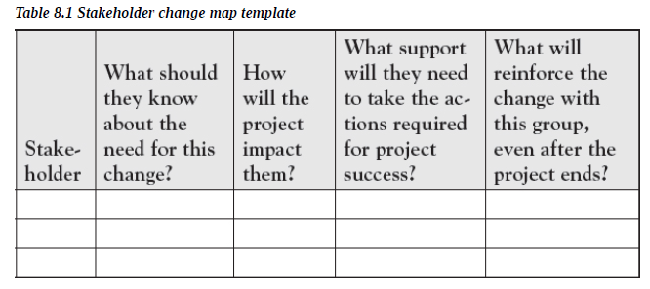
Communicating Change
Integrating Change Management into Your Communications Plan
Dr. Raef Baraka

Slide 36
Communicating Change
Integrating Change Management into Your Communications Plan
Revisit and update this chart at least as often as you review and update your project communications management plan. As with many other aspects of the project, the answers to these questions can evolve over time as the project progresses.
The end goal of both project management and change management is for the project to succeed.
But the integration of change management strategies into project management broadens the definition of success beyond simply completing the project on time, within budget, and within scope.
Dr. Raef Baraka

Slide 37
Communicating Change
Integrating Change Management into Your Communications Plan
Success means realizing the benefits of the project for the organization.
“When applying change management, the project manager’s goal is to deliver change that has been adopted (integrated into the organization’s work), and to ensure that the intended benefits are on track to be delivered operationally over time
Dr. Raef Baraka

Slide 38
Communicating Change
Lecture Summary
Projects create change. Projects are the connectors between where we are now (current state) and where we want to be (future state).
While there are different models of change management, three of the most common are Kotter’s eight-step model, Lewin’s model, and the Prosci ADKAR model.
These models can help provide frameworks for integrating change management concepts into project communications—a task that often falls to the project team.
Change creates uncertainty. When there is too much change, or the change is continuous, change fatigue can occur.

Slide 39
Communicating Change
Lecture Summary
To minimize the uncertainty and fatigue, communication to help stakeholders transition through the change is critical.
Change communications should address the need for change, the impact of the change on stakeholders, the support that will be provided to adjust to the change, and how the change will be reinforced.
Addressing change through these communication approaches can help ensure that the organization realizes the intended benefits of the project

Slide 40



Thank You

