Slide 1



Research Methodology in Computer Science (AI800)
Lecture 3
Introduction to literature Review (Part 2)
Prepared by
Dr. Mohammed Anbar
www.midocean.ae

Slide 2

Outlines
Learning Outcomes
Literature Review Sources
Building a Literature Review: A Road Map
How to find Sources
How to Read the Sources
How to Select the Journal
Analyzing Sources
Sources Evaluation
Writing Up Literature Review
Citations Styles
Focus of MLA & APA Styles
Comparing In-Text Citations
Comparing References
Citation Different Types of References
Reference management software
Mendeley
www.midocean.ae

Slide 3
Learning Outcomes
To help you understand the literature review sources, find resources, read resources, find journal, analyze and evaluate resources.
To help you to build the literature review .
To help you simplify your reference citation, creation and management workflow.
To provide demo that illustrate how to manage your literature review using Mendeley reference manager
www.midocean.ae

Slide 4
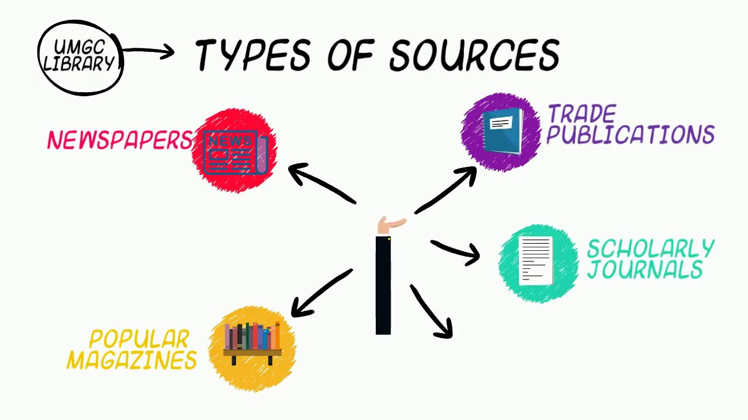
Literature Review Sources
Libraries:
  Libraries often hold archival pieces of information and other types of primary sources that cannot be retrieved online. Good researchers get acquainted with the library catalog, reference desk, and programs and systems for accessing information.
Online Databases
  Online databases are electronic sources the library pays a fee to have access to. Published articles are found through electronic databases. They search thousands of journals, books, chapters in edited books, government documents, newspapers, and theses/dissertations.
(VanderMey et al., 2011; Sheperis et al., 2017)
www.midocean.ae

Slide 5
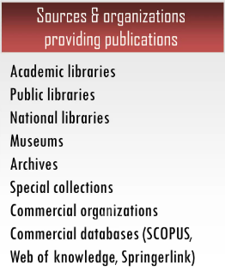

Literature Review Sources (cont.)
www.midocean.ae

Slide 6
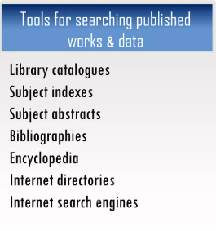

Literature Review Sources (cont.)
www.midocean.ae

Slide 7
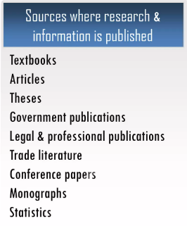

Literature Review Sources (cont.)
www.midocean.ae

Slide 8
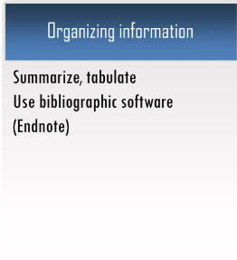
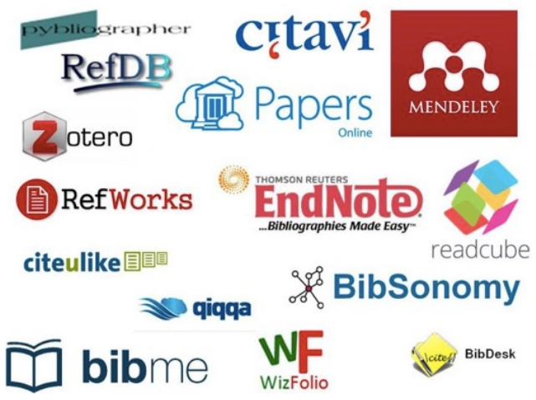
Literature Review Sources (cont.)
www.midocean.ae

Slide 9
Other Sources
Internet Sources.
Primary Sources: presents the immediate results of research activities.
  It often includes analysis of data collected in the field or laboratory.
  Primary literature presents original research and/or new scientific discoveries.
Secondary Sources summarizes and synthesizes the primary literature.
  It is usually broader and less current than primary literature.
  Since most information sources in the secondary literature contain extensive bibliographies, they can be useful for finding more information on a topic.
Tertiary Literature: presents summaries or condensed versions of materials usually with references to primary or secondary sources.
  They can be a good place to look up facts or get a general overview of a subject.
(VanderMey et al., 2011; Sheperis et al., 2017)
www.midocean.ae

Slide 10
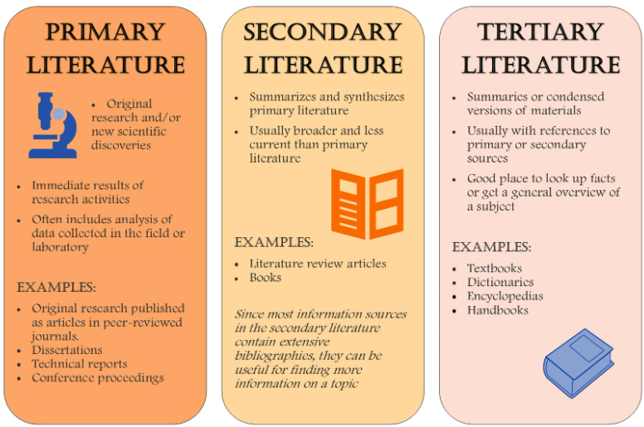
Other Sources (cont.)
www.midocean.ae

Slide 11
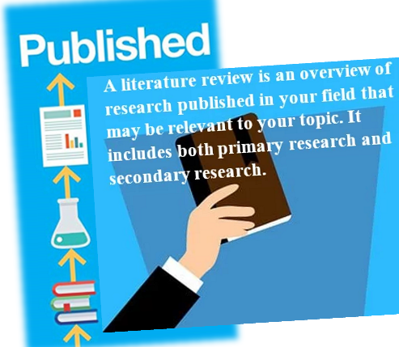
Peer Reviewed Journals
Published journal articles are a common source of literature.
Published journal articles require an editorial board to review the work, make corrections, and determine if it can be published.
The work has been reviewed, edited, evaluated and corrected.
(Sheperis, Young, and Daniels, 2017)
www.midocean.ae

Slide 12
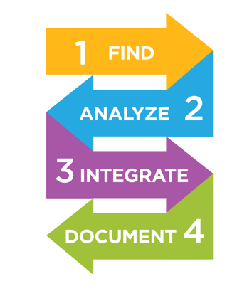
Building a Literature Review: A Road Map
Find the relevant material and resources for your literature review.
Analyze and evaluate the selected resources.
Integrate by making links between studies.
Document by writing up your research literature review
(Sheperis, Young, and Daniels, 2017)
www.midocean.ae

Slide 13

How to find Sources
Look for key authors within the field-- big name authors will be found often within bibliographies.
Computer literature searches-- most universities have an extensive on-line library with full text and citation databases.
Write or call key authors.
Look at literature in other disciplines.
Go from beginning to end of a very concern Review Paper to your field of study.
www.midocean.ae

Slide 14
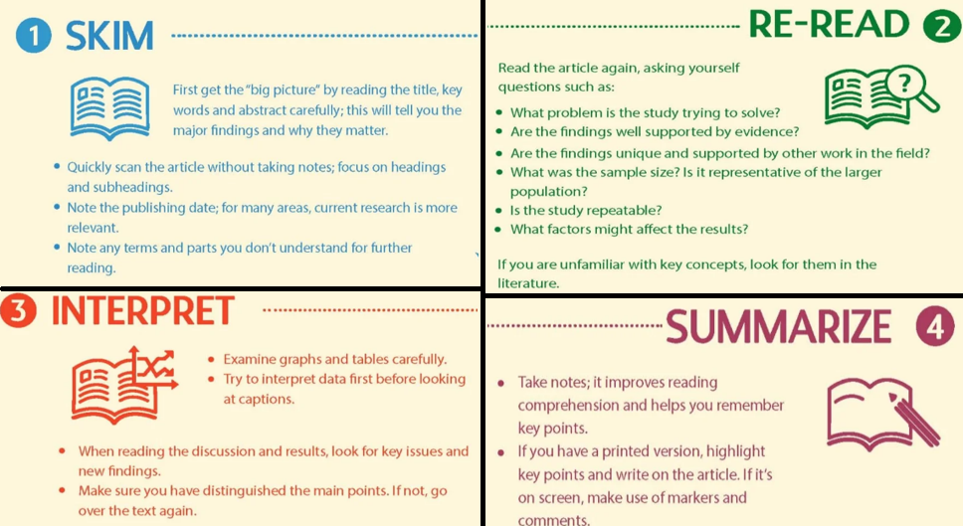
How to Read the Sources
www.midocean.ae

Slide 15

How to Select the Article
Go To https://www.sciencedirect.com/
Select Advanced Search
www.midocean.ae

Slide 16
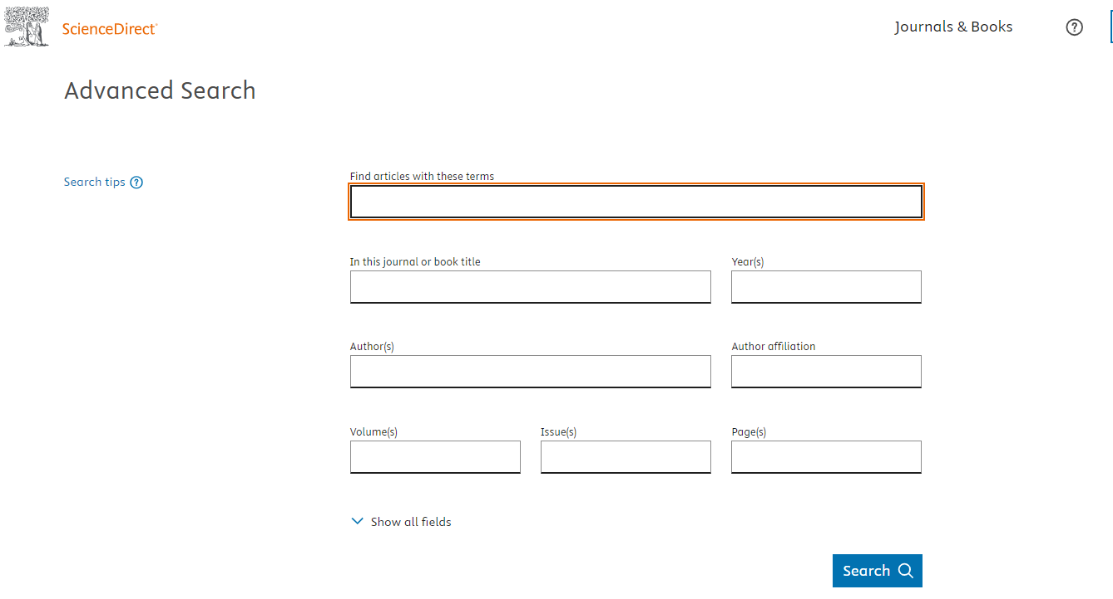
How to Select the Article (cont. )
3. Search for articles using title, abstract or author-specified keywords
www.midocean.ae

Slide 17
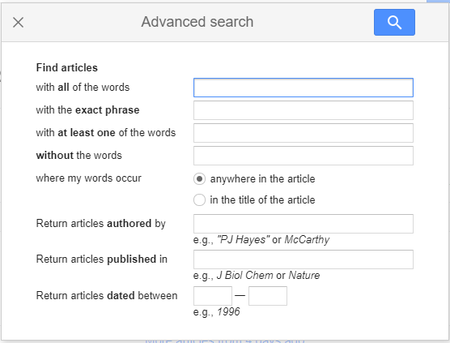

How to Select the Article (cont. )
https://scholar.google.com/
https://scholar.google.com/
www.midocean.ae

Slide 18
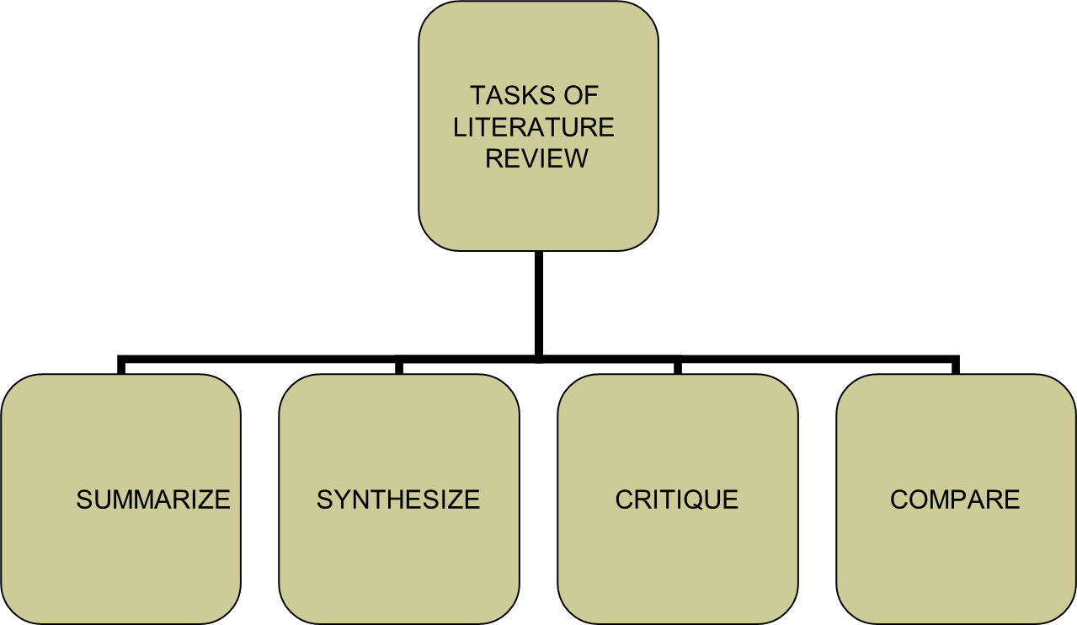
Analyzing Sources
A literature review is never just a list of studies—it always offers an argument about a body of research
Analysis occurs on two levels:
  Individual sources
  Body of research
(VanderMey et al., 2011; Sheperis et al., 2017)
www.midocean.ae

Slide 19
Critical analysis checklist
What is the main idea being put forward?
What evidence is provided?
Do you agree with the conclusions?
Is it a response to another work?
Underlying theory or assumption?
Model?
Strengths / weakness / limitations?
(VanderMey et al., 2011; Sheperis et al., 2017)
www.midocean.ae

Slide 20
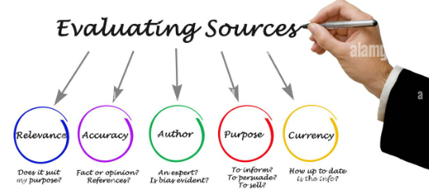
Sources Evaluation
Researchers may want to consider the following questions when examining existing literature:
Is the research Source Trustworthy?
Is the author an expert?
Is the source current?
Is the source complete?
Is the source biased or unbiased?
Is the source accurate and logical?
(VanderMey et al., 2011; Sheperis et al., 2017)
www.midocean.ae

Slide 21
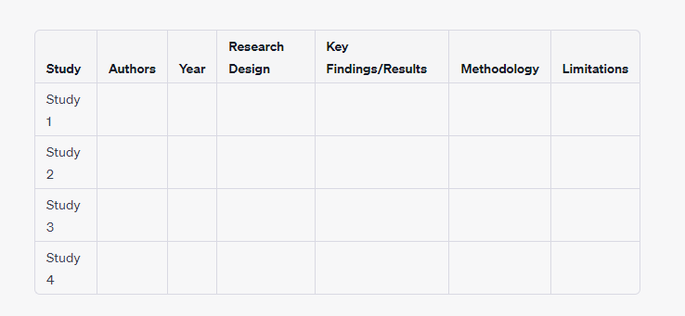
Synthesis Matrix for Literature Review
Synthesis Matrix for Literature Review
A synthesis matrix, often used in literature reviews, is a way to organize and synthesize information from multiple sources on a specific topic. Below is a simple template for creating a synthesis matrix:
A synthesis matrix, often used in literature reviews, is a way to organize and synthesize information from multiple sources on a specific topic. Below is a simple template for creating a synthesis matrix:
www.midocean.ae

Slide 22
Synthesis Matrix for Literature Review
Synthesis Matrix for Literature Review (cont.)
A synthesis matrix, often used in literature reviews, is a way to organize and synthesize information from multiple sources on a specific topic. Below is a simple template for creating a synthesis matrix:
Research Question or Subtopic: Clearly define the specific research question or subtopic you are exploring.
Study: Provide a space to list the studies or sources you are reviewing.
Authors: List the authors of each study or source.
Year: Mention the publication year of each source.
Research Design: Describe the research design or methodology used in each study (e.g., experimental, survey, case study).
Key Findings/Results: Summarize the main findings or results of each study. Be concise and clear.
Methodology: Briefly describe the methodology used in the study, including data collection methods, sample size, and any relevant details about how the research was conducted.
Limitations: Highlight the limitations or weaknesses of each study. This could include any biases, constraints, or issues with the research design or methodology.
www.midocean.ae

Slide 23
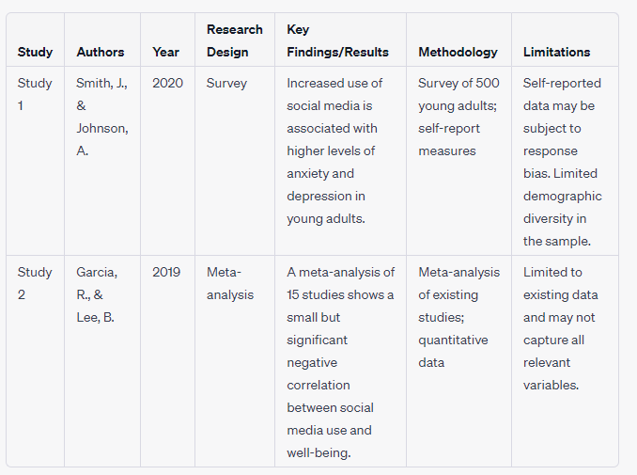
Synthesis Matrix for Literature Review
Synthesis Matrix for Literature Review (cont.)
A synthesis matrix, often used in literature reviews, is a way to organize and synthesize information from multiple sources on a specific topic. Below is a simple template for creating a synthesis matrix:
www.midocean.ae

Slide 24
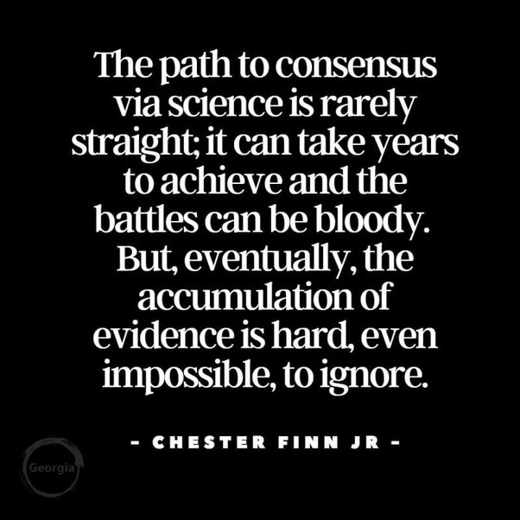
Writing Up Literature Review
It is important to write a draft of your literature review and take notes on important points and ideas such as : purpose of study reviewed, synopsis of content, research design or methods used in study, and brief review of findings.
This will help you stay organized……….
s
Keep a record and notes of the literature you collect.
Take care to make your review accurate and complete.
Record too many references, where and when you retrieved the information.
Use a citation manager program like Mendely or EndNote
www.midocean.ae

Slide 25
Synthesis Matrix for Literature Review
Writing Up Literature Review (cont.)
Two studies were examined to understand the impact of social media on mental health. The first study conducted by Smith and Johnson in 2020 utilized a survey of 500 young adults and self-report measures to investigate the relationship between social media usage and mental health. Their findings revealed a significant association between increased use of social media and higher levels of anxiety and depression among young adults. However, it's important to note that the data in this study is self-reported, which may introduce response bias, and the sample had limited demographic diversity.
The second study, carried out by Garcia and Lee in 2019, employed a meta-analysis approach, aggregating data from 15 previous studies to assess the impact of social media use on well-being. Their meta-analysis showed a small but statistically significant negative correlation between social media use and overall well-being. This approach allowed for a broad perspective, considering existing research. However, it is limited to the data available from those previous studies, and it may not capture all relevant variables contributing to the complex relationship between social media and mental health.
www.midocean.ae

Slide 26
Citations Styles
A citation style, also known as a reference system, is a set of rules for properly crediting the sources you've used in your writing.
There are several different citation styles that are commonly used are categorizes in:
Parenthetical Citations: identifying details of the source in parentheses in the text—usually the author’s last name and the publication date, plus a page number if relevant (author-date). Sometimes the publication date is omitted (author-page).
Numerical Citations: a number in brackets or in superscript, which corresponds to an entry in the numbered reference list.
Note Citations: a full citation in a footnote or endnote, which is indicated in the text with a superscript number or symbol.
www.midocean.ae

Slide 27
Focus of MLA & APA Styles
Modern Language Association (MLA)
American Psychological Association (APA)
Humanities and related areas (i.e. literature)
Focuses on authorship: “…(Smith and Johnson)”
Format is designed for ease of presentation
Often viewed as “easier” to follow by students
Commonly taught first to students
Social sciences (i.e. psychology, sociology, and linguistics)
Focuses on date of publication: “…(Smith & Johnson, 2009)”
Format is designed for comparison of research and determining relevance
Often thought of as more difficult by students
Commonly taught as an alternative citation style
www.midocean.ae

Slide 28
Basics of MLA & APA Citations (Book Example)
Modern Language Association (MLA)
American Psychological Association (APA)
Name(s) of author(s)
Work title
Publication city and year
Publisher
Publication medium (i.e. print, web)
Name(s) of author(s)
Publication year
Work title
Publication city
Publisher
In-text citations:
  MLA: “…no significant results” (Johnson 34).
  APA: “…no significant results” (Johnson, 2003, p. 34).
Reference citations:
  MLA: Johnson, Thomas. Studies in College. New York: McGraw-Hill, 2003. Print.
  APA: Johnson, T. (2003). Studies in college. New York, NY: McGraw-Hill.
www.midocean.ae

Slide 29
Comparing In-Text Citations
In-text citations are used when you need to give credit to an author for using a quote (exact wording), paraphrasing (rewording), or discussing his/her ideas. Example: (Mathis and Jones, 2009, pg. 74)
All in-text citations for MLA and APA must reference the author’s name.
Reference to the page number or publication year depends on the situation and citation style.
  When using APA, always give the year of publication.
  When quoting, always give the page number in MLA & APA.
  When paraphrasing or simply referencing, no page number is needed for either style.
www.midocean.ae

Slide 30
Comparing In-Text Citations (Cont..)
Example: “The study provided no significant findings regarding the relationship of gender and success in language classes.” -- Johnson, Thomas and Arlene Maiden. Studies in College. New York: 2003. McGraw-Hill. Print.
Paraphrase
MLA: As stated by Johnson and Maiden, the research showed that there was…
APA: As stated in Johnson & Maiden (2003), the research showed that…
Quote (incorporation in text)
MLA: As Johnson and Maiden explained, their “study…classes” (34).
APA: As Johnson & Maiden (2003) explained, their “study…classes” (p. 34).
Quote (no incorporation in text)
MLA: “…in language classes” (Johnson and Maiden 34)
APA: “…in language classes” (Johnson & Maiden, 2003, p. 34)
www.midocean.ae

Slide 31
Comparing References
A portion at the end of every research paper must be devoted to listing the details for each source you used. All the sources you cited, summarized, or quoted are included here.
If you've done your citing right, you'll have mentioned each reference work at least once in your paper and included a reference citation for every source you used.
Different citation styles use difference terms for this section:
  MLA: Bibliography (Works Cited title)
  APA: Reference Page (Reference title)
Citations in MLA and APA styles should be arranged alphabetically by the first letter of the author's last name.
www.midocean.ae

Slide 32
Citation Different Types of References
Book Template
MLA: Lastname, Firstname. Title of Work. City of Pub: Publisher, Year. Medium.
APA: Lastname, First Initial. (Year). Title of work. City of Pub, State: Publisher.
Articles in Journals Template
MLA: Lastname, Firstname. “Title of Work.” Journal Title Volume.Issue (Year):
  page numbers. Medium.
  APA: Lastname, First Initial. (Year). Title of work. Journal Title, Volume(Issue), page
  numbers.
Online Sources Template
MLA: Author. Title of Site. Sponsor, Date created (use n.d. if not given). Medium.
Date accessed. <URL (optional)/>.
APA: Author. (Year, Month[use n.d. if not given]). Article or page sub-title. Major
Publication Title, volume or issue number (if available). Retrieved from
http://url.
www.midocean.ae

Slide 33
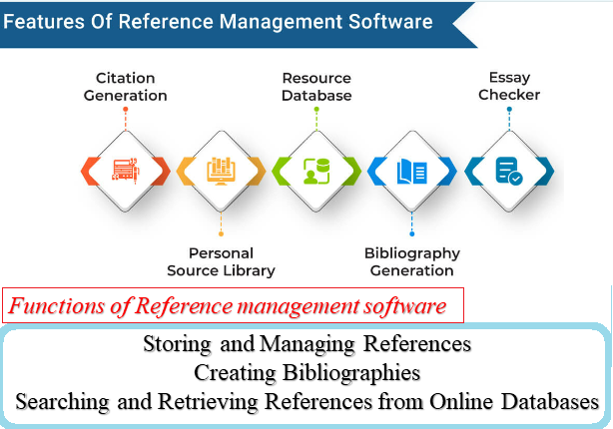
Reference management software
Reference management software is a type of computer program that helps researchers keep track of the sources they use, retrieve and organize those sources, incorporate in-text citations into their writing, and generate a reference list in a consistent format across a variety of citation styles.
Why Reference management software need??
Organize and tag citations & documents
Create instant references in standard formats.
Create personal citation database of articles on your topics.
Format papers with in-text citations and bibliographies in standard formats.
Share your database of citations/articles with others.
www.midocean.ae

Slide 34
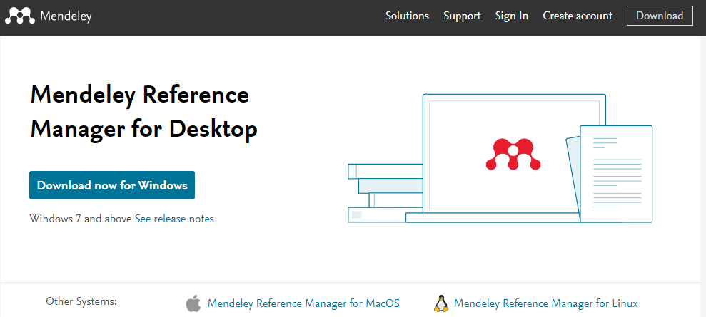
Mendeley
Mendeley is a free, award-winning, desktop and web program for managing and sharing research papers, discovering research data and collaborating online available for Windows, Mac, and Linux.
Register and Download
Open Mendeley website https://www.mendeley.com
Create Mendeley account in the Mendeley website.
Download and install Mendeley on your Desktop.
“It’s time to change the way we do research”
www.midocean.ae

Slide 35
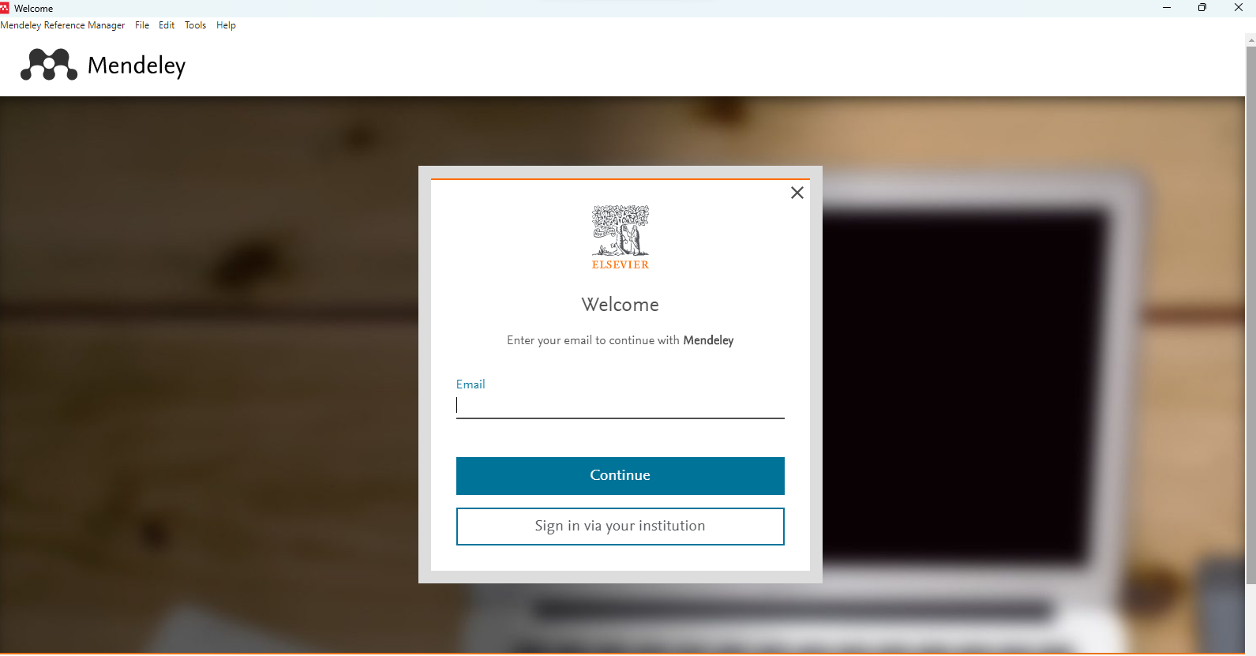
Open Mendeley Desktop
Login using your registration account
www.midocean.ae

Slide 36
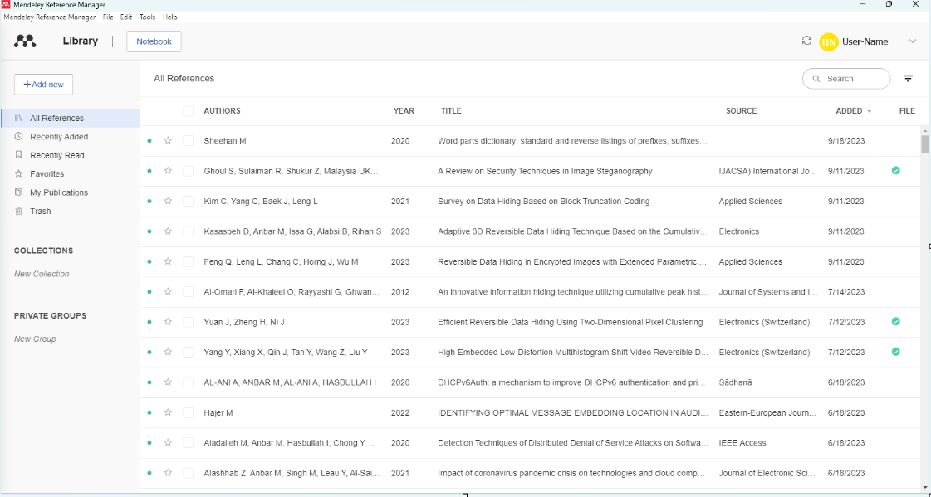
Your Desktop Library
www.midocean.ae

Slide 37
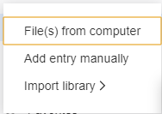
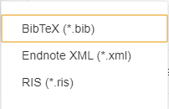
Add resources
Select a file or document to add from your computer
Import You Reference From BibTex, Endnote or RIS
www.midocean.ae

Slide 38
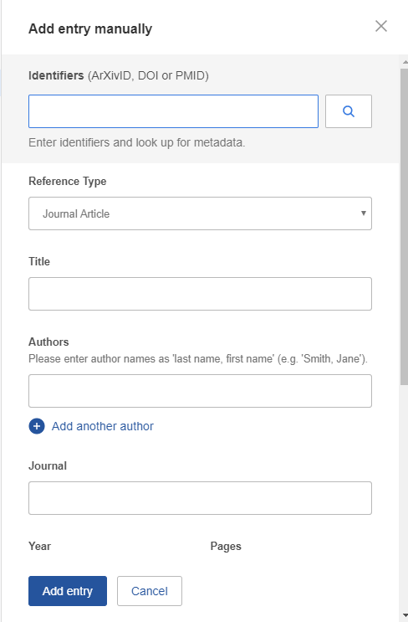
Add resources (cont. )
Select add entry manually
Enter DOI, ArXiv, or PMID + click on the magnifying class to start lookup
Mendeley Add missing info automatically
www.midocean.ae

Slide 39
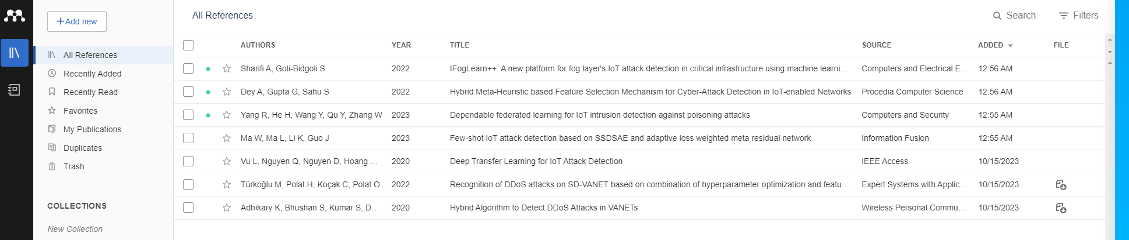
Manage Your Library
Mark as read/unread
Star favorites
Star favorites
Create category folders
Open attached PDF files in integrated viewer
www.midocean.ae

Slide 40
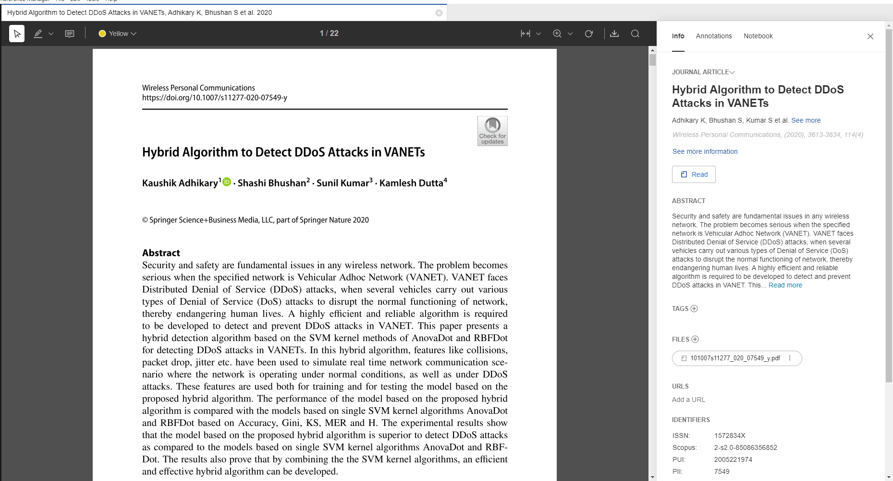
Sync
Read and Work in the PDF Viewer
www.midocean.ae

Slide 41
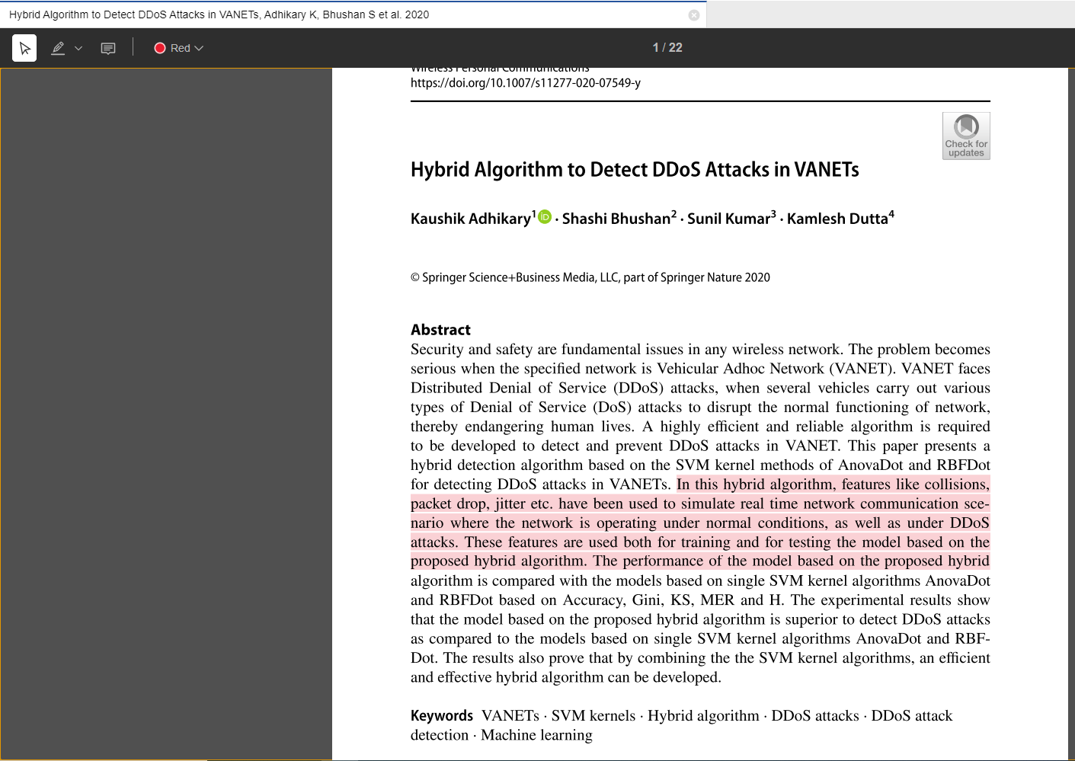
Sync
Annotate and Highlight
www.midocean.ae

Slide 42
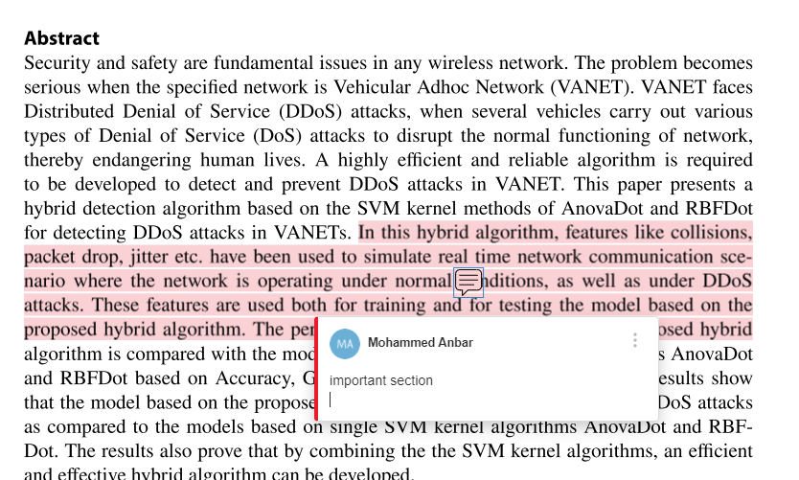
Sync
Annotate and Highlight (cont. )
www.midocean.ae

Slide 43
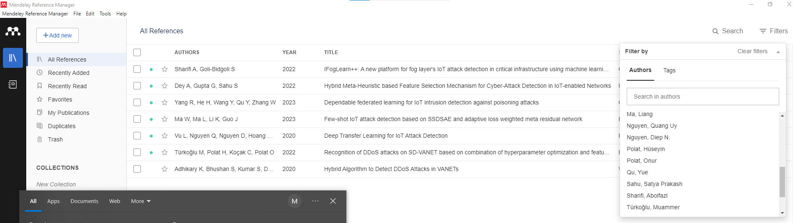
Sync
Search or filter Your Documents
Full text search, or filter your results
Filter your
documents by
author, tag,
publication,
or keyword
www.midocean.ae

Slide 44
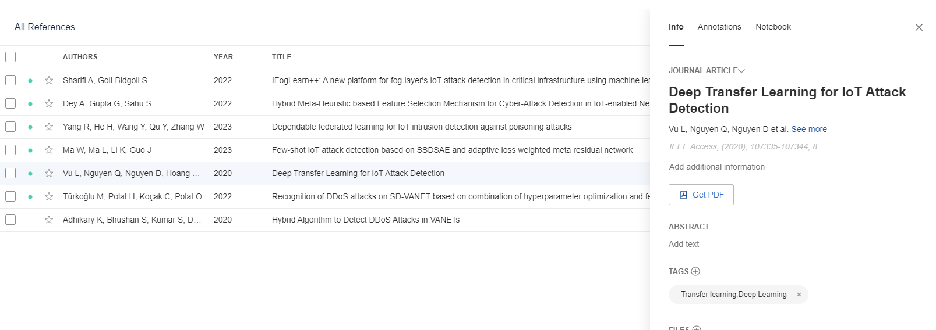
Sync
Tag Your Documents
www.midocean.ae

Slide 45
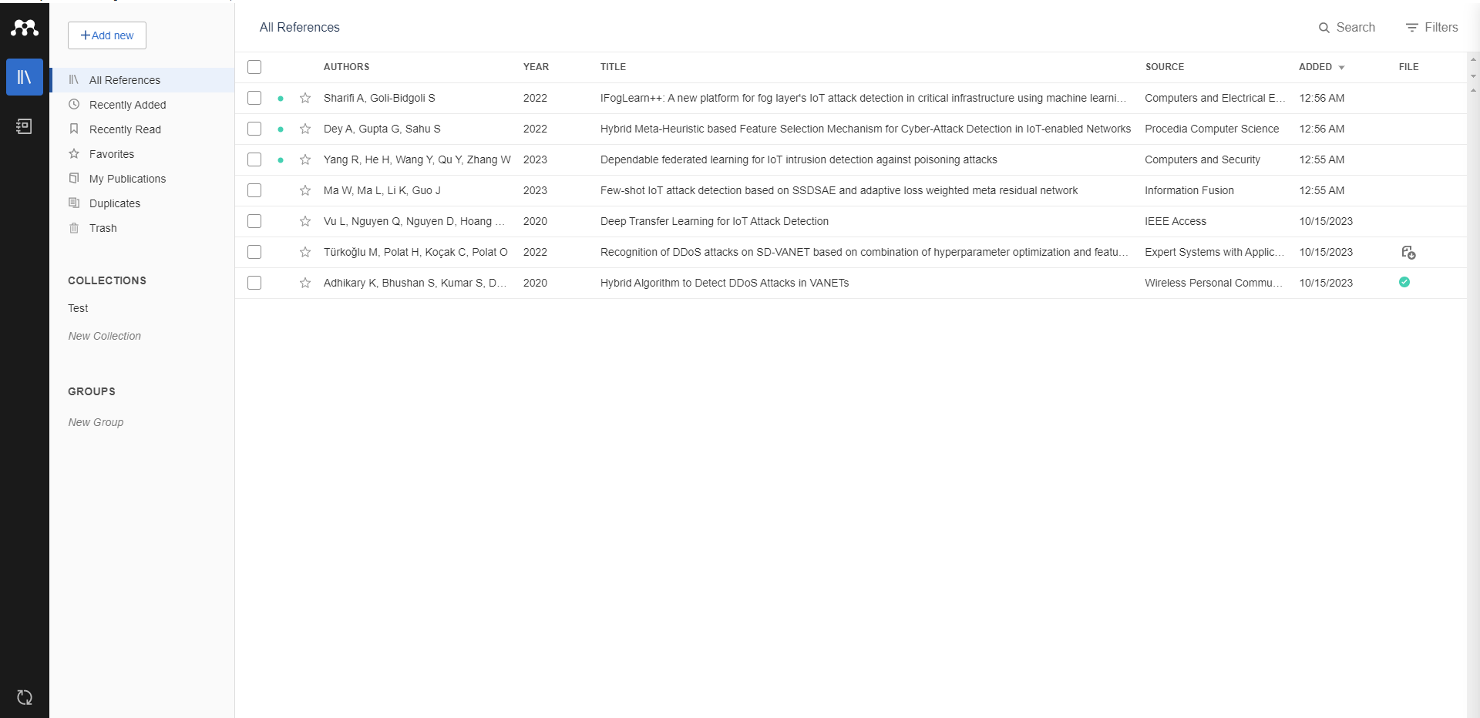
Sync
Sync
Sync your library to the Mendeley Cloud to access it anywhere & read on all your devices
Mendeley backs up your library online
Access your articles anywhere
Get customized suggestions and add them to your library
www.midocean.ae

Slide 46
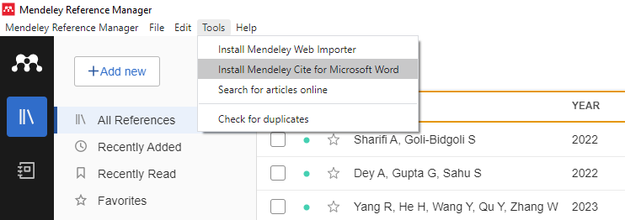

Sync
Citations & bibliography
Install the Citation Plug-in
www.midocean.ae

Slide 47
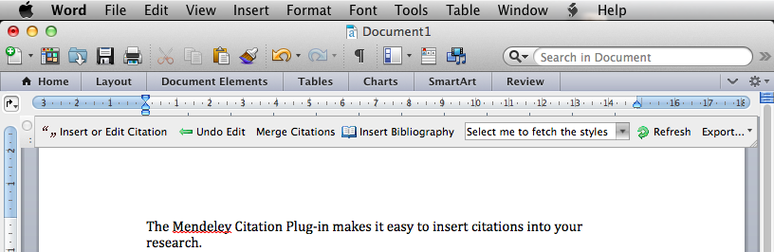
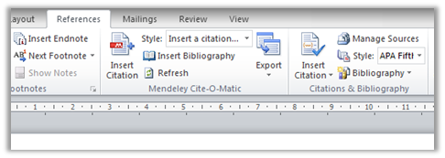
Sync
The Citation Tool Bar Appears in Word Automatically
Mac
Windows
www.midocean.ae

Slide 48
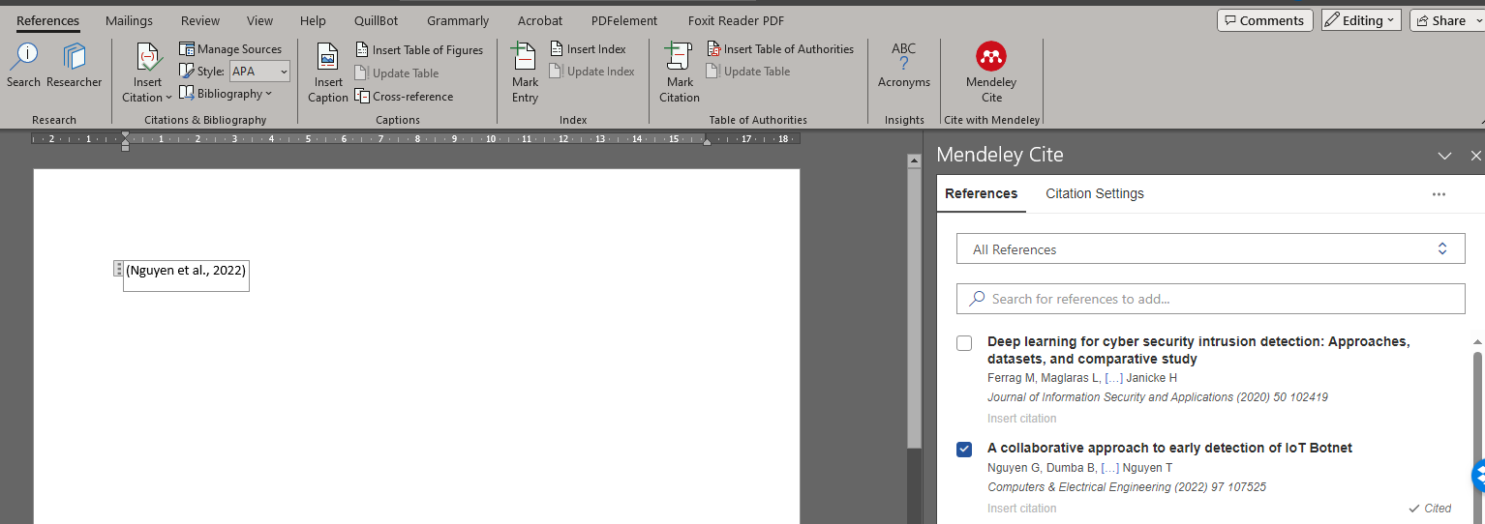
Sync
Generate In-Text Citations in Word
Click Mendeley Cite
Search ref
3. Select the article or book, and click ‘ok’ to automatically cite that text in Word
www.midocean.ae

Slide 49
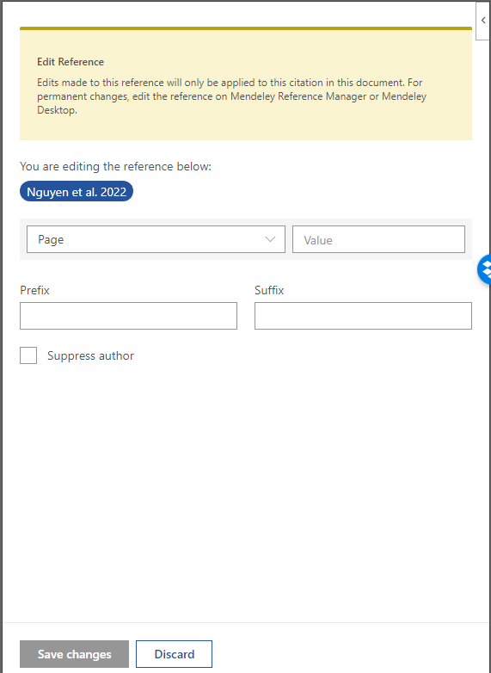
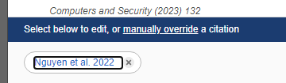
Sync
Editing and Adding to Citations
Select your citation
www.midocean.ae

Slide 50
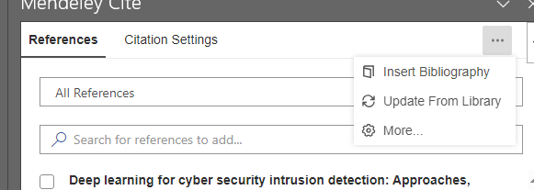
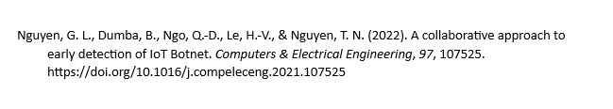
Sync
Inserting Your Bibliography
Nguyen, G. L., Dumba, B., Ngo, Q.-D., Le, H.-V., & Nguyen, T. N. (2022). A collaborative approach to early detection of IoT Botnet. Computers & Electrical Engineering, 97, 107525. https://doi.org/10.1016/j.compeleceng.2021.107525
Click Insert Bibliography
www.midocean.ae

Slide 51
Sync
Nguyen, G. L., Dumba, B., Ngo, Q.-D., Le, H.-V., & Nguyen, T. N. (2022). A collaborative approach to early detection of IoT Botnet. Computers & Electrical Engineering, 97, 107525. https://doi.org/10.1016/j.compeleceng.2021.107525
How To Use Mendeley Reference Manager ? (Beginner's Guide Demo)
www.midocean.ae

Slide 52
References
Eaves, S., Sheperis, C. J., Craft, S., Frasier, R., & Wells, D. (2008). Reviewing the literature. In B. T. Erford (Ed.), Research and evaluation in counseling. Lahaska, PA: Lahaska Press.
Sheperis, C.J., Young, J.S. & Daniels M.H. (2017). Counseling research: Quantitative, qualitative, and mixed methods (2nd ed.). Boston, MA: Pearson. ISBN-13: 978-0-13-402509-4
VanderMey, R., Meyers, V., Van Rys, J., Kemper, D., & Sebrank, P. (2011). The college writer: A guide to thinking, writing, and researching (4th ed.). Boston: Houghton Mifflin.
Abd Karim Alias (2010). A brief guide to doing a literature review. Retrieved from http://www.slideshare.net/akarim717/doing-a- literature-review6432447?qid=ea37aecb-065c- 4ac3-8975-03bd20e0a570&v=&b=&from_search=1
Teoh Yew Heng. Seminar on how to write a research plan & tackling a literature review
https://proofed.com/writing-tips/5-reasons-the-literature-review-is-crucial/
Prof. Mani Maran Ratnam – How to write a report in journal format
www.midocean.ae

Slide 53



Thank You

