Slide 2
Contents
Sequential circuits
Flip-flops
Analysis of clocked sequential circuits
Design procedure

Slide 3
Analysis of Clocked Sequential Circuits
The behavior of a clocked sequential circuit is determined from the inputs, the outputs, and the sate of flip-flops
A clocked sequential circuit can be analyzed by using:
  (i) The state equation obtained by replacing flip-flop input equations in its characteristic equation, or
  (ii) a state table.
A state equation (or transition equation) specifies the next state as a function of present state and inputs

Slide 4
State table – a multiple variable table with the following four sections:
  Present State – the values of the state variables at time (t) for each allowed state.
  Input – the input combinations allowed.
  Next-state – the value of the state at time (t+1) based on the present state and the input
  Output – the value of the output as a function of the present state and (Mealy) the input.

Slide 5
Analysis (Contd.)
Procedure: Write the Boolean expression for each flip-flop input, which is, in fact, the flip-flop output right after the next active clock edge.
Consider the circuit shown in next slide
It consists of two D flip-flops A and B, an input x and an output y
Since the D input of a flip-flop determines the value of the next state, it is possible to write a set of equations for the circuit

Slide 6
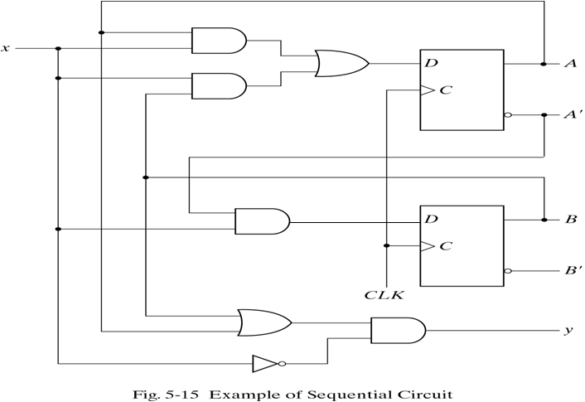
Analysis (Contd.)

Slide 7
Analysis (Contd.)
Flip-flop input equations or excitation equations (for a circuit with D flip-flops, it is the same as the state equation):
D_{A} = Ax + Bx
D_{B} = A’x
y = (A + B)x’
As the FF in use is the D FF:
Q(t+1) = D

Slide 8
Analysis (Contd.)
The state equation can be written as:
A(t+1) = A(t).x(t) + B(t).x(t)
B(t+1) = A’(t).x(t)
Or simply:
A(t+1) = Ax + Bx
B(t+1) = A’x
Similarly, the present state of output is:
y(t) = [A(t) + B(t)]x’(t),
or y = (A +B)x’

Slide 9
Analysis (Contd.)

Slide 10
Analysis (Contd.)
A state diagram is a graphical representation of a state table
represented by a circle, and the transitions between states are indicated by directed lines connecting the circles
Number of states = 2^{number of Flip Flops}
The binary number inside each circle identifies the state of the flip-flops

Slide 11
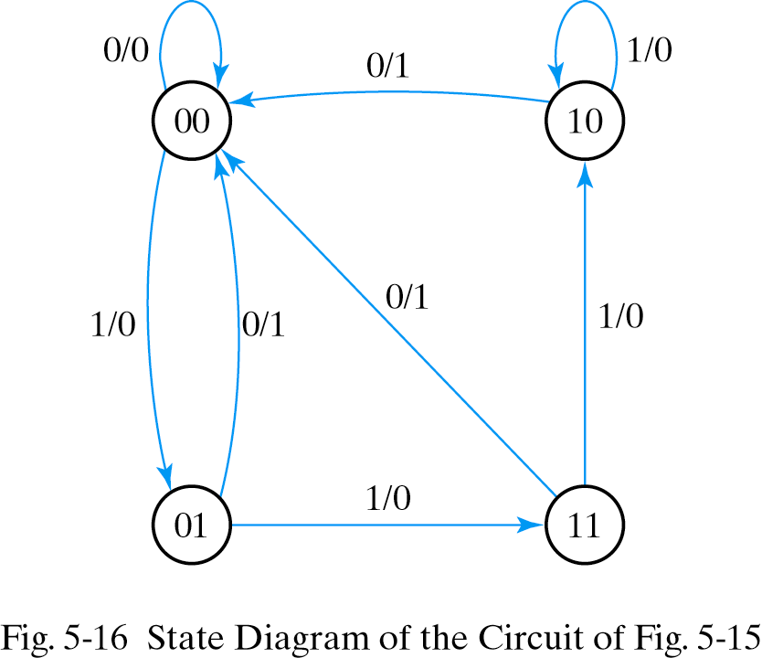
Analysis (Contd.)
The directed lines are labeled with two binary numbers separated by a slash
The state diagram follows from the state table
The state diagram for the given circuit:
I/O

Slide 12
State Diagrams Types
NOTE:
Mealy model – the output values are determined by both current state and current inputs.
Moore model – the output values are determined only by current state.

Slide 13
1) FF Input equation:
D_{A} = Ax + Bx
D_{B} = A’x
2) State equation and output:
Characteristic equation:
A(t+1)= D_{A} , B(t+1)=D_{B}
State equation:
A(t+1) = A(t).x(t) + B(t).x(t)
B(t+1) = A’(t).x(t)
Or A(t+1) = Ax + Bx
B(t+1) = A’x
state of output is:
y = (A +B)x’
3) State table.
4) State diagram (Mealy)
Analysis of D FF: summary

Slide 14
Analysis with JK flip-flops
The next state values of a sequential circuit that uses flip-flops such as JK can be derived using following procedure:
  Determine the flip-flop input equations in terms of the present state and inputs
  Use corresponding flip-flop characteristic equation to determine the next state values
We consider the sequential circuit with two JK flip-flops A and B, and one input x

Slide 15
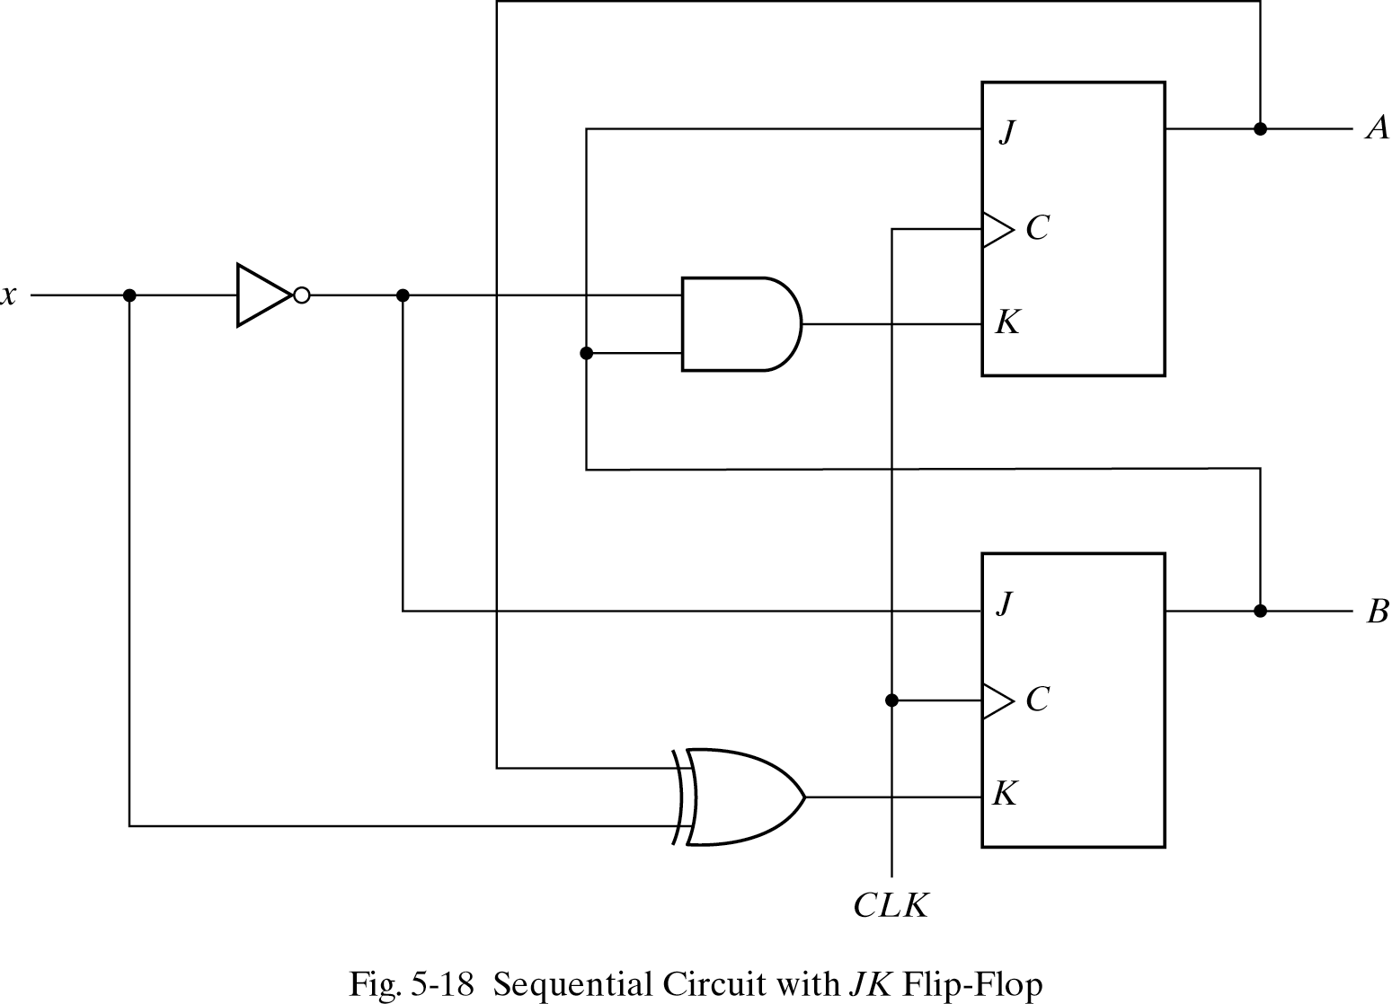
Analysis with JK flip-flops (Contd.)

Slide 16
Analysis with JK flip-flops (Contd.)
The circuit has no outputs and, so, the state table does not need an output column
The outputs of the flip-flops may be considered as the outputs in this case
The circuit can be specified by the flip-flop input equations
J_{A} = B K_{A} = Bx’
J_{B} = x’ K_{B} = A’x + Ax’ = A ⊕ x

Slide 17
Analysis with JK flip-flops (Contd.)
find the next state from the state equations by substituting the input equations into the flip-flop characteristic equations.
Characteristic equation for the JK flip-flop is:
A(t+1) = J_{A}A’ + K’_{A}A
B(t+1) = J_{B}B’ + K’_{B}B

Slide 18
Analysis with JK flip-flops (Contd.)
Substituting the values of J_{A} and K_{A}, and J_{B} and K_{B}, from the input equations, we obtain state equations for A and B as:
A(t+1) = BA’ + (Bx’)’A = A’B + AB’ + Ax
B(t+1) = x’B’ + (A ⊕ x)’B = B’x’ + ABx + A’Bx’

Slide 19
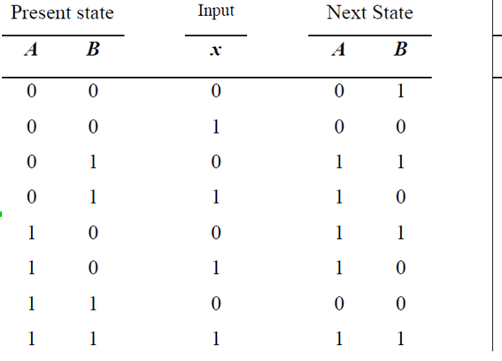
Analysis with JK flip-flops (Contd.)
A(t+1) = A’B + AB’ + Ax
B(t+1) = B’x’ + ABx + A’Bx’

Slide 20
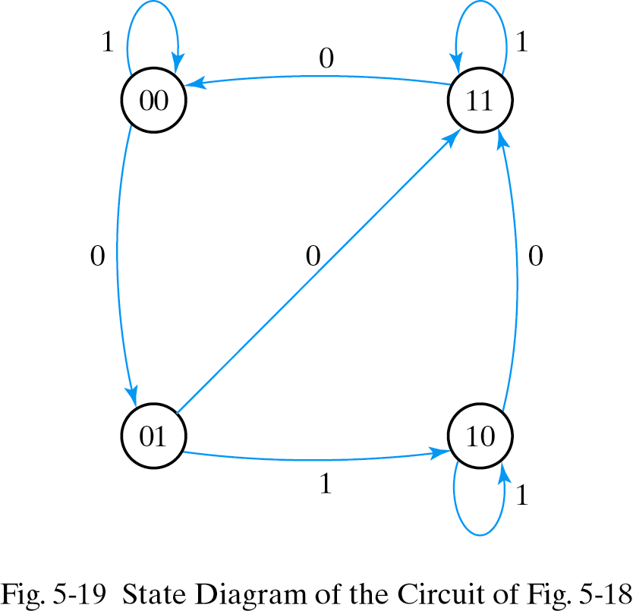
Analysis with JK flip-flops (Contd.)
The state diagram of the sequential circuit is shown right-side. Since the circuit has no outputs, the directed lines out of circles are marked with one binary number only to designate the value of input x.

Slide 21
Analysis of JK FF: summary
1) FF Input equation:
J_{A} = B K_{A} = Bx’
J_{B} = x’ K_{B} = A ⊕ x
2) State equation and output:
Characteristic equation:
A(t+1) = J_{A}A’ + K’_{A}A
B(t+1) = J_{B}B’ + K’_{B}B
State equation:
A(t+1) = BA’ + (Bx’)’A
= A’B + AB’ + Ax
B(t+1) = x’B’ + (A ⊕ x)’B
= B’x’ + ABx + A’Bx’
3) State table.
4) State diagram.

Slide 22
Analysis with T flip-flops
Similar to the analysis with JK flip-flops, the state table can be obtained by using characteristic table or the characteristic equation
Q(t+1) = T ⊕ Q = T’Q + TQ’
Consider the sequential circuit given in the next slide
It has two flip-flops A and B, one input x, and one output y

Slide 23
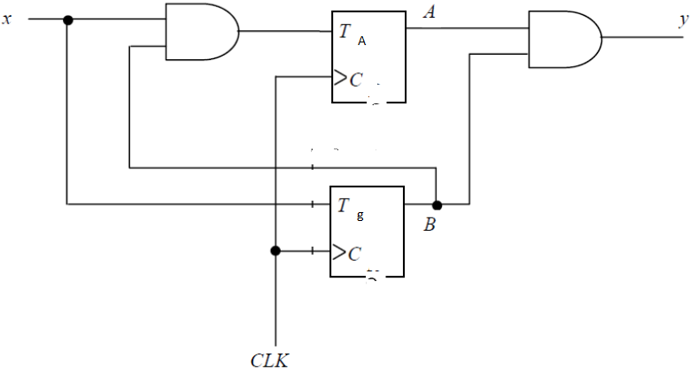
Analysis with T flip-flops (Contd.)

Slide 24
Analysis with T flip-flops (Contd.)
It can be described algebraically by two input equations and one output equation
T_{A} = Bx, T_{B} = x, y = AB
The characteristic equations are
A(t+1) = T_{A} ⊕ A, B(t+1) = T_{B} ⊕ B
Substituting the input equations with characteristic equations we get
A(t+1) = (Bx)’A + (Bx)A’ = AB’ + Ax’ + A’Bx
B(t+1) = x ⊕ B

Slide 25
Analysis with T flip-flops (Contd.)
The state table is as follows:
A(t+1) = AB’ + Ax’ + A’Bx
B(t+1) = x ⊕ B

Slide 26
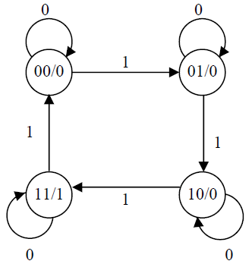
Analysis with T flip-flops (Contd.)
The state diagram is in right-side
The output is only a function of current state, not the input, and that is why the output is written inside state circles

Slide 27
1) FF Input equation:
T_{A} = Bx, T_{B} = x,
2) State equation and output:
Characteristic equation:
A(t+1) =T ‘_{A} A + T_{A} A’
B(t+1) = T’_{B} B +T_{B} B’
State equation:
A(t+1) = (Bx)’A + (Bx)A’
= AB’ + Ax’ + A’Bx
B(t+1) = x’ B +x B’
=x ⊕ B
State of the output:
y = AB
3) State table.
4) State diagram (Moore)
Analysis of T FF: summary

Slide 28
Design Sequential circuits
The procedure for designing synchronous sequential circuit is:
  Translate the design specifications to the state diagram for the circuit
  Assign binary values to the states
  Obtain the binary coded state table

Slide 29
Design Sequential circuits
  Choose the type of flip-flops to be used
  Derive the simplified flip-flop input equations and output equations
  Draw the logic diagram

Slide 30
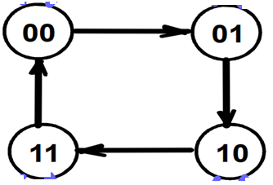
Example 1: Design 2-bit Counter using D-Flip Flops.
  Translate the design specifications to the state diagram for the circuit
  Assign binary values to the states
  Obtain the binary coded state table
Since Number of states = 2^{number of Flip Flops}
4 = 2 ^{Number of Flip FLOPS}
So, Number of Flip[ Flops = 2
We Use D-type Flip Flop

Slide 31
  3.Obtain the binary coded state table
Present State |  | Next State
A | B | A | B
0 | 0 | 0 | 1
0 | 1 | 1 | 0
1 | 0 | 1 | 1
1 | 1 | 0 | 0

Slide 32
  Choose the type of flip-flops to be used (D-type)
  Derive the simplified flip-flop input equations and output equations
  A(t+1) =A.B’ + A’.B
  B(T+1) = B’
Present State |  | Next State
A | B | A | B
0 | 0 | 0 | 1
0 | 1 | 1 | 0
1 | 0 | 1 | 1
1 | 1 | 0 | 0

Slide 33
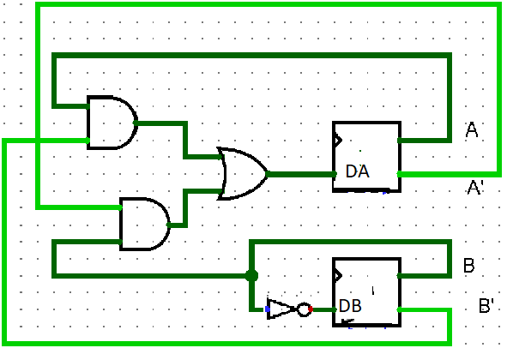
5. Draw the logic diagram
Present State |  | Next State
A | B | A | B
0 | 0 | 0 | 1
0 | 1 | 1 | 0
1 | 0 | 1 | 1
1 | 1 | 0 | 0

Slide 34
End of lecture 9

