Slide 1


Project Triangle
Chapter 5
Everyone’s Smart University
PMG101
Project communication

Slide 2


Slide 3
Section 2
Defining Project Outcomes:
A Layered Approach
Lecture
Section 1
Project Triangle

Slide 4
Section 1
Project Triangle

Slide 5
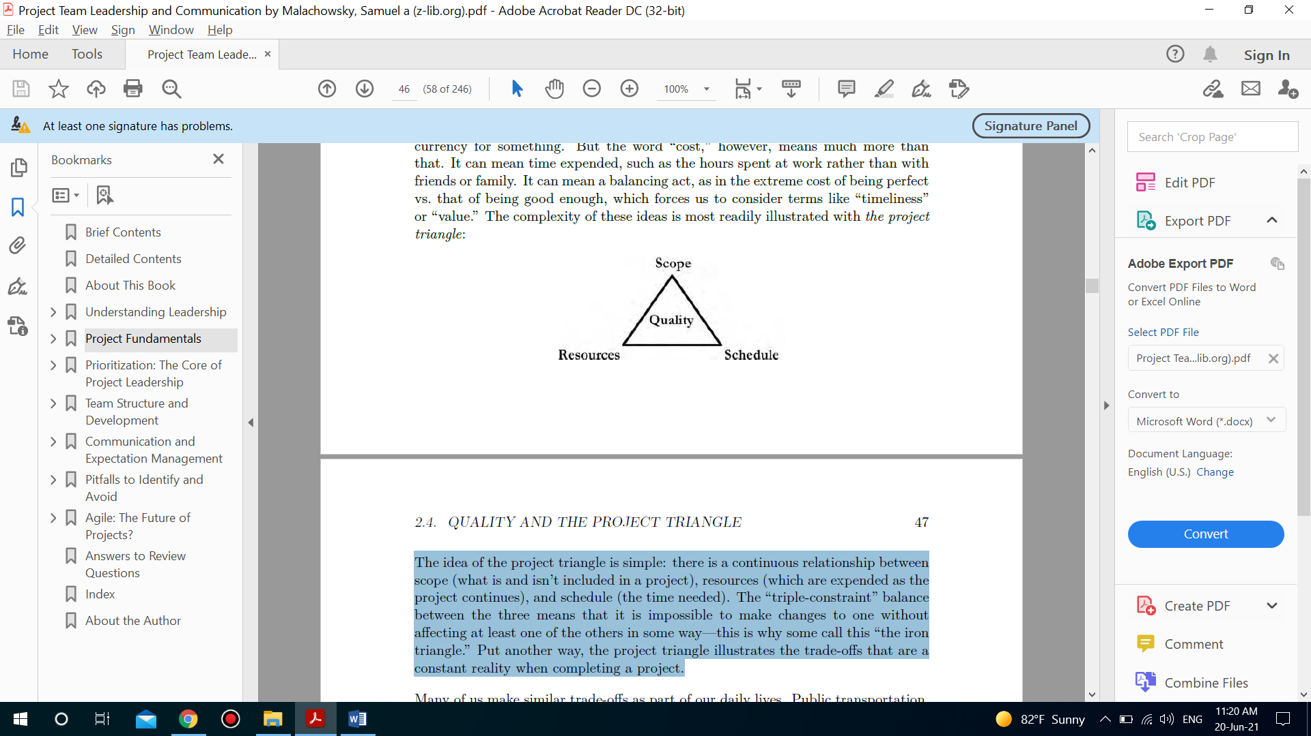
Project Triangle

Slide 6
Project Triangle
What is the idea of the project triangle?
The idea of the project triangle is simple: there is a continuous relationship between scope (what is and isn’t included in a project), resources (which are expended as the project continues), and schedule (the time needed).

Slide 7
Project Triangle
What does the “triple-constraint” means?
The “triple-constraint” balance between the three means that it is impossible to make changes to one without affecting at least one of the others in some way—this is why some call this “the iron triangle.” Put another way, the project triangle illustrates the trade-offs that are a constant reality when completing a project.
For instance, usually costs less but takes more time than taking a taxi or driving your own car. Purchasing goods at a convenience store is quicker and available at later hours, but is almost always more expensive than shopping at a grocery store. A faster, cheaper, drive-through car wash isn’t as thorough or customizable as having your car detailed by hand, but is the budget-friendly norm.

Slide 8
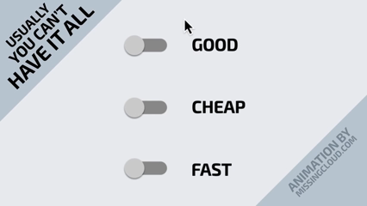

Slide 9
Resources
Project Triangle
Other commonly used terms for this concept are capital or budget. These represent the simple fact that money is the universal medium when it comes to resources.
Raw materials, components, tools, and overhead expenses such as facilities are essential to many projects. As such, selecting, acquiring, and managing them involves a major effort, especially for the project manager.

Slide 10
Resources
Project Triangle
An even bigger, more unpredictable effort often goes toward acquiring and managing the human resources—the organizational staff members and outside contractors— needed to complete the project.
Of the three sides of the project triangle, resources can often be the most inflexible for several reasons:
• Contracts frequently dictate the exact amount of capital available.
• Human resources are often assigned at the beginning of the project, which gives the project leader little flexibility and few options for change.

Slide 11
Resources
Project Triangle
Of the three sides of the project triangle, resources can often be the most inflexible for several reasons:
• Resources most directly tied to an organization’s “bottom line,” or profitability, and thus, carry a host of expectations and implications that can complicate the balance between “what’s best” for the team and “what’s best” for the organization.

Slide 12
Project Triangle
Schedule
Schedule refers to the time it takes to plan, execute, and complete a project. The modern economy and resulting pace of business has put a great deal of emphasis on ever tightening timescales.
Flexibility is an advantage
Schedule seems to be the most flexible aspect of the project triangle—they feel that if they can just work more efficient, longer hours, or even find shortcuts, they can shorten the time needed to complete a project, all without affecting the other sides of the triangle. It’s important for project leaders to resist this temptation, especially in the long term.

Slide 13
Schedule
Project Triangle
What about the limitations?
This is because an unsustainable pace can result in more waste, burnout-related mistakes, and loss of morale, leading to lower quality work and the exodus of much-needed personnel.
Another factor, schedule compression, also called “fast tracking” or “crashing,” invariably comes at a cost to resources or quality.

Slide 14
Schedule
Project Triangle
What about the limitations?
When team members are added to a project, they must be trained (at additional cost) and, for some period of time, won’t work as efficiently as preexisting members.
Additionally, more time or resources are needed to coordinate and communicate with the larger team and in turn, this faster pace taxes external dependencies such as contractors or materials providers.
If other methods are employed, they also come at a cost. Consider, for example, how having materials shipped overnight is significantly more expensive than slower alternatives.

Slide 15
Schedule
Project Triangle
What should project managers do to overcome limitations?
Project managers must weigh this decision with the hard reality that additional time cannot be added to the 24-hour day. The most practical way to shorten a project’s schedule is to directly address one of the other sides of the triangle.
More resources can be expended—hiring more experienced team members, for example, often results in quicker results with fewer errors (which themselves require schedule-extending rework).

Slide 16
Schedule
Project Triangle
What should project managers do to overcome limitations?
In addition, decreasing scope, the third side of the triangle, is often the easiest and most practical way to decrease schedule.
Finally, placing lower-priority components near the end of the schedule makes for natural selection of the most vital elements should a looming deadline or shortened schedule become a reality.
Employing cyclical or change-focused processes models make this much easier, since they are often iterative in nature.

Slide 17
Scope
Project Triangle
The term scope refers to what is and isn’t included in the project—the results to be created as the resources and schedule are consumed. Put another way, scope is the output(s) of the effort expended while implementing the project.
What is the difference between scope and deliverables?
Scope could also include other elements such as documentation, training, or future support, which are known as project deliverables. Deliverables are simply the products, services, or results that a project is intended to produce, but they aren’t always delivered at the end of the project—they can be produced as the project is implemented. Scope and the deliverables that define it are always a planned, intentional result of the project.
Many equate the concept of quality directly with scope (some even label “scope” as “quality”).

Slide 18
Project Triangle
What is the nature of the triangle?
Quality has a foundation built of standards, conformance, and excellence; each of these considerations can be applied just as readily to schedule and resource management as to the scope of the project.
Since considerations of quality should be at the center of all project activities, it’s placed at the center of the project triangle, not at its edges.
The nature of the project triangle means that scope is often involved in trade-offs with schedule and resources. Because what is to be delivered by projects varies so wildly, there’s not much more to be said about individual projects’ scopes except this: it is important to spend time properly defining with little uncertainty what the scope of a project entails

Slide 19
Section 2
Defining Project Outcomes: A Layered Approach

Slide 20
Defining Project Outcomes: A Layered Approach
Before discussing the planning stages onward, we must first define the terms.
Goals
Goals, often written just as a project is starting, are statements that provide a context for what the project is trying to achieve.
They have the following features:
• High-level: Goals provide a view of what the project is trying to achieve without necessarily specifying the specific products or actions needed to achieve them. Because goals are high-level, more specific descriptions of project outcomes are needed. Scope statements and requirements/specifications further clarify the project work needed to achieve these goals.

Slide 21
Defining Project Outcomes: A Layered Approach
Before discussing the planning stages onward, we must first define the terms.
Goals
Goals, often written just as a project is starting, are statements that provide a context for what the project is trying to achieve.
They have the following features:
• Measurable: Though high-level descriptions may seem incompatible with the idea of measurement, goals should be defined (and more specifically, worded) so that it’s clear when they have been accomplished. Ambiguity in this area may lead to out-of-control costs or schedules, or may indicate operational (non-project) work.

Slide 22
Defining Project Outcomes: A Layered Approach
Before discussing the planning stages onward, we must first define the terms.
Goals
Goals, often written just as a project is starting, are statements that provide a context for what the project is trying to achieve.
They have the following features:
• Reasonable: It’s important that goals have self-imposed limits since it’s easy to set goals that are too lofty. Because of this, goals must conform to the capabilities of the time and resources allotted to the team (as well as the organization). This doesn’t mean that they can’t be challenging—they just need to be reasonably achievable.

Slide 23
Defining Project Outcomes: A Layered Approach
Before discussing the planning stages onward, we must first define the terms.
Goals
Goals, often written just as a project is starting, are statements that provide a context for what the project is trying to achieve.
They have the following features:
• Cross-compatible: Goals must be compatible with each other as well as the mission and objectives of the organization. If goals are created that seem incompatible, more time must be dedicated to sorting out these inconsistencies; not doing so will most likely have disastrous consequences as the project progresses.

Slide 24
Defining Project Outcomes: A Layered Approach
Goals
What is the perspective of the project leader and team about goals?
Goals serve as a kind of contract. In order for the project to be called “complete,” its goals must be clearly met.
Goals which do not include numerical or black-and-white indicators need to be clarified. Often the first responsibility of a project leader is obtaining a clear understanding of the goals, their context, and what would constitute their completion.
The prudent project leader then goes on to ensure that these clarifications are recorded and agreed upon by important stakeholders.

Slide 25
Defining Project Outcomes: A Layered Approach
Objectives
Objectives are related to goals; as such, the words are sometimes used interchangeably. Objectives describe what the planned outcomes of your project are in more concrete terms. Goals are somewhat more abstract, whereas objectives tend to be more exact.
As the name implies, goals mark the beginning, or the most abstract element of defining what a project requires.

Slide 26
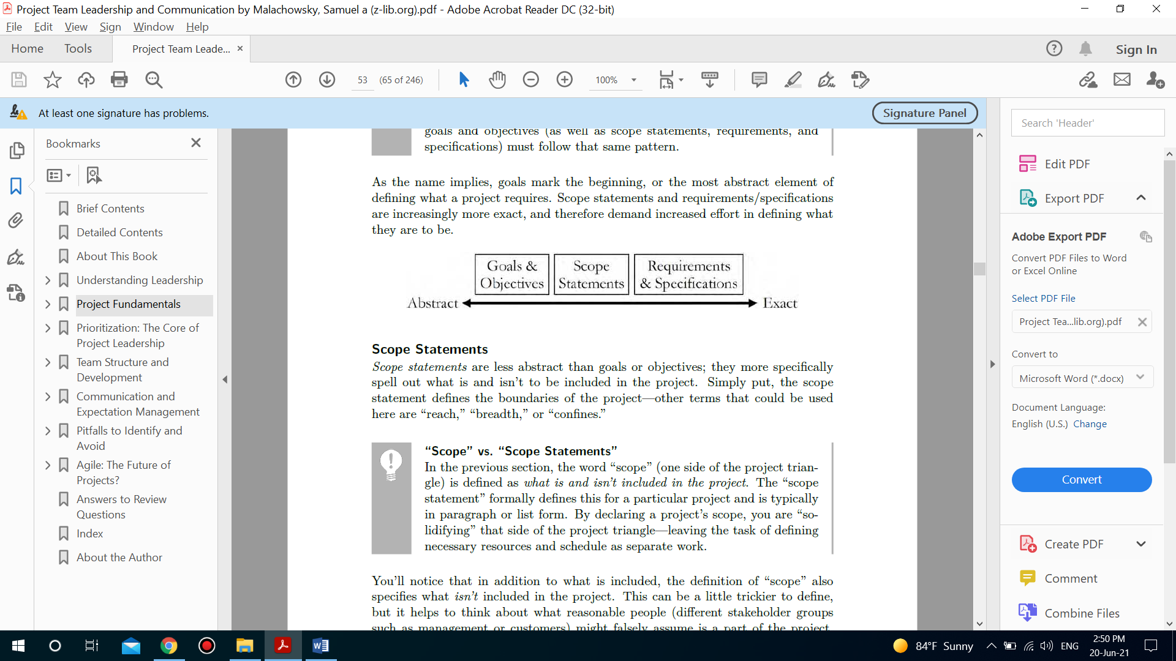
Defining Project Outcomes: A Layered Approach
Scope statement
Scope statements and requirements/specifications are increasingly more exact, and therefore demand increased effort in defining what they are to be.

Slide 27
Defining Project Outcomes: A Layered Approach
Scope statement
Scope statements are less abstract than goals or objectives; they more specifically spell out what is and isn’t to be included in the project. Simply put, the scope statement defines the boundaries of the project—other terms that could be used here are “reach,” “breadth,” or “confines.”

Slide 28
Defining Project Outcomes: A Layered Approach
The difference between Scope and Scope statement
“Scope” (one side of the project triangle) is defined as what is and isn’t included in the project.
The “scope statement” formally defines this for a particular project and is typically in paragraph or list form.
By declaring a project’s scope, you are “solidifying” that side of the project triangle—leaving the task of defining necessary resources and schedule as separate work.

Slide 29
Defining Project Outcomes: A Layered Approach
The difference between Scope and Scope statement
A solidly written scope statement includes the following features:
• A list of all major deliverables: As covered in the last section, deliverables are simply the products, services, or results that a project is intended to produce.
The scope statement should, with as little ambiguity as possible, list the important parts of the project’s intended output.
• A basic strategy: This implies the high-level steps needed to achieve the project’s goals and create its deliverables.
Though the details will be worked out later, defining these in the scope statement begins to delineate the project as a structured solution to the problem it was initiated to address.

Slide 30
Defining Project Outcomes: A Layered Approach
The Problem Statement
When defining the scope, many project teams start by carefully reexamining the problem or need the project is to address, often rewriting it as an introduction to the scope statement.
This can be extremely helpful by providing context to readers of the scope; in short, choosing to include a problem statement with the scope statement is a commonly held “best practice.”
• Constraints: Those reading the scope statement should have no problem understanding the limit of what is to be produced. An out-of-control scope results in out-of-control budgets and schedules.

Slide 31
Defining Project Outcomes: A Layered Approach
The Problem Statement
Some scope statements include a short section explaining the rationale for what is and isn’t to be included in the project.
• External dependencies: Does your project depend on variables outside your control? If possible, define these as conditions or limitations in your scope statement.
• Assumptions: Similar to dependencies, is it possible that you are making assumptions about things like the availability of resources or information? Assumptions are acceptable as long as they are explicitly defined, realistic, and agreed upon by all parties.
Though some projects try to break things down into a single sentence or statement, a proper scope statement often requires multiple paragraphs or, at the very least, a series of “bulleted” statements

Slide 32
Defining Project Outcomes: A Layered Approach
The following sample scope statements include basic but clear descriptions of what is and isn’t to be included in their associated projects:
Project: E-Flipper Marketing Campaign
Scope Statement: This project includes the initial marketing effort for the EFlipper BBQ accessory within the themes and ideas presented in the initial proposal meeting. This includes the creation of:
• Three different single-page advertisements
• One 15-second television commercial
• 6 variously-sized website banners with similar content (sizes to be determined by the client).

Slide 33
Defining Project Outcomes: A Layered Approach
The following sample scope statements include basic but clear descriptions of what is and isn’t to be included in their associated projects:
Project: E-Flipper Marketing Campaign
After approval, project will deliver screen or camera-ready, high-resolution digital files of each media item via secure file-transfer protocol.
Files will be available for 30 days after approval. Initial designs will be shared and approved by the client, with up to 3 revisions per media item before completion of refined final product.
Additional revisions or extension of ideas would be out of scope, requiring a separate contract and project. Project does not include assistance in placement of advertising media, future modifications, or retrieval of files after 30 days.

Slide 34
Examples

Slide 35
Defining Project Outcomes: A Layered Approach
Project: East Ave Hydrant Repair Project
Scope Statement:
Last month’s extensive ice damage has necessitated repair or replacement of several fire hydrants in the 400-block of East Ave. This project is designed to evaluate and repair damage to this vital system and to restore proper, code complaint active fire protection to this region. Parties expected to be engaged in this project include the city code department, fire commission, and county road construction crews.
This project will not include replacement, relocation, or augmentation of any hydrants unless deemed necessary by the code inspector, likely due to conditions that are unsafe or will lead to repetition of the original problem. In most cases, this is expected to result in continued use of existing hydrants, valves, pipes, and connections.

Slide 36
Defining Project Outcomes: A Layered Approach
Requirements and specifications tips
Clearly state what your project aims to achieve.
They are intended to span not only the product or solution your project is to create (often called “functional” requirements or specifications) but can also include other limits or needs placed on your project (“non-functional”), such as schedule and budget restrictions and less-definable qualitative elements such as safety, documentation, usability, aesthetics, and compatibility with expectations about the future.
There should be no room for abstract generalizations.

Slide 37
Defining Project Outcomes: A Layered Approach
Requirements and specifications tips
Requirements and specifications are written so that anyone reading them knows exactly what should be achieved in the execution phase of the project.
The language should be right.
The language of requirements or specifications often differs from the general vernacular and favors specificity.

Slide 38
Defining Project Outcomes: A Layered Approach
What puts into consideration when it comes to Requirements and specifications?
The process for collecting or authoring these requirements or specifications is an undertaking that varies by industry, organization, and project.
Indeed, large projects may have an entire sub-project which spans months and whose primarily deliverable is a requirements/specifications document
In some cases the specifications or requirements are dictated by the customer or stakeholders for which the project is intended. In others, experts or members of the team are the ones who write them.

Slide 39
Defining Project Outcomes: A Layered Approach
What puts into consideration when it comes to Requirements and specifications?
No matter who authors them, all parties must agree that the requirements or specifications represent precisely what the project is to deliver.
Agreeing on the requirements and specifications for a project almost always requires a relationship of mutual trust between the team and those for whom the project will be completed.
In some cases, project requirements/specifications entail the most essential part of the contract signed by both parties. In others, defining them represents the first significant interaction between the team and the customer in the beginning phases of the project.

Slide 40
Defining Project Outcomes: A Layered Approach
The Layered Approach
How do goals, scope statements, and requirements/specifications work to advance the project?
Using them properly requires you to understand their commonalities and overarching objectives as you define project outcomes:
1. To gain understanding and approval from essential stakeholders, and
2. To gain enough information and clarification for the team to begin executing the work.

Slide 41
Defining Project Outcomes: A Layered Approach
The Layered Approach
How does Layered Approach work?
A project that has been more-or-less defined before it’s started often places defining the scope before requirements or specifications.
Scope is set by the sponsor or a contract with the customer, and stakeholders (often the customer themselves) are consulted to work out the level of detail required before the team can create the requirements or specifications.
If the stakeholder asks for something outside the previously defined scope, it is politely refused or considered as an addition to the project’s baseline scope before acceptance.

Slide 42
Defining Project Outcomes: A Layered Approach
The Layered Approach
How does Layered Approach work?
This type of practice prevents undue expansion of the project and favors the expertise of the team over that of stakeholders. If the project hasn’t been previously well-defined, gathering requirements and/or writing specifications often takes place first, with a scope statement completed soon after.
Stakeholders’ needs and direct input are considered (as requirements or specifications) and that input becomes the basis for the project’s scope statement.
This method tends to favor the expertise of stakeholders, with team members relying on them to properly understand both the problem and their opinion of what a project-based solution would look like (its scope).

Slide 43
Defining Project Outcomes: A Layered Approach
The Layered Approach
When does the team need extra layers?
Some projects require even deeper levels of information or planning to proceed, especially if they are to achieve the goals of understanding, approval, and readiness required to start production.
By specifying in even more exacting terms what is to be created, the team can proceed more confident that they are all on the same page, and that their solution is more likely to meet the project’s goals.

Slide 44
Defining Project Outcomes: A Layered Approach
The Layered Approach
When does the team need extra layers?
So how do we determine which of these “layers” are needed? The answer lies in the following considerations:
• There is a minimum: Most professionals would agree that at bare minimum, projects should have a scope statement and defined goals/objectives. Small projects with teams that have completed similar work in the past may find this level of definition adequate, but at least one more layer of specificity is typically needed (usually in the form of requirements/specifications).

Slide 45
Defining Project Outcomes: A Layered Approach
The Layered Approach
When does the team need extra layers?
So how do we determine which of these “layers” are needed? The answer lies in the following considerations:
• They build upon each other: Each of these layers has a relationship with the others. For example, goals are addressed by scope statements, which are described by requirements or specifications.

Slide 46
Defining Project Outcomes: A Layered Approach
The Layered Approach
When does the team need extra layers?
So how do we determine which of these “layers” are needed? The answer lies in the following considerations:
• They are often industry or organization specific: In some cases, the differences are in name only; in others, there is a real difference between the preferences of different industries. Occasionally, regulations require specific formats; building codes and financial statements are examples of this. Sometimes entirely different documents are used (blueprints, technical spec sheets, etc.).

Slide 47
Thank You

