Slide 1


Healthcare Information Systems (Part II)
Prepared by Dr. Hesham Mousli
MHA621
Healthcare Informatics
Lecture 5

Slide 2

Intended Objectives
Chapter
05
Define Administrative Information Systems (AIS) in healthcare.
Outline key AIS components: registration, scheduling, financial, HR, ADT, and contract management.
Highlight AIS applications in optimizing healthcare operations.
Assess AIS benefits in efficiency, error reduction, and resource optimization.
Emphasize the value of AIS integration with clinical systems for better patient care.

Slide 3

Administrative Information Systems (AIS)

Slide 4


What are Administrative Information Systems (AIS)?
Information systems that:
  Support client care by managing administrative, financial, and demographic data.
  Include client-management services, financial systems, and more.

Slide 5
Key Components of AIS
Chapter
05
  Registration and Scheduling
  Financial Systems
  Payroll and Human Resources
  Quality Assurance and Risk Management
  Contract Management

Slide 6
Examples of AIS Applications

Slide 7
Registration and Scheduling Systems
Chapter
05
Importance in Healthcare Operations:
  Registration and scheduling systems are critical to the effective operation of healthcare systems.
  They ensure smooth patient flow, reduce wait times, and improve overall patient satisfaction.
  These systems help healthcare providers manage resources efficiently, such as staff, equipment, and facilities.

Slide 8
Registration and Scheduling Systems
Chapter
05
Core Functions:
  Collects and stores client identification and demographic data: This includes name, address, contact information, date of birth, insurance details, and medical history.
  Facilitates appointment scheduling: Patients can book, reschedule, or cancel appointments easily.

Slide 9
Registration and Scheduling Systems
Chapter
05
Core Functions:
  Tracks patient visits: Maintains a record of past and upcoming appointments for better continuity of care.
  Supports billing and insurance processing: Integrates with billing systems to ensure accurate invoicing and claims management.

Slide 10
Registration and Scheduling Systems
Chapter
05
Key Features:
  User-friendly interface: Simplifies the registration and scheduling process for both patients and staff.
  Real-time updates: Provides up-to-date information on appointment availability and patient status.

Slide 11
Registration and Scheduling Systems
Chapter
05
Key Features:
  Integration with Electronic Health Records (EHR): Ensures seamless access to patient data across departments.
  Automated reminders: Sends notifications via SMS, email, or phone calls to reduce no-show rates.

Slide 12
Registration and Scheduling Systems
Chapter
05
Benefits:
  Improved efficiency: Reduces administrative workload and streamlines operations.
  Enhanced patient care: Enables better coordination among healthcare teams.
  Data accuracy: Minimizes errors in patient information and scheduling.
  Resource optimization: Helps in allocating resources based on patient demand.

Slide 13
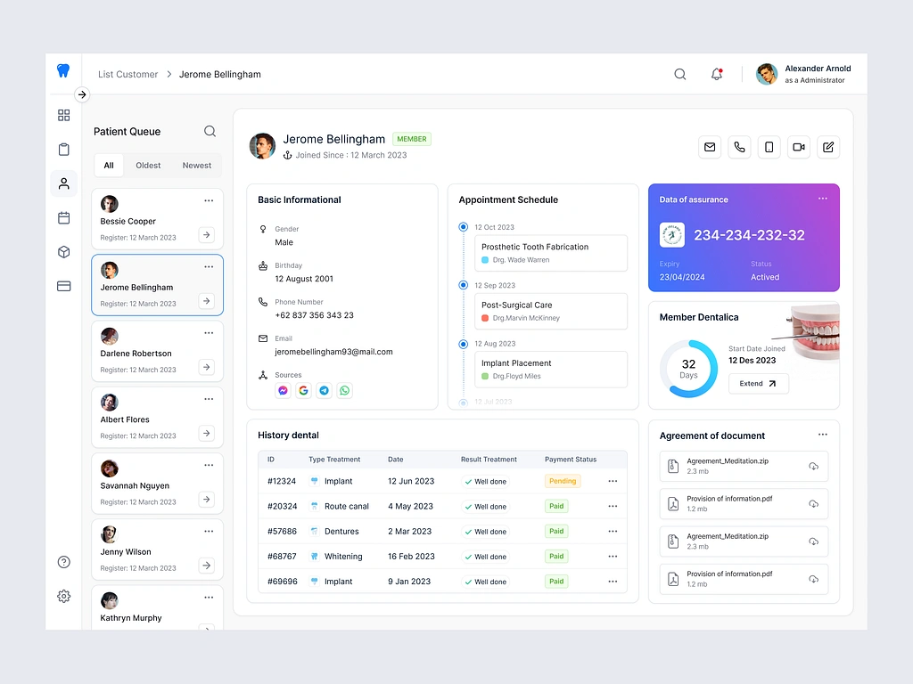
Chapter

Slide 14
Admission/Discharge/Transfer (ADT) Systems
Chapter
05
Purpose and Functionality:
  Supports the entire patient journey from admission to discharge.
  Tracks and manages patient location within the healthcare facility in real-time.
  Ensures accurate and up-to-date patient information is available to all relevant departments.

Slide 15
Admission/Discharge/Transfer (ADT) Systems
Chapter
05
Key Features:
  Admission:
    Captures patient demographic and insurance details.
    Assigns a unique patient identifier for tracking.
    Initiates the patient’s electronic health record (EHR).

Slide 16
Admission/Discharge/Transfer (ADT) Systems
Chapter
05
Key Features:
  Discharge:
    Coordinates discharge planning and documentation.
    Ensures proper handoff to post-acute care or outpatient services.
    Updates bed availability for new admissions.

Slide 17
Admission/Discharge/Transfer (ADT) Systems
Chapter
05
Key Features:
  Transfer:
    Manages patient transfers between departments, units, or facilities.
    Ensures continuity of care during transitions.
    Updates patient location and status in real-time.

Slide 18
Admission/Discharge/Transfer (ADT) Systems
Chapter
05
ADT System Integration:
  Integration with Administrative Systems:
    Links with billing and insurance systems for accurate charge capture and claims processing.
    Synchronizes with bed management systems to optimize bed utilization.
    Connects with scheduling systems for efficient appointment and resource allocation.

Slide 19
Admission/Discharge/Transfer (ADT) Systems
Chapter
05
ADT System Integration:
  Integration with Clinical Systems:
    Interfaces with Electronic Health Records (EHR) for seamless access to patient data.
    Integrates with nurse call systems to alert staff about patient needs during transfers.
    Connects with laboratory and radiology systems to ensure test results follow the patient.

Slide 20
Admission/Discharge/Transfer (ADT) Systems
Chapter
05
Benefits:
  Improves patient flow and reduces bottlenecks.
  Enhances patient safety by ensuring accurate location tracking.
  Streamlines communication between departments.
  Reduces administrative burden and errors.

Slide 21
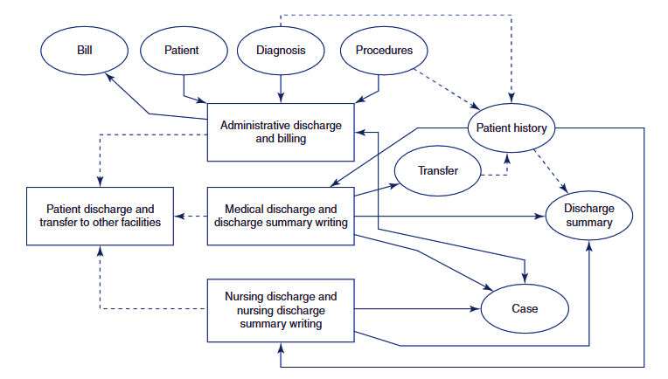

Slide 22
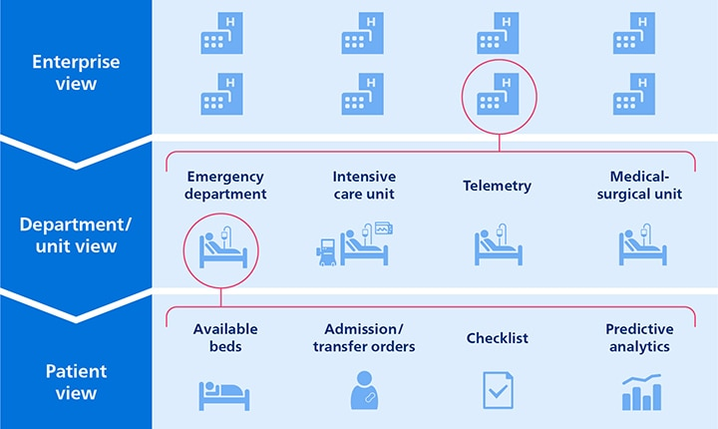

Slide 23
Payroll and HR Systems
Chapter
05
Purpose:
    Centralized software for managing employee-related processes.
    Streamlines payroll, attendance, benefits, and career development.
Key Functions:
    Tracks attendance, payroll, benefits, and performance.
    Integrates data for effective workforce management.

Slide 24
Payroll and HR Systems
Chapter
05
Key Features:
  Attendance & Time Management:
    Tracks clock-in/out, leaves, and time sheets.
  Payroll Processing:
    Automates salary calculations, taxes, and payments.

Slide 25
Payroll and HR Systems
Chapter
05
Key Features:
  Benefits Administration:
    Manages health insurance, retirement plans, and employee contributions.
  Career Development:
    Tracks performance, training, and succession planning.

Slide 26
Payroll and HR Systems
Chapter
05
Benefits:
  For Organizations:
    Saves time and reduces administrative costs.
    Provides data-driven insights for decision-making.
    Ensures compliance with labor laws and regulations.
  For Employees:
    Transparent access to payroll and benefits.
    Self-service tools for convenience and empowerment.

Slide 27
Contract Management Systems
Chapter
05
What is a Contract Management (CM) System?
  Software to manage third-party contracts and vendor agreements.
  Tracks, stores, and retrieves key documents.
Purpose
  Streamlines contract processes.
  Enhances organization and efficiency.

Slide 28
Contract Management Systems
Chapter
05
Key Functions:
  Contract Creation:
    Automates drafting using templates.
    Ensures consistency and compliance.
  E-Procurement:
    Supports vendor selection and bidding.
    Monitors procurement activities.

Slide 29
Contract Management Systems
Chapter
05
Key Functions:
  Reporting & Analytics:
    Real-time dashboards for performance tracking.
    Compliance monitoring through detailed reports.
  Alerts & Notifications:
    Reminders for renewal or expiration dates.
    Notifications for critical events.

Slide 30
Contract Management Systems
Chapter
05
Benefits:
  Increased Efficiency
    Reduces time managing contracts.
    Centralized storage for quick document retrieval.
  Risk Reduction
    Maintains audit trails and tracks changes.
    Ensures compliance with legal standards.
  Cost Savings
    Prevents missed deadlines and penalties.
    Optimizes vendor and contract performance.

Slide 31
Case Study

Slide 32
Case Study
Chapter
05
FutureCare Hospital recently implemented advanced Administrative Information Systems (AIS) to streamline hospital operations and improve patient care. This case follows a patient, Mr. Ahmed, during his journey through the hospital, illustrating the efficiency, practical functions, and importance of the AIS components.

Slide 33
Case Study
Chapter
05
Registration and Scheduling
  Scenario: Mr. Ahmed arrives at the hospital for a scheduled cardiology appointment.
  AIS Functionality:
    Patient registration is completed swiftly using pre-stored information.
    The scheduling system confirms his appointment and notifies the cardiology department.
    Efficiency: Reduces patient wait times and ensures accurate scheduling.
    Importance: Prevents overbooking and ensures resource availability.

Slide 34
Case Study
Chapter
05
Financial Systems
  Scenario: Before consultation, Mr. Ahmed pays his copayment.
  AIS Functionality:
    Generates an accurate billing summary.
    Updates his financial records in real-time.
    Efficiency: Speeds up payment processing with minimal errors.
    Importance: Ensures transparency in hospital charges and facilitates timely revenue collection.

Slide 35
Case Study
Chapter
05
Payroll and Human Resources
  Scenario: The attending nurse, Ms. Salma, is notified about Mr. Ahmed’s consultation through her shift schedule.
  AIS Functionality:
    Tracks staff schedules and assigns resources based on workload.
    Ensures Ms. Salma receives timely payroll updates linked to her shifts.
    Efficiency: Streamlines staffing and prevents scheduling conflicts.
    Importance: Boosts staff satisfaction and ensures adequate resource allocation.

Slide 36
Case Study
Chapter
05
Admission/Discharge/Transfer (ADT) Systems
  Scenario: After his consultation, Mr. Ahmed is recommended for a 24-hour observation in the hospital’s inpatient department.
  AIS Functionality:
    Updates his admission details in the ADT system.
    Tracks bed availability and assigns him a suitable room.
    Efficiency: Prevents manual tracking errors and speeds up the admission process.
    Importance: Ensures smooth transitions and improves bed management.

Slide 37
Case Study
Chapter
05
  Contract Management Systems
  Scenario: During his stay, Mr. Ahmed requires a specific cardiac monitor, sourced from a contracted vendor.
  AIS Functionality:
    The system identifies the vendor contract and places an automated requisition.
    Tracks delivery status and ensures compliance with the terms.
    Efficiency: Guarantees timely access to equipment.
    Importance: Reduces delays in care and ensures vendor accountability.

Slide 38
Wrap Up
Chapter
05
AIS components are essential for managing administrative, financial, and demographic data efficiently.
Registration and scheduling systems improve patient flow and resource allocation.
Financial systems ensure accurate billing and real-time financial tracking.
Payroll and HR systems streamline workforce management and enhance employee satisfaction.

Slide 39
Wrap Up
Chapter
05
ADT systems ensure seamless patient tracking from admission to discharge.
Contract management systems optimize vendor relationships and reduce compliance risks.
Integration of AIS with clinical systems enhances operational efficiency and patient outcomes.
AIS adoption reduces administrative burdens, improves accuracy, and ensures better decision-making in healthcare organizations.

Slide 40



Thank You

