Slide 1

Global Project Management
Prepared by Dr. Mohamed Hamouda
Lecture 9
PMG 661
Knowledge Sharing

Slide 2
Global Project Management
Prepared by Dr. Mohamed Hamouda
Lecture 9
Knowledge Sharing

Slide 3
Global Project Management
Prepared by Dr. Mohamed Hamouda
Lecture 9
Knowledge Sharing

Slide 4

PMG 661
RECAPE

Slide 5

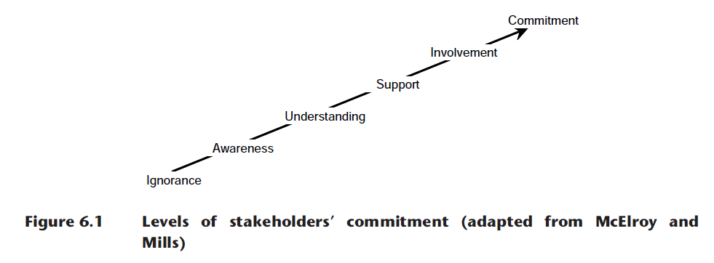
The stakeholder commitment framework

Slide 6


Identifying the stakeholders’ requirements

Slide 7

Distributing information to the global stakeholders

Slide 8

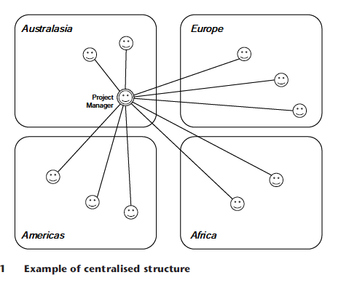
Centralized project management

Slide 9
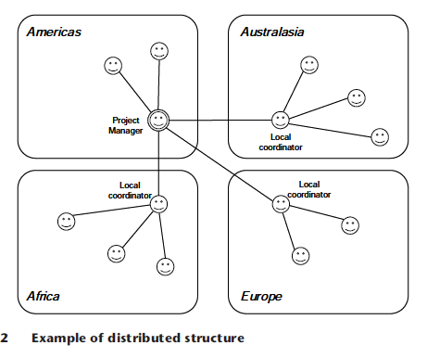
Distributed project management, with local coordinators

Slide 10
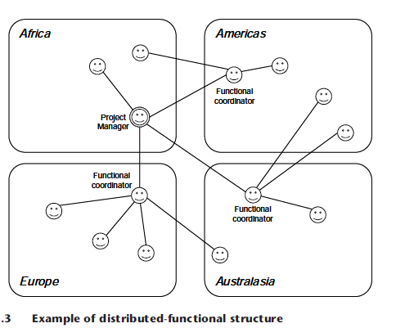
Distributed project management, with functional coordinators

Slide 11
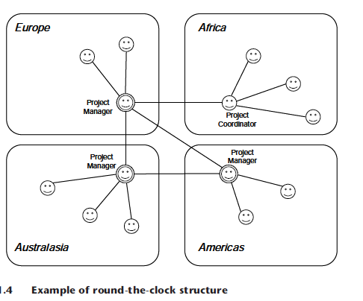
Round-the-clock project management

Slide 12
Global team members’ skills
Culture awareness – the team members that are familiar with the organizational and country cultures involved in the project may also have fewer requirements for training and coaching, and are less likely to generate conflicts. They tend to feel more comfortable than other people when working with a mix of different ethics, standards, policies or working practices.

Slide 13
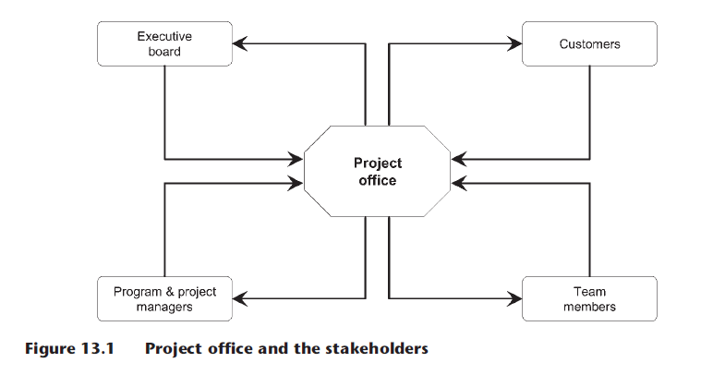
Defining project offices

Slide 14

Global Collaborative Networks
Many organisations form strategic alliances and partnerships to access specific markets, to obtain capital resources or sponsorship, or to share R&D and manufacturing skills. Very often, the relationship is sealed around a group of programs or projects. A seamless exchange of information is essential for these initiatives to be successful.

Slide 15
Collaborative networks: a project-centred approach
Castells (2000) suggests that organisations are evolving from multinational enterprises to international networks, which include large corporations and a series of small and medium business, each in a different country and organizational culture, all with a shared mission to be achieved within a limited timeframe.

Slide 16

Collaborative networks: a project-centred approach
These networks can aggregate the main suppliers, producers and customers with their sub-contractors and service providers, and are strongly reliant on the cooperation among different individuals and on the communication between the computer networks.

Slide 17
PMG 661
Knowledge Sharing

Slide 18
Knowledge Sharing
Collaborative environments need to be available on global projects to facilitate the sharing of information about the project and the products. The project manager can create the project management plan with the participation of team members in all locations, and keep all its documents in a shared workspace.

Slide 19
Knowledge Sharing
The team members can organize review cycles for design documents, keeping different versions and a history of the changes. Project-related information, like the global project binder, can be maintained in shared tables or spreadsheets, allowing the owners of tasks, issues and risks to keep their information accurate in real time and accessible to all stakeholders.

Slide 20

Knowledge Sharing
Another form of collaboration goes beyond formal documentation, by collecting knowledge in an informal manner, through discussion groups, web links and project announcements.

Slide 21
Knowledge Sharing
Originated from the BBS (Bulletin Board Systems) and newsgroups, and using a similar language and structure to chat rooms, discussion boards have the advantage of keeping discussions stored in a shared place and allowing the stakeholders to search for information at any time during the project. Global project offices can establish procedures to archive the knowledge base so that it can serve as a basis for future projects.

Slide 22
Evaluating technologies for knowledge sharing
International companies need to consider different software solutions to satisfy all their knowledge-sharing requirements and the main objective of the evaluation phase is to guarantee a good integration level among the different collaborative tools, which might also be combined with e-mail, web conferencing and calendar systems.

Slide 23
Evaluating technologies for knowledge sharing
Proprietary software can force companies to use a complete suite of tools from the same supplier and sometimes these are not the best options available. Global organisations might consider the use of open solutions for better integration and a wider choice of complementary packages.

Slide 24
Evaluating technologies for knowledge sharing
The first requirement for knowledge-sharing suites is a good system for document collaboration, which allows different team members to checkout, update documents, submit them for review, and publish a final version. The software must recognise all document types: text editors, spreadsheets, presentations, design schemas, program sources, blueprints and other files applicable to the different projects in your company.

Slide 25
Evaluating technologies for knowledge sharing
The usual knowledge management activities must be performed as easily in the knowledge-sharing software as in older file sharing systems: that is, to look for a specific document, to edit it and to save a new version. The creation of historic versions, back-ups, archiving and indexing must be performed smoothly by the software with little or no human intervention. Complex or time-consuming activities may inhibit the use of the collaborative environment.

Slide 26
Evaluating technologies for knowledge sharing
A second requirement for knowledge-sharing software is the management of discussion groups. The project office or project manager can create various groups, according to the categories of information and the types of stakeholders exchanging information (for example, environmental aspects, engineering standards, technical discussions, marketing strategies, sales forecasts, and so on).

Slide 27
Evaluating technologies for knowledge sharing
The project team members can create discussion threads, one for every topic of interest: technical or environmental discussions, suggestions to improve the quality or reduce the cost of the project deliverables, informal conversations that may reveal potential risks, opportunities or issues.

Slide 28
Evaluating technologies for knowledge sharing
When analysing the efficiency of the tool to manage the discussions, think about how intuitive it would be for any project stakeholders to write new discussion threads, to be informed about threads created by other people, to detect which replies were given to specific threads and to search for information in all threads.

Slide 29
Evaluating technologies for knowledge sharing
Project announcements are an additional and important feature, since global project teams cannot have wallboards to share personal events (like birthdays and marriages), project matters (new project members, important milestones, decisions, changes), external events that may affect the project

Slide 30
Evaluating technologies for knowledge sharing
(press releases, environmental reports, changes in the organizational structure) and project metrics (for example, important deviations on cost, schedule, quality and customer satisfaction). The announcement board must allow the posting of text, pictures and hyperlinks to project documents with detailed information on the topics being published.

Slide 31
Evaluating the existing knowledge-sharing solutions
When the organization or project already deploys knowledge-sharing solutions for collaboration among distant team members, a survey (see example in Table below) can identify the simplicity of use and compliance with the requirements identified in the section above. In this survey, you can confirm if other team members share your impression, by comparing the results with the mind map.

Slide 32
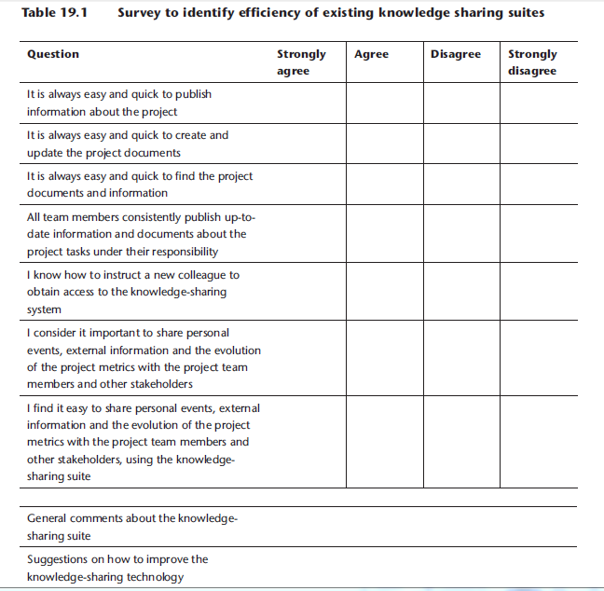

Slide 33
Implementing a new knowledge-sharing solution
After all the different components are selected, validated and integrated, a pilot implementation is recommended to identify how the stakeholders are using the different functions and to determine the best approach to deploy the knowledge-sharing suite into all global projects.

Slide 34
Implementing a new knowledge-sharing solution
This approach is also recommended when some components are being added or updated inn the existing knowledge-sharing suite. At the end of the pilot phase, the evaluation survey can be announced to all the participants, identifying if the implementation can proceed to other projects or locations in the same organization, or even extended to partner companies. Depending on the survey results, a second pilot phase can be organized to correct important gaps between the requirements and the solution in place.

Slide 35
Defining procedures for knowledge-sharing set-up
All global project stakeholders must know how to prepare their computers to access the knowledge-sharing systems (for example, by installing client software or plug-ins), how to obtain access to the applications (for example, by requesting user identifications, passwords or access rights) and how to use all the basic knowledge-sharing functions.

Slide 36
Defining procedures for knowledge-sharing set-up
The structure of the documentation must show how the various applications are integrated, how to publish the information and how to search for it. You can use the checklist in Table below opposite to produce and publish the documentation to help all project stakeholders accessing and using the knowledge-sharing suite.

Slide 37
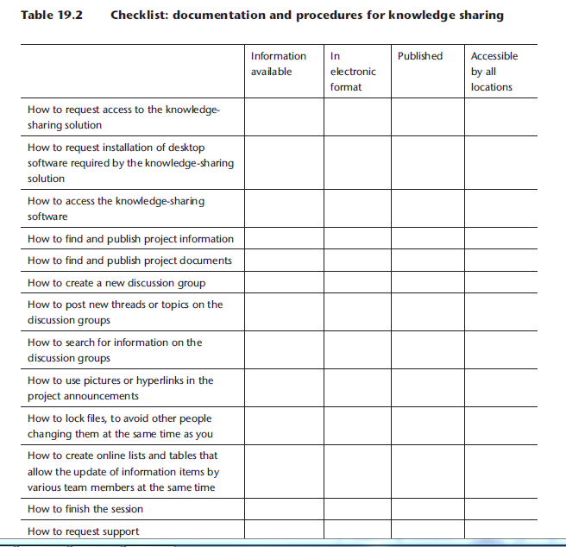

Slide 38
Evaluating the implementation
Some time after implementing the new technology components, preparing and publishing the documentation and announcing the new solution to all project team members, you may evaluate the improvements and detect if corrections are required by deploying the same assessment survey (Table above) and comparing the new results with the initial findings.

Slide 39
Evaluating the implementation
A new implementation cycle can start to correct problems or to improve the quality of the knowledge-sharing tools and the documentation.

Slide 40
Resources:
Global Project Management
Communication, Collaboration and Management Across Borders
© Jean Binder 2007

