Slide 1


Blockchain and Cryptocurrencies
Prepared by Dr. Omar Al-kasasbeh
FNT628
Blockchain and Cryptocurrencies
Orientation-lecture

Slide 2



Blockchain and Cryptocurrencies
FNT 615
Blockchain and Cryptocurrencies
Lecture 1
Orientation-lecture
Prepared by
Dr. Omar Al-kasasbeh
https://midocean.edu.km

Slide 3

Chapter
Fundamentals of Blockchain
01
1. Understand the origin, definition, and evolution of blockchain technology.
2. Explain key blockchain concepts and how blockchain works.
3. Identify the main components of a blockchain system.
https://midocean.edu.km

Slide 4
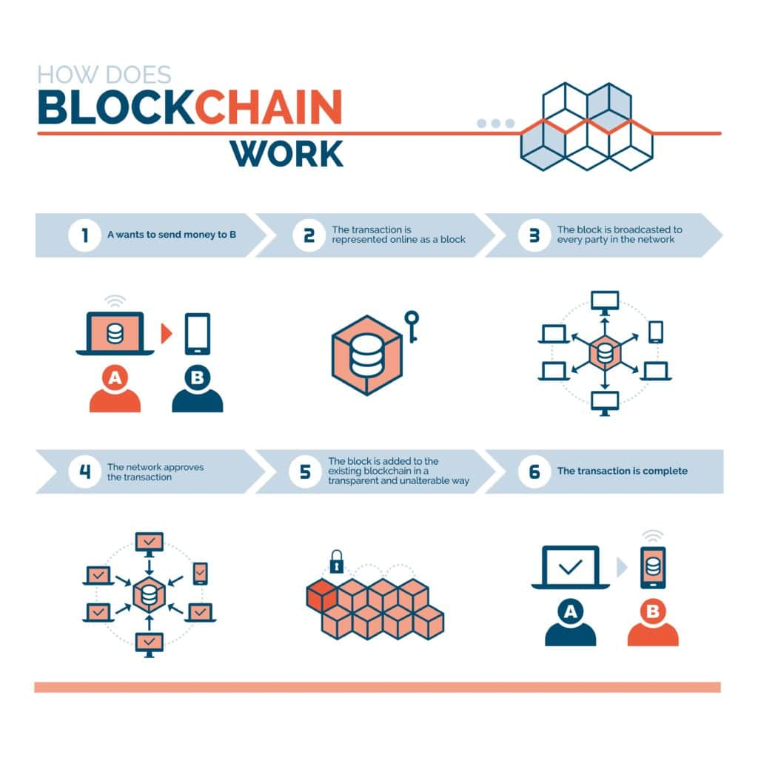
Chapter
01
https://midocean.edu.km

Slide 5
Chapter
Blockchain Technology
02
Explain the key use cases of blockchain technology.
Describe how Blockchain Technology works and its main components.
Analyze the role of Blockchain Technology in financial and digital applications.
https://midocean.edu.km

Slide 6
Chapter
02
https://midocean.edu.km

Slide 7
Chapter
Decentralized Finance - DEFI
03
Understand the key features of Decentralized Finance (DeFi).
Describe the main DeFi applications and services.
3. Analyze the benefits and risks of DeFi in the financial ecosystem.
https://midocean.edu.km

Slide 8

Chapter
03
https://midocean.edu.km

Slide 9
Chapter
Digital Currencies
04
Define digital currencies and their main types.
Explain how digital currencies operate within financial systems.
Analyze the opportunities and risks associated with digital currencies.
https://midocean.edu.km

Slide 10

Chapter
04
https://midocean.edu.km

Slide 11
An Overview of Crypto Markets
Chapter
05
Understand the structure and main characteristics of crypto markets.
2. Identify the key participants and instruments in crypto markets.
3. Analyze market dynamics and risks in crypto market
https://midocean.edu.km

Slide 12

Chapter
05
https://midocean.edu.km

Slide 13
Chapter
Cryptocurrency
06
1. Understand cryptocurrency and its key characteristics.
2. Explain how cryptocurrencies function within blockchain networks.
https://midocean.edu.km

Slide 14

Chapter
06
https://midocean.edu.km

Slide 15
Chapter
Cryptocurrency and Banking Industry
07
the role and impact of cryptocurrency in the banking industry.
2. Explore the regulatory, security, and operational challenges of cryptocurrencies.
3. Analyze the benefits and risks of integrating cryptocurrencies into banking practices.
https://midocean.edu.km

Slide 16
Chapter
07
https://midocean.edu.km

Slide 17
Chapter
Cryptocurrency and Monetary Policy
08
Explore the challenges cryptocurrencies pose to central banks and financial regulation.
2. Analyze the potential effects of cryptocurrency adoption on money supply and economic stability.
https://midocean.edu.km

Slide 18
Chapter
Crypto Investment Strategies
09
Understand different investment strategies in the cryptocurrency market.
2. Explore risk management and portfolio diversification techniques for crypto assets.
3. Analyze market trends and tools to make informed cryptocurrency investment
https://midocean.edu.km

Slide 19
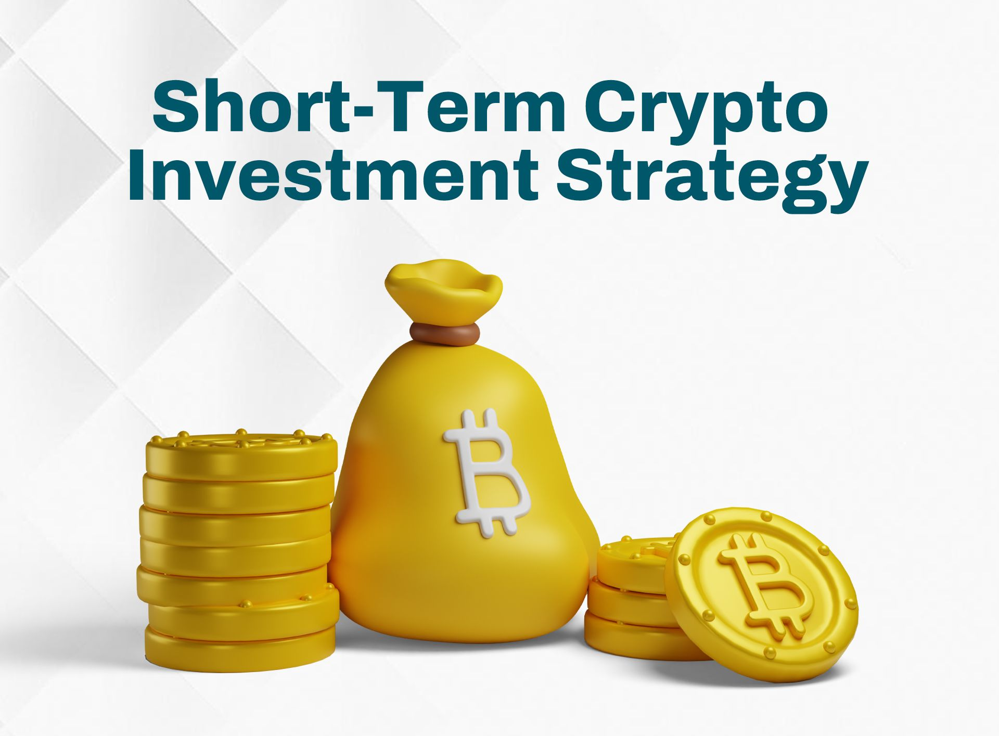
Chapter
09
https://midocean.edu.km

Slide 20



Thank You

