Slide 1


PMG 671
Leadership& Organizational
Behavior
Prepared by
Dr. Walid El Leithy
Chapter 1

Slide 2



Chapter 1
www.midocean.ae

Slide 3

Chapter
OB
1
Essentials of Organizational Behavior
Stephen P. Robbins & Timothy A. Judg
www.midocean.ae

Slide 4
Chapter
Course Content
1
Chapter 1: Introduction to OB. (Lecture 1)
Chapter 2: Attitudes and Job Satisfaction. (Lecture 2)
Chapter 3: Personality and Values ( Lecture 3)
Chapter 4 : Motivation Concepts and Applications (lecture 4)
Chapter 5: Foundations of Group Behavior (lecture 5)
Chapter 6 : Understanding Work Teams (Lecture 5)
Chapter 7: Communication (Lecture 6)
Chapter 8: Foundation of Organizational Structure (Lecture 6)
Chapter 9: Introduction to Leadership ( Lecture 7)
Chapter 10: Basic Approaches to Leadership (Lecture 8)
Chapter 11: Organizational Culture (lecture 9).
Chapter 12: Managing change ( Lecture 10)
www.midocean.ae

Slide 5
Chapter
What is OB?
1
A field of study that investigates the impact that individuals, groups, and structure have on behavior within organizations, for the purpose of applying such knowledge toward improving an organization’s effectiveness.
www.midocean.ae

Slide 6
Chapter
What is OB?
1
In other words, Organizational behavior is the study of human behavior in Organizations and the application of knowledge about how, individuals, and groups act and react in an organization, in order to reach and accomplish the highest quality of performances, and dominant results.
www.midocean.ae

Slide 7
Chapter
OB Mian Concern
1
Why do people behave a certain way in an organizational environment? What factors affect job performance, employee interaction, job commitment, leadership and managerial styles?
Individuals have studied this topic for decades in order to find ways of increasing organizational performance.
www.midocean.ae

Slide 8
Chapter
OB History As A Science
1
While Organizational Behavior as a field of academic study wasn’t fully recognized by the American Psychological Association (APA) until the 1970’s, it’s roots go back to the late 1920’s when the Hawthorne Electric Company set up a series of experiments designed to explore how changes in environment and design changed the productivity of their employees.
www.midocean.ae

Slide 9
Chapter
OB History As A Science
1
Their various studies, conducted between the years of 1924 and 1933, were broad and measured over large periods of time. The studies included the effect of various types of breaks (lots of small breaks, a few long ones, etc.) on productivity, productivity in isolation, and productivity in varying levels of light. The most famous finding resulting from the of the Hawthorne Studies is what is now called the Hawthorne Effect, the change in behavior of a test subject when they know they’re being observed.
www.midocean.ae

Slide 10
Chapter
The Importance of Interpersonal Skills
1
Until the late 1980s, Business Schools Curricula emphasized the technical aspects of Management, focusing on Economics, Accounting, Finance and so on.
Starting from the early 1990s, Business Schools realized the importance of understanding human behavior and the its role in determining a manager’s effectiveness.
www.midocean.ae

Slide 11
Chapter
The Importance of Interpersonal Skills
1
Understanding OB helps determine manager effectiveness
Technical and quantitative skills are important
But leadership and communication skills are CRITICAL
Organizational benefits of skilled managers
Lower turnover of quality employees
Higher quality applications for recruitment
Better financial performance
www.midocean.ae

Slide 12
Chapter
Why is it important to managers to understand OB?
1
Findings from organizational behavior’s body of research can be used by executives and Human Relations professionals better understand a business’ culture, how that culture may facilitate or hinder productivity and employee retention, and how to best evaluate candidates skill set and personality during the hiring process.
www.midocean.ae

Slide 13
Chapter
Why is it important to managers to understand OB?
1
Managers need an understanding of organizational behavior because a large part of their job has to do with exactly that. Organizational behavior is the study of how people behave while in groups and as individuals. Much of what a manager does has to do with trying to get people to work as effectively as possible. It can involve trying to motivate an individual worker or it can involve trying to understand how to get workers who are part of a team to interact with one another in such a way that they are able to work more efficiently and effectively.
www.midocean.ae

Slide 14
Chapter
OB Objectives
1
To determine the motivation level of employees.
To encourage the people, to work enthusiastically in the organization.
To create an environment for the development of effective leadership.
To develop effective group behavior among the employees.
To identify the reasons for conflict and to resolve the conflict.
www.midocean.ae

Slide 15
Chapter
OB Objectives
1
To find out the reasons for frustration and reduce or eliminate the reasons.
To increase the moral of employees of the organization.
To maintain the organizational environment favorable for the work.
To find out the ways for effective organizational development.
www.midocean.ae

Slide 16
Chapter
What Do Managers Do?
1
They get things done through other people.
Management Main Activities:
Make decisions
Allocate resources
Direct activities of others to attain goals
www.midocean.ae

Slide 17
Chapter
Management Functions According to Fayol
1
Henry Fayol in the early part of the twentieth century wrote that all managers perform five management functions; Planning, Organizing, Commending, Coordinating and Controlling. Today we have condensed these functions into four: Planning, Organizing, Leading and Controlling.
www.midocean.ae

Slide 18
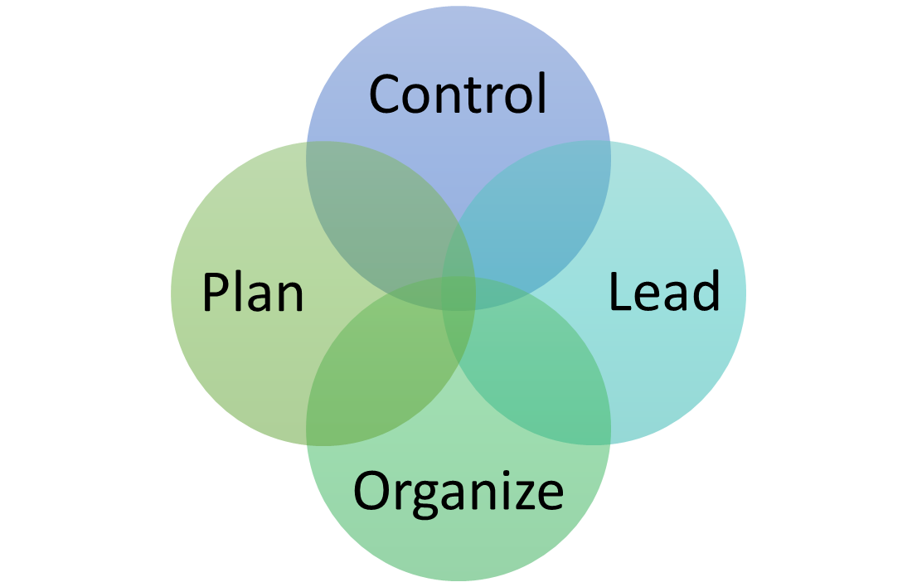
Chapter
Management Functions According to Fayol
1
www.midocean.ae

Slide 19
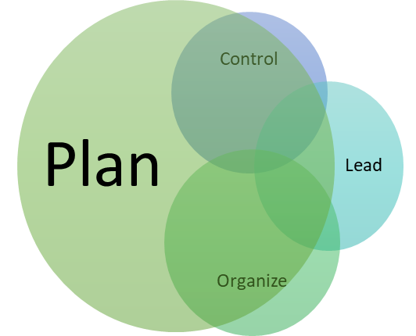
Chapter
Management Function: Plan
1
Planning
A process that includes defining goals, establishing strategy, and developing plans to coordinate activities.
As managers advance, they do this function more often.
www.midocean.ae

Slide 20
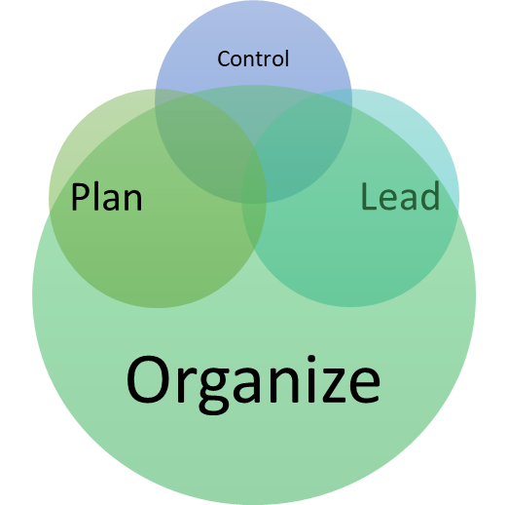
Chapter
Management Function: Organize
1
Organizing
Determining what tasks are to be done, who is to do them, how the tasks are to be grouped, who reports to whom, and where decisions are to be made.
www.midocean.ae

Slide 21
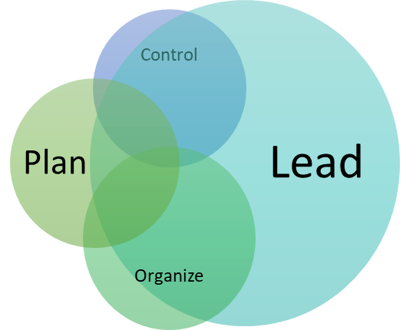
Chapter
1
Management Function: Lead
Leading
A function that includes motivating employees, directing others, selecting the most effective communication channels, and resolving conflicts.
It is about PEOPLE!
www.midocean.ae

Slide 22
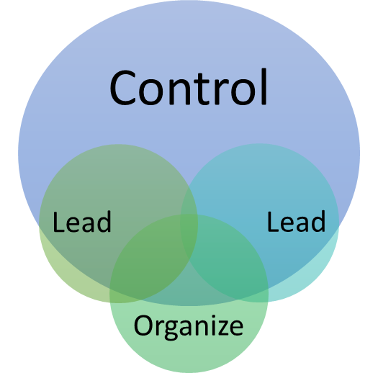
Chapter
Management Function: Control
1
Controlling
Monitoring performance, comparing actual performance with previously set goals, and correcting any deviation.
www.midocean.ae

Slide 23
Chapter
Mintzberg’s Managerial Roles
1
Henry Mintzberg undertook a careful study of five executives to determine what they mainly do on their jobs. Mintzberg identified that managers perform ten different highly interrelated roles or set of behaviors. These ten roles can be separated under three groups of behavior:
Interpersonal
Informational
Decisional
www.midocean.ae

Slide 24
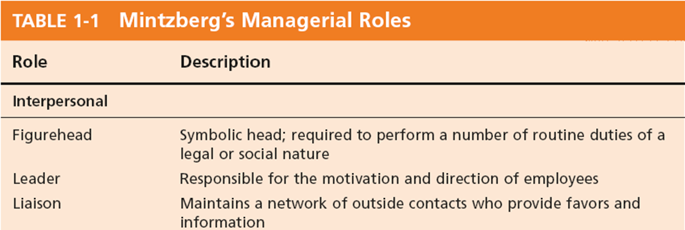
Chapter
Mintzberg’s Managerial Roles
1
www.midocean.ae

Slide 25
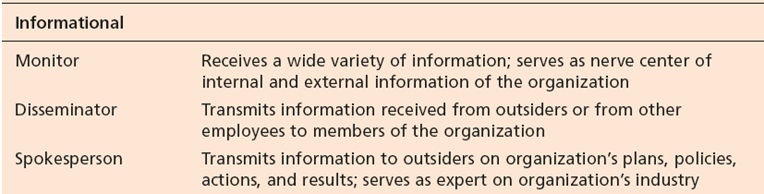
Chapter
Mintzberg’s Managerial Roles: Informational
1
www.midocean.ae

Slide 26
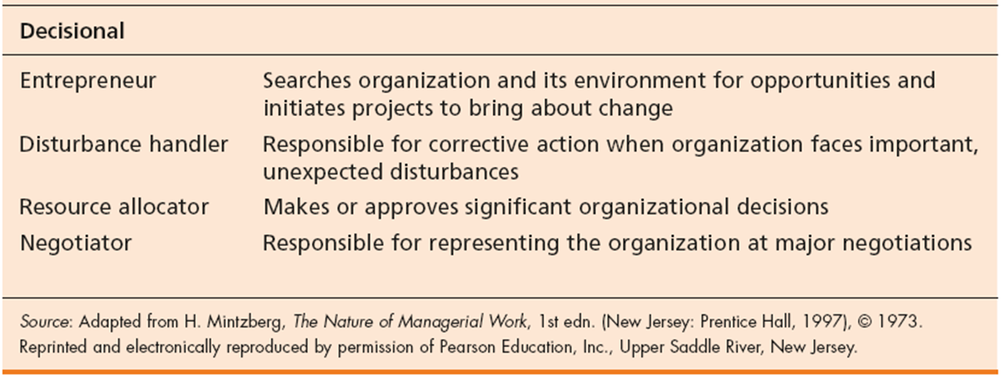
Chapter
Mintzberg’s Managerial Roles: Decisional
1
www.midocean.ae

Slide 27
Chapter
Katz’s Essential Managerial Skills
1
Another way of considering what managers do is to look at the skills or competencies they need to achieve their goals. According to Katz, researchers have identified a number of skills that differentiate effective from ineffective managers as follows:
Technical Skills
The ability to apply specialized knowledge or expertise.
Human Skills
The ability to work with, understand, and motivate other people, both individually and in groups.
.
www.midocean.ae

Slide 28
Chapter
Katz’s Essential Managerial Skills
1
Conceptual Skills
The mental ability to analyze and diagnose complex situations.
www.midocean.ae

Slide 29
Chapter
Luthan’s Study of Managerial Activities
1
Four types of managerial activity:
1.Traditional Management
Decision-making, planning, and controlling.
2. Communication
Exchanging routine information and processing paperwork.
www.midocean.ae

Slide 30
Chapter
Luthan’s Study of Managerial Activities
1
3. Human Resource Management
Motivating, disciplining, managing conflict, staffing and training.
4. Networking
Socializing, politicking, and interacting with others.
www.midocean.ae

Slide 31
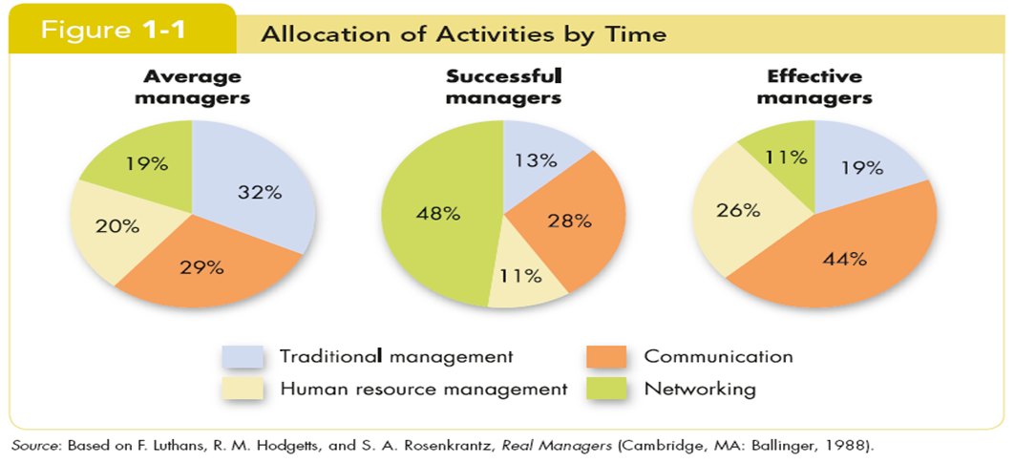
Chapter
Successful vs Effective Allocation by Time
1
www.midocean.ae

Slide 32
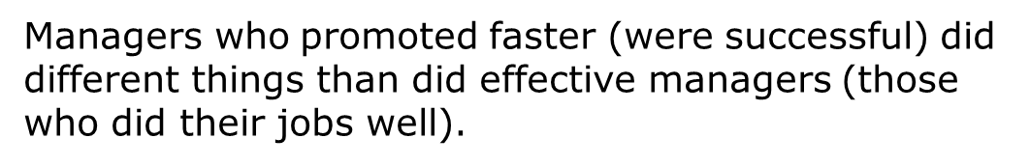
Chapter
Successful vs Effective Allocation by Time
1
www.midocean.ae

Slide 33
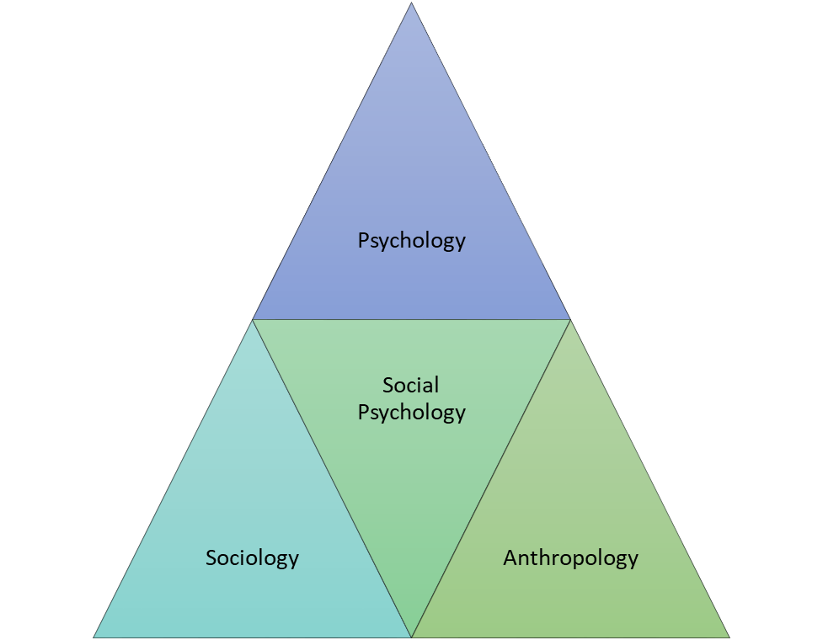
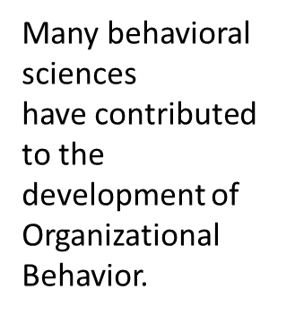
Chapter
Contributing Disciplines
1
www.midocean.ae

Slide 34
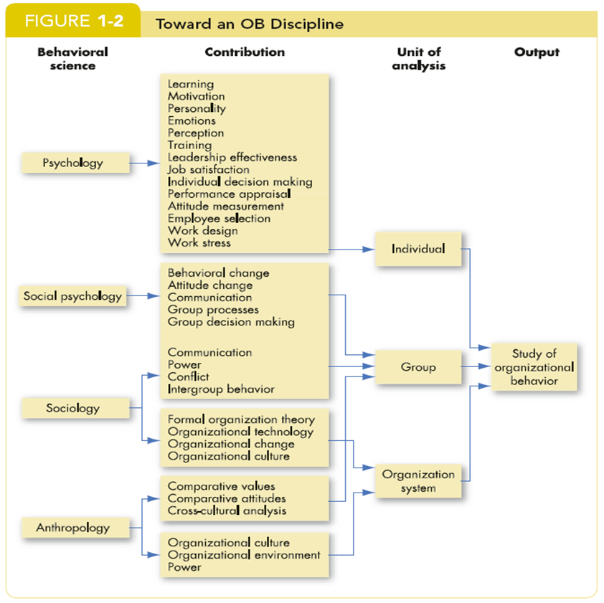
Chapter
10
Contributing Disciplines
www.midocean.ae

Slide 35
Chapter
Psychology
1
The science that seeks to measure, explain, and sometimes change the behavior of humans and other animals.
Unit of Analysis:
Individual
Contributions to OB:
Learning, motivation, personality, emotions, perception.
www.midocean.ae

Slide 36
Chapter
Psychology
1
Training, leadership effectiveness, job satisfaction.
Individual decision making, performance appraisal attitude measurement.
Employee selection, work design, and work stress.
www.midocean.ae

Slide 37
Chapter
Social Psychology
1
Social psychology is an area within psychology that blends concepts from psychology and sociology and that focuses on the influence of people on one another.
Unit of Analysis:
Group
Contributions to OB:
Behavioral change
Attitude change
www.midocean.ae

Slide 38
Chapter
Social Psychology
1
Communication
Group processes
Group decision making
www.midocean.ae

Slide 39
Chapter
Sociology
1
The study of people in relation to their fellow human beings.
Units of Analysis:
Organizational system
Group
Contributions to OB:
Group dynamics
Work teams
www.midocean.ae

Slide 40
Chapter
Sociology
1
Communication
Power
Conflict
www.midocean.ae

Slide 41
Chapter
Anthropology
1
The study of societies to learn about human beings and their activities.
Units of Analysis:
Organizational system
Group
Contributions to OB:
Organizational culture
Organizational environment
www.midocean.ae

Slide 42
Chapter
Anthropology
1
Comparative values
Comparative attitudes
Cross-cultural analysis
www.midocean.ae

Slide 43
Chapter
Challenges and Opportunities for OB
1
1. Responding to Globalization
Increased foreign assignment.
Working with people from different cultures.
www.midocean.ae

Slide 44
Chapter
Challenges and Opportunities for OB
1
2. Managing Workforce Diversity
The people in organizations are becoming more demographically heterogeneous :
Embracing diversity.
Changing demographics.
Implications: stop treating everyone alike!
www.midocean.ae

Slide 45
Chapter
Challenges and Opportunities for OB
1
3. Improving Quality and Productivity
4. Improving Customer Service
5. Improving People Skills
6. Stimulating Innovation and Change
7. Working in Networked Organizations
8. Helping Employees Balance Work-Life Conflicts
www.midocean.ae

Slide 46
Chapter
Challenges and Opportunities for OB
1
9. Creating a Positive Work Environment
10. Improving Ethical Behavior
www.midocean.ae

Slide 47
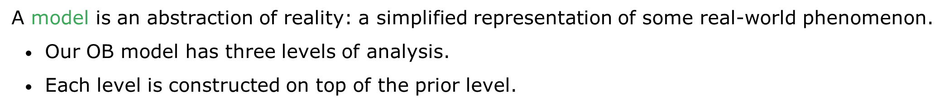
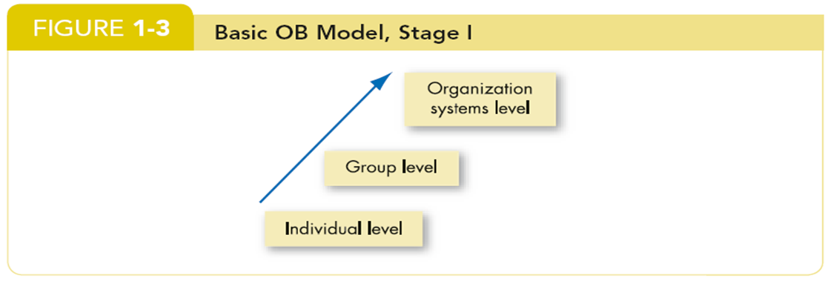
Chapter
Developing an OB Model
1
www.midocean.ae

Slide 48
Chapter
Types of Study Variables
1
Independent (X)
The presumed cause of the change in the dependent variable (Y).
This is the variable that OB researchers manipulate to observe the changes in Y.
Dependent (Y)
This is the response to X (the independent variable).
It is what the OB researchers want to predict or explain.
The interesting variable!
www.midocean.ae

Slide 49
Chapter
Interested OB Dependent Variables
1
Productivity
Transforming inputs to outputs at lowest cost. Includes the concepts of effectiveness (achievement of goals) and efficiency (meeting goals at a low cost).
Absenteeism
Failure to report to work – a huge cost to employers.
Turnover
Voluntary and involuntary permanent withdrawal from an organization.
www.midocean.ae

Slide 50
Chapter
Interested OB Dependent Variables
1
Deviant Workplace Behavior
Voluntary behavior that violates significant organizational norms and thereby threatens the well-being of the organization and/or any of its members.
Organizational Citizenship Behavior (OCB)
Discretionary behavior that is not part of an employee’s formal job requirements, but that nevertheless promotes the effective functioning of the organization.
www.midocean.ae

Slide 51
Chapter
Interested OB Dependent Variables
1
Job Satisfaction
A general attitude (not a behavior) toward one’s job; a positive feeling of one's job resulting from an evaluation of its characteristics.
www.midocean.ae

Slide 52
Chapter
The Independent Variables
1
The independent variable (X) can be at any of these three levels in this model:
Individual
Biographical characteristics, personality and emotions, values and attitudes, ability, perception, motivation, individual learning, and individual decision making.
Group
Communication, group decision making, leadership and trust, group structure, conflict, power and politics, and work teams.
www.midocean.ae

Slide 53
Chapter
The Independent Variables
1
Organization System
Organizational culture, human resource policies and practices, and organizational structure and design.
www.midocean.ae

Slide 54
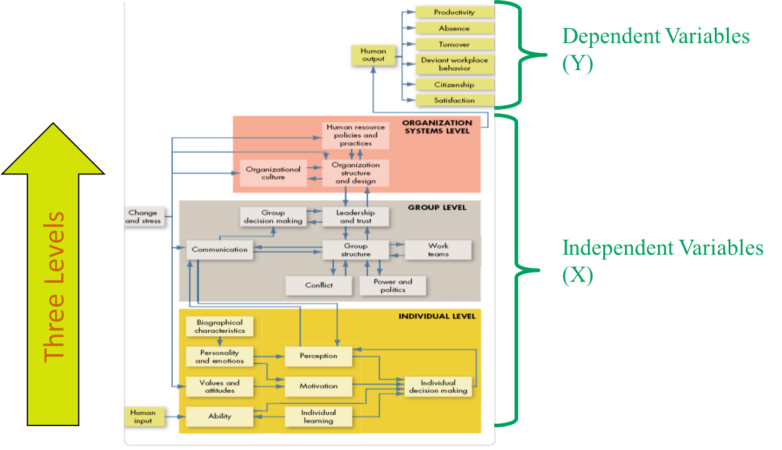
Chapter
OB Model
1
www.midocean.ae

Slide 55
Chapter
Summary and managerial Implications
1
Managers need to develop their interpersonal skills to be effective.
OB focuses on how to improve factors that make organizations more effective.
The best predictions of behavior are made from a combination of systematic study and intuition.
Situational variables moderate cause-and-effect relationships—which is why OB theories are contingent.
www.midocean.ae

Slide 56
Chapter
Summary and managerial Implications
1
There are many OB challenges and opportunities for managers today.
The textbook is based on the contingent OB model.
www.midocean.ae

Slide 57



Thank You

