Slide 1


Strategic Brand Management
Prepared by Dr. Perihan Salah
MKT733
Branding in the Digital Era
And AI’s Impact on Today’s Branding and Marketing Scenario
Lecture 10

Slide 2


Strategic Brand Management
Lecture 10
MKT733
Branding in the Digital Era
And AI’s Impact on Today’s Branding and Marketing Scenario
Prepared by
Dr. Perihan Salah
www.midocean.ae

Slide 3


Chapter
10
LEARNING OBJECTIVES
Describe changes in marketing and consumer behavior in a digital era
Define brand engagement and understand the brand engagement pyramid and key drivers of brand engagement
Understand digital communications and the various options available
Define the role of e-mail marketing and Web site optimization as important components of digital marketing strategy
www.midocean.ae

Slide 4
Chapter
10
LEARNING OBJECTIVES
Appreciate the pros and cons of various social media channels (e.g., Facebook and Twitter) as digital marketing tools
Understand the developments within mobile marketing
Develop a broad understanding of influencer marketing approaches and how word-of-mouth and social influence occurs and can be managed
Describe content marketing and its role in creating brand awareness and engagement
Describe changes in brand management organizational structure
AI’s Impact on Today’s Branding and Marketing Scenario
www.midocean.ae

Slide 5

Key Issues for Branding in the Digital Era
There are many important developments with branding in this digital era
Findings:
  Ninety-seven percent of consumers turn to a search engine like Google when they are buying a product
  Ninety-six percent of consumers search for product information from their mobile device
  Ninety-five percent of millennials expect brands to have a Facebook presence
  Eighty-nine percent of consumers do online research prior to purchasing instore

Slide 6
Key Digital Era Trends with Implications for Branding and Brand Management
Changes in the consumer decision journey
Sharp increase in buying via online retail channels
Shift in advertising and promotion expenditures toward digital channels
The rise of many-to-many communications
Dramatic increase in consumer touchpoints
Tremendous increase in data availability
The use of digital personalization
A loss of control over the brand message and the co-creation of brand meaning
The role of user experiences
The growth of brands as cultural symbols

Slide 7
1. Changes in Consumer Decision Journey
Digital marketing and social media has changed the consumer decision journey
The view of the consumer decision journey in the digital era diverges from previous journeys undertaken by consumers in many important ways.
The implications for brand management are also significant.

Slide 8
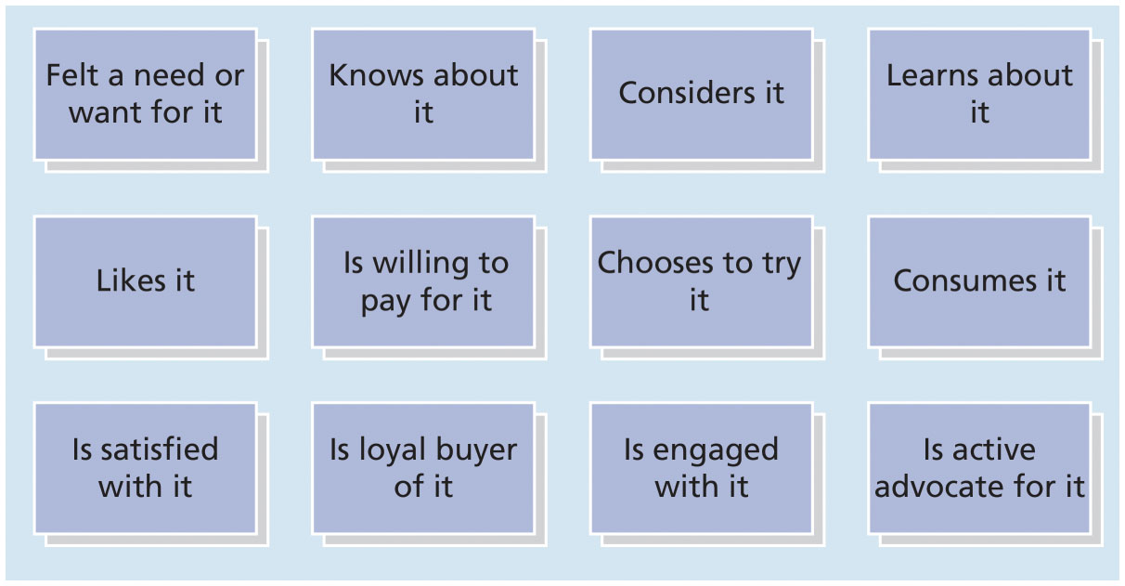
1. Expanded Consumer Decision Journey

Slide 9
2. Growth of Online Retailing
The popularity of online retailing can be inferred from the following statistics:
  Value of ecommerce sales will reach is increasing
  Sixty percent of adults are happy to not shop in a crowded mall or store
  Seventy-one percent of shoppers believe they will get a better deal online than in stores
  Forty percent of men and 33 percent of women aged 18 to 34 say they would ideally “buy everything online”

Slide 10
2. Growth of Online Retailing
One of the most prominent success stories in the online retailing context is that of Amazon.
As Amazon continues to disrupt retail through its innovations in drone deliveries and acquisitions (e.g., Whole foods), brands should be mindful of all the changes taking place in online retailing, as it significantly impacts how they merchandise and distribute their products.

Slide 11
3. Advertising and Promotions Using Digital Channels
Advertising budgets are allocated differently now across online and offline channels.
Digital media expenditures exceeded T V advertising expenditures
The growth in digital media is expected to outpace growth of traditional media channels
  It has been projected that online channels will be almost 50 percent larger than T V advertising

Slide 12
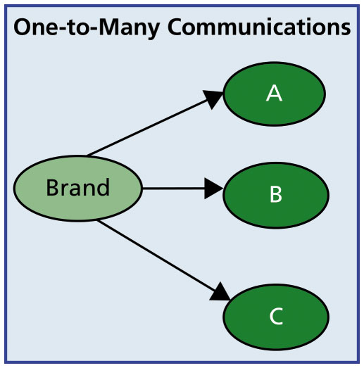
4. Traditional Marketing: One-to-Many Communications
The traditional world of marketing involved brand managers relying on mass media channels such as TV, print, and radio advertising to communicate with consumers.
The direction of communication was usually from manufacturer to consumer, and limited feedback was provided by consumers to manufacturers in turn.
Thus, audiences were generally passive recipients of carefully crafted messages sent by brand marketers.
This was particularly true in the case of the one-to-many traditional marketing.

Slide 13
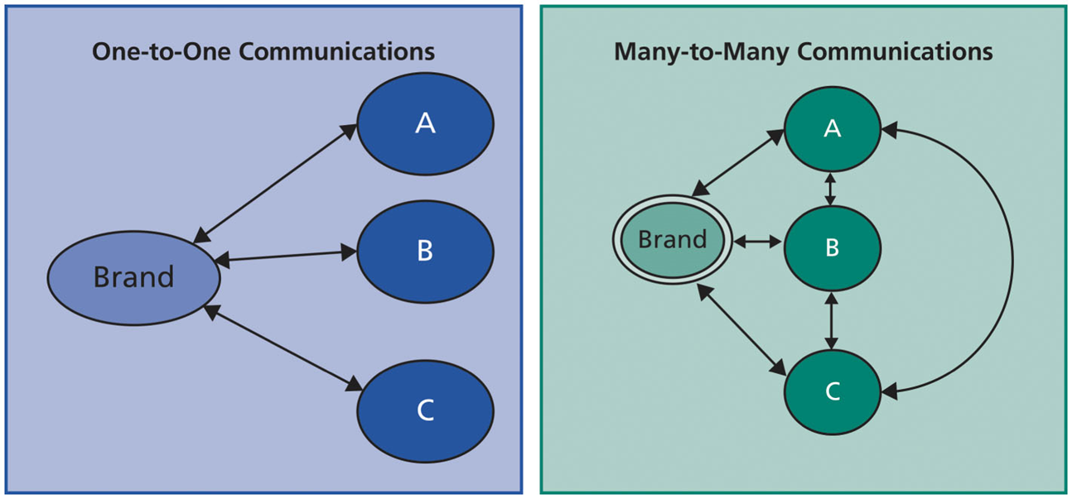
New Media Environment:
Two-Way and Many-to-Many Communications
Over time, the one-to-many channels gave way to a greater emphasis on interactive or one-to-one communications between the brand and the customer. This direct marketing approach is by viewing each customer individually.
In recent years, these one-to-many and one-to-one channels are being supplemented or even replaced by many-to-many channels, such as Facebook and Twitter, where consumers have become broadcasters in conversation with each other (many-to-many communications), as well as becoming engaged in a two-way dialogue with brand marketers.

Slide 14
5. Increase in Consumer Touchpoints
Digital marketing and social media channels and the ability to communicate with each other
  Has fueled an increase in touchpoints
Having a sharply defined brand positioning and clear guidelines on how a brand should be presented and marketed to consumers is an important step in ensuring that the brand has a consistent theme across all channels.
Another key concern of brand managers is to understand which channels are producing the greatest return on the advertising money expenditures.
This particular set of tasks—called attribution modeling—can be complex and challenging.

Slide 15
6. Increase in Data Availability
Data, data everywhere!
  Clickstream data on users’ browsing behaviors on companies’ Web pages
  Advertising metrics
    Click-through rates
    Cost per clicks
  Information regarding the number of unique visitors to a brand’s Web site
Marketers now have the ability to use information gathered from customers’ online behavior to tailor their offerings to customer needs. Yet, this quantity of information can quickly become overwhelming if brands don’t invest in tools for transforming all this information into usable bits of knowledge.

Slide 16
7. Digital Personalization
Targeting individual consumers with varying offers
  To try to ensure that they complete a purchase
Digital tools have allowed for unprecedented personalization
  Product as well as message
Dynamic pricing
  The same product can become available at different prices based on expressed customer interest

Slide 17
7. Digital Personalization
What are the implications of microtargeting for consumer behavior?
While digital personalization offers many advantages from the marketer’s perspective, the efforts can also have a downside.
Some researchers have suggested consumers may react negatively to personalization of offers because of privacy concerns.
These reactions could be overcome by reminding consumers of various free services and benefits that are provided to them online, while at the same time seeking their permission to target them or to use their information.

Slide 18
7. Digital Personalization
Three organizational prerequisites for digital personalization to be successful are:
Organizations must invest in a customer data warehouse that provides continuous monitoring and feedback regarding customer needs and wants and how well those are being satisfied through company offerings.
Organizations must deploy (organize/arrange) cross-functional teams to understand the customer’s decision journey, which may involve a variety of different channels including the company’s Web site, a mobile app, or an in-store experience.
Organizations must employ an iterative process of testing and learning to identify what works and what does not.

Slide 19
8. Loss of Control over Brand Message and Co-Creation of Brand Meaning
The digital age has created conditions such that brand meaning is primarily coproduced by three different forces:
  Firm-generated brand meaning: Through their online and offline marketing activities and programs, and other means, firms attempt to shape the meaning of brands with consumers.
  Consumer-generated brand meaning: In the digital age, consumer-to-consumer conversations are enabled through social media platforms—such as Facebook and Twitter—that supplement traditional offline word-of-mouth. These conversations taking place on various digital platforms on a large-scale can significantly shape brand meaning.

Slide 20
8. Loss of Control over Brand Message and Co-Creation of Brand Meaning
The digital age has created conditions such that brand meaning is primarily coproduced by three different forces:
  Media and cultural influences: A variety of new information intermediaries also play a significant role in co-creating brand meaning.
  Media channels may themselves contribute to brand meaning. Further, cultural influences are continually evolving and shaping customer conversations and contributing to brand meaning.

Slide 21
9. User Experience Is the Key to Digital Brand Success
A seamless user experience is crucial to a success of a digital brand
Needs an interface that consumers can effortlessly navigate
  To maximize user experience
Designing both online and offline interfaces to ensure that Web sites are so easy to navigate that consumers will easily locate what they are looking for, or ensuring that the smartphone app is designed to ensure convenience, will be critical to the success of a brand.

Slide 22
10. Brands as Cultural Symbols
Brands have greater impact as cultural icons than ever before
Brands help consumers feel a part of something
  Allows them to signal and connect with others
As brands become increasingly embedded in consumers’ daily online conversations, brand managers must deploy a new set of techniques, to ensure that brands maintain their cultural relevance.

Slide 23
Brand Engagement
Three levels of customer engagement based on the extent to which a customer engages in various types of behaviors:
  Low brand engagement: Low levels of engagement may translate into higher frequency of purchasing a product or providing positive feedback about a product or service.
  Moderate brand engagement: Calling a company’s 1-800 help line to seek additional information about a product or service, or providing the company with some feedback regarding new flavors may be viewed as moderate brand engagement.

Slide 24
Brand Engagement
Three levels of customer engagement based on the extent to which a customer engages in various types of behaviors:
  High brand engagement: Positive forms of high brand engagement include joining a brand community or starting a fan page on Facebook dedicated to a brand, evangelizing by troubleshooting customer complaints on a Web site, helping others find the right product variant to suit their needs, and so on.
  Companies should foster such evangelizing (converting) among their customers by offering various monetary and nonmonetary incentives.

Slide 25
Negative Brand Engagement
Hatred and dissatisfaction with a brand
  Companies can redress (compensate/amends) customer grievances (complains/ objections)
    Brand ambassadors
Boycotts or social movements
Brands are more readily ridiculed and parodied due to the online nature of the communication
The social media megaphone has provided consumers with unprecedented power to share information with millions of current and future consumers, thereby shifting considerable power into their hands.

Slide 26
Digital Communications
Paid channel
  A marketer typically runs paid advertising
    Facebook, T V, print, etc.
Owned channel
  Sources of information for consumers about a company’s offerings
    YouTube channel
Earned channel
  Review sites and reviews posted online typically at no expense
    Social media or blog post

Slide 27
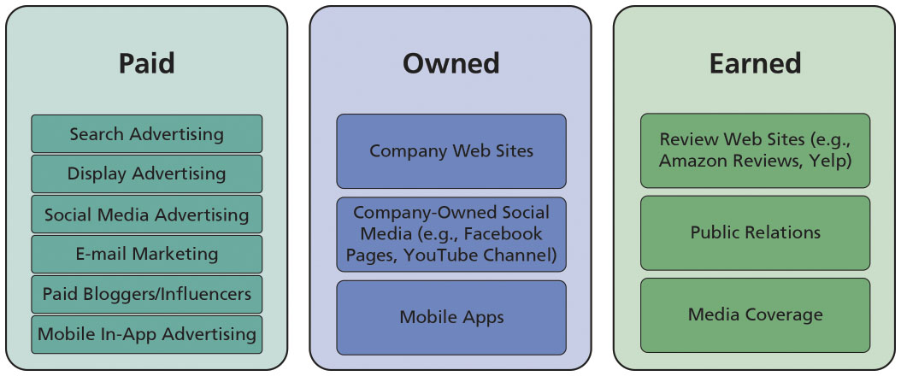
Summary of Digital Marketing Communication Channels

Slide 28
Digital Communications
Company Web Sites
E-mail Marketing
Segmenting, Targeting, and Personalization
E-mail Structure and Subject Line
Timing and Industry Differences
Entertaining and Engaging Content
Testing and Monitoring
Search Advertising
Display Advertising

Slide 29
Overview of Social Media Paid Channels (1 of 2)
Social media channels offer unparalleled access to communities of users with similar demographic, geographic, and psychographic characteristics
  Facebook and Twitter, for example
Roles of social media:
  Establishing a public voice and online presence
  Amplifying marketing message
  Helping monitor and obtain feedback from consumers
  Promoting customer engagement

Slide 30
Overview of Social Media Paid Channels (1 of 2)
Social media offers a unique way for marketers to promote dialogue with their audiences, gain feedback and insights, and solicit input regarding their products.
However, a caveat (warning/caution) is in order. With the brand engagement pyramid, only some consumers want to get involved with only some of their brands and even then maybe only some of the time.
Companies should monitor their social media presence to ensure that it is appropriate and welcomed by consumers.

Slide 31
Overview of Social Media Paid Channels (2 of 2)
Facebook
Twitter
Instagram
Pinterest
Video

Slide 32
Overview of Social Media Paid Channels (2 of 2)
Facebook
If Facebook were a country, it would be the largest country in the world!
Metrics:
  Reach
    Organic reach: number of people who have seen a post in the news feed
    Paid reach: the number of unique people who have seen an ad or a sponsored story
    Viral reach: number of unique people who have seen a story about a page published by a friend
  Followers: number of Facebook followers
  Likes and shares: number of Facebook likes is indicative of customer engagement with a particular message; shares indicate how viral a message is

Slide 33
Overview of Social Media Paid Channels (2 of 2)
Instagram
  Platform of about 400 million users
  Targeted to a younger audience and typically has higher brand engagement levels than other platforms
Pinterest
  Allows for sharing and posting of pictures featuring different brands
  Particularly conducive to marketing of certain brands that rely on visual imagery
Video
  Brand building via video has also become an important medium particularly when brands want to engage in deeper themes and story-telling using their brand

Slide 34
Overview of Social Media Paid Channels (2 of 2)
Twitter
Second largest social medium after Facebook
  Allows direct communication between customer service and customers and shows a brand’s personality

Slide 35
Mobile Marketing
Messaging services
  Short messaging service (S M S) and multimedia messaging service (M M S)
    Offer customers unique offers based on time and location
In-app advertising
  Way by which mobile marketing can help brands touch customers
Proximity systems marketing, or geo-fencing
  Involves particular advertising messages delivered to mobile users with a defined geographic area

Slide 36
Overview of Social Media Paid Channels (2 of 2)
As mobile devices continue to grow in importance to consumers’ daily lives, research has also examined how mobile marketing techniques can contribute to added sales. A few key findings from academic research worth noting include:
Environments may impact the effectiveness of mobile advertising and promotions.
Mobile targeting based on time and location is more effective the closer the promotion is to actual purchase.

Slide 37
Overview of Social Media Paid Channels (2 of 2)
Targeting consumers who are closer in physical location to competitors’ locations produces better results than targeting mobile promotions to consumers who are closer to the company’s own locations.
Targeting consumers with mobile promotional coupons can boost overall spending, particularly unplanned spending, if the coupon requires consumers to travel farther than their planned path.

Slide 38
Influencer Marketing and Social Media Celebrities
Influencer marketing involves utilizing key influencers
Sponsored bloggers
Celebrity influencers
Marketers have been utilizing influencers for their brands to a greater extent in recent years because of the results they have seen.
Sponsored bloggers and celebrity influencers can often hold greater sway over some consumers than any advertiser can.
One study reported that audiences exposed to influencer marketing spent more than $639,700 compared to an audience that had not been exposed.

Slide 39
Content Marketing
According to the Content Marketing Institute
  “Content marketing is a strategic marketing approach focused on creating and distributing valuable, relevant, and consistent content to attract and retain a clearly defined audience—and, ultimately, to drive profitable customer action.”
A key difference between content marketing and traditional marketing is that
  Consumers typically want to consume the posts that form part of a content marketing campaign

Slide 40
Content Marketing
A good content strategy has to be integrated with a broader public relations and marketing strategy.
The goals of the overall marketing strategy in terms of reaching and engaging the audience should be aligned with the content marketing strategy; doing so can help reach the audience, build a brand, increase brand awareness, generate leads, and ensure sales.

Slide 41
Summary of Pros and Cons, Integrating Across Paid Channels
Brand marketers have to make an effort to create integrated digital media campaigns that leverage the benefits of different social media

Slide 42
Brand Management Structure
Success factors for strategy-making:
  Senior management should be tasked with understanding how products and brands are researched and viewed online
  Cross-functional coordination is increasingly important
  Data-driven decision-making will become standard operating procedure
  A brand or marketing strategy should be viewed as a part of an overall strategy

Slide 43
Brand Management Structure
Success factors for strategy-making:
  High-quality data can assist marketers to personalize a given message to an audience
  Accessing data on consumers’ conversation can help uncover information that can be useful
  Understanding how online and offline communications interact and coordinating with a digital channels strategy is important

Slide 44
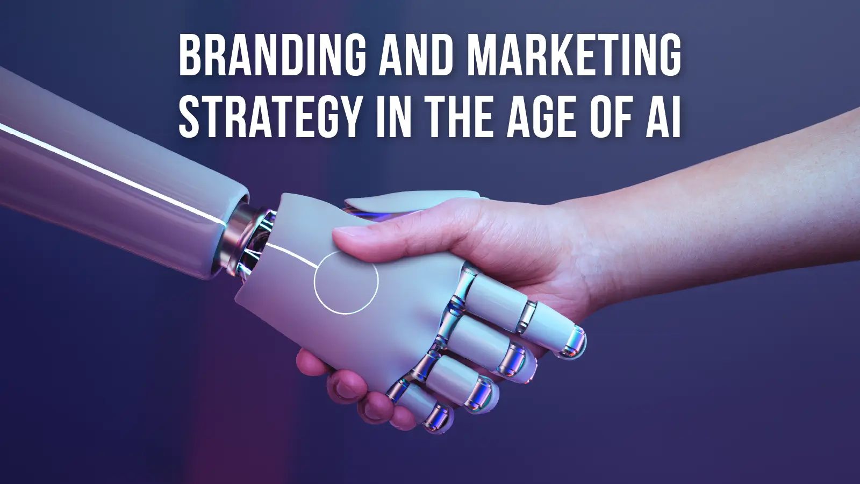
AI’s Impact on Today’s Branding and Marketing Scenario

Slide 45
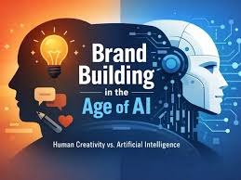
AI’s Impact on Today’s Branding and Marketing Scenario
In the fast-paced digital era, technology has become a driving force in shaping business strategies and customer interactions. One of the most groundbreaking technologies transforming the landscape of branding and marketing is Artificial Intelligence (AI).
Al's ability to process vast amounts of data, gain valuable insights, and personalize experiences has significantly impacted how businesses create, communicate, and maintain their brands.
Let us explore the profound impact of Al on today's branding and marketing scenario.

Slide 46
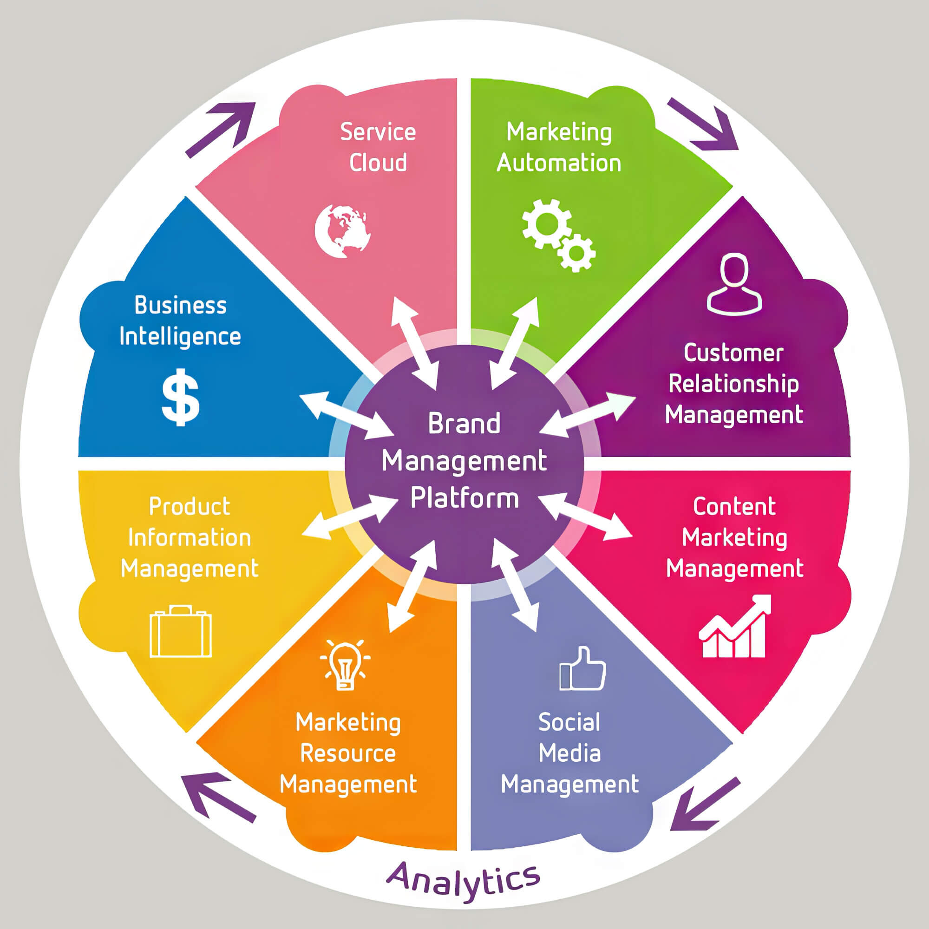
Enhanced Customer Understanding
Al-powered analytics and data processing tools have revolutionized how businesses understand their customers.
Through machine learning algorithms, brands can analyze vast data sets to identify consumer preferences, behaviors, and trends.
This in-depth understanding of the target audience enables marketers to tailor their messaging and positioning to resonate better with customers, leading to improved engagement and loyalty.

Slide 47
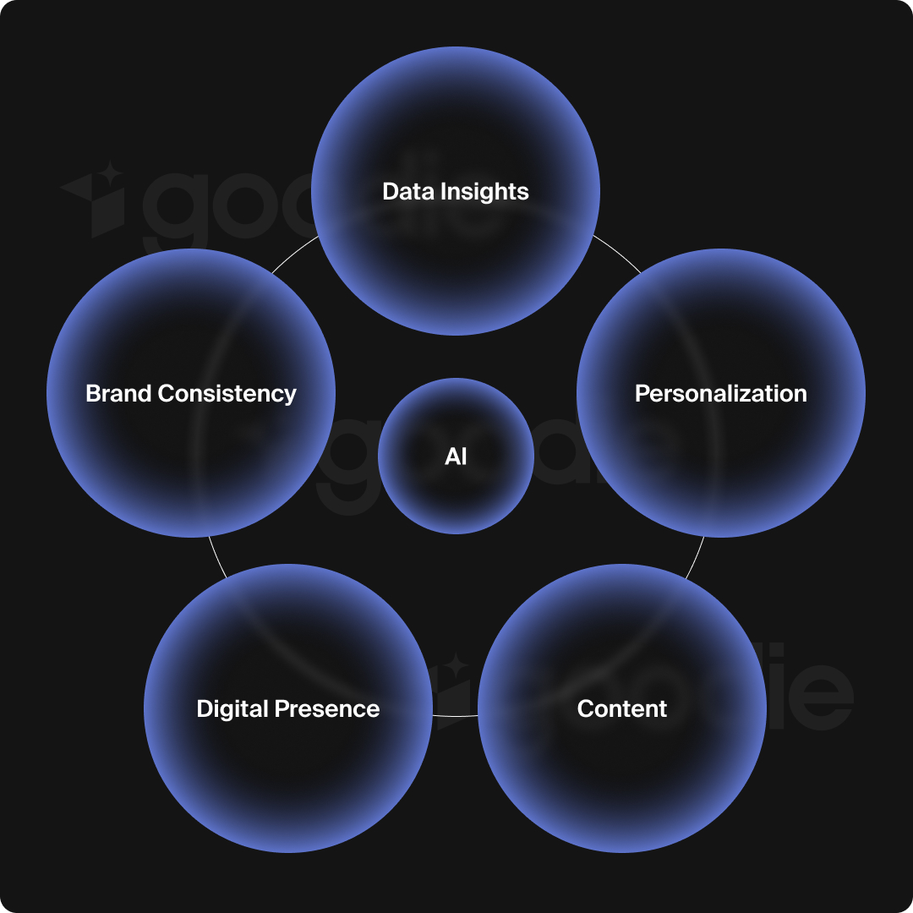
Personalization at Scale
The era of one-size-fits-all marketing is long gone.
Customers now expect personalized experiences, and Al is at the forefront of enabling such personalization at scale.
Al-driven recommendation engines on e-commerce platforms, content personalization on websites, and targeted email campaigns are just a few examples of how Al helps brands deliver relevant content and product recommendations to individual users.

Slide 48

Chatbots and Customer Service
Al-driven chatbots have transformed customer service, providing immediate and round-the-clock support.
These conversational bots can handle routine queries, process orders, and provide real-time assistance, freeing up human agents to focus on more complex issues.
This enhanced customer service experience positively impacts a brand's reputation and fosters customer loyalty.

Slide 49

Content Creation and Curation
Al is revolutionizing content creation by automating the process of generating articles, social media posts, and ad copy. While AI-generated content is not yet perfect, it can significantly reduce the time and effort required to create compelling marketing materials.
Additionally, Al-powered content curation tools help marketers find and share relevant content from various sources, keeping their audience engaged and informed.
www.midocean.ae

Slide 50
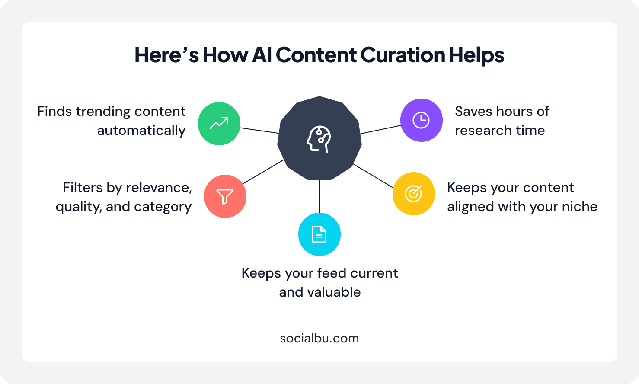
Content Creation and Curation

Slide 51
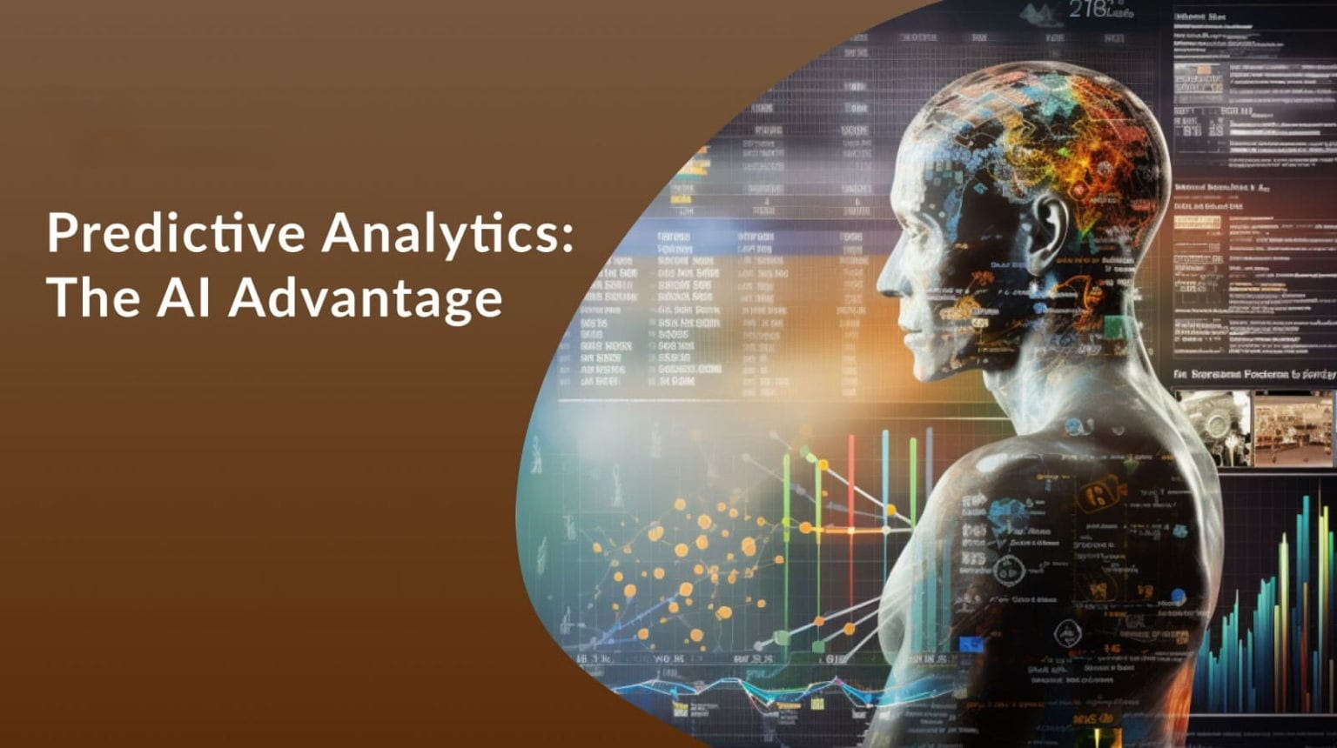
Predictive Analytics and Decision-making
Al's predictive analytics capabilities allow brands to make data-driven decisions. Marketers can anticipate market trends, identify potential opportunities, and optimize their strategies to align with customer expectations.
This data-driven approach leads to more efficient resource allocation and a higher return on investment (ROI).

Slide 52
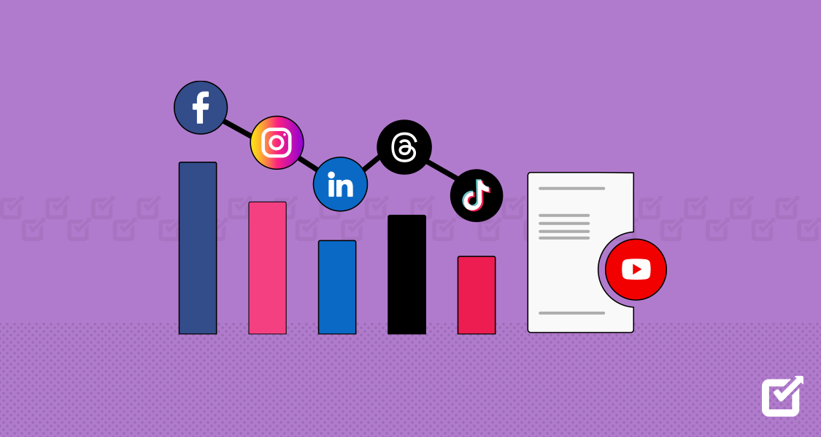
Social Media Insight
Social media is a goldmine of customer opinions and insights.
Al-powered social media monitoring tools can analyze sentiments, identify trends, and track brand mentions in real-time.
This valuable information enables brands to respond promptly to customer feedback, manage potential crises, and understand the impact of marketing campaigns better.

Slide 53
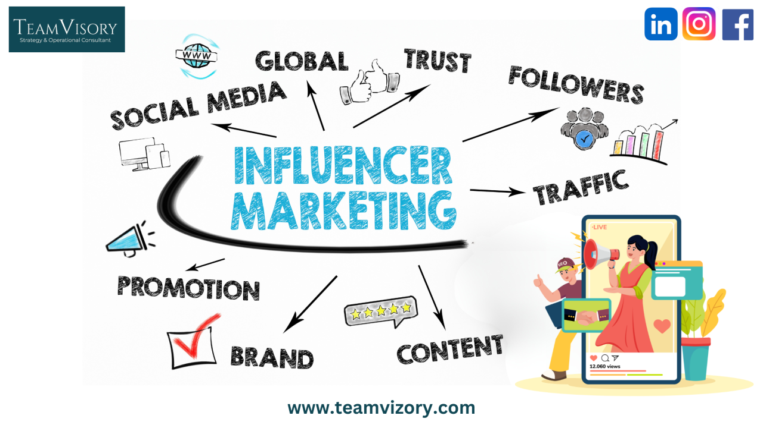
Influencer Marketing
Al plays a significant role in influencer marketing by identifying suitable influencers for a brand based on their relevance and engagement metrics.
Al-powered tools can also assess the authenticity of influencers' followers, ensuring brands collaborate with those who can genuinely drive results and foster trust.

Slide 54
Conclusion
The integration of Al in branding and marketing strategies has undoubted transformed the way businesses engage with customers.
From data analysis and personalization to customer service and content creation, Al has become a crucial ally in achieving marketing success. However, as Al continues to evolve, marketers must strike a balance between autoration and human touch to maintain the authenticity of their brand communication.
While Al can enhance efficiency and effectiveness, it is ultimately human creativity, empathy, and strategic thinking that will continue to drive successful branding and marketing initiatives in the future.
Embracing Al as a powerful tool, combined with a human-centric approach, will empower brands to thrive in the ever-evolving digital landscape.

Slide 55

www.midocean.ae
Describe changes in marketing and consumer behavior in a digital era
Define brand engagement and understand the brand engagement pyramid and key drivers of brand engagement
Understand digital communications and the various options available
Define the role of e-mail marketing and Web site optimization as important components of digital marketing strategy
Chapter
10
To Sum Up…

Slide 56
www.midocean.ae
Appreciate the pros and cons of various social media channels (e.g., Facebook and Twitter) as digital marketing tools
Understand the developments within mobile marketing
Develop a broad understanding of influencer marketing approaches and how word-of-mouth and social influence occurs and can be managed
Describe content marketing and its role in creating brand awareness and engagement
Describe changes in brand management organizational structure
AI’s Impact on Today’s Branding and Marketing Scenario
Chapter
10
To Sum Up…

Slide 57


Thank You

