Slide 1



Network
Programming
in Python
Prepared by Dr. Hamada I. AbdulWakel
Lecture 3

Slide 2



Basics of Network
Programming – Part II
Lecture 3
Prepared by
Dr. Hamada I. AbdulWakel
www.midocean.ae

Slide 3
Lecture
RECAP: LECTURE 2
03
Service Oriented Architecture (SOA).
Application Program Interface (API).
API modules in Python.
www.midocean.ae

Slide 4
Lecture
03
LECTURE MAIN POINTS
Application Program Interface (API).
BeautifulSoup and web scraping.
Socket Programming in Python.
www.midocean.ae

Slide 5
Lecture
03
GOOGLE MAPS API
Geocoding: the process of converting human-readable addresses into geographic coordinates (i.e., latitude and longitude), which you can use to place markers on a map.
Reverse geocoding: the process of converting geographic coordinates into a human-readable address.
Map APIs allow you to create location-aware infographics, mind maps and visualization aids.
www.midocean.ae

Slide 6
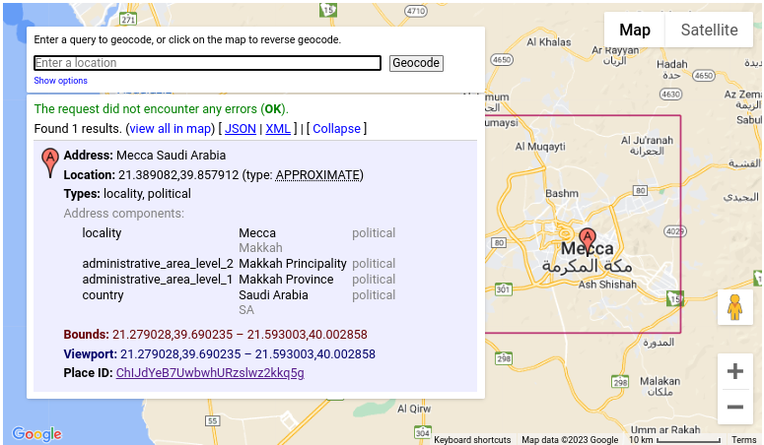
Lecture
03
GOOGLE MAPS API
Cont'd
www.midocean.ae

Slide 7
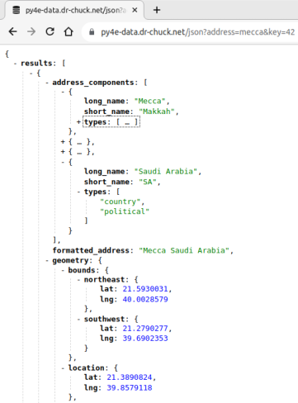
Lecture
03
GOOGLE MAPS API
Cont'd
Google map API simulation.​
  URL:
  https://py4e-data.dr-chuck.net/json?
  address=mecca&key=42​
www.midocean.ae

Slide 8
Lecture
03
GOOGLE MAPS API
Cont'd
Code:
import urllib.error, urllib.parse, urllib.request
import json
api_key = False
if api_key is False:
api_key = 42
serviceurl = 'http://py4e-data.dr-chuck.net/json?'
else:
serviceurl='https://maps.googleapis.com/maps/api/geocode/json?'
www.midocean.ae

Slide 9
Lecture
03
GOOGLE MAPS API
Cont'd
Code:
while True:
address = input("Enter location: ")
if len(address) < 1:
break
parms = dict()
parms['address'] = address
if api_key is not False:
parms['key'] = api_key
www.midocean.ae

Slide 10
Lecture
03
GOOGLE MAPS API
Cont'd
Code (inside while loop):
url = serviceurl + urllib.parse.urlencode(parms)
print('Retrieving', url)
urllib_handler = urllib.request.urlopen(url)
data = urllib_handler.read().decode()
print('Retrieved', len(data), 'characters')
try:
js = json.loads(data)
except:
js = None
www.midocean.ae

Slide 11
Lecture
03
GOOGLE MAPS API
Cont'd
Code (inside while loop):
if 'status' not in js or js['status'] != 'OK':
print('Fail to retrieve data')
print(data)
continue
print(json.dumps(js, indent=4))
lat = js['results'][0]['geometry']['location']['lat']
lng = js['results'][0]['geometry']['location']['lng']
location = js['results'][0]['formatted_address']
print('lat', lat, 'lng', lng, "location", location)
www.midocean.ae

Slide 12
Lecture
03
WEB SCRAPING
When a program pretends to be a web browser and retrieves web pages, extracts information, and then looks at more pages.
Uses:
  Monitor a site for new information.
  Make a database for a search engine.
  Get your data from a system that has no export feature.
  Pull social data.
www.midocean.ae

Slide 13

Lecture
03
BE CAREFUL WITH WEB SCRAPING
There is some controversy about web scraping.
Do not republishing copyrighted
material.
Do not violate terms of service.
www.midocean.ae

Slide 14
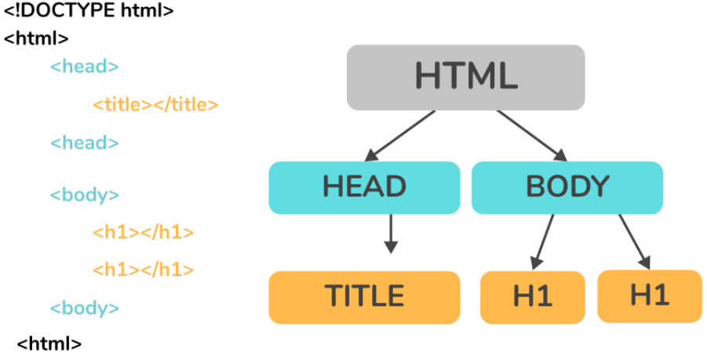
Lecture
03
BEAUTIFULSOUP MODULE
www.midocean.ae

Slide 15
Lecture
03
BEAUTIFULSOUP MODULE
Cont'd
BeautifulSoup is a Python module for pulling data out of HTML and XML files.
One of the important pieces of HTML document are tags, which may contain other tags/strings (tag’s children).
BeautifulSoup provides different ways to navigate and iterate over these tags.
BeautifulSoup is the object created when we try to scrape a web resource.
www.midocean.ae

Slide 16
INSTALLATION OF BEAUTIFULSOUP MODULE
Lecture
03
Installation:
  PyPi: pip install beautifulsoup4
Beautiful Soup supports different HTML parser such as:
  Html.parser: the default HTML parser included in Python’s standard library.
  Ixml
  pip install lxml
  Html5lib
  pip install html5lib
www.midocean.ae

Slide 17
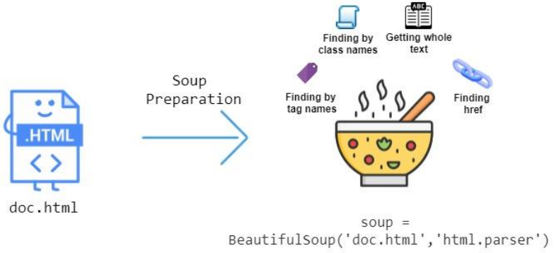
Lecture
03
WEB SCRAPING STEPS
www.midocean.ae

Slide 18
Lecture
03
WEB SCRAPING STEPS
Cont'd
Step 1: Inspect your data source:
  A manual step.
  Open the website you want to pull important content from it.
  Open inspection.
    On Mac:
  Cmd+Alt+I
    On Windows/Linux:
  Ctrl+Shift+I
  Understand the website structure to know where these important data.
www.midocean.ae

Slide 19
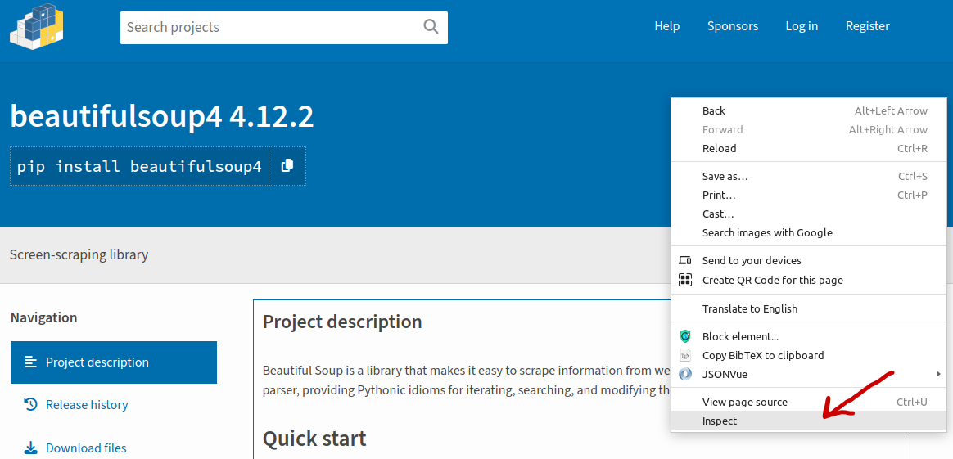
Lecture
03
WEB SCRAPING STEPS
Cont'd
www.midocean.ae

Slide 20
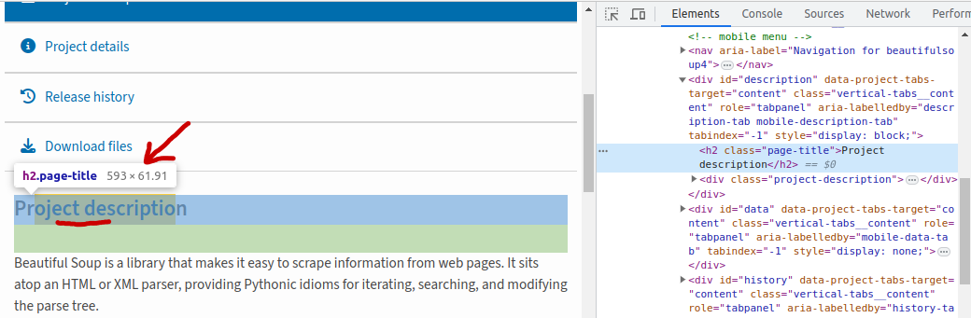
Lecture
03
WEB SCRAPING STEPS
Cont'd
www.midocean.ae

Slide 21
Lecture
03
WEB SCRAPING STEPS
Cont'd
Step 2: Scrape HTML content from a page:
  Create the soup object.
  Read the web page content using this object.
Step 3: Parse HTML code with BeautifulSoup:
  Parse the web page content to make it more accessible.
  Pick out the data from the required HTML tags.
www.midocean.ae

Slide 22
BEAUTIFULSOUP MODULE METHODS
Lecture
03
Beautifulsoup(content, parser): creates a soup object.
soupObj.prettify(): gives the visual representation of the parsed URL. It arranges all the tags in a parse-tree manner with better readability.
soupObj.title: gives the title tag with its content.
soupObj.title.string: gives the title content only without the tag.
www.midocean.ae

Slide 23
BEAUTIFULSOUP MODULE METHODS
Lecture
03
Cont'd
soupObj.find("tagName"): gives the first occurrence of the given tag name.
soupObj.find_all("tagName"): gives a list of all occurrences of the given tag name with they contents.
  firstTag = soupObj.find_all("tagName")[0]
  If the firstTag contains other tags:
    firstTag.find_all("otherTagName")
www.midocean.ae

Slide 24
BEAUTIFULSOUP MODULE METHODS
Lecture
03
Cont'd
soupObj.find_all("tagName", { css style }): gives a list of all occurrences of the given tag name with they contents which have the same given css style.
tag.get("propertyName"): gives the value of the given property for the selected tag.
tag.text: gives the content of the selected tag.
www.midocean.ae

Slide 25
Lecture
03
BEAUTIFULSOUP EXAMPLE
Code:
import requests
from bs4 import BeautifulSoup
url = 'https://www.demoblaze.com/'
html = requests.get(url)
soup = BeautifulSoup(html.content, 'html.parser')
print(soup.prettify())
print(soup.title)
print(soup.title.string)
www.midocean.ae

Slide 26
Lecture
03
BEAUTIFULSOUP EXAMPLE
Cont'd
Code:
print( soup.find("p") )
tags = soup('a') #get all anchor tags as a ResultSet
tags = soup.find_all("a") #the same as above
for tag in tags:
print( tag.get('href') )
www.midocean.ae

Slide 27
WEB SCRAPPING TO SEARCH FOR A JOB EXAMPLE
Lecture
03
Using Wuzzuf website:
from itertools import zip_longest
import requests
from bs4 import BeautifulSoup
import csv
result = requests.get('https://wuzzuf.net/search/jobs/?q=python&a=hpb')
soup = BeautifulSoup(result.content, 'html.parser')
job_titles = soup.find_all("h2", {"class":"css-m604qf"})
www.midocean.ae

Slide 28
WEB SCRAPPING TO SEARCH FOR A JOB EXAMPLE
Lecture
03
Cont'd
Using Wuzzuf website:
company_names = soup.find_all("a", {"class":"css-17s97q8"})
locations = soup.find_all("span", {"class":"css-5wys0k"})
skills = soup.find_all("div", {"class":"css-y4udm8"})
print(len(job_titles))
jobs = []
comapnies = []
locs = []
skill = []
www.midocean.ae

Slide 29
WEB SCRAPPING TO SEARCH FOR A JOB EXAMPLE
Lecture
03
Cont'd
Using Wuzzuf website:
for i in range(len(job_titles)):
jobs.append(job_titles[i].text)
comapnies.append(company_names[i].text)
locs.append(locations[i].text)
skill.append(skills[i].text)
www.midocean.ae

Slide 30
WEB SCRAPPING TO SEARCH FOR A JOB EXAMPLE
Lecture
03
Cont'd
Using Wuzzuf website:
fileLists = [jobs, comapnies, locs, skill]
exported = zip_longest(*fileLists)
with open("/path/to/create/jobsResults.csv", "w") as f:
wr = csv.writer(f)
wr.writerow(["job title", "company name", "location", "skills"])
wr.writerows(exported)
www.midocean.ae

Slide 31
Lecture
03
SOCKETS
Sockets are the endpoints of a bidirectional communications channel between connection devices.
Sockets are the most popular form of inter-process communication especially for cross-platform communication.
Sockets may communicate within a process, between processes on the same machine, or between processes on different continents.
www.midocean.ae

Slide 32
Lecture
03
THE SOCKET MODULE
Python's standard library consists of various built-in modules that support inter-process communication and networking.
The socket module defines how server and client machines can communicate at hardware level using socket endpoints on top of the operating system.
The socket module provides various objects, constants, functions and related exceptions for building full-fledged network applications including client and server programs.
www.midocean.ae

Slide 33
Lecture
03
THE SOCKET MODULE
Cont'd
To program a connection between two end-points, you need to configure both end-points sockets to know each other.
The socket configuration includes:
  Socket family: represents the IP version used.
    AF_INET for IPv4
    AF_UNIX for IPv6
  Socket type: represents the type of connection.
    SOCK_STREAM for connection-oriented type (TCP).
    SOCK_DGRAM for connectionless type (UDP).
www.midocean.ae

Slide 34
Lecture
03
THE SOCKET MODULE METHODS
socket(): creates sockets objects for the server and the client.
gethostname(): returns a string containing the hostname.
gethostbyname(): returns IP address.
bind(): binds/associates the address to the created socket object.
www.midocean.ae

Slide 35
Lecture
03
THE SOCKET MODULE METHODS
Cont'd
connect(): takes a two-item tuple object as argument. The two items are IP address and port number of the server.
listen(): starts the server and runs it into a listen loop looking for connection request from client.
accept(): when a connection request is intercepted by server, this method accepts it and identifies the client socket with its address.
close(): marks the socket as closed.
www.midocean.ae

Slide 36
Lecture
03
THE SOCKET CREATION
Code:
import socket
# create a TCP socket
soc = socket.socket(socket.AF_INET, socket.SOCK_STREAM)
print("Socket succesfully created!")
www.midocean.ae

Slide 37
THE SOCKET CREATION WITH EXCEPTION HANDLING
Lecture
03
Code:
import socket
target_host = input("Enter the target host name to connect: ")
target_port = input("Enter the target port: ")
try:
sock.connect((target_host, int(target_port)))
print("Socket Connected to", target_host, "on port:", target_port)
except socket.error as err:
print("Failed to connect to", target_host, "on port", target_port)
print("Reason:", str(err) )
www.midocean.ae

Slide 38
Lecture
03
SIMPLE SERVER USING SOCKETS
Code:
import socket
soc = socket.socket()
print("socket created")
# the server will be in the local machine
soc.bind((socket.gethostname(), 5485))
soc.listen(3) #accepts three connection
print("Waiting for connections .....")
www.midocean.ae

Slide 39
Lecture
03
QUESTIONS FOR ONLINE DISCUSSION
Write a program and use this link https://we-xpats.com/en/job/me/sa/search/?area=3411 to create a web scraping application to get the available jobs in Makkah.
www.midocean.ae

Slide 40


Thank You

