Slide 1
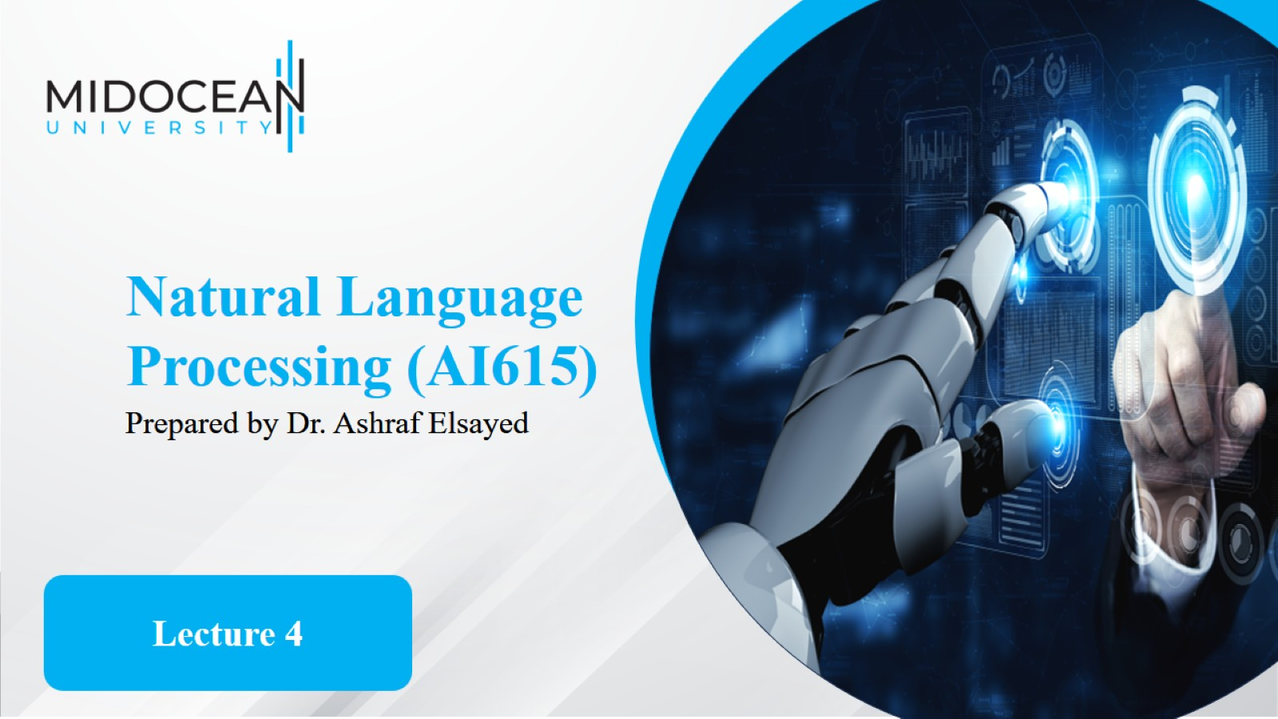

Slide 2


Slide 3
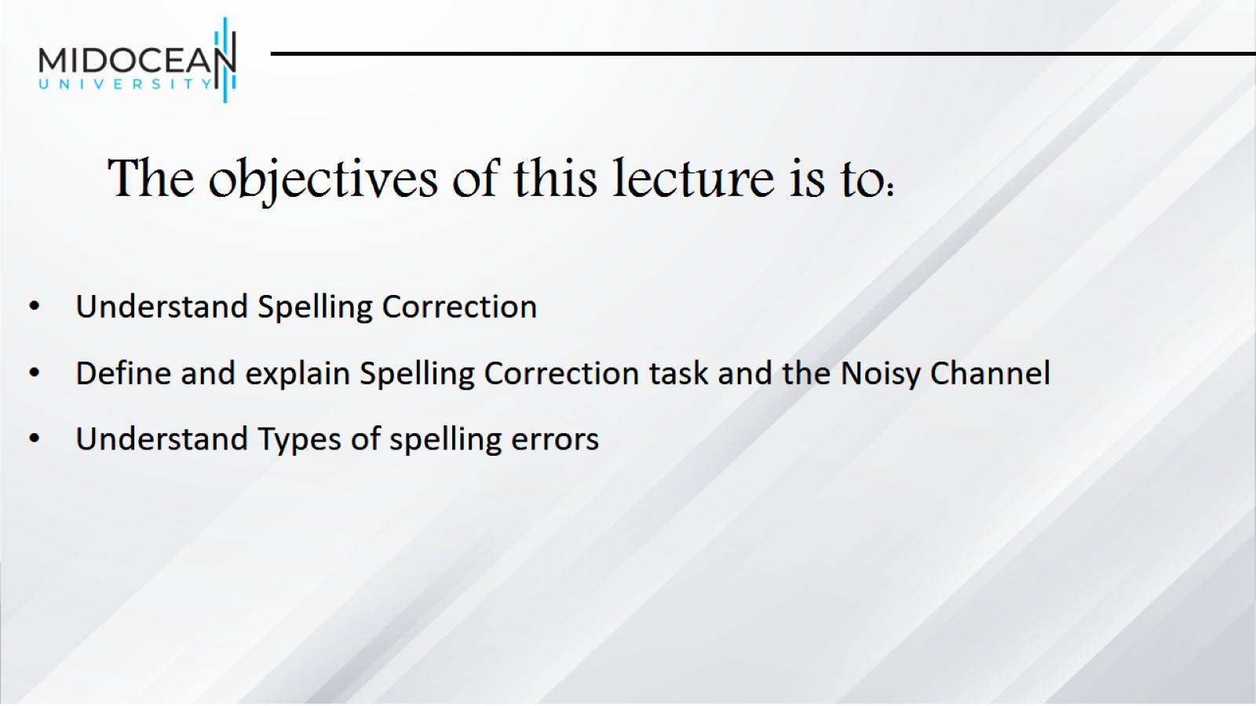
The objectives of this lecture is to:

Slide 4
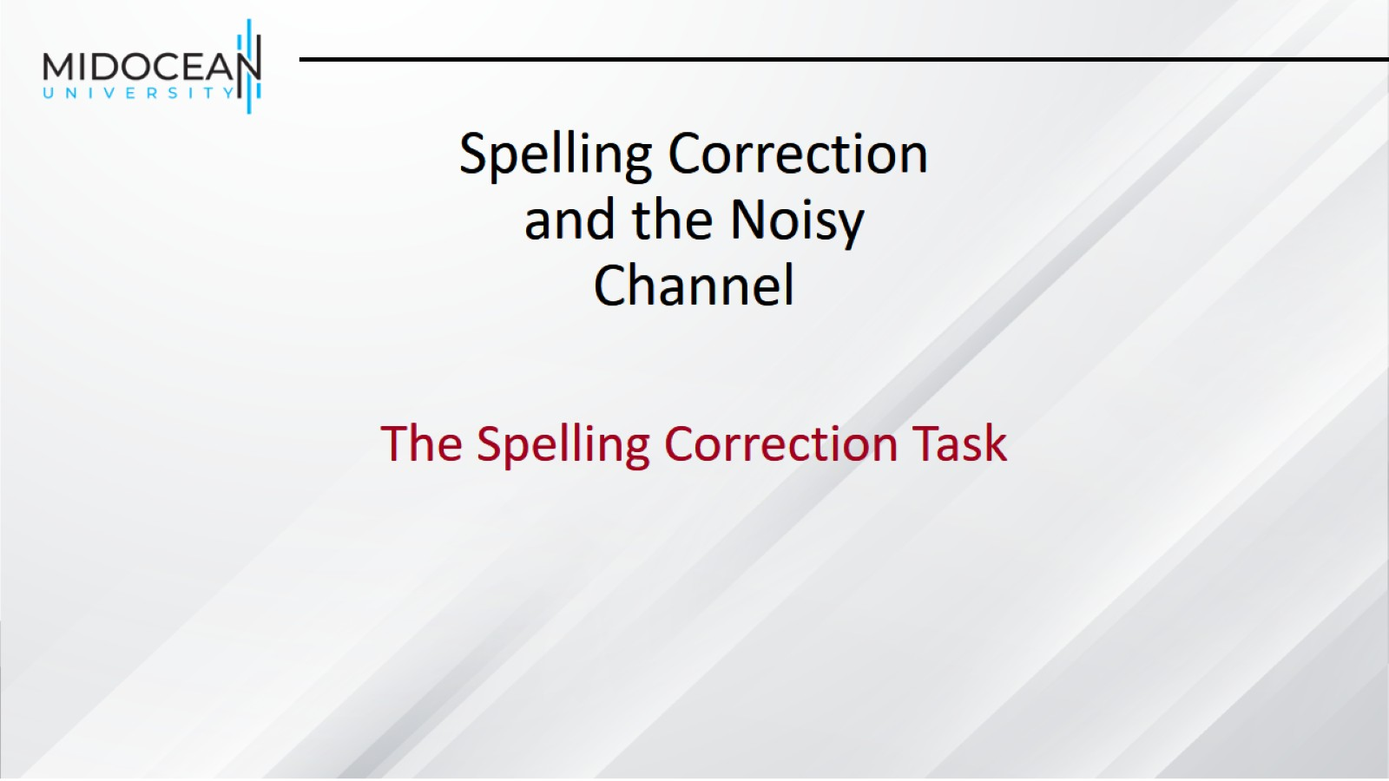
Spelling Correction and the Noisy Channel

Slide 5
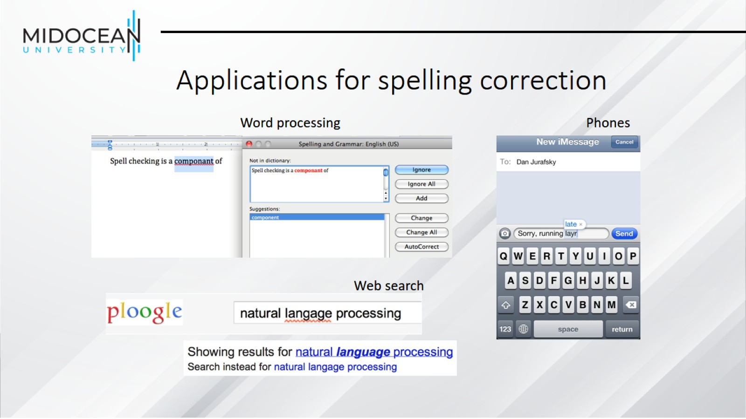
Applications for spelling correction

Slide 6
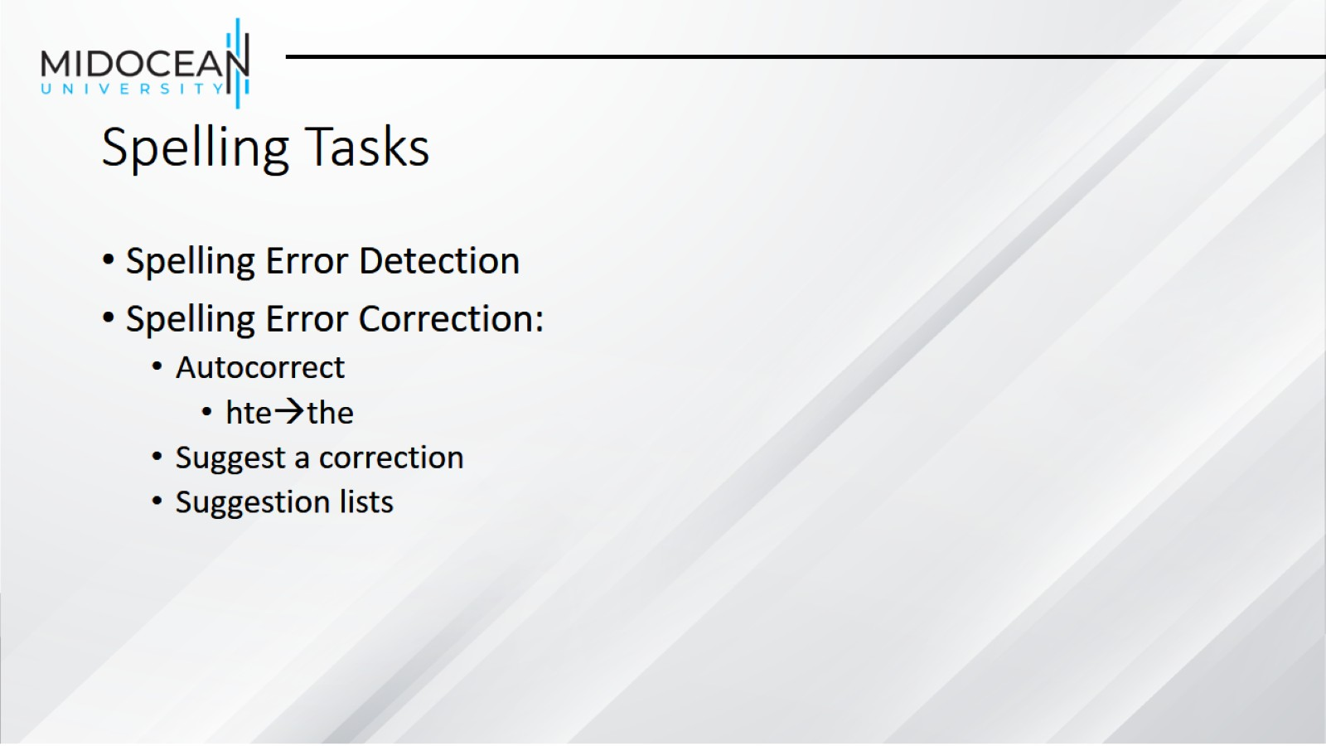
Spelling Tasks

Slide 7
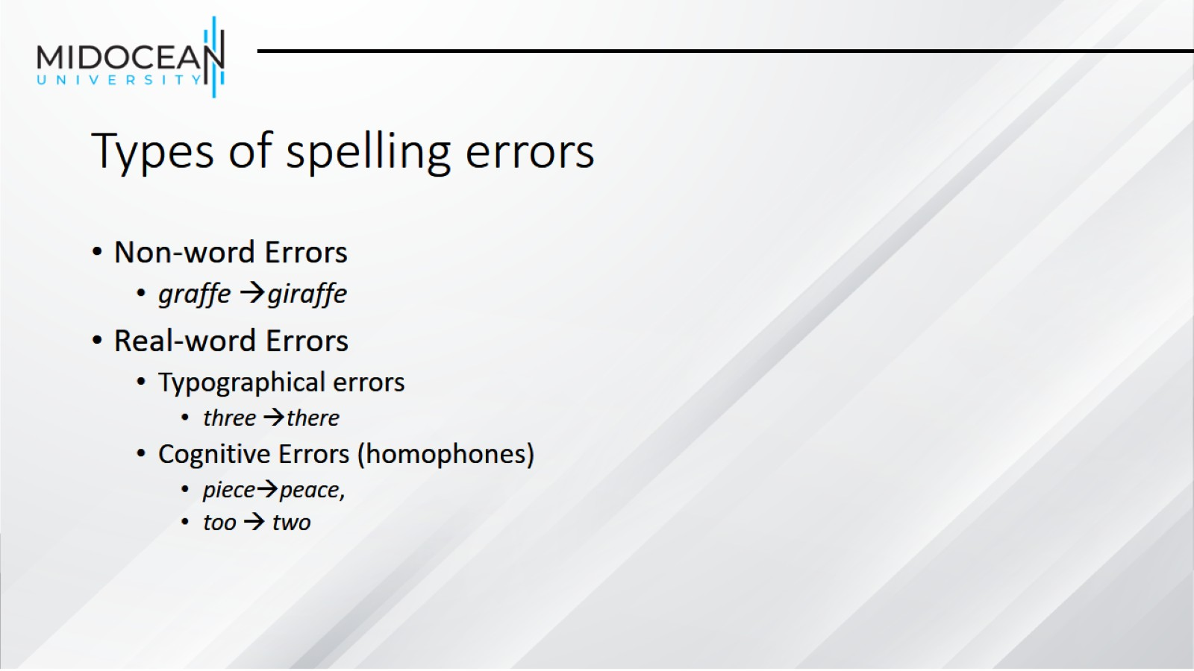
Types of spelling errors

Slide 8
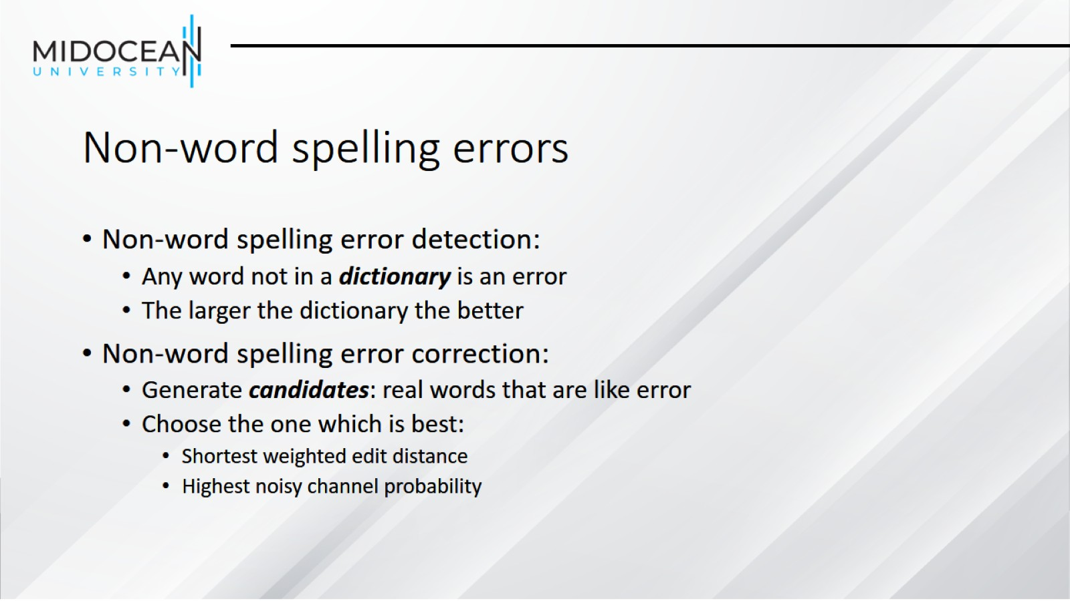
Non-word spelling errors

Slide 9
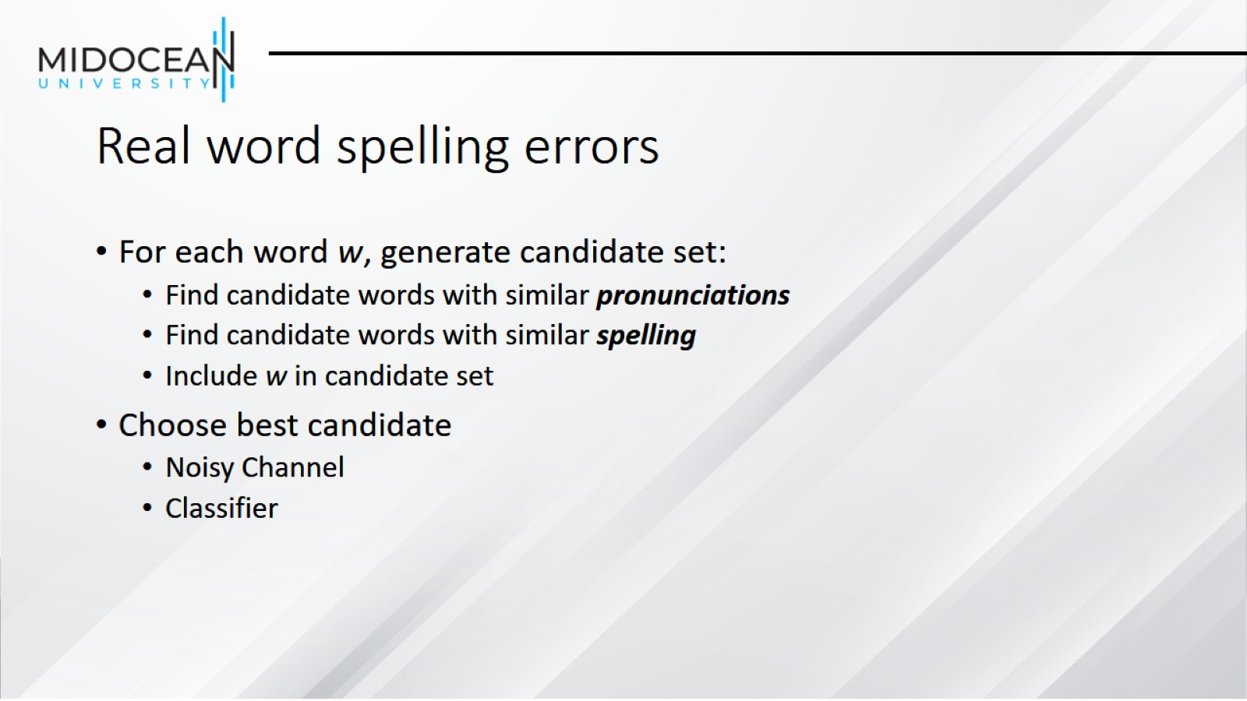
Real word spelling errors

Slide 10
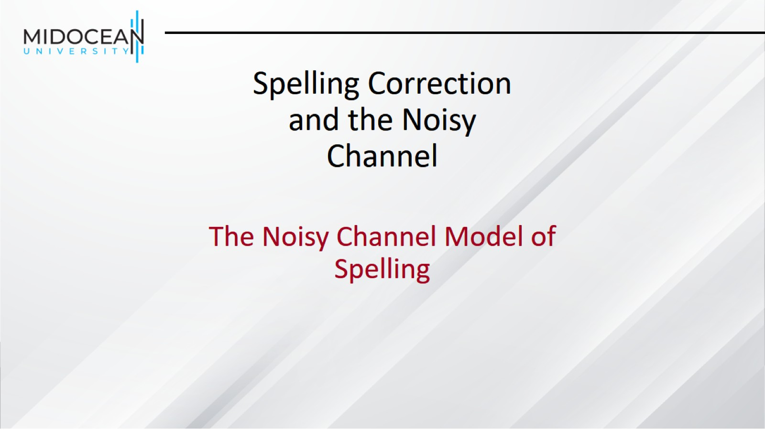
Spelling Correction and the Noisy Channel

Slide 11
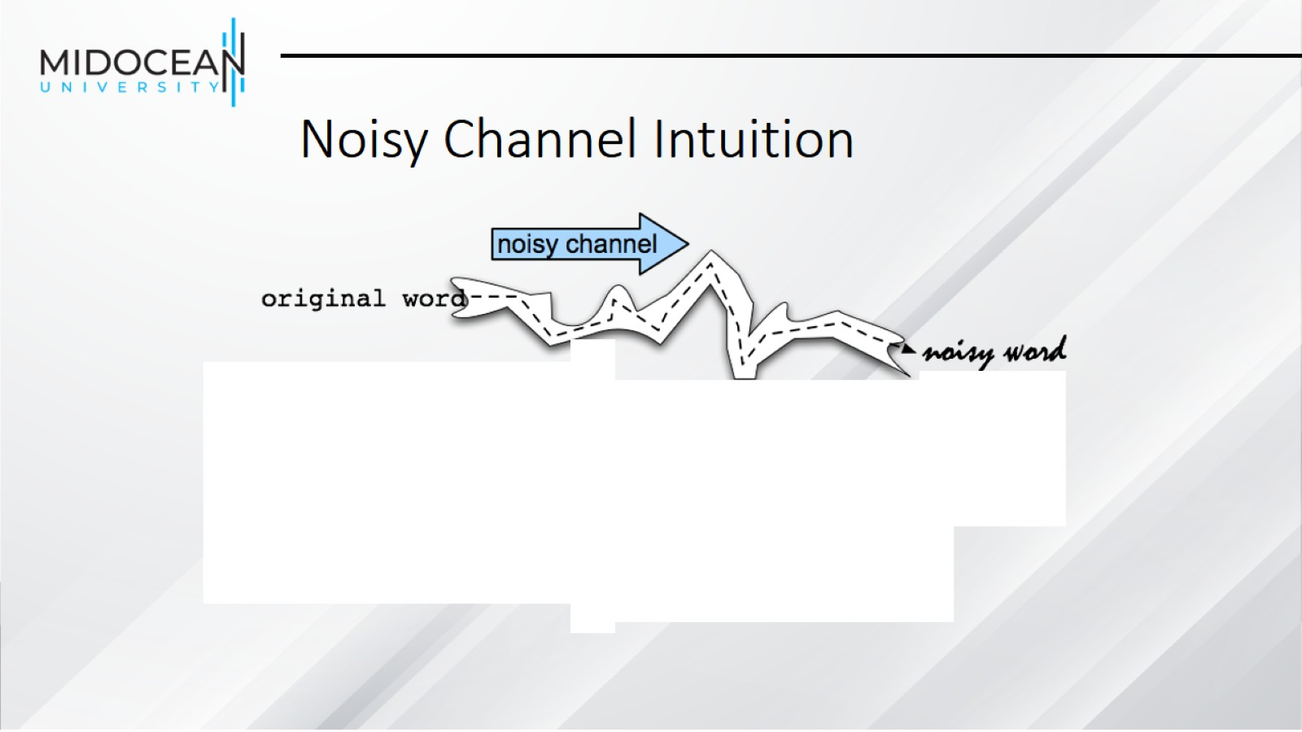
Noisy Channel Intuition

Slide 12
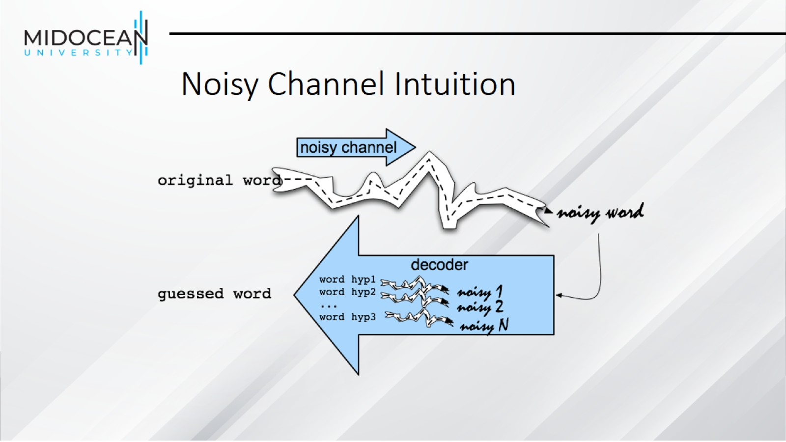
Noisy Channel Intuition

Slide 13
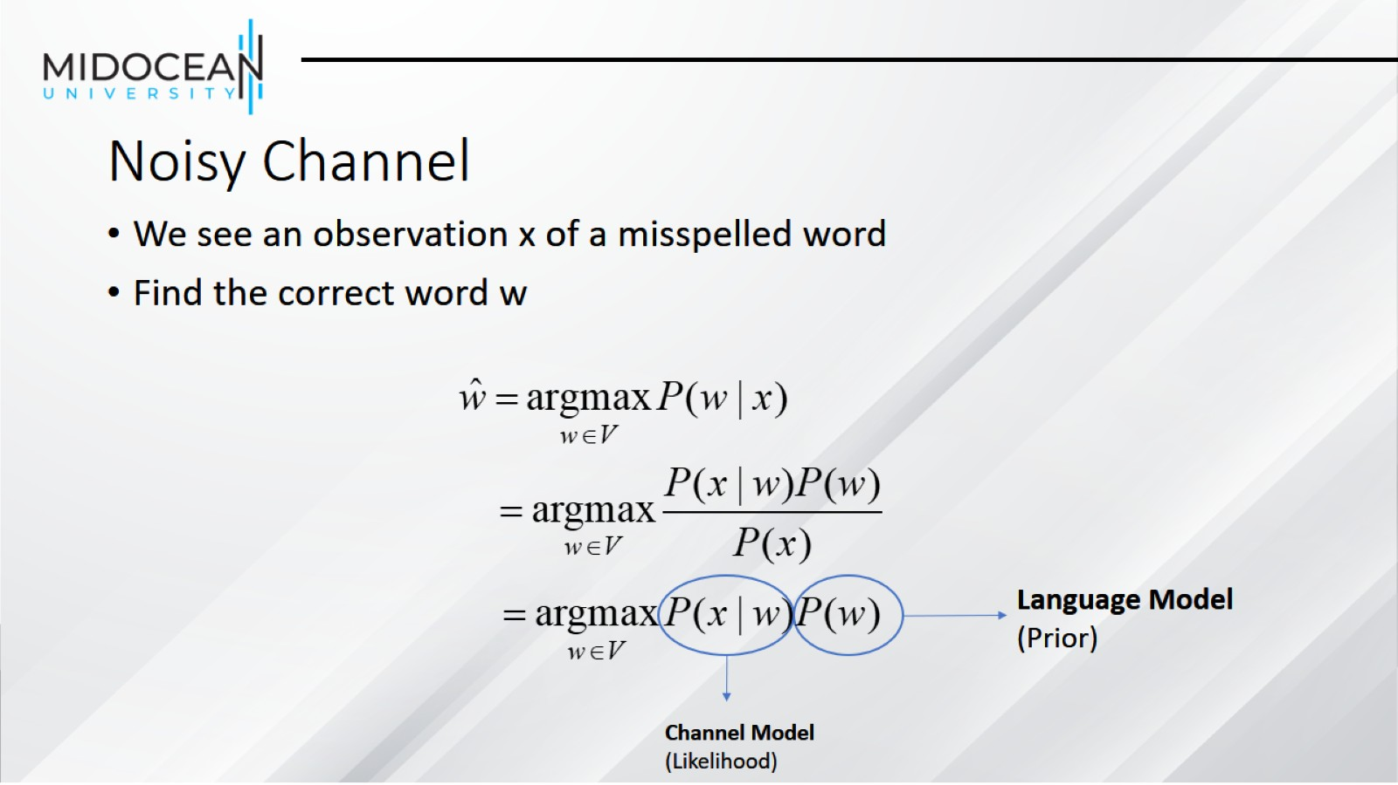
Noisy Channel

Slide 14
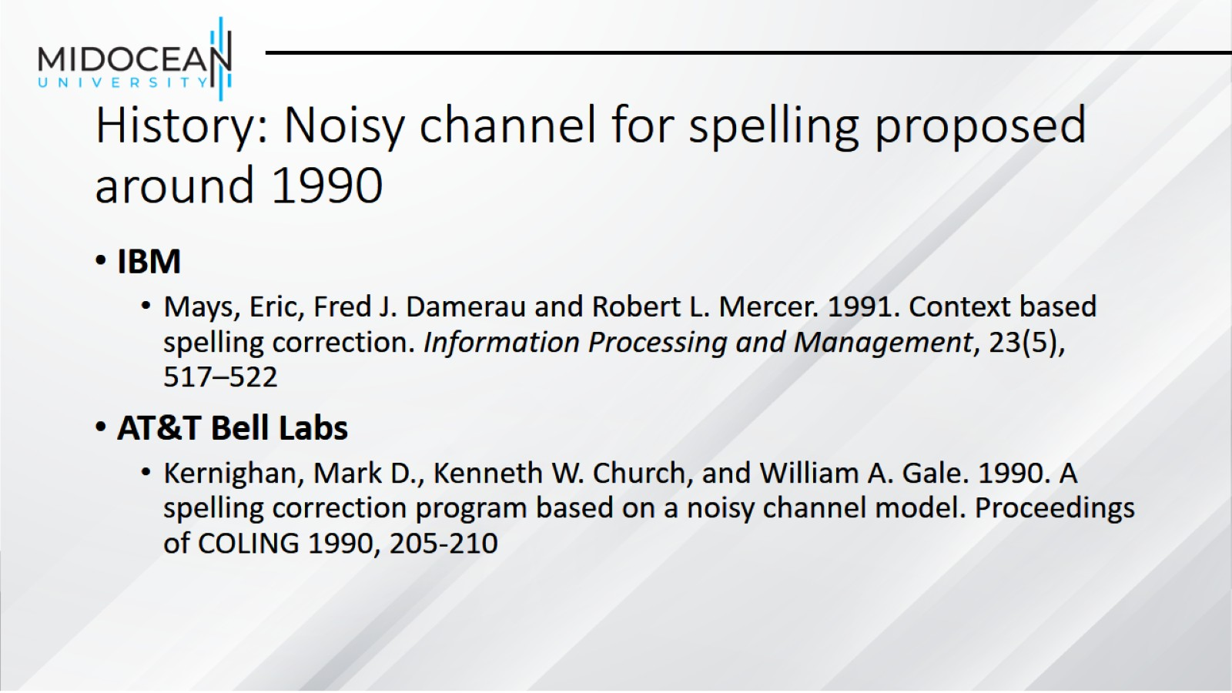
History: Noisy channel for spelling proposed around 1990

Slide 15
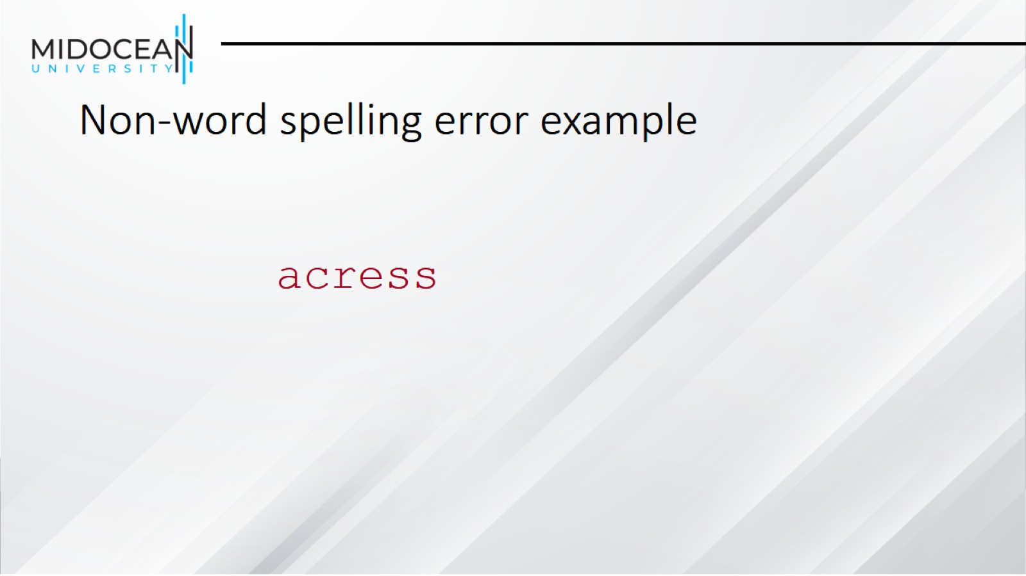
Non-word spelling error example

Slide 16
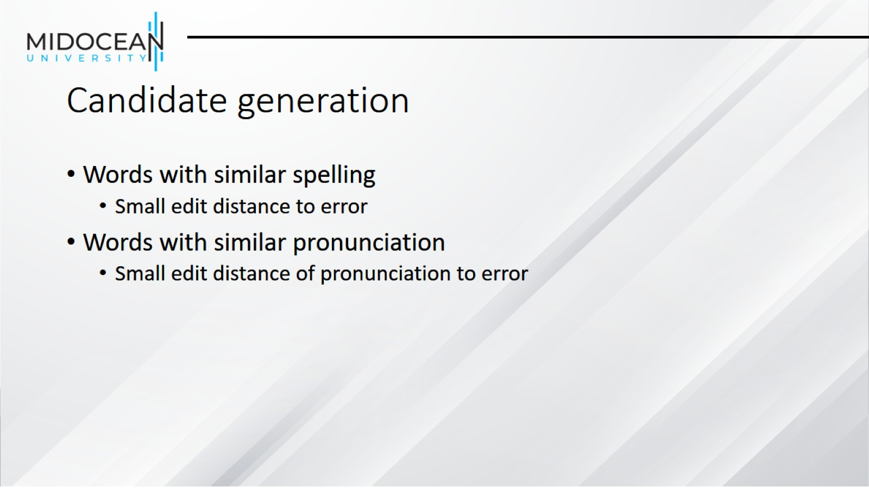
Candidate generation

Slide 17
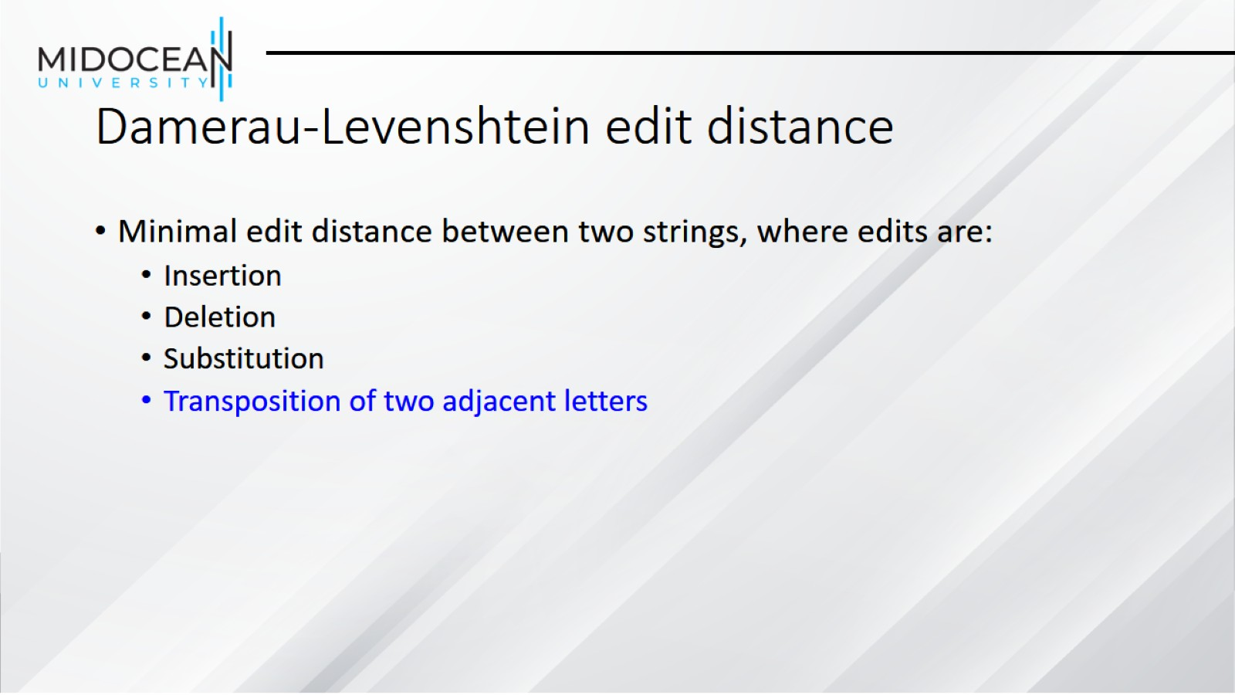
Damerau-Levenshtein edit distance

Slide 18
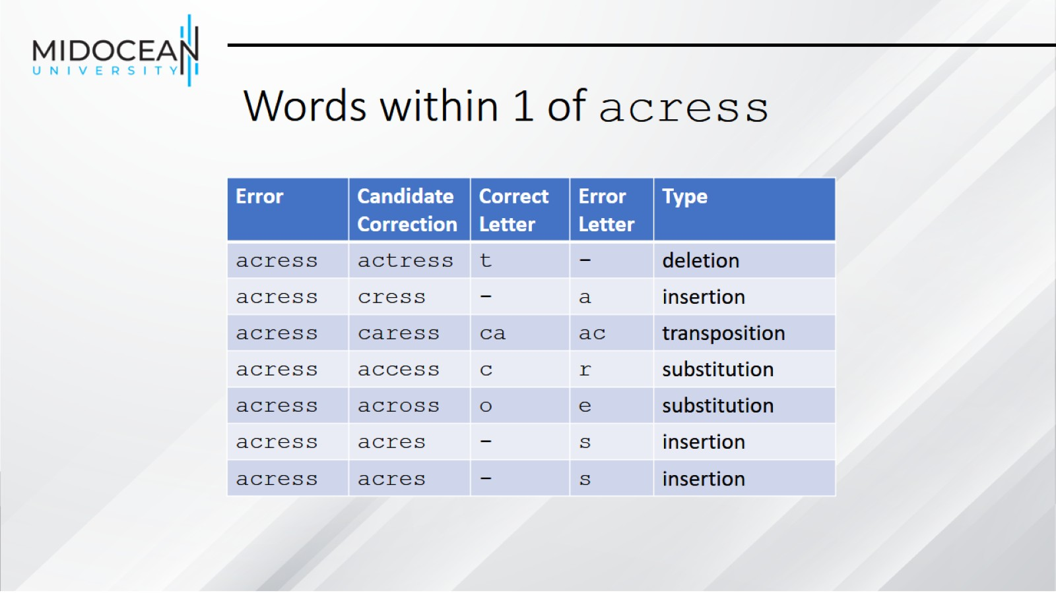
Words within 1 of acress

Slide 19
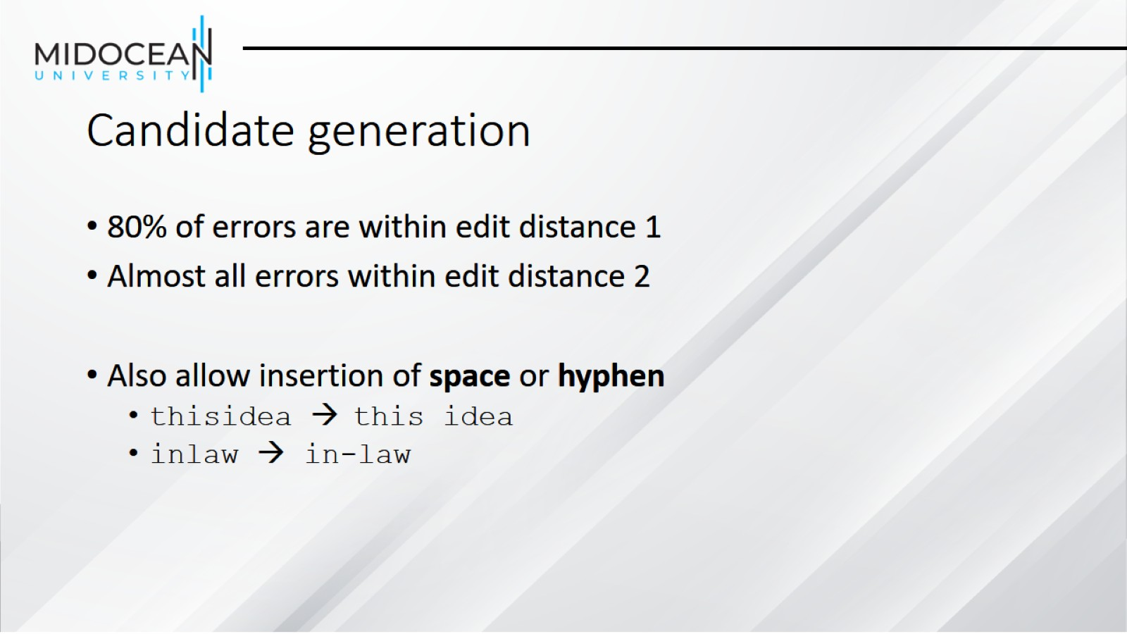
Candidate generation

Slide 20
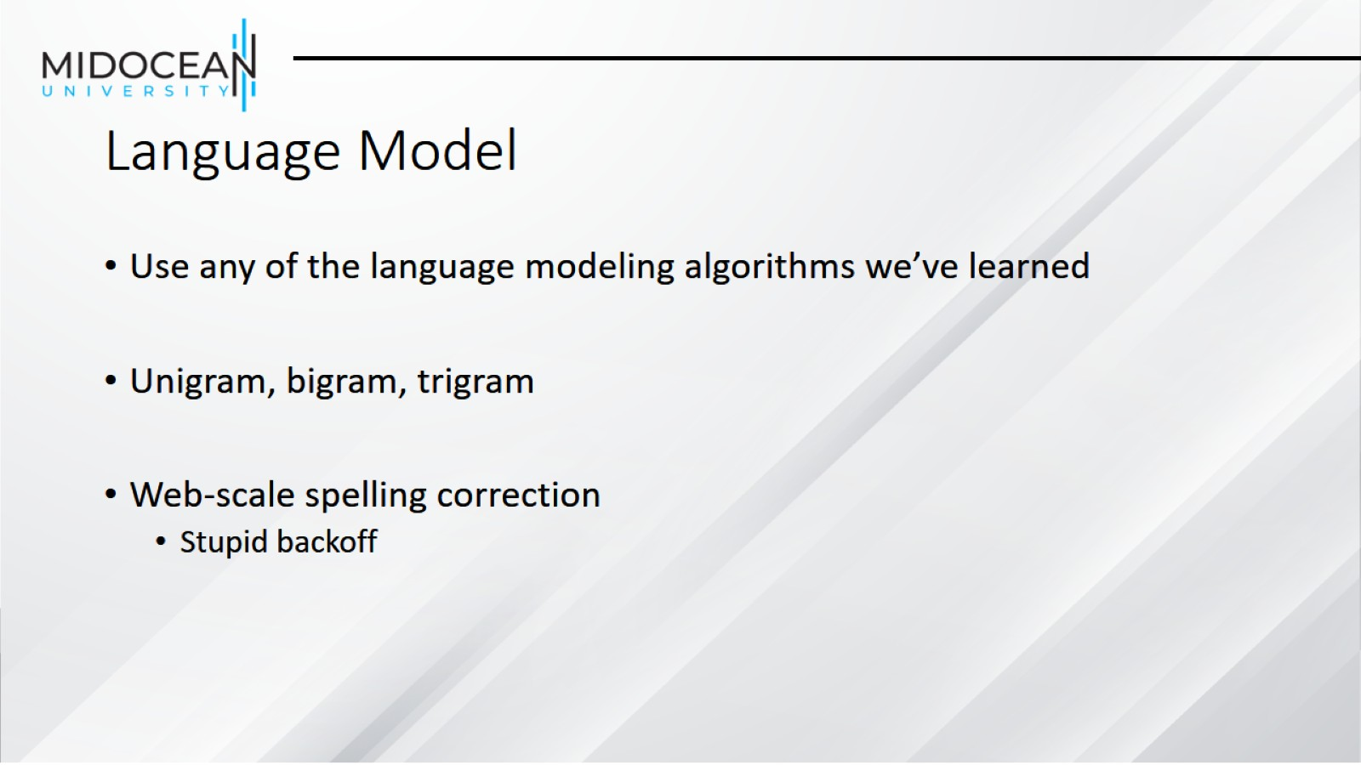
Language Model

Slide 21
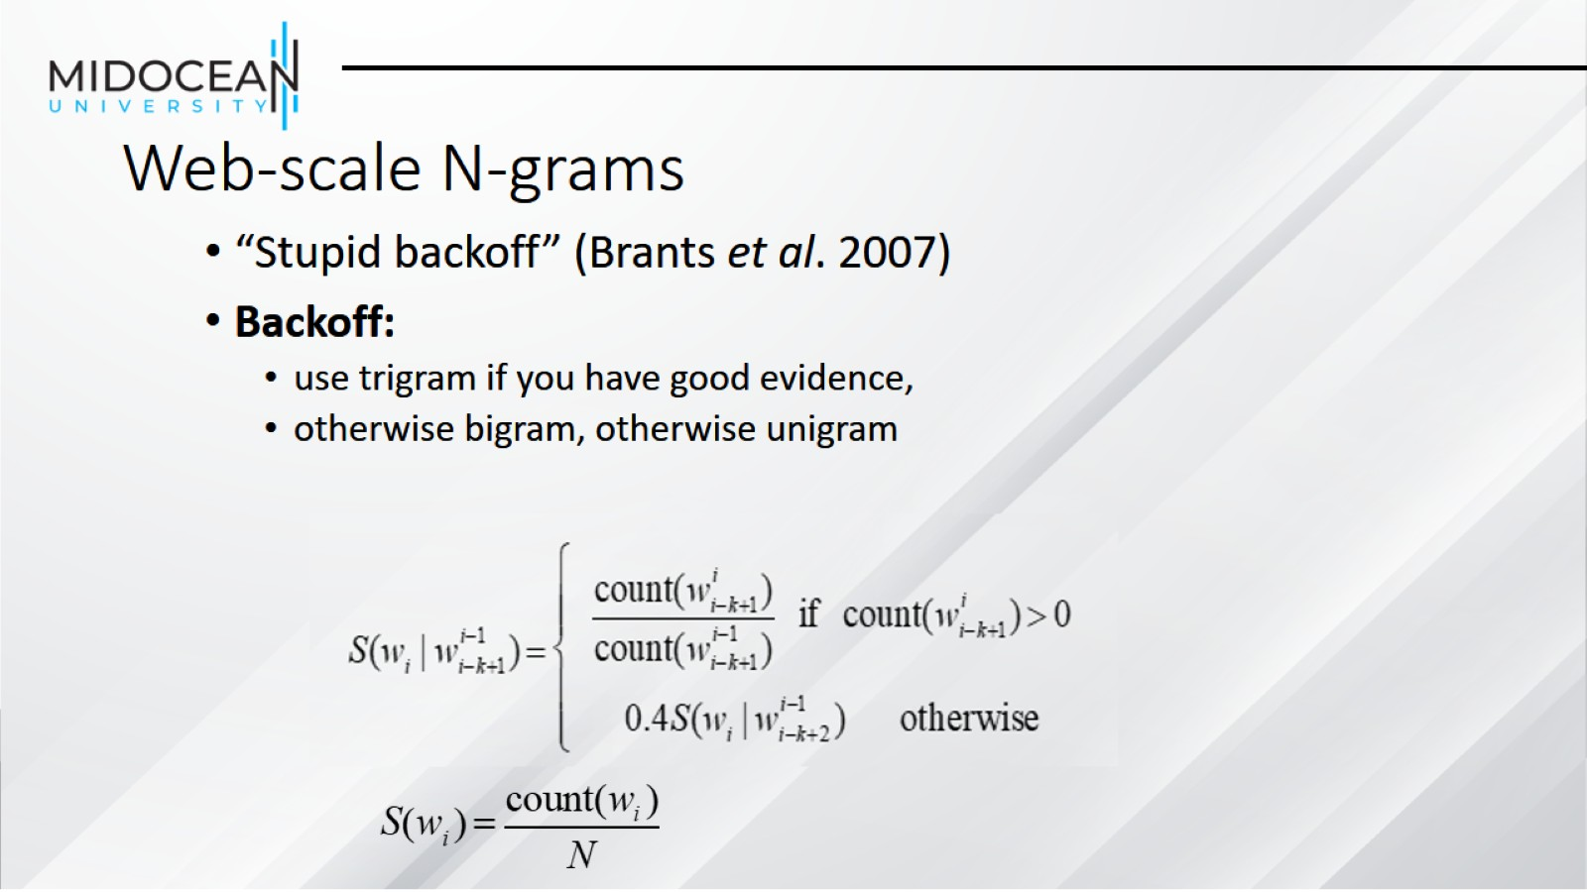
Web-scale N-grams

Slide 22
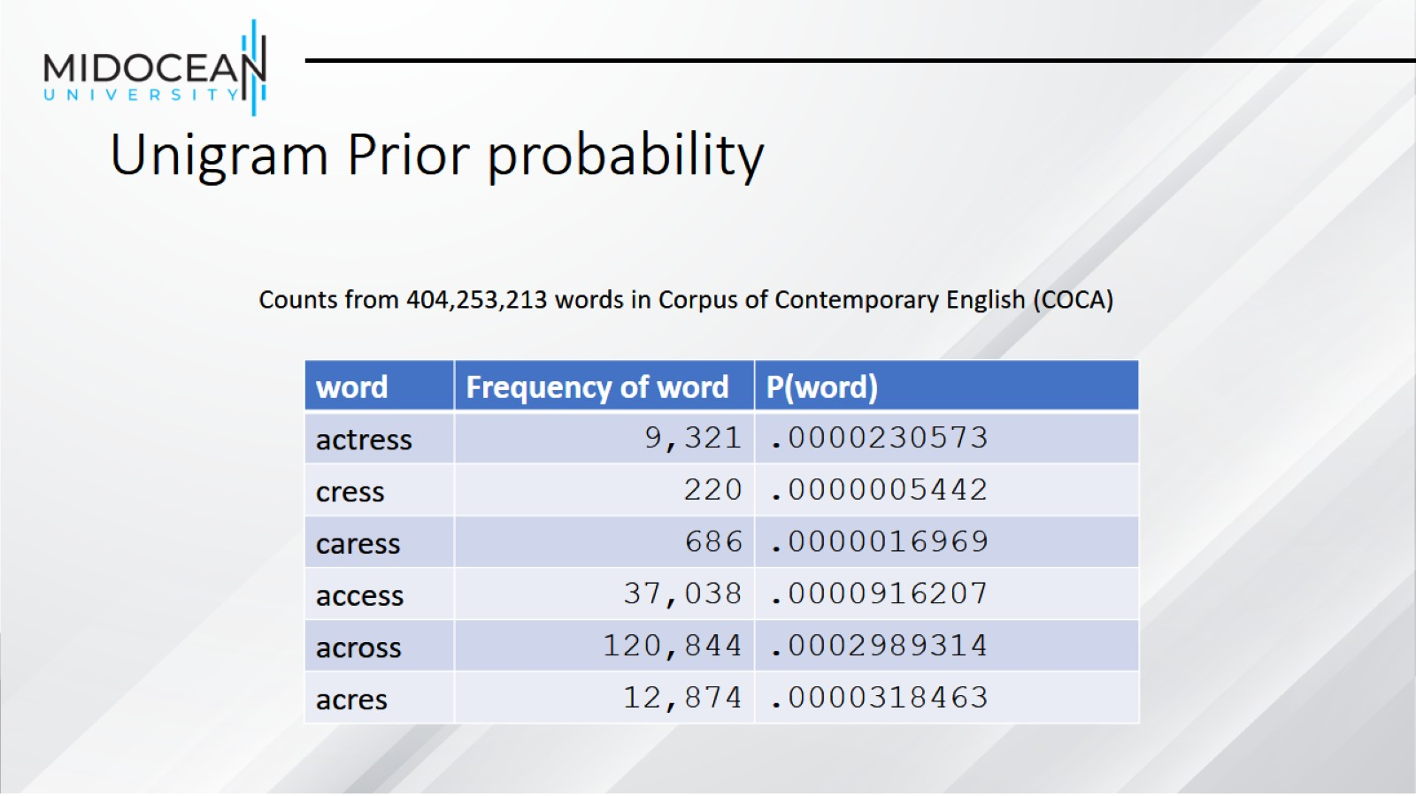
Unigram Prior probability

Slide 23
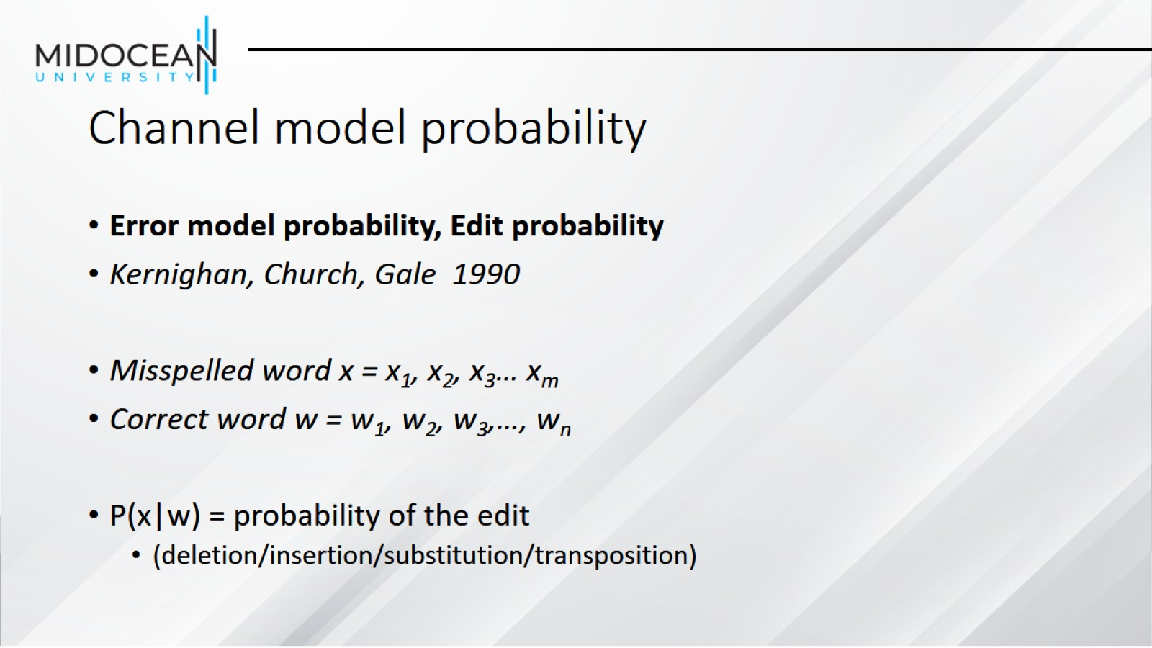
Channel model probability

Slide 24
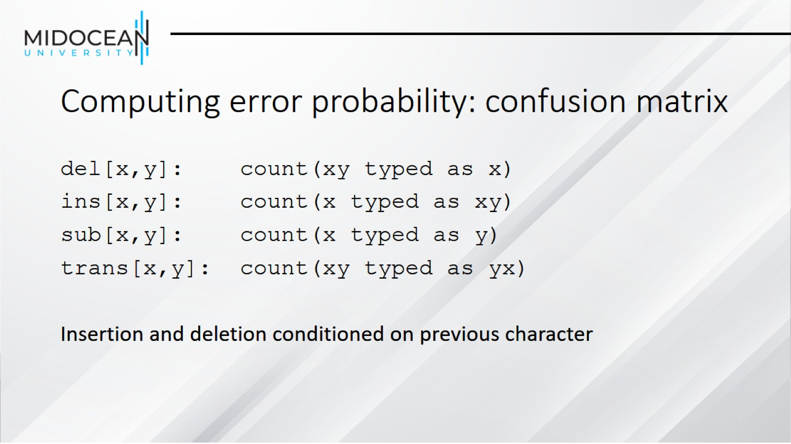
Computing error probability: confusion matrix

Slide 25
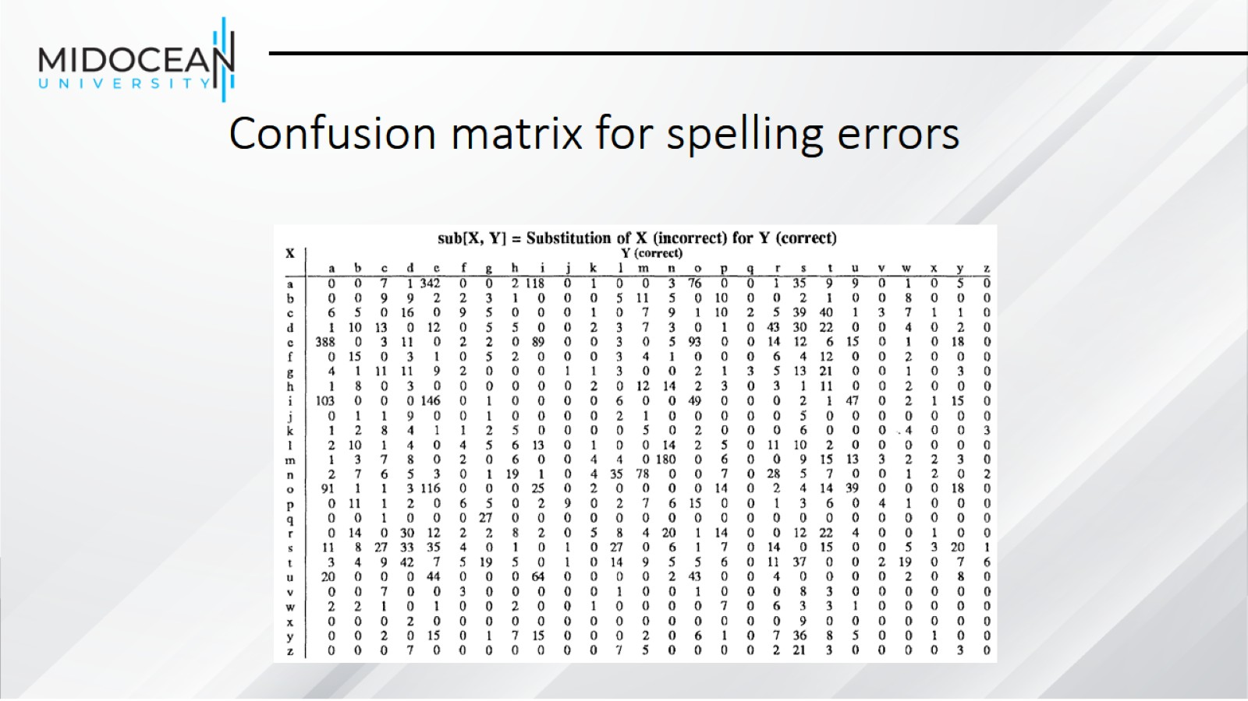
Confusion matrix for spelling errors

Slide 26
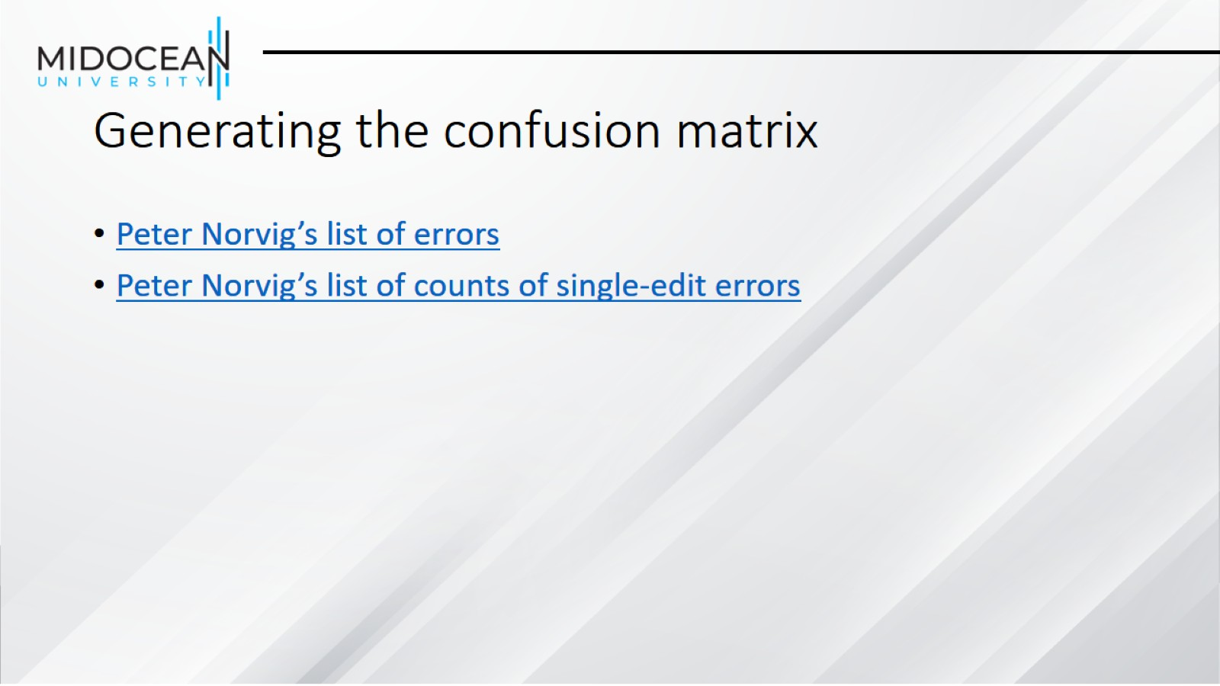
Generating the confusion matrix

Slide 27
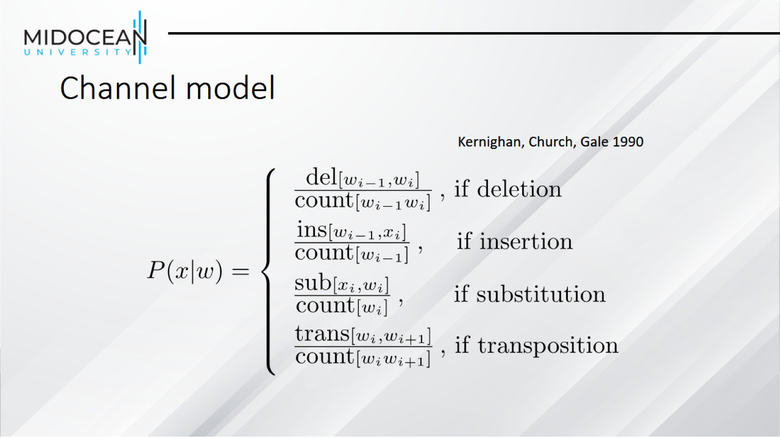
Channel model

Slide 28
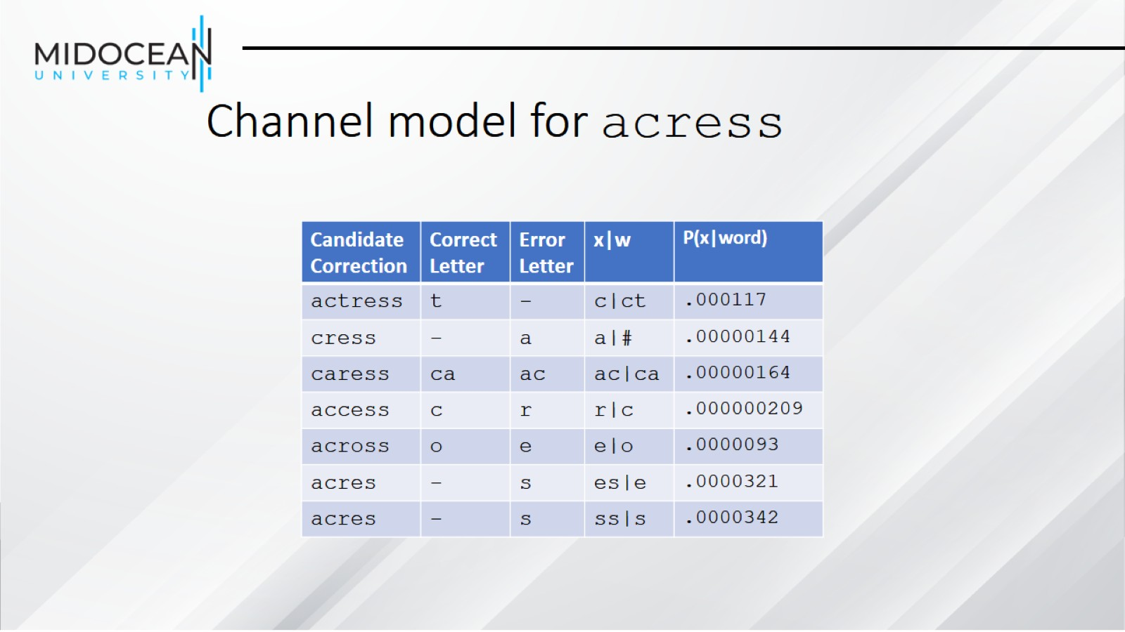
Channel model for acress

Slide 29
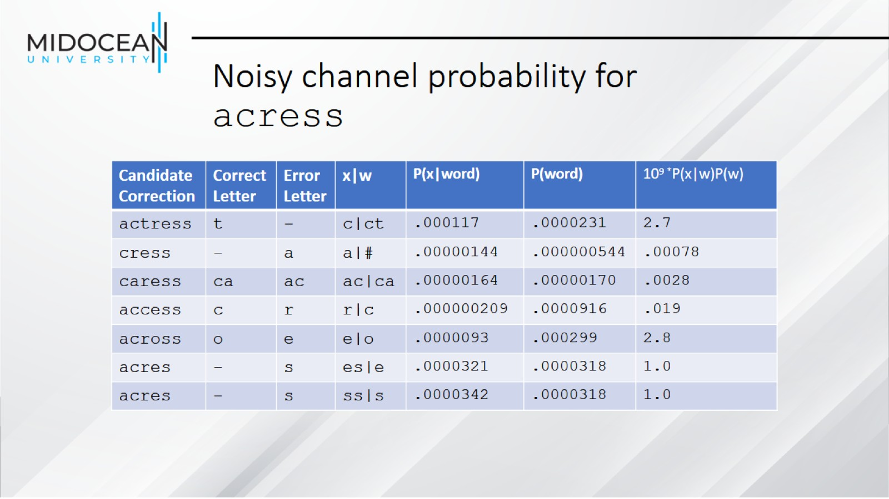
Noisy channel probability for acress

Slide 30
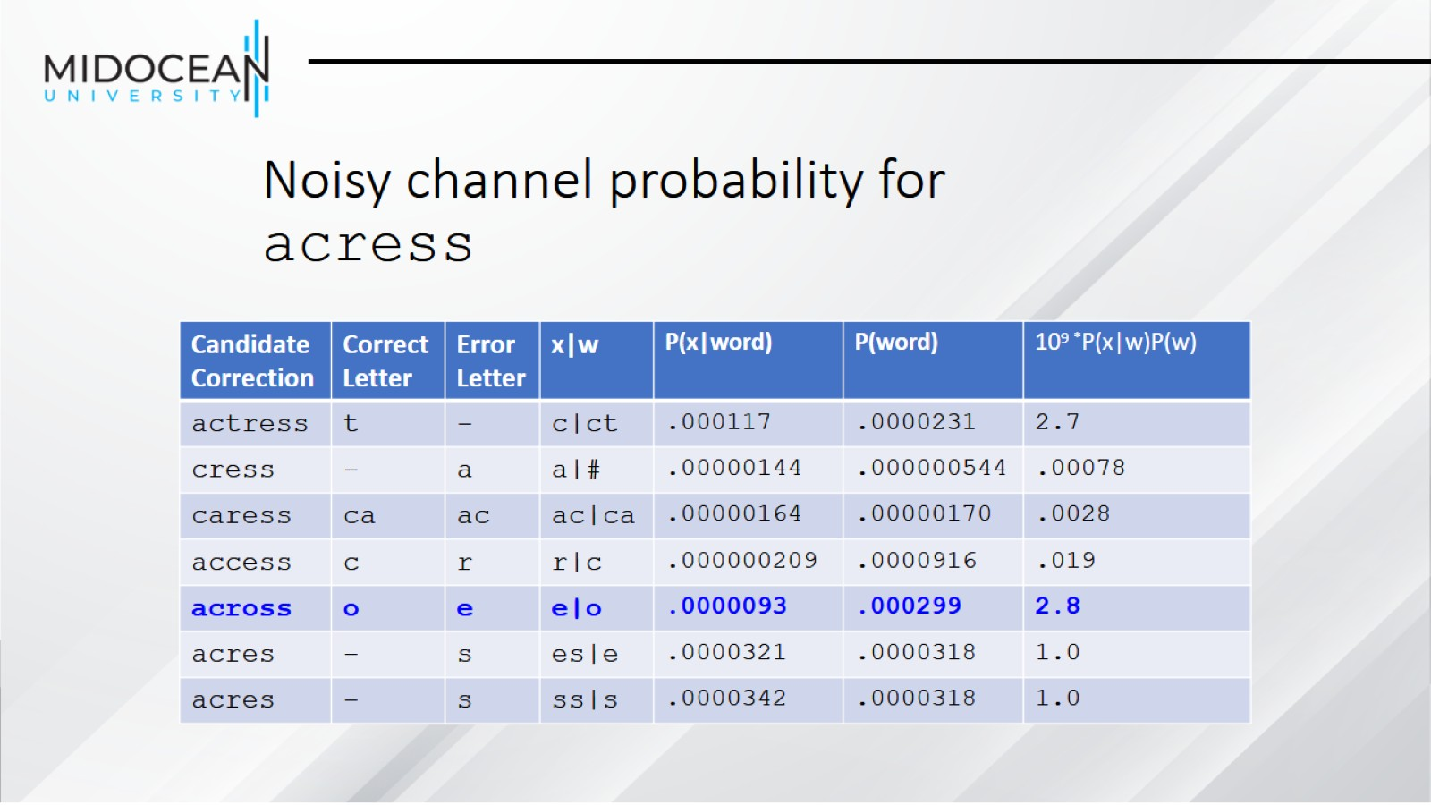
Noisy channel probability for acress

Slide 31
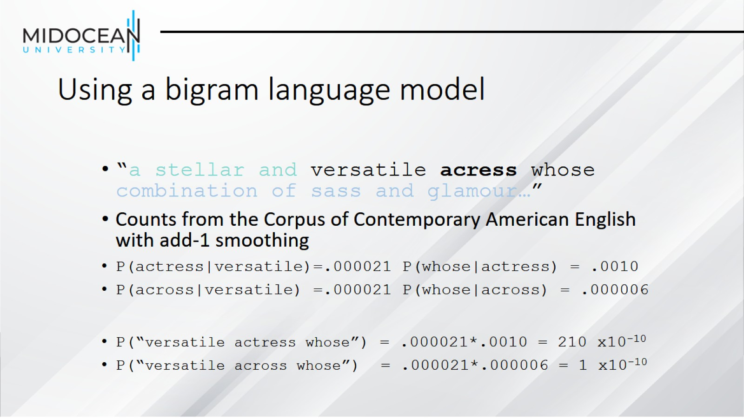
Using a bigram language model

Slide 32
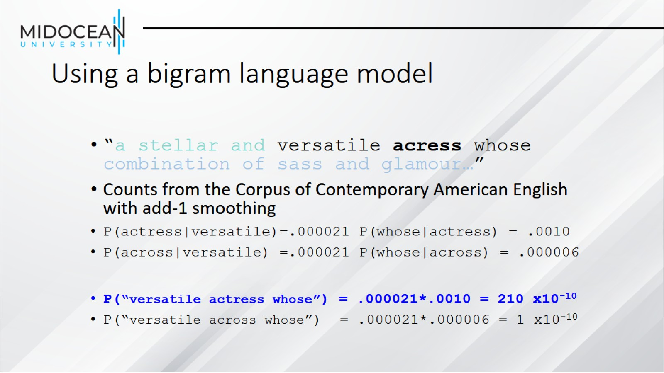
Using a bigram language model

Slide 33
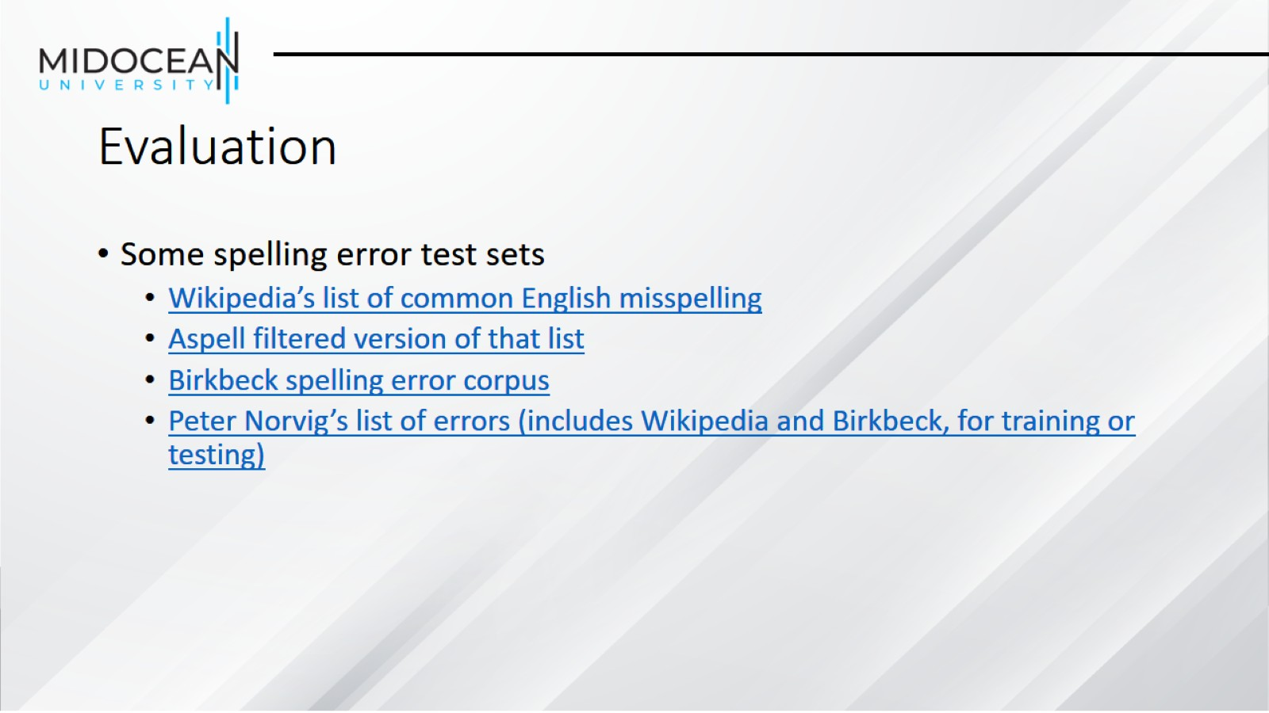
Evaluation

Slide 34
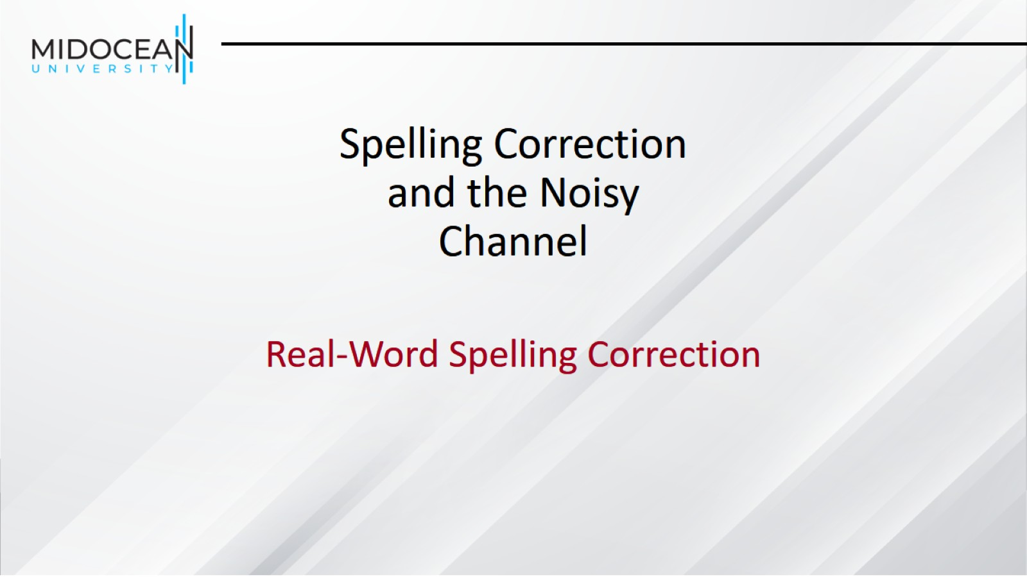
Spelling Correction and the Noisy Channel

Slide 35
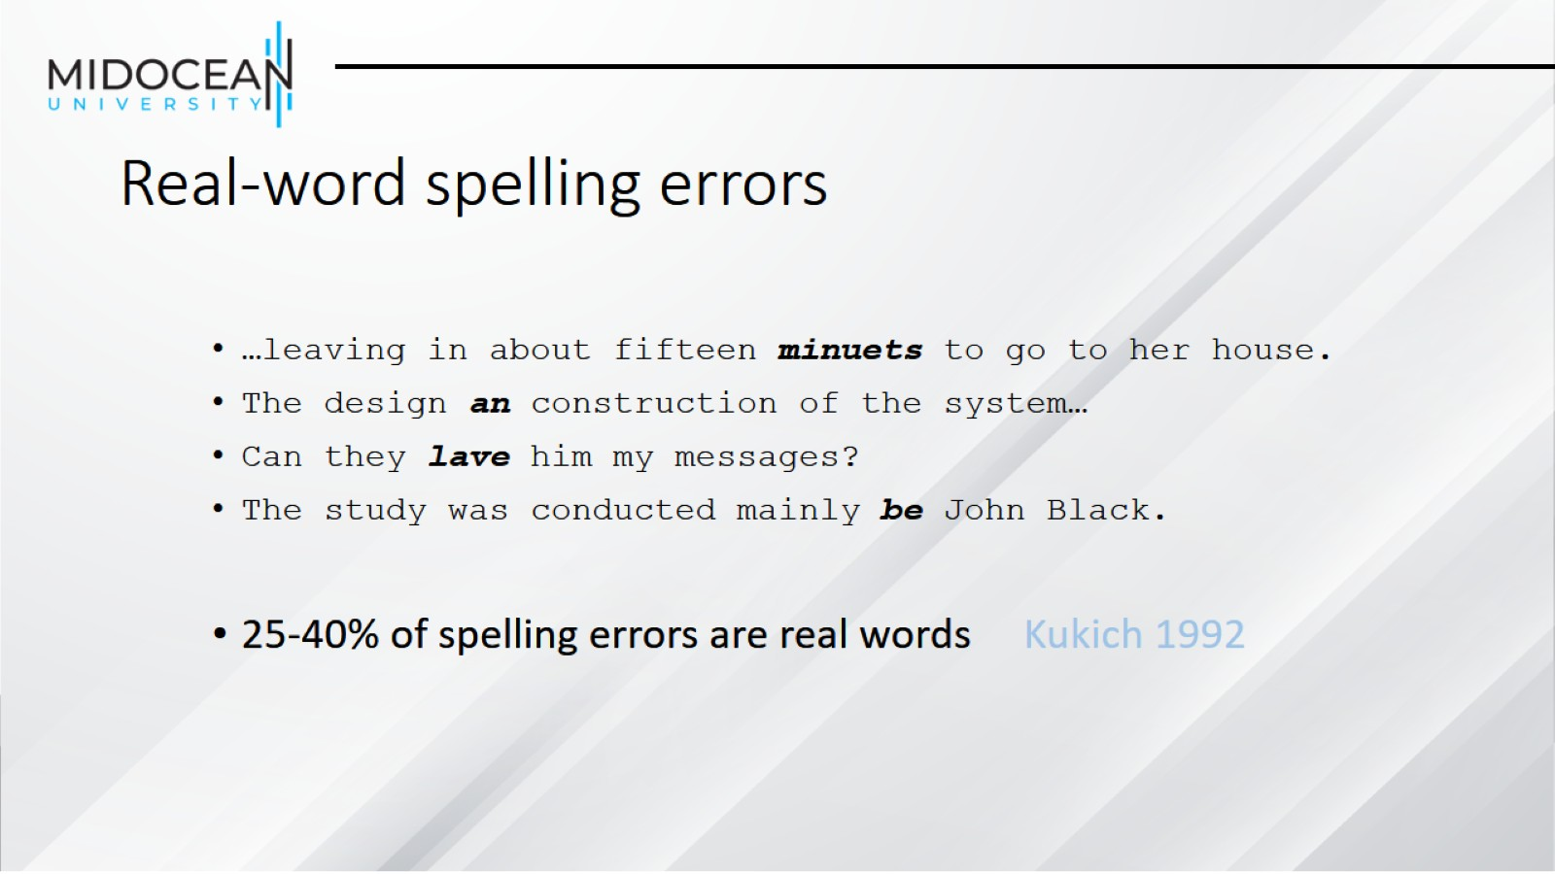
Real-word spelling errors

Slide 36
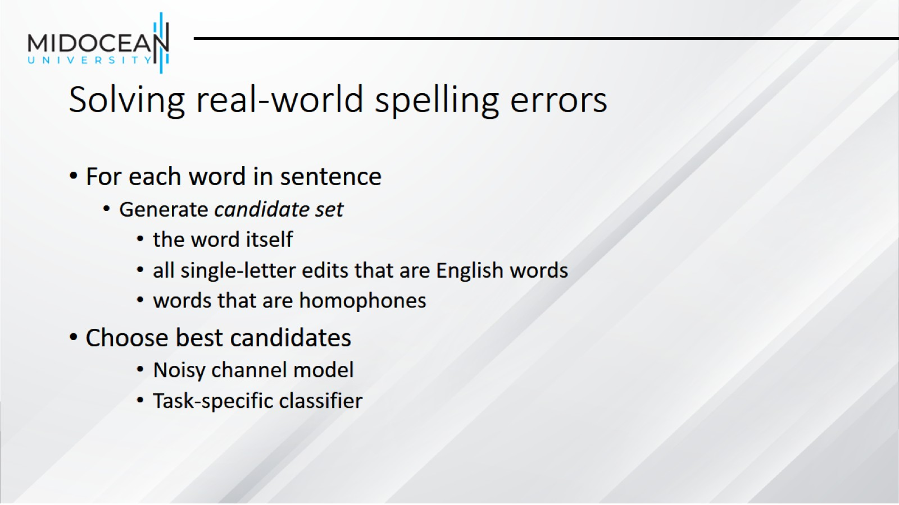
Solving real-world spelling errors

Slide 37
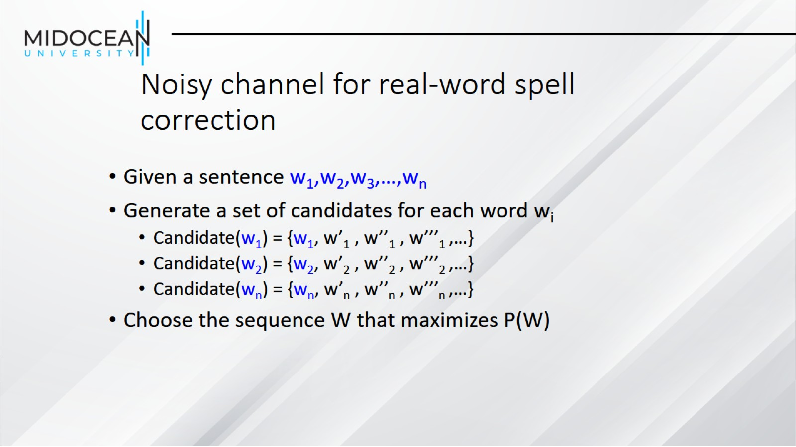
Noisy channel for real-word spell correction

Slide 38
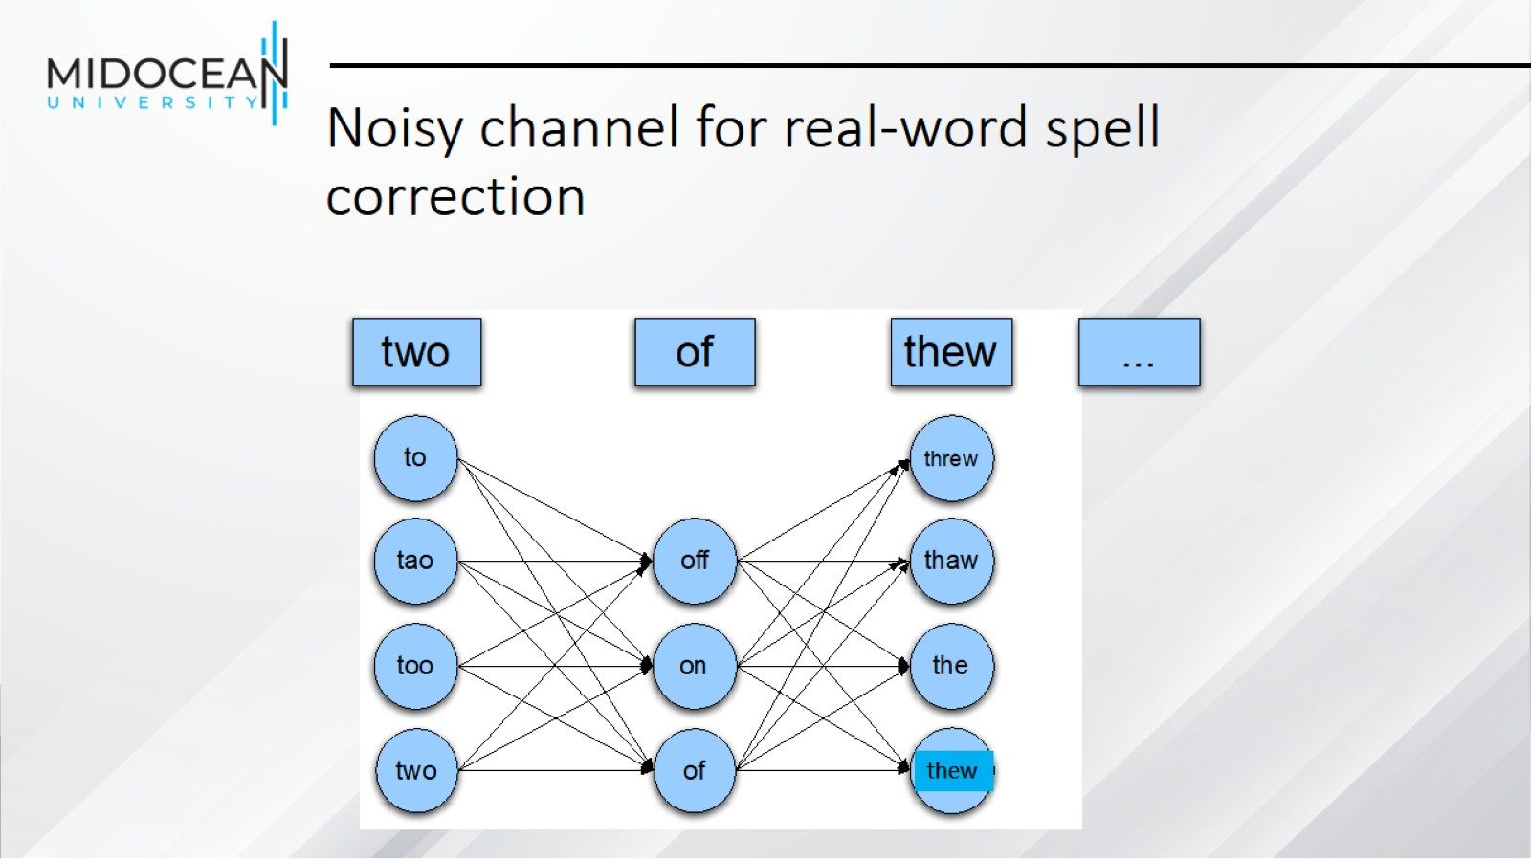
Noisy channel for real-word spell correction

Slide 39
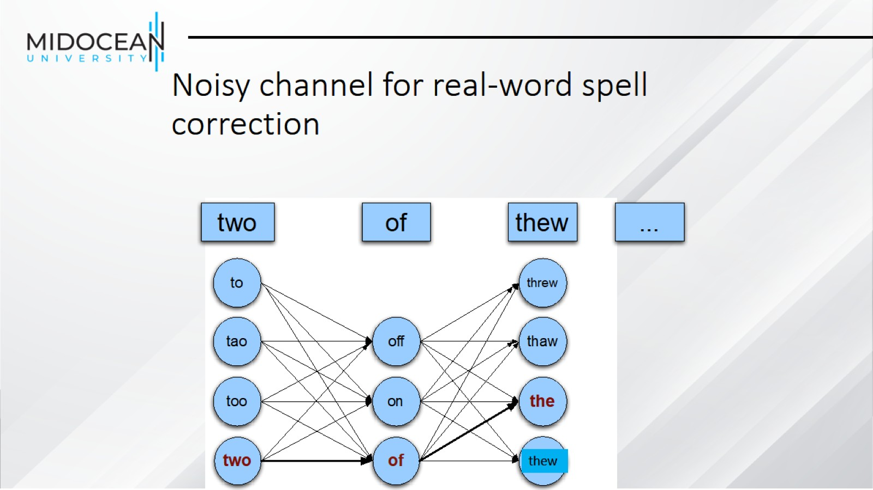
Noisy channel for real-word spell correction

Slide 40
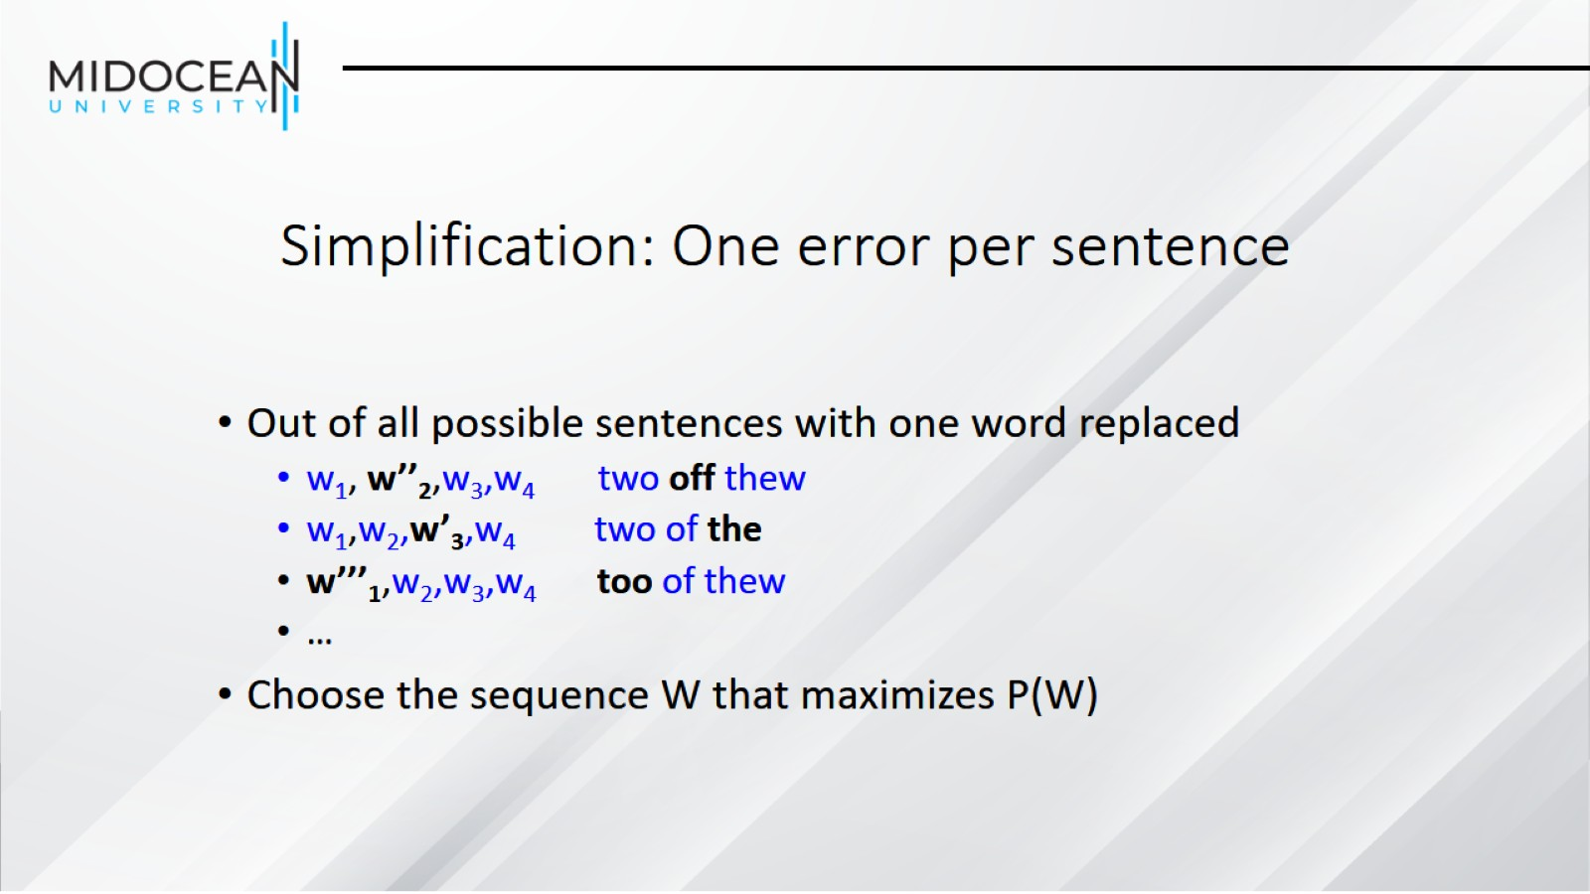
Simplification: One error per sentence

Slide 41
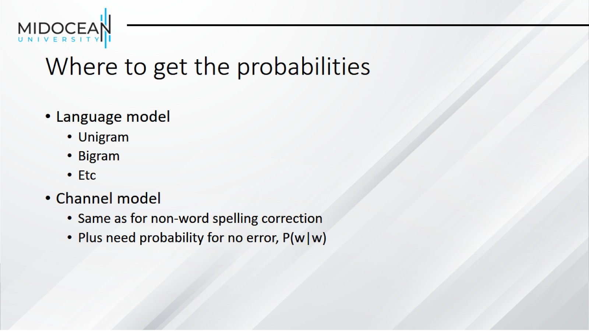
Where to get the probabilities

Slide 42
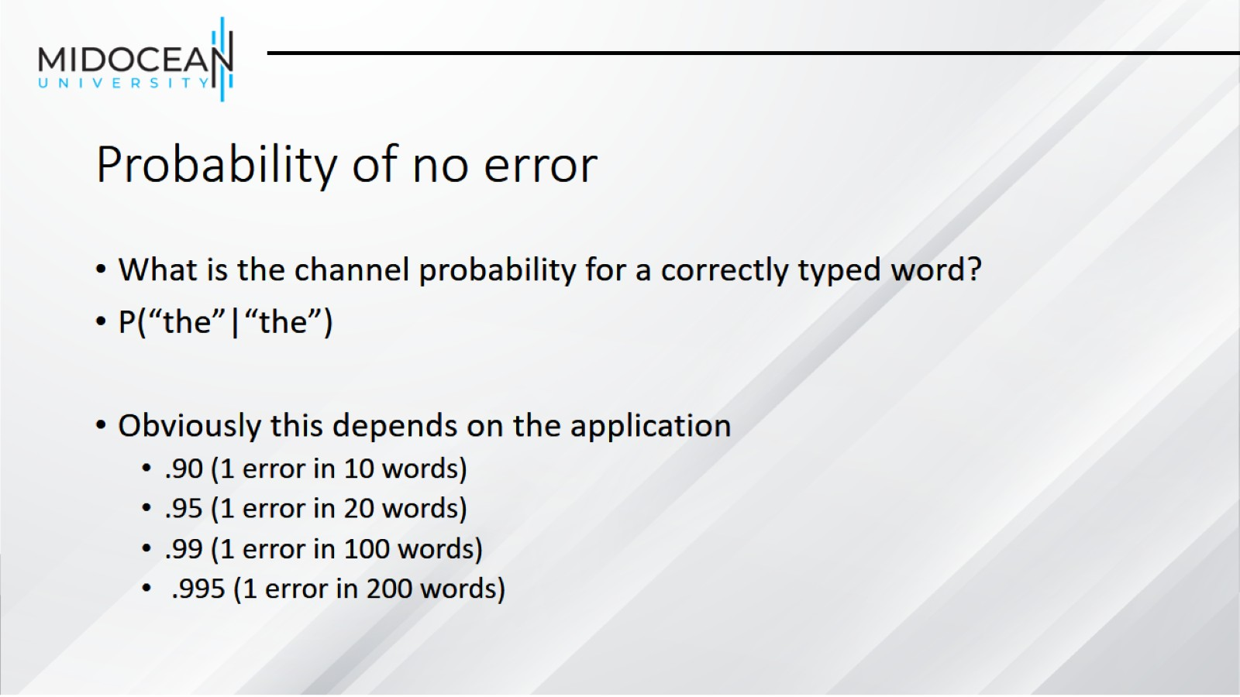
Probability of no error

Slide 43
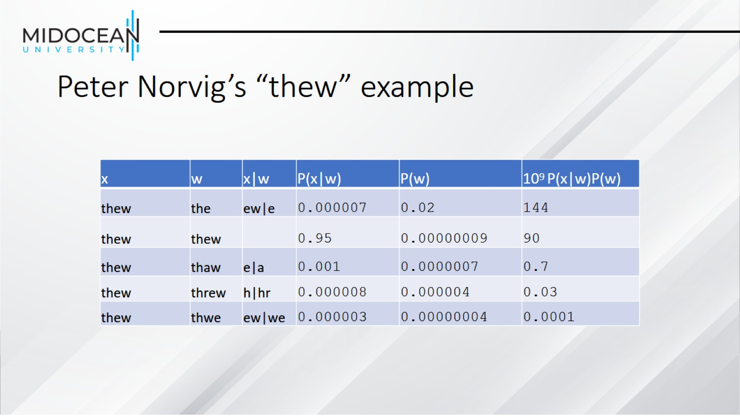
Peter Norvig’s “thew” example

Slide 44
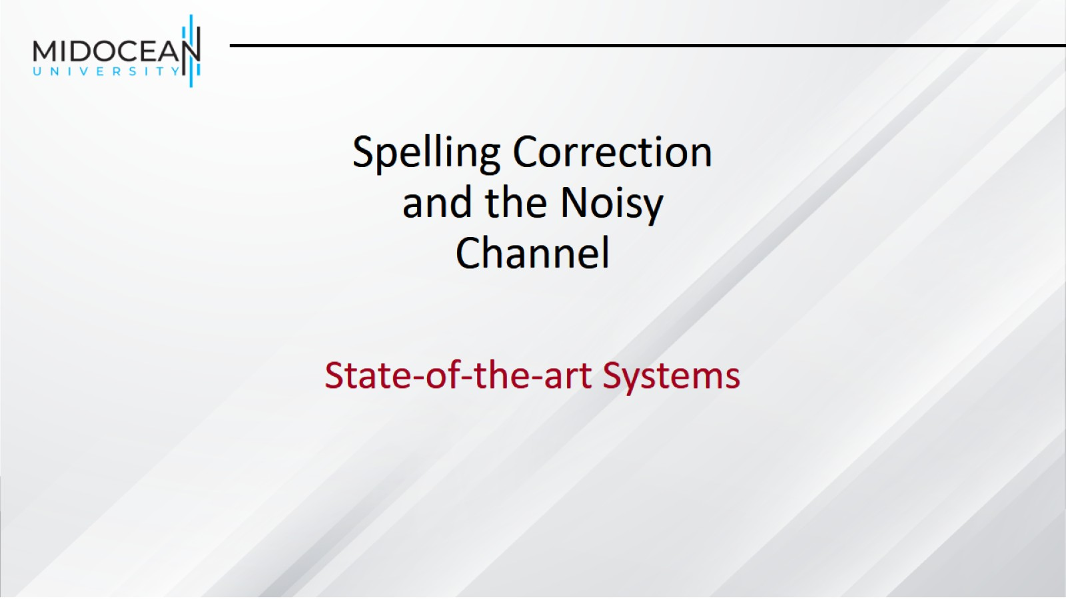
Spelling Correction and the Noisy Channel

Slide 45
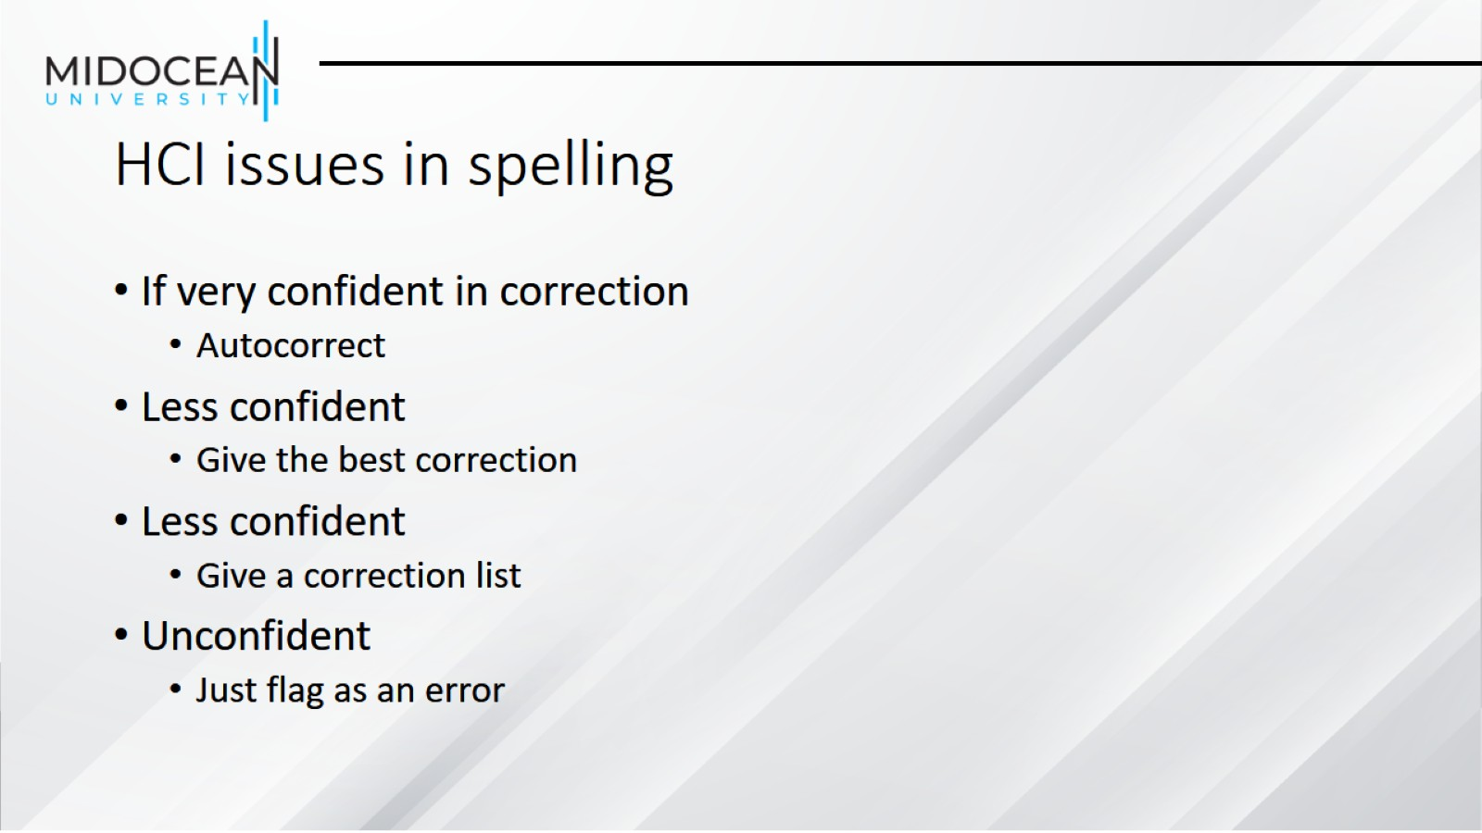
HCI issues in spelling

Slide 46
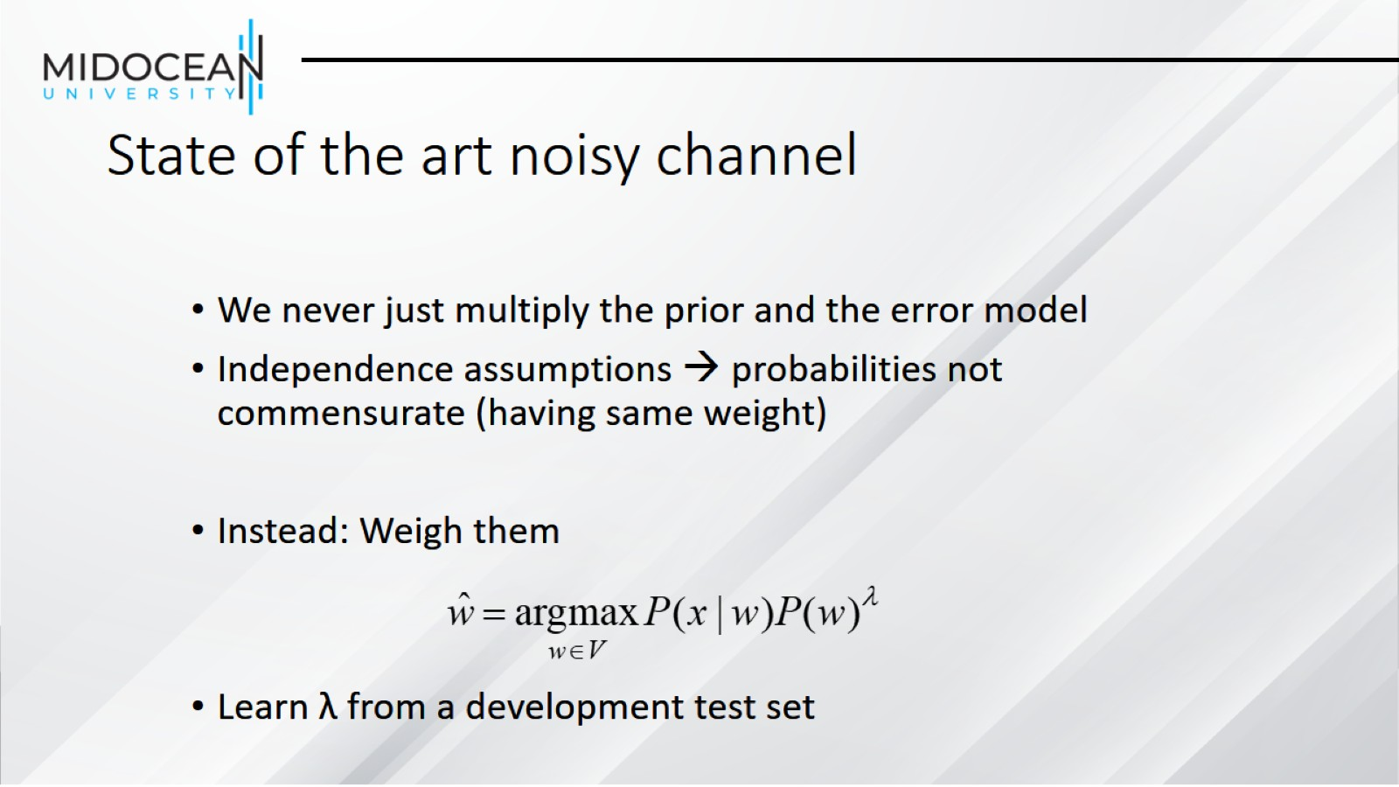
State of the art noisy channel

Slide 47
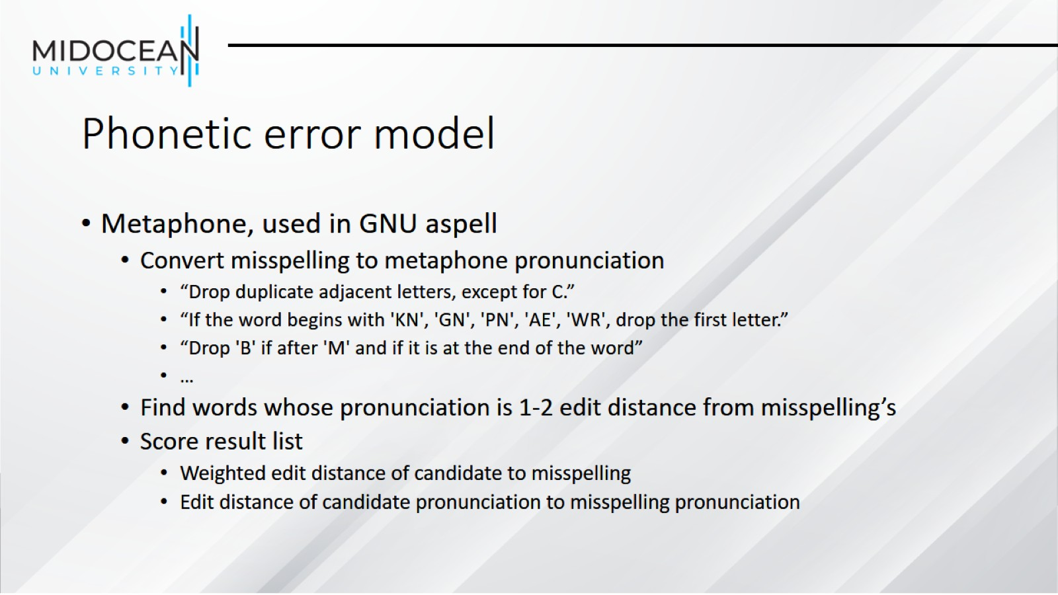
Phonetic error model

Slide 48
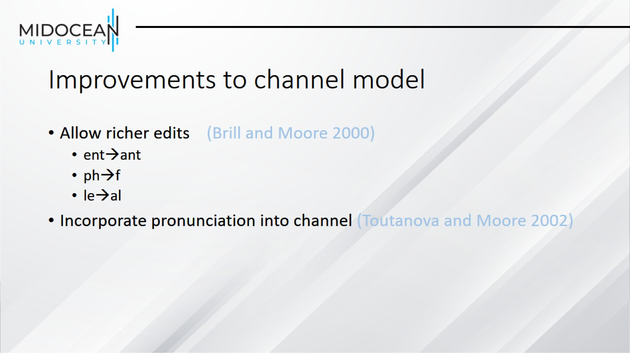
Improvements to channel model

Slide 49
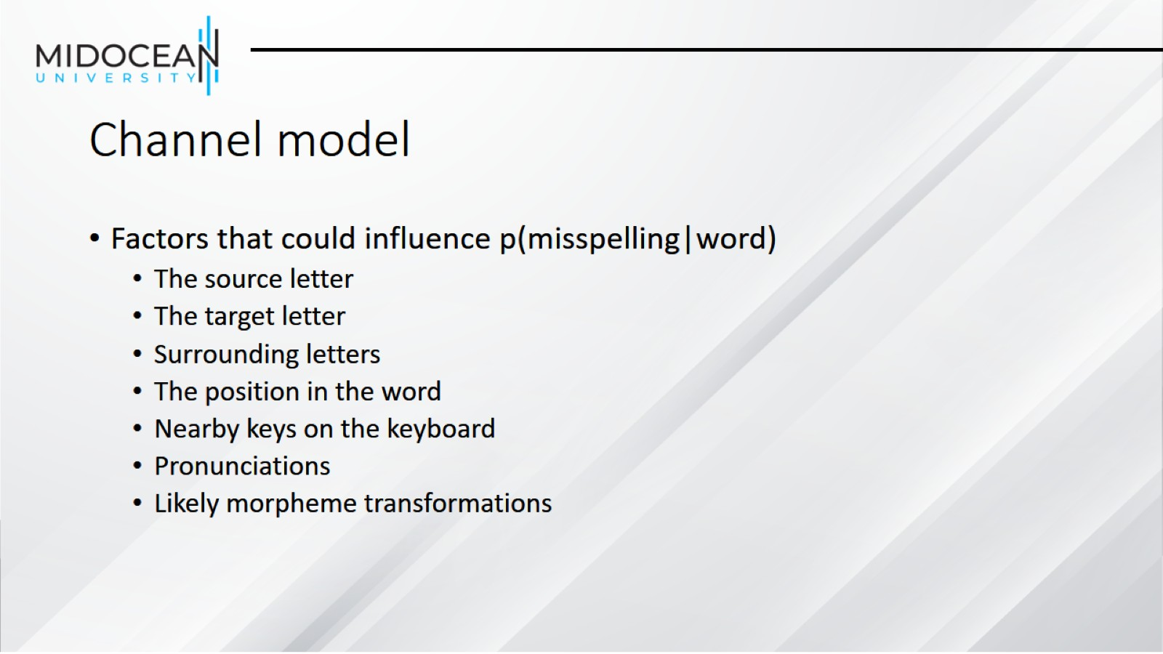
Channel model

Slide 50
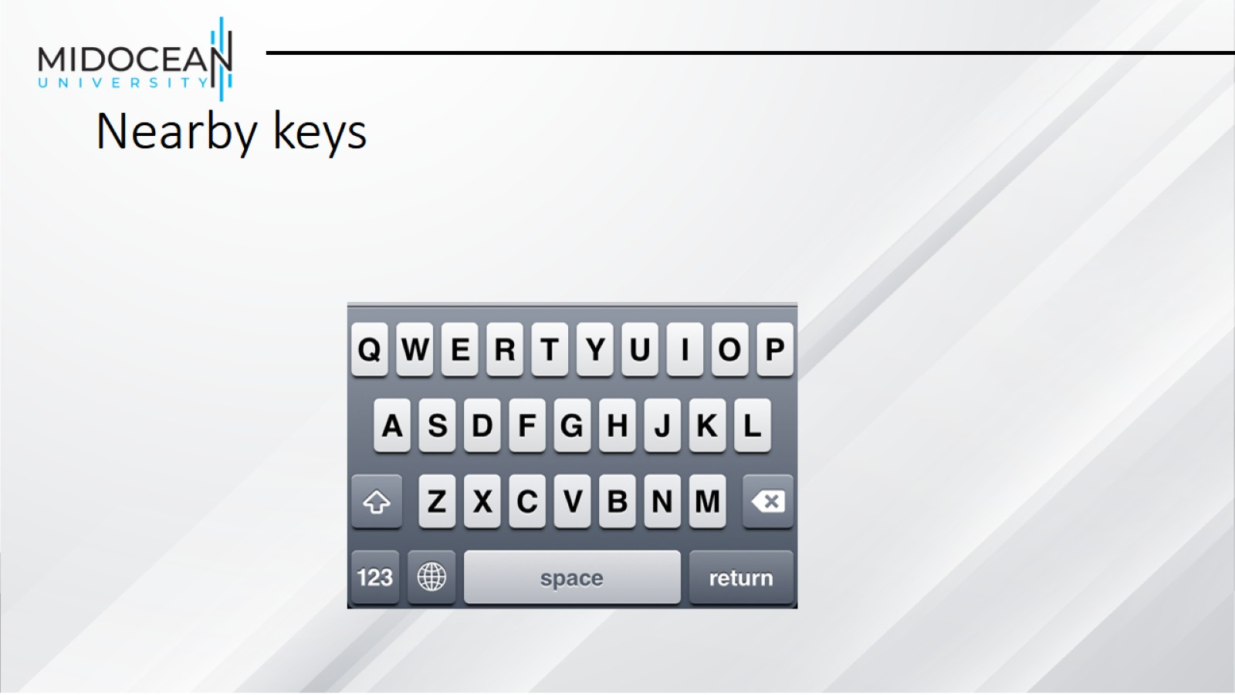
Nearby keys

Slide 51
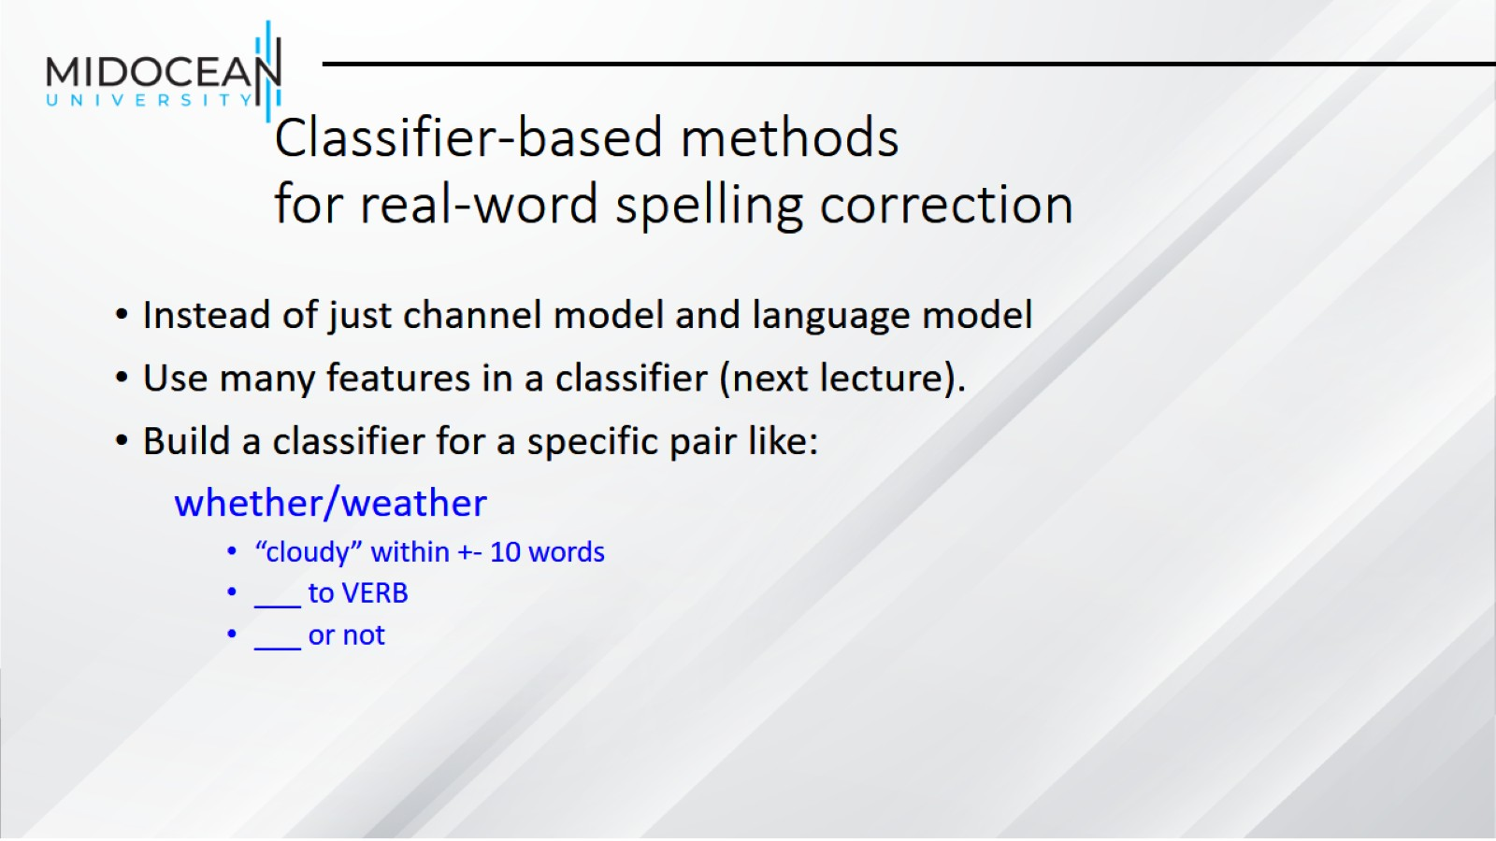
Classifier-based methods for real-word spelling correction

Slide 52


