Slide 1


The Future of FinTech
Prepared by Dr. Mohamed Sleem
FNT611
Foundations of FinTech
Lecture 11

Slide 2

The Future of FinTech
Lecture 11
FNT611
Foundations of FinTech
Prepared by
Dr. Mohamed Sleem

Slide 3
Discussion
  What are the key features and benefits of the Nasdaq SMARTS Market Surveillance Technologies?
  Answer: Nasdaq SMARTS Market Surveillance Technologies represent a comprehensive suite of tools designed to monitor and analyze trading activities across various markets to detect and prevent market manipulation and other forms of market abuse. The key features and benefits of Nasdaq SMARTS include:
  1. Real-Time Surveillance, 2. Advanced Analytics, 3. Cross-Market Surveillance, 4. Customizable Alert System, 5. Regulatory Compliance, 6. Global Application, 7. Data Integration.

Slide 4
Discussion
  What does navigating regulatory services in finance involve and what are the key considerations for financial institutions?
  Answer: Navigating regulatory services in finance involves understanding and adhering to a complex set of laws and regulations that govern the operations of financial institutions. The key considerations include:
  Understanding Regulatory Bodies
  Compliance with Laws and Regulations
  Implementing Compliance Programs
  Keeping Up with Changes.

Slide 5
Discussion
  What is Risk Management Software and what are its key features and benefits in the financial sector?
  Answer: Risk Management Software is a type of application or suite of tools designed to help organizations identify, assess, manage, and mitigate various types of risks they face, particularly in the financial sector. Key features and benefits of such software include:
  Risk Identification and Assessment.
  Risk Monitoring and Reporting.
  Compliance Management.

Slide 6
Objectives:
To analyze the Tripartite Innovation Ecosystem in FinTech and how it enhances customer experience through strategic collaboration.
To investigate methods for maximizing Data Advantage for Banks using advanced analytics.
To examine the disruptive potential of Agentic AI and Real-World Asset (RWA) Tokenization across banking operations and market infrastructure.

Slide 7
Objectives:
To analyze the continued reshaping of financial services by emerging technologies.
To conduct an academic analysis of the five game-changing factors influencing the future of FinTech.
To explore the future landscape and potential scenarios of financial services.
To examine the essential shift from being product vendors to becoming integrated solution providers in the financial sector.

Slide 8

How Emerging Technologies
Will Change Financial Services?
  Digital Disruption Continues: The financial sector is experiencing digital disruption, but its fundamental services remain the same.
  Technological Transformation: New technologies are revolutionizing the delivery of financial services, enhancing convenience, speed, and efficiency.
  FinTech's Growing Influence: FinTech is reshaping the financial industry, indicating a significant shift in how services will be provided in the future.
  Decrease in Cash Use: There is a trend towards declining cash transactions and an increase in non-cash payments, expected to grow significantly by 2020.

Slide 9
How Emerging Technologies
Will Change Financial Services?
Non-Cash Payments Growing: Global economic growth, improved payment systems, and e-commerce are driving rapid increases in non-cash transactions.
Digital and Mobile Payments Rising: Digital currencies and mobile payments are seeing significant growth.
Alternative Financing Expanding: Rising global financing needs boost alternative methods, with investable assets reaching new highs.
E-Commerce and Cryptocurrencies Shaping Payments: E-commerce and cryptocurrency adoption, like Bitcoin and Ripple, are transforming payment methods, accelerating digitalization.

Slide 10
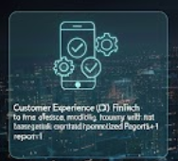
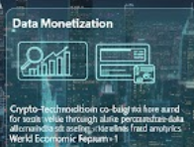


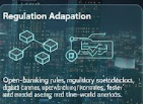
Five Game-Changers Shaping the Future of FinTech: An Academic Analysis
Customer Experience (CX): FinTech and AI shift power to firms offering simple, mobile-first journeys with instant onboarding, transparent pricing, and personalized dashboards.
Fin & Tech Connection: Banks and tech firms co-build services via APIs, cloud, and platform models, combining regulatory licenses and trust with speed, UX, and innovation.
Data Monetization: Financial institutions turn transaction and behavioral data into value through personalized pricing, alternative-data credit scoring, and real-time fraud analytics.
Crypto-technologies: Blockchain and tokenization create new rails for moving and storing value, including faster settlement, tokenized real-world assets, and programmable money via smart contracts.
Regulation Adaptation: Open-banking rules, regulatory sandboxes, digital-only licenses, and updated crypto/AI guidance enable FinTech to scale while managing consumer and systemic risk.

Slide 11

Game-Changer: Tokenization of Real-World Assets (RWA) and Digital Infrastructure
RWA Tokenization Dominates: turning a real-world asset (like T-bills, real estate, or gold) into digital tokens on a blockchain so it can be traded, split into small fractions, and moved 24/7 more easily. (Agur et al., 2025)
In 2025, tokenization—converting assets like real estate, bonds, and private credit into blockchain-based digital tokens—has moved from concept to large-scale institutional adoption.
Rethinking Capital Markets: RWA tokenization is set to restructure the financial system by redefining how ownership, settlement, and compliance work, reducing reliance on multiple intermediaries.

Slide 12
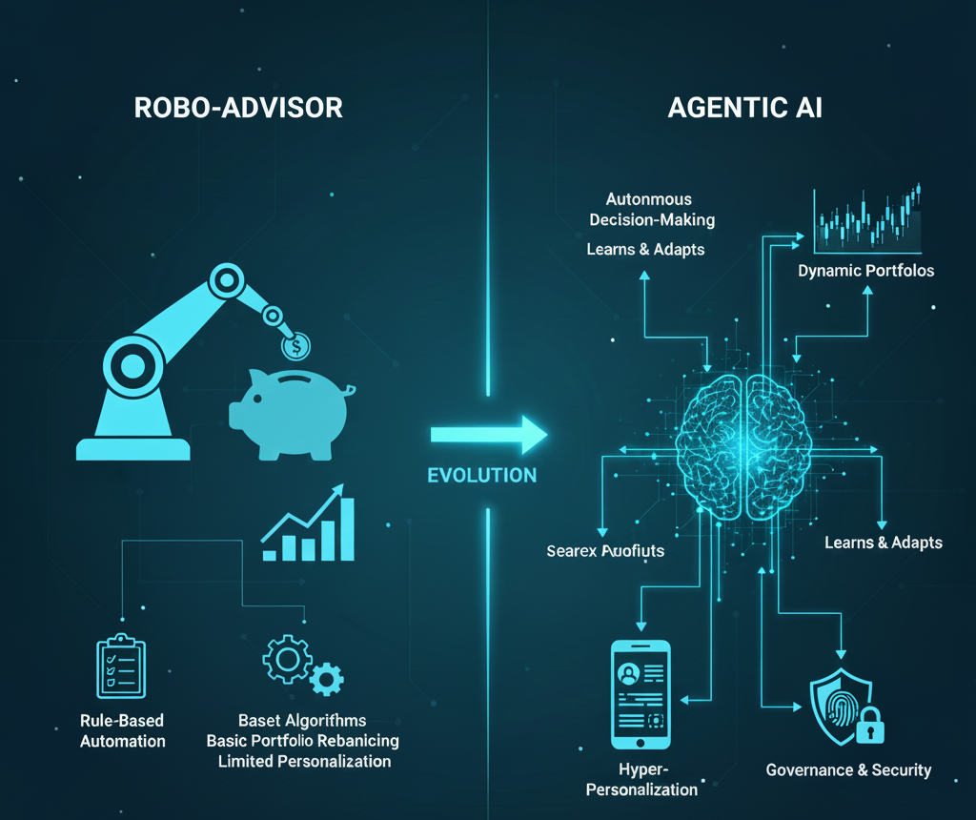
From Robo-Advisors to Agentic AI: The Revolution in Wealth Management
Foundation of Modern Automation (2024)
    In 2024, platforms such as Betterment and Wealthfront strengthened digital investing through automatic rebalancing and tax-loss harvesting, setting the baseline for the next era of AI-driven wealth management.
Shift to Agentic AI
    Wealth management is moving beyond passive robo-advice toward autonomous agentic AI that can plan, execute, and manage complex financial decisions—including dynamic portfolios and automated credit evaluations.
Hyper-Personalized Financial Services
    Generative AI enables real-time personalization at scale, offering smart savings alerts, customized credit offers, and adaptive financial plans tailored to each client’s behavior and financial footprint.
Governance, Risk & Digital Trust
    The rise of agentic AI demands strong AI oversight, human-override mechanisms, and secure digital-custody frameworks, especially when asset values depend on enforceable legal claims.

Slide 13
The Future of Financial Services
  The Future of Financing:
Streamlined Home Financing: Home purchases will become faster as mortgages are shared with multiple lenders in real estate markets.
Digital Financial Assistants (DFAs): DFAs will match borrowers with lending offers based on their financial profiles.
Growth of Crowdlending: Crowdlending will expand as platforms pool individual investments, safeguarded by credit default swaps.
Competitive Crowdlending: Low tech costs in matching and credit analysis will keep crowdlending competitive despite insurance expenses

Slide 14
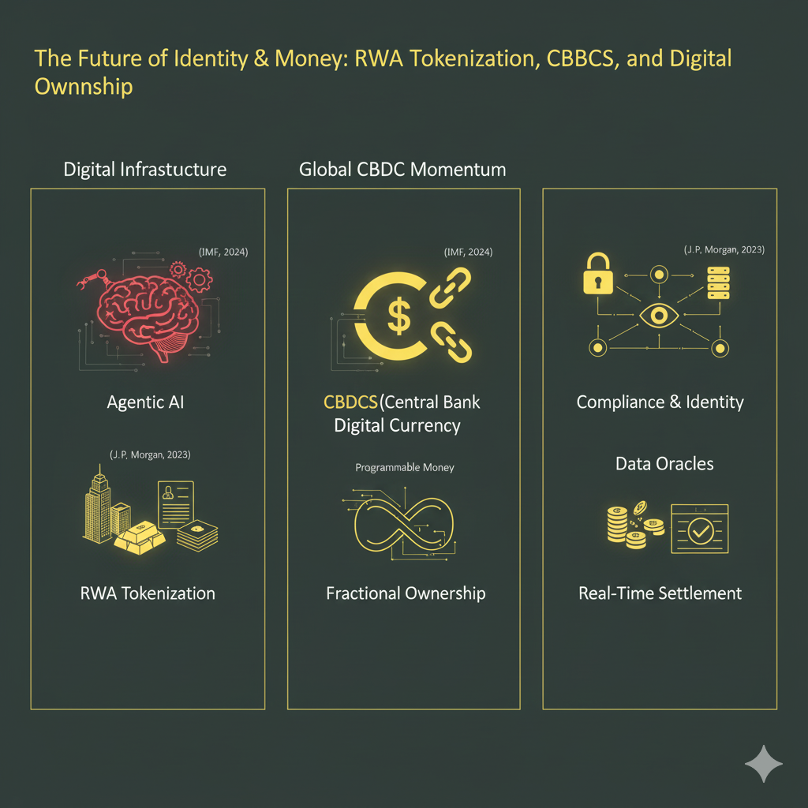
Global CBDC Momentum: Over 130 countries (≈98% of global GDP) are exploring CBDCs as a stable anchor for digital money (IMF, 2024).
Programmable Money: CBDCs and DLT enable automated, conditional payments through smart-contract functionality (BIS, 2023).
Tokenized Collateral: Institutions like J.P. Morgan’s Tokenized Collateral Network (TCN) allow near-instant transfer of tokenized MMF shares as collateral (J.P. Morgan, 2023).
Compliance & Identity: RWA tokenization requires strong AML/KYC alignment and new governance frameworks to balance transparency and privacy (WEF, 2023).
Data Oracles: Tokenized assets depend on secure off-chain data feeds (e.g., Chainlink) for valuation and proof-of-reserve (WEF, 2023).

Slide 15
The Future of Financial Services
  The Future of Money:
Electronic Currency Evolution: National banks are leveraging blockchain to issue electronic currencies.
Transparent Global Asset Databases: Governments will push for real-time tracking of financial flows via transparent databases.
Standardized Electronic Currencies: Central bank-controlled e-currencies like "ePounds" will become monetary management norms.
Balancing Transparency and Freedom: New governance will address the trade-off between financial transparency and privacy in a highly monitored world.

Slide 16
The Future of Financial Services
  The Future of Saving and Consumption
    DFAs will increasingly guide individuals in deciding whether to use available cash for saving or consumption based on user preferences and financial goals, leveraging online product information.
    A diverse ecosystem of independent and dependent DFAs will emerge, driven by different charging models, including usage fees and referral/advertising revenues.
    Users with long-term financial goals will rely on DFAs to make informed decisions, potentially delaying immediate spending in favor of saving, leading to a more sophisticated approach to the saving vs. consumption dilemma.

Slide 17
The Future Technologies & Applications in Fintech:
  Artificial Intelligence (AI):
Personalized Experiences: AI will customize financial services to enhance user interactions.
Risk and Fraud Management: AI will detect and prevent fraud while improving risk assessment.
Task Automation: AI will streamline financial operations, cutting costs and errors.
AI in Investments: Robo-advisors and AI trading systems will revolutionize investment strategies.

Slide 18
The Future Technologies & Applications in Fintech:
  Blockchain Technology
  Enhanced Security: By using a decentralized ledger, blockchain greatly reduces the risk of fraud and data breaches.
  Increased Transparency: Transactions recorded on blockchain are transparent and easily verifiable, building greater trust in financial processes.
  Cost and Time Efficiency: Blockchain cuts out intermediaries, leading to lower costs and faster transactions, especially in international dealings.
  Innovation in Services: It enables new financial services like smart contracts and decentralized finance, expanding the scope of fintech offerings.

Slide 19
The Future Technologies & Applications in Fintech:
  Cloud Computing
Efficient Data Management: Cloud computing supports large-scale data processing for trading, risk, and compliance.
Cost-Effective Resources: Subscription-based cloud models reduce costs and optimize global infrastructure usage.
Scalability and Security: Cloud solutions offer flexible storage, secure access, and automated backups for business continuity.

Slide 20
The Future Technologies & Applications in Fintech:
  Internet of Things (IoT):
  Real-Time Payments: IoT enabling instant transactions.
  Personalized Insurance: IoT devices providing data for tailored policies.
  Automated Trading: IoT sensors triggering stock market trades.
  Risk Management: IoT data enhancing fraud detection and prevention.
  Blockchain Integration: IoT devices leveraging blockchain for secure transactions.
  Smart Contracts: IoT triggering automated agreements in fintech.
  Data-Driven Lending: IoT providing insights for credit decisions.
  RegTech Solutions: IoT aiding in regulatory compliance.
  Biometric Security: IoT devices enhancing identity verification.
  Sustainable Finance: IoT data driving green investments.

Slide 21
The Future Technologies & Applications in Fintech:
  No-Code and Low-Code Platforms:
  Traditional Coding Challenges: Developing financial services traditionally required extensive coding and API integration, leading to high costs, long delays, and inflexibility in updates.
  Low-Code vs No-Code: Both approaches simplify development by removing complex coding requirements. Low-code needs some coding knowledge, while no-code doesn't require any, making it more accessible for businesses.
  Choosing the Right Platform: The choice between low-code and no-code depends on the project's complexity and the business's coding capability. Low-code suits simpler projects, while no-code is better for more complex, custom applications

Slide 22
From Financial Product Vendors to Solution Providers:
Banks as Solution Providers: Banks are shifting from selling products to offering comprehensive financial solutions using transactional data.
Tailored Financial Plans: Personalized plans replace broad product catalogues, addressing specific customer needs.
Innovation Potential: Banks leverage decades of data to create precisely timed, customized solutions.
Data-Driven Insights: Actionable insights from customer data enable effective, personalized financial offerings.

Slide 23
How Can Banks Best Leverage
Their Data Advantage?
Embracing Open Banking: Banks can adopt secure APIs to enable third-party innovations, inspired by tech giants like Apple and Google.
Middleware for Simplification: Middleware applications streamline core banking systems, facilitating developer access and fostering innovation.
Collaborating with FinTech: Partnering with FinTech platforms allows banks to leverage creativity, foster ecosystems, and create new revenue streams.

Slide 24
The Future of FinTech: A Tripartite
Innovation Ecosystem
Data Science Driving Innovation: Extracting insights from data helps create solutions based on customer needs.
Personalized Solutions with Machine Learning: Machine learning tailors financial products to customer goals and behaviors.
Collaborative Ecosystem: Banks, tech companies, and customers work together, with banks supplying essential data and services.

Slide 25
Why FinTech Banks Will Rule the World
Resistance to Change: Traditional banks lag in adapting to the digital revolution, relying on regulatory protections.
Declining Trust: Post-2008, customers increasingly prefer alternative finance, viewing banks as self-interested.
Selective FinTech Investments: Banks focus on startups that complement their products, avoiding direct competition.

Slide 26
Why FinTech Banks Will Rule the World
Shifting FinTech Models: FinTechs are evolving from peer-to-peer to marketplace models, leveraging institutional liquidity.
Marketplace Banking Growth: FinTechs now offer core banking via third-party products and APIs, bypassing traditional banks.
Challenges for FinTech Banks: Key hurdles include tech development, licensing, and customer acquisition.
Disruptive Potential: Agile and innovative, FinTech banks can challenge traditional banks with modern systems and strong reputations.

Slide 27
Banks Partnering with FinTech Start-ups to Create an Integrated Customer Experience
Evolving Entrepreneur Stereotype: Entrepreneurs now come from diverse backgrounds, including women in Africa and banking professionals.
New Innovation Models: Banks are partnering with start-ups, moving beyond traditional vendor-client relationships.
Need for Adaptation: Growing FinTech investments signal a rising impact, pushing banks to evolve.
FinTech's Disruptive Potential: Venture capitalists see FinTech as poised to transform finance, akin to changes in media, travel, and retail.

Slide 28
Banks Partnering with FinTech Start-ups
Data Beyond Firewalls: Banks need to leverage valuable data available on the open internet.
Understanding APIs: APIs enable access to external data, resources, and algorithms, often from FinTech start-ups.
Collaborative Partnerships: Working with FinTech start-ups can be mutually beneficial, despite potential competition.
Marketplace Strategies: Platforms like Lending Club use network effects to attract data-sharing partners, benefiting banks and firms.

Slide 29
Banks Partnering with FinTech Start-ups
Creating Value with Algorithms: Banks can enhance customer satisfaction by developing smart algorithms and intuitive user experiences.
Collaboration with Marketplaces: Partnering with networked marketplaces enables banks to leverage data and network effects.
Focus on Services: Banks should prioritize service-based models, following examples like NYSE and NASDAQ, which add value through services atop marketplace APIs.

Slide 30
Banks Partnering with FinTech Start-ups
Brand and Agility Combo: Combining a strong brand with startup agility gives banks a competitive edge.
Listening to Customers: Addressing marketplace users' pain points improves the customer experience.
The Great Rebundling: Banks can succeed by integrating fragmented services into seamless experiences, anticipating customer needs with new technologies.

Slide 31
Banks Partnering with FinTech Start-ups
  Price Competition in Asset Allocation: Robo-advisors are driving down the cost of asset allocation services, making it a commodity. Competing at this level with a high-cost structure is not advisable.
  Innovation in Data Science and Personalization: Wealth management firms have an opportunity to innovate in data science, personalization, and reporting services, moving away from commodity offerings.

Slide 32
Banks Partnering with FinTech Start-ups
  Race to Provide Complementary Services: Some robo-advisors aim to avoid consolidation by moving up the value stack and rebundling complementary wealth management services. This is a competitive race.
  Emergence of Micro Asset Managers: Micro asset managers, often focused on a specific asset class, are emerging as early adopters of marketplaces like Lending Club and Angel List. They offer low-cost and agile investment strategies, challenging traditional asset managers.

Slide 33
FinTech Impact on Retail Banking
Regulatory Overload: Banks are heavily focused on compliance, with 70% of budgets spent on regulation, according to Accenture.
Changing Consumer Habits: The digital economy's growth has shifted consumer expectations and behaviors.
Rising Costs: Banks face increasing IT expenses and the challenge of maintaining large branch networks.

Slide 34
FinTech Impact on Retail Banking
Revenue Pressure: Regulatory demands and digital shifts have reduced retail banking revenues, despite cost-cutting efforts.
Legacy IT Hurdles: Outdated IT systems, consuming 14% of costs, limit digital transformation.
Reluctance to Change: Fear of disruption and complexity keeps banks focused on incremental innovation rather than radical transformation.

Slide 35
FinTech Impact on Retail Banking
Outdated Full-Service Models: Traditional banking models fail to meet modern market demands, requiring bold innovation.
Misaligned Financial Focus: Banks prioritize branch networks over transformative R&D, hindering progress.
High Customer Expectations: Digital advances, driven by tech giants, have raised customer standards, increasing IT costs.
Costly Complexity: Outdated IT systems and complex offerings consume 14% of banking expenses, mostly for maintenance.

Slide 36
Summary
Understanding the Impact of Emerging Technologies on Financial Services
Academic Analysis of Key Factors Shaping FinTech's Future
Exploring the Future Landscape of Financial Services
Transitioning from Product Vendors to Solution Providers
Maximizing Data Advantage for Banks

Slide 37
Summary
Analyzing the Tripartite Innovation Ecosystem in FinTech
Enhancing Customer Experience through Banks' Collaboration with FinTech Start-ups
Strategic Collaborations between Banks and FinTech Start-ups
Impact of FinTech on Retail Banking
NEW Focus: Examining the disruptive potential of Agentic AI and Real-World Asset (RWA) Tokenization across banking operations and market infrastructure.

Slide 38
Discussion
  How are digital and mobile payments, along with cryptocurrencies, changing the global payment landscape?
  What are the key developments in FinTech business models, particularly the evolution towards marketplace banking, and what challenges and potential disruptive impacts do these changes pose for traditional banking systems?
  How will Digital Financial Assistants (DFAs) shape the future of saving and consumption?

Slide 39
References
Agur, I., Villegas-Bauer, G., Mancini-Griffoli, T., Martinez Peria, M. S., & Tan, B. J. (2025). Tokenization and financial market inefficiencies (FinTech Note 2025/001). International Monetary Fund. https://www.elibrary.imf.org/view/journals/063/2025/001/article-A001-en.xml
Barclays Group Innovation & Partnerships Office. (2025). Fintech embraces GenAI: A transformative year ahead in 2025. Barclays. https://home.barclays/content/dam/home-barclays/documents/misc/Fintech_Embraces_GenAI.pdf Barclays+1
World Economic Forum. (2025). Artificial intelligence in financial services (White paper, in collaboration with Accenture). World Economic Forum. https://reports.weforum.org/docs/WEF_Artificial_Intelligence_in_Financial_Services_2025.pdf
IRIS Business Services. (2025). Key trends in RegTech for 2025: AI, blockchain & real-time reporting. IRIS Business.
Xia, N., Zhao, X., Yang, Y., Li, Y., & Li, Y.-c. (2025). Exploration on Real-World Assets and Tokenization. arXiv. https://arxiv.org/abs/2503.01111

Slide 40


Thank You

