Slide 1


English Course- Advanced Level
Prepared by
Ahmed Soliman

Slide 2



Lecture 2
www.midocean.ae

Slide 3
Lecture Outline:
Warm-up: 2 Truths and a Lie
Listening: College Classes
Grammar: If Conditionals
Reading: The Bermuda Triangle
Speaking: An event/occasion that made you happy
www.midocean.ae

Slide 4
Warm-up
2 Truths and a Lie
www.midocean.ae

Slide 5
Listening
(College Classes)
www.midocean.ae

Slide 6
Vocabulary and Sample Sentences
intercultural (adjective): occurring between two or more cultures
– In this class, we will discuss intercultural relationships and marriages.
syllabus (noun): an outline of a course or class
– Please review the syllabus tonight, and we will review it tomorrow.
be determined (verb): be the reason for a decision
– Your grades will be determined by your performance on quizzes and tests.
midterm (test) (noun): an exam given at the middle of a school year
– The midterm will be next Monday, so please prepare.
periodic (adjective): happening regularly over a period of time
– The teachers give periodic quizzes to check your understanding.
objective (noun): a goal or purpose
– What are the main objectives of this class?
www.midocean.ae

Slide 7
Listen to the recording and answer the questions.
https://www.esl-lab.com/academic-english/college-classes/
1- The name of the class is ______.
Intercultural Commerce
Intercultural Communication
International Cooperation
2- The class meets from ______.
3:05 p.m. to 4:15 p.m.
3:15 p.m. to 4:15 p.m.
3:15 p.m. to 4:50 p.m.
www.midocean.ae

Slide 8
3- On average, how often will the class meet in the research lab during the last part of the course?
once a month
twice a month
three times a month
4- If today is Tuesday, when should the textbook be available in the bookstore?
on Thursday
today after class
on Wednesday
www.midocean.ae

Slide 9
5- A student's grade is determined by a students' participation, quizzes, and ______.
a research project
lab assignments
attendance
www.midocean.ae

Slide 10
Listening Script
Teacher: Okay, Okay, let’s begin. Hello, everyone. My name’s Karl Roberts, and I’ll be your teacher for this class, Intercultural Communication 311.
To begin with, uh, please look at the syllabus in front of you. You should all have one by now, I think. Um, this class meets on Tuesdays and Thursdays from 3:15 to 4:50. We will be meeting in this room for the first half of the course, but we will be using the research lab every other week on Thursday in room 405 during the last two months of the class.
Uh, this is the text for the class, Beyond Language. Unfortunately, the books haven’t come in yet, but I was told that you should be able buy them at the bookstore the day after tomorrow. Again, as you see on your course outline, grading is determined by your work on a midterm and final test, periodic quizzes, a research project, and classroom participation.
www.midocean.ae

Slide 11
My office hours are from 1:00 to 2:00 on Wednesdays, and you can set up an appointment to meet with me at other times as well. Okay, let me explain a little bit more about the class and its objectives.
www.midocean.ae

Slide 12
Grammar
(If Conditionals)
www.midocean.ae

Slide 13
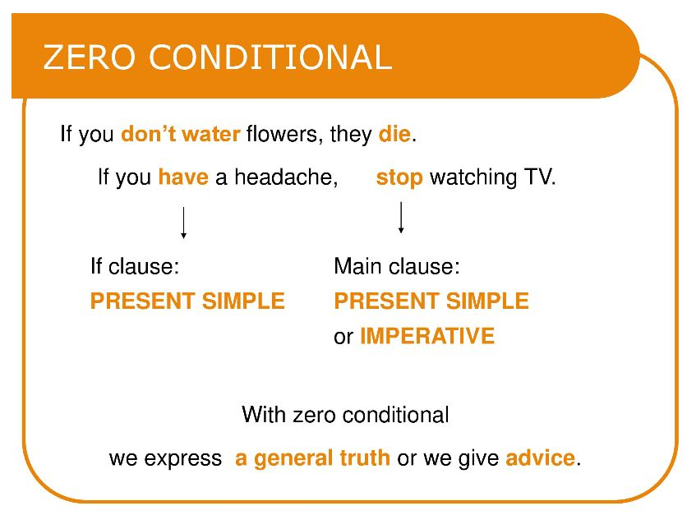
Chapter
02
www.midocean.ae

Slide 14
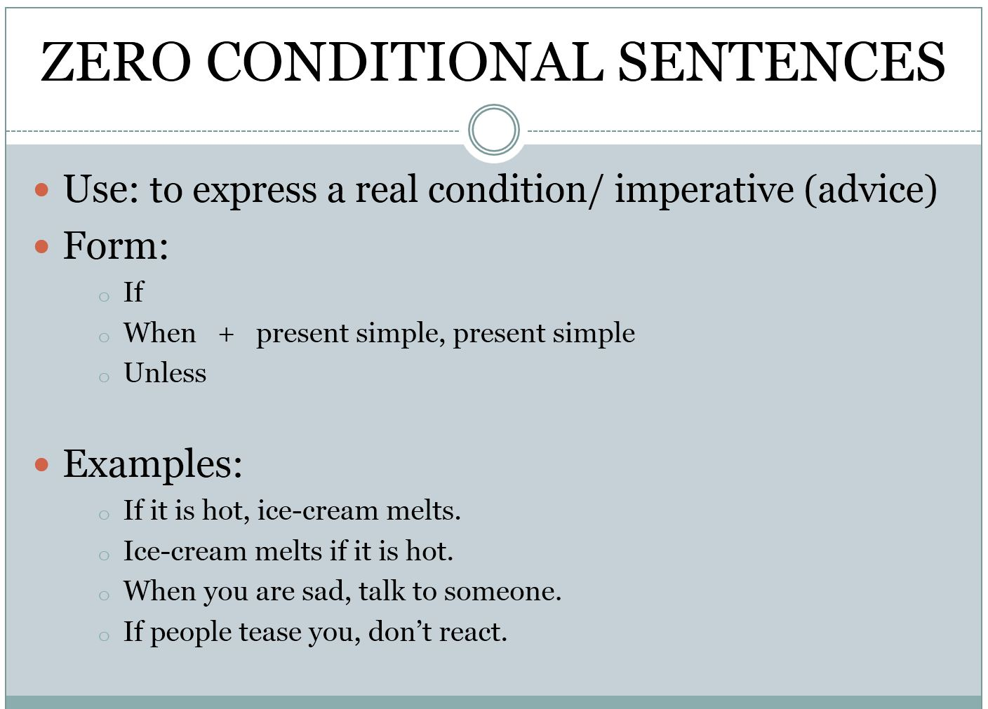
Chapter
02
www.midocean.ae

Slide 15
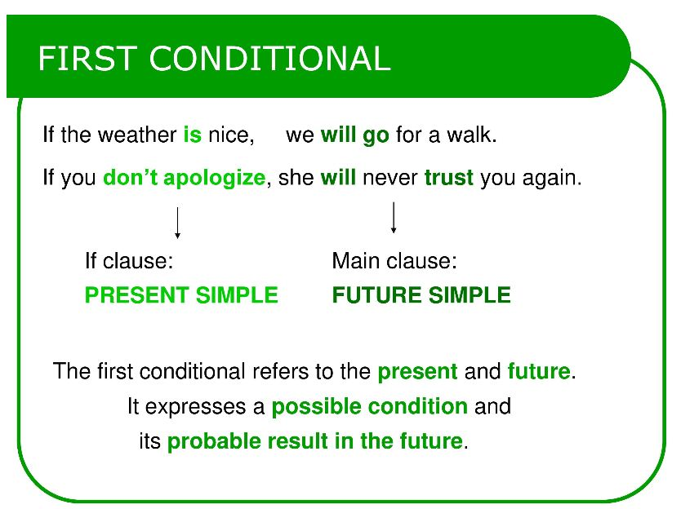
Chapter
02
www.midocean.ae

Slide 16
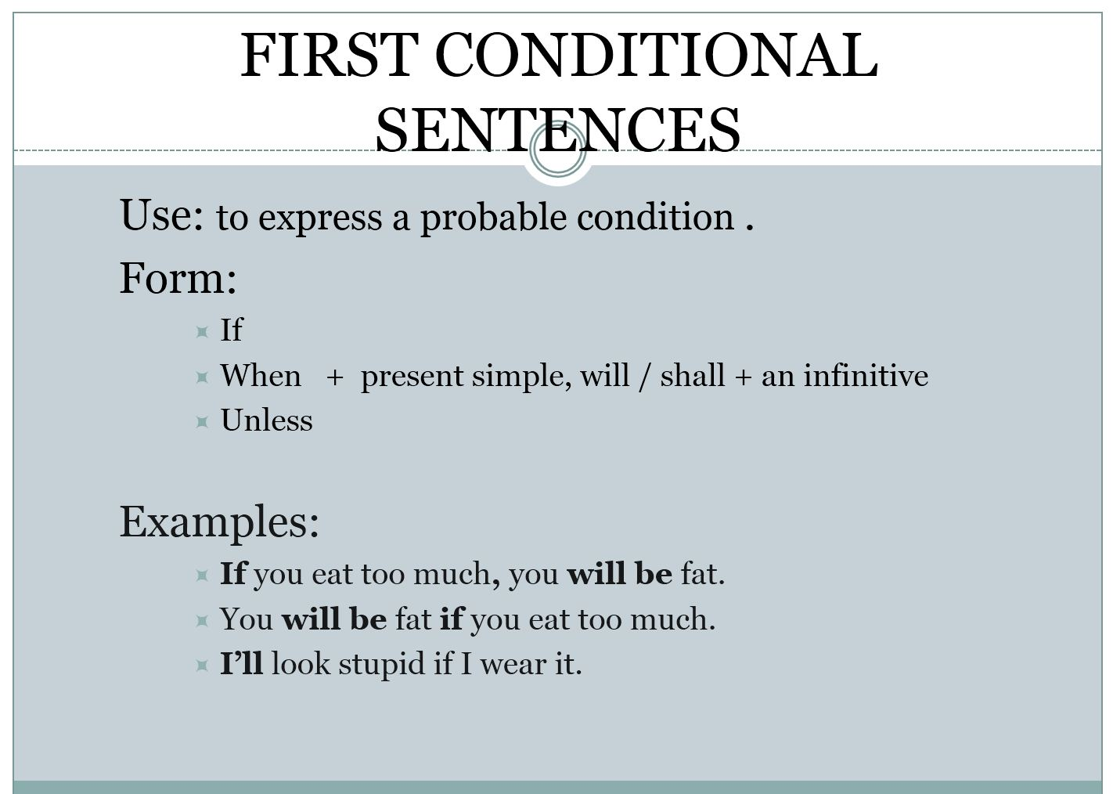
Chapter
02
www.midocean.ae

Slide 17
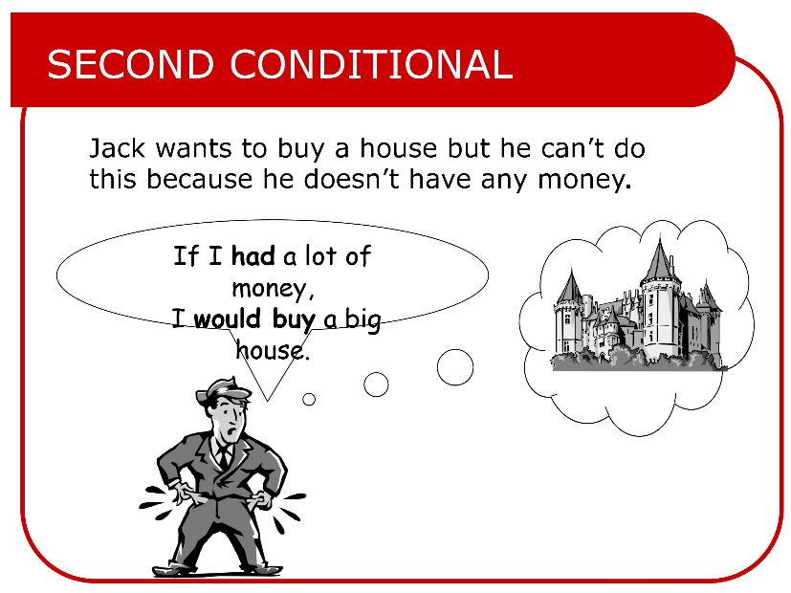
www.midocean.ae

Slide 18
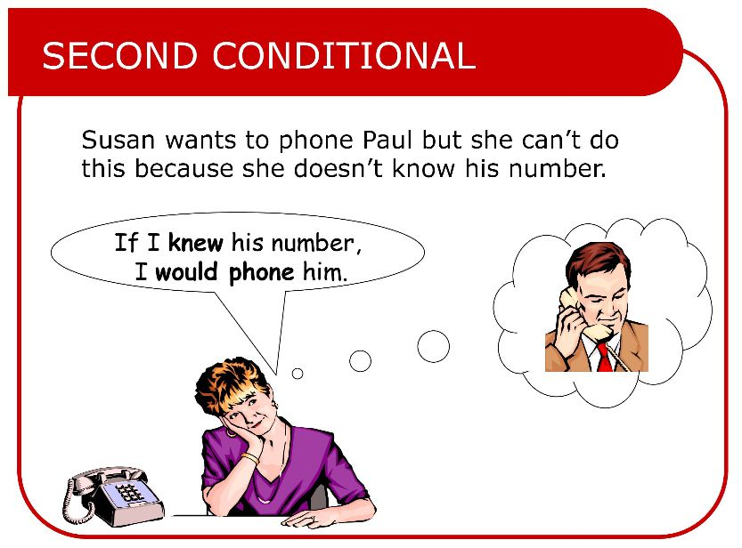
www.midocean.ae

Slide 19
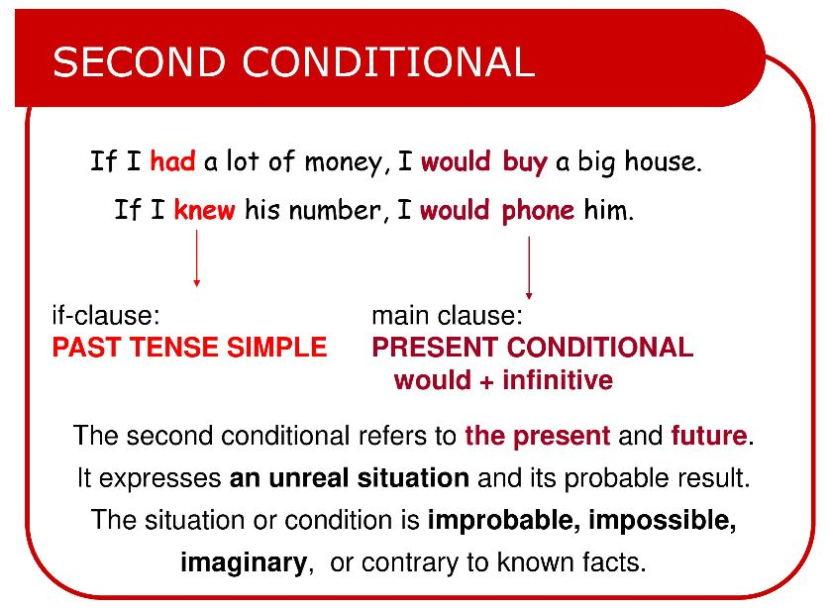
www.midocean.ae

Slide 20
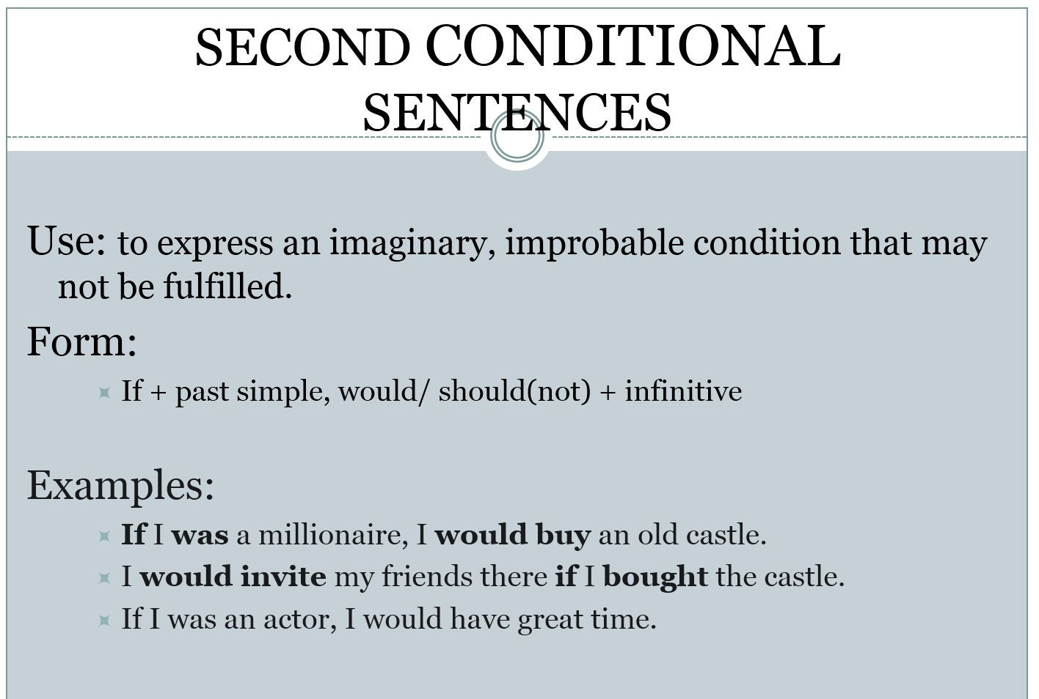
www.midocean.ae

Slide 21
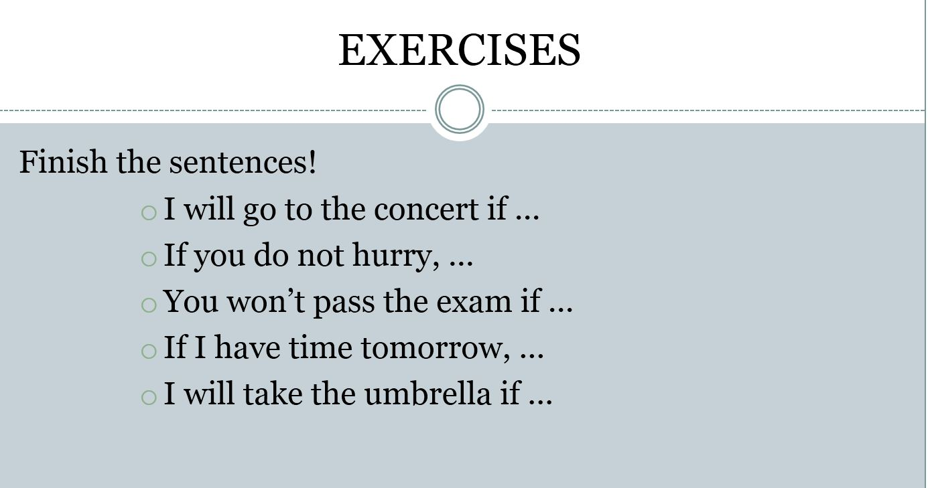
www.midocean.ae

Slide 22
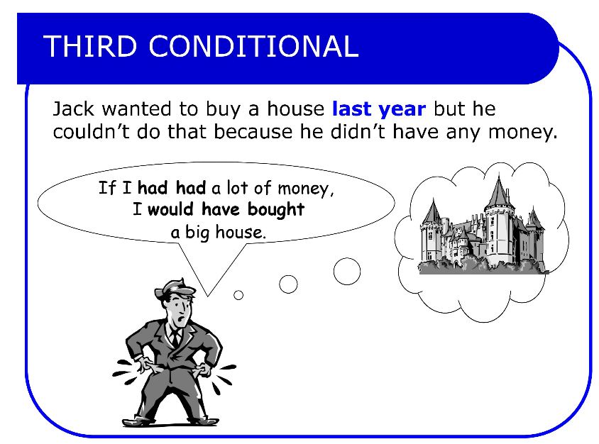
www.midocean.ae

Slide 23
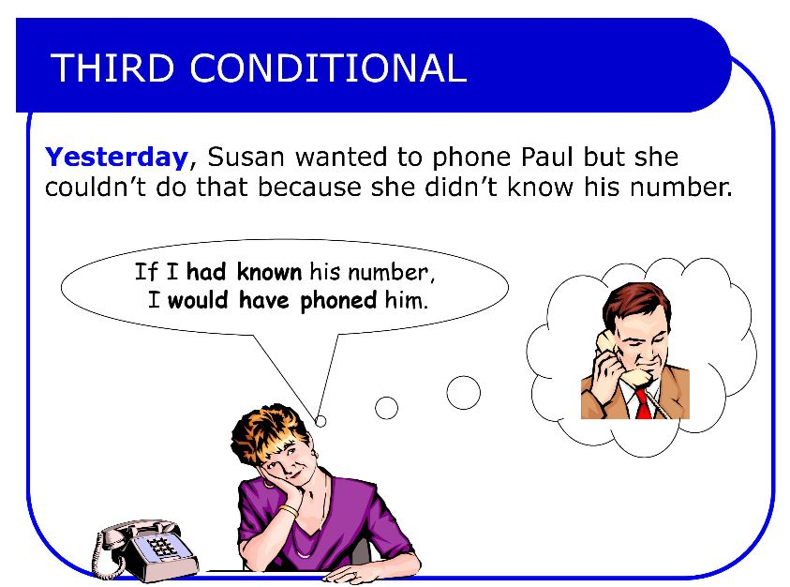
www.midocean.ae

Slide 24
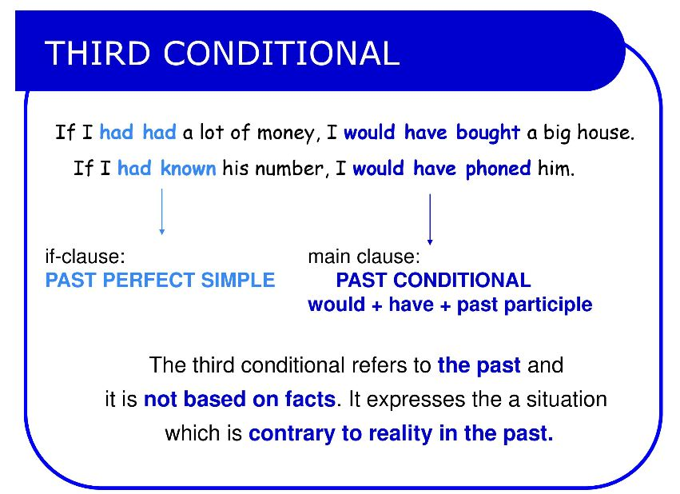
www.midocean.ae

Slide 25
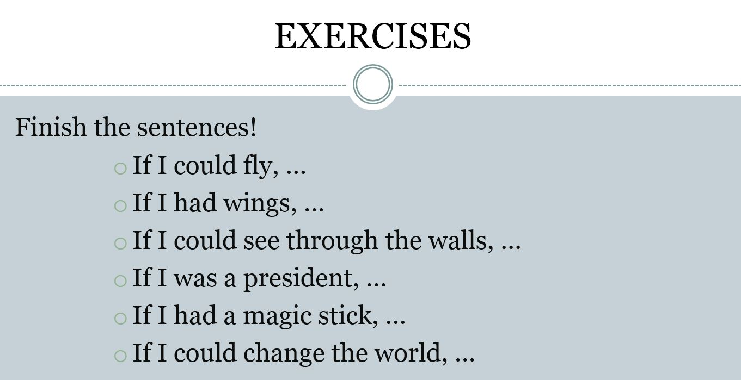
www.midocean.ae

Slide 26
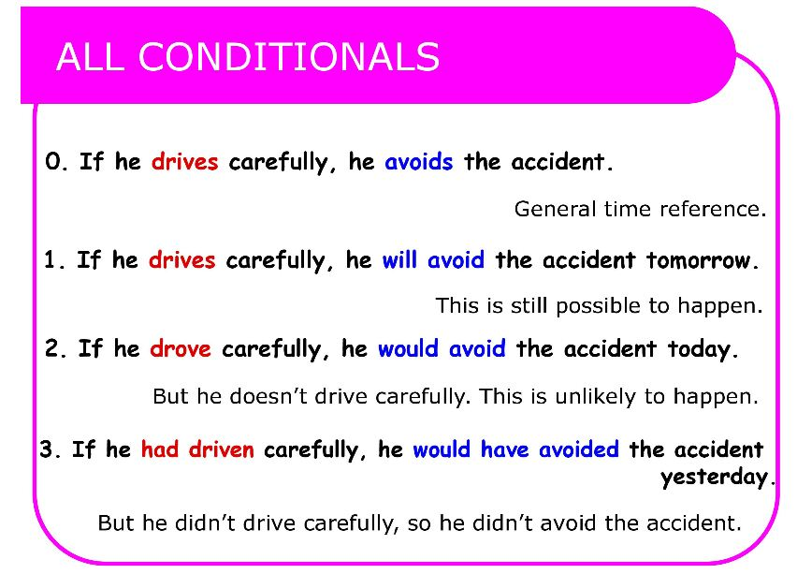
www.midocean.ae

Slide 27
Reading
(The Bermuda Triangle)
www.midocean.ae

Slide 28
Read the following passage, and then choose the best answer
The legend of the mysterious Bermuda Triangle is one of the strangest of all sea stories. The Bermuda Triangle is a section of the Atlantic Ocean off the southeastern coast of Florida. A line drawn from Florida to Bermuda, then to Puerto Rico and back to Florida, forms a rough triangle. Within this triangle, or very near it, more than fifty ships and airplanes have vanished or disappeared.
The legend began in 1945, when five American Navy bombers vanished while flying over the area. They were flying during the day, under clear weather conditions. The commander of the five planes was talking to his base by radio. He announced that they seemed to be lost. After that, the planes were never
www.midocean.ae

Slide 29
3. In 1948, an airliner flying toward Miami vanished over the Triangle. A few months later, another plane disappeared. In 1950, still another airplane flew into the Triangle, never to be seen again. A ship named The Sandra sailed into the triangle and vanished. In 1953, another ship, sailing north of the Triangle, sent out distress signals that were suddenly cut off. Ships and planes were sent to search for the ship, but they never found it.
4- There have been many explanations for these mysterious happenings.Some people believe that there is a strange force at work in this part of the ocean. Some suggest there may be some kinds of `hole' in the triangle that ships and planes go through into another world. Others think that UFO's steal the planes, ships, and their crews, and take them away.
www.midocean.ae

Slide 30
5. Some people don't believe that there is anything extraordinary about the Bermuda Triangle. Thousands of ships and airplanes have passed through the Triangle without encountering trouble. The Triangle isn't the only place where ships and planes have vanished. Many ships have vanished all over the world's oceans. Many reasons exist for such things happening, such as sudden storms or seaquakes. These are just some of the dangers of going to sea. The Bermuda Triangle just happens to be a part of the sea where there have been many disasters. Whatever the reasons for these strange happenings, the legend of the Bermuda Triangle remains the strangest of all sea tales.
www.midocean.ae

Slide 31
Paragraph 1 is mainly talking .............................
a. about the location of Bermuda Triangle
b. why Bermuda Triangle is mysterious
c. why Bermuda Triangle is a legend
d. about ships and airplanes
2. The underlined word "bombers" in paragraph 2 probably means............
a. ships
b. airplanes
c. conditions
d. stories3.
www.midocean.ae

Slide 32
3. According to Paragraph 2, the total number of the American airplanes that disappeared in 1945 in Bermuda Triangle was................
a. 5
b. 4
c. 6
d. 7
4. The pronoun " it" in paragraph 2 refers to..................
a. The search plane
b. 1945
c. The five bombers
d. Radio
www.midocean.ae

Slide 33
5. Paragraph 3 is mainly talking about the .........................
a. why the ships and airplanes disappeared in Bermuda Triangle
b. the number of the ships and airplanes which disappeared in Bermuda Triangle
c. how ships and airplanes disappear in Bermuda Triangle
d. the ships and planes which were sent to search for the lost ones
6. The main idea of Paragraph 4 is........................
a. giving explanations why ships and airplanes disappear in Bermuda Triangle
b. there is a strange force at work in this part of the ocean
c. there may be some kinds of `hole' in the Triangle
d. UFO's steal the planes, ships, and their crews, and take them away
www.midocean.ae

Slide 34
Speaking
(An event/occasion that made you happy)
www.midocean.ae

Slide 35
Talk about an event/occasion that made you happy.
•What was it?
•When did it happen?
•Where did it happen?
•Why did it make you overjoyed?
www.midocean.ae

Slide 36




Thank You

