Slide 1




HCIA-AI Huawei
Eng.Eman Elgallad
Lecture 6 - Reinforcement Learning & Lab

Slide 2
Reinforcement Learning
Lecture
06

Slide 3

Introduction
Lecture
06
Reinforcement Learning (RL) is a machine learning paradigm where an agent learns to make decisions by interacting with an environment to maximize cumulative rewards.
RL is inspired by how humans learn through trial and error and is widely applicable in various fields.

Slide 4
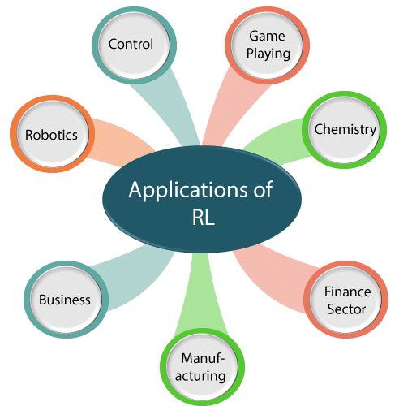
Applications of RL
Lecture
06
Robotics: RL is used to train robots to perform complex tasks like picking and placing objects.
Gaming: RL powers game-playing agents like AlphaGo and enables NPCs to adapt and learn from player interactions.
Finance: RL models optimize trading strategies and portfolio management.
Healthcare: RL assists in personalized treatment plans and medical resource allocation.

Slide 5
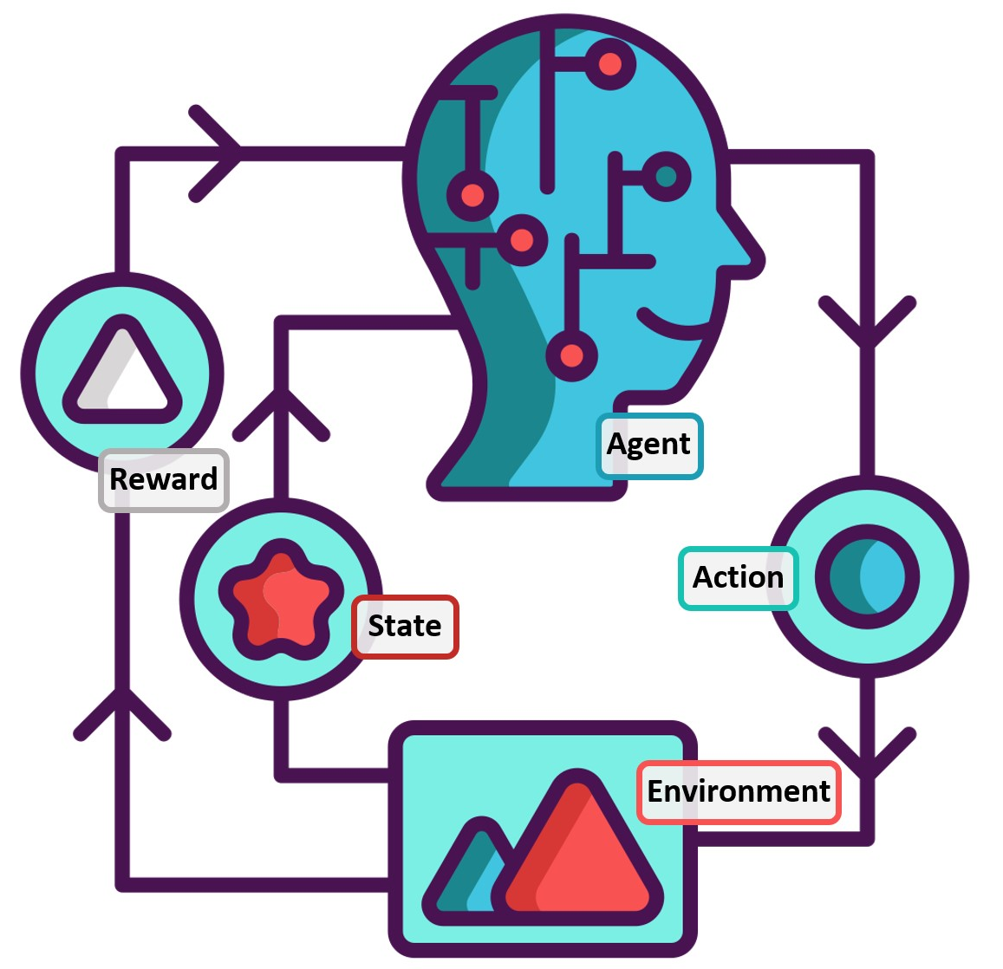
Basic Concepts
Lecture
06
Agent: The decision-maker that interacts with the environment.
Environment: The external system the agent interacts with.
Actions: Choices made by the agent that affect the environment.
Rewards: Feedback from the environment to evaluate agent's actions.
States: Representations of the environment's current condition.
Markov Decision Process (MDP): A mathematical framework to model RL problems with Markov property (future depends only on the present state).

Slide 6
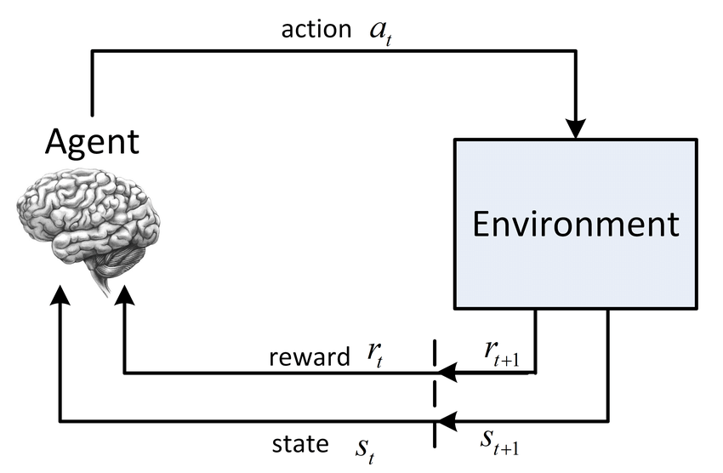
Agent-Environment Interaction
Lecture
06
Agents interact with environments by taking actions and receiving rewards.
RL is an iterative process where the agent learns from interactions over time to improve decision-making.

Slide 7
Elements of Reinforcement Learning
Lecture
06
Policy: Strategy determining agent's actions.
Value Functions: Assess desirability of states or state-action pairs.
Q-Learning: Algorithm to learn optimal actions using Q-values.

Slide 8
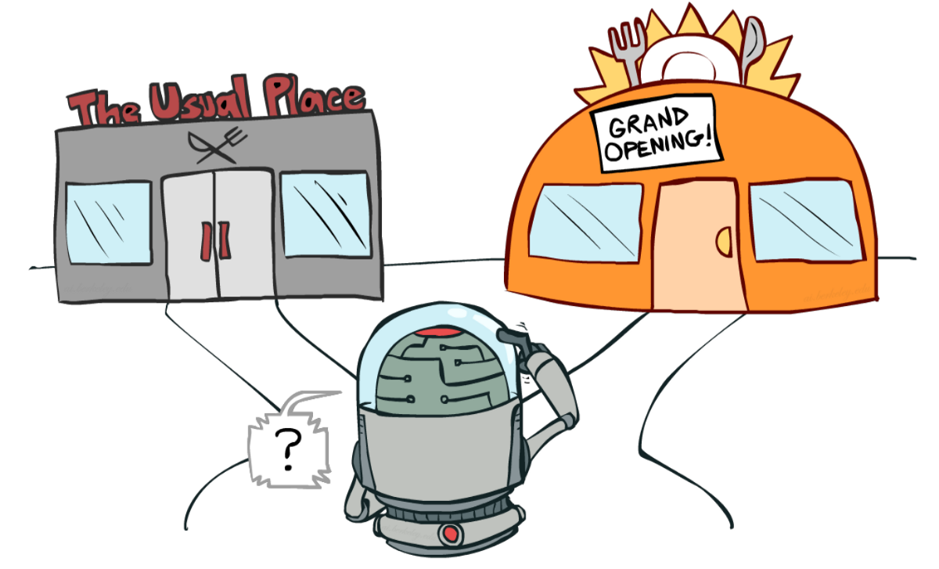
Exploration and Exploitation
Lecture
06
Exploration: Trying new actions to discover their rewards.
Exploitation: Choosing known actions for higher rewards.
Balancing exploration and exploitation is crucial for effective learning.
Strategies: ε-greedy, softmax, upper-confidence bound (UCB).

Slide 9
Reward Maximization
Lecture
06
RL aims to maximize cumulative rewards over time.
Discount Factor: Balances immediate and future rewards, enabling long-term planning.

Slide 10
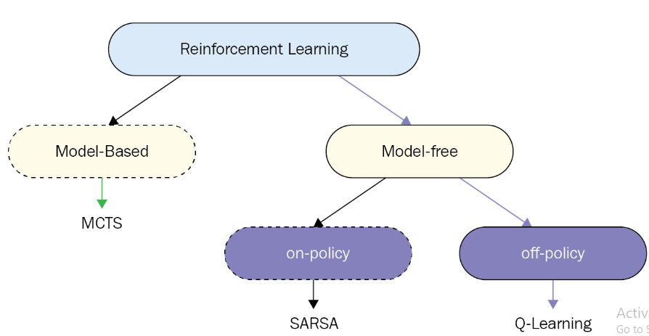
Types of RL
Lecture
06
Model-Free vs. Model-Based: Learning directly from interactions vs. learning a model of the environment.
On-Policy vs. Off-Policy: Updating based on current policy vs. using separate policies for learning and acting.

Slide 11
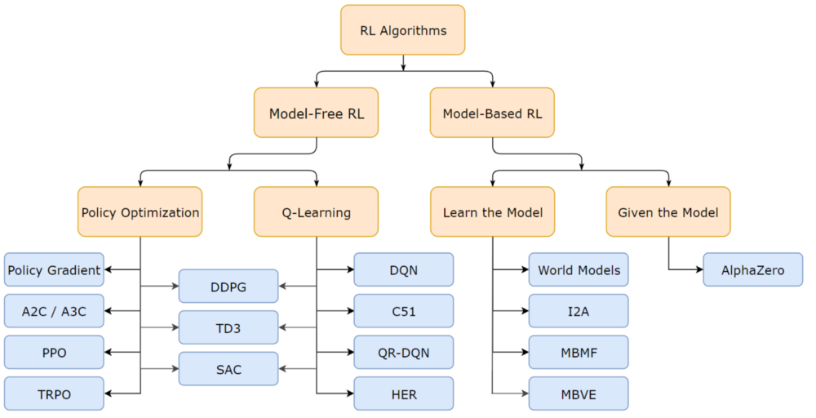
Lecture
06
Q-Learning: Off-policy algorithm to learn optimal Q-values.
SARSA: On-policy algorithm for estimating Q-values.
Deep Q-Networks (DQN): Combines Q-learning with deep neural networks for complex environments.
Policy Gradient Methods: Directly optimize policies using gradient ascent.
Actor-Critic: Combines value-based and policy-based approaches.

Slide 12
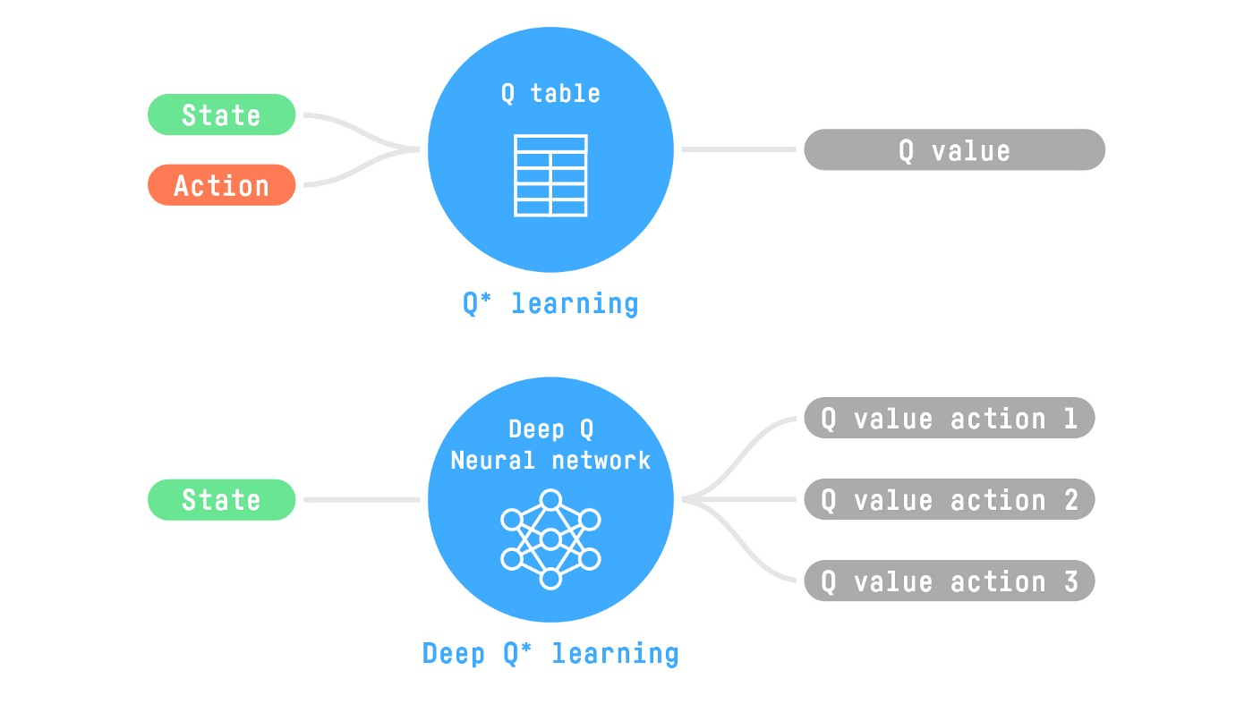
Lecture
06
Integration of neural networks with RL enables handling high-dimensional inputs and complex tasks.
Deep Q-Networks (DQN): Uses deep networks to approximate Q-values, enabling learning from raw sensory data.

Slide 13
Challenges and Future Directions
Lecture
06
Challenges: Exploration in large state spaces, sample efficiency, safety concerns.
Future Trends: Transfer learning, meta-learning, multi-agent RL, human-AI collaboration.

Slide 14
Real-world Applications
Lecture
06
Game Playing: AlphaGo's mastery of Go, Dota 2 AI.
Robotics: Robotic arms, drones, autonomous vehicles.
Autonomous Driving: Training vehicles to navigate complex environments.
Recommendation Systems: Personalized content recommendations.
Healthcare: Personalized treatment plans, drug discovery.

Slide 15
Ethical Considerations
Lecture
06
Bias: RL models can perpetuate biases present in data.
Fairness: Ensuring equitable decisions and outcomes.
Unintended Consequences: RL agents might exploit loopholes to achieve high rewards.

Slide 16
Conclusion
Lecture
06
Reinforcement Learning is a powerful paradigm for decision-making in various domains.
It involves agent-environment interaction, policy learning, and value estimation.
RL has led to groundbreaking applications and continues to drive AI research.
Encourage students to explore RL further and contribute to its exciting advancements.

Slide 17

Working Environment:
Lecture
06
What is Colab?
Google Colab, short for Collaboratory, is a free, cloud-based platform provided by Google that allows you to write and execute Python code in a web-based environment. It's designed to make it easier for individuals, especially students, researchers, and developers, to work with code, particularly machine learning and data science projects.
Cloud-Based Environment: Colab provides a virtual workspace where you can write and run Python code without needing to install anything on your own computer. All the computation happens on Google's servers.
Notebooks: In Colab, you work with documents called "notebooks." These notebooks are like interactive documents that can contain both code and explanatory text. It's a great way to combine code, comments, and visualizations.

Slide 18
Colab Features:
Lecture
06
Python Environment: Colab supports Python, one of the most popular programming languages for data analysis and machine learning.
Pre-installed Libraries: It comes with many common libraries like TensorFlow, PyTorch, and NumPy, making it convenient for machine learning projects.
Interactive Code: You can write and run code cells individually, which allows for quick testing and debugging.
Rich Text: You can add formatted text, images, and even equations to your notebook to provide context and explanations.
Visualizations: Colab supports inline plotting, so you can see graphs and charts right within your notebook.
Data Storage: You can upload and store datasets in your Google Drive, which can be easily accessed from your Colab notebooks.
Collaboration: Since it's on the cloud, you can easily share your Colab notebooks with others for collaboration.

Slide 19
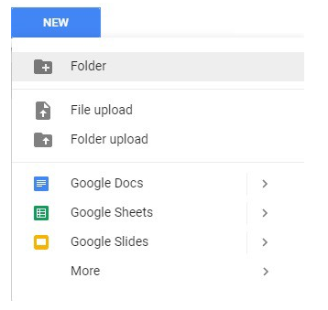
Getting Started with Colab:
Lecture
06
To start using Colab, you need a Google account. (Gmail).
Creating Folder on Google Drive
Since Colab is working on your own Google Drive, you first need to specify the folder you’ll work in. Give the folder a name on your Google Drive. You can use a name or choose the default Colab Notebooks folder instead of the named folder.

Slide 20
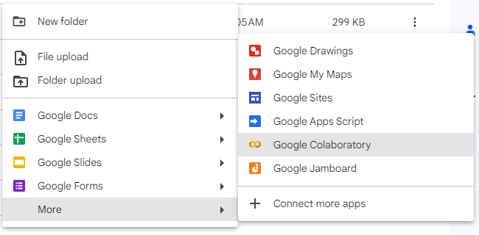
Getting Started with Colab:
Lecture
06
Creating New Colab Notebook
Create a new notebook by Right click > More > Colaboratory
Another way :
go to the Google Colab website. And create a new notebook from scratch or upload existing notebooks.
Write your Python code in the code cells and use text cells to explain your code or provide documentation.

Slide 21
Lecture
06
Running Code:
Click on a code cell to select it.
Press Shift + Enter or click the Play button to run the code in the cell.
The output of your code will be displayed below the cell.
Saving and Sharing:
Colab notebooks are automatically saved to your Google Drive.
You can also download a copy of your notebook in different formats (e.g., .ipynb, .py) to share or save locally.

Slide 22
Unsupervised Learning Lab
Let’s Practice On Colab
Lecture
06
https://drive.google.com/file/d/1NDggKsT08xsmr08XNwBMFrB4JacCzneL/view?usp=sharing

Slide 23
Supervised Learning Lab
Let’s Practice On Colab
Lecture
06
https://colab.research.google.com/drive/1mxADwMZldHi1e8aINCalILKXT333ZXC5?usp=sharing

Slide 24


