Slide 1
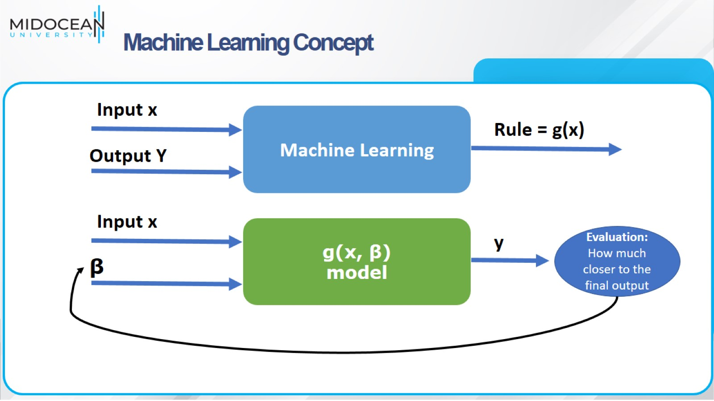
Machine Learning Concept

Slide 2
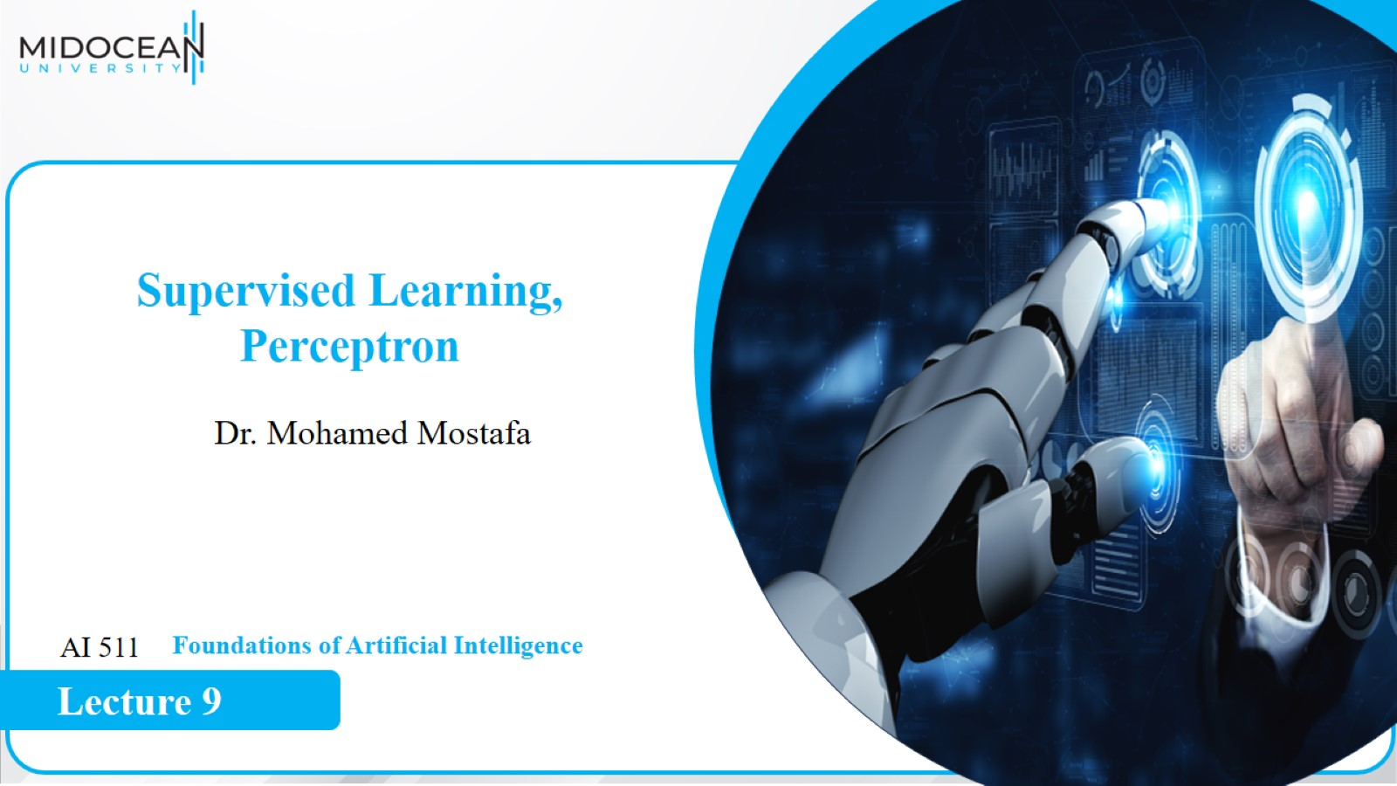

Slide 3
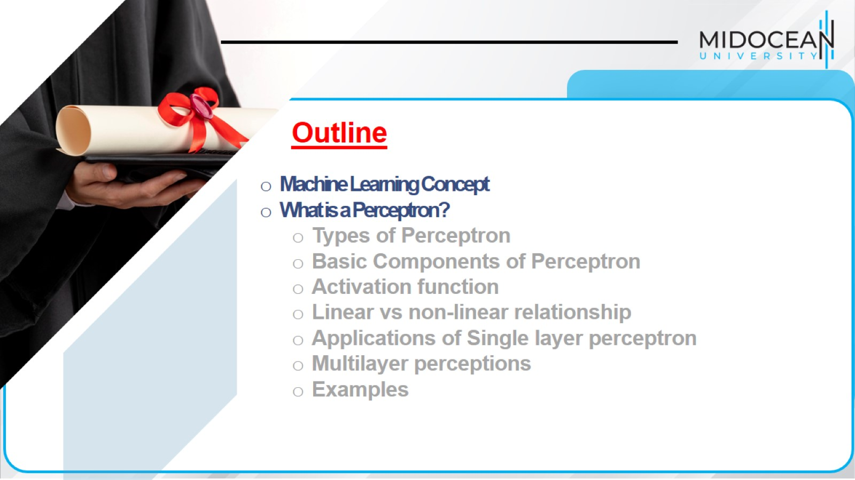

Slide 4
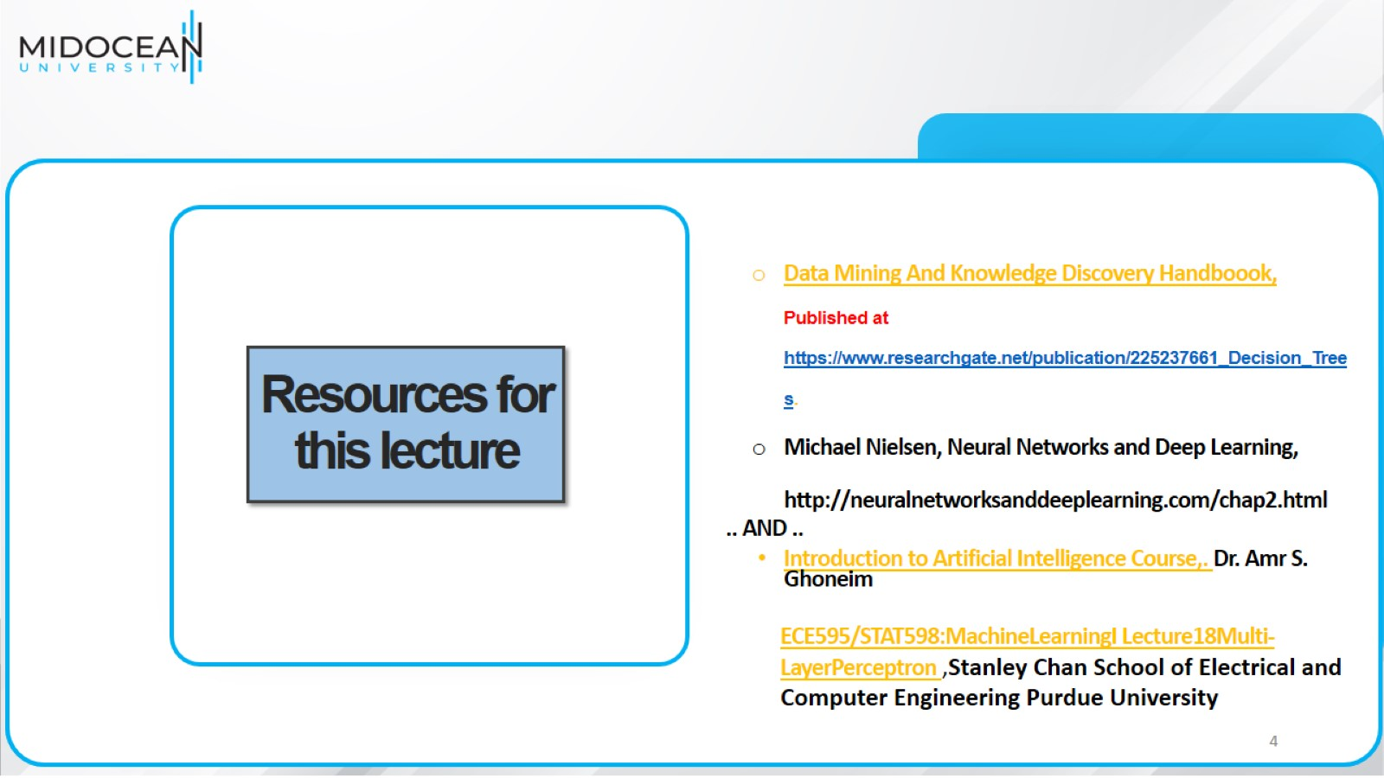
Resources for this lecture

Slide 5
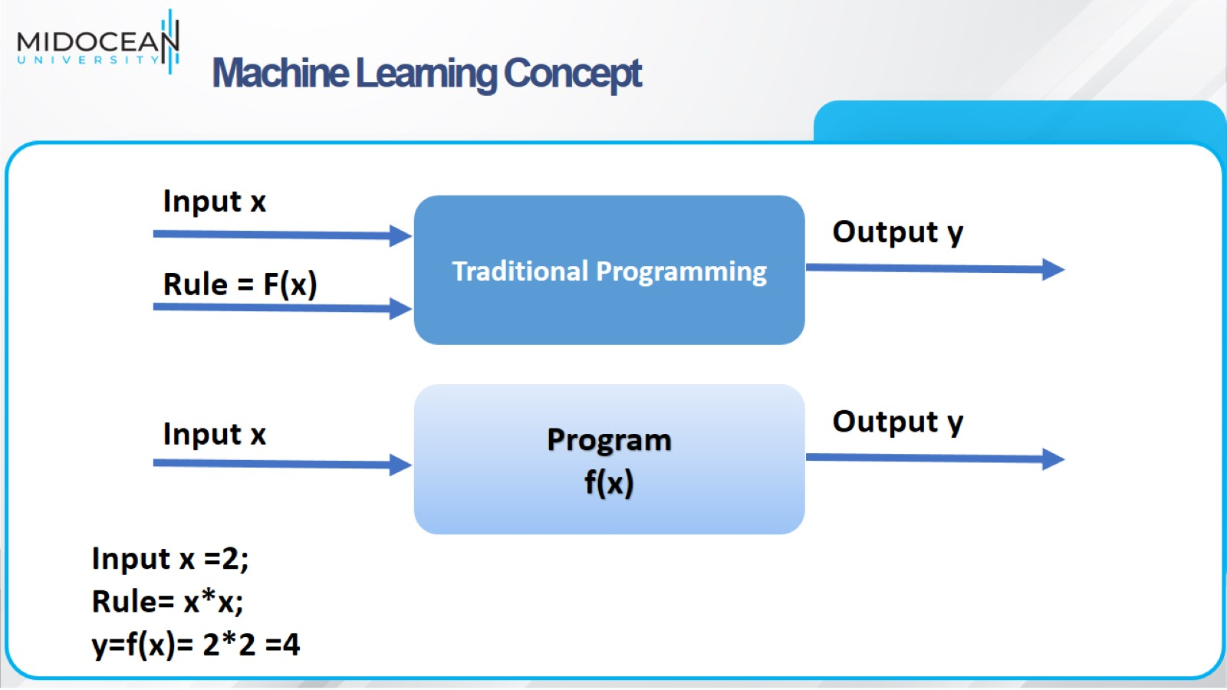
Machine Learning Concept

Slide 6
Machine Learning Concept

Slide 7
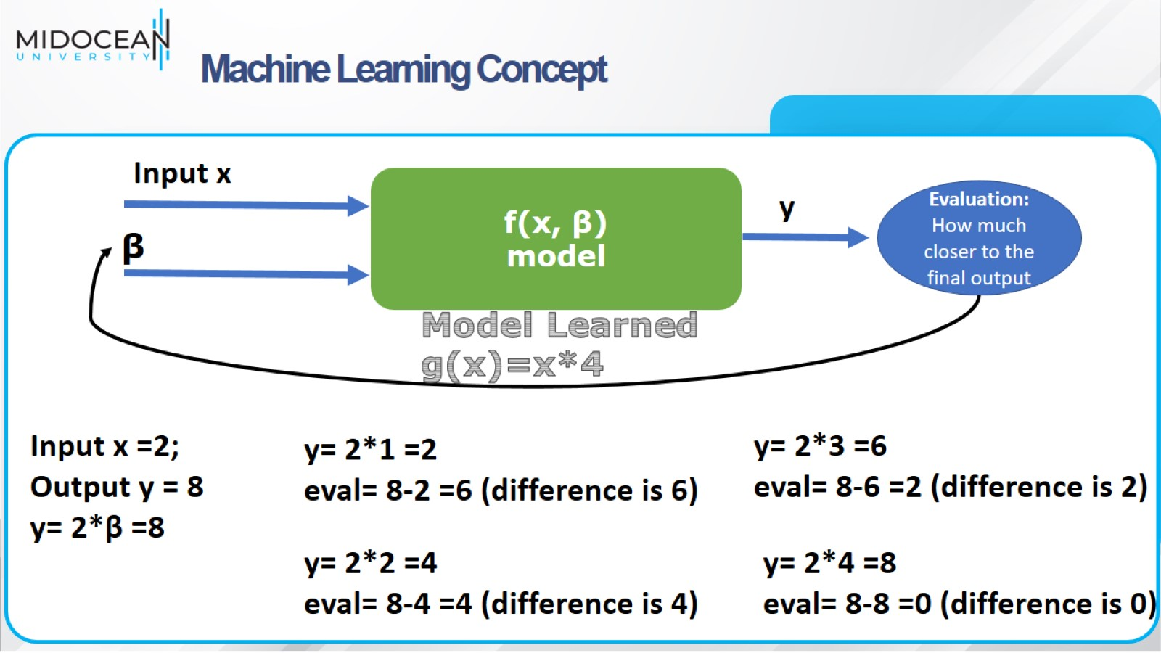
Machine Learning Concept

Slide 8
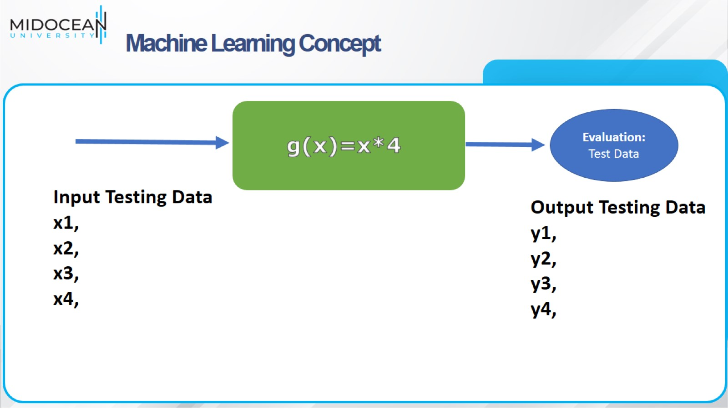
Machine Learning Concept

Slide 9
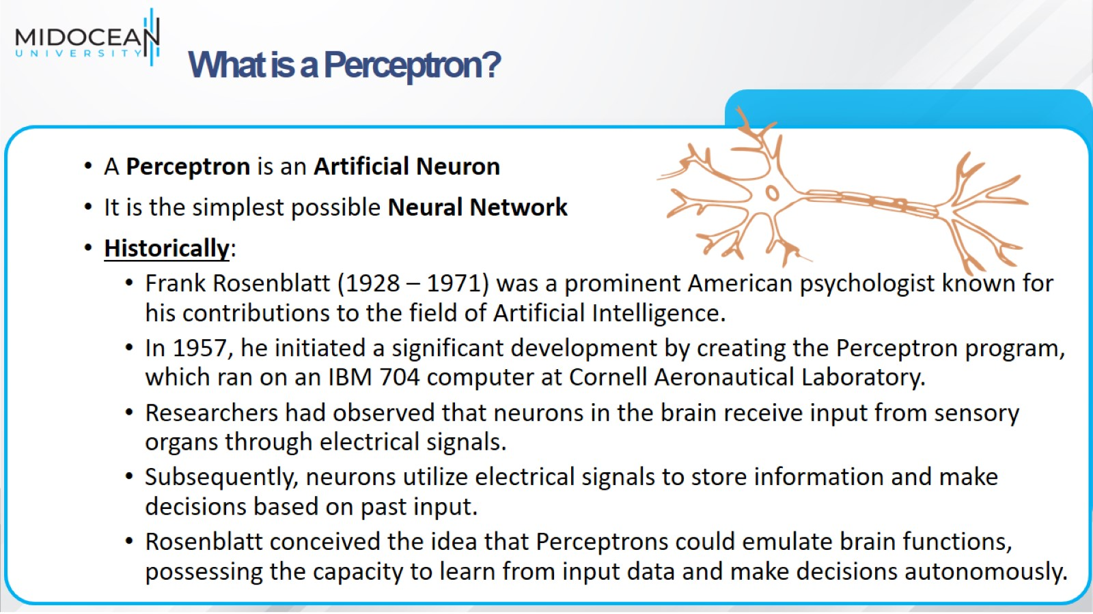
What is a Perceptron?

Slide 10
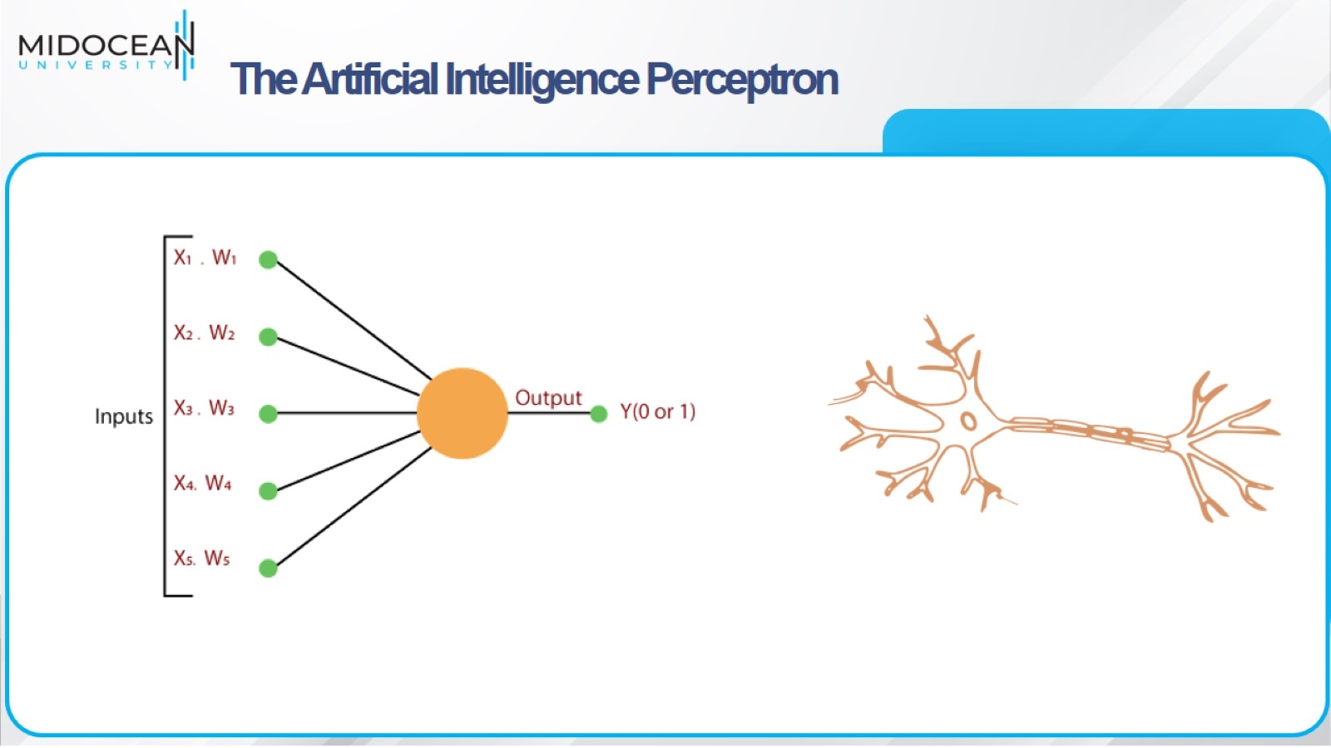
The Artificial Intelligence Perceptron

Slide 11
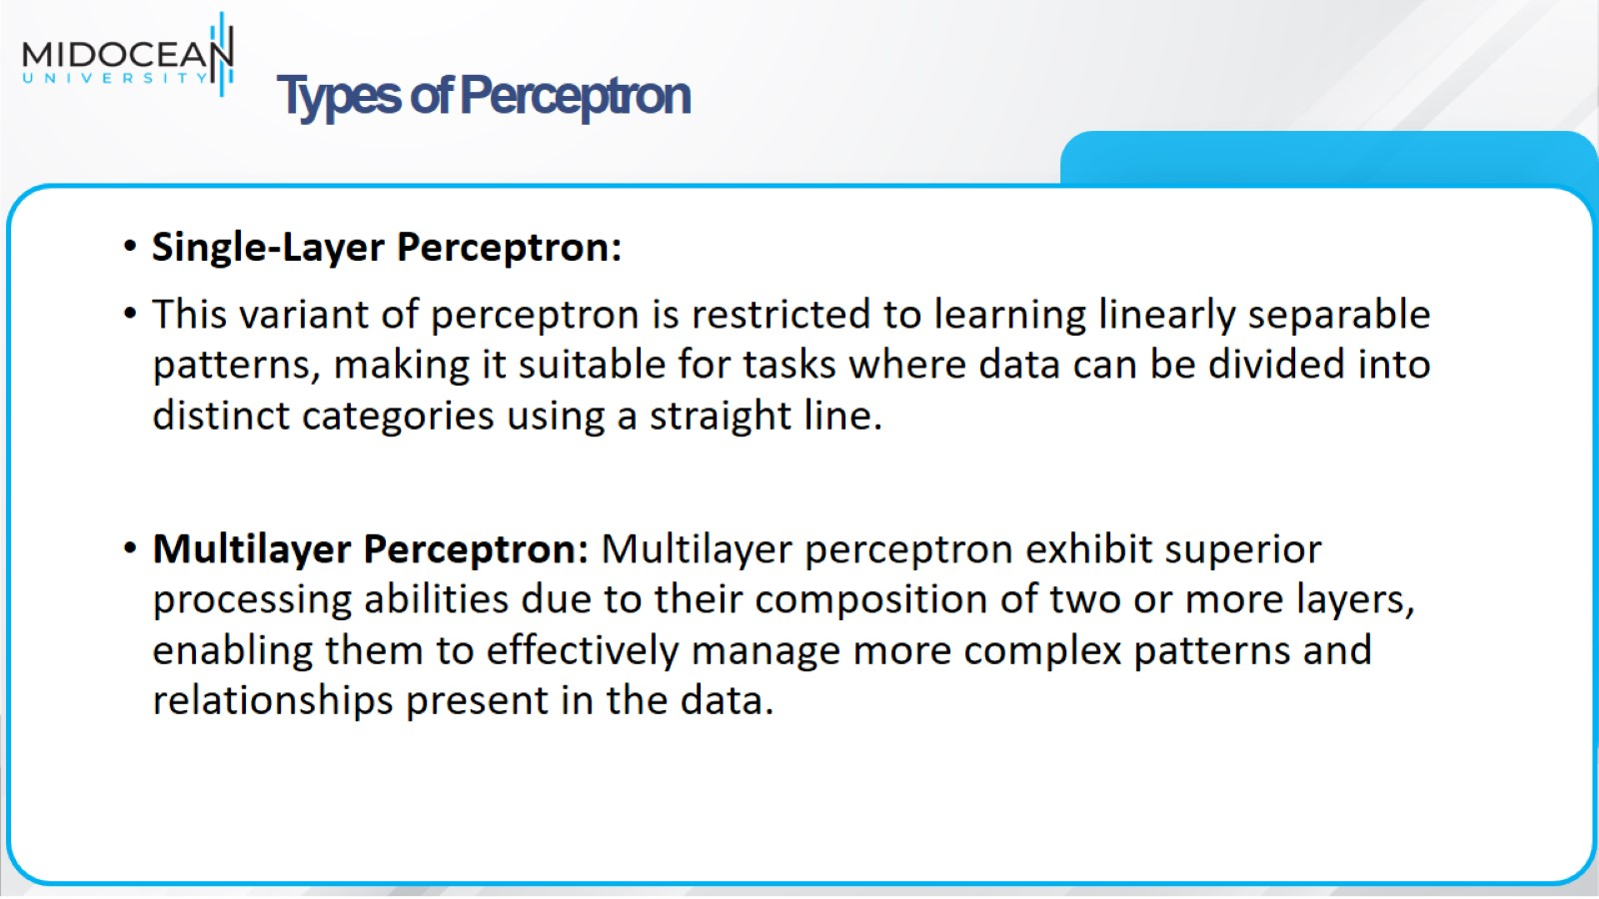
Types of Perceptron

Slide 12
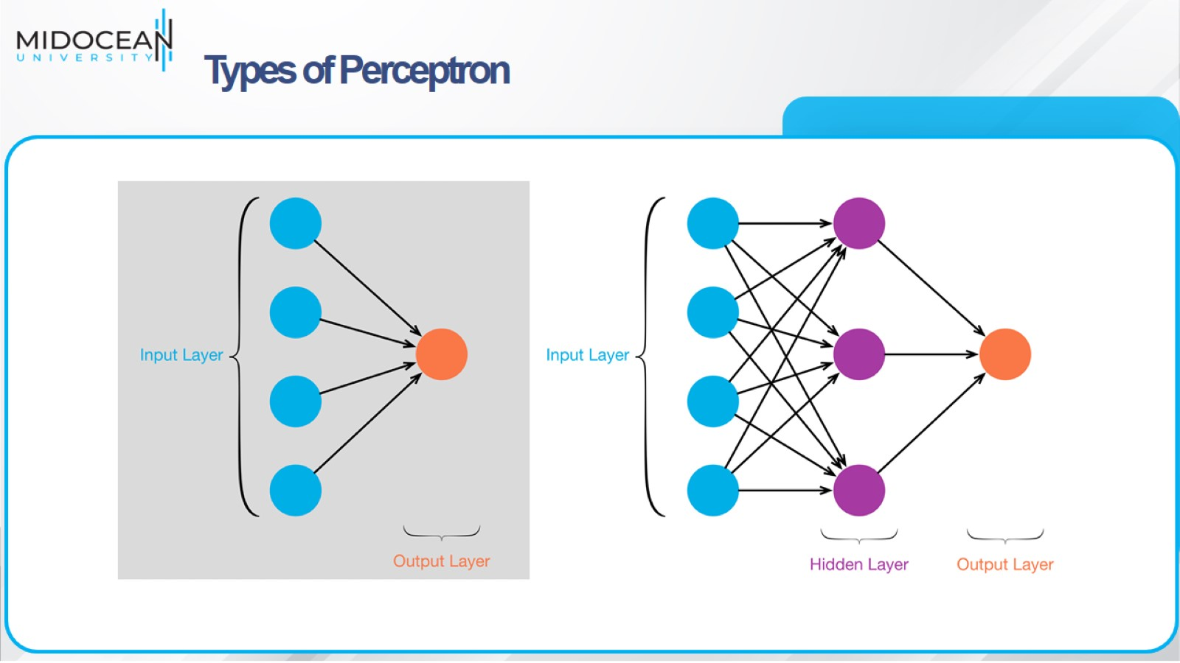
Types of Perceptron

Slide 13
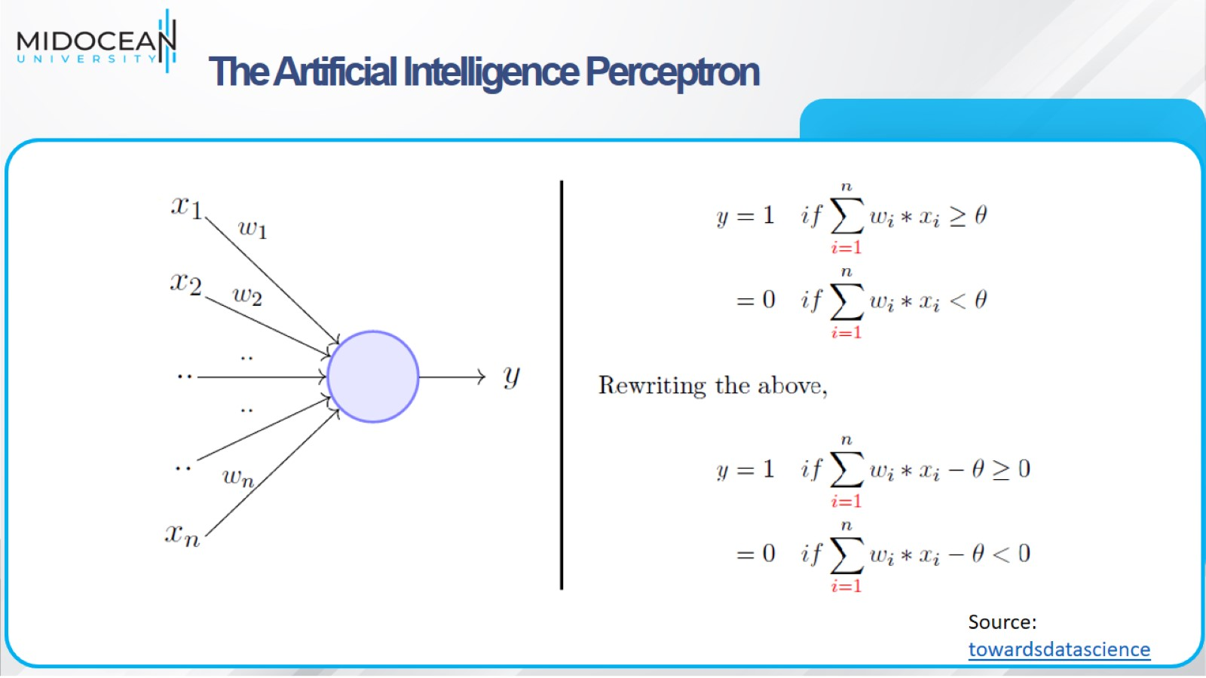
The Artificial Intelligence Perceptron

Slide 14
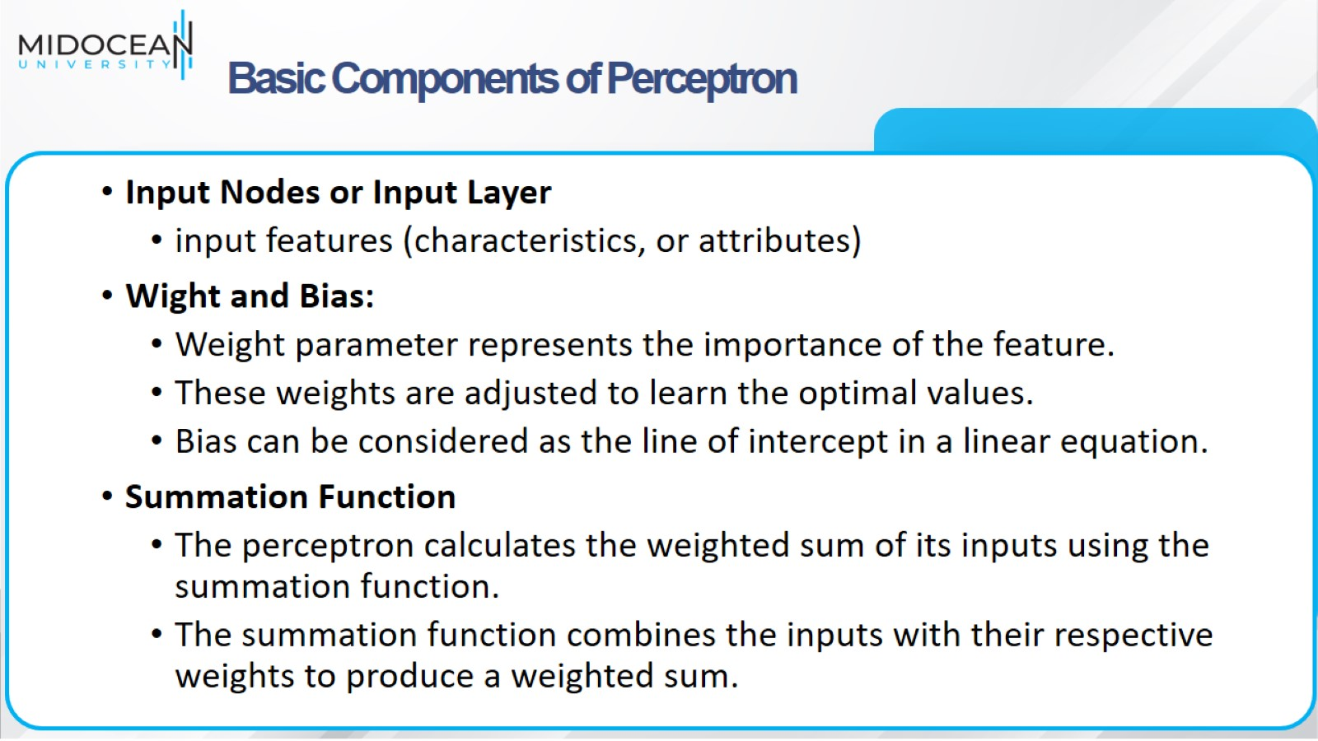
Basic Components of Perceptron

Slide 15
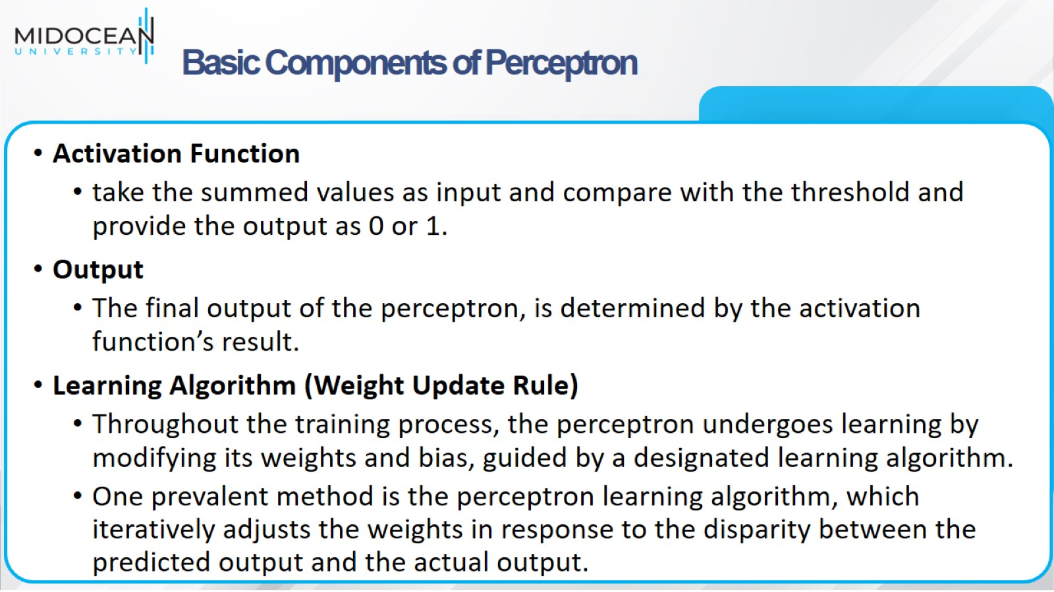
Basic Components of Perceptron

Slide 16
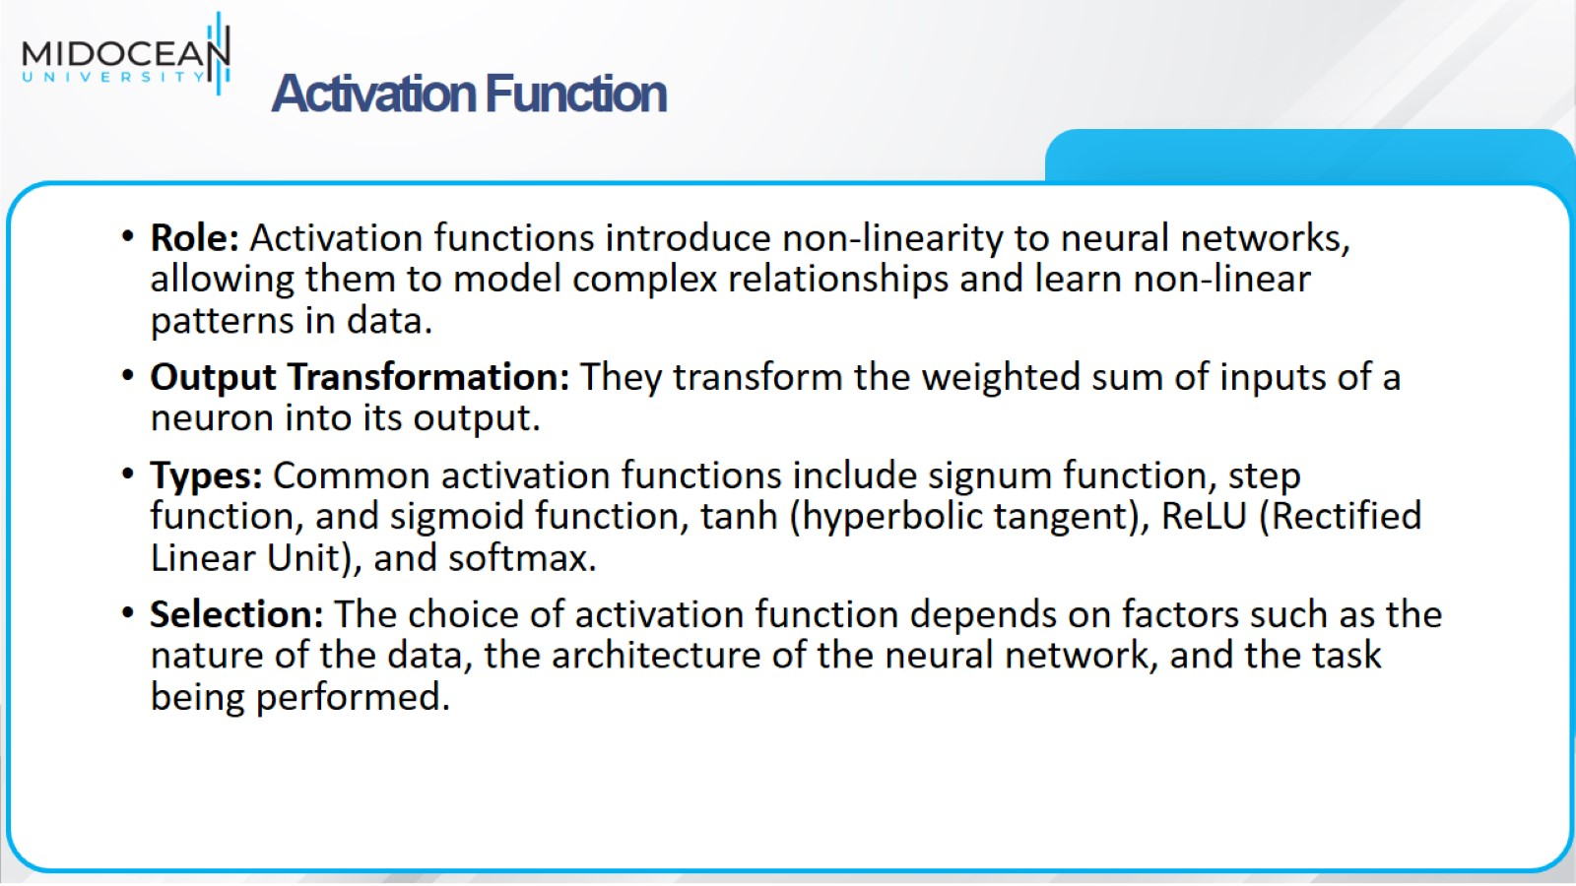
Activation Function

Slide 17
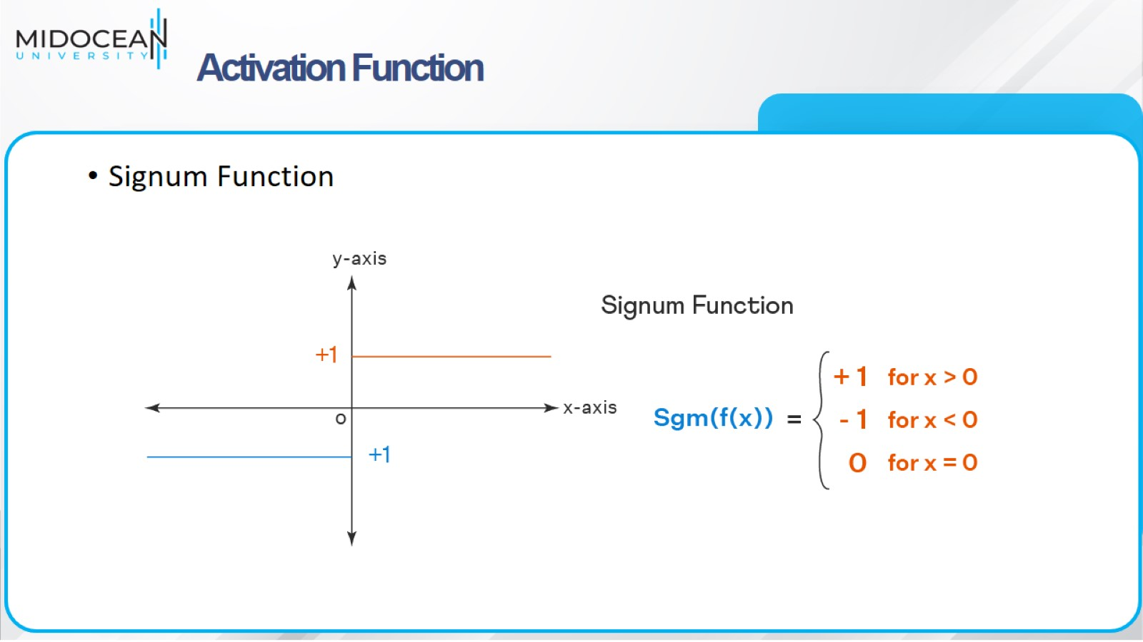
Activation Function

Slide 18
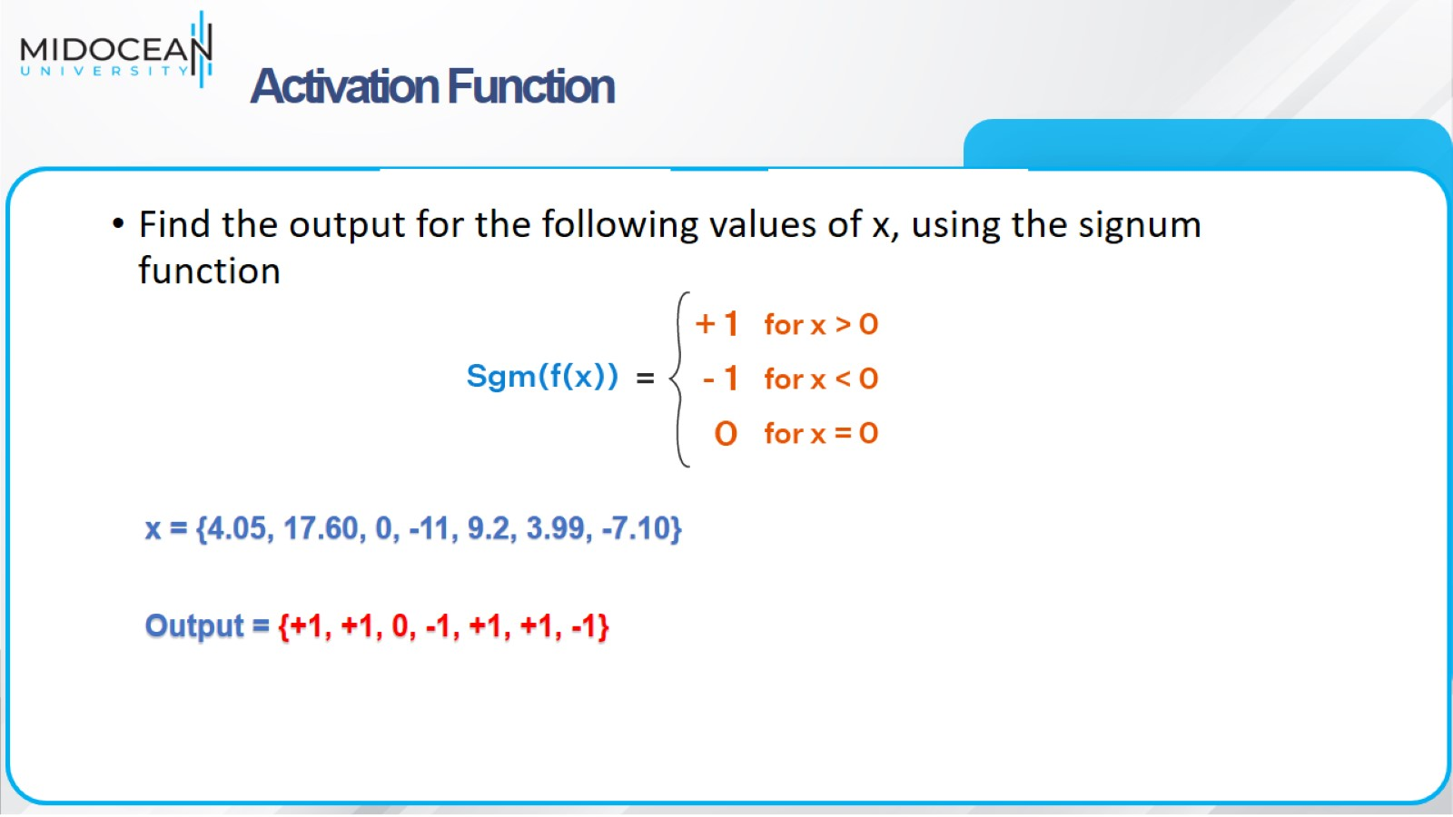
Activation Function

Slide 19
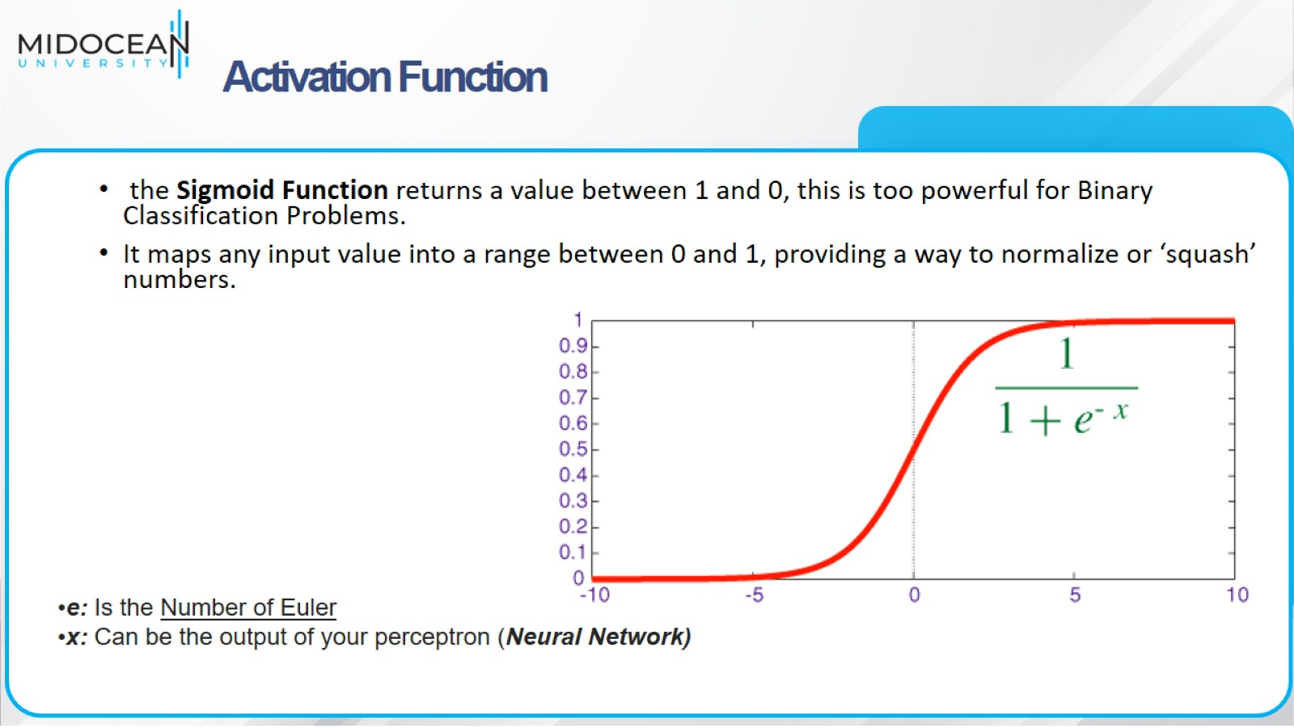
Activation Function

Slide 20
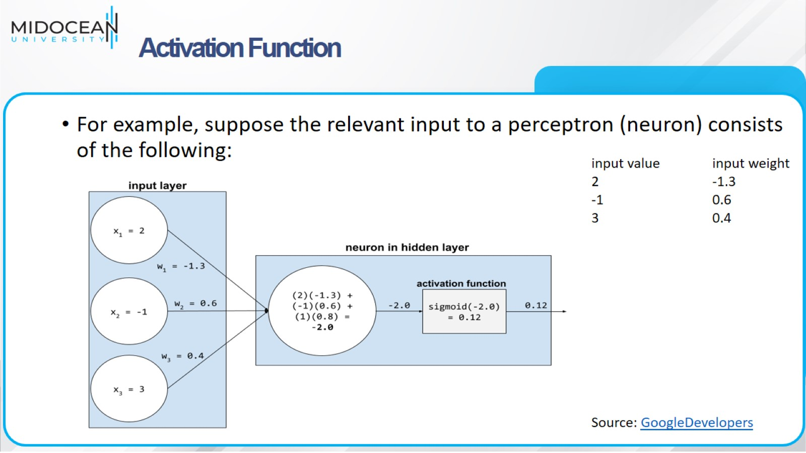
Activation Function

Slide 21
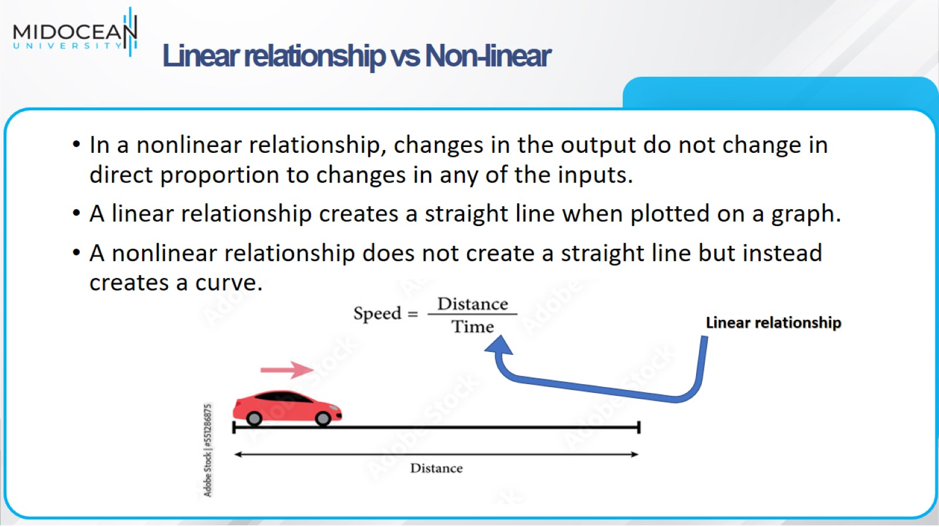
Linear relationship vs Non-linear

Slide 22
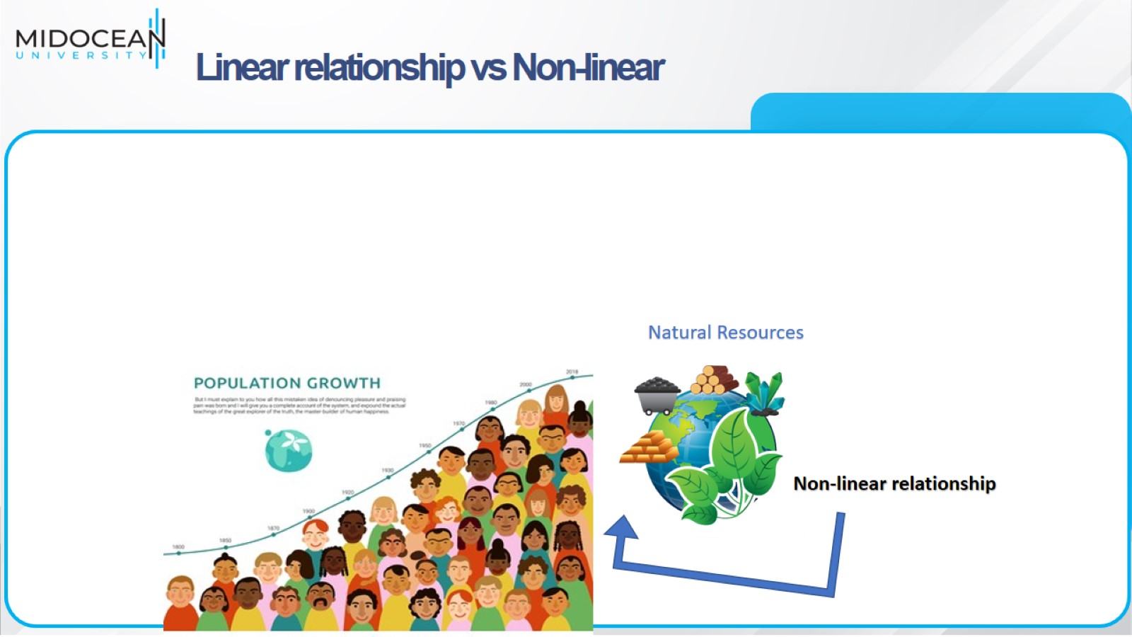
Linear relationship vs Non-linear

Slide 23
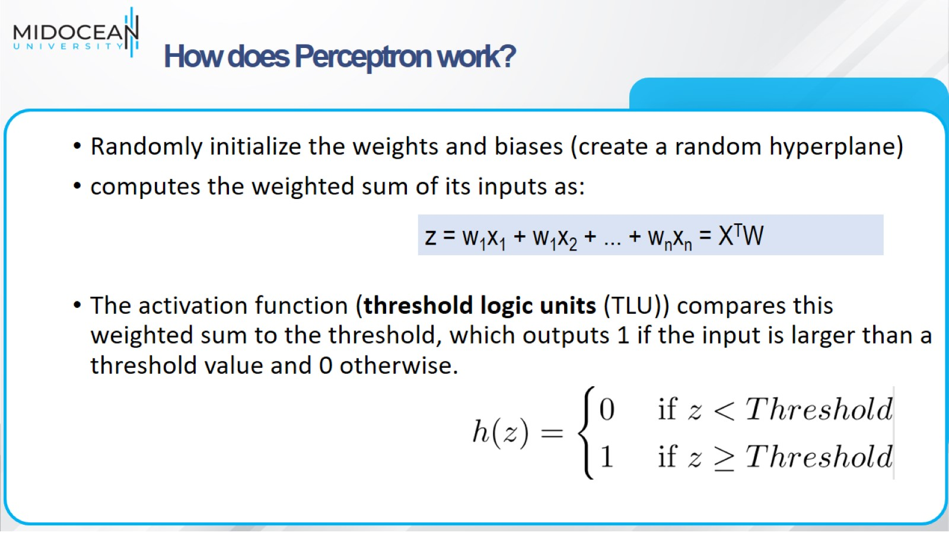
How does Perceptron work?

Slide 24
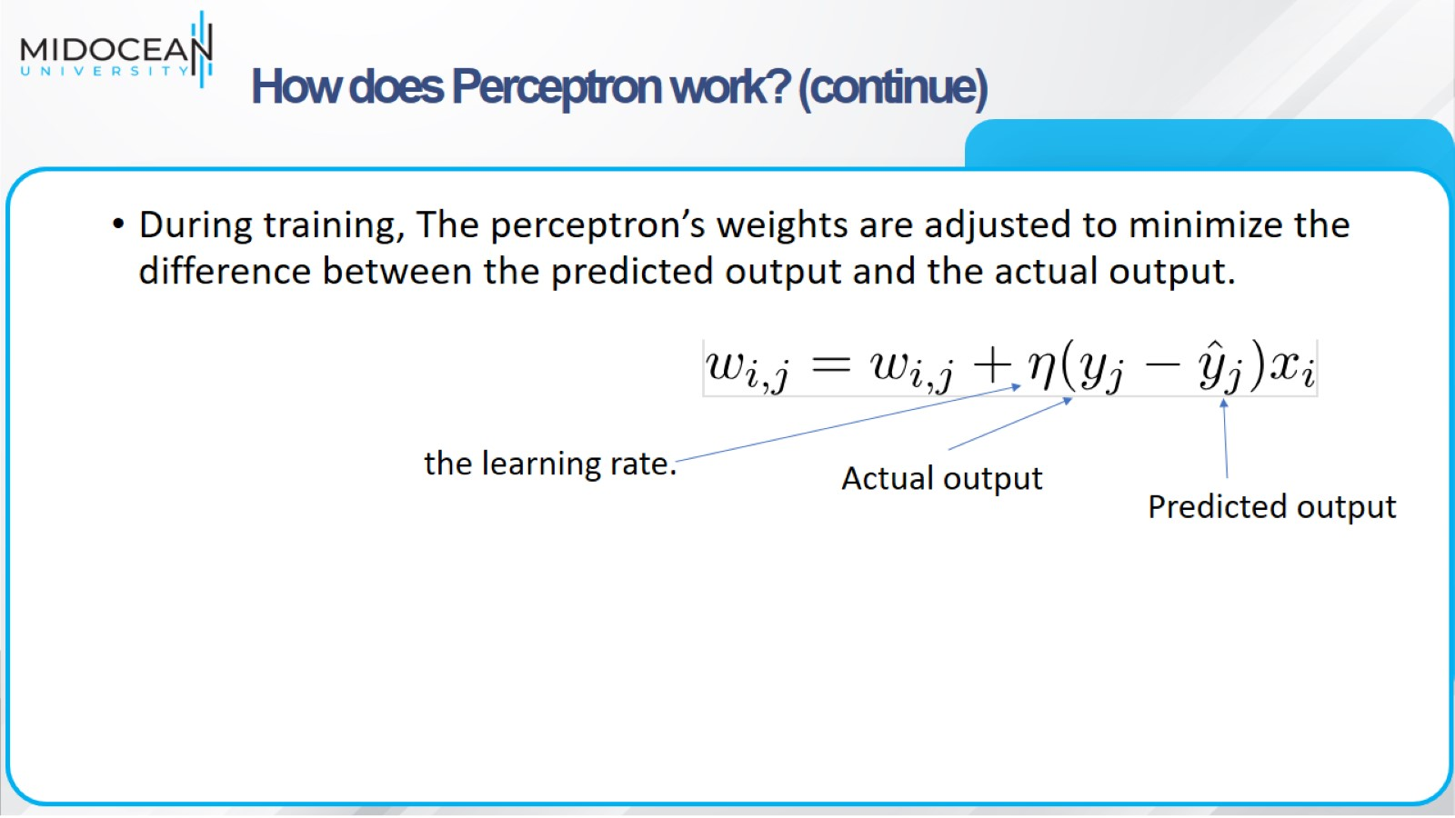
How does Perceptron work? (continue)

Slide 25
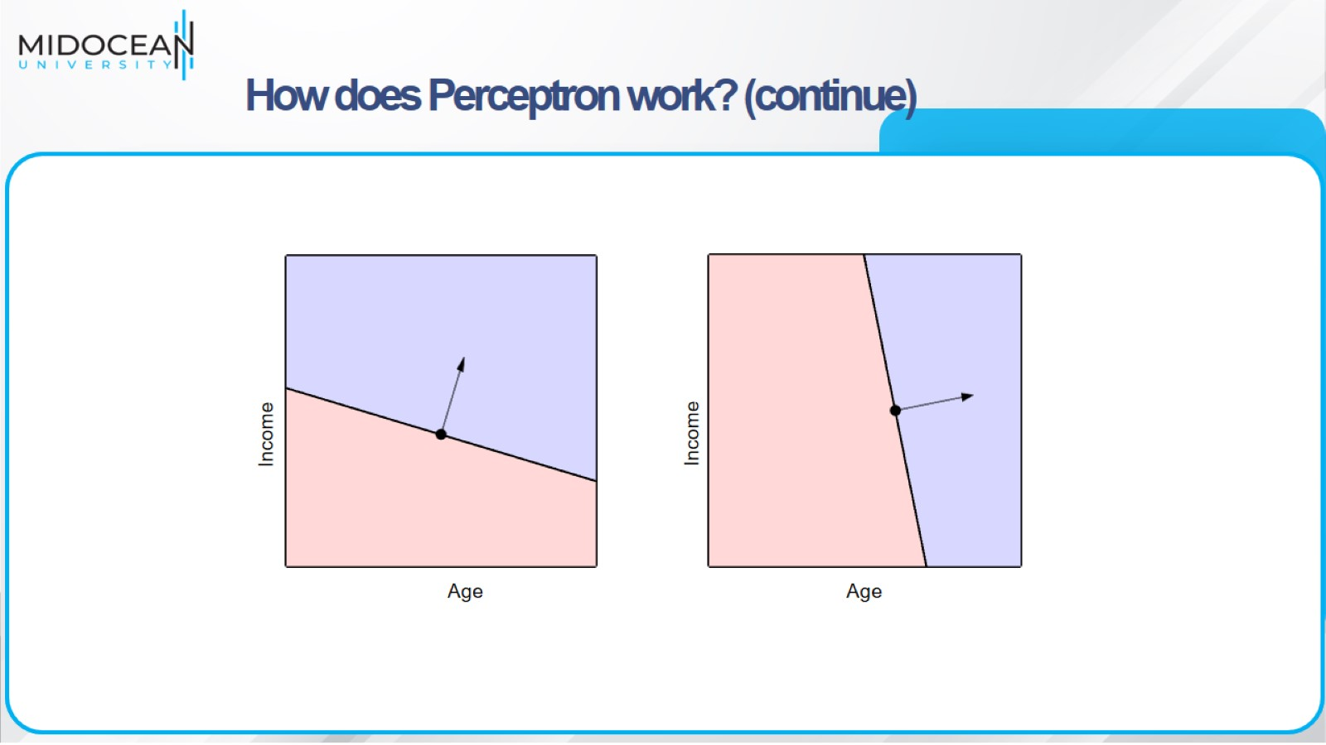

Slide 26
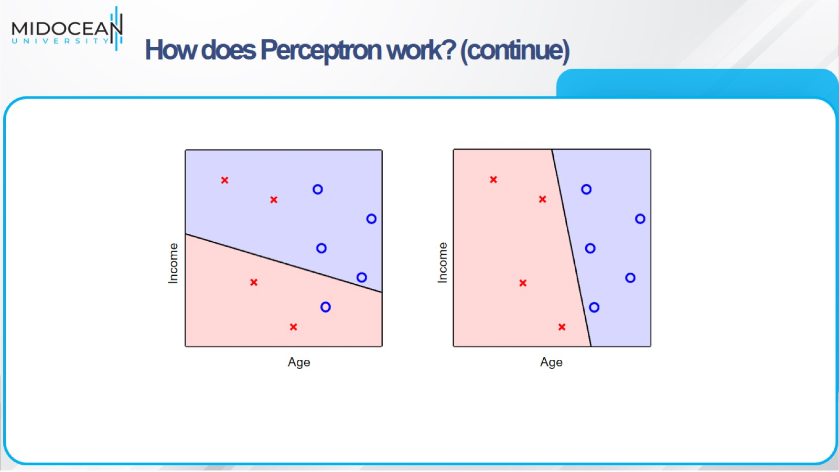
How does Perceptron work? (continue)

Slide 27
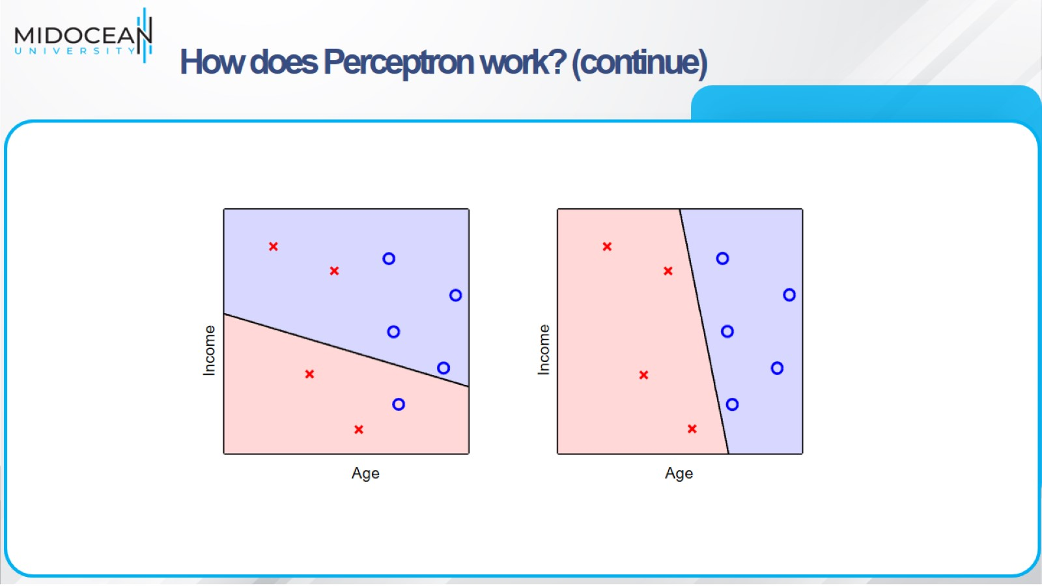
How does Perceptron work? (continue)

Slide 28
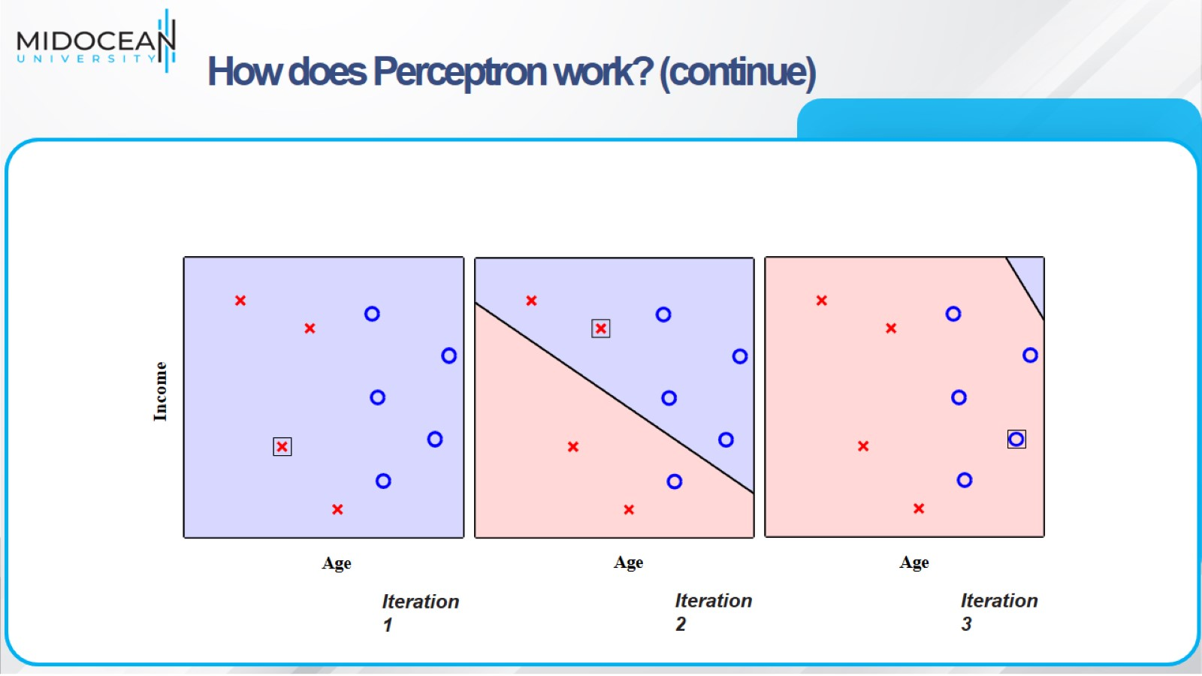
How does Perceptron work? (continue)

Slide 29
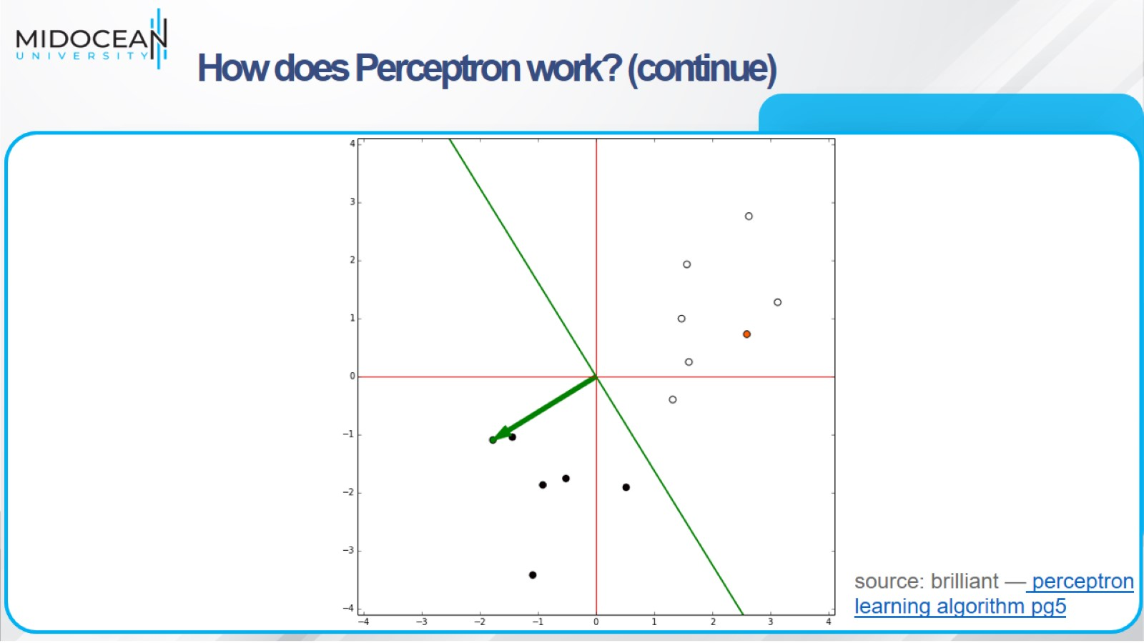
How does Perceptron work? (continue)

Slide 30
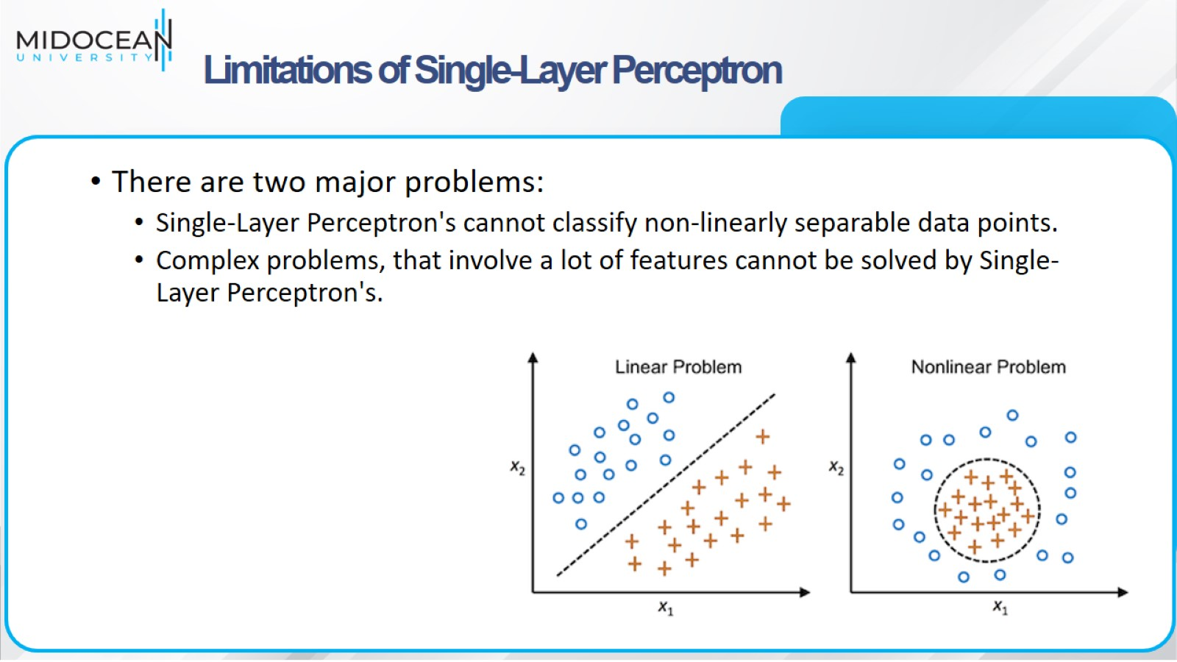
Limitations of Single-Layer Perceptron

Slide 31
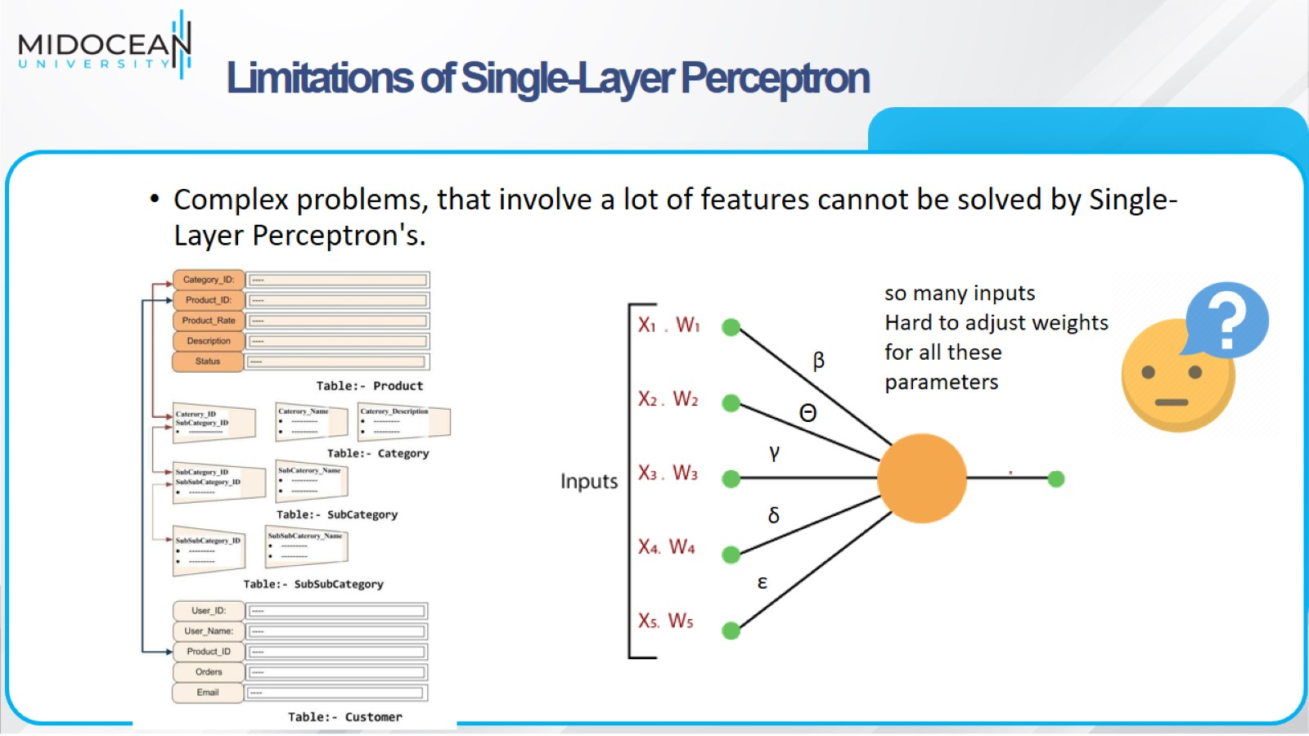
Limitations of Single-Layer Perceptron

Slide 32
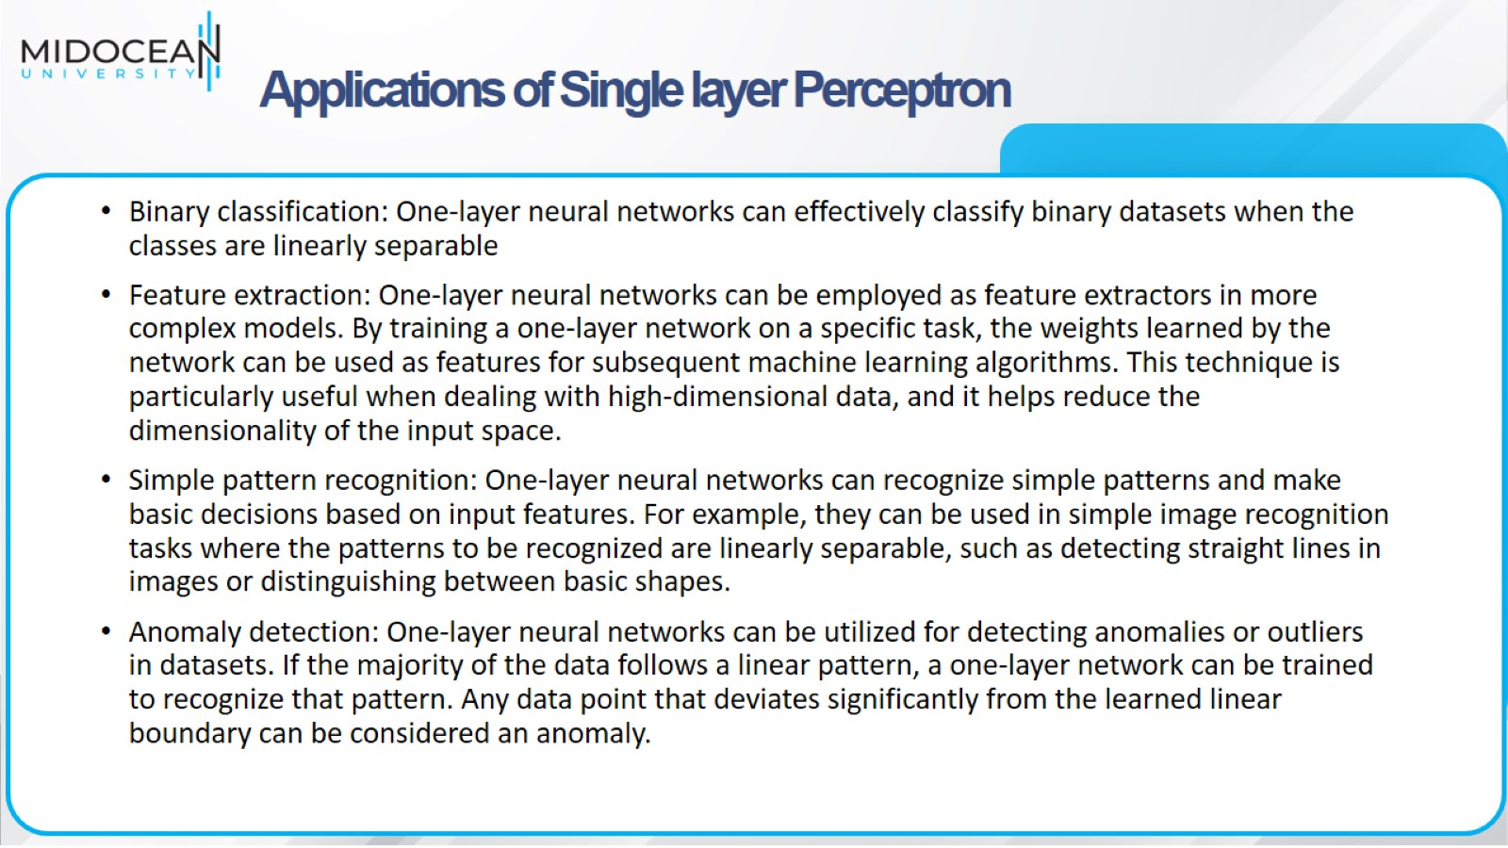
Applications of Single layer Perceptron

Slide 33
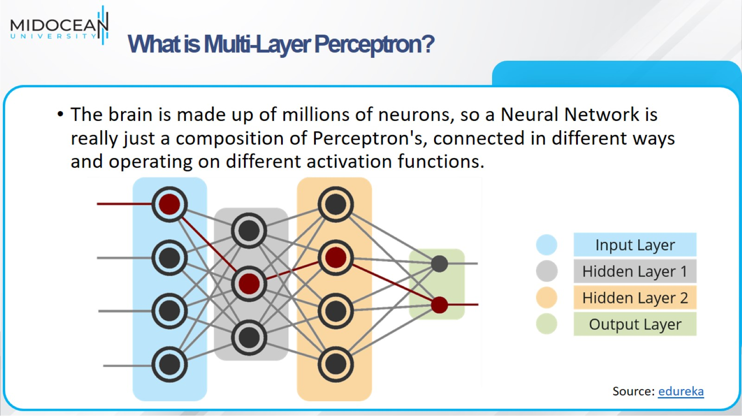
What is Multi-Layer Perceptron?

Slide 34
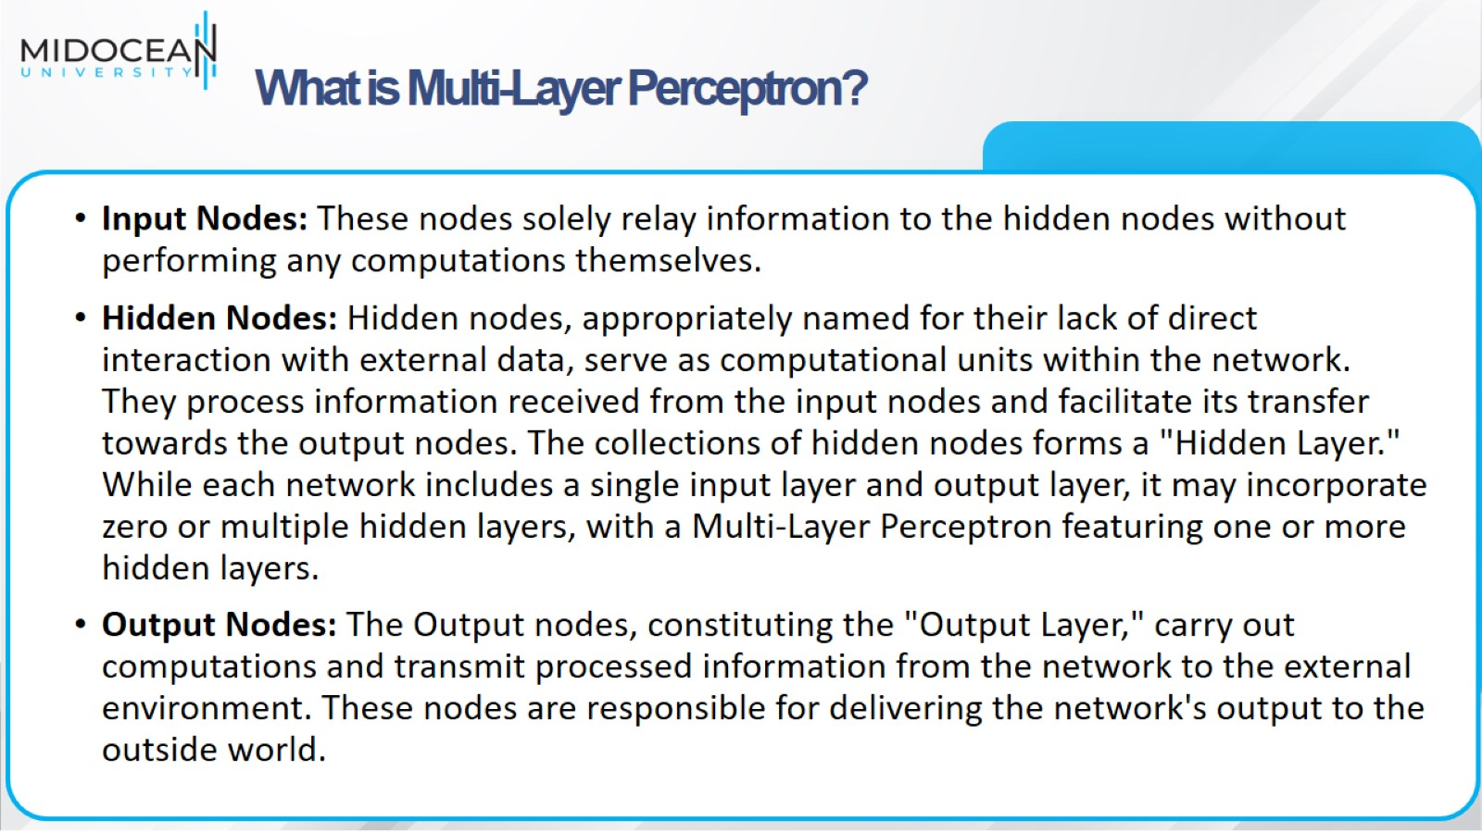
What is Multi-Layer Perceptron?

Slide 35
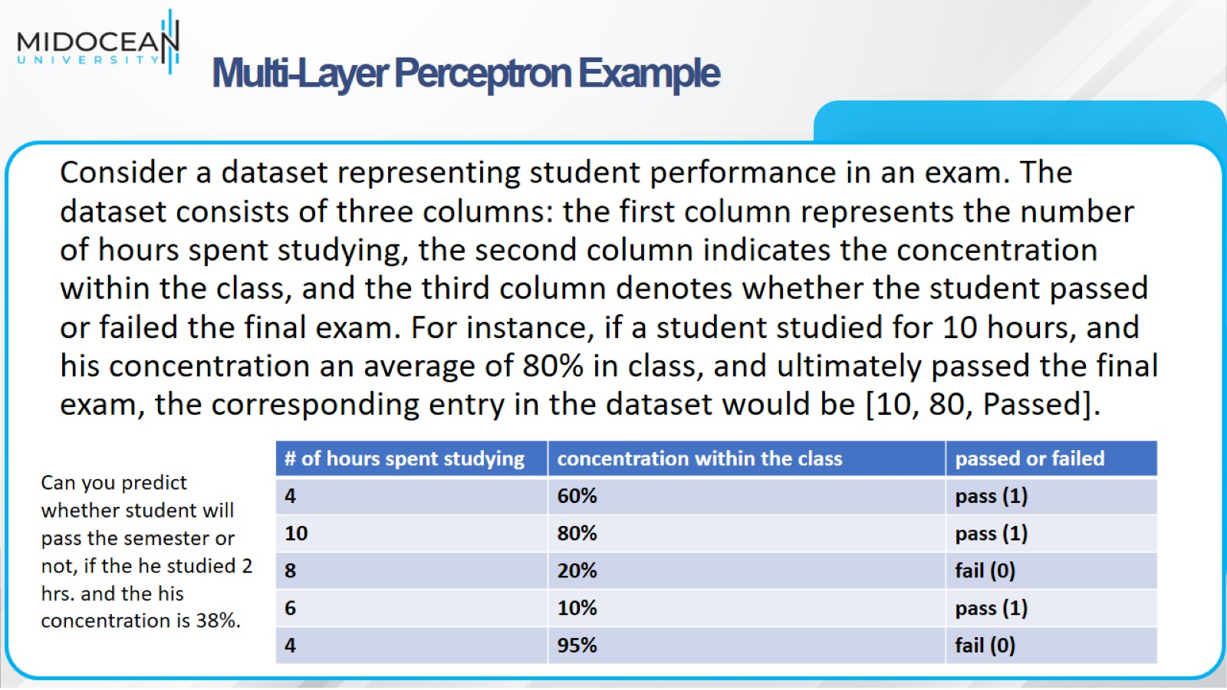
Multi-Layer Perceptron Example

Slide 36
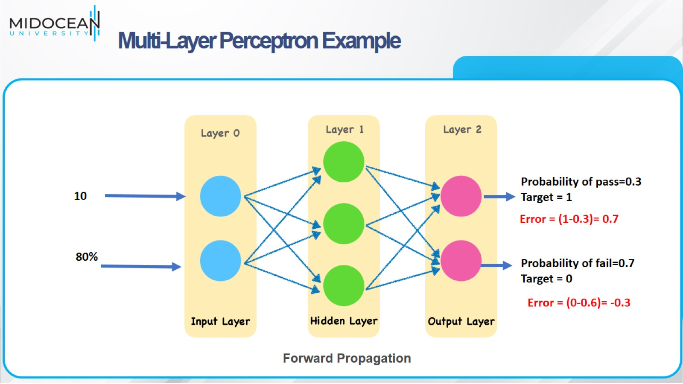
Multi-Layer Perceptron Example

Slide 37
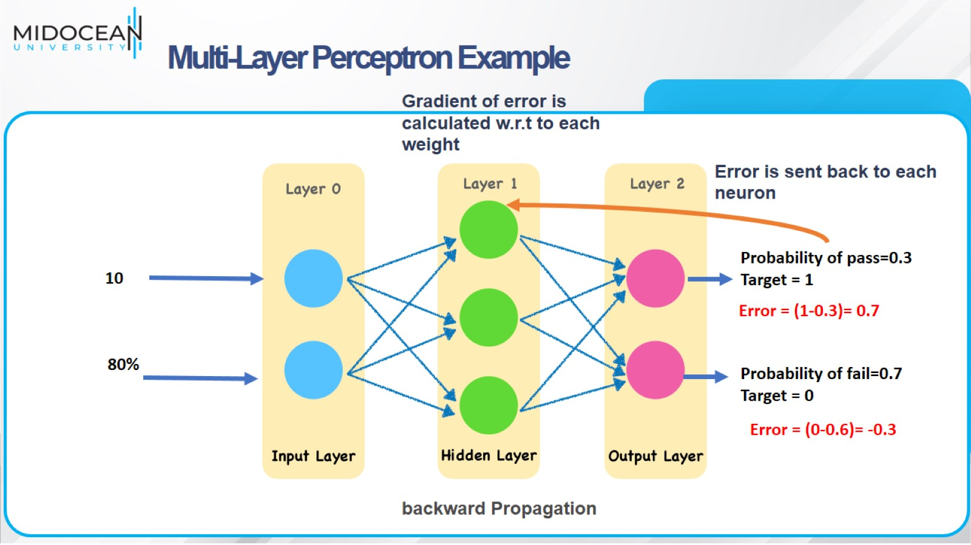
Multi-Layer Perceptron Example

Slide 38
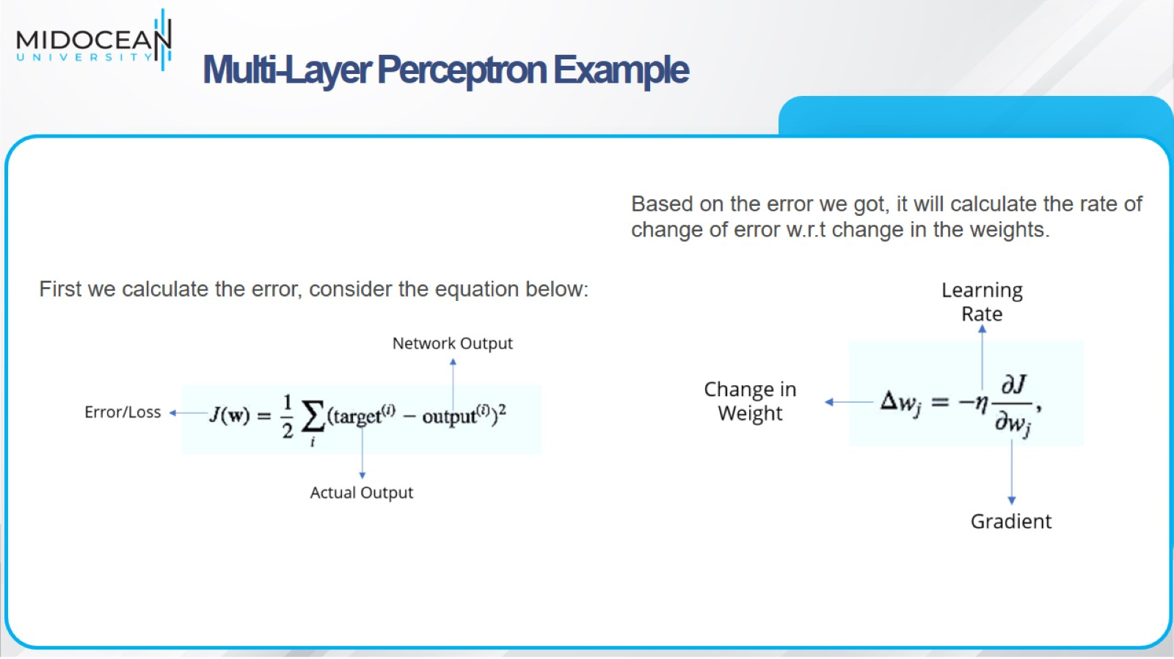
Multi-Layer Perceptron Example

Slide 39

Multi-Layer Perceptron Example

Slide 40
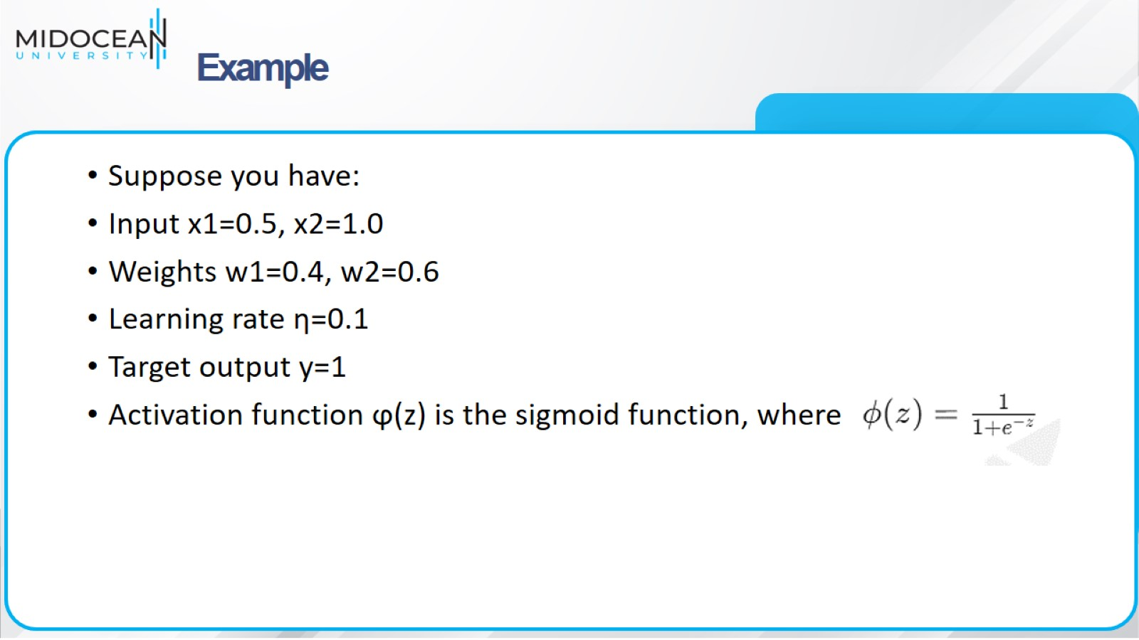
Example

Slide 41
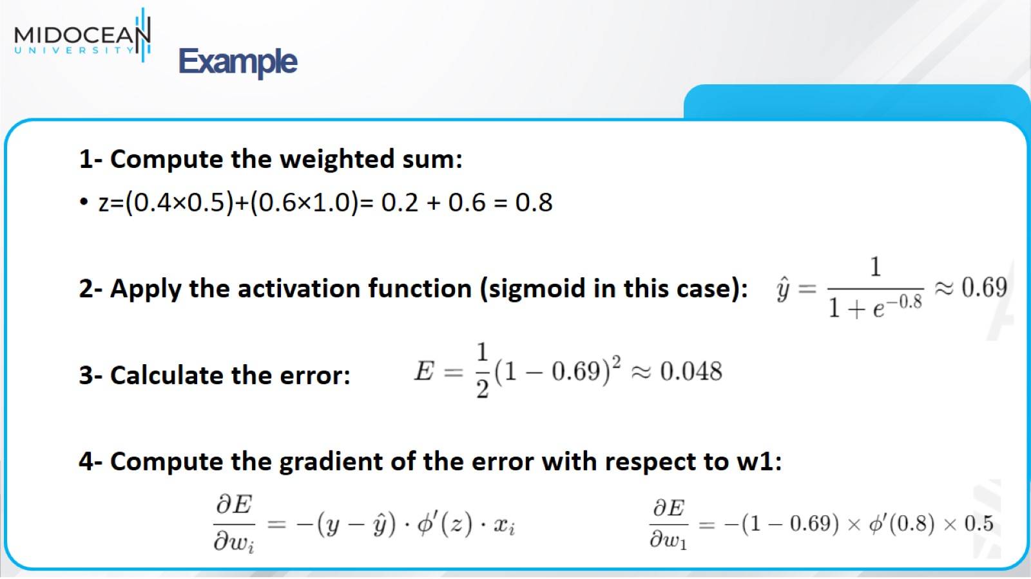
Example

Slide 42
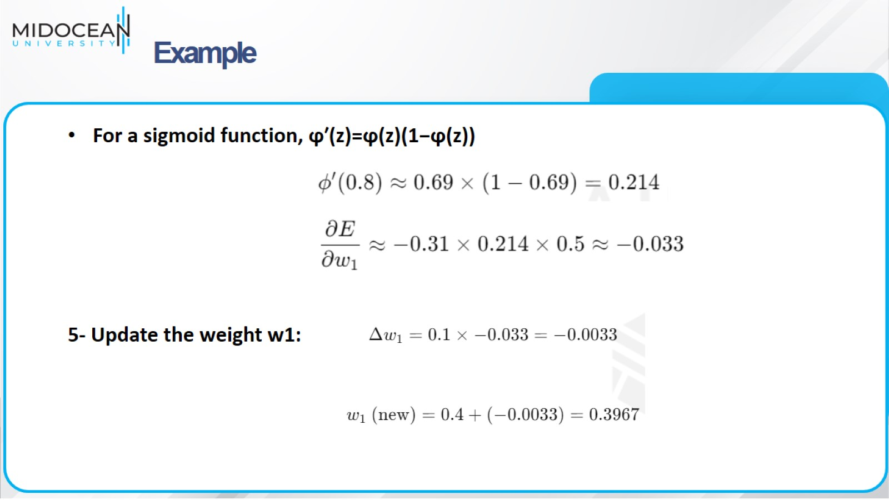
Example

Slide 43
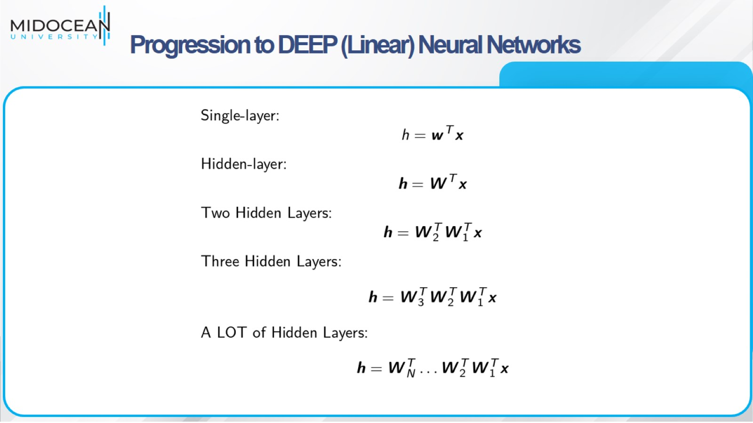
Progression to DEEP (Linear) Neural Networks

Slide 44
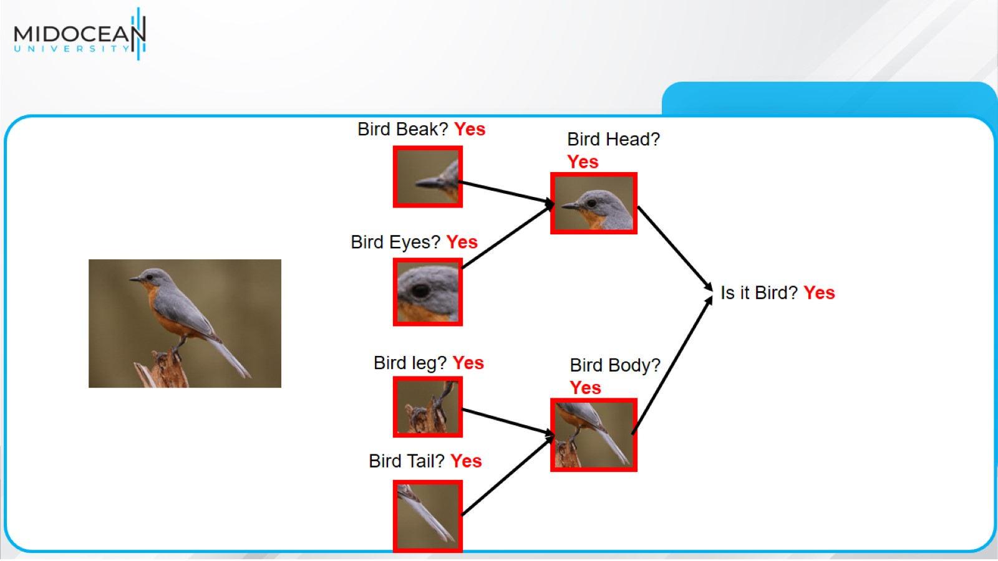

Slide 45
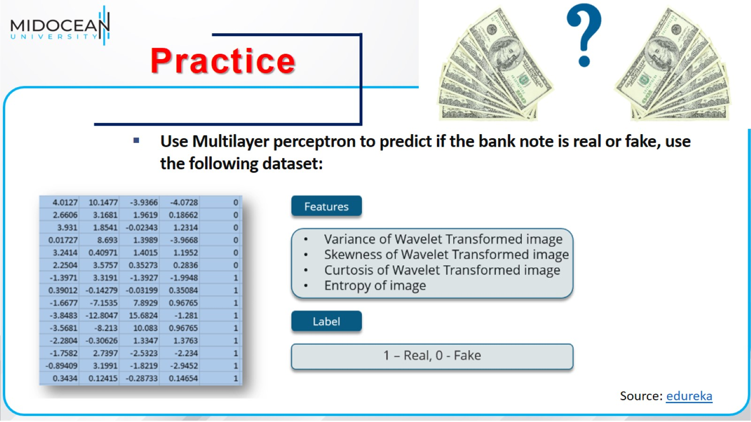

Slide 46
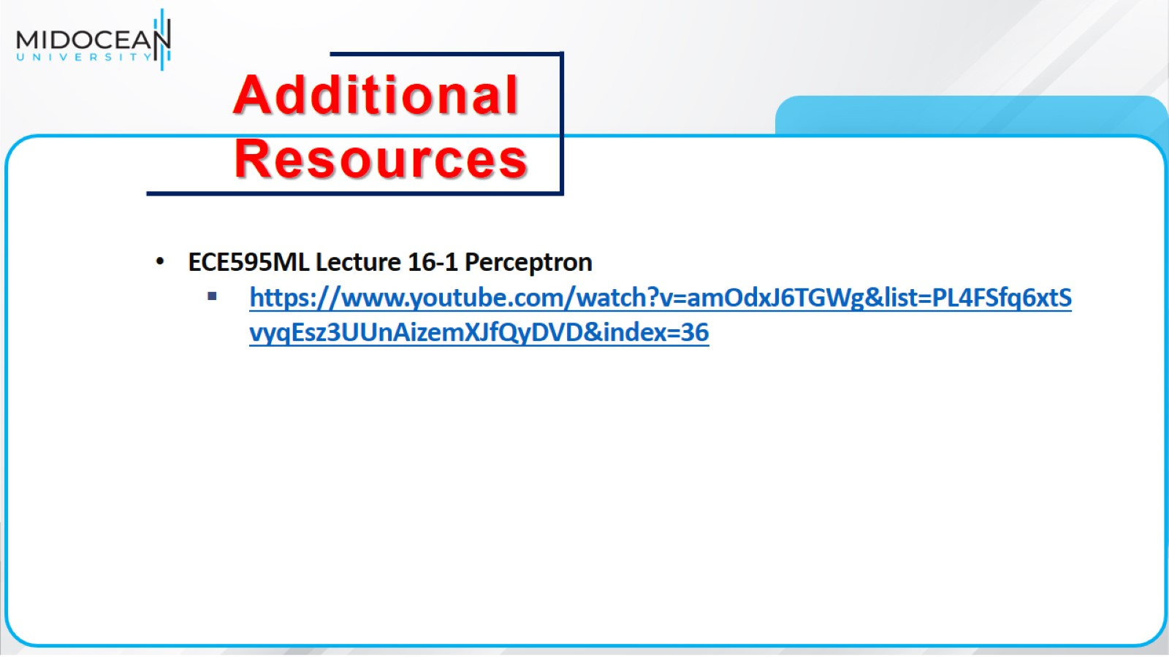

Slide 47


