Slide 1

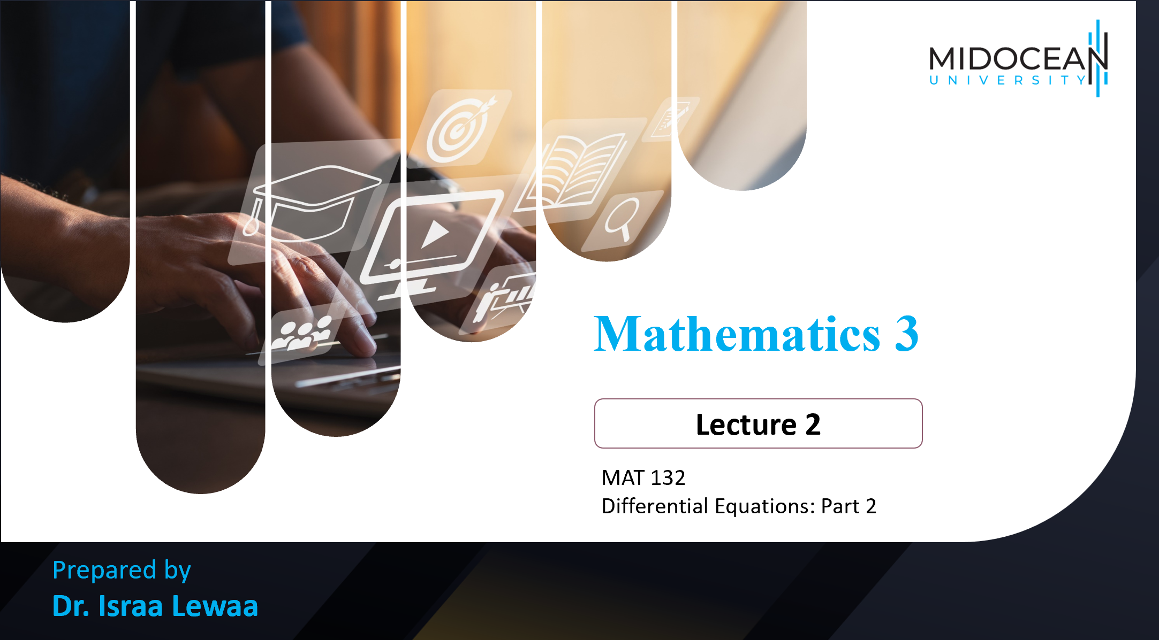



Mathematics 3 – MAT132
Dr. Israa Lewaa
Lecture 2 - Differential Equations: Part 2

Slide 2

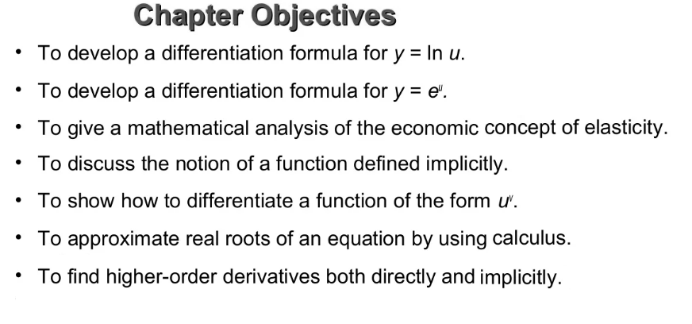
Lecture
05
Lecture Objective
Chapter Objectives

Slide 3
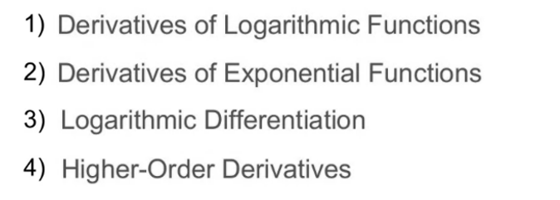
Lecture
05
Lecture Objectives
Chapter Outline

Slide 4
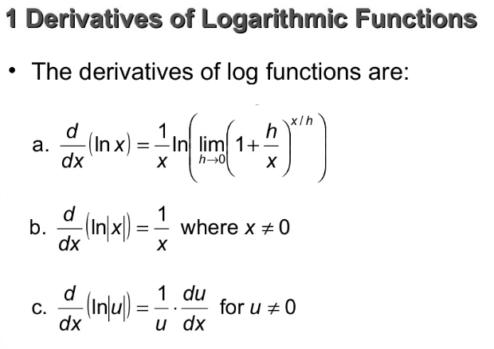
Lecture
05
1- Derivatives of Logarithmic Functions
1-

Slide 5
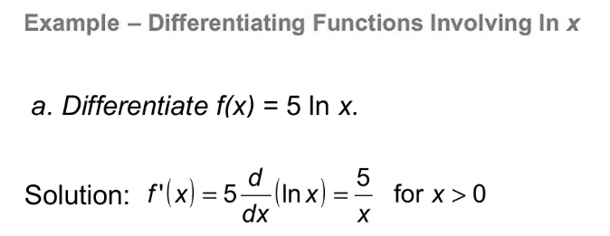
Lecture
05
Example
Example

Slide 6
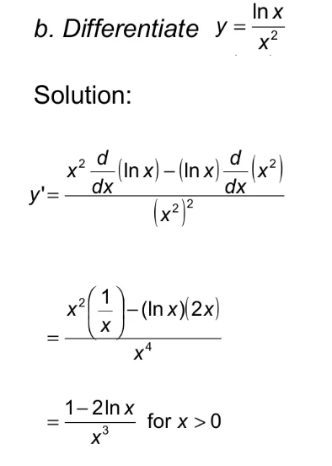
Lecture
05
Example
Example

Slide 7
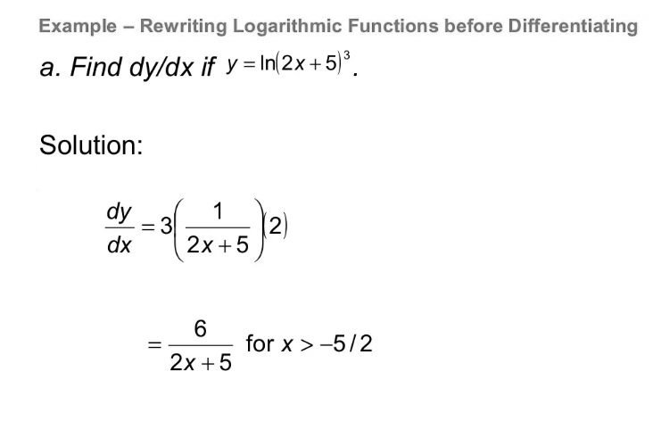
Lecture
05
Example
Example

Slide 8
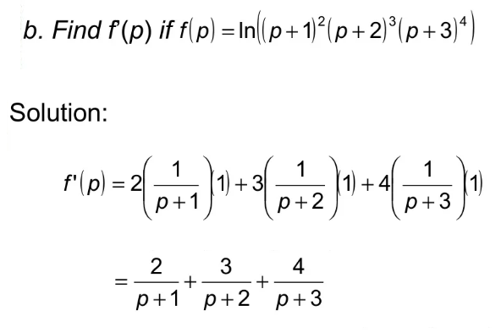
Lecture
05
Example
Example

Slide 9
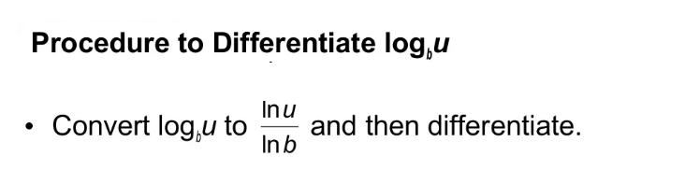
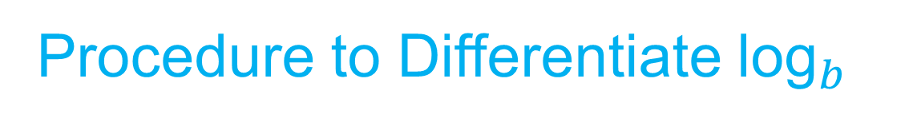
Lecture
05
Procedure to Differentiate ${\text{log}}_{b}$

Slide 10
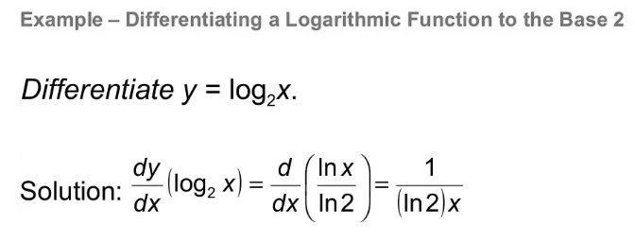
Lecture
05
Example
Example

Slide 11
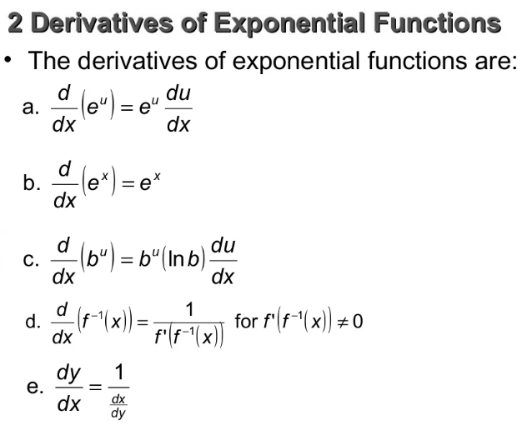
Lecture
05
Derivatives of Exponential Functions

Slide 12
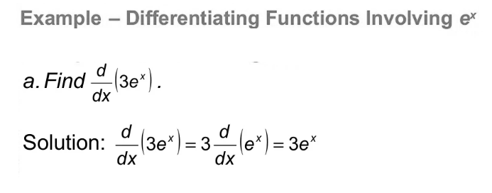
Lecture
05
Example
Example

Slide 13
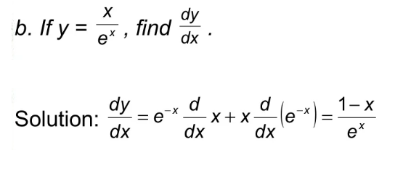
Lecture
05
Example
Example

Slide 14
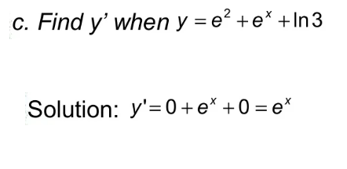
Lecture
05
Example
Example

Slide 15
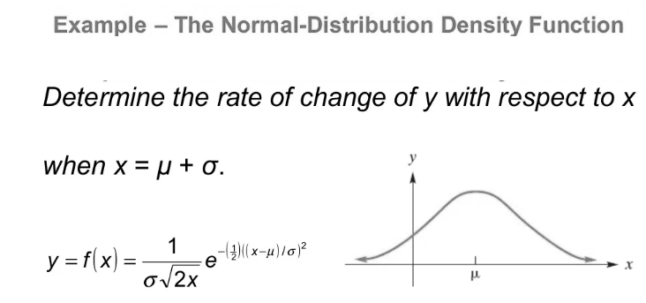
Lecture
05
Example
Example

Slide 16
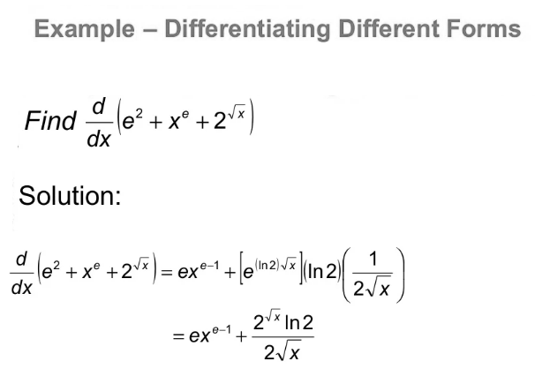
Lecture
05
Example
Example

Slide 17
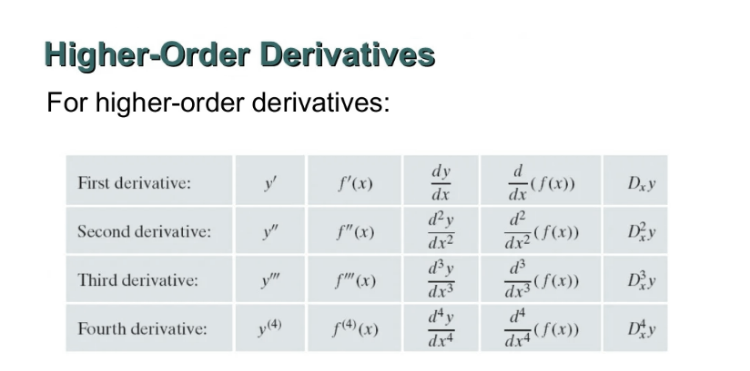
Lecture
05
Higher-Order Derivatives
Higher-Order Derivatives

Slide 18
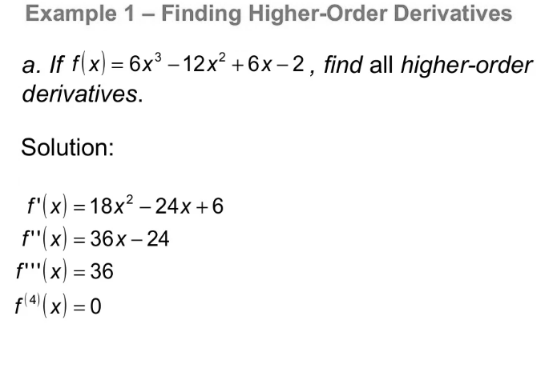
Lecture
05
Example
Example

Slide 19
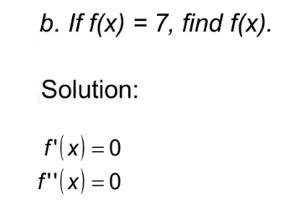
Lecture
05
Example
Example

Slide 20
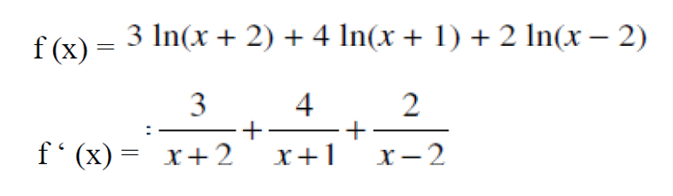
Lecture
05
Extra Practice – Example 1
Extra Practice -- Example

Slide 21
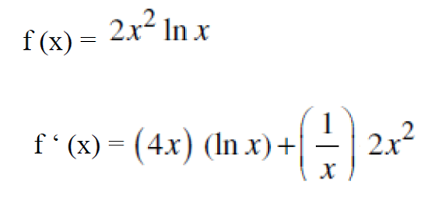
Lecture
05
Extra Practice – Example 2
Extra Practice -- Example

Slide 22
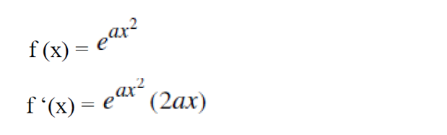
Lecture
05
Extra Practice – Example 3
Example
Differentiate the following functions:

Slide 23
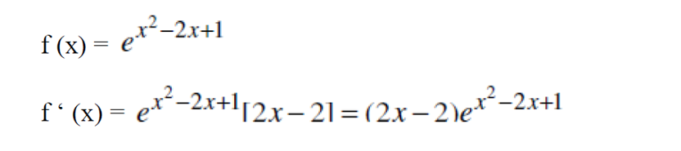
Lecture
05
Extra Practice – Example 4
Example
Differentiate the following functions:

Slide 24
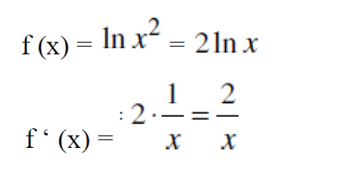
Lecture
05
Extra Practice – Example 5
Example

Slide 25
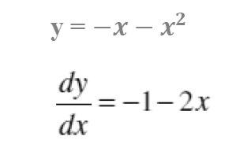
Lecture
05
Extra Practice – Example 6
Example

Slide 26
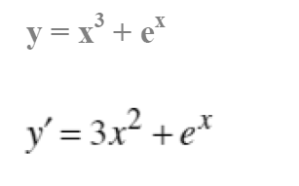
Lecture
05
Extra Practice – Example 7
Example

Slide 27
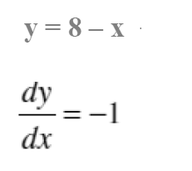
Lecture
05
Extra Practice – Example 8
Example

Slide 28
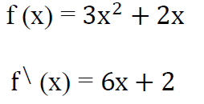
Lecture
05
Extra Practice – Example 9
Example

Slide 29
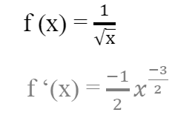
Lecture
05
Extra Practice – Example 10
Example

Slide 30
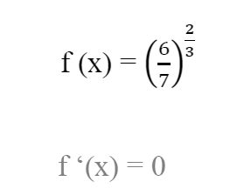
Lecture
05
Extra Practice – Example 11
Example

Slide 31
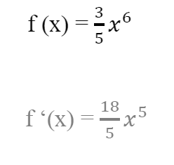
Lecture
05
Extra Practice – Example 12
Example

Slide 32
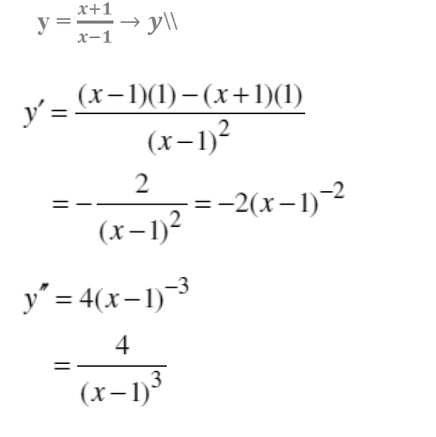
Lecture
05
Extra Practice – Example 13
Example

Slide 33
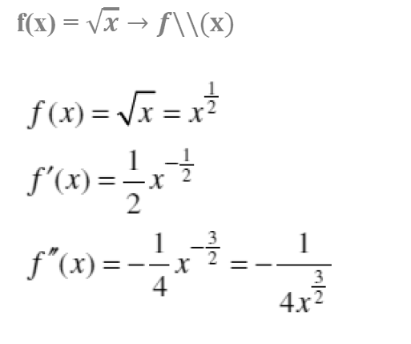
Lecture
05
Extra Practice – Example 14
Example

Slide 34
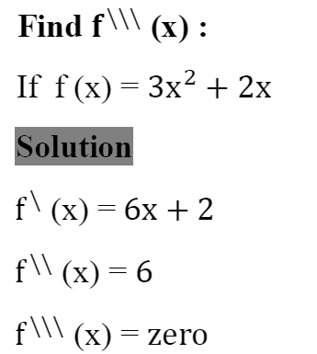
Lecture
05
Extra Practice – Example 15
Example

Slide 35
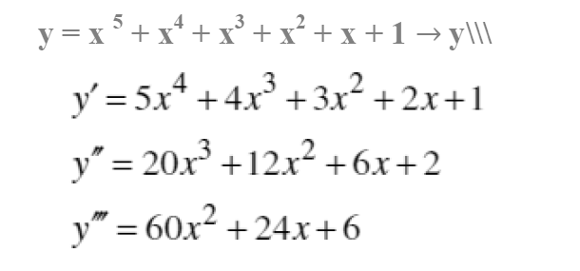
Lecture
05
Extra Practice – Example 16
Example

Slide 36
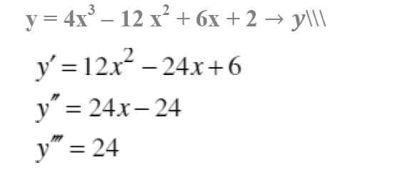
Lecture
05
Extra Practice – Example 17
Example

Slide 37
Lecture
05
Lecture Summary
Lecture Summary

Slide 38



Thank You

