Slide 1



English Course
Writing
Prepared by
Ahmed Soliman
www.midocean.ae

Slide 2

FORMAL AND INFORMAL EMAIL
www.midocean.ae

Slide 3
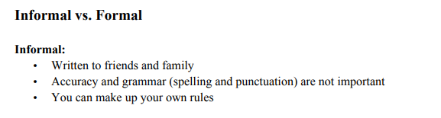
www.midocean.ae

Slide 4
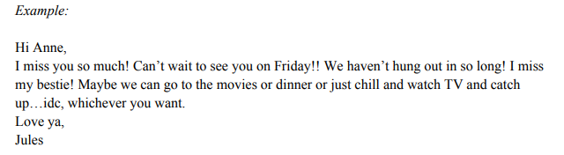
www.midocean.ae

Slide 5
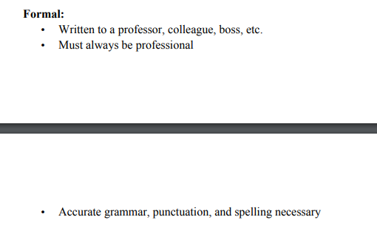
www.midocean.ae

Slide 6
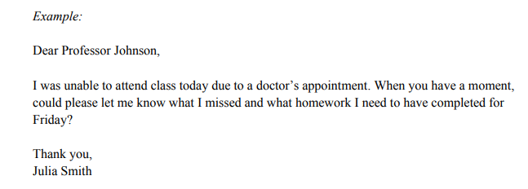
www.midocean.ae

Slide 7
www.midocean.ae

Slide 8
FORMAL EMAIL
Email | To
Email | From
---/---/2019 | Date
Noun / Phrase | Subject
Formal Greeting
To Whom it May Concern
Dear Mr./ Ms.
Dear Hiring Manager
Body
Opening Sentence (I hope this email finds you well)
Formal Closing (Thanks)
Thank you for your time and effort
Ending
Contact Information
Best wishes,
Name of the Sender,
Position
No (xxxxx)

Slide 9
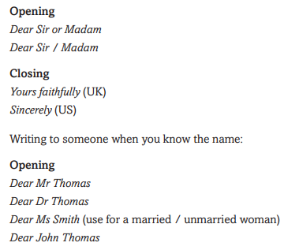
www.midocean.ae

Slide 10
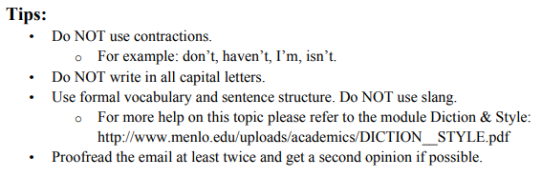
www.midocean.ae

Slide 11
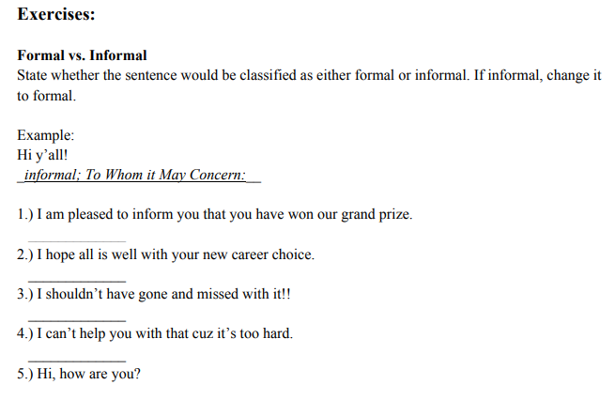
www.midocean.ae

Slide 12
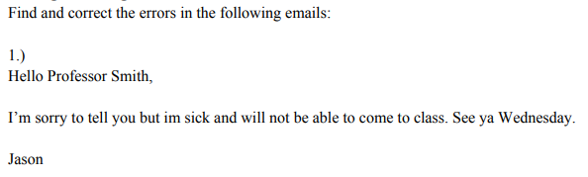
www.midocean.ae

Slide 13
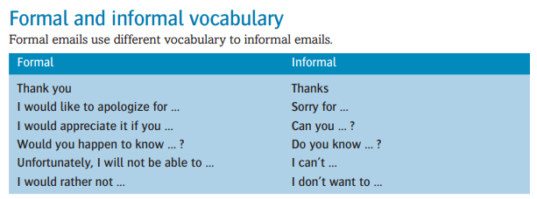
www.midocean.ae

Slide 14
Write an email to your professor asking him/her to postpone the exam.
www.midocean.ae

Slide 15
Writing a Paragraph
www.midocean.ae

Slide 16
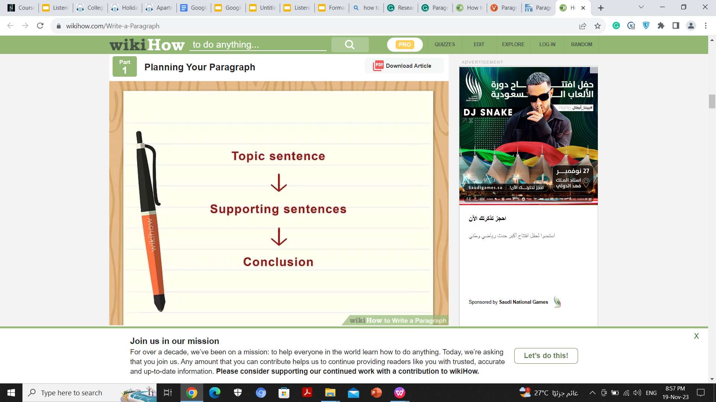
www.midocean.ae

Slide 17
1- Topic sentence
The topic sentence introduces the main idea that the paragraph is about. It shouldn’t reveal too much on its own, but rather prepares the reader for the rest of the paragraph by stating clearly what topic will be discussed.
www.midocean.ae

Slide 18
2. Supporting Sentences
Supporting sentences explain the topic sentence in detail. They expand the main topic and develops the main idea into the explanation. They explain the main topic using examples, facts, quotes, etc. They have to be related to the topic sentence.
www.midocean.ae

Slide 19
2. Supporting Sentences
Supporting sentences explain the topic sentence in detail. They expand the main topic and develops the main idea into the explanation. They explain the main topic using examples, facts, quotes, etc. They have to be related to the topic sentence.
www.midocean.ae

Slide 20
3- concluding sentence.
The concluding sentence of your paragraph should tie everything together. A good concluding sentence will reinforce the idea outlined in your topic sentence, but now it has all the weight of the evidence or arguments contained in your supporting sentences behind it. After reading the concluding sentence, the reader should have no doubt as to the accuracy or relevance of the paragraph as a whole.
www.midocean.ae

Slide 21
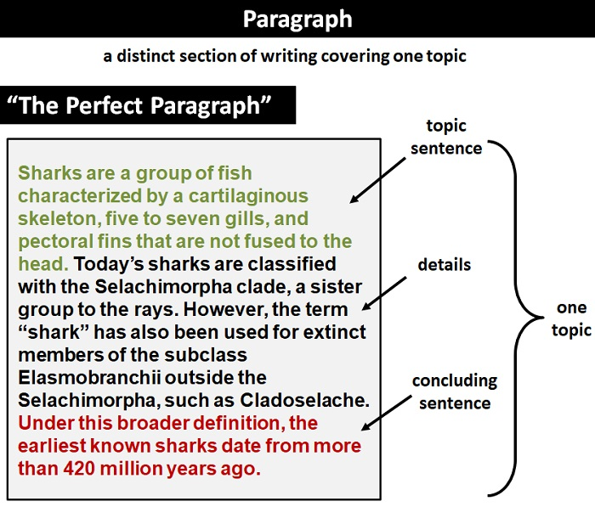
www.midocean.ae

Slide 22


Thank You

