Slide 1
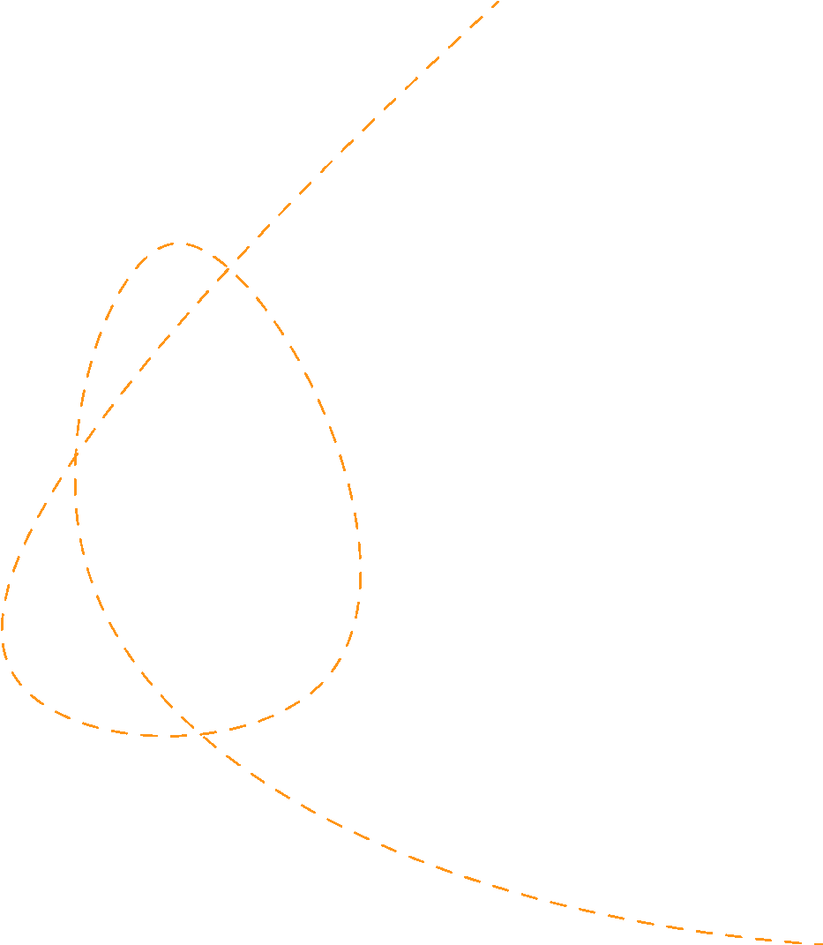





Simultanious Eqns. & Equilibrium
Prepared by Dr. Sahar ALBOSAILY
Lecture 05
MTH 112
Business Mathematics

Slide 2
At the end of this section you should be familiar with:
How to solve two simultaneous equations in two unknowns using: (a) Algebra
(b) Graphical methods
Determining when two equations in two unknowns have: (a) A unique solution
(b) No solution
(c) Infinitely many solutions
Solving three simultaneous equations in three unknowns.
Equilibrium of Goods

Slide 3
Solving simultaneous equations
Reminder:
A solution of an equation in an unknown, say x, is simply the value for .vfor which the left-hand side (LHS) of the equation is equal to the right-hand side (RHS).
For example, consider the equation x + 4 = 6
The solution of this equation is x = 2 x=2 is the only value of x for which the LHS= RHS.
The statement 'x = 2 satisfies the equation' is another way of saying that x = 2 is a solution.
Therefore, the solution of a set of simultaneous equations is a set of values for the variables which satisfy all the equations.

Slide 4
Solving simultaneous equations - Example
Two equations in two unknowns
Example: Given the simultaneous equations
$x+3y=4$
$$-x+2y=6$$
Solve for $x$ and $y$ algebraically.
Solve for $x$ and $y$ graphically.

Slide 5
Solving simultaneous equations- Solution (a)(1/5)
Two equations in two unknowns
Solution: (a)Method:
Eliminate $x$ from the system of equations by adding equations (1) and (2).
The two equations reduce to a single equation in which the only unknown is $y$.
Solve for $y$, then substitute the value of $y$ into either of the original equations and solve for $x$:

Slide 6
Solving simultaneous equations- Solution (a)(2/5)
Two equations in two unknowns
Solution: (a)
Step 1:
$x+3y=4$ (1)
$-x+2y=6$ (2)
____________
$0+5y=10$ (adding (1) and (2))
$y=\frac{10}{5}=2$ solving for $y$

Slide 7
Solving simultaneous equations- Solution (a)(3/5)
Two equations in two unknowns
Solution: (a)
Step 2:
Solve for $x$ by substituting $y=2$ into either equation (1) or equation (2):
$-x+(2)(2)=6$ (Substituting $y=2$ into equation (2))
$-x=6-4$
$x=-2$

Slide 8
Solving simultaneous equations- Solution (a)(4/5)
Two equations in two unknowns
Solution: (a)
Step 3:
Check the solution $x=-2,y=2$ by substituting these values into equations (1) and (2) and confirm that both equations balance.
Substitute x = -2 and y = 2 into equation (1):
$x+3y=4$
$(-2)+3(2)=4$ (substituting in $x=-2\text{and}y=2$)
$-2+6=4→4=4$ so equation (1) balances and $x=-2,y=2$ is a solution

Slide 9
Solving simultaneous equations- Solution (a)(5/5)
Two equations in two unknowns
Solution: (a)
Step 3:
Substitute x = -2 and y = 2 into equation (2):
$-x+3y=6$
$-(-2)+2(2)=6$ (substituting in $x=-2\text{and}y=2$)
$-2+4=6→6=6$ so equation (2) balances and $x=-2,y=2$ is a solution.
Since the point (—2,2) satisfies equations (1) and (2), then this point is at the point of intersection of the lines represented by equations (1) and (2) as shown in (b).

Slide 10
Solving simultaneous equations- Solution (b)
Two equations in two unknowns
Solution: (b)
The two lines are plotted in Figure 3.1.The point of intersection is the solution. The coordinates of this point are $x=-2\text{and}y=2$. In this case, it is a unique solution, that is, the lines intersect at only one point. This point is on the first line so it satisfies equation (1) and also on the second line, so it satisfies equation (2).

Slide 11

Simultaneous equations
A set of simultaneous equations may have:
Unique solution: This occurs when a set of equations has one set of values which satisfy all equations.
No solution: This occurs when a set of equations has no set of values which satisfy all equations.
Infinitely many solutions: A set of equations has infinitely many solutions when there is an infinite number of sets of values that satisfy all equations.

Slide 12
Simultaneous equations -No solution Example
Example:
Given the simultaneous equations
y = 1+ x
y=2+x
Solve for x and y algebraically.
Solve for x and y graphically.

Slide 13
Simultaneous equations -No solution Example
Solution:

Slide 14
Simultaneous equations -No solution Example
Solution:

Slide 15
Simultaneous equations -No solution Example
Solution:

Slide 16
Simultaneous equations -No solution Example
Solution:

Slide 17
Simultaneous equations -No solution Example
Solution:

Slide 18
Simultaneous equations -No solution Example
Solution:

Slide 19
Simultaneous equations -No solution Example
Solution:

Slide 20
Simultaneous equations -No solution Example
Solution:

Slide 21
Simultaneous equations -No solution Example
Solution:

Slide 22
Simultaneous equations -No solution Example
Solution:

Slide 23
Simultaneous equations -Three equations

Slide 24



Simultaneous equations -Three equations

Slide 25
Simultaneous equations -Three equations

Slide 26
Simultaneous equations -Three equations

Slide 27
Simultaneous equations -Three equations

Slide 28
Simultaneous equations -Three equations

Slide 29
Equilibrium in the goods and labour markets

Slide 30
Equilibrium in the goods and labour markets
Example
The demand and supply functions for a good are given as
Demand function
Supply function
Calculate the equilibrium price and quantify algebraically and graphically.

Slide 31
Equilibrium in the goods and labour markets
Solution

Slide 32
Equilibrium in the goods and labour markets

Slide 33
Equilibrium in the goods and labour markets

Slide 34
Equilibrium in the goods and labour markets

Slide 35
Equilibrium in the goods and labour markets
Price ceiling
. Price cooling is used by governments in cases where they believe that the equilibrium price is too high for the consumer to pay. Thus, price ceiling operates below market equilibrium and are aimed to protecting consumers.

Slide 36
Equilibrium in the goods and labour markets
The demand and supply functions for a good are given by
Demand function
' supply function
analyst the effect of the introduction of a price ceiling of £40 in this market.
Calculate the profit made by blackmarketters if a black market operated in this market

Slide 37
Equilibrium in the goods and labour markets

Slide 38
Equilibrium in the goods and labour markets

Slide 39
Equilibrium in the goods and labour markets

Slide 40
Equilibrium in the goods and labour markets

Slide 41
Equilibrium in the goods and labour markets

Slide 42
Equilibrium in the goods and labour markets

Slide 43
Equilibrium in the goods and labour markets

Slide 44
Thank you

