Slide 1


E-Commerce
Prepared by Dr. Magdy Alhaj
MGM 212
Lecture 3

Slide 2



E-business infrastructure
Lecture 3
MGM 212
Prepared by
Dr. Magdy Alhaj
www.midocean.ae

Slide 3
03
COURSE OUTLINE
Lecture
Lecture 1: Introduction to e-business and e-commerce.
Lecture 2: E-commerce fundamentals.
Lecture 3: E-business infrastructure.
Lecture 4: - E-environment.
Lecture 5: E-business strategy.
Lecture 6: E-procurement.
Lecture 7: E-marketing.
Lecture 8: Customer relationship management.
Lecture 9: Analysis and design.
Lecture 10: Implementation and maintenance.
www.midocean.ae

Slide 4
Lecture
03
LECTURE OUTLINE
1. Introduction.
- E-business infrastructure.
- E-business infrastructure components.
2. Internet technology.
- Hosting of web sites and e-business services.
- The Internet timeline.
3. Web technology.
4. Managing e-business infrastructure.
www.midocean.ae

Slide 5
Lecture
03
LEARNING OBJECTIVES
After completing this chapter the student should be able to:
1. Outline the hardware and software technologies used to build an e-business infrastructure within an organization and with its partners
2. Outline the hardware and software requirements necessary to enable employee access to the Internet and hosting of e-commerce services.
www.midocean.ae

Slide 6

TITLE OF LECTURE
E-business infrastructure
Lecture
03
1. Introduction:
Defining an adequate technology infrastructure is vital to all companies adopting e-business. The infrastructure directly affects the quality of service experienced by users of the systems in terms of speed and responsiveness. The e-business services provided through a standardized infrastructure also determine the capability of an organization to compete through differentiating itself in the marketplace. Mcafee and Brynjolfsson suggest that to use digital technology to support competition the mantra for the CEO should be:
www.midocean.ae

Slide 7
Lecture
TITLE OF LECTURE
E-business infrastructure
03
- E-business infrastructure
refers to the combination of hardware such as servers and client PCs in an organization, the network used to link this hardware and the software applications used to deliver services to workers within the e-business and also to its partners and customers. Infrastructure also includes the architecture of the networks, hardware and software and where it is located.
www.midocean.ae

Slide 8

Lecture
TITLE OF LECTURE
E-business infrastructure
03
Finally, infrastructure can also be considered to include the methods for publishing data and documents accessed through e-business applications. A key decision with managing this infrastructure is which elements are located within the company and which are managed externally as third-party managed applications, data servers and networks.
www.midocean.ae

Slide 9

Lecture
TITLE OF LECTURE
E-business infrastructure
03
- E-business infrastructure components
Figure 3.1 summarizes how the different components of e-business architecture which need to be managed relate to each other. The different components can be conceived of as different layers with defined interfaces between each layer. The different layers can best be understood in relation to a typical task performed by a user of an e-business system.
www.midocean.ae

Slide 10

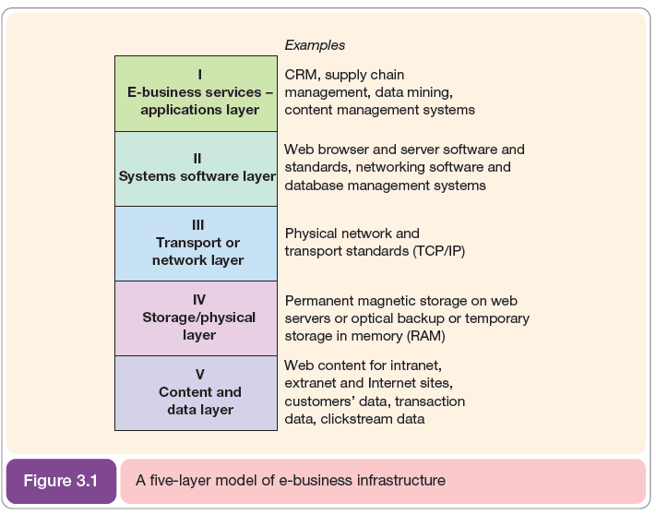
Lecture
TITLE OF LECTURE
E-business infrastructure
03
www.midocean.ae

Slide 11

Lecture
TITLE OF LECTURE
E-business infrastructure
03
For example, an employee who needs to book a holiday will access a specific human resources application or program that has been created to enable the holiday to be booked (Level I in Figure 3.1). This application will enable a holiday request to be entered and will forward the application to their manager and human resources department for approval. To access the application, the employee will use a web browser such as Microsoft Internet Explorer, Mozilla Firefox or Google Chrome using an operating system such as Microsoft Windows XP or Apple OS X (Level II in Figure 3.1).
www.midocean.ae

Slide 12

Lecture
TITLE OF LECTURE
E-business infrastructure
03
This systems software will then request transfer of the information about the holiday request across a network or transport layer (Level III in Figure 3.1). The information will then be stored in computer memory (RAM) or in long-term magnetic storage on a web server (Level IV in Figure 3.1). The information itself which makes up the web pages or content viewed by the employee and the data about their holiday request are shown as a separate layer (Level V in Figure 3.1), although it could be argued that this is the first or second level in an e-business architecture.
www.midocean.ae

Slide 13
Lecture
TITLE OF LECTURE
E-business infrastructure
03
2. Internet technology:
As you will know, the Internet enables communication between millions of connected computers worldwide, but how does the seamless transfer of data happen? Requests for information are transmitted from client computers and mobile devices whose users request services to server computers that hold information and host business applications that deliver the services in response to requests. Thus, the Internet is a large-scale client/server system.
www.midocean.ae

Slide 14
Lecture
TITLE OF LECTURE
E-business infrastructure
03
Figure 3.2 shows how the client computers within homes and businesses are connected to the Internet via local Internet service providers (ISPs) which, in turn, are linked to larger ISPs with connection to the major national and international infrastructure or backbones which are managed by commercial.
www.midocean.ae

Slide 15
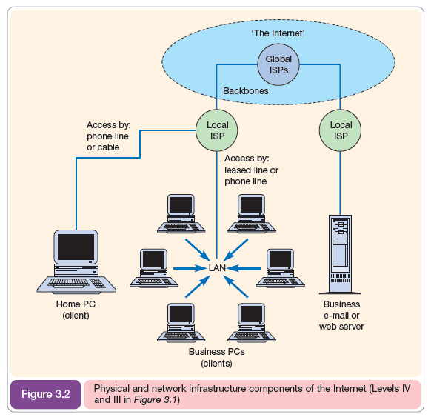
Lecture
TITLE OF LECTURE
E-business infrastructure
03
www.midocean.ae

Slide 16
Lecture
TITLE OF LECTURE
E-business infrastructure
03
Globally, there are many submarine cables which form the backbone between countries, which are susceptible to damage, for example in January 2008 a ship’s anchor severed a cable in the Mediterranean resulting in a dramatic slowdown in Internet access for people in India, Sri Lanka, Pakistan and the Middle East.
www.midocean.ae

Slide 17
Lecture
TITLE OF LECTURE
E-business infrastructure
03
- Hosting of web sites and e-business services:
While it is possible for companies to manage their own services by setting up web servers within their own company offices, or to use their ISP, it is common practice to use a specialist hosting provider to manage this service. For example, Rackspace (Figure 3.3) describe itself as ‘Europe’s fastest growing hosting company’. Since 2001 Rackspace has been hosting and supporting mission critical web sites, Internet applications, e-mail servers, security and storage services for over 4,000 customers. Rackspace also has US offices.
www.midocean.ae

Slide 18
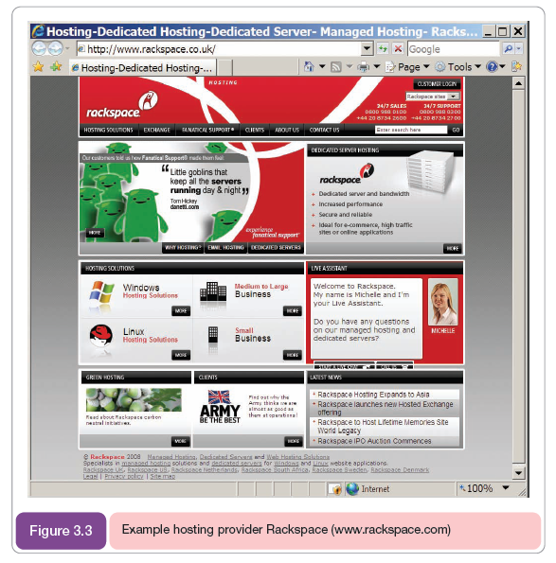
Lecture
TITLE OF LECTURE
E-business infrastructure
03
www.midocean.ae

Slide 19
Lecture
TITLE OF LECTURE
E-business infrastructure
03
- The Internet timeline:
The Internet is only the latest of a series of developments in the way that the human race has used technology to disseminate information. Kampas identifies ten stages that are part of five ‘mega waves’ of change. The first six stages are summarized in Table 3.2. It is evident that many of the major advances in the use of information have happened within the last hundred years. This indicates that the difficulty of managing technological change is likely to continue. Kampas goes on to speculate on the impact of access to lower-cost, higher-bandwidth technologies.
www.midocean.ae

Slide 20
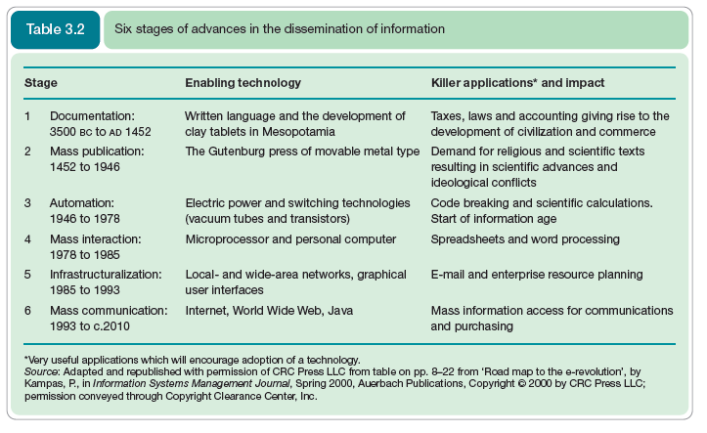
Lecture
TITLE OF LECTURE
E-business infrastructure
03
www.midocean.ae

Slide 21
Lecture
TITLE OF LECTURE
E-business infrastructure
03
- Intranet applications
Intranets are used extensively for supporting sell-side e-commerce from within the marketing function. They are also used to support core supply-chain management activities as described in the next section on extranets. A marketing intranet has the following advantages:
www.midocean.ae

Slide 22
Lecture
TITLE OF LECTURE
E-business infrastructure
03
- Reduced product lifecycles – as information on product development and marketing campaigns is rationalized we can get products to market faster.
- Reduced costs through higher productivity, and savings on hard copy.
- Better customer service – responsive and personalized support with staff accessing customers over the web.
- Distribution of information through remote offices nationally or globally.
www.midocean.ae

Slide 23
Lecture
TITLE OF LECTURE
E-business infrastructure
03
Intranets are also used for internal marketing communications since they can include the following types of information:
- Staff phone directories;
- Staff procedures or quality manuals;
- Information for agents such as product specifications, current list and discounted prices, competitor information, factory schedules, and stocking levels, all of which normally have to be updated frequently and can be costly;
- Staff bulletin or newsletter;
- Training courses.
www.midocean.ae

Slide 24
Lecture
TITLE OF LECTURE
E-business infrastructure
03
- Extranet applications
Although an extranet may sound complex, from a user point of view it is straightforward. If you have bought a book or CD online and have been issued with a username and password to access your account, then you have used an extranet. This is a consumer extranet. Extranets are also used to provide online services which are restricted to business customers.
www.midocean.ae

Slide 25
Lecture
TITLE OF LECTURE
E-business infrastructure
03
Vlosky et al. (2000) refer to these business benefits of an extranet:
1. Information sharing in secure environment. Information needed to support business through a range of business partners can be shared using an extranet.
2. Cost reduction. Operating processes can be made more efficient through an extranet.
3. Order processing and distribution. The authors refer to an ‘electronic integration effect’.
4. Customer service. Improving levels of service is one of the main benefits of the Premier Dell.com extranet described above although it also has the other benefits listed above.
www.midocean.ae

Slide 26
Lecture
TITLE OF LECTURE
E-business infrastructure
03
- Firewalls
Firewalls are necessary when creating an intranet or extranet to ensure that outside access to confidential information does not occur. Firewalls are usually created as software mounted on a separate server at the point where the company is connected to the Internet. Firewall software can then be configured to only accept links from trusted domains representing other offices in the company. A firewall has implications for e-marketing since staff accessing a web site from work may not be able to access some content such as graphics plugins.
www.midocean.ae

Slide 27
Lecture
TITLE OF LECTURE
E-business infrastructure
03
- Encouraging use of intranets and extranets
Although intranets and extranets have many benefits for the business, they often represent a change to existing methods of working for business people. As such, encouraging their usage is often a challenge. In many ways, this challenge is similar to encouraging customers to use open-access web sites.
www.midocean.ae

Slide 28
Lecture
TITLE OF LECTURE
E-business infrastructure
03
3. Web technology:
The World Wide Web, or ‘web’ for short, has proved so successful since it provides a standard method for exchanging and publishing information on the Internet.
- Web browsers and servers
Web browsers are software such as Microsoft Internet Explorer and Mozilla Firefox which we use to access the information on the WWW that is stored on web servers.
www.midocean.ae

Slide 29
Lecture
TITLE OF LECTURE
E-business infrastructure
03
- Web servers
Web servers are used to store, manage and supply the information on the WWW. The main web browsers are Microsoft Internet Explorer and Mozilla Firefox with the Apple Safari browser and Google Chrome having relatively small market share. Browsers display the text and graphics accessed from web sites and provide the interactions.
www.midocean.ae

Slide 30
Lecture
TITLE OF LECTURE
E-business infrastructure
03
4. Managing e-business infrastructure:
As explained at the start of the chapter, e-business infrastructure comprises the hardware, software, content and data used to deliver e-business services to employees, customers and partners. In this part of the chapter we look at the management of e-business infrastructure by reviewing different perspectives on the infrastructure. These are:
www.midocean.ae

Slide 31
Lecture
TITLE OF LECTURE
E-business infrastructure
03
1. Hardware and systems software infrastructure. This refers mainly to the hardware and network infrastructure discussed in the previous sections. It includes the provision of clients, servers, network services and also systems software such as operating systems and browsers (Layers II, III and IV in Figure 3.1).
2. Applications infrastructure. This refers to the applications software used to deliver services to employees, customers and other partners (Layer I in Figure 3.1).
www.midocean.ae

Slide 32
Lecture
TITLE OF LECTURE
E-business infrastructure
03
1. Managing hardware and systems software infrastructure:
Management of the technology infrastructure requires decisions on Layers II, III and IV in Figure 3.1.
Layer II – Systems software
The key management decision is standardization throughout the organization. Standardization leads to reduced numbers of contacts for support and maintenance and can reduce purchase prices through multi-user licences.
www.midocean.ae

Slide 33
Lecture
TITLE OF LECTURE
E-business infrastructure
03
- Layer III – Transport or network
Decisions on the network will be based on the internal company network, which for the e-business will be an intranet, and for the external network either an extranet or VPN or links to the public Internet.
www.midocean.ae

Slide 34
Lecture
TITLE OF LECTURE
E-business infrastructure
03
- Layer IV – Storage
The decision on storage is similar to that for the transport layer. Storage can be managed internally or externally. This is not an either–or choice. For example, intranet and extranet are commonly managed internally while Internet storage such as the corporate web site is commonly managed externally or at an application service provider. However, intranets and extranets can also be managed externally.
www.midocean.ae

Slide 35
Lecture
03
TITLE OF LECTURE
E-business infrastructure
Managing Internet service and hosting providers:
Service providers who provide access to the Internet for consumers or businesses are usually referred to as ‘ISPs’ or ‘Internet service providers’. ISPs may also host the web sites which publish a company’s web site content. But many organizations will turn to a separate hosting provider to manage the company’s web site and other e-business services accessed by customers and partners such as extranets, so it is important to select an appropriate hosting provider.
www.midocean.ae

Slide 36
Lecture
TITLE OF LECTURE
E-business infrastructure
03
- ISP connection methods
Figure 3.2 shows the way in which companies or home users connect to the Internet. The diagram is greatly simplified in that there are several tiers of ISPs. A user may connect to one ISP which will then transfer the request to another ISP which is connected to the main Internet backbone.
www.midocean.ae

Slide 37
Lecture
TITLE OF LECTURE
E-business infrastructure
03
- Issues in management of ISP and hosting relationships
The primary issue for businesses in managing ISPs and hosting providers is to ensure a satisfactory service quality at a reasonable price. As the customers and partners of organizations become more dependent on their web services, it is important that downtime be minimized.
www.midocean.ae

Slide 38
Lecture
TITLE OF LECTURE
E-business infrastructure
03
- Speed of access
A site or e-business service fails if it fails to deliver an acceptable download speed for users. In the broadband world this is still important as e-business applications become more complex and sites integrate more rich media such as audio and video.
www.midocean.ae

Slide 39
Lecture
TITLE OF LECTURE
E-business infrastructure
03
- Availability
The availability of a web site is an indication of how easy it is for a user to connect to it. In theory this figure should be 100 per cent, but sometimes, for technical reasons such as failures in the server hardware or upgrades to software, the figure can drop substantially below this.
www.midocean.ae

Slide 40
Lecture
TITLE OF LECTURE
E-business infrastructure
03
- Service-level agreements
To ensure the best speed and availability a company should check the service-level agreements (SLAs) carefully when outsourcing web site hosting services.
- Security
Security is another important issue in service quality. How to control security was referred to in the earlier section on firewalls and is considered in detail in the Focus on security design.
www.midocean.ae

Slide 41
Lecture
03
TITLE OF LECTURE
E-business infrastructure
2. Managing e-business applications infrastructure:
Management of the e-business applications infrastructure concerns delivering the right applications to all users of e-business services. The issue involved is one that has long been a concern of IS managers, namely to deliver access to integrated applications and data that are available across the whole company.
www.midocean.ae

Slide 42



TITLE OF LECTURE
E-business infrastructure
References:
E-Business and E-Commerce Management : strategy, implementation and practice, fourth edition.
By: dave chaffey.
Chapter 3
Thank You
www.midocean.ae

