Slide 1

RHSA (Admin 1) Red Hat Enterprise Linux 8 Essentials
Prepared by Eng. Taghreed Elsayed
Lecture 2
Access the Command Line

Slide 2


Chapter
02
Access the Command Line
THE bash SHELL A command line is:
a text-based interface which can be used to input instructions to a computer system. The Linux command line is provided by a program called the shell.
Over the long history of UNIX-like systems, many shells have been developed. The default shell for users in Red Hat Enterprise Linux is the GNU Bourne-Again Shell (bash). Bash is an improved version of one of the most successful shells used on UNIX-like systems, the Bourne Shell (sh).
This is called the shell prompt. When a regular user starts a shell, the default prompt ends with a $ character.
The $ is replaced by a # if the shell is running as the super user, root. This makes it more obvious that it is a super user shell, which helps to avoid accidents and mistakes in the privileged account.

Slide 3
Chapter
02
Access the Command Line
# Using bash to execute commands can be powerful. The bash shell provides a scripting language that can support automation of tasks. The shell has additional capabilities that can simplify or make possible operations that are hard to accomplish efficiently with graphical tools.
VIRTUAL CONSOLES Users access the bash shell through a terminal. A terminal provides a keyboard for user input and a display for output.
On text-based installations, this can be the Linux machine's physical console, the hardware keyboard and display. Terminal access can also be configured through serial ports.
Another way to access a shell is from a virtual console. A Linux machine's physical console supports multiple virtual consoles which act like separate terminals. Each virtual console supports an independent login session.

Slide 4
Chapter
02
Access the Command Line
SHELL BASICS Commands entered at the shell prompt have three basic parts:
• Command to run
• Options to adjust the behavior of the command
• Arguments, which are typically targets of the command The command is the name of the program to run.
It may be followed by one or more options, which adjust the behavior of the command or what it will do. Options normally start with one or two dashes (-a or --all, for example) to distinguish them from arguments.
Commands may also be followed by one or more arguments, which often indicate a target that the command should operate on. For example, the command line usermod -L morgan has a command (usermod), an option (-L), and an argument (morgan).

Slide 5
Chapter
02
Access the Command Line
The effect of this command is to lock the password on user morgan's account. To use a command effectively, a user needs to know what options and arguments it takes and in what order it expects them (the syntax of the command). Most commands have a --help option. This causes the command to print a description of what it does, a "usage statement" that describes the command's syntax, and a list of the options it accepts and what they do.
Usage statements may seem complicated and difficult to read. They become much simpler to understand once a user becomes familiar with a few basic conventions: • Square brackets, [], surround optional items. • Anything followed by ... represents an arbitrary-length list of items of that type. • Multiple items separated by pipes, |, means only one of them can be specified. • Text in angle brackets, <>, represents variable data. For example, means “insert the filename you wish to use here”. Sometimes these variables are simply written in capital letters (e.g., FILENAME). Consider the first usage statement for the date command:

Slide 6

Chapter
02
Access the Command Line
This indicates that date can take an optional list of options ([OPTION]...), followed by an optional format string, prefixed with a plus character, +, that defines how the current date should be displayed ([+FORMAT]). Since both of these are optional, date will work even if it is not given options or arguments (it will print the current date and time using its default format).

Slide 7
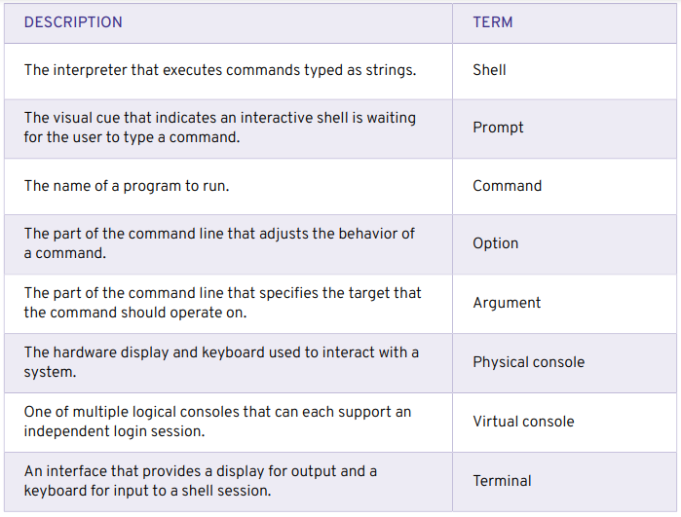
Chapter
02
Access the Command Line
LOCAL CONSOLE ACCESS TERMS

Slide 8
Chapter
02
Access the Command Line
EXECUTING COMMANDS USING THE BASH SHELL
BASIC COMMAND SYNTAX The GNU Bourne-Again Shell (bash) is a program that interprets commands typed in by the user. Each string typed into the shell can have up to three parts:
the command, options (that begin with a - or --), and arguments.
Each word typed into the shell is separated from each other with spaces. Commands are the names of programs that are installed on the system. Each command has its own options and arguments.
The Enter key is pressed when a user is ready to execute a command. Each command is typed on a separate line and the output from each command displays before the shell displays a prompt.
If a user wants to type more than one command on a single line, a semicolon, ;, can be used as a command separator. A semicolon is a member of a class of characters called meta characters that has special meanings for bash.

Slide 9
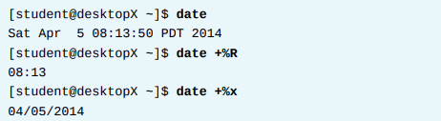
Chapter
02
Access the Command Line
EXAMPLES OF SIMPLE COMMANDS The date command is used to display the current date and time. It can also be used by the super user to set the system clock. An argument that begins with a plus sign (+) specifies a format string for the date command.
The pass word command changes a user's own password. The original password for the account must be specified before a change will be allowed. By default, pass word is configured to require a strong password, consisting of lowercase letters, uppercase letters, numbers, and symbols, and is not based on a dictionary word. The super user can use the pass word command to change other users' passwords.

Slide 10
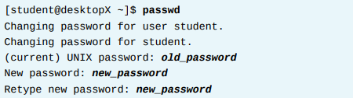
Chapter
02
Access the Command Line
Pass word: all authentication tokens updated successfully.
Linux does not require file name extensions to classify files by type. The file command scans the beginning of a file's contents and displays what type it is. The files to be classified are passed as arguments to the command.

Slide 11
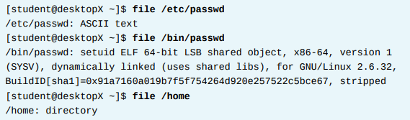
Chapter
02
Access the Command Line
The head and tail commands display the beginning and end of a file respectively. By default, these commands display 10 lines, but they both have a -n option that allows a different number of lines to be specified. The file to display is passed as an argument to these commands.

Slide 12
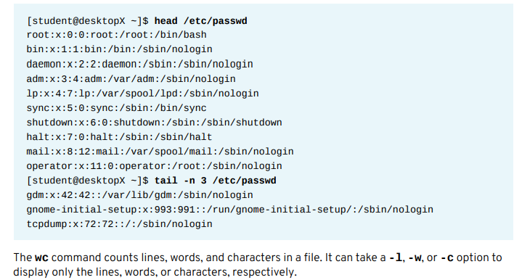
Chapter
02
Access the Command Line

Slide 13
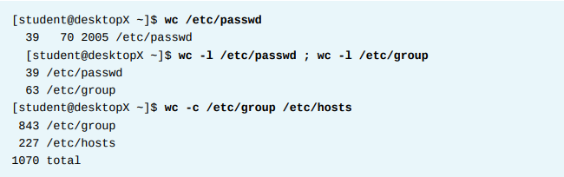
Chapter
02
Access the Command Line

Slide 14
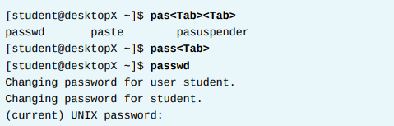
Chapter
02
Access the Command Line
TAB COMPLETION
Tab completion allows a user to quickly complete commands or file names once they have typed enough at the prompt to make it unique. If the characters typed are not unique, pressing the Tab key twice displays all commands that begin with the characters already typed.

Slide 15
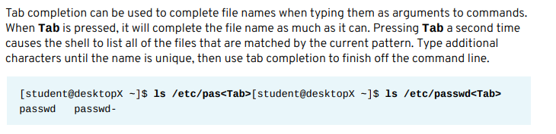

Chapter
02
Access the Command Line

Slide 16
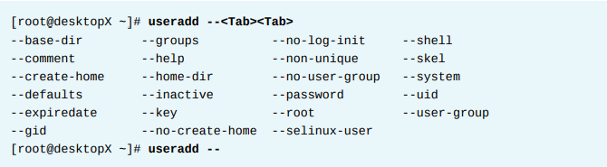
Chapter
02
Access the Command Line

Slide 17
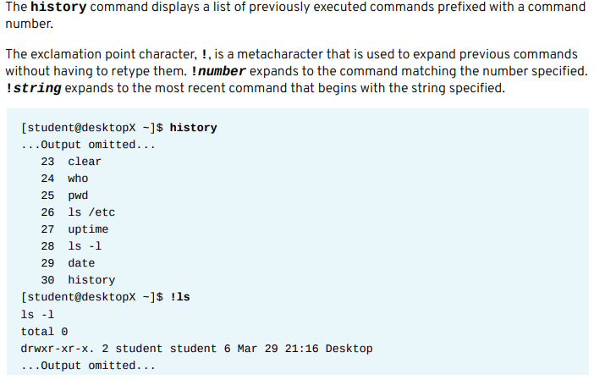
Chapter
02
COMMAND HISTORY

Slide 18
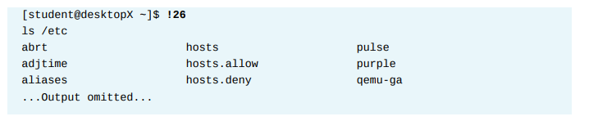
Chapter
02
Access the Command Line
The arrow keys can be used to navigate through previous command lines in the shell's history. Up Arrow edits the previous command in the history list. Down Arrow edits the next command in the history list. Use this key when the Up Arrow has been pressed too many times. Left Arrow and Right Arrow move the cursor left and right in the current command line being edited.
The Esc+. key combination causes the shell to copy the last word of the previous command on the current command line where the cursor is. If used repeatedly, it will continue to go through earlier commands.

Slide 19
Chapter
02
Editing Command Line
EDITING THE COMMAND LINE When used interactively, bash has a command line-editing feature. This allows the user to use text editor commands to move around within and modify the current command being typed.
Using the arrow keys to move within the current command and to step through the command history was introduced earlier in this session. More powerful editing commands are introduced in the following table.

Slide 20
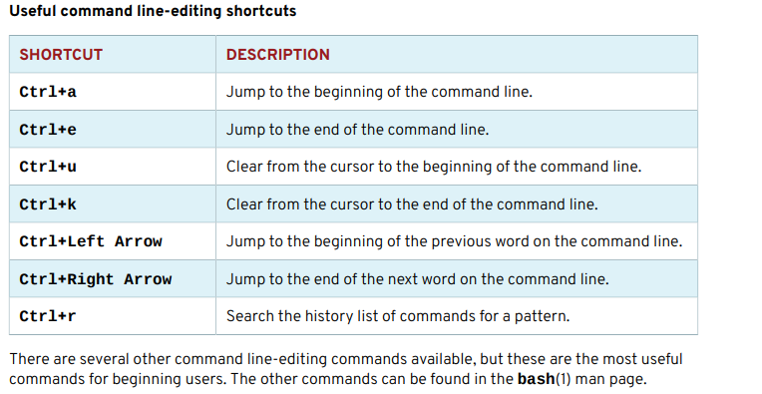
Chapter
02
Editing Command Line

Slide 21
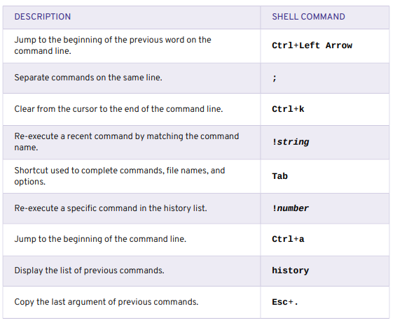
Chapter
02
BASH COMMANDS AND KEYBOARD SHORTCUTS

