Slide 1




Artificial Intelligence
Eng.Eman Elgallad
Lecture 2- Python Basics For AI

Slide 2


Lecture
Content
02
1. Introduction to Python
2. Lists and Tuples
3. Strings
4. Dictionaries
5. Conditional and Looping Statements
6. Functions
www. esu.ac.ae

Slide 3
Introduction

Slide 4
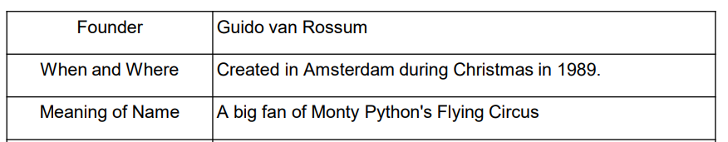
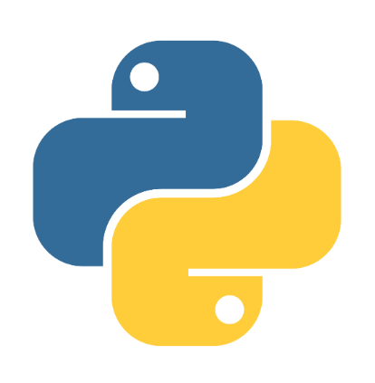
What Is Python?
Lecture
02
Python is one of the achievements of free software.
IT is a general-purpose and advanced programming language.
Python applies to programming in many fields:
➢ Data science
➢ Writing system tools
➢ Developing applications with graphical UIs
➢ Writing network-based software
➢ Interacting with databases
www. esu.ac.ae

Slide 5
Python VS Other Languages
Lecture
02
Python VS C:
➢ Python is dynamic while C is static.
➢ Memory is managed by the developer in C but by the interpreter in Python.
➢ Python has many libraries, but C has no standard library for a hybrid tuple
(Python list) and a hash table (Python dictionary).
➢ Python cannot be used to write a kernel, but C can.
➢ C or C++ extends Python functions based on the Python APIs.
www. esu.ac.ae

Slide 6
Python VS Other Languages
Lecture
02
Python VS Java:
➢ Python is dynamic while Java is static.
➢ Python supports object-oriented and function-based programming while
Java supports object-oriented programming only.
➢ Python is simpler than Java, and typically applies to quick prototyping.
➢ Python and Java enable multiple programmers to develop a large
project together step by step.
www. esu.ac.ae

Slide 7
Advantages of Python
Lecture
02
Simple: Python is an ideal programming language of simplicity.
Easy-to-learn: few key words, simple structure.
Open-source: Python is one of Free/Libre and Open-Source Software (FLOSS).
Interpretability: Python program does not need to be compiled into binary code and can be directly run from source code.
Scalability: If you want to speed up running of some key code or keep some algorithms not open, you can write some programs using C or C++ and use them in Python.
Embedded: Python can be embedded in a C or C++ program to provide scripting to program users.
Object-oriented: Python supports both process-oriented programming and Functional programming. In a process-oriented language, a program is built from a process or a function that is merely reusable code. In an object-oriented language, programs are built from the combination of data and functionality.
Rich libraries: The Python standard library is huge. It can help you with all kinds of work, including regular expressions, document generation, unit tests, threads, databases, Web browsers, CGI,Numpy, Pandas, HTML, WAV files, password systems, GUI, TK, and other system-related operations.
www. esu.ac.ae

Slide 8
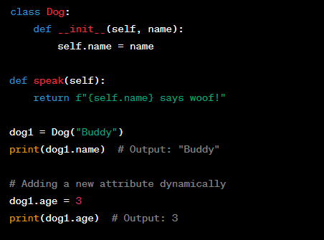
Features of Python Statements
Lecture
02
Dynamic: Objects (like attributes and methods) can be changed during execution.
www. esu.ac.ae

Slide 9
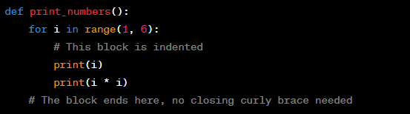

Features of Python Statements Cont.
Lecture
02
Python uses indentation instead of a pair of curly braces {} to divide a block of statements.
Multiple statements on one line are separated by “;”.
But it is not recommended and goes against the Pythonic style guidelines. Python emphasizes readability and clarity, so it's better to have one statement per line.
www. esu.ac.ae

Slide 10
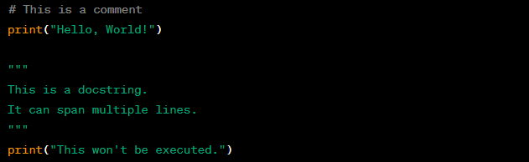
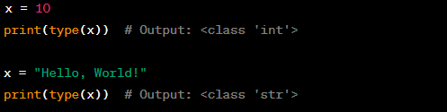
Features of Python Statements Cont.
Lecture
02
the hash (#) symbol is used to comment out a single line, while triple quotes ("""...""") are used for docstrings, which can also be used to comment out multiple lines.
Variables do not need type definitions, variables are dynamically typed, meaning you don't need to explicitly declare their data types. It is determined during runtime based on the value assigned
www. esu.ac.ae

Slide 11
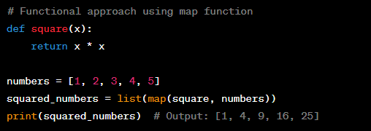
Features of Python Statements Cont.
Lecture
02
the Functional Programming (FP) is available.
Functional programming allows you to write more expressive code, and Python's support for it gives you the flexibility to choose between different programming styles based on the problem at hand.
www. esu.ac.ae

Slide 12
Lists and Tuples

Slide 13
Lists:
Lecture
02
A list is an ordered set of elements that you can add and delete at any time.
The element types in the list can be different. You can access each element in the list by index. The first digit of the index starts from 0, and the reverse index starts from -1.
Common Operations on Lists
Create and Access List:
  # Creating a list
  fruits = ["apple", "banana", "orange", "grape"]
  # Accessing elements by index
  print(fruits[0])
  # Output: "apple"
  print(fruits[-1])
  # Output: "grape"
www. esu.ac.ae

Slide 14
Methods of Python Listing
Lecture
02
list.append(obj) list.count(obj) list.extend(seq) list.index(obj) list.insert(index, obj)
list.pop(obj=list[-1]) list.remove(obj) list.sort([func]) list.reverse()
  # Append an element to the end of the list
  fruits.append("pear")
  print(fruits)
  # Output: ["apple", "banana", "orange", "grape", "pear"]
  # Insert an element at a specific index
  fruits.insert(1, "kiwi")
  print(fruits)
  # Output: ["apple", "kiwi", "banana", "orange", "grape", "pear"]
  # Remove an element by index
  del fruits[0]
  print(fruits)
  # Output: ["kiwi", "banana", "grape", "pear"]
www. esu.ac.ae

Slide 15
List method examples
Lecture
02
fruits = ["apple", "banana", "orange", "apple"]
# Count occurrences of an element in the list
print(fruits.count("apple"))
# Output: 2
# Extend the list by appending elements from another list
fruits_to_add = ["kiwi", "grape"]
fruits.extend(fruits_to_add)
print(fruits)
# Output: ["apple", "banana", "orange", "apple", "pear", "kiwi", "grape"]
# Find the index of the first occurrence of an element in the list
print(fruits.index("banana"))
# Output: 1
www. esu.ac.ae

Slide 16
List method examples Cont.
Lecture
02
# Remove the last element from the list and return it
popped_fruit = fruits.pop()
print(popped_fruit)
# Output: "grape"
print(fruits)
# Output: ["apple", "banana", "mango", "orange", "apple", "pear", "kiwi"]
# Remove the first occurrence of an element from the list
fruits.remove("apple")
print(fruits)
# Output: ["banana", "mango", "orange", "apple", "pear", "kiwi"]
www. esu.ac.ae

Slide 17
List method examples Cont.
Lecture
02
# Sort the list in ascending order
fruits.sort()
print(fruits)
# Output:
["apple", "banana", "kiwi", "mango", "orange", "pear"]
# Reverse the elements in the list
fruits.reverse()
print(fruits)
# Output:
["pear", "orange", "mango", "kiwi", "banana", "apple"]
www. esu.ac.ae

Slide 18
Tuple
Lecture
02
Tuple is expressed using ().
Like a list, a tuple cannot be modified once initialized, and the elements need to be identified when a tuple is defined.
A tuple does not have the append () or insert () method, nor can it be
assigned to another element. It has the same fetching methods as a list.
Because a tuple is unchangeable, the code is more secure. Therefore, if possible, use a tuple instead of a list.
A tuple is simple to create. You only need to add elements to
parentheses and separate them with commas.
www. esu.ac.ae

Slide 19
Common Tuple Operations
Lecture
02
1. Accessing Elements in a Tuple:
# Accessing elements by index
fruits_tuple = ("apple", "banana", "orange", "grape")
print(fruits_tuple[0])
# Output: "apple"
print(fruits_tuple[-1])
# Output: "grape"
www. esu.ac.ae

Slide 20
Common Tuple Operations
Lecture
02
2. Modifying Tuples (Tuple Calculation):
Tuples are immutable in Python, meaning their elements cannot be changed once they are created. So, you cannot directly modify a tuple. However, you can perform tuple operations that create new tuples based on existing tuples.
# Tuple Concatenation
tuple1 = (1, 2, 3)
tuple2 = (4, 5, 6)
concatenated_tuple = tuple1 + tuple2
print(concatenated_tuple)
# Output: (1, 2, 3, 4, 5, 6)
# Tuple Repetition
repeated_tuple = tuple1 * 3
print(repeated_tuple)
# Output: (1, 2, 3, 1, 2, 3, 1, 2, 3)
www. esu.ac.ae

Slide 21
Common Tuple Operations
Lecture
02
3. Deleting a Tuple (using del):
Since tuples are immutable, you cannot delete elements within a tuple. However, you can delete the entire tuple using the `del` keyword.
# Creating a tuple
fruits_tuple = ("apple", "banana", "orange", "grape")
# Deleting the entire tuple
del fruits_tuple
# After this point, the tuple 'fruits_tuple' is no longer accessible or exists in memory
4. Tuple Operators (+ and *):
As shown in the previous example, you can use the `+` operator to concatenate two tuples, and the `*` operator to repeat a tuple.
www. esu.ac.ae

Slide 22
Common Tuple Operations
Lecture
02
5. Tuple Indexing and Slicing (Interception):
Tuples support indexing and slicing, just like lists.
numbers_tuple = (1, 2, 3, 4, 5)
# Indexing
print(numbers_tuple[2])
# Output: 3
# Slicing
print(numbers_tuple[1:4])
# Output: (2, 3, 4)
www. esu.ac.ae

Slide 23
Embeded Functions of tuple
Lecture
02
-len(tuple) -max(tuple)
-min(tuple) -tuple(seq)
1.`len(tuple)`: Returns the number of elements in the tuple.
numbers_tuple = (1, 2, 3, 4, 5)
print(len(numbers_tuple))
# Output: 5
2. `max(tuple)`: Returns the largest element in the tuple.
numbers_tuple = (1, 2, 3, 4, 5)
print(max(numbers_tuple))
# Output: 5
3. `min(tuple)`: Returns the smallest element in the tuple.
numbers_tuple = (1, 2, 3, 4, 5)
print(min(numbers_tuple))
# Output: 1
`4. `tuple(seq)`: Converts a sequence (e.g., a list or string) into a tuple.
my_list = [1, 2, 3, 4, 5]
converted_tuple = tuple(my_list)
print(converted_tuple)
# Output: (1, 2, 3, 4, 5)
www. esu.ac.ae

Slide 24
Strings

Slide 25
Strings
Lecture
02
In Python, a string is a sequence of 0 or more characters, and a string is one of several sequences built in Python. Strings are unchangeable and are like string constants in the C and C++ languages.
1. Creating Strings:
# Single quotes
single_quote_str = 'Hello, I am a string.'
# Double quotes
double_quote_str = "I am also a string."
# Triple quotes for multiline strings
multiline_str = '''This is a multiline
string in Python.'''
www. esu.ac.ae

Slide 26
Strings
Lecture
02
3. String Concatenation:
first_name = "John"
last_name = "Doe"
full_name = first_name + " " + last_name
print(full_name)
# Output: "John Doe“
4. String Length:
text = "Hello, Python!"
print(len(text))
# Output: 14
2. String Indexing and Slicing:
my_string = "Hello, World!"
# Accessing characters by index
print(my_string[0])
# Output: "H"
print(my_string[-1])
# Output: "!"
# Slicing to get substrings
print(my_string[7:12])
# Output: "World"
www. esu.ac.ae

Slide 27
5- Strings Methods
Lecture
02
Strings come with various built-in methods for various operations. Some common methods include:
my_string = "Hello, Python!"
# Convert to lowercase
print(my_string.lower())
# Output: "hello, python!"
# Convert to uppercase
print(my_string.upper())
# Output: "HELLO, PYTHON!"
# Replace characters
print(my_string.replace("Python", "World"))
# Output: "Hello, World!"
# Split the string into a list of words
print(my_string.split())
# Output: ['Hello,', 'Python!']
www. esu.ac.ae

Slide 28
Strings
Lecture
02
6. String Formatting:
name = "Alice"
age = 30
message = "Hello, my name is {} and I am {} years old.".format(name, age)
print(message)
# Output: "Hello, my name is Alice and I am 30 years old."
7. Escape Sequences:
# Using escape sequences
print("This is a new line.\nThis is a tab:\t\tTab is used for indentation.")
www. esu.ac.ae

Slide 29
Dictionaries

Slide 30
Dictionaries:
Lecture
02
- A dictionary is a collection of key-value pairs.
- Each key-value pair in the dictionary is separated by a colon (":").
- Key-value pairs are separated by a comma (",").
- The entire dictionary is enclosed in curly braces "{}".
- Keys in a dictionary are generally unique, and their type is unchangeable (immutable).
- If a key repeats, the last key-value pair replaces the previous one. Dictionaries do not allow duplicate keys.
- The values in a dictionary can be of any data type (e.g., int, float, string, list, tuple, another dictionary, etc.).
- Dictionaries are mutable, meaning you can add, modify, or delete elements after creation.
A dictionary is represented in the following format:
d = {key1: value1,
key2: value2,
key3: value3}
www. esu.ac.ae

Slide 31
Dictionaries:
Lecture
02
Here’s code example of creating and accessing elements from a dictionary:
person = {
"name": "John Doe",
"age": 30,
"occupation": "Engineer",
"is_employed": True}
# Accessing elements using keys
print(person["name"])
# Output: "John Doe"
print(person["age"])
# Output: 30
print(person["is_employed"])
# Output: True
Dictionaries provide an efficient way to store and retrieve data using keys, making them an essential data structure in Python for many programming tasks.
www. esu.ac.ae

Slide 32
Conditional and Looping Statements

Slide 33
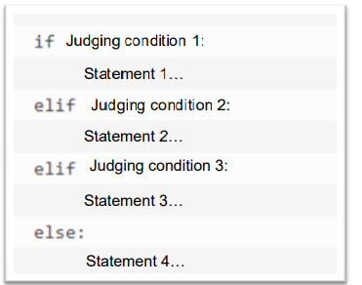
If Statement
Lecture
02
In Python, there are three main control structures for flow control: `if`, `for`, and `while`. However, unlike some other programming languages like C, Python does not have a built-in `switch` statement.
Control Structures in Python:
1. `if` Statement:
The `if` statement is used for conditional execution. It allows you to control the flow of your program based on specific conditions. The basic form of an `if` statement in Python is as follows:
Code Example:
x = 10
if x > 5:
print("x is greater than 5")
else:
print("x is not greater than 5")
www. esu.ac.ae

Slide 34
For Loop:
Lecture
02
2. `for` Loop:
The `for` loop is used to iterate over a sequence (such as lists, tuples, or strings) or other iterable objects.
It allows you to perform a set of actions repeatedly for each item in the sequence.
The basic form of a `for` loop in Python is as follows:
for item in sequence:
# Code block to execute for each item in the sequence
Code Example:
fruits = ["apple", "banana", "orange"]
for fruit in fruits:
print(fruit)
www. esu.ac.ae

Slide 35
While Loop:
Lecture
02
3. `while` Loop:
The `while` loop is used for repeated execution of a code block as long as a given condition is True. It is useful when the number of iterations is not known in advance. The basic form of a `while` loop in Python is as follows:
When the condition of a while statement is never a Boolean false, the loop will never end, forming an infinite loop, also known as a dead loop. You can use the break statement in a loop to force a dead loop to end.
while condition:
# Code block to execute as long as the condition is True
Code Example:
count = 1
while count <= 5:
print("Current count:", count)
count += 1
www. esu.ac.ae

Slide 36
Nesting Loop :
Lecture
02
Python allows one loop to be nested inside another loop. This means you can have loops inside other loops, creating nested structures for more complex iterations.
Syntax of for loop nesting:
for iterating_var_outer in sequence_outer:
for iterating_var_inner in sequence_inner:
# Statements for inner loop
# Statements for outer loop
Syntax of while loop nesting:
while expression_outer:
while expression_inner:
# Statements for inner loop
# Statements for outer loop
www. esu.ac.ae

Slide 37
Break and Continue Statements:
Lecture
02
1. `break` statement:
The `break` statement is used to terminate the entire loop prematurely.
When a `break` statement is within the loop, the loop execution is immediately stopped, and the control moves to the next line of code after the loop, skipping any remaining iterations.
If the loop is nested (i.e., one loop inside another), the `break` statement will only terminate the innermost loop where it is encountered.
for i in range(5):
if i == 3:
break
print(i)
Output:
0
1
2
www. esu.ac.ae

Slide 38
Break and Continue Statements:
Lecture
02
2-continue statement:
The continue statement is used to end the current iteration of the loop prematurely and start the next iteration.
When a continue statement is encountered within the loop, the current iteration's remaining statements are skipped, and the loop proceeds to the next iteration.
If the loop is nested, the continue statement will only affect the innermost loop where it is encountered.
Both the break and continue statements can be used with both for and while loops.
for i in range(5):
if i == 3:
continue
print(i)
Output:
0
1
2
4
www. esu.ac.ae

Slide 39
Functions

Slide 40
Python Functions:
Lecture
02
A function is a code segment that is organized, reusable, and used to implement a single function or associated functions.
Functions can improve the modularity of applications and reuse of code.
Python provides a number of built-in functions, such as print(). You can also create your own functions, which are called user-defined functions.
Defining a Function
The function code block begins with a def keyword, followed by the function name and parentheses ().
Any incoming arguments and independent variables must be placed in the middle of the parentheses. Parentheses can be used to define arguments.
The first line of the function can selectively use the document string to hold the description of the function.
The function content starts with a colon and indents.
return[expression] ends a function, and selectively returns a value to the caller. Returning without an expression is equivalent to returning none.
www. esu.ac.ae

Slide 41
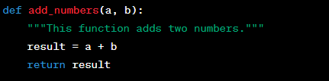
Python Functions:
Lecture
02
Example of a simple function:
In this example, we define a function named add_numbers that takes two parameters a and b. It adds the two numbers and returns the result.
www. esu.ac.ae

Slide 42
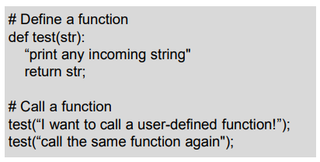
Calling Function:
Lecture
02
After the basic structure of this function is complete, you can execute it through another function call, or you can execute it directly from the Python prompt.
www. esu.ac.ae

Slide 43
Variables Scope
Lecture
02
1. A variable defined within a function has a local scope and is called a local variable. It means that the variable is only accessible within the specific function where it is defined. Local variables are created when the function is called and destroyed when the function exits. Attempting to access a local variable outside of its function will result in an error.
2. A variable defined outside of any function has a global scope and is called a global variable. Global variables are accessible throughout the entire program, including all functions. They are created when the program starts and exist until the program ends.
www. esu.ac.ae

Slide 44
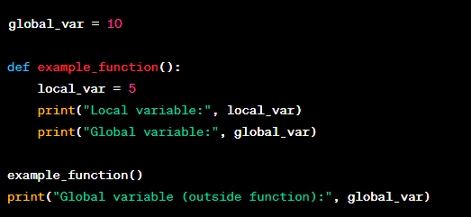
Variables Scope Example
Lecture
02
In this example, `global_var` is a global variable, and `local_var` is a local variable defined within the `example_function()`.
The `example_function()` can access the global variable `global_var`, but it cannot access `local_var` outside of the function.
www. esu.ac.ae

Slide 45
Variables Scope Cont.
Lecture
02
3. When a function is called, all variable names stated within the function are added to the local scope of that function. This means that variables with the same name as global variables will create a new local variable with the same name within the function, and any modifications made to the local variable will not affect the global variable.
www. esu.ac.ae

Slide 46
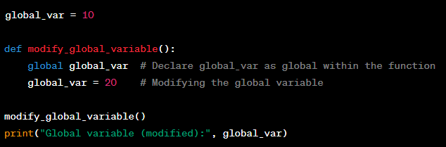

Variables Scope Cont.
Lecture
02
4. If you want to modify a global variable from within a function, you need to use the `global` keyword to declare the variable as global. This way, Python will know that you are referring to the global variable and not creating a new local variable with the same name.
www. esu.ac.ae

Slide 47


