Slide 1


Writing in
Organizations
Prepared by Dr. Magdy Alhaj
MGM 202
Lecture 7

Slide 2


Writing Instructions
and Procedures.
Lecture 7
MGM 202
Prepared by
Dr. Magdy Alhaj
www.midocean.ae

Slide 3
Lecture 7
Course Outline
Lecture 1: Getting Started: Writing and Your Career.
Lecture 2: The Writing Process and Collaboration at Work.
Lecture 3: Writing Routine Business Correspondence.
Lecture 4: Writing Letters: Some Basics for Communicating with Audiences Worldwide.
Lecture 5: How to Get a Job: Searches, Dossiers, Portfolios, Résumés, Letters, and Interviews.
Lecture 6: Designing Successful Documents, Visuals, and Websites.
Lecture 7: Writing Instructions and Procedures.
Lecture 8: Writing Effective Short Reports.
Lecture 9: Writing Proposals.
Lecture 10: Writing Careful Long Reports.

Slide 4
Lecture 7
Lecture Outline
1- Instructions, Procedures, and Your Job.
2- Why Instructions Are Important.
3- Using Word Processing Programs to Design Instructions.
4- Assessing and Meeting Your Audience’s Needs.
5- The Process of Writing Instructions.
6- Using the Right Style.
7- Using Visuals Effectively in Instructions.
8- The Five Parts of Instructions.
9- Model of Full Set of Instructions.
10- Writing Procedures for Policies and Regulations.
11- Some Final Advice.

Slide 5
Lecture 7
Writing Instructions and Procedures
1- Instructions, Procedures, and Your Job:
As part of your job, you may be asked to write instructions, alone or with a group, for your co-workers as well as for the customers who use your company’s services or products. Your employer stands to gain or lose much from the quality and the accuracy of the instructions you prepare.

Slide 6
Lecture 7
Writing Instructions and Procedures
You may also be called on to write a set of procedures as a part of your job. The purpose of writing procedures is very different from preparing instructions. As we saw, a set of instructions explains how to install, repair, or safely use something. Procedures, however, refer to policies, duties, or protocols that a business or organization expects its employees to follow.

Slide 7
Lecture 7
Writing Instructions and Procedures
2- Why Instructions Are Important:
Perhaps no other type of occupational writing demands more from the writer than do instructions because so much is at stake—for both you and your reader. The reader has to understand what you write and perform the task as well. You cannot afford to be unclear, inaccurate, or incomplete. Instructions are significant for many reasons, including safety, efficiency, and convenience.

Slide 8
Lecture 7
Writing Instructions and Procedures
- Safety
Carefully written instructions get a job done without damage or injury. Poorly written instructions can be directly responsible for an injury to the person trying to follow them and may result in costly damage claims or even lawsuits.
To make sure your instructions are safe, they must be:
■ accurate
■ consistent
■ thorough
■ clearly written
■ carefully organized
■ legally proper

Slide 9
Lecture 7
Writing Instructions and Procedures
- Efficiency
Well-written instructions help a business run smoothly and efficiently.
- Convenience
Clear, easy-to-follow instructions make a customer’s job easier and less frustrating. In the customer’s view, instructions reflect a product’s quality and convenience.

Slide 10
Lecture 7
Writing Instructions and Procedures
3- Using Word Processing Programs to Design Instructions:
To make sure your instructions are easy to read both for native as well as non-native speakers of English, take advantage of the following word processing features that will help you draft, revise, and format:
1. Brainstorming/clustering to get ideas/steps down.
2. Use the Outline feature.
3. Choose a font that is easy to read.
4. Use numbered and bulleted lists.
5. Include boldface sparingly.
6. Be careful about the images you take from a clip art library.

Slide 11
Lecture 7
Writing Instructions and Procedures
4- Assessing and Meeting Your Audience’s Needs:
Put yourself in the readers’ position. In most instances, you will not be available for readers to ask you questions when they do not understand something. Consequently, they will have to rely only on your written instructions.

Slide 12
Lecture 7
Writing Instructions and Procedures
- Key Questions to Ask About Your Audience
The more you known about your audience, the better your instructions can be. To determine your audience’s needs, ask yourself the following questions:
■ How and why will my readers use my instructions?
■ What language skills do they possess—is English their first (native) language?
■ How much do my readers already know about the product or service?
■ How much background information will I have to supply?

Slide 13
Lecture 7
Writing Instructions and Procedures
■ What steps will most likely cause readers trouble?
■ How often will they refer to my instructions—every day or just as a refresher?
■ Where will my audience most likely be following my instructions—in the workplace, outdoors, in a workshop equipped with tools, or alone in their homes?
■ What resources, such as special equipment or power sources, will my readers need to perform my instructions successfully?

Slide 14
Lecture 7
Writing Instructions and Procedures
- Writing Instructions for International Audiences:
Your instructions will often be aimed at a worldwide audience of potential customers, many of whom do not use English as their first language and may be following your instructions through a translation of them into their native language. Here are some useful guidelines when writing instructions for this diverse group of readers:

Slide 15
Lecture 7
Writing Instructions and Procedures
1. Write in plain, simple language. Use international English.
2. Use terms and units of measurement that your readers will understand.
3. Make sure all of your visuals are clear and culturally appropriate.
4. Be aware that colors can have different meanings.
5. Ask a non-native speaker to review your instructions.

Slide 16
Lecture 7
Writing Instructions and Procedures
5- The Process of Writing Instructions:
To make sure your instructions are accurate and easy for your audience to perform, follow these steps.
A - Plan Your Steps
Make sure you know
■ the reason for doing something
■ the parts or tools required
■ the steps to follow to get the job done
■ the results of the job
■ the potential risks or dangers

Slide 17
Lecture 7
Writing Instructions and Procedures
B - Perform a Trial Run
Actually perform the job (assembling, repairing, conducting, maintaining, testing) yourself or with all your writing team present. Go through a number of trial runs.
C - Write and Test Your Draft
Transform your notes into a draft (or drafts) of the instructions you want readers to follow.
D - Revise and Edit
Based on your observations and user feedback, revise your draft(s) and edit the final copy of the instructions that you will give to readers. Always consider whether your instructions would be easier to accomplish if you included visuals.

Slide 18
Lecture 7
Writing Instructions and Procedures
6- Using the Right Style:
To write instructions that readers can understand and turn into effective action, observe the following guidelines:
1. Choose verbs in the present tense and imperative mood. Imperatives are commands that have deleted the pronoun you.
2. Write clear, short sentences in the active voice.
3. Use precise terms for measurements, distances, and times.
4. Include connective words as signposts.
5. Number each step when you present your instructions in a list.

Slide 19
Lecture 7
Writing Instructions and Procedures
7- Using Visuals Effectively in Instructions:
Readers welcome visuals in almost any set of instructions. Visuals will help your readers your get a job done more quickly and increase their confidence. A visual can help users in:
■ locate parts, areas, and so on
■ identify the size and placement of parts

Slide 20
Lecture 7
Writing Instructions and Procedures
■ learn how to assemble parts effectively and easily
■ understand the right and wrong way to do something
■ identify possible sources of danger, injury, or malfunction
■ determine whether a problem is serious or minor
■ recognize and follow normal and safe limits/ranges

Slide 21
Lecture 7
Writing Instructions and Procedures
- Guidelines for Using Visuals in Instructions
Follow these guidelines to use visuals effectively in your instructions:
1. Set visuals off with white space so it is easy to find and read them.
2. Place each visual next to the step it illustrates, not on another page or buried at the bottom of the page.
3. Select a visual that is appropriate for your audience.
4. Assign each visual a number.

Slide 22
Lecture 7
Writing Instructions and Procedures
5. Make sure the visual looks like the object the user is trying to assemble, maintain, run, or repair. Don’t use a photo of a different model.
6. Always inform readers if a part is missing or reduced in your visual.
7. Where necessary, label or number parts of the visual.

Slide 23
Lecture 7
Writing Instructions and Procedures
8- The Five Parts of Instructions:
a set of instructions generally contains five main parts: (1) an introduction; (2) a list of equipment and materials; (3) the actual steps to perform the process; (4) warnings, cautions, and notes; and (5) a conclusion (when necessary).
1- Introduction
The function of your introduction is to provide readers with enough necessary background information to understand why and how your instructions work. An introduction must make readers feel comfortable and well prepared before they turn to the actual steps.

Slide 24
Lecture 7
Writing Instructions and Procedures
- What to Include in an Introduction
1. State why the instructions are useful for a specific audience.
2. Indicate how a particular piece of equipment or process works.
3. Point out any safety measures or precautions a reader may need to be aware of.
4. Stress any advantages or benefits the reader will gain by performing the instructions.
5. Provide hyperlinks.

Slide 25
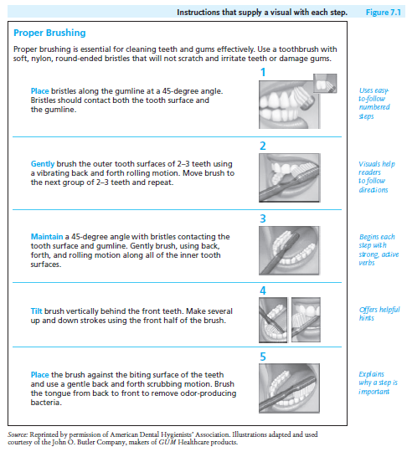
Lecture 7
Writing Instructions and Procedures
2- List of Equipment and Materials
Clearly, some instructions, as in Figure 7.1, do not need to inform readers of all equipment or materials they will need. But when you do, make your list complete and clear.
3- Steps for Your Instructions
The heart of your instructions will consist of clearly distinguished steps that readers must follow to achieve the desired results.

Slide 26
Lecture 7
Writing Instructions and Procedures
- Guidelines for Writing Steps
1. Put the steps in their correct order and number them.
2. Include only the right amount of information in each step.
3. Group closely related activities into one step.
4. Give the reader hints on how best to accomplish the procedure.
5. State whether one step directly influences (or jeopardizes) the outcome of another.

Slide 27
Lecture 7
Writing Instructions and Procedures
6. Where necessary, insert graphics to assist readers in carrying out the step.
7. Your instructions might be translated into an international reader’s language.
4- Warnings, Cautions, and Notes
At appropriate places in the steps of your instructions, you may have to stop the reader to issue a warning, a caution, or a note.

Slide 28
Lecture 7
Writing Instructions and Procedures
Guidelines on Using Warnings, Cautions, and Notes
1. Do not regard warnings and cautions as optional.
2. Put warnings and cautions immediately before the step to which they pertain.
3. Put warnings and cautions in a distinctive format.
4. Include relevant explanations to help readers know what to watch out for and what precautions to take.
5. Do not include a warning or a caution just to emphasize a point.
6. Use notes only when the procedure calls for them and when they helpreaders.

Slide 29
Lecture 7
Writing Instructions and Procedures
5- Conclusion
Not every set of instructions requires a conclusion. For short instructions containing only a few simple steps, such as those in Figure 7.1, no conclusion is necessary. For longer, more involved jobs, a conclusion can provide a succinct wrap up of what the reader has done or end with a single sentence of congratulations, or reassure readers.

Slide 30
Lecture 7
Writing Instructions and Procedures
9- Model of Full Set of Instructions:
Study Figure 7.6, which is a set of instructions on setting up an Epson printer that includes the parts discussed in this chapter: an introduction; a list of materials; numbered steps; and warnings, cautions, and notes. Pay special attention to how the writer coordinates words with visuals to assist readers.

Slide 31
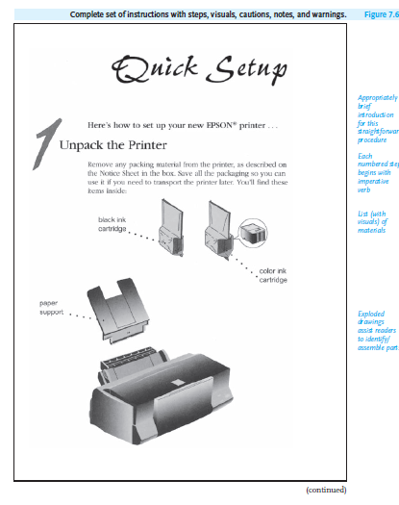
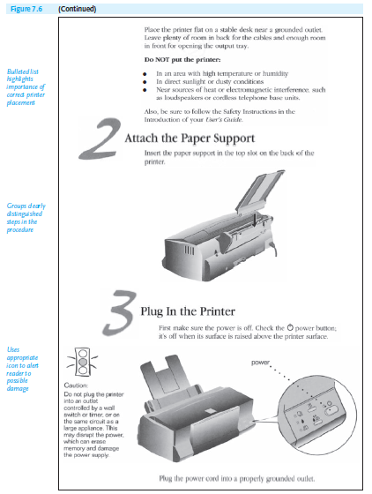
Lecture 7
Writing Instructions and Procedures

Slide 32
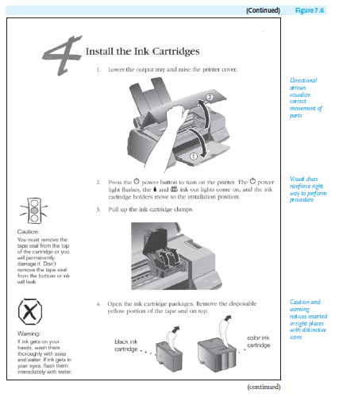
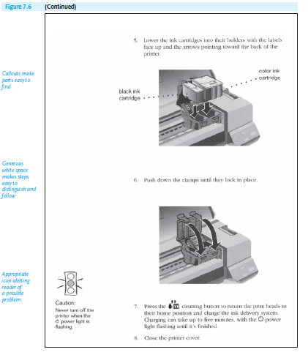
Lecture 7
Writing Instructions and Procedures

Slide 33
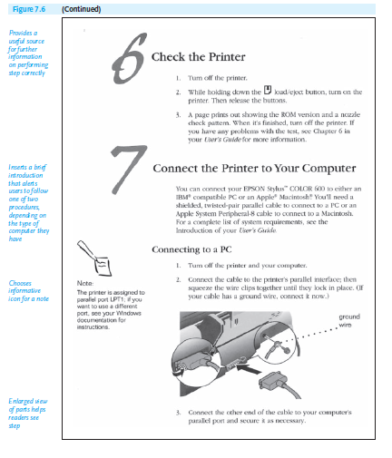
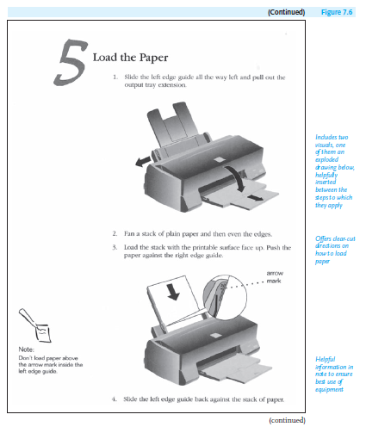
Lecture 7
Writing Instructions and Procedures

Slide 34
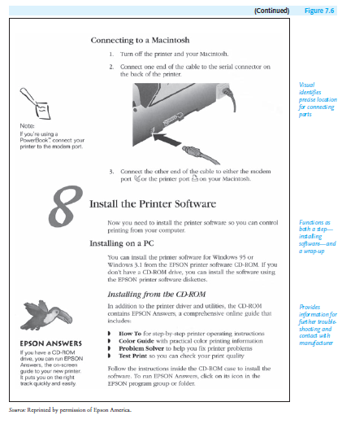
Lecture 7
Writing Instructions and Procedures

Slide 35
Lecture 7
Writing Instructions and Procedures
10- Writing Procedures for Policies and Regulations:
Up to this point, we have concentrated primarily on instructions dealing with how to put things together; how to install, repair, or use equipment; and how to alert readers to mechanical or even personal danger(s). But there is another similar type of writing that deals with guidelines for getting things done in the world of work— procedures. These concern policies and regulations found in employee handbooks and other internal corporate communications, such as on websites, in memos, in e-mail messages, or on a company’s intranet (a private computer network).

Slide 36
Lecture 7
Writing Instructions and Procedures
Some Examples of Procedures
Procedures deal with a wide range of “how-to” activities within an organization, including the following:
■ accessing a company file or database
■ preparing for an audit, a transition, a merger
■ applying for family or medical leave
■ dressing professionally at work or at a job site
■ submitting and routing information
■ reserving a company vehicle or facility

Slide 37
Lecture 7
Writing Instructions and Procedures
■ taking advantage of telecommuting options
■ filing a work-related grievance
■ requesting travel expense reimbursement
■ seeking safety in case of a fire, flood, spill or other emergency
■ fulfilling promotion requirements
■ applying for a disability accommodation
■ requesting a transfer within a company
■ using company e-mail

Slide 38
Lecture 7
Writing Instructions and Procedures
11- Some Final Advice:
Perhaps the most important piece of advice to leave you with is this: Do not take anything for granted when you have to write a set of instructions or procedures. It is wrong and on occasion dangerous to assume that your readers have performed the procedure before, that they will automatically supply missing or “obvious” information, that they will easily anticipate your next step or know what is expected of them at work without being informed. No one ever complained that a set of instructions or procedures was too clear or too easy to follow.

Slide 39

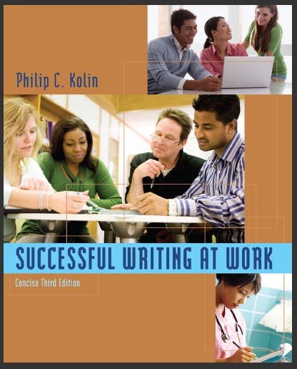

References:
Successful Writing at Work, Concise Third Edition,
By: Philip C. Kolin
University of Southern Mississippi
Chapter 7
Thank You

