Slide 1



Machine Learning
Prepared by Dr. Yasser Abdelhamid
DS 620
Machine Learning
Lecture 1

Slide 2

Objectives
Understanding why data scientists use machine learning
Discussing the process for model building
Using machine learning techniques
Gaining hands-on experience with machine learning
midocean.edu.km

Slide 3
Lecture Outline
Artificial Intelligence & Machine Learning
Applications of Machine Learning
Types of Machine Learning Systems
Supervised vs Unsupervised ML systems
Batch vs Online ML systems
Instance-based vs Model-based ML systems
midocean.edu.km

Slide 4
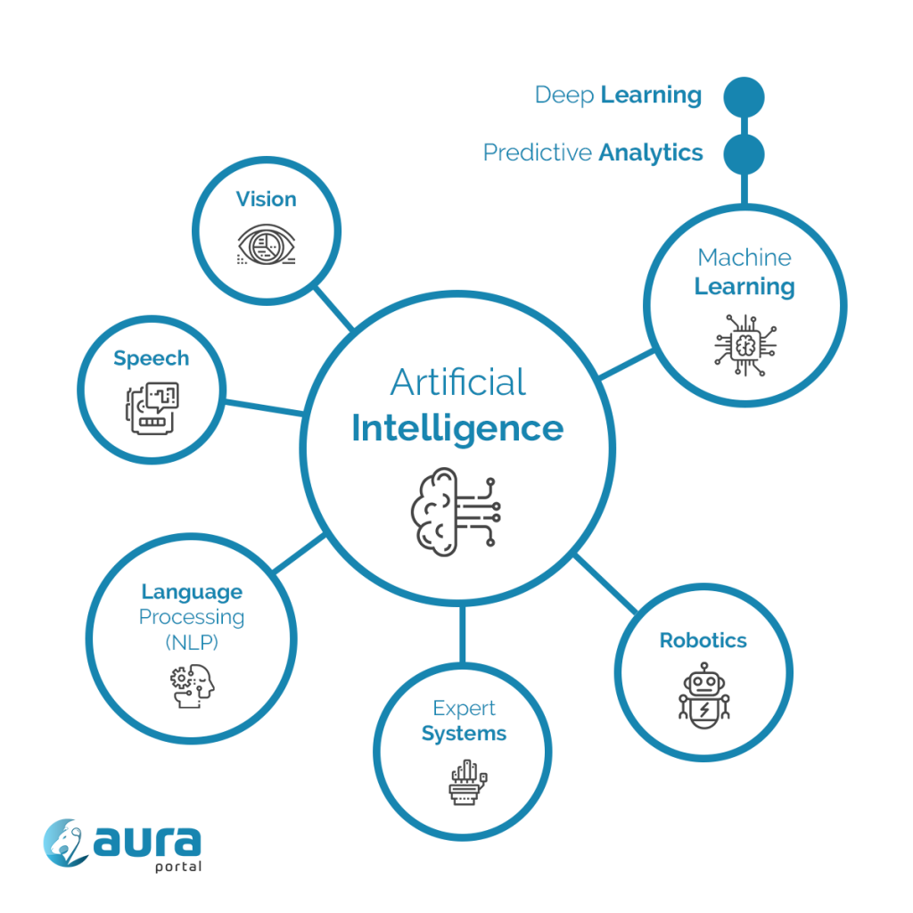
Artificial Intelligence
The study of how to make computers do things that people are better at.
midocean.edu.km

Slide 5
Machine Learning
Machine Learning is the science (and art) of programming computers so they can learn from data.
Machine Learning is the field of study that gives computers the ability to learn without being explicitly programmed.(Arthur Samuel, 1959)
A computer program is said to learn from experience E with respect to some task T and some performance measure P, if its performance on T, as measured by P, improves with experience E. (Tom Mitchell, 1997)

Slide 6
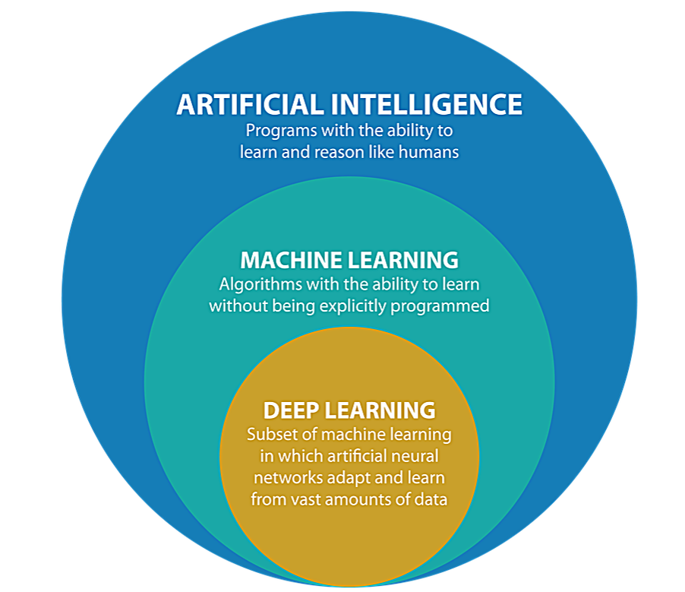
Artificial Intelligence, Machine learning, and deep learning

Slide 7
Machine Learning is good for…
Problems for which existing solutions require a lot of fine-tuning or long lists of rules.
Complex problems for which using a traditional approach yields no good solution.
Fluctuating environments: a Machine Learning system can adapt to new data.
Getting insights about complex problems and large amounts of data. (Data Mining)

Slide 8

Analysing images of products on a production line to automatically classify them.

Slide 9
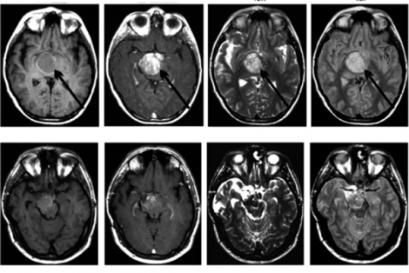
Detecting tumors in brain scans.

Slide 10
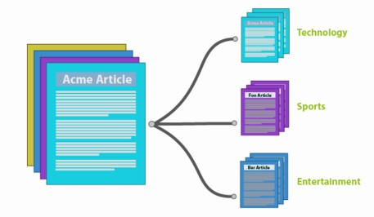
Automatically classifying news articles.

Slide 11
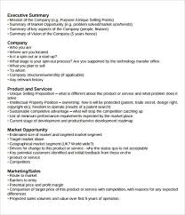
Summarizing long documents automatically.

Slide 12


Automatically flagging offensive comments on discussion forums.

Slide 13

Creating a CHATBOT or a personal assistant.

Slide 14
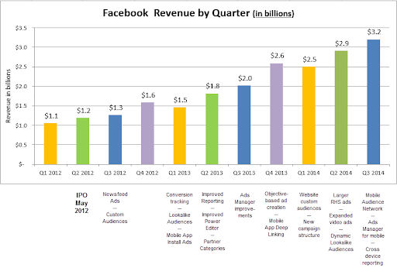
Forecasting your company’s revenue next year, based on many performance metrics.

Slide 15
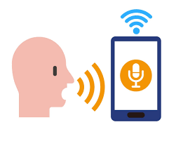
Making your app react to voice commands.

Slide 16
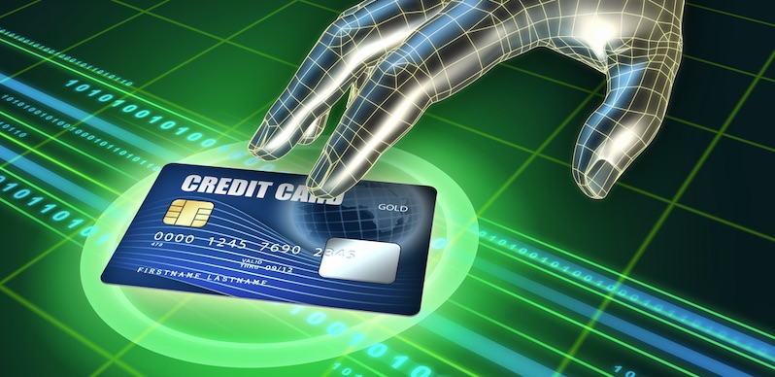
Detecting credit card fraud.

Slide 17
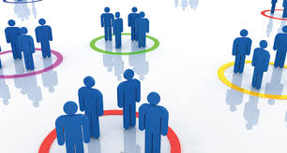
Segmenting clients based on their purchases to design different marketing strategy for each segment.

Slide 18
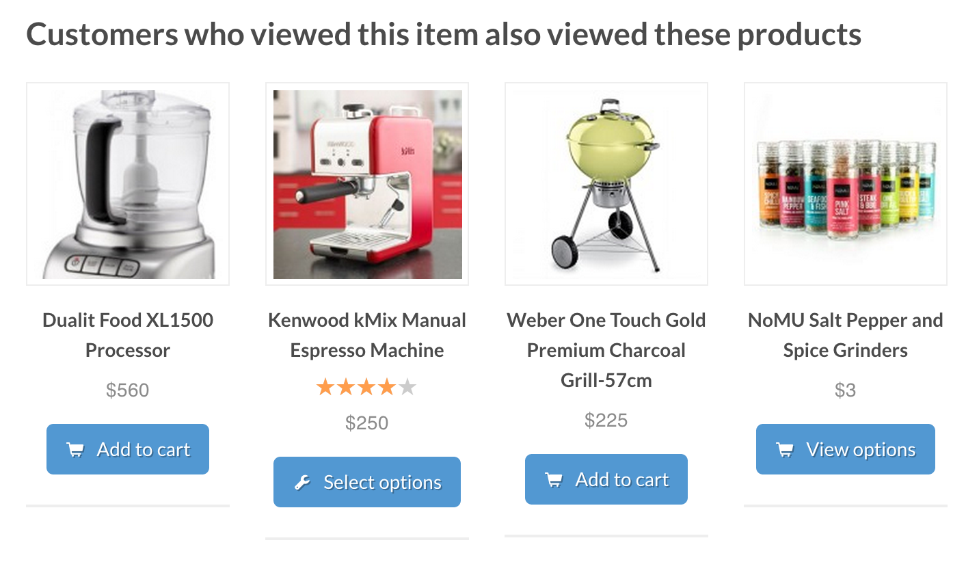
Recommending a product, based on past purchases.

Slide 19
Types of Machine Learning Systems
Supervised, unsupervised, semi-supervised, and Reinforcement Learning.
Online versus batch learning.
Instance-based versus model-based learning.

Slide 20
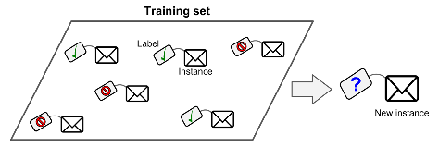
Supervised/Unsupervised Learning
Supervised learning
  In supervised learning, the training set you feed to the algorithm includes the desired solutions, called labels.
    Classification
    Prediction
    Regression (Prediction of a numeric value)
    Logistic Regression (probability of belonging to a given class).

Slide 21
Examples of supervised learning algorithms
k-Nearest Neighbours
Linear Regression
Logistic Regression
Support Vector Machines (SVMs)
Decision Trees and Random Forests
Neural networks

Slide 22
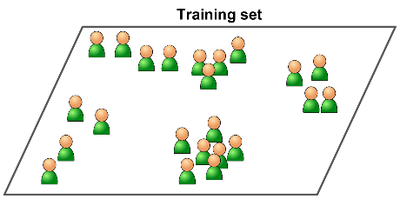
Unsupervised learning
In unsupervised learning, the training data is un-labelled. The system tries to learn without a teacher.

Slide 23
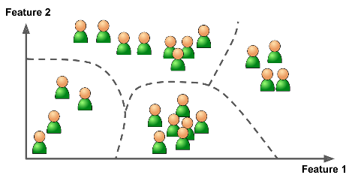
unsupervised learning algorithms
Clustering
  K-Means
  DBSCAN
  Hierarchical Cluster Analysis (HCA)

Slide 24
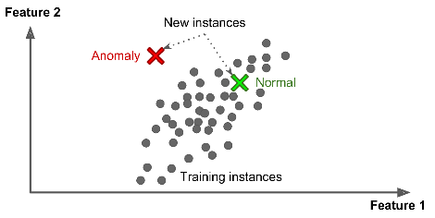
unsupervised learning algorithms (Cont.)
Anomaly detection and novelty detection
  One-class SVM
  Isolation Forest

Slide 25
Visualization and dimensionality reduction unsupervised learning algorithms
Visualization refers to the process of representing and presenting the patterns, structures, or relationships discovered in unlabeled data in a visual format.
Dimensionality reduction refers to the process of reducing the number of input features or variables in a dataset while preserving the essential information or structure of the data. It aims to overcome the curse of dimensionality, where high-dimensional data can lead to computational challenges, increased complexity, and decreased model performance.
  Principal Component Analysis (PCA)
  Kernel PCA
  Locally Linear Embedding (LLE)
  t-Distributed Stochastic Neighbour Embedding (t-SNE)

Slide 26
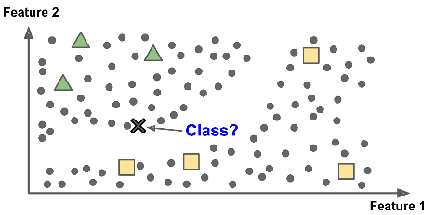
Semi-supervised learning
Can deal with data that’s partially labelled.
Most semi-supervised learning algorithms are combinations of unsupervised and supervised algorithms.

Slide 27
Reinforcement Learning
An agent, can observe the environment, select and perform actions, and get rewards in return (or penalties in the form of negative rewards).
It learns by itself what is the best strategy, called a policy, to get the most reward over time.
A policy defines what action the agent should choose when it is in a given situation.

Slide 28
Batch and Online Learning
Another criterion used to classify Machine Learning systems is whether or not the system can learn incrementally from a stream of incoming data.

Slide 29
Batch learning
In batch learning, the system is incapable of learning incrementally: it must be trained using all the available data.
  Not suitable for huge and rapidly changing data.

Slide 30
Online learning
In online learning, you train the system incrementally by feeding it data instances sequentially, either individually or in small groups called mini-batches.
Great for systems that receive data as a continuous flow (e.g., stock prices) and need to adapt to change rapidly or autonomously.
Can also be used to train systems on huge datasets that cannot fit in one machine’s main memory (out-of-core learning).

Slide 31
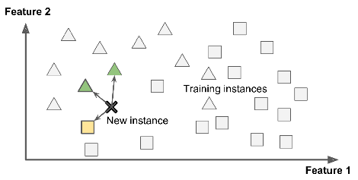
Instance-Based Versus Model-Based Learning
Instance-based learning
  The system generalizes to new cases by using a similarity measure to compare them to the learned examples

Slide 32
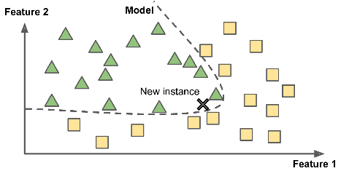
Instance-Based Versus Model-Based Learning
Model-based learning
  The system generalizes from a set of examples by building a model of these examples and then using that model to make predictions.

Slide 33
Summary
Artificial Intelligence
Machine Learning
What applications Machine Learning is suitable for
Examples of machine learning applications
Types of Machine Learning Systems
Supervised vs Unsupervised ML systems
Batch vs Online ML systems
Instance-based vs Model-based ML systems

Slide 34


Thank You

