Slide 1


Overview of Project Management
Lecture 1
PMG 101
Foundations of Project Management
www.midocean.ae

Slide 2
Why Studying Project Management Course?
A project management course equips you with strong planning abilities, including the capacity to set clear goals and realistic objectives, along with a schedule with specific stages to achieve the project goals. Budgeting, time frames, and resource estimates are typically covered by project management course. You’ll learn skills for not only setting goals for achievement within a realistic budget and time, but also for reviewing and vetting costs and resource estimates.
www.midocean.ae

Slide 3
Learning Objectives
Defining project and its attributes.
Key constraints within which a project must be managed.
Difference between Routine work (regular operations) and Project.
Know different concepts of project management.
Why project management.
Know about Project Manager and his responsibilities .
Understand Selection of a Project Manager.
Know about Characteristics of Project Management Team.
Know about the phases of Project Management .
Understand Project Environment.
The 7S of Project Management .
www.midocean.ae

Slide 4
What is a project?
A project is a group of unique, interrelated activities that are planned and executed in certain sequence to create a unique product or service, within a specific time frame, budget and the client’s specifications.
A project is a temporary endeavor undertaken to create a unique product, service or result.
  Temporary means: A Project is a one-off event and not an ongoing operation It has a definite
beginning and a definite end.
The end is reached when:
The project’s objectives have been achieved.
When it becomes clear that the project objectives will not or cannot be met.
The need for the project no longer exists and the project is terminated.
www.midocean.ae

Slide 5
Attributes of a Project
A Project is a planned set of activities.
A Project has a specific scope.
A Project has time, cost, quality and resource constraints.
Has a well-defined objective.
Has a defined life span with a beginning and an end.
Involves doing something unique.
Has a customer.
Involves a degree of uncertainty.
www.midocean.ae

Slide 6
Examples of Projects
Construction of a hospital.
Writing a book.
Designing and implementing a computer system.
Introducing a new product in the market.
Construction of a new bridge over a river.
Designing and producing a brochure.
A Politician contesting an election.
Building a dam.
Organizing a seminar.
www.midocean.ae

Slide 7
Difference between project and routine work
Project
Routine work
One time
Use of wide variety of skills
Use of special purpose equipment for short duration
No revenue during
Project stages
Repetitive
Limited Skills
Equipments are in continuous use
Revenues are there
www.midocean.ae

Slide 8
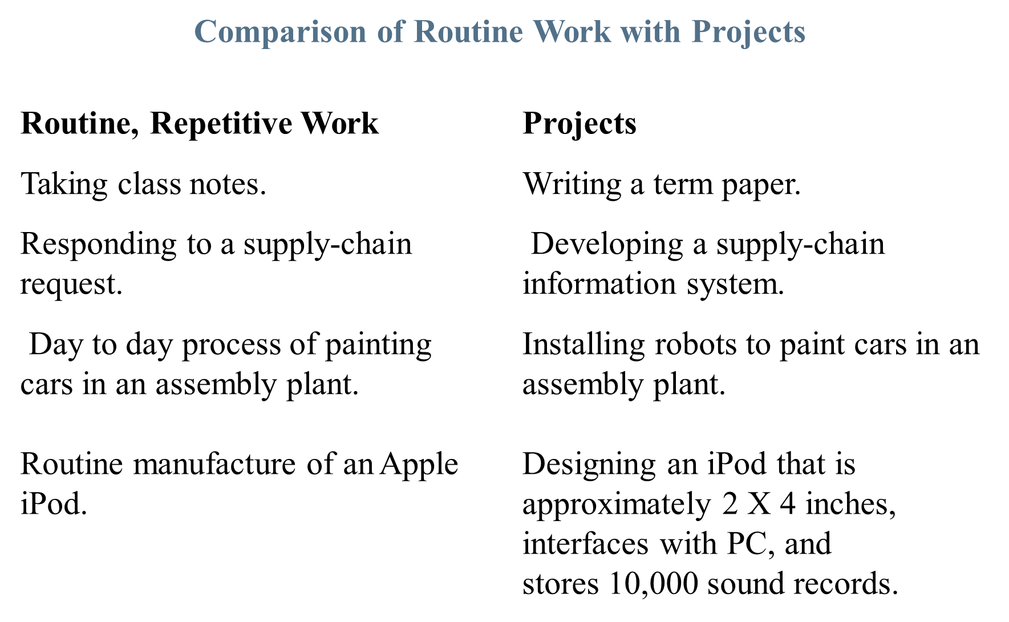
www.midocean.ae

Slide 9
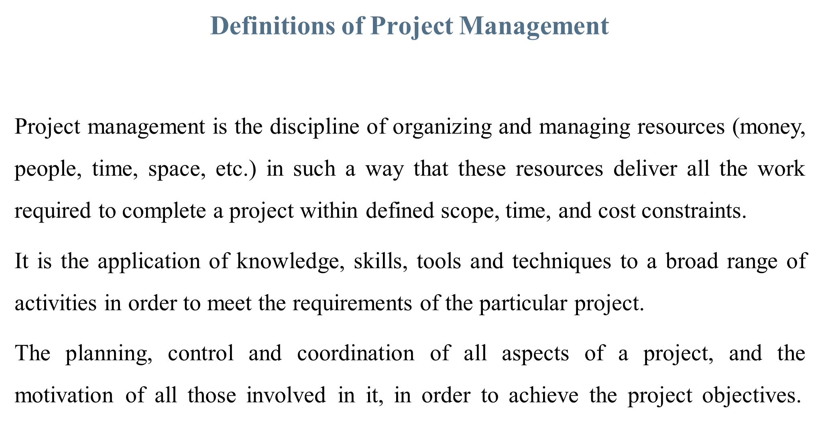
www.midocean.ae

Slide 10
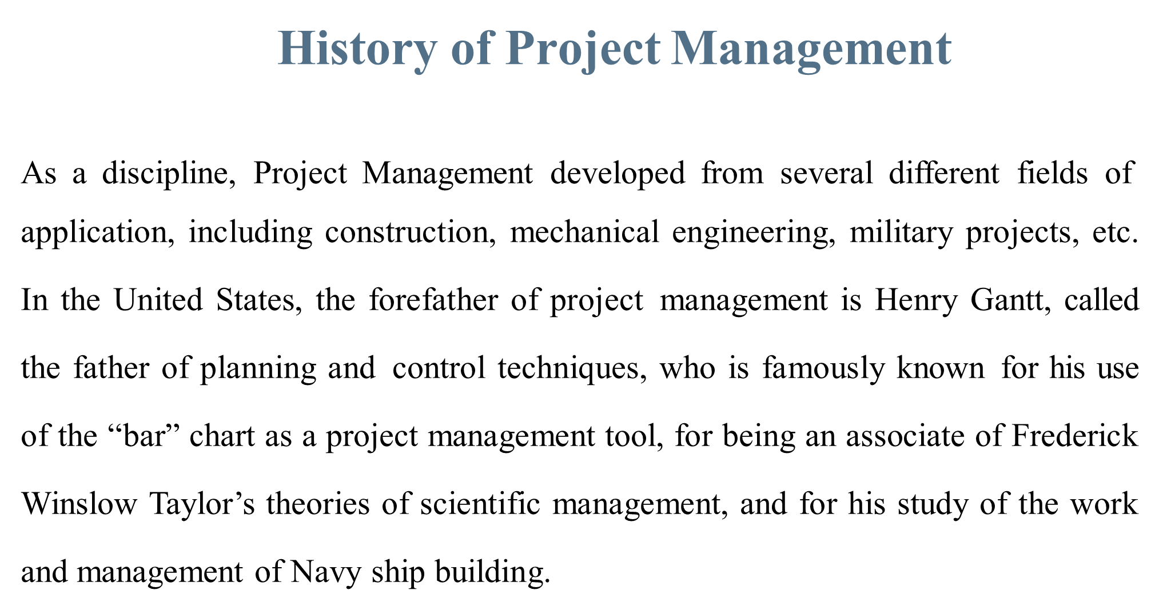
www.midocean.ae

Slide 11
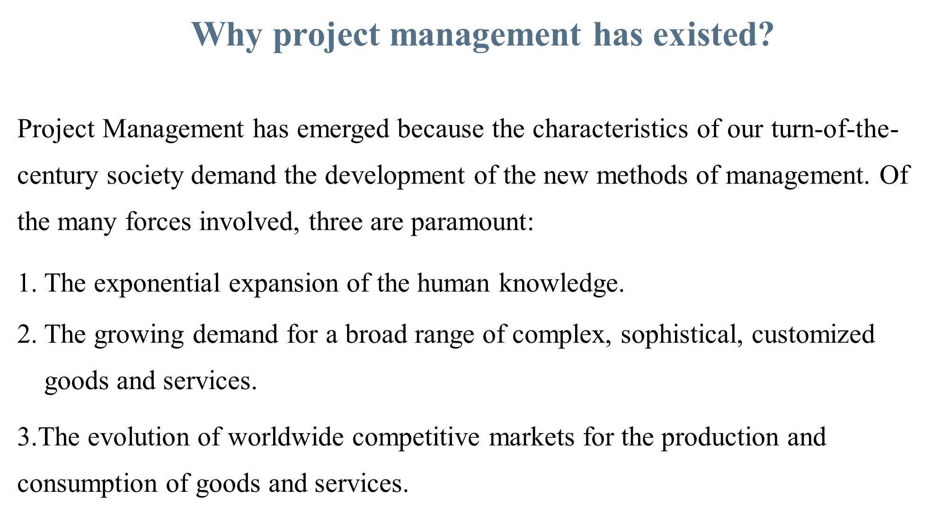
www.midocean.ae

Slide 12
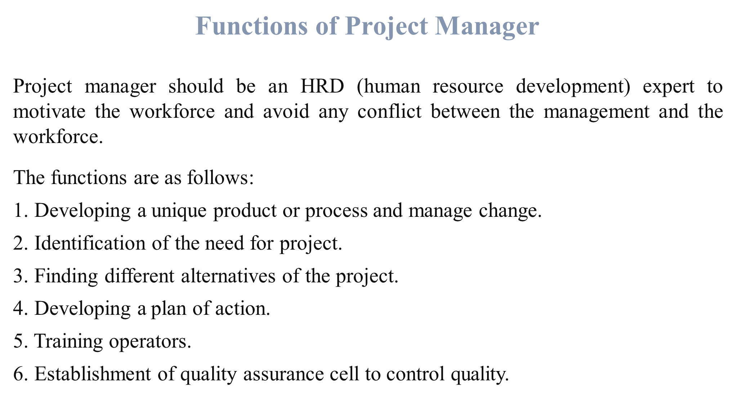
www.midocean.ae

Slide 13
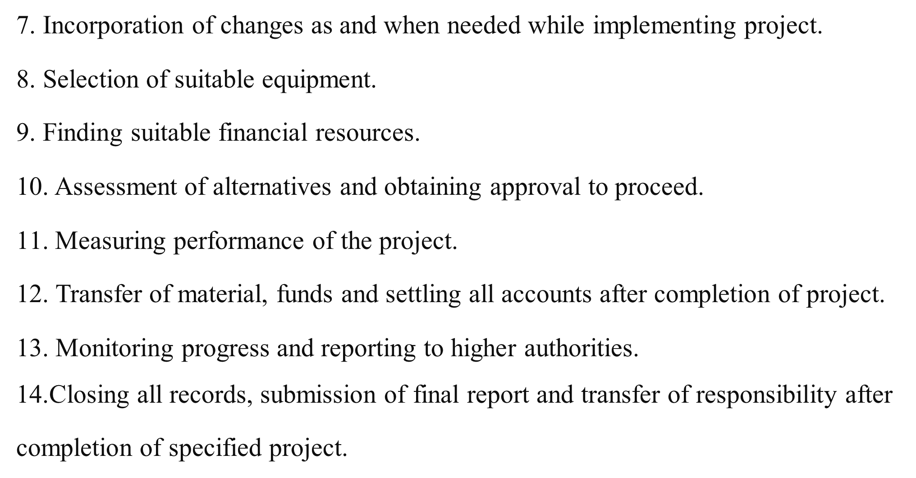
www.midocean.ae

Slide 14
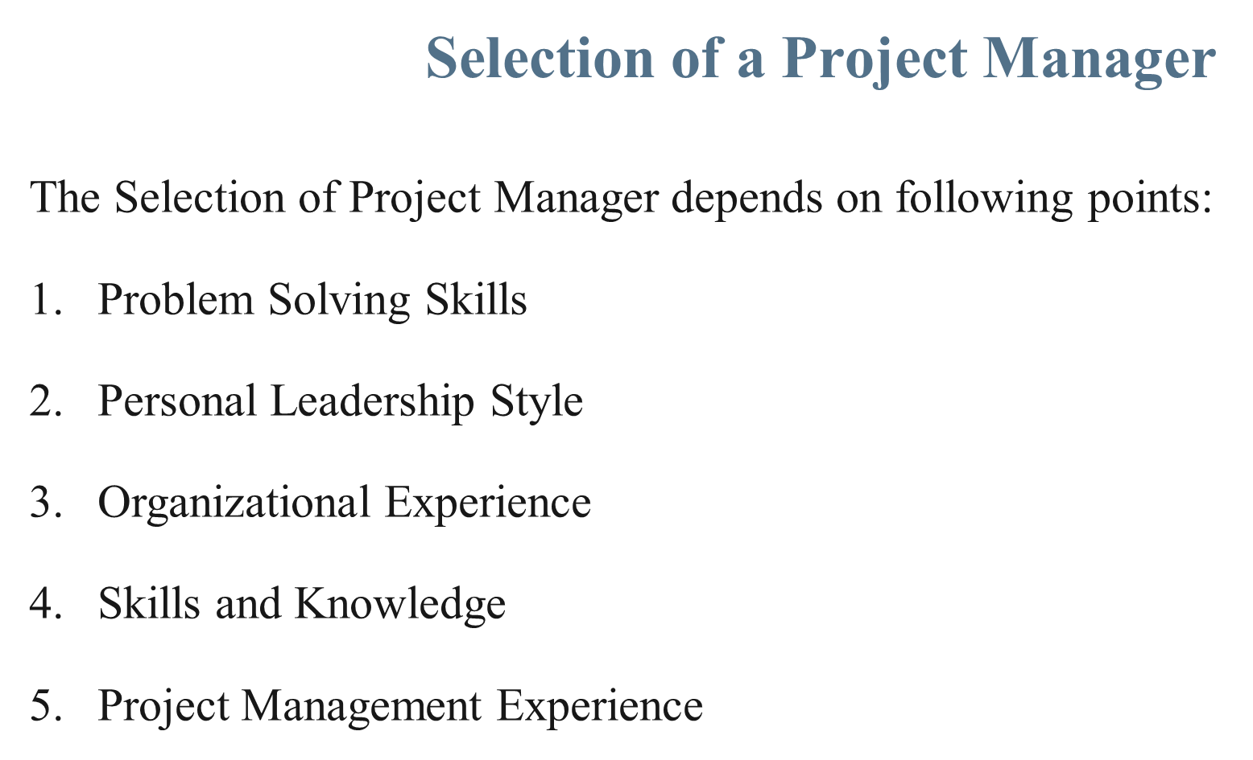
www.midocean.ae

Slide 15
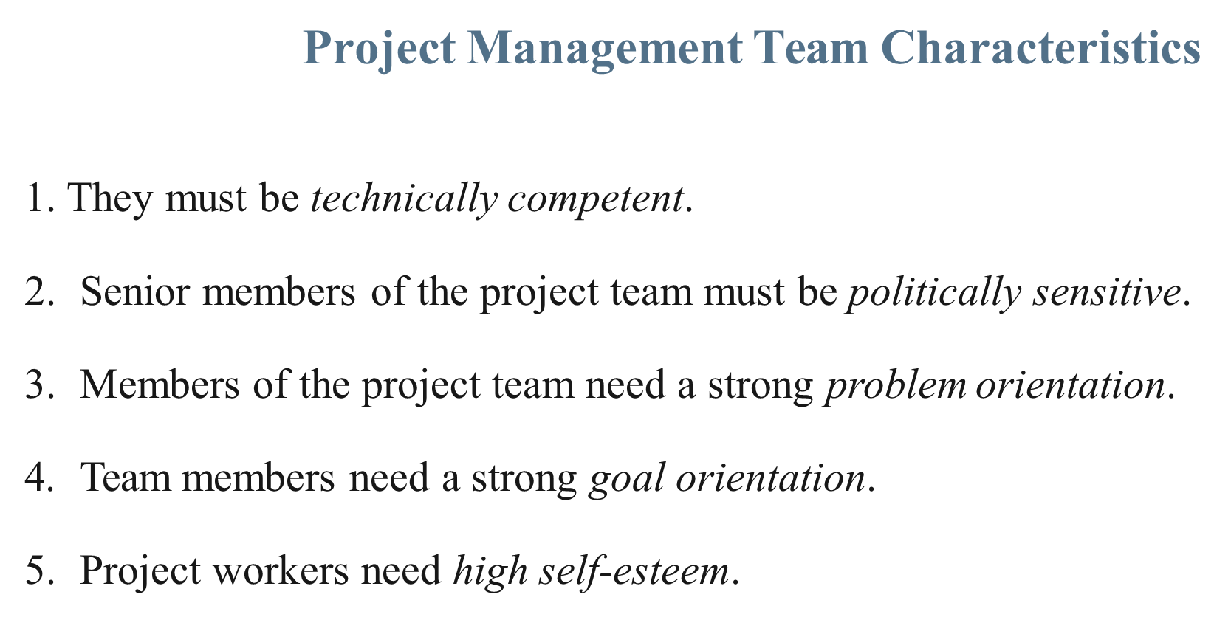
www.midocean.ae

Slide 16
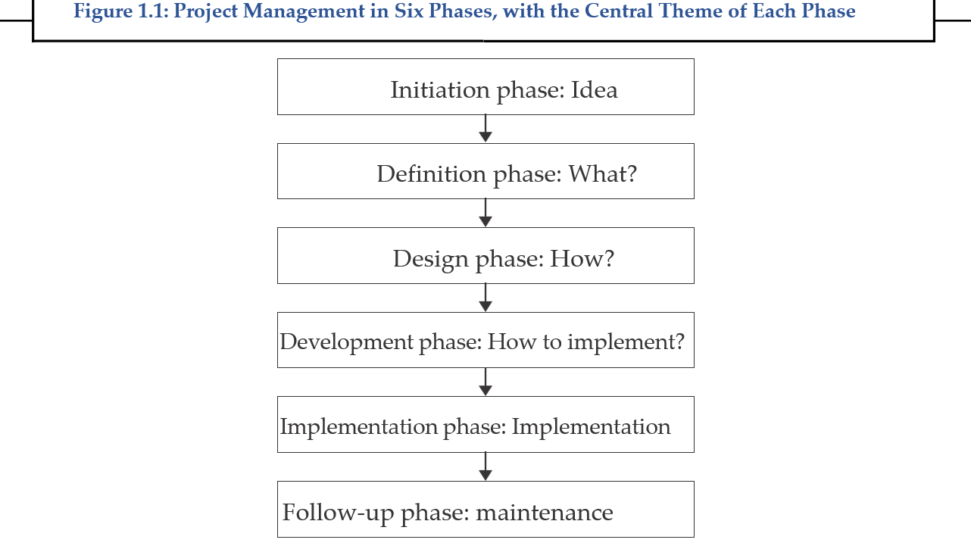
www.midocean.ae

Slide 17
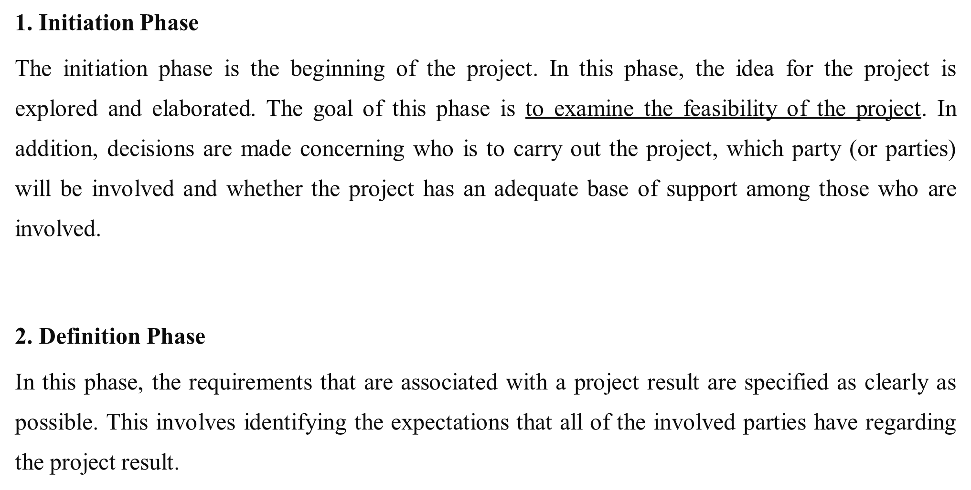
www.midocean.ae

Slide 18
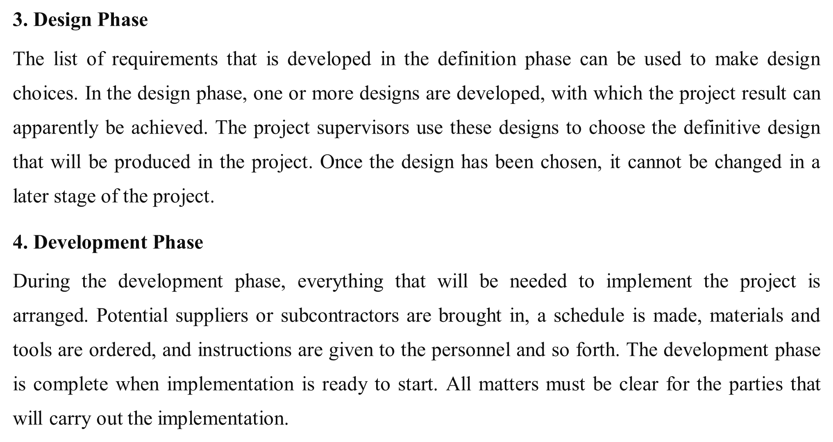
www.midocean.ae

Slide 19
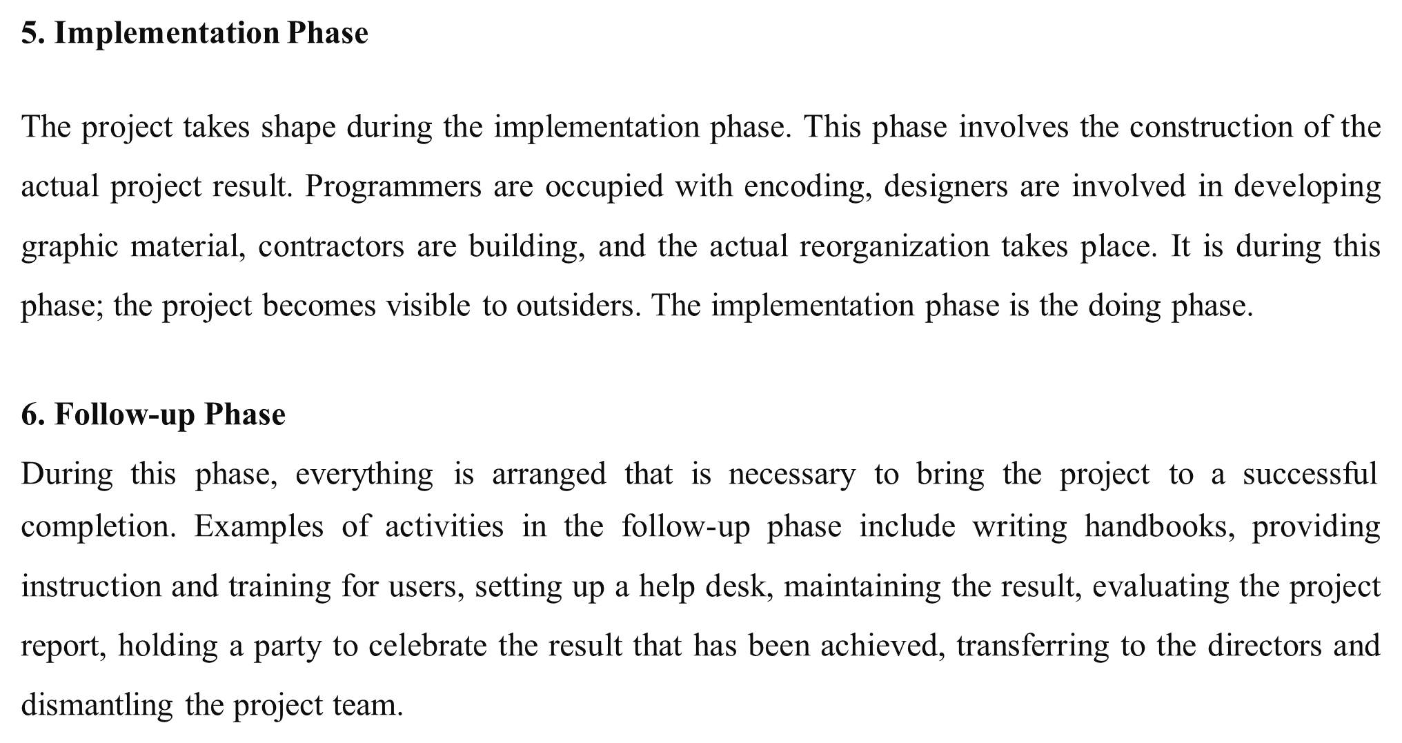
www.midocean.ae

Slide 20
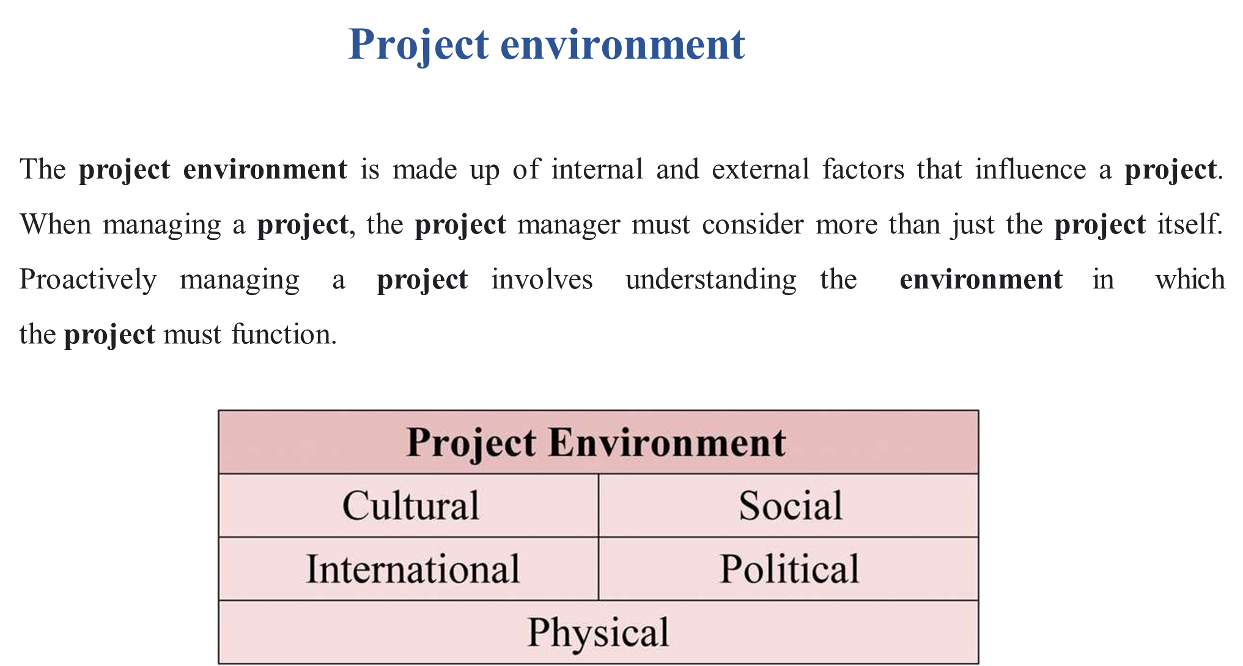
www.midocean.ae

Slide 21
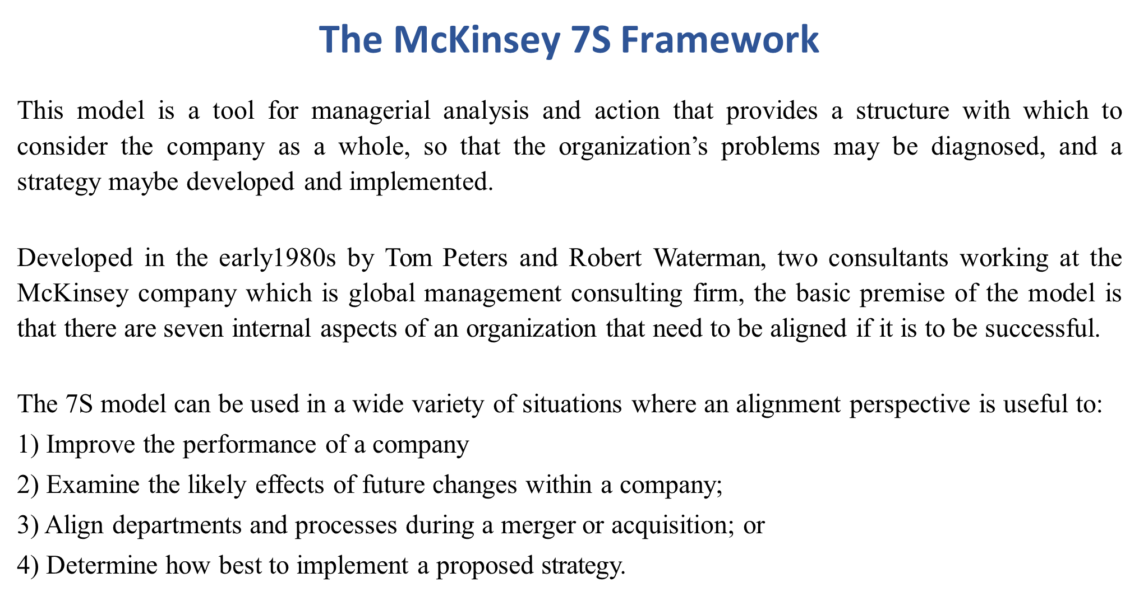
www.midocean.ae

Slide 22
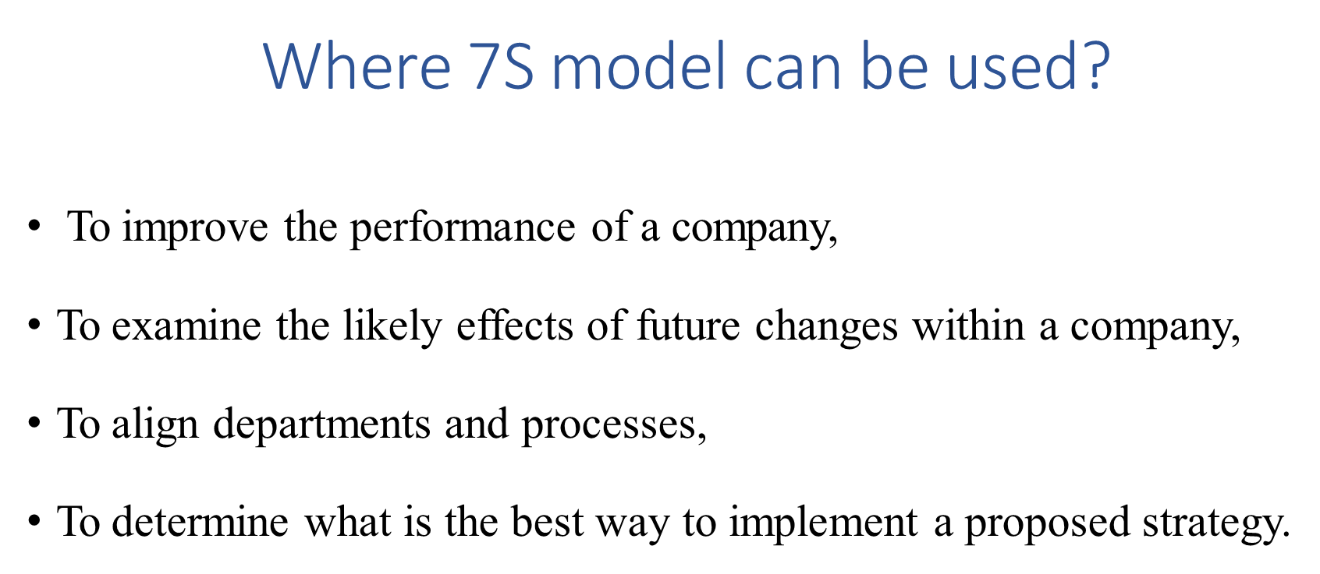
www.midocean.ae

Slide 23
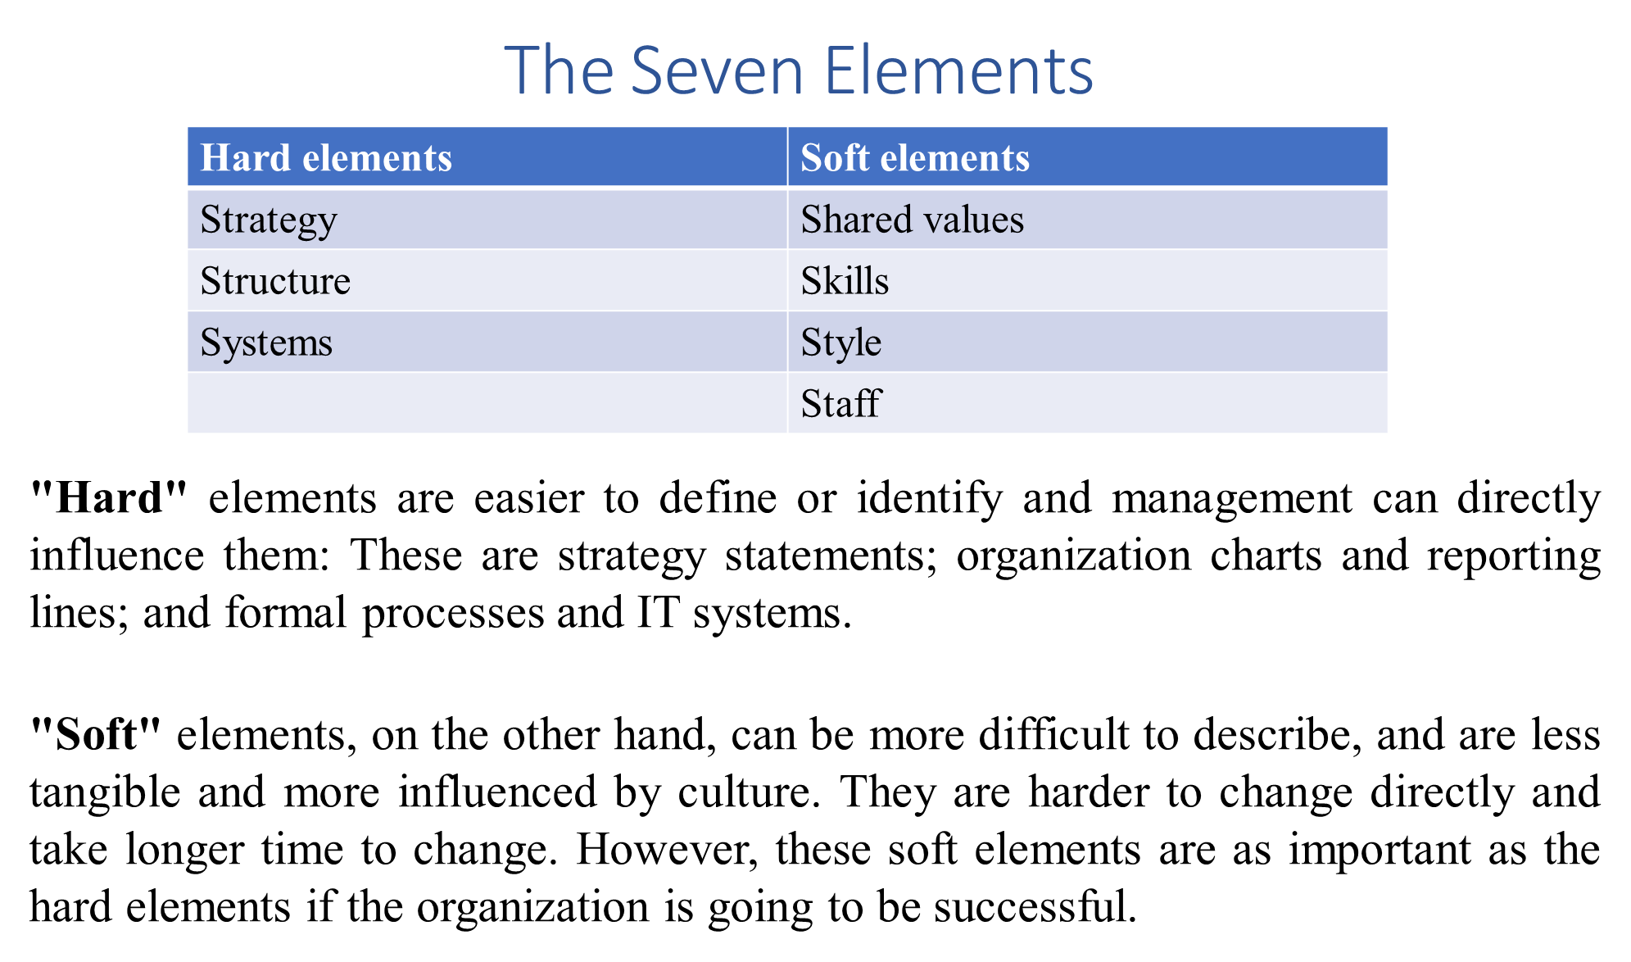
www.midocean.ae

Slide 24
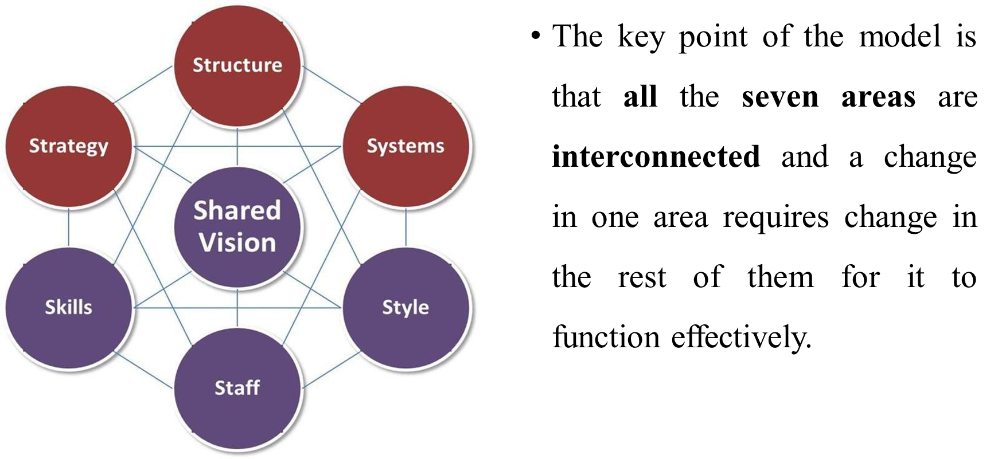
www.midocean.ae

Slide 25
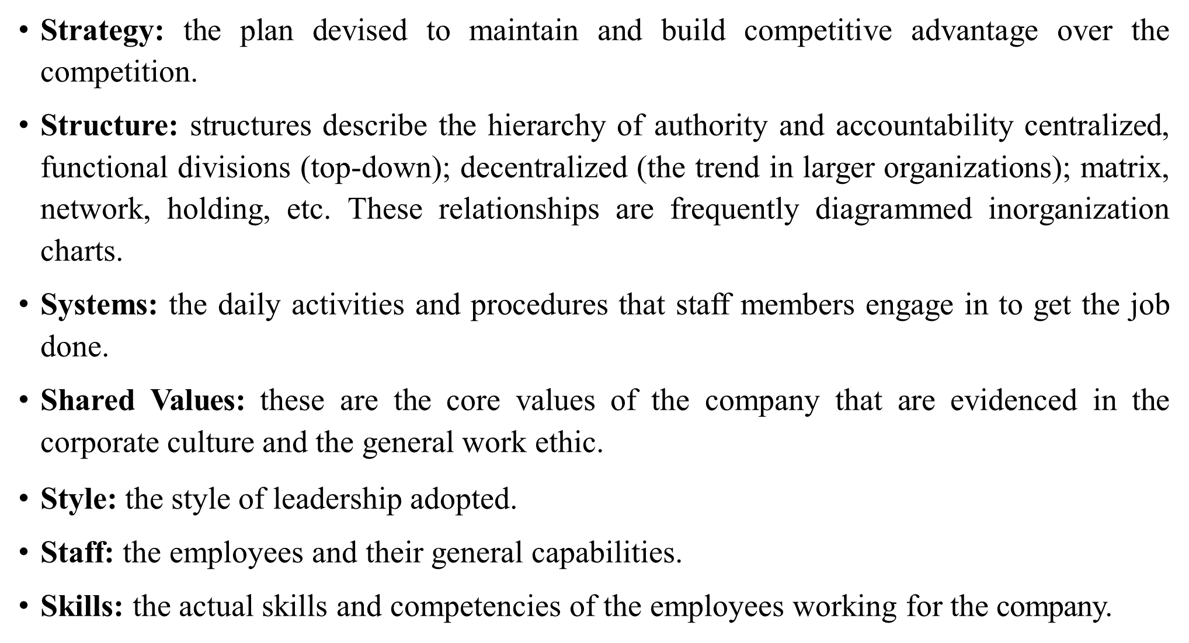
www.midocean.ae

Slide 26
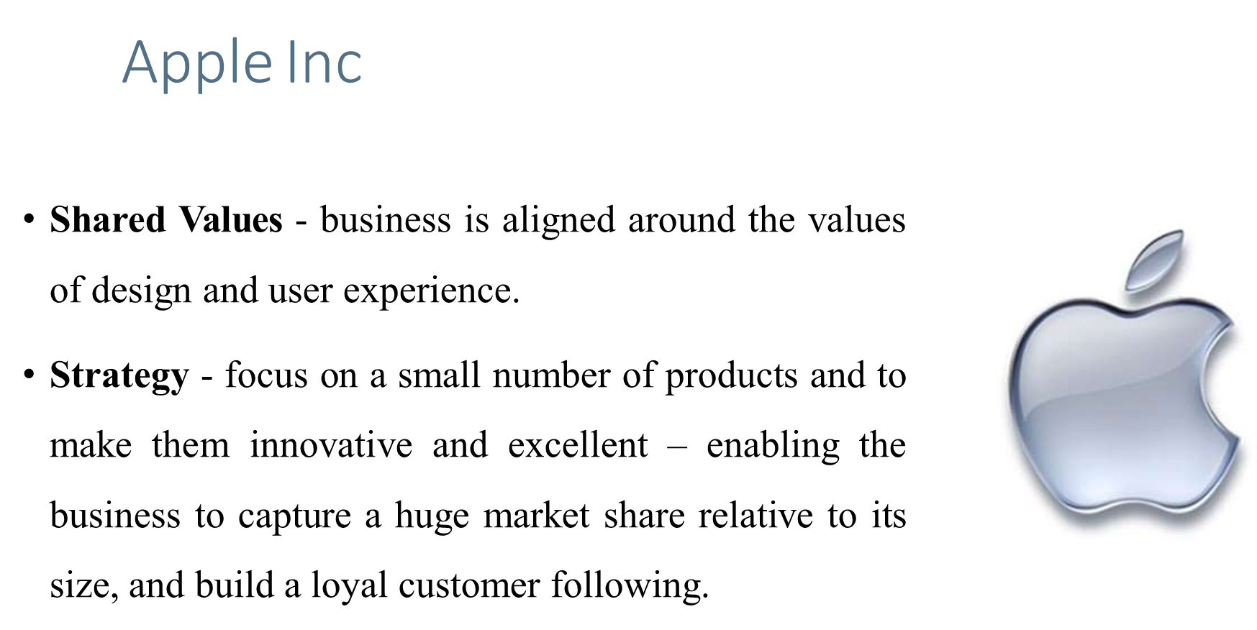
www.midocean.ae

Slide 27
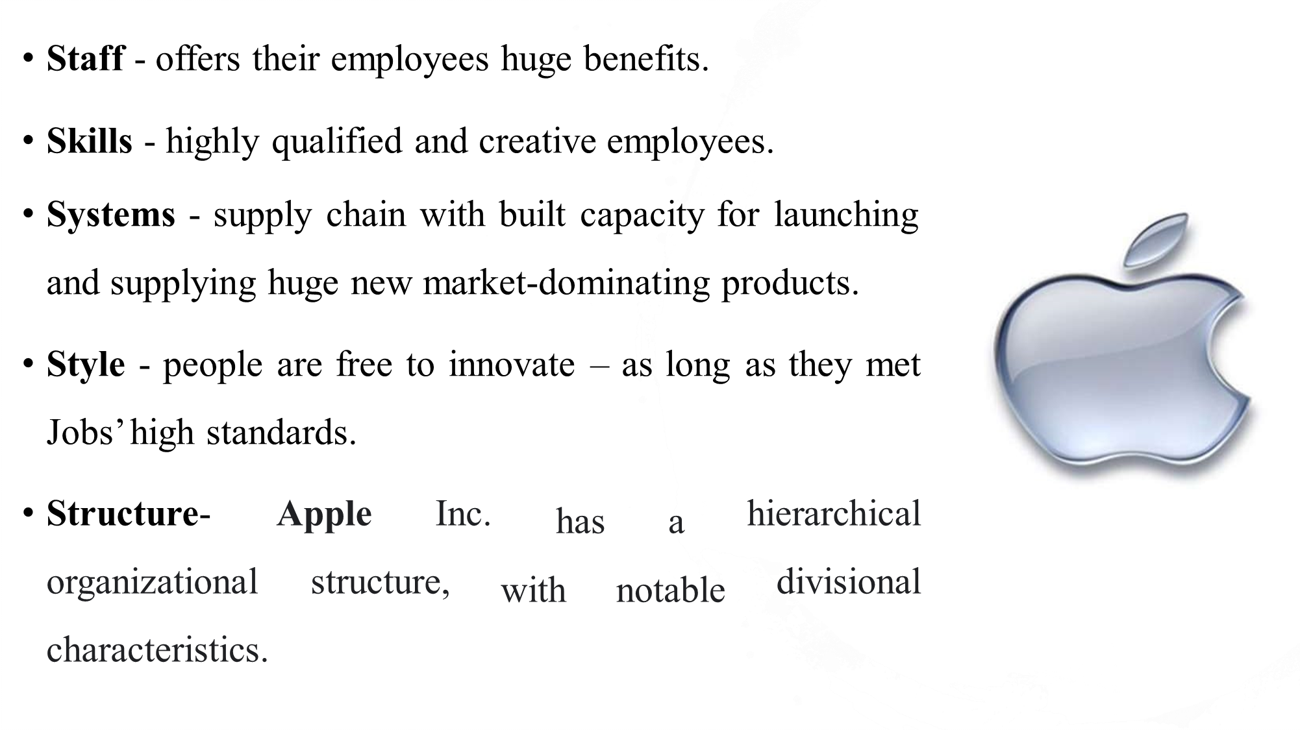
www.midocean.ae

Slide 28



Thank You

