Slide 1


Probability and
Statistics
Prepared by Dr. Alfaisal Hasan
STA 201
Probability and Statistics
Lecture NO 6

Slide 2



Probability and
Statistics
Lecture NO 6
STA 201
Probability and Statistics
Prepared by
Dr. Alfaisal Hasan
www.midocean.ae

Slide 3

Chapter
Topics
Chapter 1: Introduction To Statistics
Chapter 2: Descriptive Statistics
Chapter 3: Probability
Chapter 4: Discrete Probability Distributions
Chapter 5: Normal Probability Distributions
Chapter 6: Confidence Intervals
Chapter 7: Hypothesis Testing with One Sample
Chapter 8: Hypothesis Testing with Two Samples
Chapter 9: Correlation And Regression
Chapter 10: Chi-Square Tests and The F-Distribution
www.midocean.ae

Slide 4
Chapter
Confidence Intervals
6.1 Confidence Intervals for the mean ( Large Samples)
6.2 Confidence Intervals for the mean ( Small Samples)
6.3 Confidence Interval for the population Proportion
6.4 Confidence Intervals for Variance and Standard Deviation
www.midocean.ae

Slide 5
Confidence Intervals for the Mean
(large samples)
Chapter
Estimating Population Parameters
Finding a Point Estimate
Finding the Margin of Error
Confidence Interval for the population mean
Sample Size
www.midocean.ae

Slide 6
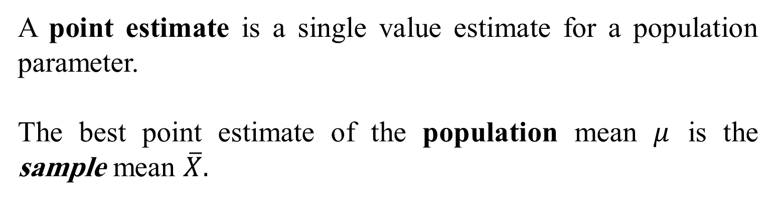
Chapter
Point Estimate
A point estimate is a single value estimate for a population parameter.
The best point estimate of the population mean $μ$ is the sample mean $\overline{X}.$
www.midocean.ae

Slide 7
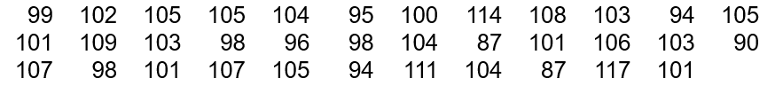
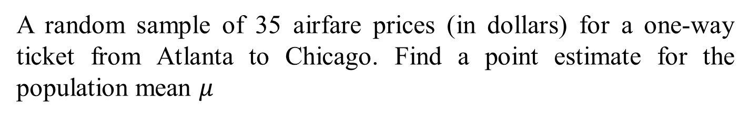
Chapter
Example: Point Estimate
A random sample of 35 airfare prices (in dollars) for a one-way ticket from Atlanta to Chicago. Find a point estimate for the population mean $μ$
www.midocean.ae

Slide 8

Chapter
Solution: Point Estimate
The sample mean is
The point estimate for the price of all one way tickets from Atlanta to Chicago is $101.77.
www.midocean.ae

Slide 9
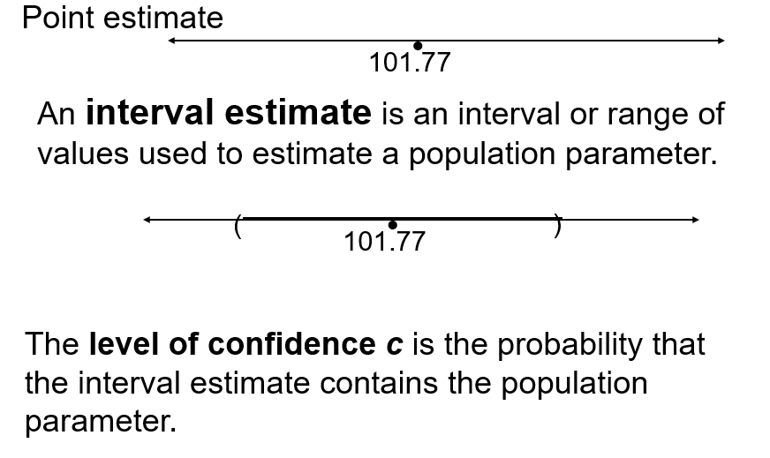
Chapter
Interval Estimate
www.midocean.ae

Slide 10
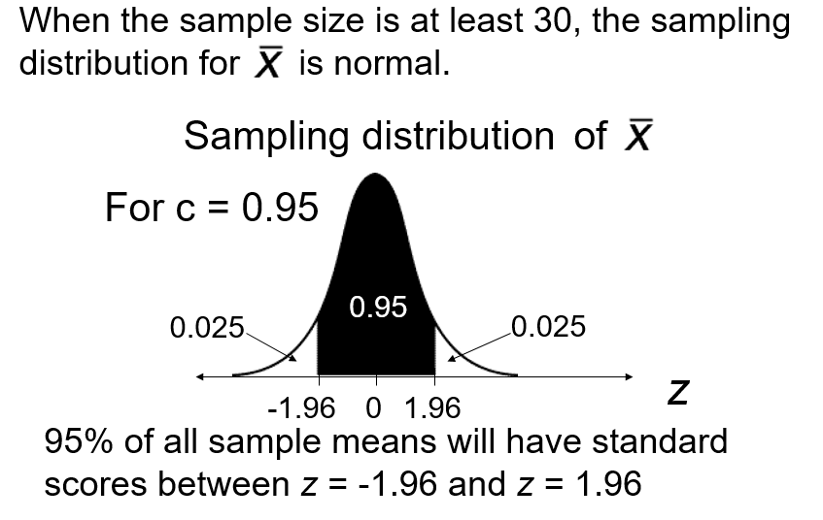
Chapter
Distribution of Sample Means
www.midocean.ae

Slide 11
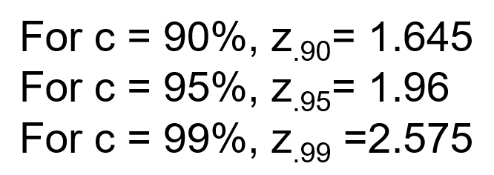
Chapter
Distribution of Sample Means
www.midocean.ae

Slide 12
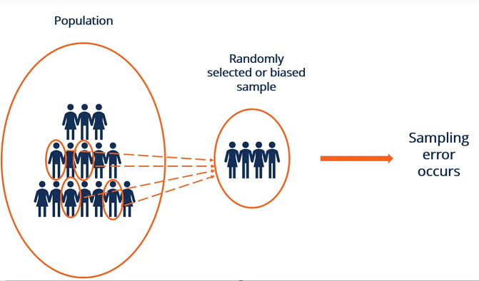
Chapter
Sampling Error
The difference between the point estimate and the actual parameter mean value is called the sampling error.
www.midocean.ae

Slide 13

Chapter
Maximum Error of Estimate
The margin of error E is the greatest possible distance between the point estimate and the value of the parameter it is estimating for a given level of confidence c.
When n > 30, the sample standard deviation s can be used in place of σ
www.midocean.ae

Slide 14
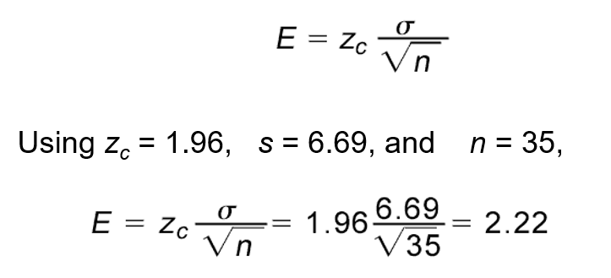
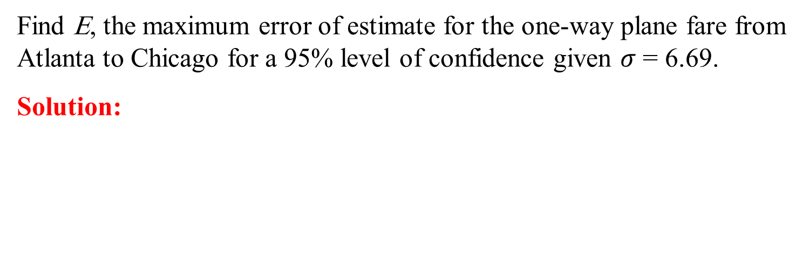
Chapter
Example: Maximum Error of Estimate
Find E, the maximum error of estimate for the one-way plane fare from Atlanta to Chicago for a 95% level of confidence given $σ$ = 6.69.
Solution:
You are 95% confident that the maximum error of estimate is $2.22.
www.midocean.ae

Slide 15
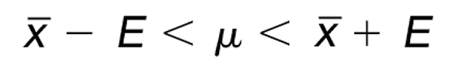

Chapter
Confidence Intervals for $μ$
A confidence interval for the population mean is
Find the 95% confidence interval for the one-way plane fare from Atlanta to Chicago.
www.midocean.ae

Slide 16
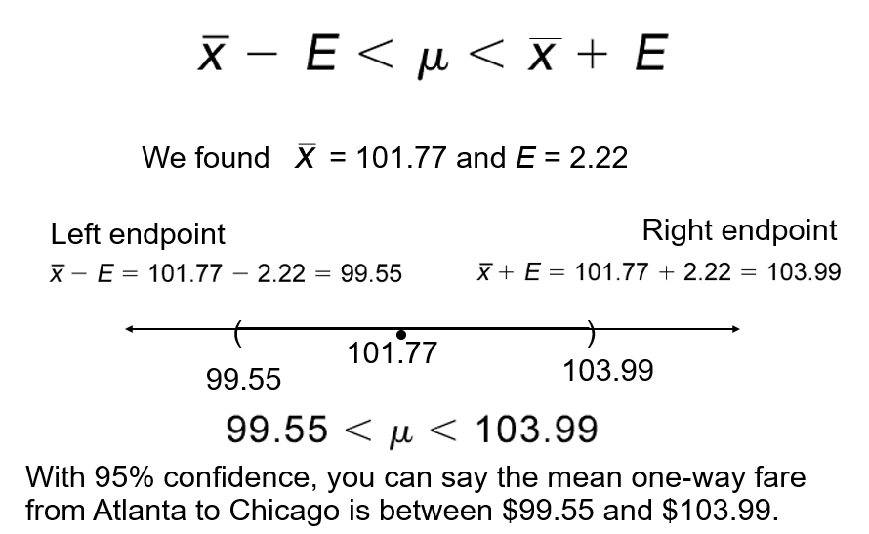
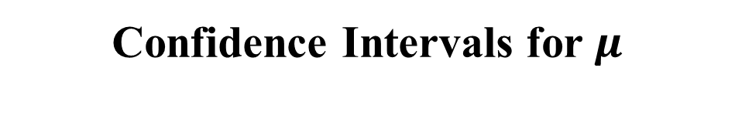
Confidence Intervals for $μ$
Chapter
www.midocean.ae

Slide 17
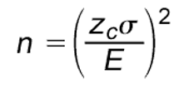
Chapter
Sample Size
Given a confidence level and a margin of error, the minimum sample size n needed to estimate the population mean is
www.midocean.ae

Slide 18

Chapter
Sample Size
You want to estimate the mean one-way fare from Atlanta to Chicago. How many fares must be included in your sample if you want to be 95% confident that the sample mean is within $2 of the population mean?
You should include at least 43 fares in your sample. Since you already have 35, you need 8 more.
www.midocean.ae

Slide 19
Confidence Intervals for the Mean
(Small samples)
Chapter
Small sample size and large sample size
The t distribution
Critical value from t distribution
Confidence interval using t distribution
www.midocean.ae

Slide 20
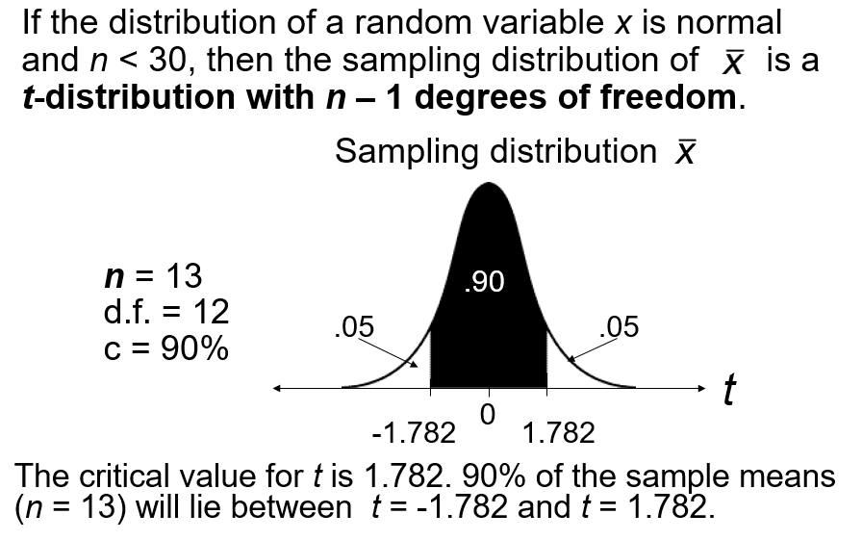
Chapter
The T Distribution
www.midocean.ae

Slide 21
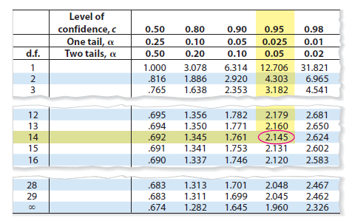
Example: t-distribution
Chapter
Finding Critical Values of t
Find the critical value for a 95% confidence level when the sample size is 15.
Solution:
Because n = 15, the degrees of freedom are n-1 = 15-1 = 14
portion of t table 5 is shown. Using d.f. = 14 and c= 0.95, you can find the critical value as shown by the highlighted areas in the table, which equal to 2.145
www.midocean.ae

Slide 22

T- distribution table
Chapter
www.midocean.ae

Slide 23
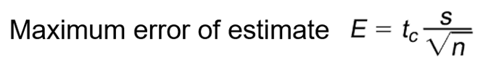
Maximum error of Estimate -- Small Samples
Chapter
Where;
S is the Sample standard deviation
tc is the value obtained from t table
n is the sample size
www.midocean.ae

Slide 24
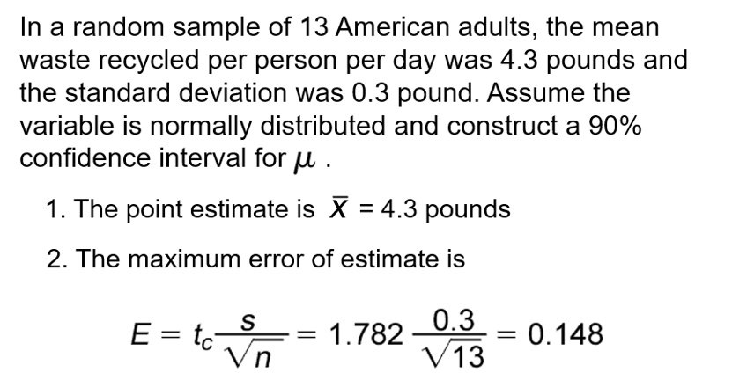
Chapter
Example: Maximum error of Estimate
www.midocean.ae

Slide 25


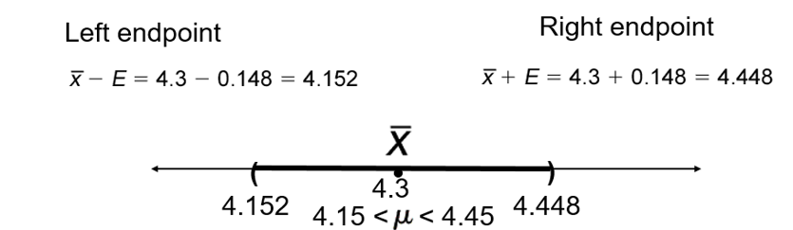
Confidence Interval – Small Sample
Chapter
2. Confidence Interval:
www.midocean.ae

Slide 26
Chapter
6.3 Confidence Intervals for Population Proportions
Point Estimate for Proportion Proportions
Confidence interval for Proportion Proportions
Finding the minimum Sample Size
www.midocean.ae

Slide 27
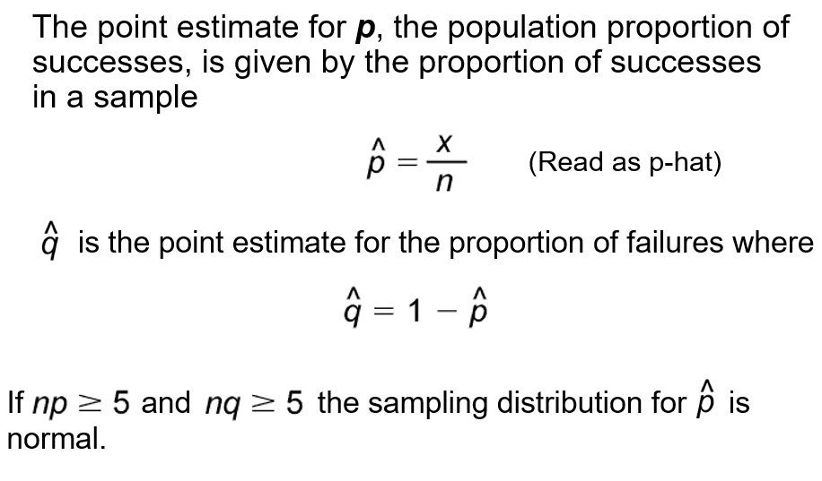
Confidence Intervals for Population Proportions
Chapter
www.midocean.ae

Slide 28
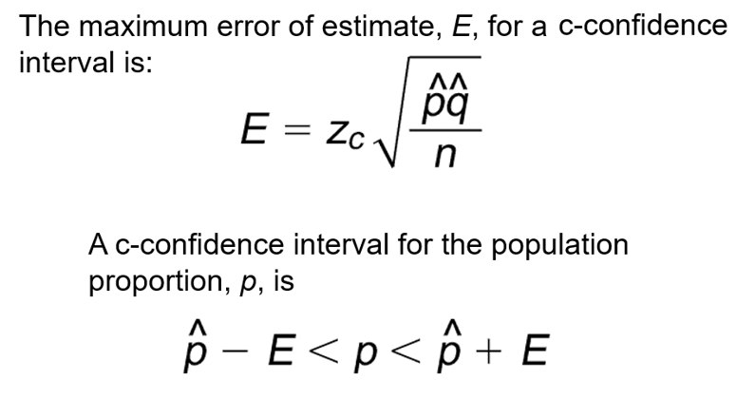
Confidence Intervals for Population Proportions
www.midocean.ae

Slide 29
Chapter
Example: Confidence Intervals for Population Proportions
In a study of 1907 fatal traffic accidents, 449 were alcohol related. Construct a 99% confidence interval for the proportion of fatal traffic accidents that are alcohol related.
www.midocean.ae

Slide 30
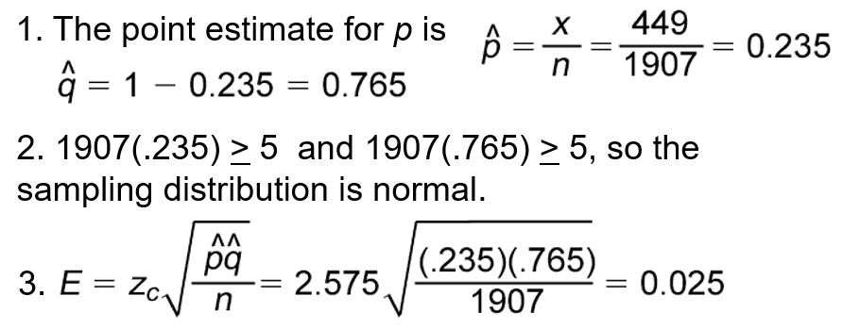
Solution : Confidence Intervals for Population Proportions
www.midocean.ae

Slide 31
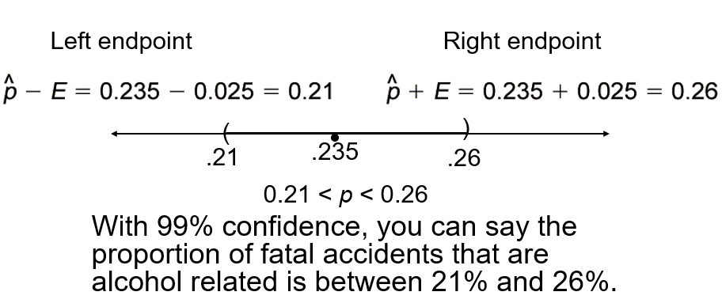
Solution : Confidence Intervals for Population Proportions
www.midocean.ae

Slide 32
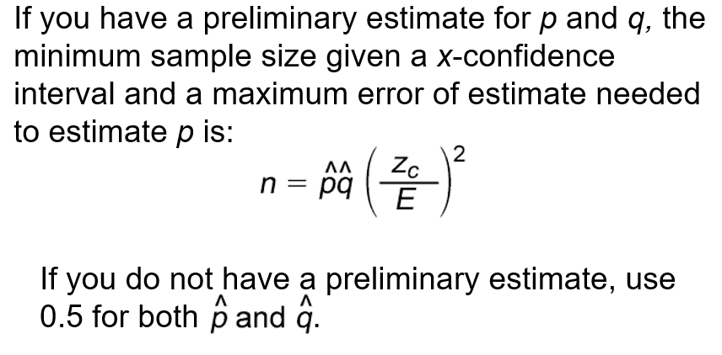
Chapter
Minimum Sample Size
www.midocean.ae

Slide 33
Chapter
Example: Minimum Sample Size
You wish to estimate the proportion of fatal accidents that are alcohol related at a 99% level of confidence. Find the minimum sample size needed to be accurate to within 2% of the population proportion
www.midocean.ae

Slide 34
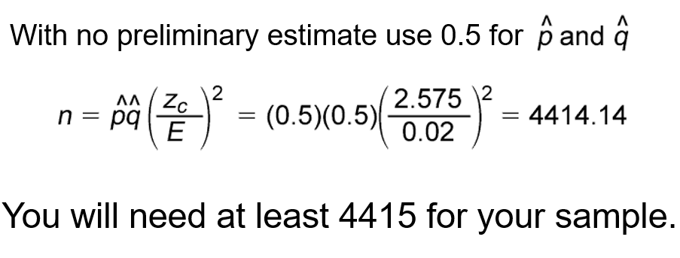
Chapter
Solution: Minimum Sample Size
www.midocean.ae

Slide 35

Chapter
Example: Minimum Sample Size
You wish to estimate the proportion of fatal accidents that are alcohol related at a 99% level of confidence. Find the minimum sample size needed to be be accurate to within 2% of the population proportion. Use a preliminary estimate of p = 0.235.
www.midocean.ae

Slide 36
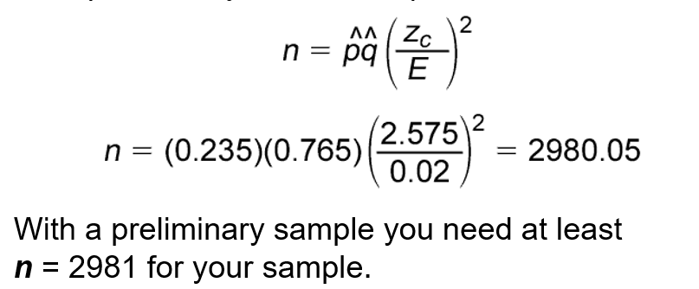
Chapter
Solution: Minimum Sample Size
www.midocean.ae

Slide 37
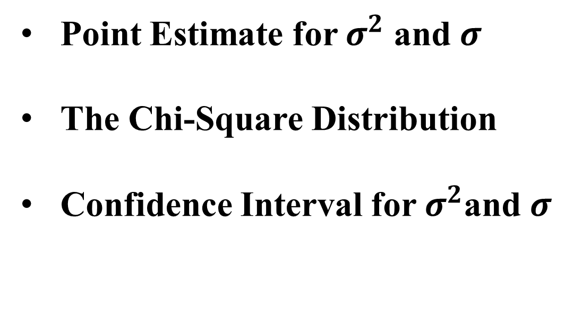
Chapter
6.4 Confidence Intervals for Variance and Standard Deviation
Point Estimate for $σ^{2}$ and $σ$
The Chi-Square Distribution
Confidence Interval for $σ^{2}$and $σ$
www.midocean.ae

Slide 38
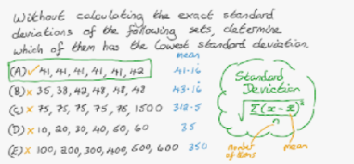

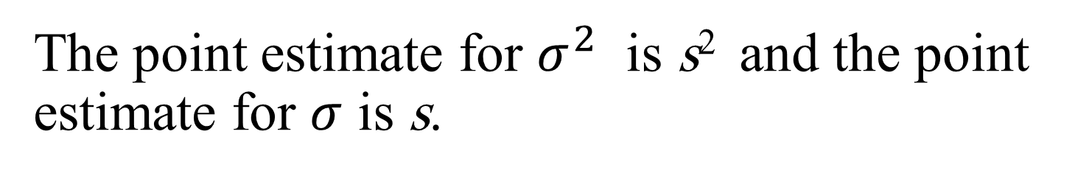
Chapter
Point Estimate for $σ^{2}$ and $σ$
The point estimate for $σ^{2}$ is s² and the point estimate for $σ$ is s.
www.midocean.ae

Slide 39
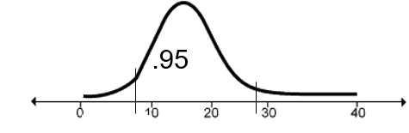
Chapter
The Chi-Square Distribution
If the sample size is n, use a chi-square x² distribution with n – 1 degrees of freedom to form a c-confidence interval.
www.midocean.ae

Slide 40
Chapter
Example: The Chi-Square Distribution
Find x_{R}² the right-tail critical value and x_{L}² the left-tail
critical value for c = 95% and n = 17.
Solution:
When the sample size is 17, the degrees of freedom = n-1 = 17-1 = 16
Area to the right of x_{R}² is (1 – 0.95)/2 = 0.025
Area to the right of x_{L}² is (1 + 0.95)/2 = 0.975
www.midocean.ae

Slide 41
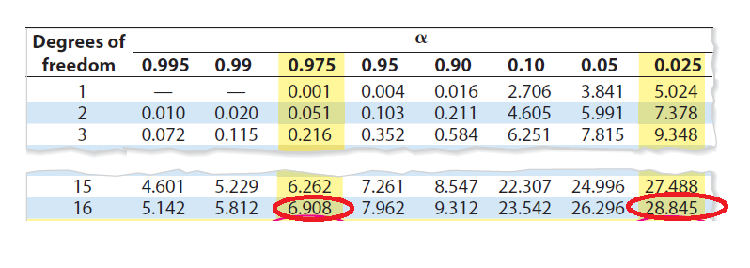



Example: The Chi-Square Distribution
www.midocean.ae

Slide 42
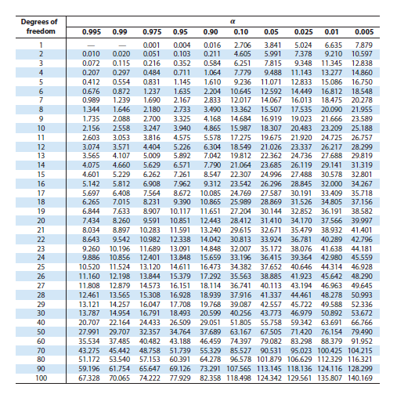
The Chi-Square Table
www.midocean.ae

Slide 43
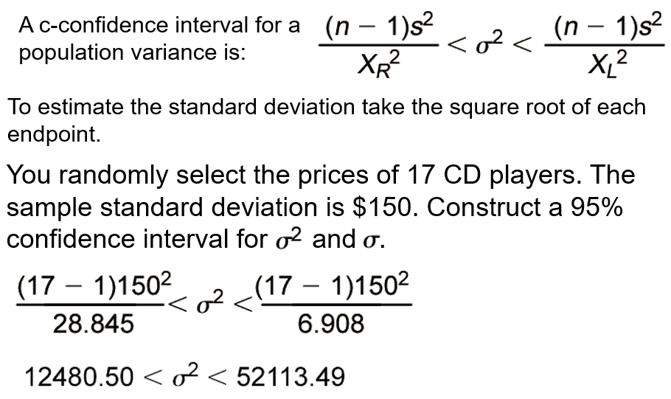

Confidence Interval for $σ^{2}$and $σ$
www.midocean.ae

Slide 44
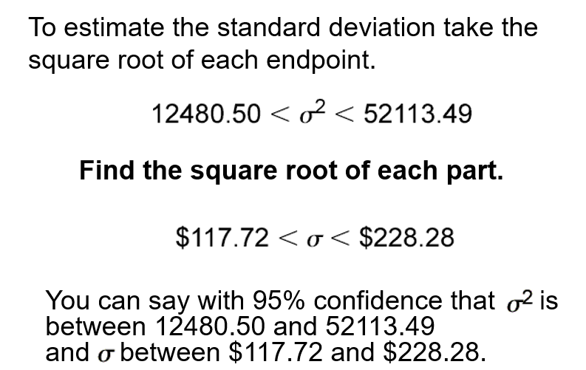
Confidence Interval for $σ^{2}$and $σ$
www.midocean.ae

Slide 45
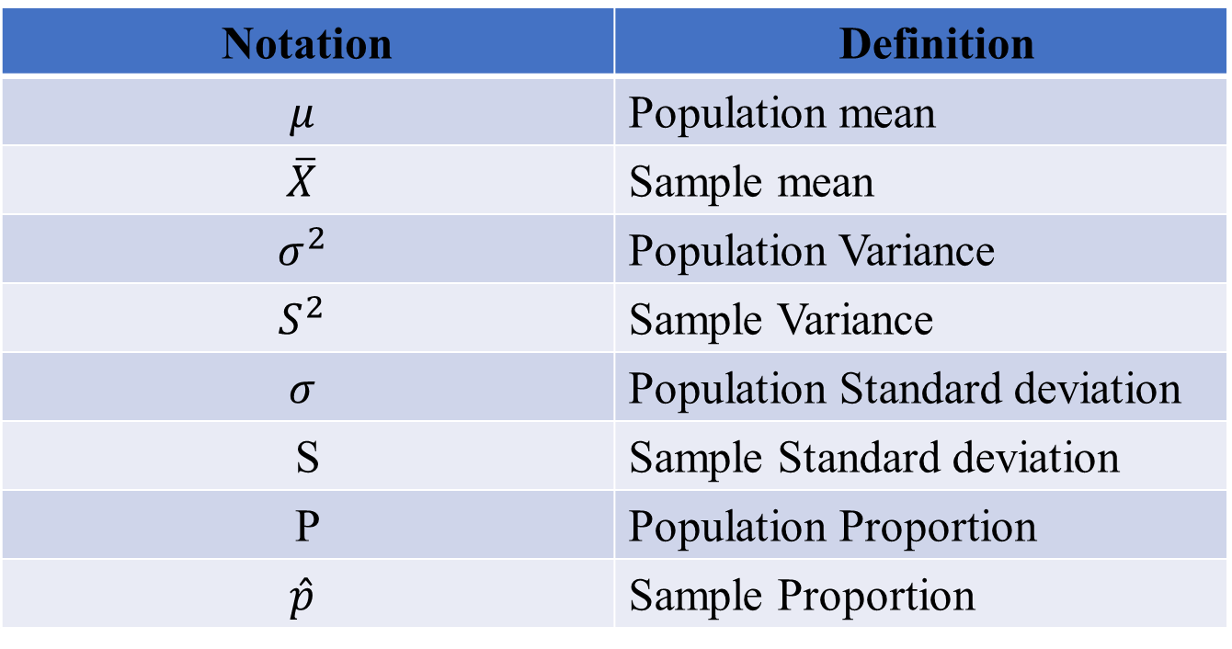
Notation Summary
Notation | Definition
$$μ$$ | Population mean
$$\overline{X}$$ | Sample mean
$$σ^{2}$$ | Population Variance
$$S^{2}$$ | Sample Variance
$$σ$$ | Population Standard deviation
S | Sample Standard deviation
P | Population Proportion
$$\hat{p}$$ | Sample Proportion
www.midocean.ae

Slide 46


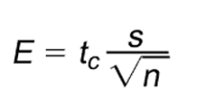
Chapter Summary
Confidence Intervals for the mean ( Large Samples)
Confidence Intervals for the mean ( Small Samples)
www.midocean.ae

Slide 47

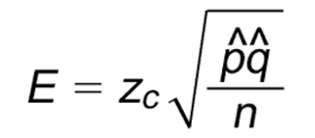
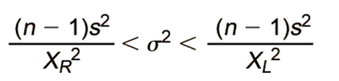
Chapter Summary
Confidence Interval for the population Proportion
Confidence Intervals for Variance and Standard Deviation
www.midocean.ae

Slide 48
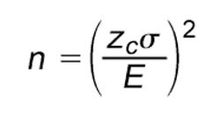
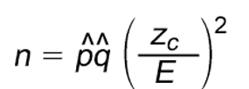
Chapter Summary
Sample Size
Estimate Mean:
Estimate Proportion:
www.midocean.ae

Slide 49
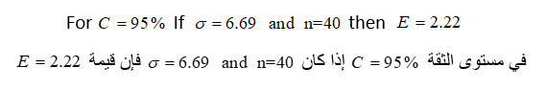
Un Solved Examples
Chapter
www.midocean.ae

Slide 50

Un Solved Examples
Chapter
www.midocean.ae

Slide 51


Thank You

