Slide 1

International Business Management
Prepared by Dr. Badur elgasim
Lecture 9
MGM 506
Control of International Operations

Slide 2

Learning Objective
Learning Objectives
Purpose and Functions of the Control Process
Control Mechanisms
Control Approaches
Cultural Aspects of MNC Control
Additional Control Problems of MNCs
Ownership and Host Government Involvement

Slide 3

Introduction
No organization can accomplish its goals without proper control. The imperative of organizational control is heightened when firms cross national borders and expand into unfamiliar foreign markets. During the 1980s, many developing countries experienced financial crises. Most of them were forced to block the transfer of hard currencies abroad. Multinational companies (MNCs) operating in these nations were unable to repatriate earnings or assets. In effect, the MNCs’ control of these funds, and indirectly a partial control of their businesses, was subject to host government policies.

Slide 4

Some firms used unique methods to move the blocked funds abroad. Columbia Pictures, for example, filmed a movie in Kenya to use up blocked funds generated by its parent company, Coca-Cola. In Tanzania, another firm found a creative way to spend money blocked in the country. For a while, it booked all its airline tickets for all destinations in or out of Tanzania at Dar es Salaam, the capital of Tanzania. The blocking of funds is only one way host governments interfere with the normal business operations of MNCs. Often, MNCs lose some control over their foreign subsidiaries due to host government demands

Slide 5
The effective management of an organization, among other factors, depends on securing continuous and sufficient progress toward goals. Management must determine if the organization is following the right strategies and if these strategies are being implemented correctly. Sound management also involves asking whether the organization is moving in the proper direction and if the results obtained are those intended. Organizational control could provide answers to these questions. Control is needed not only for detecting problems and deviations from plans but also for anticipating problems before they occur

Slide 6
Purpose and Functions of the Control Process
Organizational control refers to the process of monitoring and evaluating the effectiveness and efficiency of organizational performance and taking corrective action when performance falls short of expectations. Based on this definition, there are four major components in a control system.
First, spell out the intended results, and establish the standards against which organizational activities and accomplishments can be measured.
Second, monitor and collect information on organizational activities that are aimed at goal accomplishment.

Slide 7
Third, evaluate organizational performance and results for effectiveness.
Fourth, make necessary adjustments to correct deficiencies during and after the implementation of the strategy.
Deficiencies could be due to shortcomings in implementation or flaws in the strategy.
The failure of a strategy could also be related to changes in the environmental factors that were the basic premises of the strategic plan. In any case, a properly constructed control mechanism should provide information regarding the shortcomings.

Slide 8
Control Mechanisms
Several control mechanisms can be used individually or in combination in an organization.
Some are very formal, such as various reports from lower levels of the organizational hierarchy to higher levels. Others are informal, such as socialization and acculturation, which instill organizational values in members and create uniformity in decisions and actions.
In the following section, we will review the major control mechanisms

Slide 9
Input and Output Controls
Input control is regarded as behavioral control, where expectations are communicated to employees in advance. Then, through personal supervision and surveillance, they are guided and directed to reach goals. Of course, rewards and punishment are the instruments that are used to induce goal-oriented behavior modification. It works best in small organization.
Output control is result oriented and uses impersonal measures such as the difference between the expected and the final outcome. It relies on feedback information to correct deviations. Output control works well for large organizations, where the complexity and heterogeneity of activities require standard objective measures of comparison

Slide 10
Locus of Decision Making
Usually, all major strategic and critical decisions are made by top-level executives. Some organizations may allow dispersion of decision-making power for other important matters among lower-level managers
Centralization of decision-making is characteristic of a firm in which most decisions are made by top-level managers. In a centralized MNC, foreign subsidiaries have limited decision-making authority, and most important matters are decided by headquarters.
The opposite is decentralization, where decision-making power is dispersed among more managers. Decentralized MNCs give more autonomy to their foreign subsidiaries

Slide 11
Communication and Information Flow
Information collection on organizational performance is the linchpin in any control system. To assess the firm’s viability and the relevance of its strategy, a variety of data must be collected from inside and outside the firm. To monitor performance, a variety of information is communicated between different parts of the organization.
Strategies, goals, and expectations are communicated from headquarters to subsidiaries. Communication and information flow ranges from periodic financial and operations reports to occasional face-to-face meetings. Telecommunications technology has expanded MNCs’ information-processing capability and has resulted in movements toward both centralization and decentralization

Slide 12
Formal Reports
Formal reporting on financial and operational aspects along with local market data are essential means of subsidiary control by the MNC. Most MNCs rely heavily on financial reports for control of foreign subsidiaries. Financial data such as return on investment and inventory turnover allow comparison with industry norms and provide information on the progress made in strategy implementation. Intrafirm business transactions and corporate tax variations among host countries make the use of financial data by MNCs more complex

Slide 13
Informal Communication
Informal communication is used along with formal communication to convey to members of the organization what the performance expectations are and to cajole them to comply with the norms.
Informal communication is more subtle and indirect in enforcing organizational standards. Some firms, for example, communicate dress codes to members without making a formal statement about it.

Slide 14
Organizational Structure
Increased competition and changing market conditions require a timely, concerted, and uniform response from various organizational units.
To increase the organizational capabilities for a proper response to competition and other market forces, firms may need to institute more central control.
For example, MNCs that find themselves faced with intense competition may require tighter control and could centralize their operations by restructuring

Slide 15
Integrative Mechanisms
Various integrative mechanisms are used to control and manage interdependencies among different organizational units. The more common integrative mechanisms are liaison positions, cross-unit committees, integrators, and the matrix structure. These mechanisms form a continuum from simple to complex, moving from liaison to matrix in terms of complexity. A low level of interdependency calls for the use of a simple integrative mechanism, such as a liaison role. A more complex integrative mechanism, such as a matrix, is appropriate for the management and control of a high level of interdependency

Slide 16
Resource Allocation
The primary relationships among various units of a business organization center on economics. One way of exerting control is through resource allocation. The pattern of distribution of resources (anything that people value, e.g., money, material, promotion, knowledge, technology, vacation, a large office, etc.) indicates to the members the performances and outcomes desired by the organization. By changing the allocation of resources among subsidiaries, MNCs effectively exercise control over them. In some MNCs, the direction of resource flow is from the headquarters to the subsidiaries; in integrated MNCs, however, the flow of resources is multidirectional.

Slide 17
Budgeting System
Budgeting is the allocation of resources among various organizational units on the basis of present needs, past performance, and the projection of future needs. Budgets are standards against which actual performance can be measured.
Firms use different budgets for monitoring important activities and functions, such as the capital expenditure budget, the marketing and promotion budget, and the research and development (R&D) budget. With a budgeting system, MNCs not only monitor subsidiaries’ activities, they also establish priorities that reflect corporate strategies. Increasing or decreasing the budget is an effective way to dictate the direction of a subsidiary’s development and progress.

Slide 18
Control Approaches
The three approaches to control are the market approach, rules approach, and cultural approach. Based on the proposed that the three approaches form a triangular continuum along which organizations use a combination of two methods of control: input control and output control (Fig. 9.1.).
The three approaches do not exist in pure form. Each, however, may be a dominant form in a given organization. Among the three approaches, as we will argue, cultural control may be needed to respond to the uncertainty and complexity of the international environment.

Slide 19
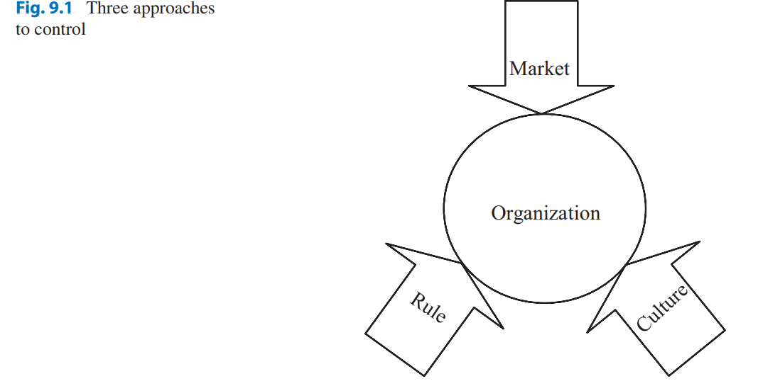

Slide 20
Market Approach
Control mechanisms employed in a market approach are external market forces. Competition, supply and demand, and contractual agreements are among the external forces that govern the relationships among organizational units. An MNC using the market approach resembles a federation of autonomous units that are free to deal with internal (other units and subsidiaries) or external suppliers.
Output control is the dominant method in a market approach, which includes transfer pricing, bargaining, and management compensation.

Slide 21
Rule Approach
In most organizations, the rules approach seems to be more visible than other controls. A rules-oriented organization uses both input and output controls. It relies extensively on established rules and procedures, such as planning, budgeting, formal reports, performance evaluation, and hierarchical structure. Rules work best when both goal incongruence and performance ambiguity are moderately high and when the environment is relatively stable.
When there is less congruence among the various goals pursued by the members, a rules-oriented control system provides a common ground for action and coordination

Slide 22
Culture Approach
In a cultural approach, external rules and procedures are internalized. Instead of the supervisory surveillance that is common in a rule-oriented organization, individuals exercise self-control and abide by cultural norms and expectations. Less time is needed to respond to feedback information, and the cost of control is lower than is the case in the other two approaches. Also, culture is a vital factor in the globalization of the firm. It facilitates control over foreign operations. The most common example of the cultural approach is found in Japanese organizations. Japanese organizations are generally more loosely organized.

Slide 23
Cultural Aspects of MNC Control
Culture is the most effective control mechanism. Societies effectively manage and control their people by devising cultural controls. Through the socialization process, members internalize the values and norms of society, which become the criteria for judging behavior. The internalized values are also strong motivating forces that induce people to behave according to society’s expectations. Organizations employ culture and socialization for control purposes too. Because the MNCs operate in culturally diverse environments, the challenge, however, is to build a control system that capitalizes on the synergy of cultural diversity

Slide 24
Corporate Socialization
could be described as the process by which members learn what behaviors and perspectives are customary and desirable in the work environment. Corporate socialization takes place through a combination of obvious and subtle means. The obvious means of corporate socialization include job rotation management development programs, and informal company-sponsored events. Of course, the corporate reward and compensation system is an obvious and powerful tool for shaping employee behavior and promoting the socialization process. For a domestic firm, socialization of employees is a relatively routine process.

Slide 25
The dispersed operations of an MNC make the socialization process more difficult and challenging. Aware of the challenge, many MNCs use job rotation to introduce employees early in their careers to the firm, the culture, and “the ropes” around their global operations. For example, to demonstrate that contrary to employees’ perceptions, international experience was not a roadblock to career advancement, General Electric revamped its job rotation program. It started sending its brightest stars to foreign assignments rather than the run-of-the-mill managers it used to pick for posts abroad

Slide 26
Evolution of Coordination and Control of MNCs
Because of the additional coordination and control difficulties that MNCs face, they need more sophisticated control mechanisms than are used by domestic firms. The need to respond simultaneously to the different strategic requirements of foreign countries demands much flexibility. Consequently, in addition to formal means of control and coordination, MNCs need to rely on a wide range of informal mechanisms, including informal networks of communication, corporate culture and socialization, and career path management

Slide 27
Multinational/ Multidomestic: The control and coordination mechanisms of firms focusing on the multidomestic strategy are dependent upon the national level business environments. These business environments affecting international business activities included nationalist sentiments, protectionist barriers, and communication and transportation difficulties.
Global: Because of more favored economic and political environments (e.g., market liberalization and deregulation), advancements in production technologies increased economies of scale and decreased transportation and communication costs, and firms have become more centralized in production and marketing activities

Slide 28
Transnational: Because of increased global competition and radically changing global business environments, the need to flexibly manage subsidiaries (or business units) has become more significant; the requirement to centralize and decentralize interorganizational control and coordination has increased.
Technological developments have resulted in the globalization/standardization of business and competition in many industries

Slide 29
Additional Control Problems of MNCs
In addition to the control problems associated with managing dispersed subsidiaries in economically and politically diverse environments, MNCs also encounter several other specific control problems:
1. Language and cultural differences.
2. Geographic distance between the headquarters and subsidiaries.
3. Legal differences.
4. Security issues.
5. Intrafirm business transactions (transfer pricing).
6. Currency exchange rate fluctuations

Slide 30
Language and Cultural Differences
Diversity in language and culture among various foreign operations is the source of many of the difficulties the MNCs’ headquarters encountered. Some of the problems can be reduced by assigning expatriates who are “acculturated” at headquarters to key managerial positions in the subsidiaries and identifying local managers who are proficient in the language of the headquarters. Typically, however, most staff at headquarters have limited or no foreign language skills, and the language problem remains real. The result is that communication between much of the headquarters staff and foreign subsidiaries is limited to contact with those subsidiary employments who can speak the language of the headquarters

Slide 31
Geographical Distance
Telecommunication technologies and improvements in transportation facilities have greatly aided the expansion of MNC operations. Vast geographical distances between the MNCs’ subsidiaries, however, pose control problems that even today’s modern telecommunications and ease of travel have not been able to fully overcome.
Nothing can substitute for face-to-face communication and personal visits. Written communication, telephone calls, and voice and computer messages are not the same as personal visits. Often, to travel from the headquarters and visit a foreign subsidiary takes at least a couple of days and much advance preparation.

Slide 32
Legal Differences
Laws and legal procedures are central to the concept of organizational control. The control of a business firm depends on the legal institutions and practices of the host country. The practices that legally are accepted or rejected in one country are not necessarily honored by the other.
The MNCs’ control of foreign subsidiaries can take place only within the confines of the legally accepted business norms of host countries. In effect, the host country’s legal system may place limitations on the control that headquarters can exercise

Slide 33
Security Issues
Most nations have benefited from globalization. However, increased international trade; the information explosion, including the use of the Internet; and increased immigration have also made it easier for various groups to engage in terrorism.
Terrorism adversely affects international business and poses serious questions regarding control of MNC operations. For a long time, developing countries had certain concerns over the loss of control to MNCs

Slide 34
Intrafirm Business Transactions
Firms can use various strategies for entering into foreign markets, including exports, contractual agreements, and direct investment. Within this context, therefore, an MNC could be viewed as a network of resource (products and components, capital, technology and knowledge, and personnel) flow across national borders among business units controlled by the headquarters. In this network, resources flow from the MNC’s headquarters located in the home country to subsidiaries in foreign countries. Additionally, there are inter-subsidiary business transactions between them and the headquarters that are controlled by headquarters

Slide 35
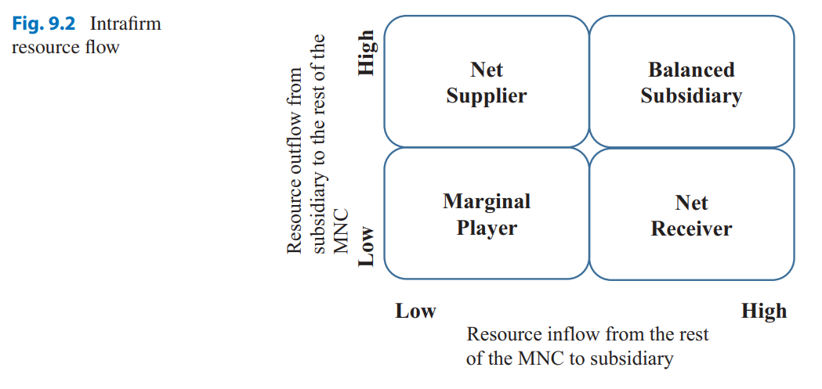

Slide 36
Other Factors
The pattern of resource allocations and the amount of control exerted by the headquarters is determined by many factors; among them are the importance of a subsidiary to the MNC and the required relationship between the subsidiary and the host government. A subsidiary, for example, may be given more decision-making authority if it has to establish certain links with the local community, and to do requires more autonomy. Also, the headquarters’ confidence in the managers of subsidiaries determines the amount of central control exercised over them

Slide 37
Ownership and Host Government Involvement
In discussing control concerns of multinational corporations, two separate, but interrelated, issues stand out. The first one is the control of organizational performance as just discussed. It deals with the activities and operation of the enterprise and provides information and assurances that the corporate plans have been accomplished. Typically, it is the control of organizational performance that comes to mind when discussing the subject of control. The second issue is the legal and ownership control that deals with business-government relationships and participation of the host country in the ownership of a foreign subsidiary. The legal and ownership issues of control are even more challenging and complex than those involving corporate strategies

Slide 38
Financial and Investment Decisions
The most prevalent demand by host governments is for financial participation in foreign subsidiaries. Particularly in Asia and South America, host governments pressure MNCs to share equity ownership of their subsidiaries with domestic investors or host government agencies.
Under pressure, some MNCs succumb to these demands. Most MNCs do not strongly object to a minority equity ownership by locals. In fact, sharing of ownership with host country investors is an effective protection against host government policy decisions that could adversely affect the MNC operations

Slide 39
Business Decisions
Host governments interfere with business decisions by establishing certain performance criteria for foreign subsidiaries. These criteria include the local component requirement, market share limits, tie-in products, and export quotas. Local component requirements involve the demand of many host governments that products sold by the MNCs in the host markets incorporate locally produced components or raw materials. For instance, there is a requirement on FDI (foreign direct investment) imposed by the Indian government that foreign firms, single-brand retailers, have to order 30% of parts/components to local Indian suppliers. The aim is to increase the MNCs’ contribution to the local economy and employment and to reduce hard currency spending

Slide 40
Human Resource Management Decisions
The host governments’ desire to increase the employment, skills, and knowledge of their people is manifested in several ways. The host government may demand that host nationals be appointed to top managerial positions within local subsidiary operations. Compliance with this demand makes the control of local operations more difficult, especially where trust and competence become issues. MNCs become more cautious and increase headquarters control when they are forced to appoint a host national as the head of a foreign subsidiary. Most MNCs grant more decision-making authority to expatriate managers than to host nationals, and having home country nationals at the head of foreign subsidiaries is perceived to reduce the need for other means of control

Slide 41
Ownership and Control of Foreign Affiliates
Besides the nature of the decisions, other factors influence the centralization of decision-making at the headquarters and reduce the autonomy of affiliates. We have already referred to a few of these factors, including the skills and experience of managers and their nationality.
Other factors are the size and degree of internationalization of the MNC, the type of product produced by the subsidiary, the markets that the affiliate serves, and the size of equity owned by others

Slide 42
Resources:
Kamal Fatehi & Jeongho Choi
International Business Management
Succeeding in a Culturally Diverse World, Second Edition

