Slide 1



Common Information Security Threats
Lecture 4
HCIA-Security
Prepared by
Dr. Abdelrhman Ahmed

Slide 2
Chapter
04
Foreword
• Information systems are often vulnerable and have sensitive, confidential information that needs to be communicated. Therefore, they are under threat in various scenarios and through various means.
• This class uses some case studies about common attacks to introduce possible threats to the information system.

Slide 3
Chapter
04
Objectives
• Upon completion of this course, you will be able to:
□ Categorize information security threats.
□ Describe common information security threat means.

Slide 4
Chapter
04
Endless Security Incidents

Slide 5
Chapter
04
Beginning of the Cyberwar - Stuxnet
In February 2011, Iran suddenly announced it was to unload fuel from its first nuclear power station. Previously, the industry said Iran needed only one year to be capable of quickly creating nuclear weapons. However, the Stuxnet attack ruined one fifth of the centrifuges of Iran, postponing the research for at least two years, during which time the global landscape changed.

Slide 6
Chapter
04
Evolution of Information Security Attacks

Slide 7
Chapter
04
Security Threat Categories

Slide 8
Chapter
04
DDoS Attacks Against Dyn DNS Service in the United States
• On October 21, 2016, the DNS service from Dyn in the U.S. was hit by DDoS attacks from about 11:00 a.m. to 5:00 p.m. UTC. The attacks paralyzed nearly half the networks in the United States.
• These large-scale DDoS attacks were launched from botnets formed by loT devices, which were infected with mirai malwar

Slide 9
Chapter
04
DDoS Attacks Against Dyn DNS Service in the United States
• Dyn is a DNS SaaS provider whose core service is providing managed DNS for its users. The DDoS attacks severely affected DNS services, preventing Dyn users from accessing their websites. Because Dyn serves many companies, the damage caused spread quickly, causing serious harm. More than 100 websites became inaccessible due to these attacks for as long as three hours. Amazon alone suffered a loss of tens of millions of dollars.
• The "zombies" launching the attacks mainly consisted of network cameras, digital hard disk recorders, and smart routers. The Mirai botnet infected millions of devices, of which only one tenth were involved in this attack.
• Currently, the Internet has many zombie hosts and botnets. Driven by the desire for profit, DDoS attacks have become a major security threat to the Internet.

Slide 10
Chapter
04
Process of a Mirai Attack

Slide 11
Chapter
04
Process of a Mirai Attack
• Look for zombies: By default, the remote login function is enabled for loT devices to facilitate remote management of the administrators. An attacker can scan IP addresses to discover live loT devices, which are then scanned for open Telnet ports.
• Build a botnet: Some loT device users use the default password directly or set a simple password (a simple combination of username/digits, such as "admin/123456") for their devices. These passwords are easily cracked by an attacker through brute force. After successfully cracking the password to a loT device and logging in to it through Telnet, the attacker remotely implants the Mirai malware into the loT device to obtain absolute control over the device.
□ After obtaining absolute control over the infected devices, in addition to using the devices to launch DDoS attacks, the malware can also cause serious damage to the systems, services, and data of the devices. For example, the malware can tamper with data, steal privacy, modify configurations, and delete files, and may further attack core service systems.
• Load the attack module: The attacker loads the DNS DDoS attack module on the loT device.
• Launch an attack: The attacker launches a DDoS attack against DNS service from Dyn in the United States through the botnet, bringing down hundreds of customer websites.

Slide 12
Chapter
04
Scanning

Slide 13
Chapter
04
Spoofing Attack - Obtaining the Control Permission
• Attackers can obtain the control permission by brute force cracking of passwords. Also, attackers can launch spoofing attacks such as IP spoofing to obtain access and control permissions.
• IP spoofing: An attacker may send packets with forged source IP addresses to target hosts to obtain superior access and control permissions.

Slide 14
Chapter
Spoofing Attack - Obtaining the Control Permission
04
• IP spoofing is launched by exploiting the normal trust relationships between hosts. Hosts with IP address-based trust relationships use IP address-based authentication to determine whether to allow or reject the access of another host. Between two hosts with a trust relationship, users can log in to one host from another without password verification.
• The process of an IP spoofing attack is as follows:
□ Crash the network where a trusted host resides to launch the attack without resistance.
□ Connect to a port of the target host to guess the sequence and sequence increment value.
□ Masquerade the source address as the address of a trusted host and send a data segment with the SYN flag set to initiate a connection.
□ Wait for the target host to send a SYN-ACK packet to the compromised host.
□ Send the target host an ACK packet, with the source address masqueraded as the address of a trusted host and sequence number as that expected by the target host, plus 1.
□ After the connection is established, send commands and requests to the target host.

Slide 15
Chapter
04
Launching a DDoS Attack
• DDoS attacks:
□ Exhaust network bandwidth
□ Exhaust server resources

Slide 16
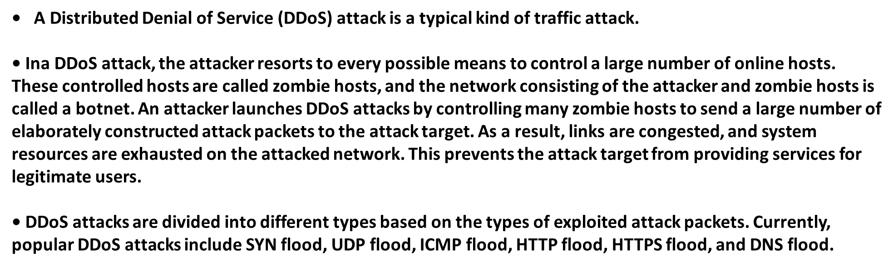
Chapter
04
Launching a DDoS Attack

Slide 17
Chapter
04
Defense Measures for Cyber Attacks
• Firewalls: Deploying firewalls at the intranet egresses of medium- and large-sized enterprises and data centers can efficiently defend against common DDoS attacks and traditional single-packet attacks.
• Anti-DDoS devices: Anti-DDoS solutions provide professional anti-DDoS services for carriers, enterprises, data centers, portal websites, online games, online videos, and DNS services.

Slide 18
Chapter
04
Worm Attack Against Weibo
• Sina Weibo (the Chinese Twitter) was once hit by a worm that affected over 30,000 users in less than an hour. The attack process was as follows:

Slide 19
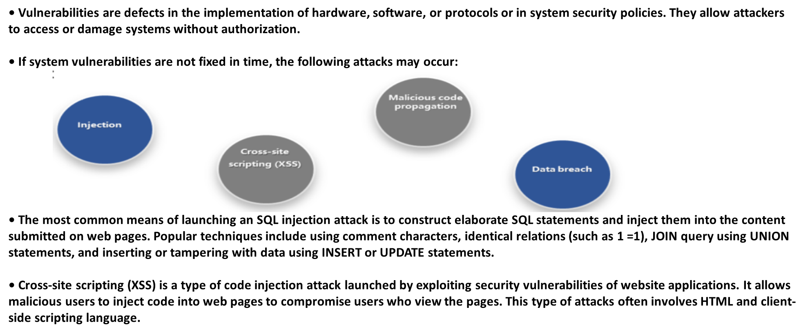
Chapter
04
Threats Brought by Vulnerabilities

Slide 20
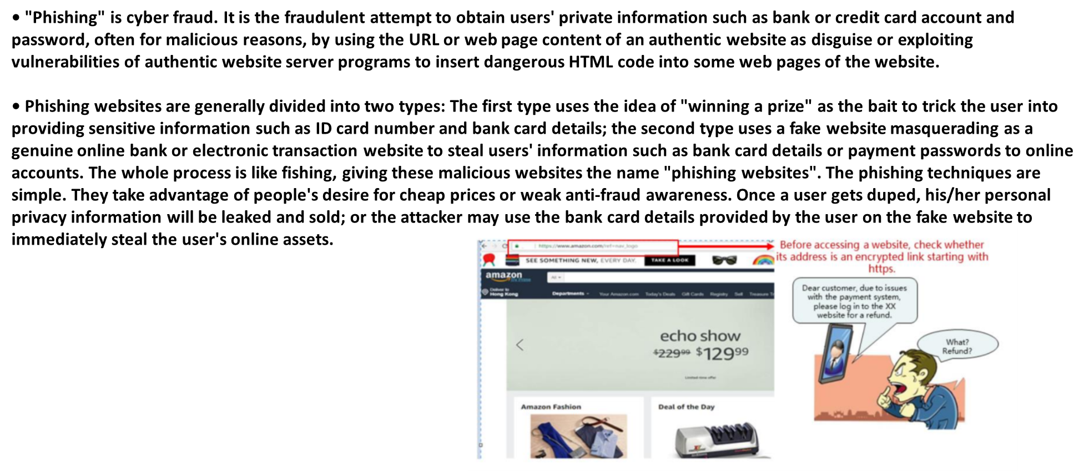
Chapter
04
Phishing

Slide 21
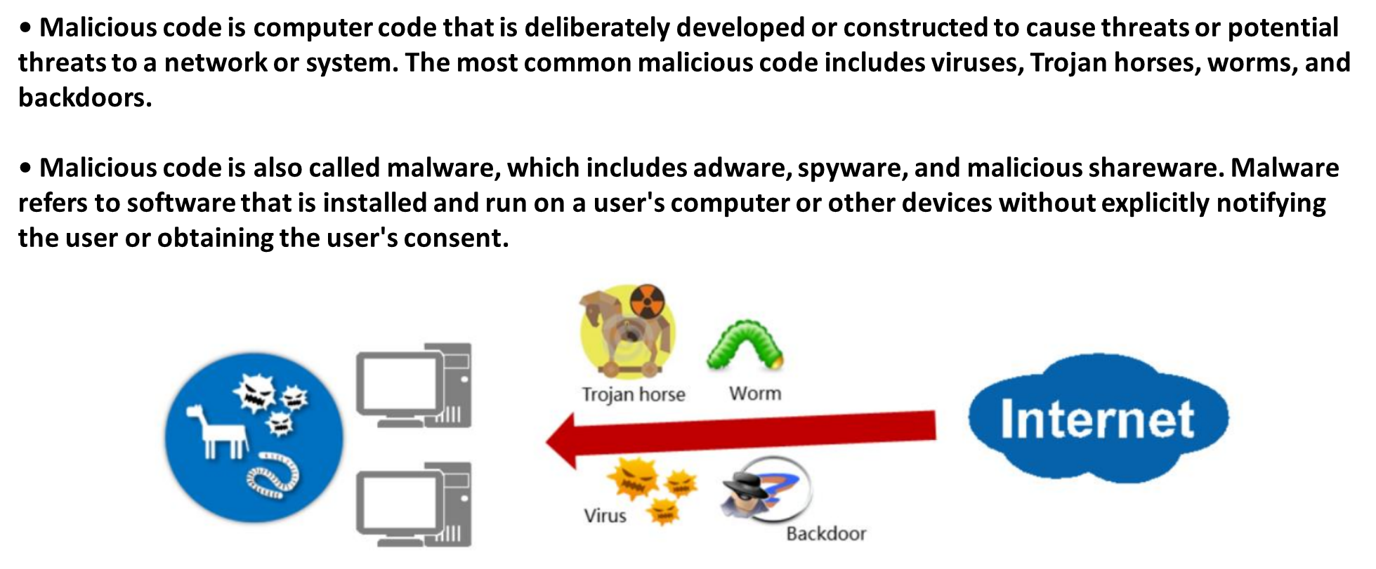
Chapter
04
Malicious Code

Slide 22
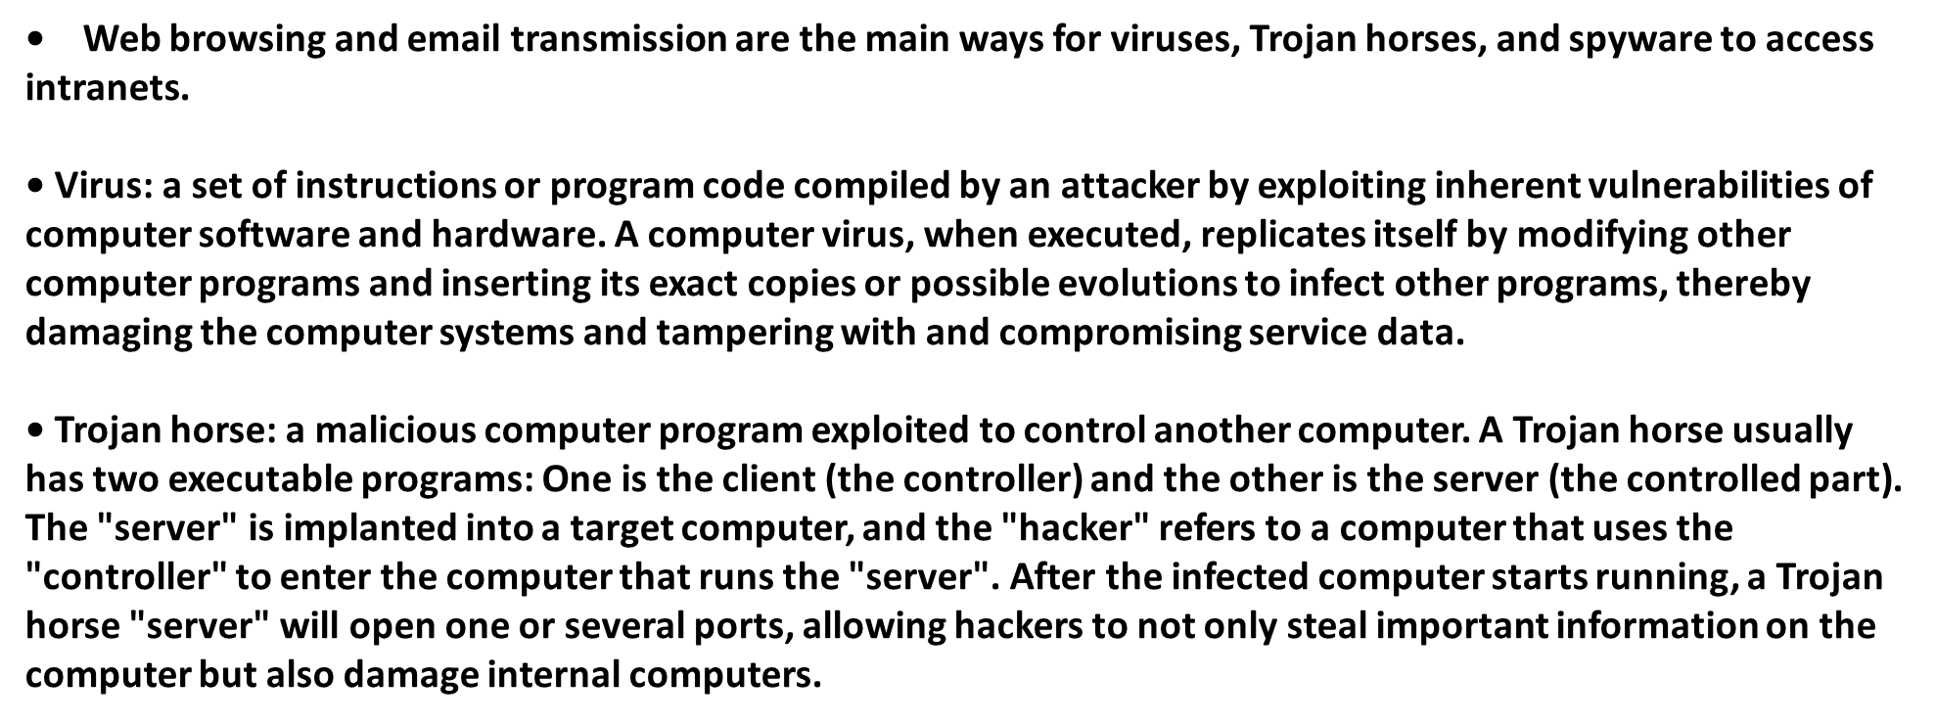
Chapter
04
Malicious Code

Slide 23
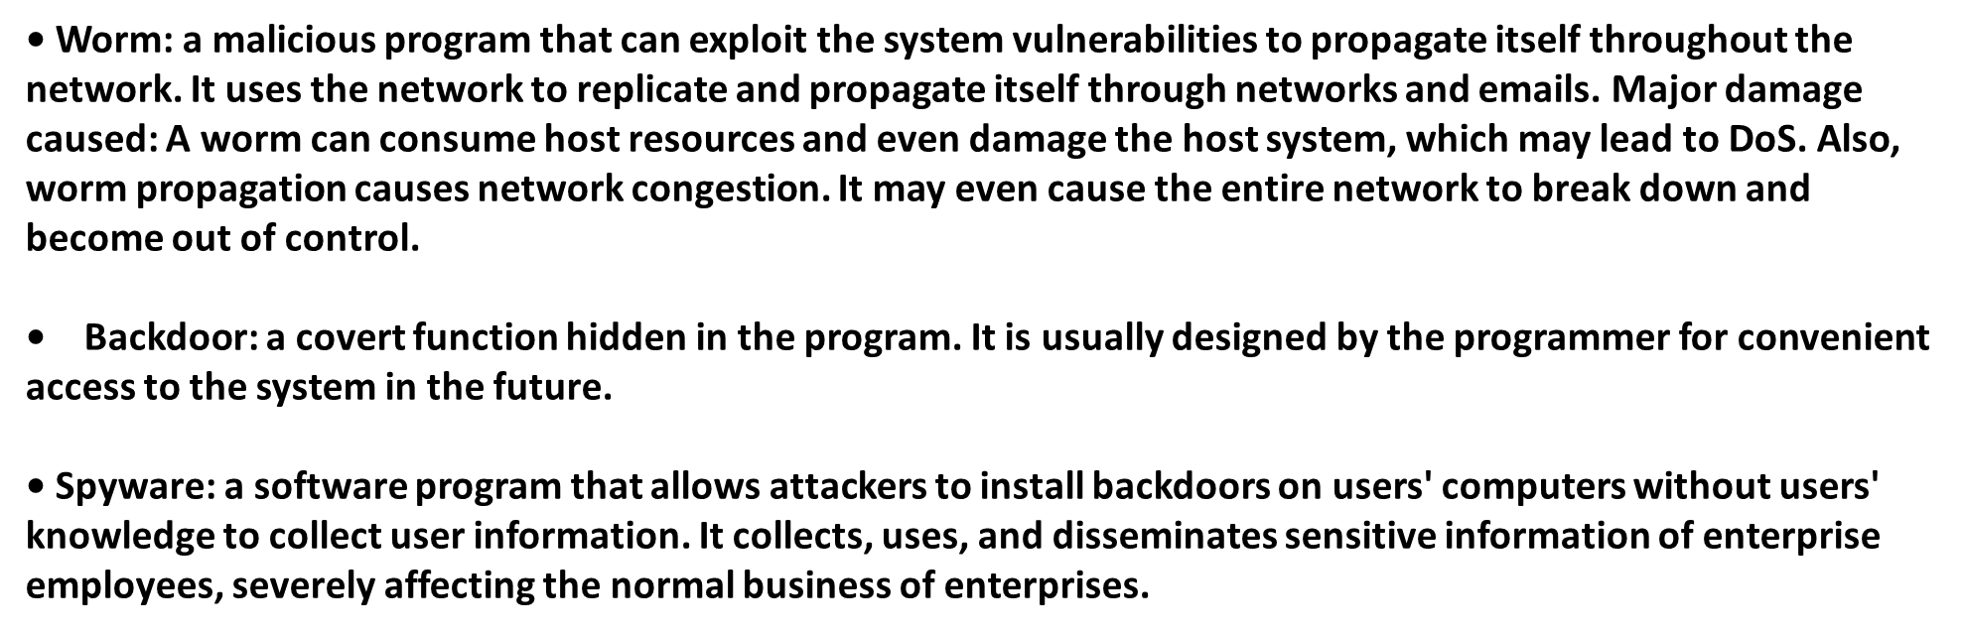
Chapter
04
Malicious Code

Slide 24
Chapter
04
Defense Measures for Application Attacks
• Using professional tools for vulnerability scanning and restoration on systems or personal computers can prevent virus intrusion and infection to a certain extent.
• As a border device, the firewall can block unauthorized network access, web page and email viruses, illegitimate applications, etc., to protect the intranet.
• WAF is short for Web Application Firewall. It is a protection device that protects web applications by executing a series of HTTP/HTTPS security policies.

Slide 25
Chapter
04
Interception of User Communications
• The National Security Agency (NSA) U.S. listened to encrypted communication between Google (including Gmail) and Yahoo users on the cloud.
• The NSA exploited the encryption/decryption flaw of Google's front-end server to circumvent the server and directly listen to backend plaintext data.

Slide 26
Chapter
04
Tumblr User Information Breaches
• More than half of the accounts and passwords of the microblogging website Tumblr were stolen by hackers.
• Hackers invaded the Tumblr server in a certain way and stole information of Tumblr users. Tumblr stated that the breach would not cause damage to users because the database information was encrypted. However, the facts showed that the user information was encrypted using weak algorithms. After obtaining the encrypted user information, the hackers were able to quickly crack a large amount of user information.

Slide 27
Chapter
04
Threats in Communication Process

Slide 28
Chapter
04
MITM Attack
• Man-in-the-middle (MITM) attack: A type of indirect intrusion attacks. In MITM attacks, an attacker uses a variety of technical means to virtually place a controlled computer between two computers in the network. This controlled computer is called a man in the middle.
• Consequences of MITM attacks
□ Information tampering
□ Information theft

Slide 29
Chapter
04
Information Not Encrypted or Inadequately Encrypted
• If information is not encrypted, information security may be compromised. However, even if data is encrypted, information may also be stolen and cracked

Slide 30
Chapter
04
Authentication Attack
• An attacker obtains a user's identity authentication information by certain means, and uses the identity information to steal sensitive information or carry out illegal acts. It is a common form of attack.
• Prevention suggestions:
□ Install genuine antivirus software.
□ Use strong passwords.
□ Reduce the relevance between different passwords.

Slide 31



Thank You

