Slide 1



Introduction to Digital Media
Introduction
DGM 711
Orientation Lecture
Prepared by
Dr. Shereen Kedwany

Slide 2

Outline
Introduction
I. Course Description.
II. Course Objectives.
III. Learning Outcomes.
IV. Student Assessment.
V. Topics.
VI. The Emergence of the Digital Environment.
VII. The Global Digital Population .
VIII. Conclusion.

Slide 3

Introduction
I. Course Description
In this course, students are introduced to the large and rich world of digital media. It provides a strong starting point for understanding digital media’s social and political significance to our culture and the culture of others drawing on an emergent and increasingly rich set of empirical and theoretical studies on the role and development of digital media in contemporary societies. Touching on the core points behind the discipline, the course addresses a wide range of topics. These include media economics, online cooperation, AI-generated content, open source, social media, software production, globalization, brands, marketing, the cultural industry, labor, and consumption.

Slide 4

Introduction
II. Learning Objectives
This course aims to provide the students with a critical understanding of the new media environment and a comprehensive knowledge of the theories and practices of digital media.
In addition, the students will be equipped with the specialized skills needed to produce multimedia content in the rapidly growing field of digital media in the Arab world and globally.

Slide 5

Introduction
III. Learning Outcomes
At the conclusion of this course, students should be able to demonstrate the following:
•Explain the key concepts of digital media, and its development and characteristics.
•Identify the difference between new and old media.
•List the features of digital media.
•Understand how the digital media work.
•Describe the opportunities, risks and barriers for digital media environment.
•Recognize the effects of the digital media in contemporary societies.
•Understand the professional standards of the digital media content.
•Understand Artificial Intelligence uses in digital media.
•Analyze and evaluate the digital media content.
•Become a skilled digital media specialist.

Slide 6

Introduction
IV. Students Assessment
Weekly Tests.

Slide 7

Introduction
Weekly Discussion Session

Slide 8
V. Topics
Introduction
The Digital Environment.
New and Old Media.
The Digital Media Characteristics.
Infrastructures and Platforms.
The effects of the digital media in contemporary societies.
Artificial Intelligence in Digital Media: Opportunities, Challenges, and Future Directions.

Slide 9



Introduction
VI. The Emergence of the Digital Environment
The evolution of computers is part of the history of the information society, which began centuries ago with the idea that information about social and economic facts could be collected, stored, and calculated.
The spread of digital media has grown steadily since the 1980s.
Since then, we have seen the diffusion of (relatively) cheap and easy‐to‐use personal computers, themselves an effect of the evolution of microprocessor technology.

Slide 10

Introduction
VI. The Emergence of the Digital Environment
The scholars have suggested that we have witnessed the birth of a new digital environment.
Through the mass diffusion of personal computers, smartphones, tablets and other mobile technologies, in the last two decades digital media have entered into the daily life of ordinary people.
Furthermore, the billions of microprocessors and computers diffused worldwide are used in a wide range of human activities, from agriculture to industrial production, services, entertainment, and education.
Digital media have become part of everyday life.

Slide 11

Introduction
Digital media have become part of everyday life.

Slide 12

Introduction
What is the digital environment ?
Video
https://www.youtube.com/watch?v=O7OcVioX7Xg

Slide 13


Introduction
VI. The Emergence of the Digital Environment
Technologies have complex histories that weave together social, cultural, and political factors with technical and material possibilities.
We must analyze the social, cultural, and economic contexts within which digital media have emerged.
Digital media studies is considered interdisciplinary .

Slide 14
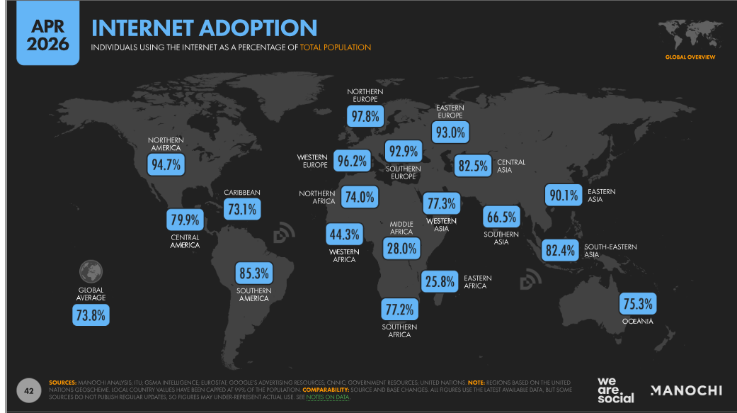
Introduction
VII. The Global Digital Population
Source: https://wearesocial.com/uk/blog/2026/04/digital-2026-mid-year-global-update-report/

Slide 15
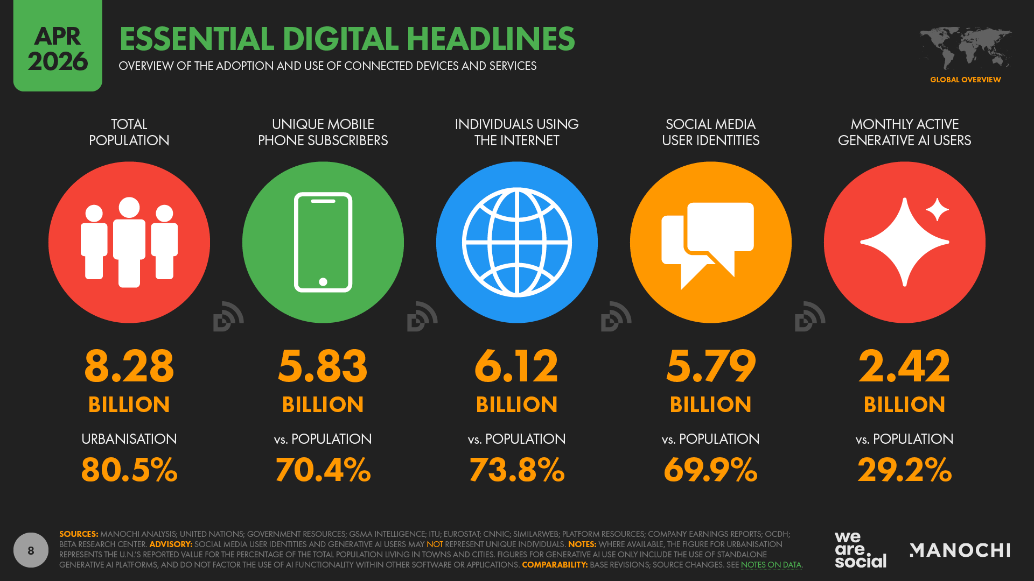
Introduction
VII. The Global Digital Population
Source: https://wearesocial.com/uk/blog/2026/04/digital-2026-mid-year-global-update-report/

Slide 16
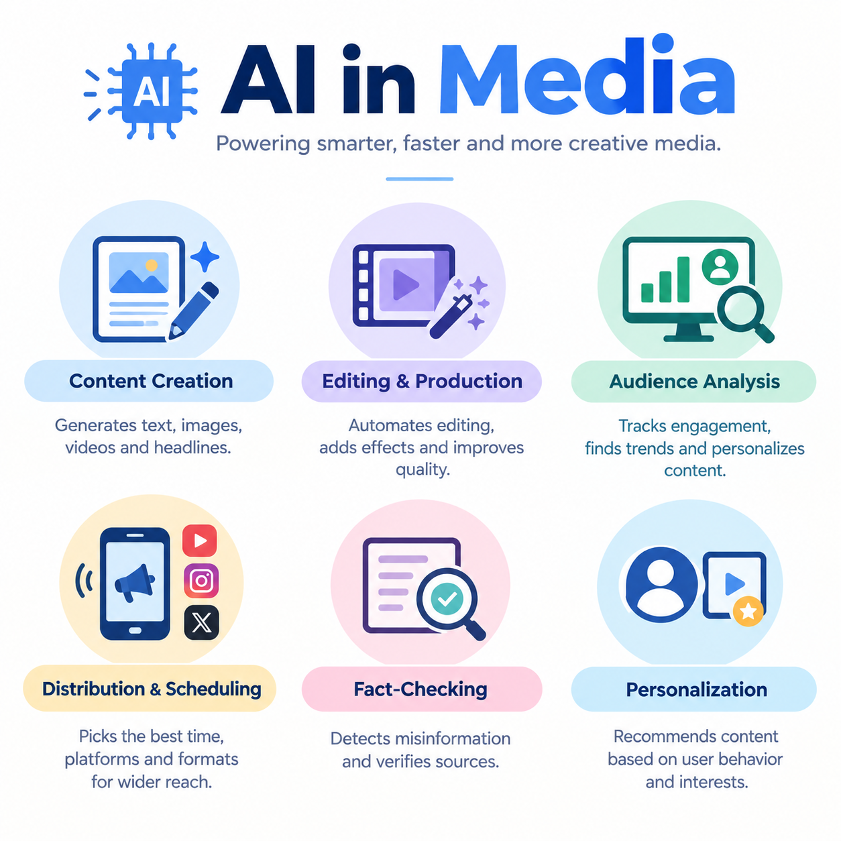
Introduction
VII. The Global Digital Population

Slide 17
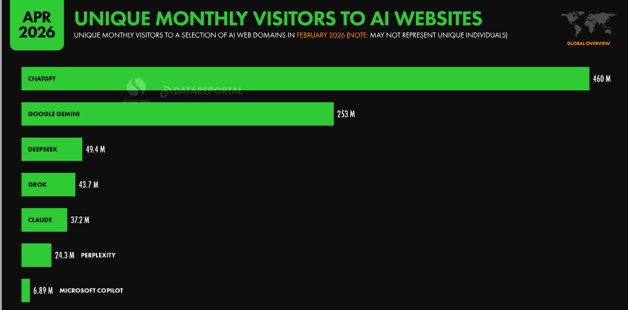
Introduction
VII. The Global Artificial Intelligence Use
Source: https://wearesocial.com/uk/blog/2026/04/digital-2026-mid-year-global-update-report/

Slide 18

Introduction
VIII. Conclusion
Digital media have become part of everyday life.
We have witnessed the birth of a new digital environment.
Digital media Studies is considered interdisciplinary .
There are now more than 6 billion internet users around the globe.
Artificial Intelligence (AI) is used in media to content creation, data analysis, news editing, audience targeting, and improving the speed and accuracy of media work.

Slide 19
Introduction
References:
Introduction to Digital Media, by Alessandro Delfanti & Adam Arvidsson.
Tech Giants, Artificial Intelligence and the Future of Journalism, by Whittaker, Jason Paul.
Newsmakers: Artificial Intelligence and the Future of Journalism, by Francesco Marconi.

Slide 20


Thank You

