Slide 1


Master of Financial Technology
Prepared by Dr. Omar Al-kasasbeh
FNT 615
Finance Concepts
Lecture 8

Slide 2



Finance Concepts
FNT 615
Finance Concepts
Prepared by
Dr. Omar Al-kasasbeh

Slide 3
Lecture
8
Stocks and Stock Valuation

Slide 4
Lecture
8
Table of contents
Determinants of Stock Prices
Risk and Return in Stock Investment
3. Economic Factors (Interest Rates and Inflation)
4. Preferred Stock
5. Efficient Markets

Slide 5
Lecture
8
Stocks, like bonds, give investors a claim on a company’s future earnings and cash flows. However, they differ significantly from bonds in valuation, structure, and income generation.
Unlike bonds, stocks do not provide guaranteed cash flows, fixed maturity dates, face value, or coupon payments. Instead, returns from stocks are uncertain and depend mainly on company performance.
Stocks may generate income through dividends, but these are not guaranteed and are declared at the discretion of the company’s board of directors. Once declared, dividends are paid to shareholders on a specified date. Because there are no guaranteed payments, stocks are generally riskier than bonds and other fixed-income investments.

Slide 6
Lecture
8
While there are many reasons for an investor to choose to purchase common stock, three of the most common reasons are
• to use stocks as instruments or repositories for maintaining value;
• to accumulate wealth over the term of the stock investment; and
• to earn income through capital gains and dividend payments.
As with any financial instrument, common stock purchases offer advantages and disadvantages to investors.
Important advantages include the following:
• Returns through dividends and price appreciation of shares can be substantial.
• Stocks are a liquid form of investment and can be bought or sold within secondary markets relatively easily.
• Information about companies, markets, and important trends are widely published and readily available to the investing public.

Slide 7
Lecture
8
These advantages are significant and lead many individuals to move into stock investments. Yet it is important to realize that stock has some significant disadvantages, which can include the following:
• General risk levels are greater than with bonds or other fixed-income investments.
• Timing the buy-and-sell transactions of stock can be tricky and may lead to losses or not taking full advantage of share price opportunities.
• Dividends (provided that the stock does indeed pay them, as not all do) are uncertain and subject to change based on decisions of company management.
We will discuss these topics in this chapter and cover many of the details regarding why corporations issue common stock and why investors purchase that stock.

Slide 8
Lecture
Determinants of Stock Prices
8
Stock prices are influenced by both macroeconomic and firm-specific factors. At the macro level, interest rates, inflation, and economic growth play key roles. Higher interest rates reduce stock values by increasing discount rates, while inflation affects costs, purchasing power, and investor confidence.
At the firm level, performance indicators such as earnings, revenue growth, and efficiency are critical. Strong financial results usually increase stock prices, while weak performance leads to declines. Qualitative aspects like management quality, innovation, and governance also shape investor perceptions.
Additionally, market sentiment and behavioral factors impact prices. Investor psychology and speculation can cause deviations from intrinsic value. Risk is also essential, as higher uncertainty requires higher expected returns.

Slide 9
Lecture
8
Stock Valuation Models
Stock valuation determines a share’s intrinsic value based on expected future performance. The Dividend Discount Model (DDM) estimates value by discounting future dividends, making it suitable for firms with stable dividend policies.
The Price-to-Earnings (P/E) ratio compares stock price to earnings per share, offering a quick way to judge valuation. High P/E suggests growth expectations, while low P/E may indicate undervaluation or risk.
Free Cash Flow (FCF) models focus on cash generation rather than dividends, making them ideal for firms that reinvest earnings. These models estimate value by discounting future cash flows.
Since each method has limitations, investors typically use multiple models for a more accurate valuation and better investment decisions.

Slide 10
Lecture
8
Risk and Return in Stock Investment
Risk and return represent the fundamental trade-off in equity investment and underpin modern portfolio theory. Investors expect compensation for bearing uncertainty, but returns are uncertain in both size and timing. Unlike fixed-income securities, stocks do not guarantee cash flows, making risk assessment essential. Return includes both realized gains and expected performance, while risk reflects the variability of outcomes.
The main sources of return are capital appreciation and dividends. Capital gains result from increases in stock prices driven by improvements in firm performance, such as higher revenues or better efficiency. Dividends provide direct income to shareholders but are not guaranteed, as they depend on company policies and financial conditions. Therefore, investors must evaluate earnings sustainability and the likelihood of future payouts to estimate total return.

Slide 11
Lecture
8
Risk in equity markets is multidimensional, with a key distinction between systematic and unsystematic risk. Systematic (market) risk arises from macroeconomic factors like interest rates, inflation, and global conditions, and cannot be diversified away. In contrast, unsystematic risk is firm- or industry-specific and can be reduced through diversification across assets and sectors.
Risk measurement is central to portfolio management. Variance and standard deviation assess return volatility, while beta measures a stock’s sensitivity to market movements. A beta above one indicates higher volatility than the market, whereas a beta below one reflects lower sensitivity.
Generally, risk and return have a positive relationship higher expected returns require higher risk. This is formalized in models like CAPM, where expected return depends on systematic risk and the risk premium. However, real markets may deviate from theory due to behavioral biases and inefficiencies.

Slide 12
Lecture
8
Behavioral biases, such as overconfidence, herd behavior, and loss aversion, significantly influence investment decisions, often leading to overtrading, holding losing positions, or amplifying market volatility. Recognizing these psychological influences is crucial for effective risk management.
Practical risk management combines diversification, asset allocation, and ongoing portfolio monitoring. Diversification reduces unsystematic risk, while asset allocation balances investments across equities and other asset classes. Maintaining a long-term horizon can also smooth short-term market fluctuations.
Successful investing requires a disciplined approach that balances return objectives with risk control. By combining quantitative analysis with qualitative judgment, investors can create strategies that are both resilient and adaptable to changing market conditions.

Slide 13
Lecture
Why Invest in Stocks?
8
Investing in stocks is a common and effective way to build wealth over time, as stocks represent ownership in a company and allow investors to share in its profits and growth. Unlike bonds and other fixed-income securities, stocks offer higher potential returns but also carry greater risk. One main reason to invest is capital appreciation: as a company grows and becomes more profitable, its share value typically rises, allowing investors to buy low and sell high. Factors like revenue growth, cost efficiency, market expansion, and innovation drive this growth. Another important reason is dividend income, where companies distribute a portion of their profits to shareholders, usually quarterly. Dividend-paying stocks provide regular cash flow while still offering the potential for price appreciation, making them appealing to investors seeking both income stability and long-term growth.

Slide 14
Lecture
8
Investing in stocks provides several important benefits. Portfolio diversification allows investors to spread capital across sectors, industries, and regions, reducing individual risks and mitigating losses while still participating in market growth. Combining stocks with other assets, like bonds or real estate, further balances risk and return. Stocks also offer liquidity, as publicly traded shares can be bought or sold quickly, giving flexibility and access to capital, unlike less liquid investments such as real estate. Finally, stocks provide inflation protection, historically outperforming inflation and preserving purchasing power over the long term, making them effective for wealth growth and preservation.

Slide 15
Lecture
8
Investing in stocks promotes financial discipline and long-term planning. Successful investing requires research, analysis, and strategic decision-making, as investors must monitor company performance, market trends, and economic conditions. Holding stocks over time also allows investors to benefit from compounding returns, significantly enhancing wealth accumulation.
Stock investment provides opportunities for active engagement and learning. Investors can attend shareholder meetings, vote on corporate decisions, and track company developments closely. This involvement increases awareness of business and economic trends and enables more informed portfolio choices. Understanding behavioral factors, such as market psychology and investor sentiment, further improves decision-making and risk management.

Slide 16
Lecture
8
Economic conditions, particularly interest rates and inflation, significantly influence stock prices. Higher interest rates increase borrowing costs for businesses and consumers, slowing economic growth and potentially reducing corporate profits and stock values, while lower rates encourage investment and spending, supporting revenues and stock prices. Inflation has a dual effect: moderate inflation signals economic growth, but high inflation erodes purchasing power, raises costs, and can lower profit margins and stock valuations. Inflation also impacts discount rates in valuation models, reducing the present value of future cash flows. Investors monitor indicators like GDP growth, unemployment, and consumer confidence, as well as fiscal and monetary policies, to gauge market trends. In essence, interest rates and inflation shape the economic environment, affecting both company performance and investor sentiment, making them key drivers of stock price movements.

Slide 17
Lecture
8
Firm Performance
The performance of individual companies is a major determinant of stock prices. Metrics such as revenue growth, profitability, cash flow, debt levels, and operational efficiency indicate a firm’s health. Companies with consistent earnings growth and strong management typically attract investor confidence, boosting stock prices, while firms with declining performance or weak leadership may see valuations fall.
Key indicators include earnings per share (EPS), profit margins, return on equity (ROE), and return on assets (ROA). Positive earnings surprises, dividend announcements, and share buybacks often lead to stock price increases, whereas missed targets or profit warnings can cause declines.
Analysts also consider qualitative factors like corporate strategy, leadership effectiveness, innovation, and market share. Financial ratios, debt, and liquidity are monitored to assess stability and risk. In short, strong, sustainable firm performance drives stock appreciation, while poor fundamentals tend to depress valuations, making firm performance a cornerstone of investment decisions.

Slide 18
Lecture
8
Market Sentiment (Investor Psychology and Its Impact on Stock Prices)
Market sentiment refers to the overall investor attitude toward a stock or the market, driven by emotions, expectations, and perceptions rather than fundamentals.
It plays a major role in short-term price movements and can sometimes override fundamental values.
Sentiment is classified into:
Bullish: optimism → increased buying → rising stock prices
Bearish: pessimism → increased selling → falling stock prices
It directly affects supply and demand dynamics, influencing price levels in financial markets.
Behavioral finance explains sentiment-driven decisions, highlighting psychological biases.
Herd behavior: investors follow others’ actions without independent analysis, often pushing prices above intrinsic value.
Panic selling: during downturns, fear leads to rapid selling, causing sharp price declines.

Slide 19
Lecture
8
Overconfidence: investors overestimate their ability to predict markets → leads to excessive trading and higher market volatility.
Loss aversion: investors prefer avoiding losses over gains → hold losing stocks too long and sell winning stocks too early, distorting prices.
Market sentiment is influenced by external factors, including:
News and media coverage
Economic and political developments
Positive news (e.g., strong earnings, innovation, favorable policies) → increases confidence → pushes stock prices upward.
Geopolitical events
Negative news (e.g., crises, instability, scandals) → creates fear → leads to market declines.

Slide 20
Lecture
8
Market sentiment is measured using indicators such as the Volatility Index (VIX), trading volume, put-call ratios, and investor sentiment surveys, which technical analysts use to assess trends and identify potential turning points. Although these tools do not guarantee precise predictions, they provide valuable insights into investors’ overall mood and expectations.
Market sentiment is a powerful force influencing stock prices, especially in the short term, as it is driven by emotions and perceptions rather than fundamentals. Despite this, it significantly affects investor behavior and market dynamics. Understanding sentiment and incorporating behavioral insights enables investors to make more informed decisions, manage risks effectively, and identify potential investment opportunities.

Slide 21
Lecture
8
Systematic vs. Unsystematic Risk in Stock Investment

Slide 22
Lecture
8
Risk is a fundamental concept in stock investment, representing the uncertainty of future returns. Since investors are generally risk-averse, they require higher expected returns to compensate for higher risk. Total risk is divided into systematic risk and unsystematic risk, a distinction that is essential for effective portfolio management.
Systematic risk, or market risk, affects the entire market and arises from macroeconomic factors such as interest rates, inflation, recessions, political instability, and global crises. It cannot be eliminated through diversification, as these factors impact most companies simultaneously. Even well-diversified portfolios remain exposed to such risks. Systematic risk is typically measured by beta (β), which reflects a stock’s sensitivity to overall market movements.
In contrast, unsystematic risk is specific to individual firms or industries and results from internal factors such as management decisions, operational performance, financial structure, and competitiveness. Unlike systematic risk, it can be reduced or eliminated through diversification. For example, a company may experience declining stock prices due to poor management or product failure, even when the broader market is performing well.

Slide 23
Lecture
8
Unlike systematic risk, unsystematic risk can be significantly reduced or even eliminated through diversification. By investing in a variety of assets across different sectors, investors can offset losses from one investment with gains from others, ensuring that poor performance in a single company does not heavily affect the overall portfolio. This principle is central to modern portfolio theory, which highlights diversification as a key strategy for reducing total risk.
The distinction between systematic and unsystematic risk is crucial for investors. While unsystematic risk can be managed through diversification, systematic risk must be accepted as an inherent part of investing. As a result, expected returns are primarily determined by exposure to systematic risk rather than total risk. This idea underpins models like the Capital Asset Pricing Model (CAPM), which states that investors are compensated only for bearing systematic risk.

Slide 24
Comparison Between Stocks and Bonds: Risk, Return, and Investment Characteristics
Lecture
8
Risk Profile: Stocks are inherently riskier than bonds because their returns depend on company performance and market conditions. Equity investors face market volatility, economic fluctuations, and firm-specific uncertainties, causing stock prices to vary significantly over short periods. Bonds, in contrast, are relatively safer, offering fixed interest payments and usually returning the principal at maturity. Although bonds carry risks such as interest rate, credit, and inflation risk, their predictable cash flows result in lower volatility compared to equities.
Return Potential: Stocks compensate for higher risk with the potential for greater returns, including capital appreciation and dividends, allowing investors to benefit from price growth and profit-sharing. Historically, equities have outperformed bonds over the long term, particularly during periods of economic expansion. Bonds provide stable, predictable income through coupon payments, appealing to risk-averse investors. While bond returns are generally lower, they are less affected by short-term market fluctuations, making them a dependable component of a balanced portfolio.

Slide 25
Lecture
8
Stocks and bonds are both affected by systematic risks like interest rates, inflation, and economic cycles, but stocks are more sensitive due to their link to company performance and market sentiment. Unsystematic risk impacts individual stocks but has little effect on diversified bonds, especially high-quality ones.
Liquidity varies between the two: stocks are usually highly liquid, while bonds’ liquidity depends on type and market, though government bonds are generally stable.
Regarding income and investment horizon, stocks suit long-term investors seeking growth, with dividends that are not guaranteed. Bonds offer more predictable income, appealing to conservative investors or those needing steady cash flows. The choice depends on risk tolerance, financial goals, and the balance between growth and stability.

Slide 26
Lecture
8
Portfolio Considerations: Combining stocks and bonds helps investors optimize the trade-off between risk and return. Stocks provide growth, while bonds add stability and income, reducing overall portfolio volatility.
Conclusion: Stocks and bonds complement each other: stocks offer higher returns but more risk, while bonds provide predictable income and safety with lower returns. Understanding their differences and risk responses is essential for constructing efficient portfolios and making informed investment decisions.

Slide 27
Lecture
8
Valuation is the process of estimating a stock’s intrinsic value based on future cash flows, risk, and growth to guide buy or sell decisions. It relies on the time value of money, meaning future cash flows are discounted to present value using a risk-adjusted rate. It is important because market prices may deviate from true value due to sentiment or inefficiencies, creating opportunities for investors. Valuation methods include absolute approaches such as DDM and relative approaches such as the P/E ratio. In practice, valuation involves both quantitative models and subjective assumptions, so investors often use multiple methods to improve accuracy.
8
8

Slide 28
Lecture
8
Intrinsic value represents the true worth of a stock based on fundamentals such as earnings, dividends, growth, and risk, while market price is the actual trading price determined by supply, demand, and investor sentiment. The difference between them creates investment opportunities: if intrinsic value is higher than market price, the stock is undervalued (buy); if lower, it is overvalued (sell); if equal, it is fairly valued. However, these gaps may persist due to market inefficiencies and behavioral factors like optimism or fear. Therefore, successful investors focus on intrinsic value rather than short-term market movements, which is the core idea of value investing.

Slide 29
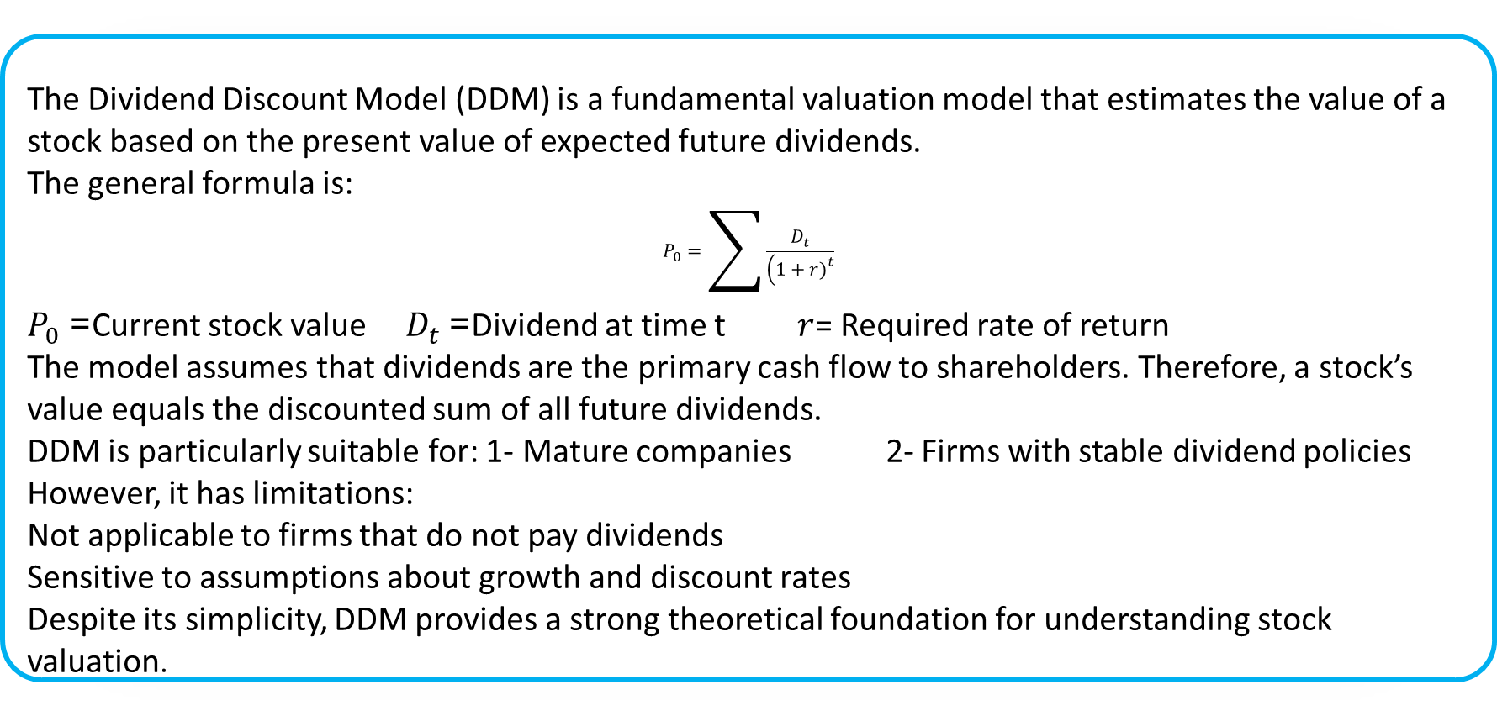
Lecture
8
Dividend Discount Model (DDM)
The Dividend Discount Model (DDM) is a fundamental valuation model that estimates the value of a stock based on the present value of expected future dividends.
The general formula is:
$$P_{0}=\sum{\frac{D_{t}}{\left(1+r{\left.)\right.}^{t}\right.}}$$
$P_{0}$= Current stock value $D_{t}$= Dividend at time t $r$= Required rate of return
The model assumes that dividends are the primary cash flow to shareholders. Therefore, a stock’s value equals the discounted sum of all future dividends.
DDM is particularly suitable for: 1- Mature companies 2- Firms with stable dividend policies
However, it has limitations:
Not applicable to firms that do not pay dividends
Sensitive to assumptions about growth and discount rates
Despite its simplicity, DDM provides a strong theoretical foundation for understanding stock valuation.

Slide 30
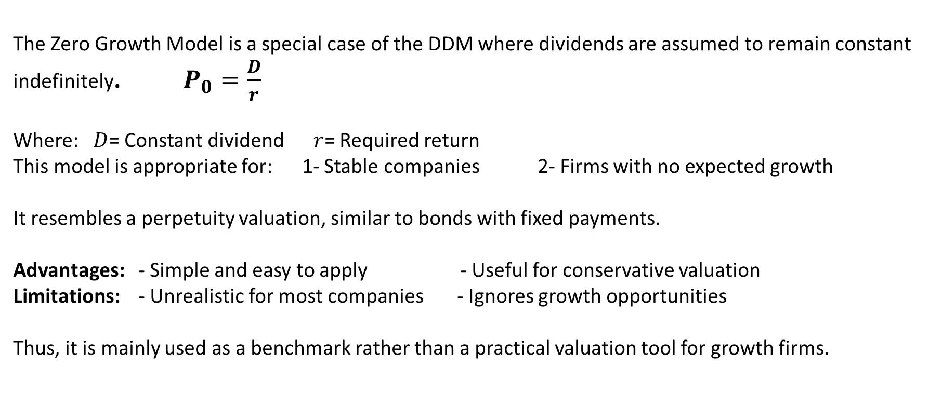
Lecture
8
Zero Growth Model
The Zero Growth Model is a special case of the DDM where dividends are assumed to remain constant indefinitely. $P_{0}=\frac{D}{r}$
Where: $D$= Constant dividend $r$= Required return
This model is appropriate for: 1- Stable companies 2- Firms with no expected growth
It resembles a perpetuity valuation, similar to bonds with fixed payments.
Advantages: - Simple and easy to apply - Useful for conservative valuation
Limitations: - Unrealistic for most companies - Ignores growth opportunities
Thus, it is mainly used as a benchmark rather than a practical valuation tool for growth firms.

Slide 31
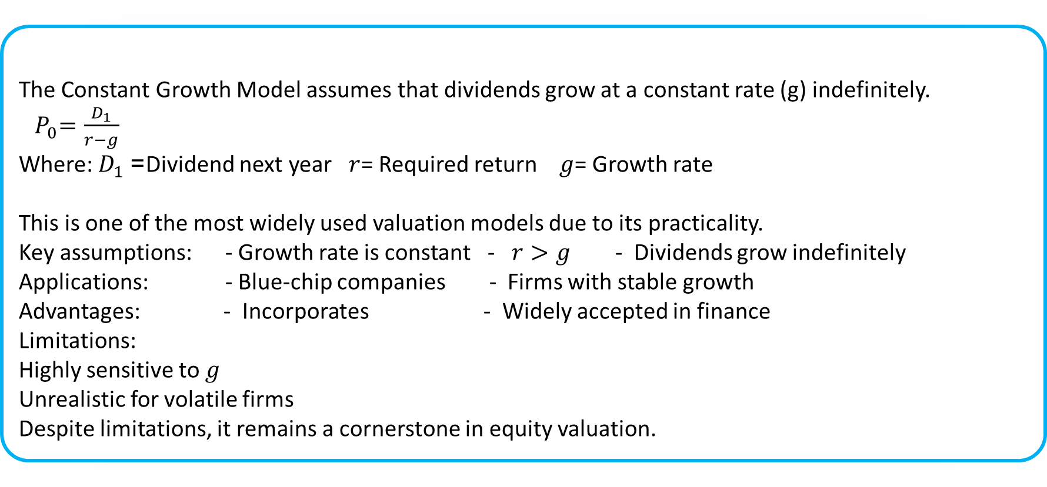
Lecture
8
Constant Growth Model (Gordon Growth Model)
The Constant Growth Model assumes that dividends grow at a constant rate (g) indefinitely.
${ P}_{0}=\frac{D_{1}}{r−g}$
Where: $D_{1}$= Dividend next year $r$= Required return $g$= Growth rate
This is one of the most widely used valuation models due to its practicality.
Key assumptions: - Growth rate is constant - $r>g$ - Dividends grow indefinitely
Applications: - Blue-chip companies - Firms with stable growth
Advantages: - Incorporates - Widely accepted in finance
Limitations:
Highly sensitive to $g$
Unrealistic for volatile firms
Despite limitations, it remains a cornerstone in equity valuation.

Slide 32
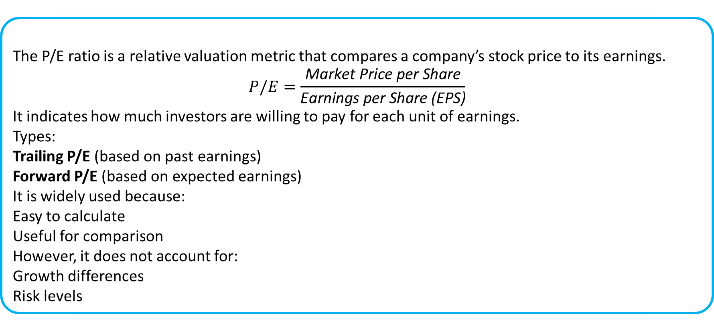
Lecture
Price/Earnings (P/E Ratio)
8
The P/E ratio is a relative valuation metric that compares a company’s stock price to its earnings.
$$P/E=\frac{\text{Market} \text{Price} \text{per} \text{Share}}{\text{Earnings} \text{per} \text{Share}\text{ (}\text{EPS}\text{)}}$$
It indicates how much investors are willing to pay for each unit of earnings.
Types:
Trailing P/E (based on past earnings)
Forward P/E (based on expected earnings)
It is widely used because:
Easy to calculate
Useful for comparison
However, it does not account for:
Growth differences
Risk levels
8

Slide 33
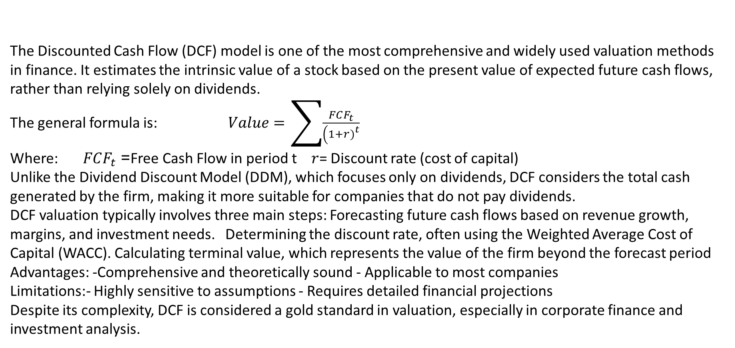
Lecture
Discounted Cash Flow (DCF) Model
The Discounted Cash Flow (DCF) model is one of the most comprehensive and widely used valuation methods in finance. It estimates the intrinsic value of a stock based on the present value of expected future cash flows, rather than relying solely on dividends.
The general formula is: $Value=\sum{\frac{FCF_{t}}{\left(1+r{\left.)\right.}^{t}\right.}}$
Where: $FCF_{t}$= Free Cash Flow in period t $r$= Discount rate (cost of capital)
Unlike the Dividend Discount Model (DDM), which focuses only on dividends, DCF considers the total cash generated by the firm, making it more suitable for companies that do not pay dividends.
DCF valuation typically involves three main steps: Forecasting future cash flows based on revenue growth, margins, and investment needs. Determining the discount rate, often using the Weighted Average Cost of Capital (WACC). Calculating terminal value, which represents the value of the firm beyond the forecast period
Advantages: -Comprehensive and theoretically sound - Applicable to most companies
Limitations:- Highly sensitive to assumptions - Requires detailed financial projections
Despite its complexity, DCF is considered a gold standard in valuation, especially in corporate finance and investment analysis.
8
8

Slide 34
Lecture
Preferred Stock
8
Preferred stock is a type of equity that gives investors priority over common shareholders in dividends and asset claims. It typically pays a fixed dividend that must be distributed before any dividends to common stockholders. In the event of liquidation, preferred shareholders have a higher claim on company assets than common shareholders.
Preferred stock usually has a stated par value but no maturity date, meaning there is no obligation to repay the principal unless the company is liquidated or the shares are retired. Dividends may be cumulative, where unpaid dividends must be paid in the future, or noncumulative, where missed dividends are not recovered.

Slide 35
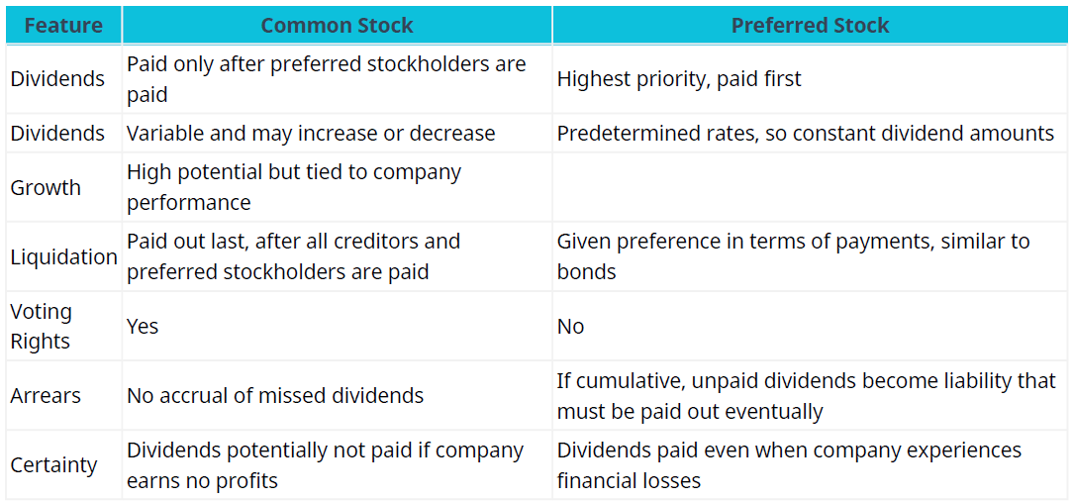
Lecture
Differences between Preferred and Common Stock
8

Slide 36
Lecture
Behavioral Considerations in Valuation
8
Behavioral considerations in valuation highlight how psychological biases and investor behavior can distort asset pricing, leading to differences between market prices and intrinsic values, unlike traditional models that assume rationality and market efficiency.
Investors may exhibit overreaction, causing excessive short-term price movements in response to news, or underreaction, where prices adjust slowly over time; both create opportunities as prices eventually move toward intrinsic value.
Additionally, herd behavior leads investors to follow others instead of independent analysis, often resulting in market bubbles during optimism and sharp declines during panic, pushing prices away from their fundamental values.
8

Slide 37
Lecture
Behavioral Considerations in Valuation
8
Overconfidence bias leads investors to overestimate their ability to predict markets, resulting in excessive trading, underestimated risk, and inflated stock valuations. Anchoring bias causes investors to rely too heavily on past information, such as previous stock prices, even when it is no longer relevant.
Loss aversion makes investors more sensitive to losses than gains, leading them to hold losing stocks too long or sell winning stocks too early, which distorts price adjustments toward intrinsic value.
Market sentiment, influenced by news, media, and social factors, amplifies these biases, where positive sentiment can drive overvaluation and negative sentiment can cause undervaluation, increasing short-term volatility and deviations from fair value.

Slide 38
Lecture
8
The implications for valuation are significant. Behavioral biases can cause traditional valuation models to appear inaccurate in the short term, even if they are theoretically sound. Therefore, investors should not rely solely on quantitative models but also consider market psychology when making decisions. Incorporating behavioral insights can improve timing strategies, risk management, and the identification of mispriced securities.
behavioral considerations highlight that financial markets are not always perfectly efficient. Psychological biases and collective investor behavior can lead to persistent deviations between market prices and intrinsic values. By understanding these behavioral factors, investors can enhance their valuation analysis, avoid common decision-making errors, and exploit opportunities arising from market inefficiencies.
8
8

Slide 39
Lecture
Integrating Valuation Techniques in Investment Decisions
8
Investment decisions rely on assessing both potential returns and a stock’s intrinsic value. Valuation techniques help investors determine if a stock is fairly priced, undervalued, or overvalued, guiding portfolio allocation, risk management, and timing of market entry or exit.
Intrinsic value reflects a stock’s true worth based on expected cash flows, growth, and risk, while market price is set by supply, demand, and sentiment. Comparing the two helps investors identify opportunities and avoid overpaying.
Key valuation methods include the Dividend Discount Model (DDM) for stable dividend-paying companies, the Price-to-Earnings (P/E) ratio for relative valuation within industry context, and Free Cash Flow (FCF) models that focus on actual cash generation, useful for firms that reinvest profits rather than distribute dividends.

Slide 40
Lecture
Integrating Valuation Techniques in Investment Decisions
8
Integrating multiple valuation techniques improves risk assessment and return potential by providing a more complete view of a stock’s value. For instance, a high P/E ratio might seem expensive, but strong free cash flow can justify the price, while DDM comparisons can reveal undervalued dividend-paying stocks. Using several methods reduces reliance on a single metric and enhances understanding of a company’s financial health and growth prospects.
Effective valuation also considers qualitative factors like corporate governance, management quality, competitive position, and macroeconomic conditions, which influence the sustainability of projected cash flows. Combining quantitative models with qualitative judgment forms the basis of a disciplined investment strategy.

Slide 41
Lecture
References
8
Julie Dahlquist, and Rainford Knight. (2022). Principles of finance. OpenStax.
Allen, F., Brealey, R. A., & Myers, S. C. (2011). Principles of corporate finance (p. 1043). New York: McGraw-Hill/Irwin.
Damodaran, A. (2012). Investment valuation: Tools and techniques for determining the value of any asset. John Wiley & Sons.

Slide 42



Thank You

