Slide 1



Integrated Marketing
Communication
Designs
Prepared by Dr. Perihan Salah
MKT728
An Introduction to Integrated
Marketing Communications
Lecture 1

Slide 2


Integrated Marketing
Communication
Designs
Lecture 1
MKT728
An Introduction to Integrated
Marketing Communications
Prepared by
Dr. Perihan Salah

Slide 3

Chapter
LEARNING OBJECTIVES
01
To examine the marketing communication function and the growing importance of advertising and other promotional elements in the marketing programs of domestic and foreign companies
To introduce the concept of integrated marketing communications (IMC) and consider how it has evolved
To examine reasons for the increasing importance of the IMC perspective in planning and executing advertising and promotional programs
To introduce the various elements of the promotional mix and consider their roles in an IMC program
To examine the various types of contact points through which marketers communicate with their target audiences
www.midocean.ae

Slide 4
Chapter
LEARNING OBJECTIVES
01
To examine how various marketing and promotional elements must be coordinated to communicate effectively
To introduce a model of the IMC planning process and examine the steps in developing a marketing communications program
Describe the role of advertising and other promotional elements in marketing.
Discuss the evolution of the integrated marketing communications (IMC) concepts.
Explain the increasing value of the IMC perspective in advertising and promotional programs.
Describe the steps in the IMC planning process.
www.midocean.ae

Slide 5
The Growth of Advertising and Promotion
The Growth of Advertising and Promotion
Vital communications system for both consumers and businesses
1980, dominant forms of marketing communication
Advertising spending has shifted from traditional media to online digital advertising formats and social media
  Largest category of Internet advertising is paid search on search engines
  Growth in mobile marketing

Slide 6
The Role of Marketing
Marketing: Activity, set of institutions, and processes for creating, communicating, delivering and exchanging offerings that have value for:
Customers, clients, partners, and society at large
Exchange: Involves parties with:
Something of value to one another
Desire and ability to give up something to the other party
Way to communicate with each other

Slide 7
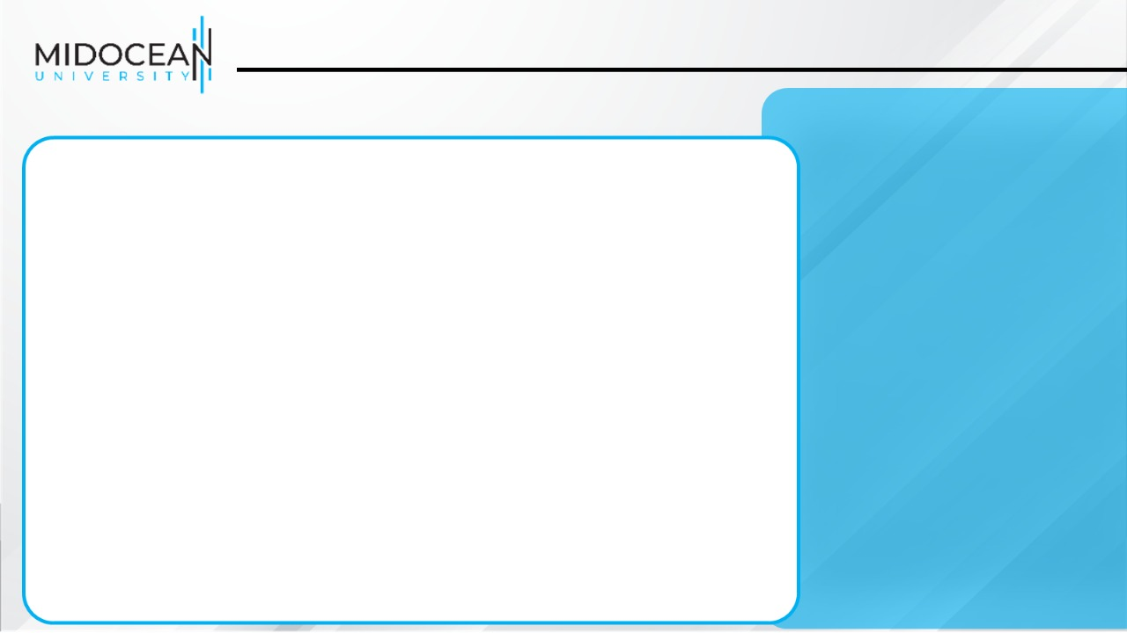
The Role of Marketing
- Value: Customer’s perception of benefits of a product or service against the costs of acquiring and consuming it –
Benefits are functional, experiential, and/or psychological
- Costs - Money paid for:
• Acquiring a product or service or information about it
• Making the purchase and learning to use
• Maintaining and disposing the product

Slide 8


Slide 9
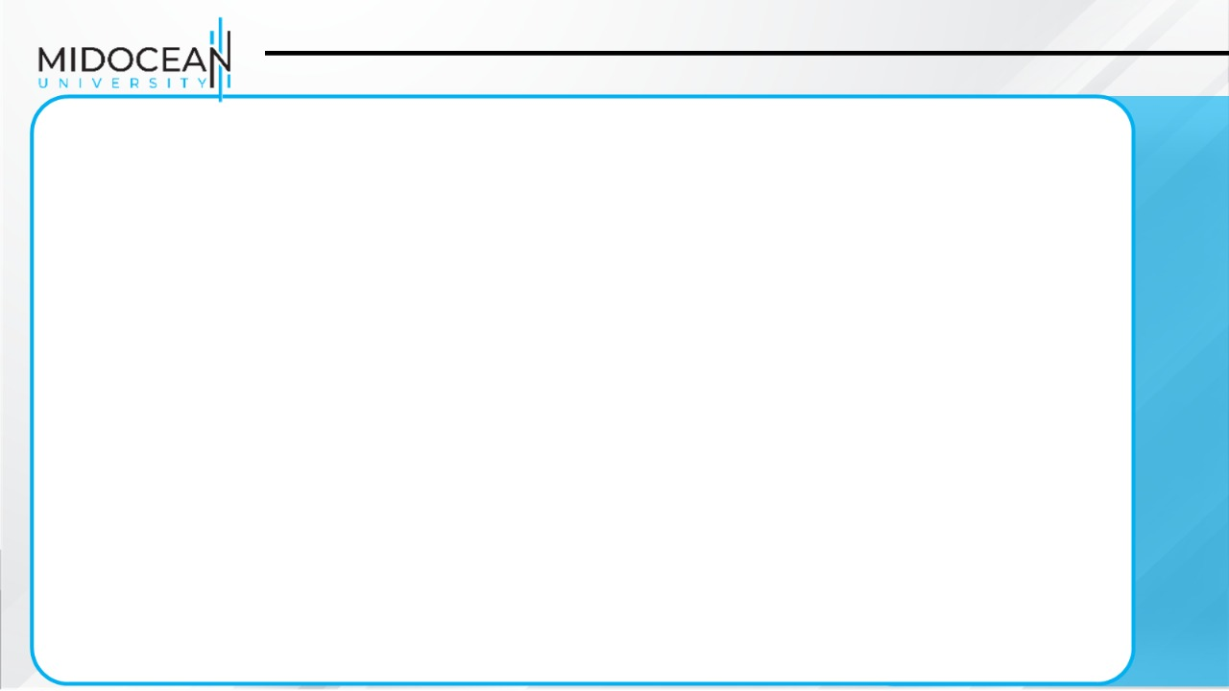
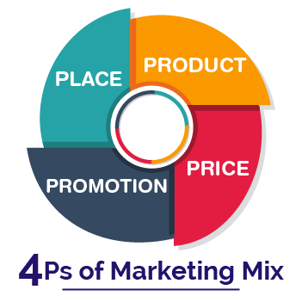
Marketing Mix
Chapter
Product, price, place, and promotion
To develop an effective marketing mix, marketers must:
Be knowledgeable about the issues and options of each element of the mix
Know how to combine the elements to form an effective marketing program
Analyze the market and use the data to develop the marketing strategy and mix

Slide 10
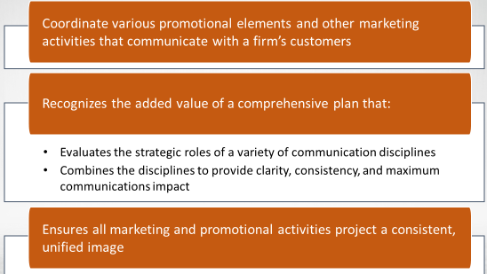
Integrated Marketing Communications (IMC) Functions

Slide 11
Integrated Marketing Communications (IMC)
Criticism - Inside-out marketing approach
  Packs promotional mix elements together, making them look and sound alike
Contemporary perspective
  Goal - Generate short-term financial returns and build long-term brand and shareholder value
  Views IMC ongoing strategic business process

Slide 12
Reasons for the Growing Importance of IMC
Strategically integrates various communications functions
Develops more efficient and effective marketing communications programs
Avoids duplication and takes advantage of synergy among promotional tools
Changing environment
  Evolution to micromarketing
  Consumers’ unresponsiveness to traditional advertising
  Changing rules of marketing

Slide 13
The Role of IMC in Branding
Helps develop and sustain brand identity and equity
Recognizes the need for companies to connect with consumers based on trust, transparency, and authenticity
Sustainability: development that meets the needs of the current generation without compromising the ability of future generations to meet their needs
  Companies are addressing sustainability by carefully examining the social and environmental impacts of their marketing strategies.

Slide 14
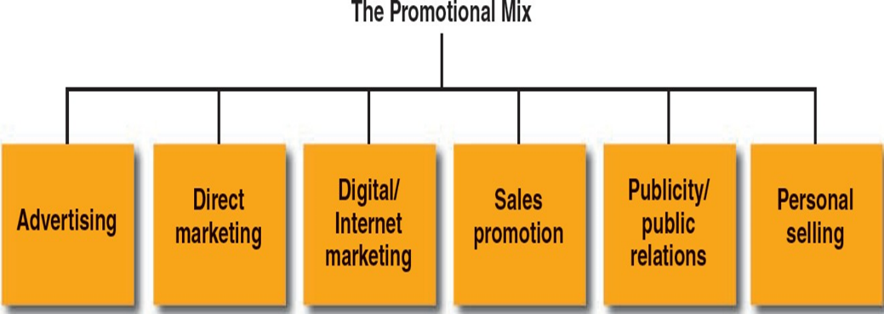
Elements/Pillars of the Promotional Mix IMC Pillars

Slide 15
The Promotional Mix: The Tools for IMC
Tools that accomplish an organization’s communication objectives
Promotion: Coordination of all seller-initiated efforts to:
Set up channels of information and persuasion
Sell goods and services or promote an idea

Slide 16

The Promotional Mix: The Tools for IMC
Advertising: Any paid form of non-personal communication:
About an organization, product, or service
With an idea from an identified sponsor
The non-personal component:
Involves mass media
Message is transmitted to large groups of individuals
No opportunity for immediate feedback

Slide 17


Marketing an Idea

Slide 18
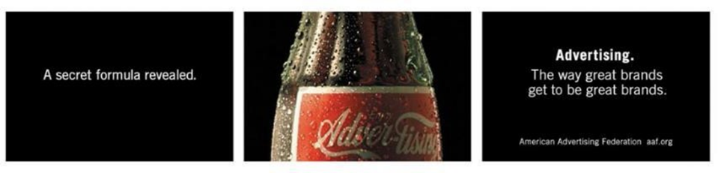
The Promotional Mix: The Tools for IMC
Benefits of Advertising
Most cost-effective way to reach large numbers of consumers
Builds brand equity by influencing consumers’ perceptions

Slide 19
Advertising to Consumer Markets
National advertising
Done on a nationwide basis or in most regions of the country
Retail/local advertising: encourage consumers to:
Shop at a specific store
Use a local service
Patronize a particular establishment
  Primary- versus selective-demand advertising
Primary-demand: stimulates demand for the general product class or entire industry
Selective-demand: creates demand for a specific company’s brands

Slide 20


Slide 21
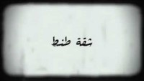

Slide 22
Advertising to Consumer Markets
Business-to-business advertising
Targets individuals who buy or influence the purchase of industrial goods or services for their companies
Professional advertising
Targets professionals, encouraging them to use a company’s product in their business operations
Trade advertising
Targets marketing channel members, encouraging them to stock, promote, and resell the manufacturer’s branded products to their customers

Slide 23

The Promotional Mix: The Tools for IMC
Direct Marketing: Communicating directly with target customers to generate a response and/or a transaction
Involves:
Database management
Direct selling
Telemarketing
Direct-response advertising
  Encourages the consumer to purchase directly
  from the manufacturer

Slide 24
The Promotional Mix: The Tools for IMC
Digital/Internet Marketing
Interactive media
  Allow users to participate in and modify the form and content of the information they receive in real time
Social media
  Online means of communication and interactions used to
create, share, and exchange content
-The growing number of social media users shaped marketing trends and strategies into the new approach called influencer marketing.

Slide 25


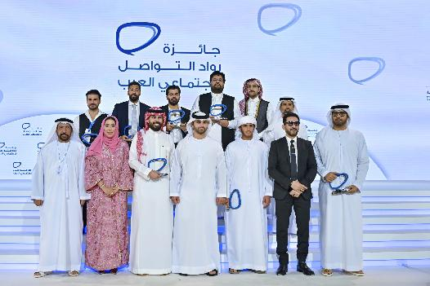
The Promotional Mix: The Tools for IMC
Digital/Internet Marketing

Slide 26
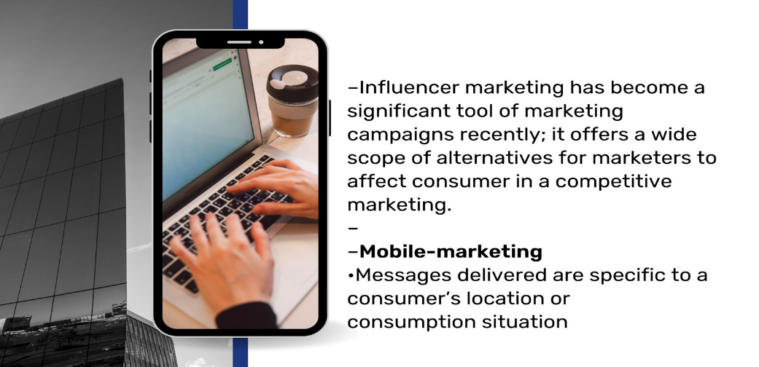
The Promotional Mix: The Tools for IMC
Digital/Internet Marketing

Slide 27

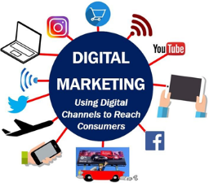
The Promotional Mix: The Tools for IMC
Advantages of Digital/Internet Marketing
Interactive nature
Capability to precisely measure the effects of advertising and other forms of promotion

Slide 28

The Promotional Mix: The Tools for IMC
Sales Promotion: Marketing activities
that provide extra value or incentives to the:
Sales force
Distributors
Ultimate consumer
Aids in stimulating immediate sales
Categories
Consumer-oriented
Trade-oriented

Slide 29



The Promotional Mix: The Tools for IMC

Slide 30
The Promotional Mix: The Tools for IMC
Reasons for Increased Emphasis of Sales Promotion
Declining brand loyalty
Increased consumer sensitivity to promotional deals
Retailers’ demand for more trade promotion support from companies

Slide 31
The Promotional Mix: The Tools for IMC
Publicity: Non-personal communications regarding an organization, product, service, or idea not directly paid for or run under identified sponsorship
Advantages
High credibility and low cost Disadvantages
Not always under the control of an organization
Negative stories are highly damaging

Slide 32
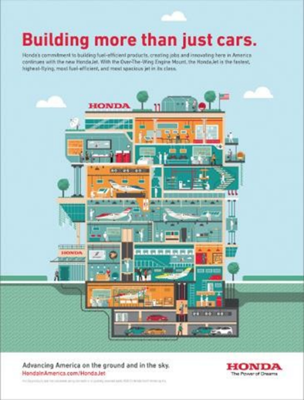
The Promotional Mix: The Tools for IMC
Public Relations
Evaluates public attitudes
Identifies policies and procedures of an individual or
Organization with the public interest
Goal - Establish and maintain a positive image
among various publics

Slide 33
The Promotional Mix: The Tools for IMC
Personal Selling: Person-to-person communication in which seller attempts to assist and/or persuade prospective buyers to:
Purchase a company’s product
Act on an idea
Allows seller to tailor messages to the customer’s specific needs or situation
Involves immediate and precise feedback

Slide 34

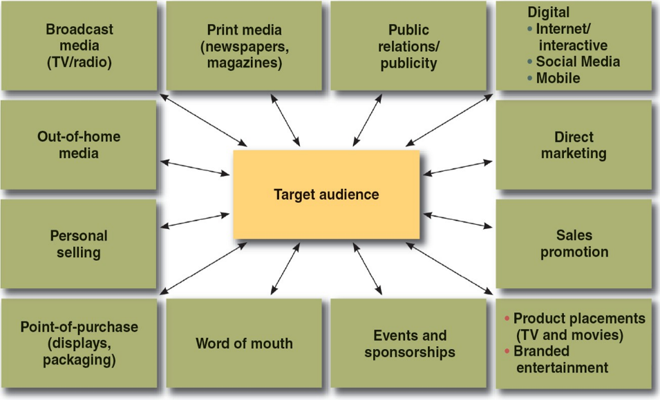
IMC Audience Contact Tools
Every opportunity a customer has to see or hear about a company and/or its brands or have an encounter or experience with it

Slide 35
The IMC Planning Process
Integrated marketing communications management
  Planning, executing, evaluating, and controlling the use of the promotional-mix elements to effectively communicate with target audiences
Integrated marketing communications plan
  Developing, implementing, and controlling an organization’s IMC program

Slide 36
IMC Planning Model
Review of marketing plan
Analysis of promotional program situation and the communication process
Budget determination
Develop integrated marketing communications programs
Advertising
Direct
marketing
Digital/Internet
marketing
Sales
promotion
PR/publicity
Personal selling
Advertising
objectives
Direct-
marketing
objectives
Internet
marketing
objectives
Sales
promotion
objectives
PR/publicity
objectives
Personal-selling
objectives
Advertising
strategy
Direct-
marketing
strategy
Internet
marketing
strategy
Sales
promotion
strategy
PR/publicity
strategy
Personal-selling
strategy
Advertising
message &
media strategy
& tactics
Direct-
marketing
message &
media strategy
& tactics
Internet
message &
media strategy
& tactics
Sales promotion
message &
media strategy
& tactics
PR/publicity
message &
media strategy
& tactics
Sales message
strategy and
sales tactics
Integrate and implement marketing communications strategies
Monitor, evaluate, and control IMC Program
Notes:
Relation to Text:
This slide relates to page 31 of the text and Figure 1-7.
Summary Overview:
This slide presents the four major processes required of an IMC program for it to effectively communicate with target audiences.
Use of this Slide:
This slide can be used to explain to students that the Integrated Marketing Communications Plan provides the framework for developing, implementing, and controlling the IMC program. Those involved with the program must:
Decide on the role and function of the specific elements of the promotional mix
Develop strategies for each element
Determine how they will be integrated
Plan their implementation
Consider how to evaluate the results achieves, and
Make any necessary adjustments

Slide 37
The Promotional Mix: The Tools for IMC
The IMC Planning Process
Marketing Plan:
Describes overall marketing strategy and programs for an organization and includes:
Detailed situation analysis
Specific marketing objectives with time frame and mechanism for measuring performance.
Selection of target market(s) and plans for the four elements of the marketing mix.
Program for implementing the marketing strategy.
Process for monitoring and evaluating performance.

Slide 38
The IMC Planning Process
Review of Marketing Plan
Review of the Examining overall marketing plan and objectives
Identifying the role of advertising and promotion
Performing competitive analysis
Assessing environmental influences

Slide 39
The IMC Planning Process
Internal Analysis: Assesses the firm and relevant areas involving the product/service offering
Assessment of:
Capability to develop and implement promotional program
Brand image and implications for promotion
A product’s relative strengths and weaknesses
Reviews previous promotional programs and results

Slide 40
The IMC Planning Process
External Analysis: Focuses on characteristics of a firm’s customers, market segments, positioning strategies, and competitors
Customer analysis
Competitive analysis
Environmental analysis

Slide 41
The IMC Planning Process
Analysis of Communication Process
Involves analyzing:
  Receiver’s response processes
  Source, message, and channel factors
Establishes communication goals and objectives

Slide 42
The IMC Planning Process
Objectives in the Analysis of the Communication Process
Marketing objectives
  Determine what is to be accomplished by the overall marketing program in terms of sales, market share, or profitability
Communication objectives
  Determine what the firm seeks to accomplish with its
promotional program
  Stated in terms of:
    Nature of the message to be communicated
    Specific communication effects to be achieved

Slide 43
The IMC Planning Process
Developing the Integrated Marketing Communications Program
Involves deciding the role and importance of each promotional-mix element
Aspects of an advertising program
  Creative strategy - Determining the basic appeal and
message to be conveyed to the target audience
  Media strategy - Determining the communication channels to use to deliver the message

Slide 44
The IMC Planning Process
Monitoring, Evaluation, and Control
Determining how well the program is:
  Meeting communication objectives
  Helping the firm accomplish its overall marketing goals and
objectives
Evaluating promotional program results/effectiveness
Taking measures to control and adjust promotional strategies

Slide 45
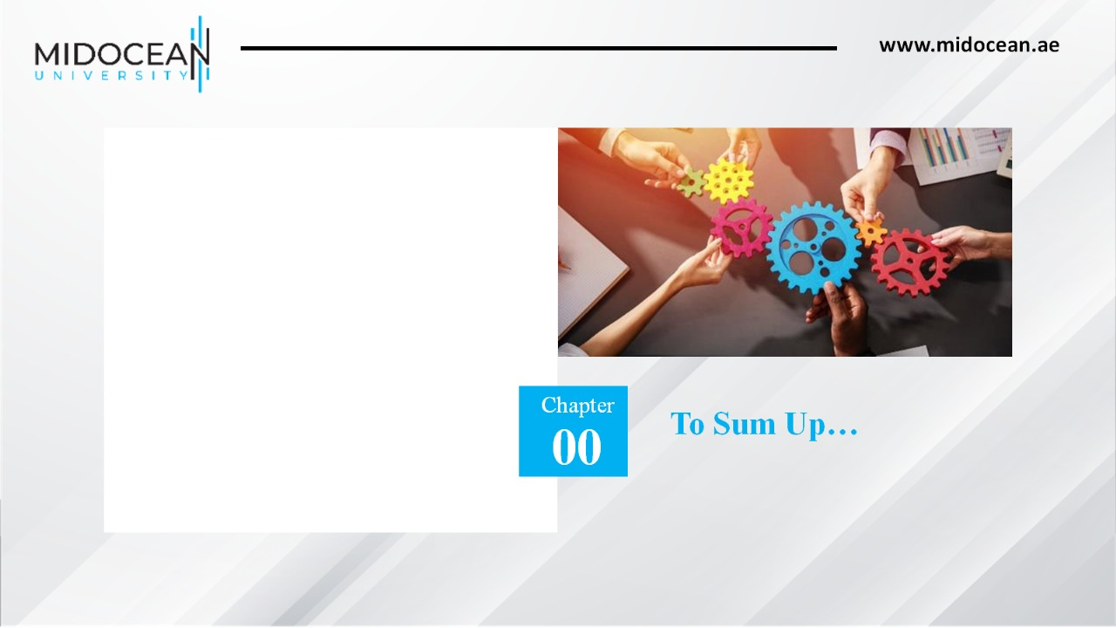
We described the role of advertising and other promotional elements in marketing.
We discussed the evolution of the integrated marketing communications (IMC) concepts.
We explained the increasing value of the IMC perspective in advertising and promotional programs.
We identified the elements of promotional mix.
We described the steps in the IMC planning process.
01

Slide 46

Thank You
Dr. Perihan Salah

