Slide 1

Digital Consumer Behavior
Prepared by Dr. Noha El Aswad
Lecture 3
MKT713_
Master of Digital Marketing

Slide 2
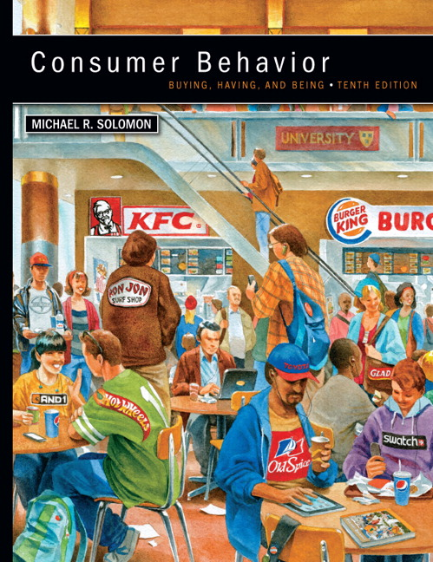

Chapter
01
Buying, Having, Being
CONSUMER BEHAVIOR, 10e
Michael R. Solomon

Slide 3
Chapter
01
Chapter Objectives
When you finish this chapter, you should understand why:
Consumers use products to help them define their identities in different settings.
Consumer behavior is a process.
Marketers need to understand the wants and needs of different consumer segments.

Slide 4
Chapter
01
Chapter Objectives (continued)
The Web is changing consumer behavior.
Consumer behavior relates to other issues in our lives.
Many different types of specialists study consumer behavior.
There are two major perspectives that seek to understand and study consumer behavior.

Slide 5
Chapter
01
Lecture objectives
When you finish this lecture, you should understand:
The rest of learning objective 2
Quick revision of learning objective 1&2
Factors and trends shaping consumer behavior
Examples of Customer Behavior Trends Emerging This Year 2023

Slide 6
Chapter
01
Quick revision of learning objective 1&2
Learning Objective 1
Consumers use products to help them define their identities
Consumers segmented by demographics and psychographics
Consumers understood in part based on their consumption communities and reference groups.
The concept of consumption community

Slide 7
Chapter
01
Quick revision of learning objective 1&2
Learning Objective 1
Consumer identity theory
Brands target consumers using market segmentation strategies.
Consumers may choose brands that match with their own identities.
Consumer behavior: the study of the processes involved when individuals or groups select, purchase, use, or dispose of products, services, ideas, or experiences to satisfy needs and desires.

Slide 8
Chapter
01
Quick revision of learning objective 1&2
Learning Objective 2
Consumer behavior is a process.
Consumer behavior is an ongoing process
The exchange
Expanded view

Slide 9
Chapter
01
Quick revision of learning objective 1&2
Learning Objective 2
A consumer
The purchaser and the user of a product
Stages in the Consumption Process
Consumers’ Impact on Marketing Strategy 1/3
Consumers Are Different! How We Divide them Up.1/2

Slide 10
Chapter
01
Factors and trends shaping consumer behavior 1/ 3
Consumer behavior is complex, multidimensional process.
Successful marketing decision by firms, non-profit organizations, and regulatory agencies require an understanding of the process underlying consumer behavior.

Slide 11
Chapter
01
Factors and trends shaping consumer behavior 2/3
Successful marketing decisions require organizations to collect information about the specific consumers involved in the marketing decision at hand.
Marketing practices designed to influence consumer behavior involve ethical issues that affect the firm, the individual, and society.

Slide 12
Chapter
01
Factors and trends shaping consumer behavior 3/3
Sufficient knowledge of consumer behavior exist to provide usable guidelines. However, applying these guidelines effectively requires monitoring the environment for changes and factoring those changes into marketing decisions. It also require practice.

Slide 13
Chapter
01
Examples of Customer Behavior Trends Emerging This Year 2023 1/24
Robots and Automation
Robots and automation are transforming the way we shop. By 2023, it’s predicted that autonomous systems and robots will be helping shoppers make decisions about what to buy. This shift in technology will enable consumers to access goods faster than ever before, but how do these changes affect consumer trends?

Slide 14
Chapter
01
Examples : Robots and Automation 2/24
Today’s consumers are used to convenience. Online ordering from retailers like Amazon has changed our expectations of speed and service. However, robots and automation are taking shopping convenience one step further by providing shoppers with detailed product information tailored to their needs. Artificial intelligence can now provide personalized recommendations as well as price comparisons across different retailers – all at the click of a button!

Slide 15
Chapter
01
Examples :Personalized Experiences 3/24
The future of shopping is all about personalized experiences. In 2023, consumers will be expecting tailored and unique shopping trips that cater to their individual needs and preferences.

Slide 16
Chapter
01
Examples :Personalized Experiences 4/24
Technology has advanced to the point where retailers can offer services such as virtual reality dressing rooms that recommend clothes in a person’s exact size and style preference. Through data collection, customer service agents have access to customers’ past purchases, enabling them to make more accurate recommendations for future purchases.

Slide 17
Chapter
01
Examples :Personalized Experiences 5/24
Retailers are adopting new technologies that enable shoppers to use their phones as wallets; making it easier for them to pay without cash or cards on premises such as supermarkets or department stores.

Slide 18
Chapter
01
Examples :Personalized Experiences 6/24
Online retailers are using AI technology in order to personalize product recommendations based on each customer’s purchase history and preferences. Consumers will also benefit from increased access through delivery options with quicker turn-around times than ever before

Slide 19
Chapter
01
Examples :Online Shopping Boom 7/24
The ecommerce industry is booming, and no wonder why. Online shopping has been a game changer for how we do business. With the click of a button, shoppers can buy anything from groceries to furniture without ever leaving the comfort of their homes.

Slide 20
Chapter
01
Examples :Online Shopping Boom 8/24
This shift in consumer behavior has become apparent over the past decade, especially after the Pandemic of COVID19, and shows no sign of slowing down anytime soon.

Slide 21
Chapter
01
Examples :Digital Payments Evolution 9/24
The rise of digital payments has revolutionized the way we shop. From contactless cards to mobile pay, consumers are now able to purchase goods and services more quickly and conveniently than ever before.

Slide 22
Chapter
01
Examples :Digital Payments Evolution 10/24
Over the past decade, consumers have embraced digital payment methods with open arms. These new technologies not only allow shoppers to make purchases without having to carry physical cash or cards, but also offer features such as personalized deals and rewards programs.

Slide 23
Chapter
01
Examples: Digital Payments Evolution 11/24
As a result, more retailers are offering customers incentives for using these payment systems – leading many people to switch from traditional modes of payment such as cash or cheque. Additionally, online marketplaces like Amazon and eBay have made it easier for shoppers to browse products from around the world at competitive prices.

Slide 24
Chapter
01
Examples: Environmental Consciousness 12/24
As we move further into the future, “Environmental Consciousness” will become increasingly important in the way that consumers shop. In 2023, this trend is expected to be at its peak, with more people turning to sustainable and eco-friendly options when it comes to purchasing items.

Slide 25
Chapter
01
Examples: Environmental Consciousness 13/24
Consumers are becoming more aware of the environmental impact their shopping habits have on the planet and are therefore opting for long-term solutions which focus on reducing waste and energy consumption.

Slide 26
Chapter
01
Examples: Environmental Consciousness 14/24
Companies who understand this trend and continue to prioritize sustainability in their business models will be at an advantage as they gain consumer trust by placing a higher value on quality over quantity.

Slide 27
Chapter
01
Examples: Environmental Consciousness 15/24
Eco-friendly packaging, innovative recycling methods and renewable energy sources will also help businesses stand out from their competitors in 2023.

Slide 28
Chapter
01
Examples: Power to the People 16/24
By 2023, consumers are expected to demand more control over their purchase decisions than ever before. Shopping experiences that empower customers with flexible payment options, personalization capabilities and access to a wider range of products will become increasingly popular.

Slide 29
Chapter
01
Examples: Power to the People 17/24
According to Mintel 2023 Global Consumer Trends study, “Brands have to make room for a new ‘c’ in their c-suite: consumers”, as consumers are shaping brands more than ever before. “This idea goes beyond brands conceding that ‘the customer is always right’ and is evolving into a model where consumers are investing, co-creating and voting for change alongside brands.

Slide 30
Chapter
01
Examples: Power to the People 18/24
According to Mintel’s study, “Responding to this demand requires brands to listen from the backseat while keeping one foot on the gas to create market innovation. The stars seem to have aligned to give the Power to the People, and this trend promises to continue evolving.

Slide 31
Chapter
01
Examples : Me Mentality 19/24
Just as important as giving power to the people, a quite interesting consumer trend is consumers being eager to re-focus on themselves, and according to Mintel’s study, brands can help individual consumers “take center stage in the years to come.”

Slide 32
Chapter
01
Examples : Me Mentality 20/24
What this trend means is “Consumers may want to stand out rather than blend into the crowd but might not know how to do so. By celebrating the interests that make consumers unique, brands can help give consumers the assurance they need to try something new, or even help them rethink who they are.

Slide 33
Chapter
01
Examples : Me Mentality 21/24
Consumers are ready for a confidence boost, and brands can provide this to them in the form of new experiences or products that feed their curiosity as they form new tastes, routines and preferences that align with who they are or who they want to be”, mentions the study.

Slide 34
Chapter
01
Examples : Me Mentality 22/24
According to this study, what matters the most is the responsibility brands have in shaping the way consumers are responding to the new world that emerged from the pandemic.

Slide 35
Chapter
01
Examples: Into the Future of 2023 23/24
In conclusion, the consumer trends for 2023 paint a bright future for businesses as customers take an increasingly active role in shaping their own experiences. As consumers strive to make more mindful purchasing decisions, companies must rise to the challenge of developing products and services that respond to those needs.

Slide 36
Chapter
01
Examples: Into the Future of 2023 24/24
By investing in the customer experience and focusing on these trends, businesses can build strong relationships with their target audiences and stay ahead of the curve. With the right strategies, businesses can create a powerful and lasting impact on their customers.

Slide 37
Chapter
01
Actors in Consumer Behavior
Consumer: A person who identifies a need or desire, makes a purchase, and then disposes of the product.

Slide 38
Chapter
01
Chapter Objectives
We have been learning:-
Quick revision of learning objective 1&2
Factors and trends shaping consumer behavior
Examples of Customer Behavior Trends Emerging This Year 2023

Slide 39


