Slide 1


Project Meeting & Plan
Chapter 3
Everyone’s Smart University
PMG101
Project communication

Slide 2
Section 2
The Project Plan
Lecture
Section 1
Project Kick-off meeting

Slide 3
Section 1
Project Kick-off meeting

Slide 4
Project Kick-off meeting
The Project’s Early Stages
Once begun, a project follows a planned life cycle that includes:
Early stage
Middle stage
Late (concluding) stage
Although the way a project starts can vary widely in different organizations, there are two elements that many project inceptions have in common:
The project kickoff meeting
The project plan document.

Slide 5
Project Kick-off meeting
What is a project kick-off meeting?
A project kick-off meeting is the first meeting with the project team and the client of the project where applicable. This meeting is the time to establish common goals and the purpose of the project.
When does kick-off meeting take place?
For small projects, the kickoff meeting takes place immediately after the initiation phase and includes all team members. For many team members, this will be the first meeting with other members and therefore, it’s an opportunity to get to know others.
Smaller projects only have one kickoff meeting.

Slide 6
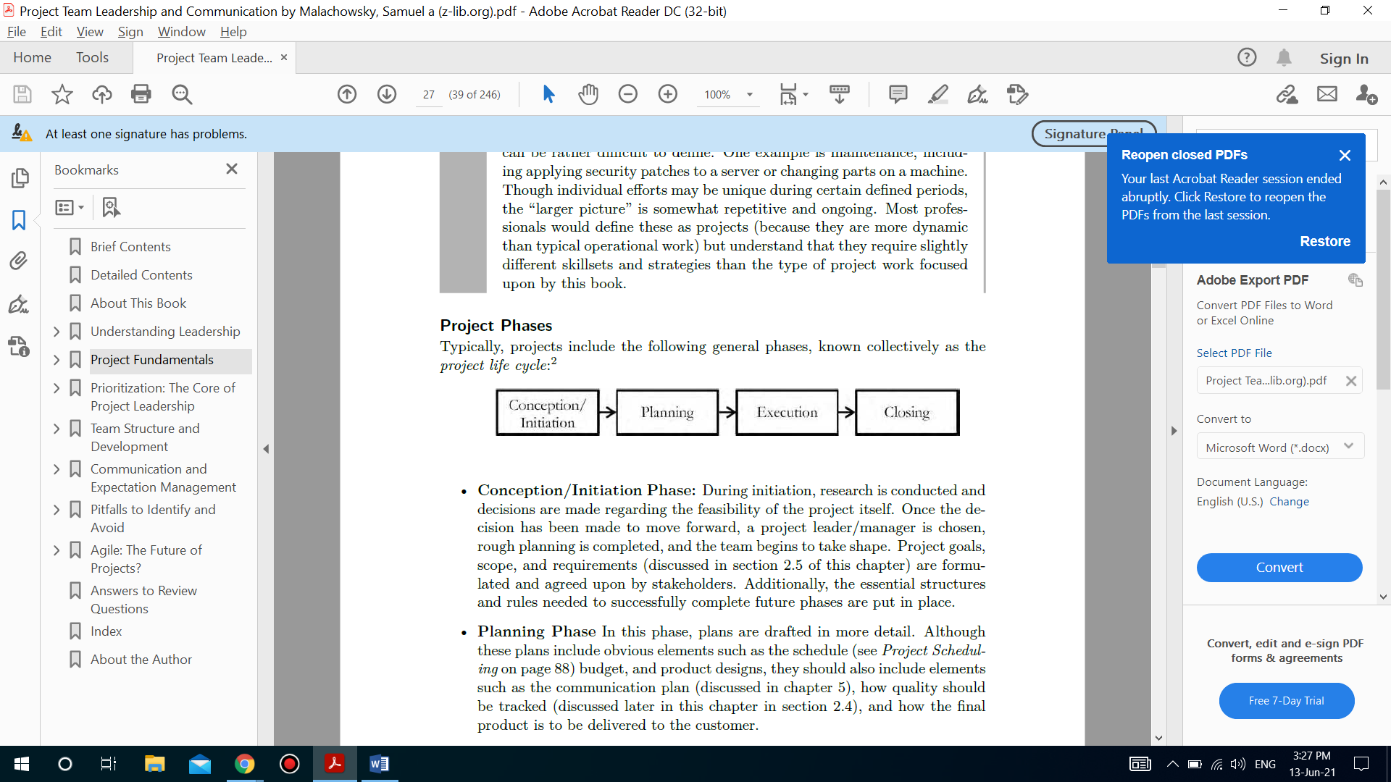
Project Kick-off meeting

Slide 7
Project Kick-off meeting
What is a project kick-off meeting?
A project kick-off meeting is the first meeting with the project team and the client of the project where applicable. This meeting is the time to establish common goals and the purpose of the project.
When does kick-off meeting take place?
In larger projects, you will conduct the kickoff meeting when the planning is completed and execution is about to start. If the project is multiphase, you can have a kickoff meeting at the beginning of each phase.
If the project is spread across a large geographical area, you will have a virtual kickoff meeting so team members can communicate through the internet.

Slide 8
Project Kick-off meeting

Slide 9


Slide 10
Project Kick-off meeting
The purpose of project kick-off meeting
A project team is comprised of new team members so a familiarization session is essential. This session provides an opportunity for team members to get to know each other, build trust, and promote mutual understanding.
In the session, you can discuss project objectives, assumptions, constraints, deliverable(s), challenges, methodologies, procedures, plans, working environment, and the roles of each stakeholder, etc.
A successful kickoff meeting can set the tone for the project. It ensures that stakeholders are on the same page and have a common understanding of the project objectives. It helps them to reach an agreement on how to work as a team.

Slide 11
Project Kick-off meeting
The purpose of project kick-off meeting
A kickoff meeting helps clients build a relationship with the project team and understand how the project will proceed.
It informs the project planning phase of the project, and also allows your team and the client to iron out and finalize details such as project timeline, project management and methodology success measurement, and more.

Slide 12
Project Kick-off meeting
Benefits of project kick-off meeting
The kickoff meeting has the following benefits:
It helps team members get to know each other.
It shows the project manager’s authority and leadership skills.
It helps team members understand the project objectives.
It allows stakeholders to understand the milestones, risks, assumptions, and constraints of the project.
It assists the project manager in gaining support from stakeholders.
It provides attendees with an opportunity to clarify doubts.
It gets stakeholders on the same page.

Slide 13
Project Kick-off meeting
Structuring the meeting
How you structure your meeting agenda depends on the project, but key elements should include the 5 W’s, or who, what, where, when, why and how:
Introductions
How are you going to work together
What’s the background of the project
What does success look like
Why are you doing it
What is the project scope
What’s the action plan
Who’s doing what

Slide 14
Project Kick-off meeting
What is involved in a kick-off meeting?
Introductions
Get the ball rolling. Don’t assume everyone knows each other, so let everyone introduce themselves, their role in the project, and what they’ll be delivering. Bonus points if you can think of a fun and quick icebreaker.
Statement of work, project scope, timeline, and deliverables
Out of everything you’re discussing during the project kick-off meeting, this is one of the most important parts. It solidifies what’s involved in the project and whether or not everyone is on the same page.

Slide 15
Project Kick-off meeting
What is involved in a kick-off meeting?
The statement of work
you submitted to the client describes the work you’ll deliver and by what deadline.
The project scope
includes a detailed description of project deliverables and the work needed to accomplish them.

Slide 16
Project Kick-off meeting
What is involved in a kick-off meeting?
The project timeline
is an overview of what is expected to be delivered and when. This can be as detailed as needed for your project.
Deliverables
are the actual items you will send to your customer or client, and they’re usually noted on the timeline.

Slide 17
Project Kick-off meeting
Tracking progress/milestones and communicating them
During your kick-off meeting, establish a baseline for how you plan to share progress with your stakeholders or client. You can use a status report to show how the project is tracking on budget, tasks, milestones, and timeline.
The status report should be available to all stakeholders and anyone whose work might be affected by the project, to make sure everyone is aware of the progress (or delays). For client projects, it’s important that your client agrees with the level of detail they will receive in the status reports to ensure easier invoicing and payments.

Slide 18
Project Kick-off meeting
Tools and methods
Put together a set of collaboration tools you’ll be using during the project and decide with your team how you’ll be using them to communicate. How will you be sharing your status reports and other files? Aligning on these things early on will help to keep the project’s communication streamlined.
It’s also helpful a to make sure your team or client can access whatever tools you decide to use to keep informed about the project. Some project tools you may use include:
A work management system to track items in progress. Examples include Jira, Basecamp, or Asana.
A shared document system to make sure everyone (including your client) has access to important project documents and information. Examples include Microsoft docs, Google docs, or you can use a document management system that has built-in hierarchy and organization tools like Confluence.

Slide 19
Project Kick-off meeting
Tools and methods
Put together a set of collaboration tools you’ll be using during the project and decide with your team how you’ll be using them to communicate. How will you be sharing your status reports and other files? Aligning on these things early on will help to keep the project’s communication streamlined.
It’s also helpful a to make sure your team or client can access whatever tools you decide to use to keep informed about the project. Some project tools you may use include:
A communication tool like email or Slack so that the teams can stay in touch about any questions or needs that emerge.
For client work, there may be other tools you’ll need access to before you can started. Think design assets like logos, fonts, or style guides, templates, databases, logins (to CMS, social, analytics, etc), access to your client’s intranet, and the correct details for invoicing.

Slide 20
Project Kick-off meeting
Document your project kick-off
Give the project plan a try to help you to define, manage, and track your next project, and keep stakeholders in the know.

Slide 21
Project Kick-off meeting
Preparing tips before the meeting
The pre-kickoff meeting
Have an internal meeting where you talk about the client’s background, their stakeholders, their problems, and the proposed solution so the team can come prepared for the actual kickoff.
Prepare everything
A good kickoff meeting is a result of great preparation. Find out as much you can about the client’s background and previous projects. Also, make copies of relevant documents and handouts that will be useful during the meeting. It’s also a good practice to ensure that the equipment like projectors are working properly to avoid the resulting awkwardness in front of the clients.

Slide 22
Project Kick-off meeting
Preparing tips before the meeting
Send out a clear agenda
Share the complete agenda–the list of things to be covered in the meeting–with all the attendees.

Slide 23
Project Kick-off meeting
During the meeting tips
Don’t delve too much into details
The point of the kickoff meeting is to get all stakeholders acquainted with the project and not to talk specifics like tasks and subtasks. There are other meetings for that.
Keep it brief
No one likes to sit in a meeting that goes on and on with no signs of coming to a close. The kickoff meeting should have a tight time limit and a focused agenda so everyone feels their time is being valued.
Don’t broadcast information
If it’s going to be a one-way conversation, you might as well have shared a document or a presentation. This meeting is an intersection of ideas and opinions. So make it a two-way street.

Slide 24
Project Kick-off meeting
During the meeting tips
Ask for inputs from the attendees
The attendees are key stakeholders and they’ll have assumptions and views on the constraints
Take notes
Assign a dedicated note-taker for the meeting or record the meeting if possible and with permission.

Slide 25
Project Kick-off meeting
After the meeting tips
Send out meeting minutes
Share the meeting notes or a summary to all attendees as well as those who couldn’t attend so they can refer to it at any point.
Send an email
It’s quite often the case that some people don’t feel comfortable raising questions in a group seeing. Send out an email saying they could contact you for more information or if they have any questions.

Slide 26
Section 2
The Project Plan

Slide 27
The Project Plan
Term Definition
A project plan defines project goals and objectives, specifies tasks and how goals will be achieved, identifies what resources will be needed and associated budgets and timelines for completion. A project plan defines all work in a project and identifies who will do it. A typical project plan consists of: A statement of work, a resource list, work breakdown structure, a project schedule and a risk plan.

Slide 28
The Project Plan
Importance
1. Visualize your goals and the path needed to take there. Gant charts, PERT charts and Critical Path Method (CPM) charts allow you to see your project requirements and timelines at a glance.
2. Improve communication. Because a description of communication protocols are a part of a project plan, your project team, stakeholders and decision-makers all know how and when they need to communicate with each other.

Slide 29
The Project Plan
Importance
3. Decrease time and costs. In many ways, a project plan works like a dry run, with everyone in the team able to foresee problems before they happen.
4. Improve your control of the project. When stakeholders agree on a project plan, they are less likely to try to change the course of a project once it has begun. When they do want to make changes, you can refer to the plan and show how the change will affect the schedule and costs.

Slide 30
The Project Plan
Importance
5. Improve the allocation of resources. Because a project plan includes a schedule, you will know exactly when team members are required to do their work and when they will need tools and supplies to do it. Imagine, for example, renting a truck a week before your team needs it, or scheduling that truck a week late.
6. Keep you on course. Projects invariably get off track. People, for example, get sick or finish tasks earlier than anticipated. With a project schedule, it's much easier to make adjustments as you go along to ensure the project stays on course.

Slide 31
The Project Plan
The Project Plan Components:
An executive summary: Limited to one page or less, this serves to quickly explain the basic why, what, who, when, and how to the reader.
By reading this single page, someone can acquire a general understanding of the project:
Why has the project been initiated?
What is the project supposed to accomplish? What are its main outcomes?
Who, at the highest levels, are the project’s major stakeholders?
When is it supposed to begin and end? What are the major stops along the way?
How, in a brief description, is it to be accomplished?
Note that although it’s the first page of the document, it’s typically one of the last written.

Slide 32
The Project Plan
The Project Plan Components:
Appropriately detailed outcomes:
This includes as many of the “layers” as needed to properly define the project outcomes Examples include goals, objectives, scope statements, requirements, and specifications, and each warrants its own sub-heading.
Remember that the elements required to appropriately define your project outcomes may vary. This section is typically written first, starting with the most abstract sections (objectives, goals, and deliverables) moving toward more exacting details (scope statements, requirements, etc.).

Slide 33
The Project Plan
The Project Plan Components:
Components/Sections:
• Goals and/or Objectives
Scope Statement:
• Requirements and/or Specifications
• Work Breakdown Structure

Slide 34
The Project Plan
The Project Plan Components:
Scope Statement:
• Requirements and/or Specifications
• Work Breakdown Structure

Slide 35
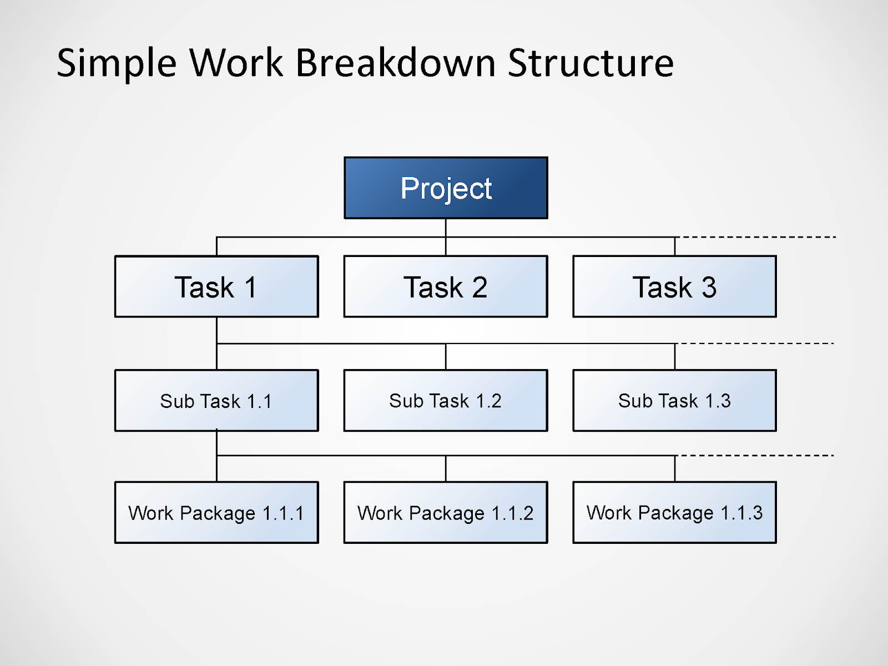
The Project Plan
The Project Plan Components:

Slide 36
The Project Plan
The Project Plan Components:
• Project Deliverables
Schedule and budget information: Typically written after defining the project’s planned outcomes, this section lays out the expected schedule and budget information for the project.
If significant materials or resources are needed to execute the project, information on how to choose and procure these items would also be included here.
If any significant changes are made to the schedule or budget, revisions need to be made to this section as well.

Slide 37
The Project Plan
The Project Plan Components:
Components/Sections:
• Milestones: Major scheduling milestones (see Visualizing the Schedule.
• Schedule: Built through estimation and scheduling efforts.
• Budget: Financial information related to the project. Often governed by the organization’s policies and procedures.
• Procurement Plan: A plan for resources or services that are to be acquired in the course of the project.
• Dependencies: Internal and external resources or events that are needed for the schedule and budget to be valid.

Slide 38
The Project Plan
The Project Plan Components:
Components/Sections:
• Human Resource Management: A listing of the project’s team members and external human resources, their reporting structure, and their responsibilities.
• Project Resource Management: A listing of the non-human resources available to the project and how they are to be managed.
• Processes and Change Procedures: This references or lists the processes that the team will follow in each phase of the project or when making major changes to schedules or budgets.
• Quality: Defining up-front how your project is going to address both process and product quality ensures that team members and stakeholders have proper expectations in this area.

Slide 39
The Project Plan
The Project Plan Components:
Components/Sections:
• Process Quality
– Standard Procedures: Often previously defined by the organization or team.
– Artifacts to be Created: Should include approval or review procedures needed for each.
– Process Review and Improvement Plan: Related to a project’s Lessons Learned.
Components/Sections:
• Product Quality
– Quality Specifications: Clearly specified tests or standards to be met (conforming to explicitly defined quality elements.
– Quality Focus: The implicit focus of quality efforts—the quality-related goals the project hopes to achieve.

Slide 40
The Project Plan
The Project Plan Components:
Stakeholder analysis and communication planning: It’s important to define who the project’s stakeholders are and the team’s plans for communicating important project information to them at regular intervals.
• Stakeholder Register: A table containing a list of all individuals or groups who can affect or are affected by the project.
• Communication Plan: A communication plan should include the following information:
What
To Whom
Who
How
When

Slide 41
The Project Plan
The Project Plan Components:
• Communication Plan: A communication plan should include the following information:
What: The type of information to be communicated.
How: The method, or channel, of delivery.
To Whom: The recipients of each type of communication. These should line up with the stakeholders identified in your stakeholder register.

Slide 42
The Project Plan
The Project Plan Components:
• Communication Plan: A communication plan should include the following information:
When: Information about the frequency of communication or specific scenarios that would trigger a communique. This relates to the idea of Expectation Management.
Who: The team members or roles responsible for conducting the communication. Different team structures will handle this differently.

Slide 43
The Project Plan
The Project Plan Components:
Consideration of risks and issues: Though we hope for ideal conditions and predictable results, it’s important for the project team to consider situations where the project faces delays, shortages, or other negative conditions.
This section creates a place to list issues, seeks out potential risks, and establishes procedures for addressing these issues and risks
• Initial Risk and Issue Analysis: SWOT analysis is an appropriate tool to help with this.
• Risk Register: Establishment of a risk table which should be revisitedfrequently throughout the project.

Slide 44
The Project Plan
The Project Plan Components:
Consideration of risks and issues: Though we hope for ideal conditions and predictable results, it’s important for the project team to consider situations where the project faces delays, shortages, or other negative conditions.
This section creates a place to list issues, seeks out potential risks, and establishes procedures for addressing these issues and risks
• Issue List: Often tracked electronically. Includes issue names, details, and resources assigned to resolving them.

Slide 45
The Project Plan
The Project Plan Components:
Establishing a set of procedures for managing important
Changes to the project minimizes the chance of surprised stakeholders and failed project objectives.
Including a revision log can clarify which version of the document a stakeholder has. In addition, including approval information specifies which parties must formally review and sign-off on the plan.

Slide 46
The Project Plan
The Project Plan Components:
Establishing a set of procedures for managing important
• Change Procedures: The procedures that should be followed when making major changes to the project’s deliverables, schedule, or budget.
• Revision History: A log of major changes listing revision details, which includes authors and dates. This may be created electronically).
• Approval: Proof of plan acceptance by appropriate parties, which, in some cases, may include physical signatures.

Slide 47
Thank You

