Slide 1


Project Time Management
مقرر: إداره وقت المشروع
Prepared by Dr. Amira Elfekky
PMG 212
Lecture 7

Slide 2

Agenda
Scheduling
Who is the Scheduler
Attributes of Planner/Scheduler
Importance of the Schedule
Scheduling Tools
Critical Path Method
Scheduling Terminology
Relationships (Logic) – 4 Types
www.midocean.ae

Slide 3
Agenda
Scheduling
Who is the Scheduler
Attributes of Planner/Scheduler
Importance of the Schedule
Scheduling Tools
Critical Path Method
Scheduling Terminology
Relationships (Logic) – 4 Types
www.midocean.ae

Slide 4
Chapter
Scheduling
07
If PLANNING is an Art form based on Experience and Knowledge, then SCHEDULING is a Systematic exercise in using applied Logic.
www.midocean.ae

Slide 5
Chapter
Scheduling
07
Scheduling in project management is the listing of activities, deliverables, and milestones within a project.
A schedule usually includes a planned start and finish date, duration, and resources assigned to each activity.
www.midocean.ae

Slide 6
Chapter
Scheduling
07
The 6 processes of time management in scheduling;
When people discuss the processes for building a schedule, they are usually referring to the first six processes of time management:
Plan schedule management
Define project activities
Sequence activities
Estimate resources
Estimate durations
Develop the project schedule
www.midocean.ae

Slide 7
Chapter
Scheduling
07
Benefits of project scheduling in project management
Project scheduling provides the following benefits:
Assists with tracking, reporting, and communicating progress
Ensures everyone is on the same page with tasks, dependencies, and deadlines
Highlights issues and concerns, such as a lack of resources
Identifies task relationships
Monitors progress and identify issues early
www.midocean.ae

Slide 8
Chapter
Scheduling
07
Seven tips for creating a solid project schedule
The time management processes identified above are the key steps to creating a project schedule. However, keep these seven tips in mind to make sure your schedule is realistic.
Get input from stakeholders: Don’t create your schedule in isolation. It’s important to use your team and other stakeholders to identify tasks, resources, dependencies, and durations.
Reference past projects: Looking at previous projects with similar scope and requirements can help create realistic estimates and ensure you haven’t forgotten any tasks.
Keep risk in mind: Identify and document any factors that pose a risk to staying on schedule. This will help your risk management efforts.
www.midocean.ae

Slide 9
Chapter
Scheduling
07
Seven tips for creating a solid project schedule
Consider any non-work time: For example, make sure vacations and holidays are reflected in your schedule so that you’re not assuming people will be working when they’re not.
Define the critical path on your project: Identifying your project’s critical path allows you to prioritize and allocate resources to the most important tasks in the project.
Record scheduling assumptions: Write down the logic behind your scheduling predictions. For example, if you assume it will only take 10 hours to complete a task because you have a senior engineer. Then, if you end up with a junior engineer, you can understand and explain why it took twice as long as planned.
www.midocean.ae

Slide 10
Chapter
Scheduling
07
Seven tips for creating a solid project schedule
Include project milestones: Milestones are events or markers that stand for an important point in your project. They’re useful for creating a summary schedule, reporting to executives, and identifying problems early. Here are some milestone examples:
Project kickoff
Design approvals
Completion of requirements
Product implementation
Project closeout
Create
www.midocean.ae

Slide 11
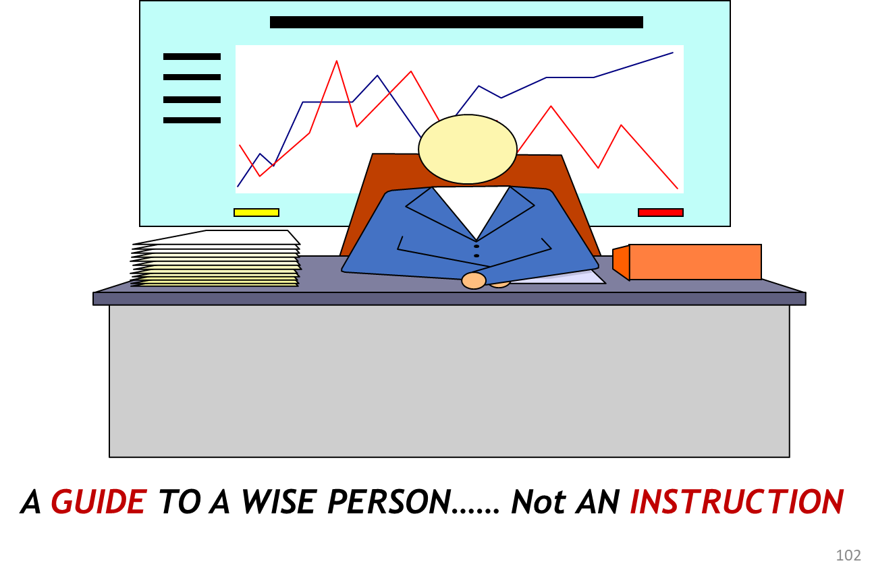
Chapter
Scheduling
07
www.midocean.ae

Slide 12
Agenda
Scheduling
Who is the Scheduler
Attributes of Planner/Scheduler
Importance of the Schedule
Scheduling Tools
Critical Path Method
Scheduling Terminology
Relationships (Logic) – 4 Types
www.midocean.ae

Slide 13
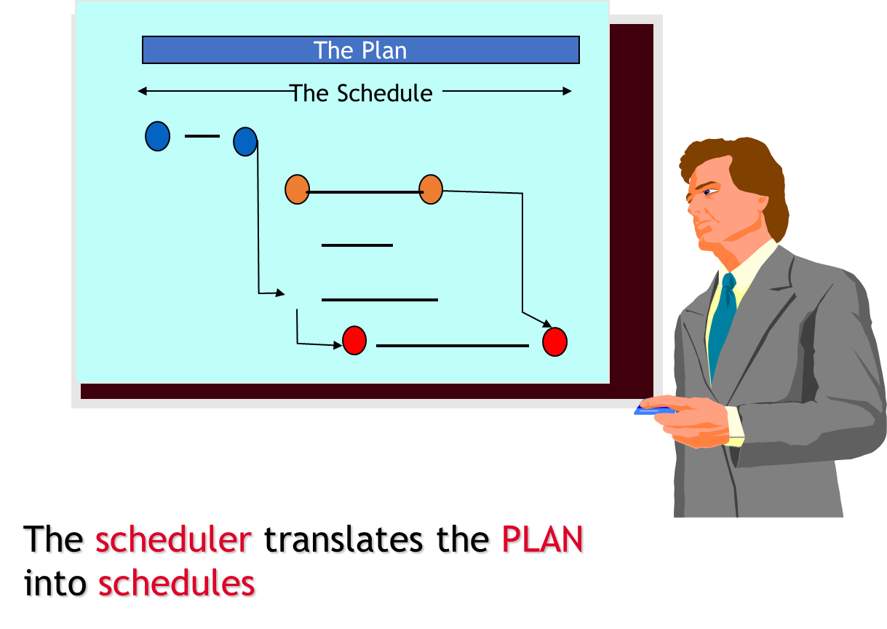
Chapter
Who is the Scheduler
07
www.midocean.ae

Slide 14
Agenda
Scheduling
Who is the Scheduler
Attributes of Planner/Scheduler
Importance of the Schedule
Scheduling Tools
Critical Path Method
Scheduling Terminology
Relationships (Logic) – 4 Types
www.midocean.ae

Slide 15
Chapter
07
Attributes of Planner/Scheduler
Possess PEOPLE skills!
  Exercise humility and salesmanship
  Exercise care when recommending various approaches
  Do not alienate the managing parties
  Ease off when needed
  Emphasize his/her role is to coordinate and integrate ideas and plans into a coherent project schedule.
امتلاك المهارات الشخصية (عدم الاعتماد على البرامج الحاسوبية)
  التحلي بمهارات التواصل بين أقسام المشروع
  العناية الشديدة عند التوصية بإستخدام أساليب مختلفة
  العمل على عدم نفور الأطراف ذات الصلة
  الحد من المشكلات عند الحاجة
  تنسيق ودمج الأفكار والخطط في جدول زمني متماسك
www.midocean.ae

Slide 16
Agenda
Scheduling
Who is the Scheduler
Attributes of Planner/Scheduler
Importance of the Schedule
Scheduling Tools
Critical Path Method
Scheduling Terminology
Relationships (Logic) – 4 Types
www.midocean.ae

Slide 17
Chapter
Importance of the Schedule
07
Depicts يصورthe Scope of work
Improves the probability for the project team to meet its goals
Establishes overall schedule parameters
Aids in determining staffing requirements
www.midocean.ae

Slide 18
Chapter
Importance of the Schedule
07
Resource loading basis
Identifies long lead items
Identifies the phases in the project
www.midocean.ae

Slide 19
Chapter
07
Importance of the Schedule
Standardized scheduling techniques motivates the project team to:
  Think through the entire project
  Predict a realistic project completion
  Recognize impacts of unexpected events
www.midocean.ae

Slide 20
Chapter
Importance of the Schedule
07
Standardized scheduling techniques motivates the project team to:
  Identify claims or time extensions
  Coordinate interfaces and reduce conflicts
  Plan resource requirements and cash flow
  Serve as a record of the project’s progress
  Communication Tool
www.midocean.ae

Slide 21
Chapter
07
Importance of the Schedule
  Tells you where you’ve been.
  Tells you where you are.
  But most importantly, it tells you where are you going!
Must have sufficient detail to control the project
  To much detail is cumbersome to maintain.
  Not enough detail and the analysis of the schedule is difficult.
www.midocean.ae

Slide 22
Agenda
Scheduling
Who is the Scheduler
Attributes of Planner/Scheduler
Importance of the Schedule
Scheduling Tools
Critical Path Method
Scheduling Terminology
Relationships (Logic) – 4 Types
www.midocean.ae

Slide 23
Chapter
07
Scheduling Tools
In practice, the best project management software will give you everything you need to plan, manage, and deliver projects effectively. It should provide a single central platform where teams can assign tasks, share resources, communicate about work, and track project progress and metrics in real-time.
The reality is that many of even the best-known tools for managing projects struggle in these functions. The trouble is that you’re unlikely to know these limitations in advance.
www.midocean.ae

Slide 24
Chapter
07
Scheduling Tools
That’s why, in this guide, we’ve selected each tool based on how they perform in these five functions:
Project visualizations. How you physically see your projects affects how you manage and complete them. Does your platform have a timeline view, to help you meet deadlines? Do colleagues have a user-friendly dashboard where they can track their own individual work? How customizable is the software to your unique work structure? These are all critical questions you need answers to.
www.midocean.ae

Slide 25
Chapter
07
Scheduling Tools
That’s why, in this guide, we’ve selected each tool based on how they perform in these five functions:
Team collaboration. The best work management software should also streamline your teams’ communications by bringing it all under one roof. With instant messaging, commenting, shared editing, and even Scrum capabilities, you can dramatically reduce the number of emails you send. Choose the tool that has the communication functionality that’s right for you.
www.midocean.ae

Slide 26
Chapter
07
Scheduling Tools
That’s why, in this guide, we’ve selected each tool based on how they perform in these five functions:
Resource planning and management. Project management software should provide a single source of truth for your work. For teams, it’s crucial that it offers easy access to the docs, files, and assets they need. For project managers, it should provide tools to help track and plan for budgets and colleagues’ capacity, such as timesheets.
www.midocean.ae

Slide 27
Chapter
07
Scheduling Tools
That’s why, in this guide, we’ve selected each tool based on how they perform in these five functions:
Reporting and analytics. Project management tools should provide detailed information on how your projects are progressing and whether you’re on budget and on schedule. Many tools do this well, but the analytics they provide may be limited to individual projects rather than your whole portfolio. This may be OK for some teams, but others may want a more scalable solution.
www.midocean.ae

Slide 28
Chapter
07
Scheduling Tools
That’s why, in this guide, we’ve selected each tool based on how they perform in these five functions:
Workflow automations. Rather than just providing a platform for you to work, the most advanced tools can actually do part of that work for you, thanks to automation. For instance, with Wrike you can automate some repetitive work, such as assigning tasks and subtasks. If you’re serious about boosting organizational efficiency, this can be a hugely useful feature.
www.midocean.ae

Slide 29
Chapter
07
Scheduling Tools
P6 (Primavera)
Microsoft Project Planner (MSP)
Suretrak (Primavera)
Milestones, etc.. - Bar Chart
TILOS- Linear Scheduling
www.midocean.ae

Slide 30
Agenda
Scheduling
Who is the Scheduler
Attributes of Planner/Scheduler
Importance of the Schedule
Scheduling Tools
Critical Path Method
Scheduling Terminology
Relationships (Logic) – 4 Types
www.midocean.ae

Slide 31
Chapter
07
Scheduling Methodology
www.midocean.ae

Slide 32
Chapter
07
Critical Path Method
Item | Price
A | 100
B | 100
C | 100
D | 100
E | 100
F | 100
Sum | 600
The calculation of the earliest and latest start and finish dates of activities based on their duration's and relationships to other activities
a resource-utilization algorithm for scheduling a set of project activities
www.midocean.ae

Slide 33
Chapter
Activities
07
The Basic element into which a project is subdivided for scheduling a network (CPM)
  Has a definable start and finish
  Consumes resources
  Is assignable
  Is measurable
  Is defined by a Work Package
  Is a Physical Task for Construction
www.midocean.ae

Slide 34
Agenda
Scheduling
Who is the Scheduler
Attributes of Planner/Scheduler
Importance of the Schedule
Scheduling Tools
Critical Path Method
Scheduling Terminology
Relationships (Logic) – 4 Types
www.midocean.ae

Slide 35
Chapter
07
Scheduling Terminology: Work Package
A group or number of Engineering/Construction Deliverables that will enable Procurement or Construction to accomplish a meaningful task. WP is the lowest level of a WBS.
  All of the Data Sheets & Specifications required for a Purchase Order.
  All of the Drawings & Details necessary to Locate, Excavate, Form and Pour a Foundation
  Earthwork
  Foundation
  Cabling
www.midocean.ae

Slide 36
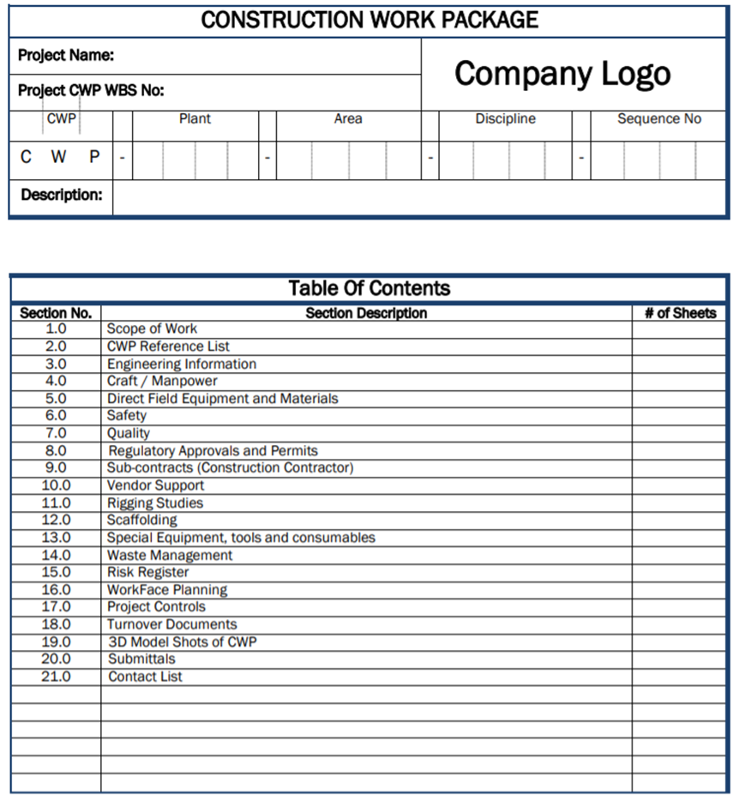
Scheduling Terminology:
Work Package Template
Chapter
07
www.midocean.ae

Slide 37
Chapter
Scheduling Terminology: Milestone
07
Is a GOAL to be achieved.
    Can be either a Start or Finish Achievement
    Is a single point in Time
    Has no duration
    Has no resources
    Has a specific and unique Definition
    It is either YES or NO
www.midocean.ae

Slide 38
Chapter
Scheduling Terminology
07
Predecessor = An activity that must occur before another activity. A predecessor activity controls the start or finish date of its successor(s). An activity can have multiple predecessors, each with a different relationship to it.
Successor = An activity that must occur after another activity. An activity can have multiple successors, each with a different relationship to it.
www.midocean.ae

Slide 39
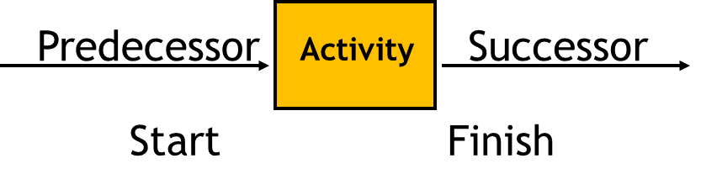
Chapter
Scheduling Terminology
Predecessor and Successor Synonymsمرادفات
07
Dependencies
Prerequisites
Interface requirements
Links
Logic relationships “To” and “From”
التابعين (الاعتماديين)
المتطلبات المسبقة
متطلبات الواجهة/الربط
الروابط
العلاقات المنطقية "إلى" و "من"
www.midocean.ae

Slide 40
Agenda
Scheduling
Who is the Scheduler
Attributes of Planner/Scheduler
Importance of the Schedule
Scheduling Tools
Critical Path Method
Scheduling Terminology
Relationships (Logic) – 4 Types
www.midocean.ae

Slide 41
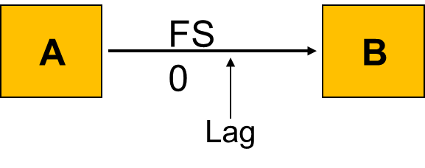
Chapter
07
Relationships (Logic) – 4 Types
  Finish to Start - FS - A relationship in which the predecessor activity must Finish before its successor activity can Start.
www.midocean.ae

Slide 42
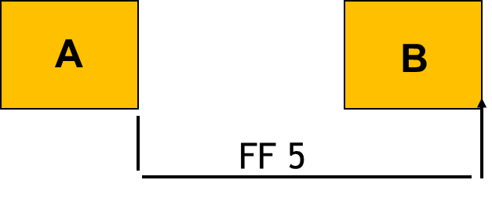
Chapter
07
Relationships (Logic) – 4 Types
  Finish to Finish - FF - A relationship in which the Finish of a successor activity depends on the Finish of its predecessor activity.
www.midocean.ae

Slide 43
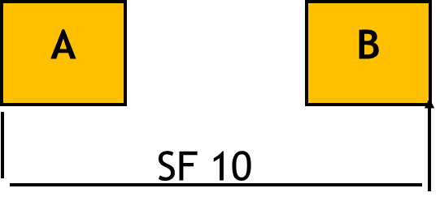
Chapter
07
Relationships (Logic) – 4 Types
  Start to Finish - SF - A relationship in which the Start of the predecessor activity controls the Finish of a successor activity. Not used
www.midocean.ae

Slide 44
Chapter
07
Relationships (Logic) – 4 Types
  Start to Start - SS - A relationship in which the Start of the predecessor activity controls the Start of a successor activity .
A
B
SS 0
www.midocean.ae

Slide 45

www.midocean.ae

Slide 46




Thank You

