Slide 2
COURSE DESCRIPTION
The course aims to explore the importance of the operating system and its function. The different techniques used by the operating system to achieve its goals as resource manager. This course introduce also, the fundamentals of modern operating system function, design, and implementation. Topics include concurrency, synchronization, processes, threads, scheduling, memory management, file systems, device management, and security.

Slide 3
COURSE OBJECTIVES
By the end of this course the student will be able to:
Recognize the importance of the operating systems.
Recognize how the applications interact with the operating system as the later working as intermediary program between the machine and the application.
Know how the operating systems transport the application requests to the hardware.
Understand how operating systems managing resources such as processors, memory and I/O.
Realize the efficiency or the deficiency of the different techniques used by some operating systems.

Slide 4
COURSE SCHEDULING
Module 1: Operating System Introduction.
Module 2: Processes and threads.
Module 3: Concurrency.
Module 4: Memory management.
Module 5: Scheduling and Deadlock.
Module 6: File management.
Module 7: Operating System security.
Module 8: Virtualization.

Slide 5
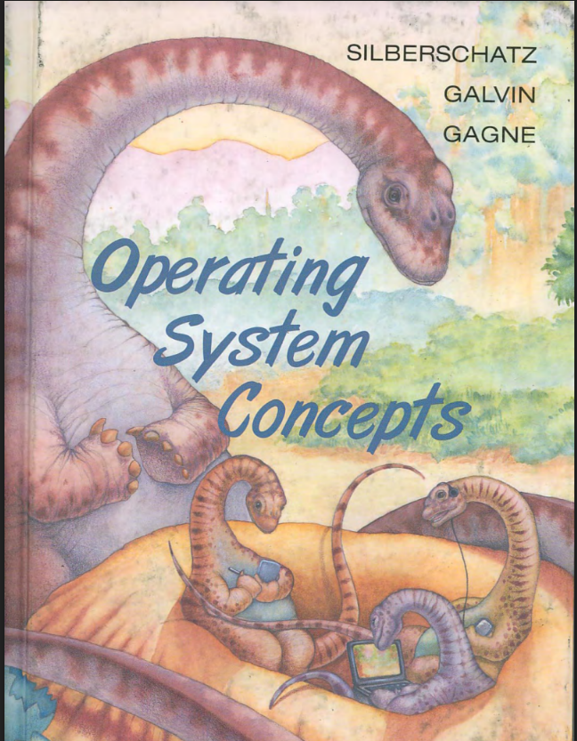
TEXT BOOK
Silberschatz, Galvin, Gagne. Operating System Concepts. John Wiley & sons , inc

Slide 6
Chapter 1: Introduction
What Operating Systems Do
Computer-System Organization
Computer-System Architecture
Operating-System Structure
Operating-System Operations
Process Management
Memory Management
Storage Management
Protection and Security
Distributed Systems
Special-Purpose Systems
Computing Environments
Open-Source Operating Systems

Slide 7
Objectives
To provide a grand tour of the major operating systems components
To provide coverage of basic computer system organization
Explore core ideas in Operating Systems in two ways:
  understanding the concepts behind resource management, abstraction, hardware interface, protection, security, concurrency, and performance.
  2) practical coding experience with a real OS to understand challenges of systems

Slide 8
What is an Operating System?
A system software program that acts as an intermediary between a user of a computer and the computer hardware. It Provides abstractions for resources (CPU, memory and I/O devices)
  User View: A virtual machine on top of real machine to provide a more convenient user interface for the computer system
    hide the details of individual devices and components
    high level abstraction of the machine
  System View: A resource manager to make efficient use of computer systems components
    Shared resource: CPU, memory and I/O devices
    Multiprogram batch systems: allow multiple batch jobs share the computer system
    Time-sharing systems: allow multiple interactive jobs share the system
Provide environment in which applications software can execute as if they use the hardware alone.

Slide 9
History: Evolution of Systems
Batch Systems
  Goal: Maximize amount work done for multiple users
  Applications run one after the other. One application at a time!
  Application uses all computer resources
Batch Multiprogramming
  Multiple applications in memory
  When one waits for I/O, another executes
    Better utilization of CPU

Slide 10
History: Evolution of Systems
Timesharing Systems
  Interactive use of computers
    Responsiveness matters
    Expect system to respond to keyboard input immediately
  Several users/applications can share computer
    Share CPU, Disk, Memory...
Real Time

Slide 11
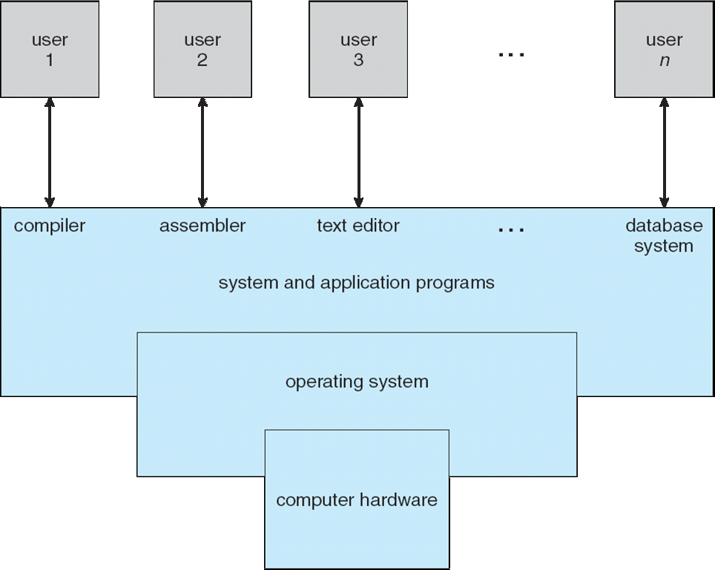
Computer System Structure
Four Components

Slide 12
Computer System Structure
Computer system can be divided into four components
  Hardware – provides basic computing resources
    CPU, memory, I/O devices
  Operating system
    Controls and coordinates use of hardware among various applications and users
  System/Application programs – define ways in which the system resources are used to solve the computing problems of the users
    Word processors, compilers, web browsers, database systems, video games
  Users
    People, machines, other computers

Slide 13
Operating System Definition
OS is a resource allocator
  Manages all resources (CPU, memory, disk space, peripherals)
  Decides between conflicting requests for efficient and fair resource use
OS is a control program
  Controls execution of programs to prevent errors and improper use of the computer
No universally accepted definition

Slide 14
Operating System Definition
“Everything a vendor ships when you order an operating system” is good approximation
  But varies wildly
“The one program running at all times on the computer” is the kernel. Everything else is either a system program (ships with the operating system) or an application program. kernel
  provides resources to them
  Controls their execution

Slide 15
Computer Startup
How can an Operating system being loaded in Memory????
Answer: we need a program that loads OS from Disk into memory. This program is the boostraper
bootstrap program is loaded at power-up or reboot
  Typically stored in ROM or EPROM, generally known as firmware
  Initializes all aspects of system
  Loads operating system kernel and starts execution

Slide 16
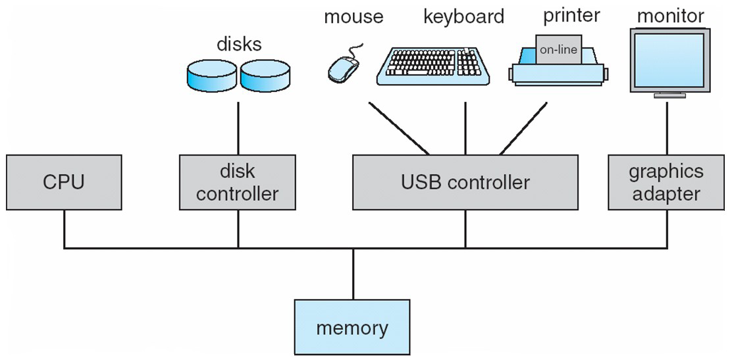
HW Architecture and OS Services
How do hardware & applications interact with the OS?
Computer-system operation
  One or more CPUs, device controllers connect through common bus providing access to shared memory
  Concurrent execution of CPUs and devices competing for memory cycles

Slide 17
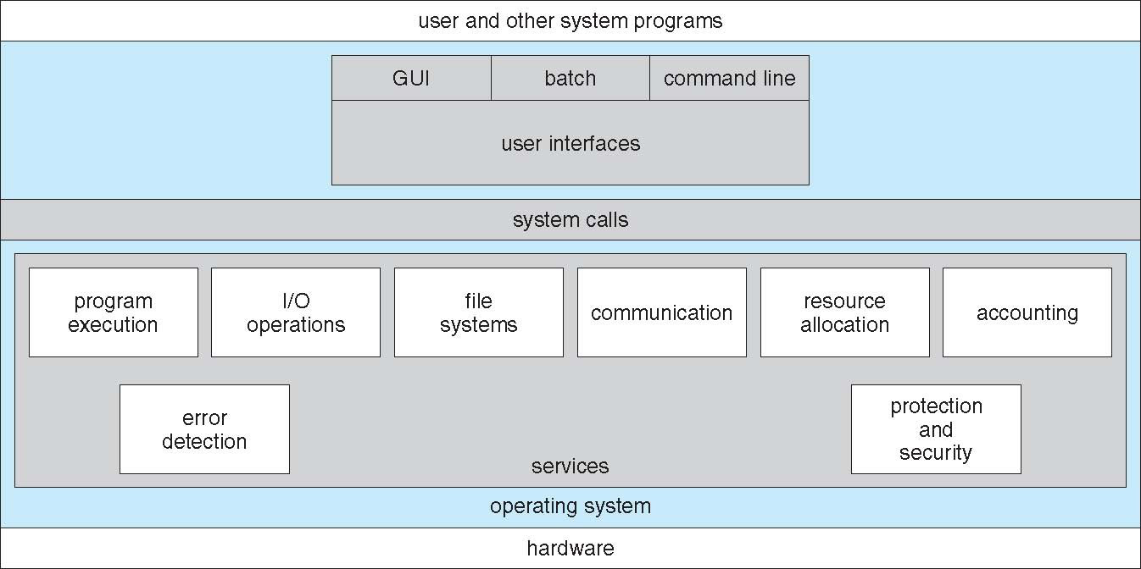
HW Architecture and OS Services

Slide 18
OS Services: I/O Management
Each device controller is in charge of a particular device type
Each device controller has a local buffer/control regs
CPU moves data from/to main memory to/from local buffers
Protocol: To get a byte of data from a device
  CPU sets registers in controller with command to read e.g. character from keyboard
  I/O is from the device to local buffer of controller
  Device controller informs CPU that it has finished its operation by causing an interrupt
  CPU moves data from controller to memory
I/O devices and the CPU can execute concurrently
Notes:
Interrupt
1. an external event raised by hardware: e.g. I/0
2. an internal event trigger by software: e.g. system calls
Interrupt Handler
an subroutine in the operating system to process a particulartype of interrupt
Interrupt Vector
an array of starting addresses of interrupt handlers
The index for a particular interrupt to the array is provided bythe hardware.

Slide 19
OS Services: I/O Management
Each device controller is in charge of a particular device type
Each device controller has a local buffer/control regs
CPU moves data from/to main memory to/from local buffers
Protocol: To get a byte of data from a device
  CPU sets registers in controller with command to read e.g. character from keyboard
  I/O is from the device to local buffer of controller
  Device controller informs CPU that it has finished its operation by causing an interrupt
  CPU moves data from controller to memory
I/O devices and the CPU can execute concurrently
Notes:
Interrupt
1. an external event raised by hardware: e.g. I/0
2. an internal event trigger by software: e.g. system calls
Interrupt Handler
an subroutine in the operating system to process a particulartype of interrupt
Interrupt Vector
an array of starting addresses of interrupt handlers
The index for a particular interrupt to the array is provided bythe hardware.

Slide 20
I/O
I/O Techniques
  Programmed I/O: processor interacts with I/O module directly
    issues I/O commands to I/O module
    interrogates status bits repeatedly (Pooling)
    reads or writes: transfers the data between CPU and I/O module
  Interrupt-Driven I/O: I/O module interrupts when I/O module is ready
    issues I/O commands to I/O module
    goes off to run other processes (doing something else)
    get interrupted when I/O module is ready and reads or writes in interrupt handlers
Direct Memory Access (DMA): A separate module called DMA module takes care of the interrupt from I/O and data transfer
  Processor sends request to DMA (starting address, number of bytes, address of I/0 device, read or write)
  DMA interacts with I/O module and completes the bulk transfer
  DMA interrupts processor when done

Slide 21
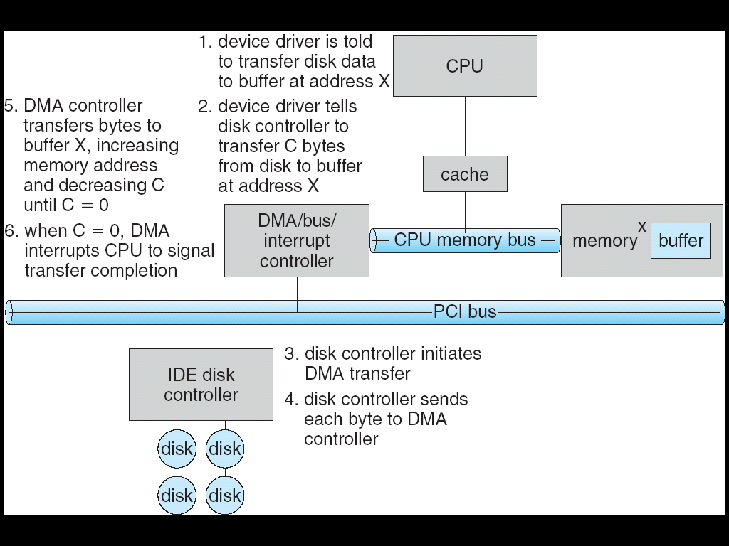
Six Step Process to Perform DMA Transfer

Slide 22
Direct Memory Access Structure
Used for high-speed I/O (e.g. networking card 1G/sec) devices able to transmit information at close to memory speeds
Device controller transfers blocks of data from buffer storage directly to main memory without CPU intervention
Only one interrupt is generated per block, rather than the one interrupt per byte. Block size varies from device to device.

Slide 23
Interrupts
Interrupt
  1. an external event raised by hardware: e.g. I/0
  2. an internal event trigger by software: e.g. system calls (means application needs a service from the OS. It calls a service). TRAP
Interrupt Handler
  a subroutine in the operating system to process a particular type of interrupt
Interrupt Vector
  an array of starting addresses of interrupt handlers
  The index for a particular interrupt to the array is provided
  by the hardware.
IR
(printer)
IR
(Keyboard)
Interrupt Vector
Memory

Slide 24
CPU/Device Interaction: Interrupts
Interrupt transfers control to the interrupt service routine (ISR) generally, through the interrupt vector, which contains the addresses of all the service routines. ISR is identified by address in interrupt vector
Interruption handling (overhead)
  Interrupt architecture must save the address of the interrupted instruction
  After servicing interrupt, CPU resumes execution at previously interrupted address (or “flow of control”)

Slide 25
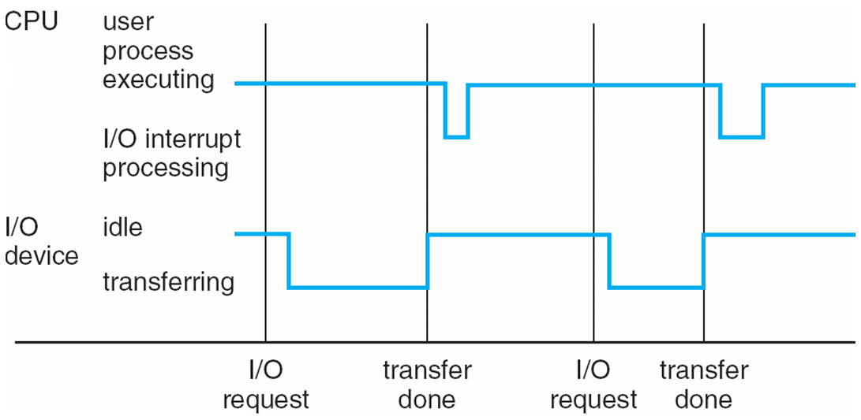
CPU/Device Interaction: Interrupts

Slide 26
Interrupt Handling
Separate segments of code determine what action should be taken for each type of interrupt
Incoming interrupts are disabled while another interrupt is being processed to prevent a lost interrupt
An operating system is interrupt driven

Slide 27
I/O Structure - I/O Device driver
Operating systems have a device driver for each I/O controller.
  It understands the device controller (hide the peculiarities of the device)
  presents a uniform interface of the device to the rest of the operating system.

Slide 28
I/O Structure - I/O Device driver
To get a service from a device driver application make
  System call – request to the operating system to allow user to wait for I/O completion
    Device-status table contains entry for each I/O device indicating its type, address, and state

Slide 29
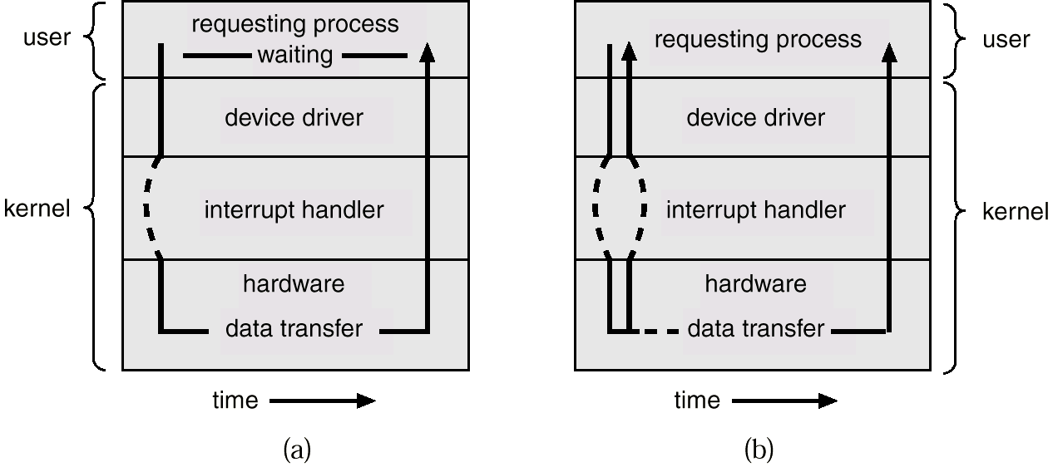
I/O Structure- Sync and Async I/O
Synchronous : After I/O starts, control returns to user program only upon I/O completion
Asynchronous: After I/O starts, control returns to user program without waiting for I/O completion
Synchronous
Asynchronous

Slide 30
How a Modern Computer Works
- CPU : unit where instructions are Executed
- Memory: storage where both program and data are stored
I/O subsystem: unit to input and output data
- Instruction Execution Cycle
do forever
1. fetch next instruction
2. execute the instruction
3. check and process interrupt

Slide 31
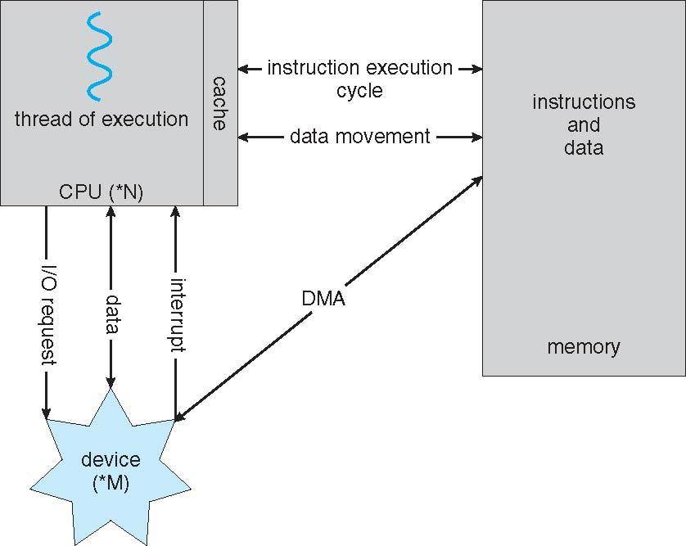
How a Modern Computer Work

Slide 32
Storage Structure
Main memory – only large storage media that the CPU can access directly.
Secondary storage – extension of main memory that provides large nonvolatile storage capacity.
Magnetic disks – rigid metal or glass platters covered with magnetic recording material
  Disk surface is logically divided into tracks, which are subdivided into sectors.
  The disk controller determines the logical interaction between the device and the computer.

Slide 33
Storage Hierarchy
Storage systems organized in hierarchy.
  Speed
  Cost
  Volatility
Caching – copying information into faster storage system; main memory can be viewed as a last cache for secondary storage.

Slide 34
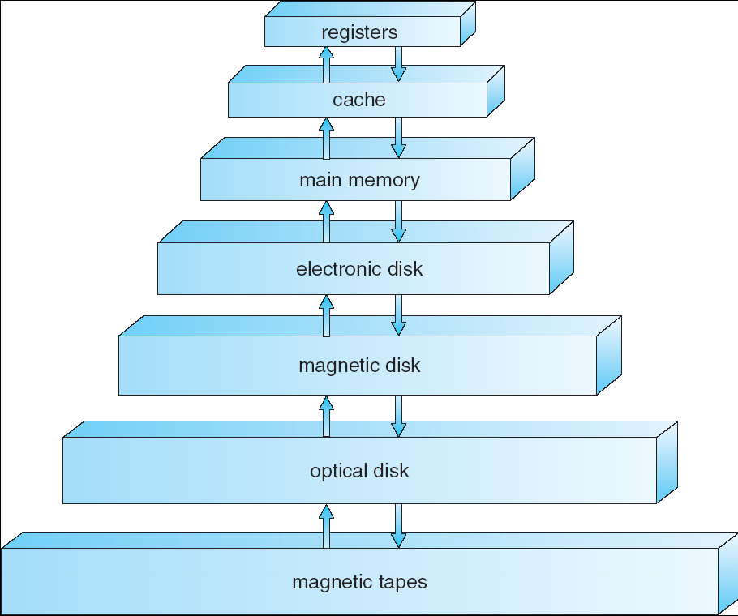
Storage-Device Hierarchy

Slide 35
Caching
Important principle, performed at many levels in a computer (in hardware, operating system, software)
Information in use copied from slower to faster storage temporarily
Faster storage (cache) checked first to determine if information is there
  If it is, information used directly from the cache (fast)
  If not, data copied to cache and used there
Cache smaller than storage being cached
  Cache management important design problem
  Cache size and replacement policy

Slide 36
Computer-System Architecture
Most systems use a single general /special-purpose processor
Multiprocessors systems growing in use & importance
  Advantages
    Increased throughput
    Economy of scale
    Increased reliability
  Two types
    Asymmetric Multiprocessing
    Symmetric Multiprocessing

Slide 37
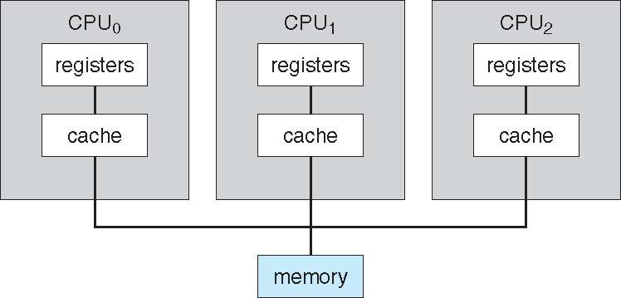
Symmetric Multiprocessing Architecture

Slide 38
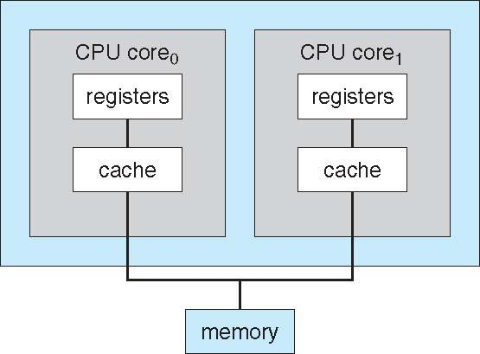
A Dual-Core Design

Slide 39
End lecture 1
Thank You

