Slide 1



Project Business
Analysis
PMG 461 – MGM 461
Lecture 10
Delivering Requirements and Managing Changes
Prepared by
Eng. Ahmed Hussein, MBA, PfMP©, PMP©, CMP APMG

Slide 2

Lecture
What we will cover
10
Delivering Requirements
Managing Changes to Requirements
Managing the Human Side of Change
10 – 2

Slide 3


Delivering Requirements
Lecture
10
10 – 3

Slide 4
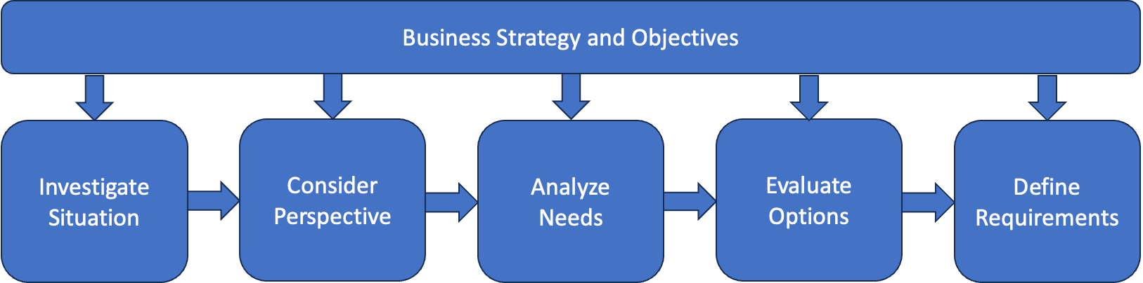
In Previous Lectures
Pre-Project
Project
Elicitation
10 – 4

Slide 5
Business Change Lifecycle
for Delivering Projects
Lecture
10
Business Case
Alignment
Definition
Design
Implementation
Testing/Quality Control
Realization
10 – 5

Slide 6


Agile vs. Traditional Lifecycle
Traditional: Requirements Engineering is performed at the beginning of the project
Agile : Requirements Engineering is done throughout the project
Plan
Develop
Test
Final Outcome
Deploy
Classic/Traditional/Predictive/Waterfall Approach
Project Timeline
Agile/Incremental/Iterative Approach
Iteration 1
Iteration 2
Iteration 3
………….
Iteration N
Develop
Test
Develop
Test
Develop
Test
Develop
Test
Plan
Deploy
Plan
Deploy
Plan
Deploy
Plan
Deploy
Intermediate Outcome
Intermediate Outcome
Intermediate Outcome
Final Outcome
10 – 6

Slide 7
Lecture
Agile vs. Traditional Lifecycle
10
 | Waterfall | Agile
Requirements | Fixed | Dynamic
# of Deliveries | Single delivery | Frequent small deliveries
Activities | Performed once for the entire project | Repeated until correct
Goal | Manage cost | Customer value via frequent deliveries and feedback
Change | Constrained as much as possible | Incorporated in real-time delivery
Stakeholders | Involved at specific milestones | Continuously involved
Risks and Costs | Controlled by detailed planning or mostly knowable considerations | Controlled as requirements and constraints emerge
Source: Project Management Institute, Agile Practice Guide, Project Management Institute Inc., 2017, Page 18.
10 – 7

Slide 8
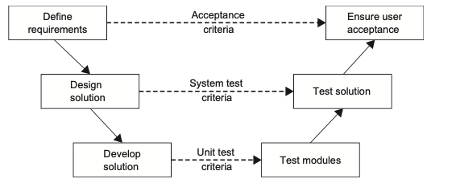
Lecture
Other Lifecycles
10
Adaptive
Halfway between traditional and agile
Hybrid
Mixing Traditional and Agile
V-Lifecycle
V-Lifecycle
10 – 8

Slide 9
Lecture
Factors Impacting the Lifecycle
10
Context
Nature of organization and the project
Lifecycle and Approach
process, methods, and standards adopted for developing and implementing the solution
Roles
key roles in the project;
Deliverables
Products or services to be delivered
Techniques
Management and development techniques used to plan, analyze and document work.
10 – 9

Slide 10
Business Analyst Role in
Delivering Requirements (1 / 3)
Lecture
10
Facilitating Communication
  Act as a liaison between stakeholders, including business users, developers, and project managers, to ensure clear communication of requirements throughout the implementation process.
Stakeholder Engagement
  Maintain ongoing communication and collaboration with stakeholders to address concerns, resolve issues, and ensure satisfaction with the delivered solution.
Requirement Traceability
  Establish traceability between business requirements, system specifications, and test cases to ensure that all requirements are adequately addressed in the final solution.
10 – 10

Slide 11
Business Analyst Role in
Delivering Requirements (2 / 3)
Lecture
10
Acceptance Testing/Quality Control
  Collaborate with stakeholders to define acceptance criteria and participate in acceptance testing to verify that the implemented solution meets business requirements and quality standards.
Requirement Verification
  Verify requirements with stakeholders through reviews, walkthroughs, and demonstrations to ensure accuracy, completeness, and alignment with expectations.
Requirement Engineering for New Requirements
  New or modified requirements elicitation, prioritization, documentation, and validations.
10 – 11

Slide 12
Business Analyst Role in
Delivering Requirements (3 / 3)
Lecture
10
Change Management
  Manage changes to requirements throughout the implementation process, assessing their impact on scope, schedule, and budget, and obtaining stakeholder approval as needed.
Continuous Improvement:
  Identify opportunities for improvements and enhancements based on lessons learned, aiming to optimize future projects and deliver greater value to the organization.
10 – 12

Slide 13
Lecture
Roles in Execution based on Lifecycle
10
Traditional
Agile
Project Manager
Business Analyst
Architect/Designer
Developer/Team Member
Tester /Quality Control
Product Owner: Business representative
Team Leader/Agile Coach/Project Manager
Team Member: team is 5-9 people, cross-functional or T-Shaped
10 – 13

Slide 14
Lecture
Testing/Quality Control
10
Based upon
Use Case Scenarios (Traditional)
User Stories in (Agile)
Role of Business Analyst
Develop Use case scenarios or user stories
Detail Acceptance criteria
Participate in testing
Facilitate testing between stakeholders (or end users) and technical teams
10 – 14

Slide 15
Lecture
Verification of Requirements
10
Performed after Testing results and involves Stakeholders to confirm requirement is met
Business analyst with technical team, might do a demo, walkthrough or test.
Uses Requirements Traceability Matrix as bases, and verification results are recorded in it.
Requirement Information |  |  | Relationship Traceability
ID | Requirement | Source | Business Objective | Deliverable | Verification | Validation
Unique ID for requirement | Description of the requirement | Name Of person who identified the requirements | List the business objective that is met by fulfilling the requirement. | Identify the deliverable that is associated with the requirement. | Describe the metric that is used to measure the satisfaction of the requirement. | Describe the technique that will be used to validate that the requirement meets the stakeholder needs.
10 – 15

Slide 16
Managing Changes to Requirements
Lecture
10
10 – 16

Slide 17
Lecture
Requirements Changes in Execution?
10
Why?
Unforeseen Needs
Shifting priorities
Evolving stakeholder expectations
What?
New Requirements
Modify Requirements
Remove Requirement
10 – 17

Slide 18
How to Handle Requirement Changes?
Lecture
10
Assessing the impact of modifications
Obtaining appropriate approvals
Implementing adjustments
Minimizing disruption
“any change with the potential to affect the main project baselines—scope, cost, schedule, and quality—necessitates careful analysis through a change management process”.
10 – 18

Slide 19
Change Management Process
Change Identification
Identify the need for changes to the project and the reason such as new requirements, unexpected events, or shifts in priorities.
Change Assessment
Perform Impact Assessment of Change on Scope, Solution. Schedule, Budget, Quality and Risk
Change Evaluation
Change Board reviews Change Request
They can Approve/Reject/Defer Change
Fill the Assessment in a Change request Form
Change Documentation and Communication
Adjust solution and requirements document based on new change
Implement
Implement Change
Communicate Change to all relevant stakeholders and team members
Monitor and Evaluate results
10 – 19

Slide 20
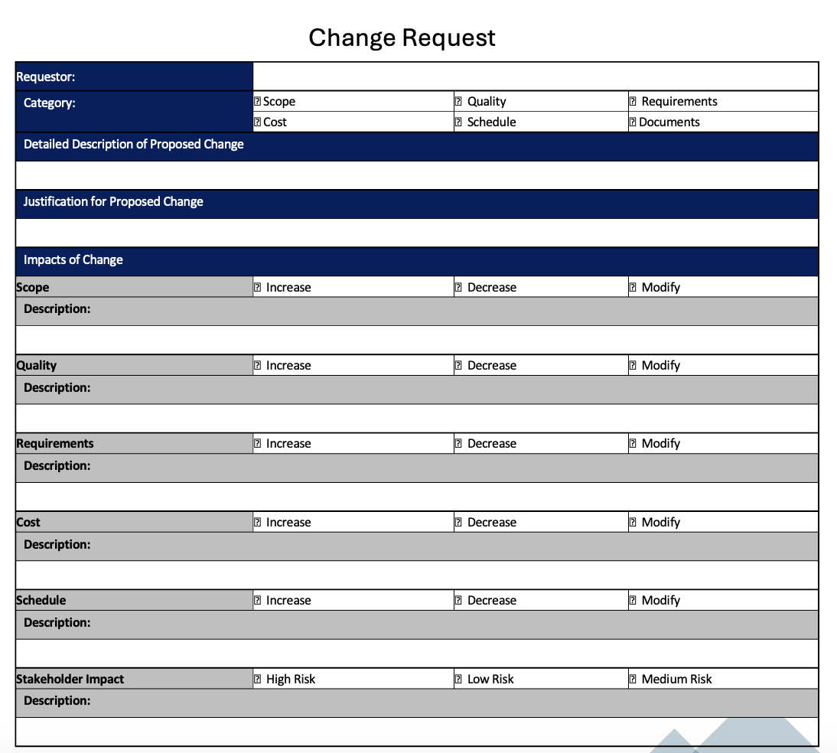
Change Request Form
A change request is a formal document submitted to project sponsor or relevant stakeholders to request modifications in the project.
Change requests include rationale for the change, impact on project objectives, potential risks, required resources, and any supporting documentation.
Change requests are subject to review and approval or rejection.
10 – 20

Slide 21
Lecture
Change Log Form
10
A change log is a document that records and tracks all changes made to a project over its lifecycle.
Captures information as description, status, approval status, implementation details, and any associated comments or notes.
Serves as a centralized repository for documenting and managing changes.
It enables project stakeholders to monitor the status of change requests.
10 – 21

Slide 22
Managing the Human Side of Change
Lecture
10
10 – 22

Slide 23
Lecture
The four views of a Business System
10
Business System A set of business components working together in order to achieve a defined purpose. The components of a system include people, IT systems, processes and equipment.
Change Management:
Training
Communication
Support
Organization
Technology
People
Processes
10 – 23

Slide 24
Lecture
Mckinsey 7s Framework
10
STRUCTURE
Organization is made up of 7 interacting elements.
These components might need to change to fill the gap between current and future state.
Analyze the 7 components and determine changes needed to fill the gap.
Hard Elements: Strategy, Structure, and Systems
Soft Elements: Shared Values, Skills, Style, Staff
STRATEGY
SYSTEMS
SHARED
VALUES
SKILLS
STYLES
(of Leadership)
STAFF
10 – 24

Slide 25
Lecture
Projects Deliver Change
10
Value/ Benefits
Current State
Desired State
Change
Time
Change is the transition from a current state to a future desired state to achieve required business value/benefits..
10 – 25

Slide 26
Lecture
What is Change Management?
10
“A structured approach for transitioning individuals, groups, and organizations from a current state to a future state with intended business results.”
Change management is a discipline that guides how we prepare, equip and support individuals to successfully adopt change in order to drive organizational success and outcomes.
Change Management makes sure that Change is Embraced, Adopted and used by the people impacted by the change
10 – 26

Slide 27
Lecture
10
Many projects fail because of People’s Resistance to Change
Project Management + Change Management = SUCCESS
Technical Side (Project Management)
Current State
Desired State
Design, Develop, Deliver
Results
Outcomes
Success
People Side (Change Management)
Embrace, Adopt, Use
Adapted from Prosci®, https://www.prosci.com/
10 – 27

Slide 28
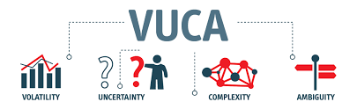
Why do Organizations Embark on new
Projects to Change?
Lecture
10
Business Environment is Changing at a Rapid Pace
(changes in PESTLE Factors)
Organizations need to change to align to changing environment and stay relevant and competitive.
10 – 28

Slide 29
How Change is Perceived in Individuals
(The Change Curve)
The Change Curve (Kubler-Ross Negative Change Curve)
The Change Curve helps you understand the phases people pass by during Change.
The intensity and duration of each phase differs according to the personality type and his perceived impact of the change.
We should provide support to people through the different stages to help them move faster to integration
10 – 29

Slide 30
Lecture
Kotter’s 8 Steps to Lead Change
10
Establishing a sense of urgency
Forming a powerful guiding coalition
Creating a vision
Communicating the vision
Empowering others to act on the vision
Planning for and creating short-term wins
Consolidating improvements and producing still more change
Institutionalizing new approaches
10 – 30

Slide 31
Lecture
The 5 Pillars of Change Management
10
Change Management Pillars
Sponsor Roadmap
Stakeholder Engagement
Communication
Training and Coaching
Resistance Management
What do we need from executive sponsors(s)?
When? With whom? How?
Who are the stakeholders?
What are the needs/requirements?
How can we engage them in the project?
What messages we need to deliver? To whom?
When? How? How often?
Who needs training or coaching?
On what? How? And when?
Who will resist? How? Why? and
How can we overcome this resistance?
10 – 31

Slide 32
“Stages of Concern”
Getting people to accept the change requires time and effort
Stage 6: Refocus/Refine
“How can we implement improvements?”
Stage 5: Collaboration
“How can I help others with the change?”
Stage 4: Consequences
“What are the benefits for the business?”
“What will the overall impact of the change be?”
Stage 3: Management
“How will this change be accomplished”
Stage 2: Personal
“How will the change affect me and my job?”
”How will I be evaluated?”
Stage 1: Information
“How does it work?”
Stage 0: Awareness
“What is it?”
10 – 32

Slide 33
Tailor Messages for needs
of each stakeholder
Lecture
10
Why are we changing?
What are benefits?
Change vision
What does this mean for you?
What is changing and when?
10 – 33

Slide 34
Guidelines for Overcoming
Resistance to Change
Lecture
10
Awareness and Education
Educate and inform individuals about the necessity and positive impact of change.
Effective Communication
Clearly articulate the vision and goals of change. Respect individuals' opinions and concerns, foster dialogue and build understanding.
Highlight Personal Benefits
Emphasize how change can personally benefit individuals and improve their lives.
Provide Support and Training
Offer appropriate support and training to equip individuals with necessary skills and resources to adapt successfully.
Engagement of Individuals
Involve individuals in decision-making and change planning processes to increase their readiness to accept and work towards change.
10 – 34

Slide 35
Guidelines for Overcoming
Resistance to Change
Lecture
10
Motivation and Reward
Use motivation and rewards to incentivize individuals to accept and adapt to change.
Planning and Organization
Develop a clear and organized plan for implementing change, outlining required steps and tasks to minimize confusion and resistance.
Adaptation Skills Training
Provide training on skills such as creative thinking, problem-solving, and strategic analysis to enhance individuals' ability to adapt to change.
Patience and Flexibility
Be patient and flexible to navigate challenges and difficulties that may arise during the change process.
Demonstration of Positive Role Models
Leaders and influential individuals should exemplify positive attitudes towards change, inspiring others to accept and work towards it.
10 – 35

Slide 36
Lecture
Key Points
10
Business Analyst role is involved throughout execution in various activities as facilitating communication, stakeholders engagement, requirements traceability and verifications, and requirements change management.
The role and activities for the business analyst differs between Traditional and Agile Lifecycles.
Requirements Traceability Matrix is the main document used to monitor and control requirements.
Requirements Changes that leads to changes in scope, schedule, cost or quality need to a follow a formal change request process.
Business analyst participate and contribute to managing the human side of the project through continuous communication with stakeholders.
Key principles we need to follow in change management as understanding the change curve, following Kotter’s 8 step model, communicating effectively , and applying techniques to overcomes resistance.
10 – 36

Slide 37

For Discussion Panel:
Watch the video “Who Moved My Cheese”
Reading, Chapters 12 “Delivering the Requirements” and 14 “Implementing Business Change”
from textbook “Business Analysis” by James Cadle, Malcolm Eva, Keith Hindle, Debra Paul, 2nd edition
Lecture
10
For Discussion Panel and Next Lecture
10 – 37

Slide 38
This is only the Beginning of the Journey NOT the End!
Business Analysis a dynamic and growing discipline that is continuously adapting and evolving in response to changing project management requirements. The Business Analysis role is expanding offering great career prospects for practitioners.
10 – 38

Slide 39


Main Business Analysis Organizations and Certifications
Lecture
10
The PMI Guide to Business Analysis
A Guide to the Business Analysis Body of Knowledge by IIBA
PMI Professional in Business Analysis (PMI-PBA)®
Certified Business Analysis Professional (CBAP®)
10 – 39

Slide 40



Thank You

