Slide 1



Business law
Prepared by Dr. Galal Elmasry
LAW26
Lecture Introductory

Slide 2



Business law
Lecture Introductory
LAW26
Prepared by
Dr. Galal Elmasry
www.midocean.ae

Slide 3


Chapter
01
Welcome speech to students:
Dear students,
I am excited to welcome you all at the start of the third semester of the 2023 academic year at the Faculty of Management, Midocean University!
It brings me great joy to teach you Business Law, which will allow us to learn together the fundamental concepts and principles of this vital field. We will cover legal terms, sources of business law, contracts, companies, consumer protection and labor laws.
I hope you find this course worthwhile in gaining valuable knowledge and honing useful skills in a pillar of business management. I am eager to answer your questions and ensure you reap maximum benefits from this course.
Let us make the most of this semester. I wish you a productive and successful one ahead!
Sincerely
www.midocean.ae

Slide 4
Lecture Introductory
Introductory Lecture in Business Law Course
The most important main themes of the lecture:
1- Introducing the students to the course description.
2- The themes included in the course.
3- The general cognitive and skill objectives of the course.
4- The targeted educational outcomes of the course.
5- The most important teaching strategies in the course.
6-The key recommended references and resources for the course.
7- Assessment methods and course evaluation. .
www.midocean.ae

Slide 5
Lecture Introductory
1- Introducing the students
to the course description:
Business Law is a foundational course that provides an overview of the legal concepts, principles, and frameworks relevant to business activities and transactions. The course aims to equip students with core legal knowledge to understand the regulatory environment in which businesses operate.
We will cover a wide range of key topics in business law, including the basics of the legal system, the law of contracts and torts, different forms of business organizations, employment law, intellectual property rights, and other emerging legal issues impacting business.
www.midocean.ae

Slide 6
Lecture Introductory
1- Introducing the students
to the course description:
Through discussions of cases, laws, and real-world scenarios, the course will expose students to business legal practices and how to effectively manage legal risks and obligations. Students will gain practical knowledge to identify legal issues, understand compliance requirements, and make business decisions while considering the legal implications.
By the end of this course, students will have developed legal literacy and analytical skills to apply legal principles to business situations. The course will provide a strong foundation for those pursuing careers in business management, accounting, marketing, human resources, and other commercial fields.
I look forward to exploring the interesting world of business law together! Please feel free to ask any questions you may have about the course content and structure.
www.midocean.ae

Slide 7
Lecture Introductory
2- The main topics covered in the course:
Chapter 1 - Basic Terms in Law.
Chapter 2 - Definition, Sources and Subjects of Business Law.
Chapter 3 - Basic Law of Obligations.
Chapter 4 - Companies and Business Entities.
Chapter 5 - Consumer Law.
Chapter 6 - Business Organizations.
Chapter 7 - Workplace Privacy and Information Security.
Chapter 8 - Employment Law.
Chapter 9 - Credit Transactions and IP Rights.
Chapter 10 - Competition Law.
www.midocean.ae

Slide 8

Lecture Introductory
3- The general cognitive and skill objectives of the course:
*Cognitive Objectives:
Understand the foundations of the legal system including key terminology, court structure, sources of law, and dispute resolution.
Learn the elements required to form different types of legally binding contracts.
Recognize the characteristics and legal implications of various forms of business organizations.
Identify the key regulations related to consumer protection, employment, and intellectual property.
Develop knowledge of government oversight and compliance matters such as antitrust law.
www.midocean.ae

Slide 9
Lecture Introductory
3- The general cognitive and skill objectives of the course:
* Skill Objectives:
Improve ability to read and analyze laws, contracts, and regulatory policies.
Enhance critical thinking to weigh legal risks in business situations.
Strengthen problem-solving skills to make lawful decisions and avoid legal disputes.
Refine written and verbal communication skills to explain legal issues clearly.
Cultivate research abilities to find reliable legal resources and apply laws appropriately.
Gain real-world legal knowledge to handle on-the-job business scenarios.
www.midocean.ae

Slide 10
Lecture Introductory
3- The general cognitive and skill objectives of the course:
- By accomplishing these cognitive and skill goals, students will build a strong foundation in core concepts and applications of business law. This will equip them with legal literacy to navigate the regulatory environment for organizations and commercial transactions.
www.midocean.ae

Slide 11
Lecture Introductory
4- The targeted learning outcomes of the course:
-Here are the key targeted learning outcomes for students in this Business Law course:
Demonstrate understanding of legal terminology and the court systems
Explain the elements required to form a legally binding contract
Distinguish between different business structures and recommend an appropriate form based on case factors
Draft basic contracts for goods, services, and employment agreements
Identify intellectual property protections and determine infringement issues.
Discuss employment laws related to hiring, discrimination, safety, benefits, and termination.
www.midocean.ae

Slide 12
Lecture Introductory
4- The targeted learning outcomes of the course:
-Here are the key targeted learning outcomes for students in this Business Law course:
7-Summarize regulations pertaining to consumer protection, environmental compliance, antitrust, etc.
8- Analyze a business scenario, identify legal risks and liabilities, and propose lawful solutions.
9- Find relevant legal sources and apply the appropriate laws and regulations to business situations.
10- Communicate legal analysis clearly in written and oral formats.
11- Work effectively in teams to conduct legal research and develop compliance recommendations.
www.midocean.ae

Slide 13
Lecture Introductory
4- The targeted learning outcomes of the course:
- By achieving these outcomes, students will have the legal knowledge and analytical abilities to understand compliance requirements, avoid unnecessary risks and disputes, and make sound decisions in line with laws and regulations impacting businesses. This establishes a strong foundation for future careers interacting with legal matters.
www.midocean.ae

Slide 14
Lecture Introductory
5-The most important teaching
strategies used in the course:
1. Pre-recorded video lectures -A new lecture video will be posted at the start of each week on Saturdays covering key concepts and topics.
2. Live discussion sessions -We will have a one hour weekly discussion session to review the recorded lecture, clarify doubts, and answer your questions. This allows real-time interaction.
www.midocean.ae

Slide 15
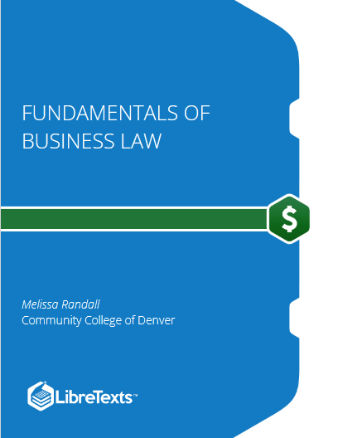
Lecture Introductory
6-The key recommended references and resources for the course:
www.midocean.ae

Slide 16
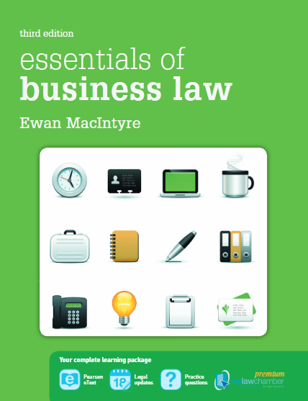
Lecture Introductory
6-The key recommended references and resources for the course:
www.midocean.ae

Slide 17
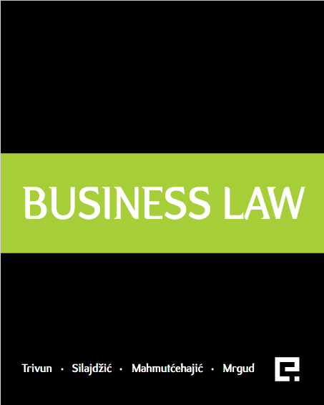
Lecture Introductory
6-The key recommended references and resources for the course:
www.midocean.ae

Slide 18
Lecture Introductory
7- Assessment methods and course evaluation:
Here are the assessment methods and course evaluation details for this Business Law course:
- This course employs a balance of ongoing and summative assessments to evaluate student learning and comprehension.
- There will be 10 weekly quizzes administered throughout the semester. Each quiz will cover key concepts from the lectures and assigned readings of that week. The quizzes aim to test understanding of definitions, principles, analytical abilities, and applications. These cumulative weekly quizzes carry a weightage of 80% towards the final grade.
www.midocean.ae

Slide 19
Lecture Introductory
7- Assessment methods and course evaluation:
Here are the assessment methods and course evaluation details for this Business Law course:
- The final exam carries a weightage of 20% of the final grade. It will be a comprehensive exam testing a broad range of topics covered over the entire semester. The exam will include multiple choice questions, short answer questions, and analytical case scenarios. This will evaluate both breadth of knowledge and depth of understanding.
- The total course grade is calculated out of a maximum of 100 marks. Grades will be assigned based on absolute performance using a prescribed grading scheme. The assessment methods aim to be fair, consistent, and aligned to the learning objectives. Feedback will be provided regularly to aid improvement.
www.midocean.ae

Slide 20


Thank You

