Slide 1



Discrete Mathematics
Dr. Shahira Ahmed
IT241
Lecture 1

Slide 2



Discrete Mathematics
Lecture 1
Basic Structures:
Sets,Tuples
Dr. Shahira Azab
www.midocean.ae

Slide 3
Lecture Outline
Definition of sets
Describing Sets
  Roster Method
  Set-Builder Notation
Some Important Sets in Mathematics
Empty Set and Universal Set
Subsets and Set Equality
Cardinality of Sets
Set Operations
Tuples
Cartesian Product

Slide 4
Motivations
Important for Counting.
Programming languages and Databases have set operations.
Data structure.

Slide 5

Sets Examples

Slide 6


Sets Examples

Slide 7
Sets
A set is an unordered collection of objects.
  the students in this class
The objects in a set are called the elements, or members of the set.
The notation a ∈ A denotes that a is an element of the set A.
If a is not a member of A, write a ∉ A

Slide 8
Describing a Set: Roster Method
S = {a,b,c,d}
Order not important
S = {a,b,c,d} = {b,c,a,d}
Ellipses (…) may be used to describe a set without listing all of the members when the pattern is clear.
S = {a,b,c,d, ……,z }
Repetition is not important
S = {a,b,c,d} = {a,b,c,b,c,d}

Slide 9
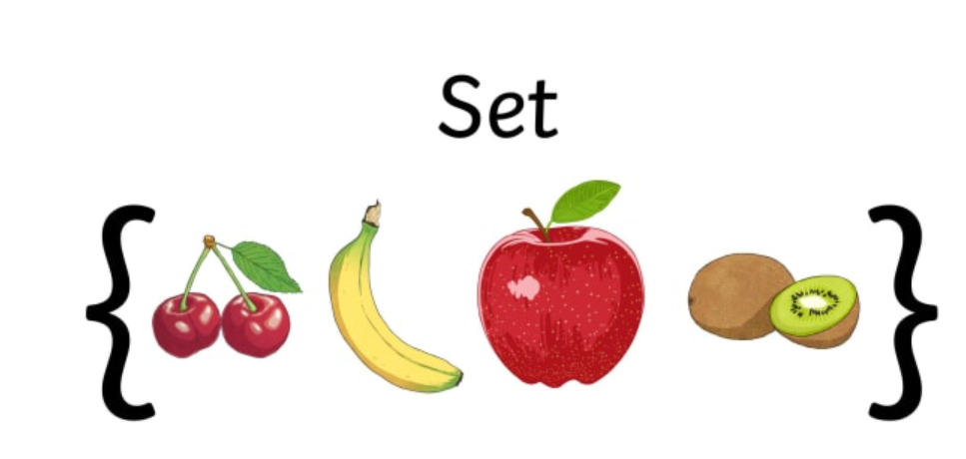
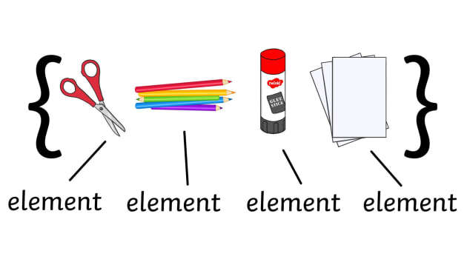
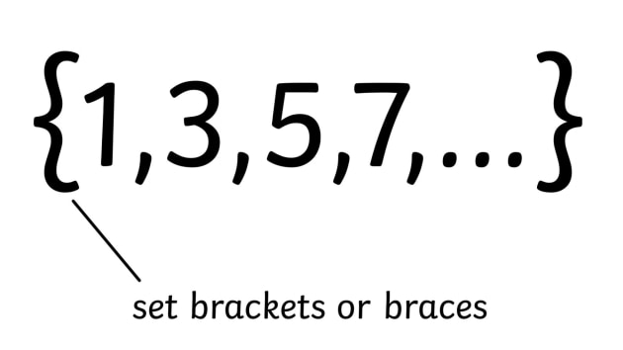
Roster Method

Slide 10
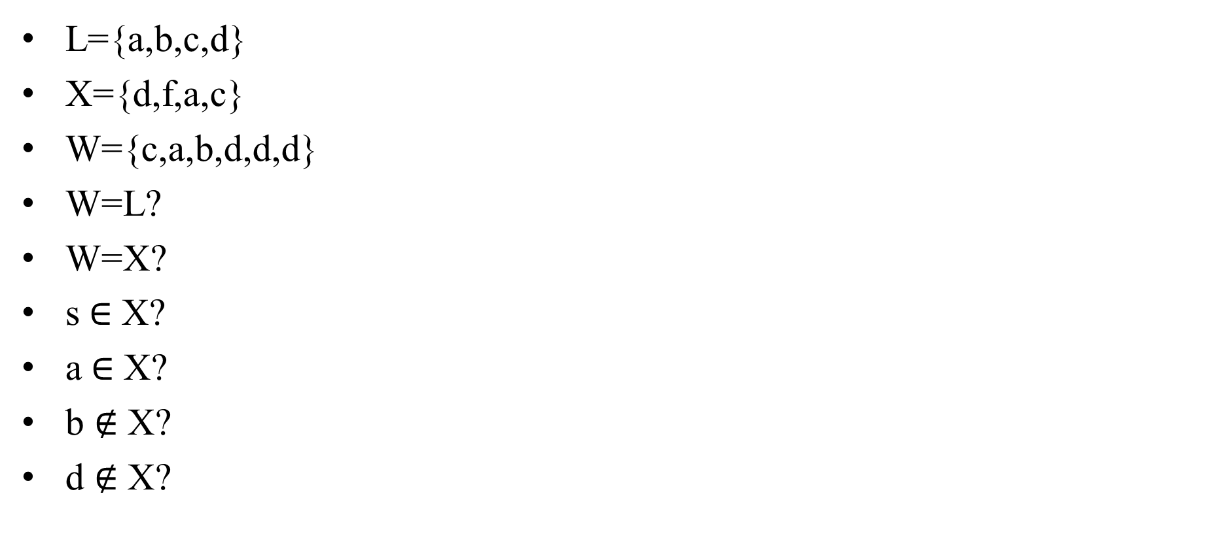
Quiz
L={a,b,c,d}
X={d,f,a,c}
W={c,a,b,d,d,d}
W=L?
W=X?
s$∈$ X?
a$∈$ X?
b $∉$ X?
d $∉$ X?

Slide 11
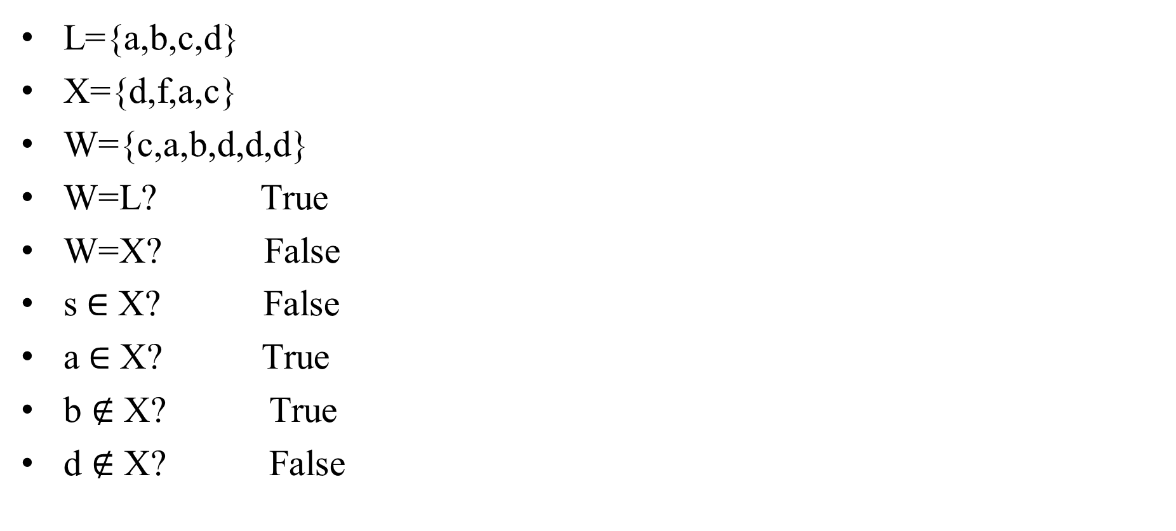
Quiz
L={a,b,c,d}
X={d,f,a,c}
W={c,a,b,d,d,d}
W=L? True
W=X? False
s$∈$ X? False
a$∈$ X? True
b $∉$ X? True
d $∉$ X? False

Slide 12
Quiz
List using Roster Method
  Set of all vowels in the English alphabet:
  Set of all odd positive integers less than 10:
  Set of all positive integers less than 100:
  Set of all integers less than 0:

Slide 13
Quiz
Set of all vowels in the English alphabet:
V = {a,e,i,o,u}
Set of all odd positive integers less than 10:
O = {1,3,5,7,9}
Set of all positive integers less than 100:
S = {1,2,3,……..,99}
Set of all integers less than 0:
S = {…., -3,-2,-1}

Slide 14
Some Important Sets
N = natural numbers = {0,1,2,3….}
Z = integers = {…,-3,-2,-1,0,1,2,3,…}
Z⁺ = positive integers = {1,2,3,…..}
R = set of real numbers
R⁺ = set of positive real numbers

Slide 15
Set-Builder Notation
Specify the property or properties that all members must satisfy:
S = {x | x is a positive integer less than 100}
O = {x | x is an odd positive integer less than 10}
O = {x ∈ Z⁺ | x is odd and x < 10}

Slide 16
Interval Notation
[a,b] = {x | a ≤ x ≤ b}
[a,b) = {x | a ≤ x < b}
(a,b] = {x | a < x ≤ b}
(a,b) = {x | a < x < b}
closed interval [a,b]
open interval (a,b)
[a,b] = {x | a ≤ x ≤ b}
[a,b[ = {x | a ≤ x < b}
]a,b] = {x | a < x ≤ b}
]a,b[ = {x | a < x < b}

Slide 17
Interval Notation
[a,b] = {x | a ≤ x ≤ b}
[a,b) = {x | a ≤ x < b}
(a,b] = {x | a < x ≤ b}
(a,b) = {x | a < x < b}
closed interval [a,b]
open interval (a,b)

Slide 18
Interval Notation
[a,b] = {x | a ≤ x ≤ b}
[a,b) = {x | a ≤ x < b}
(a,b] = {x | a < x ≤ b}
(a,b) = {x | a < x < b}
closed interval [a,b]
open interval (a,b)
[a,b] = {x | a ≤ x ≤ b}
[a,b[ = {x | a ≤ x < b}
]a,b] = {x | a < x ≤ b}
]a,b[ = {x | a < x < b}

Slide 19
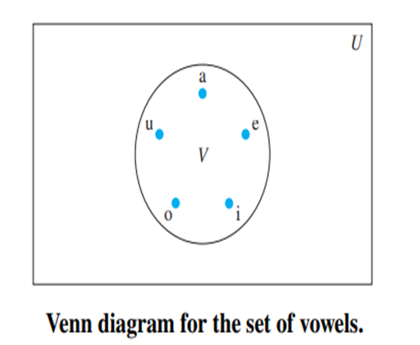
Universal Set and Empty Set
The universal set U is the set containing everything currently under consideration.
The empty set(null set) is the set with no elements. ∅, {}

Slide 20
Venn Diagram
Sets can be represented graphically using Venn diagrams, named after the English mathematician John Venn, who introduced their use in 1881

Slide 21
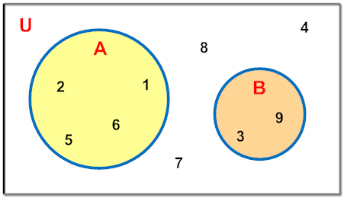
Quiz
A = {1, 2, 5, 6} and
B = {3, 9}
U= {1, 2, 3, 4, 5, 6, 7, 8, 9},
DISJOINT SETS

Slide 22
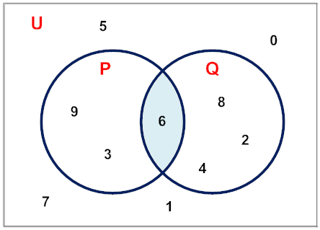
Quiz
P= {3,6,9} and
Q = {2,4,6,8}
U= {3,6,9,2,4,8,0,1,5,7}
JOINT SETS

Slide 23
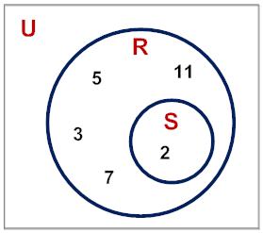
Quiz
R = {2,3,5,7,11} and
S = {2}
U= {2,3,5,7,11}
SUBSETS

Slide 24
Remember
Sets can be elements of sets.
A= {{1,2,3},a, {b,c}}
The empty set is different from a set containing the empty set.
∅ ≠ { ∅ }

Slide 25
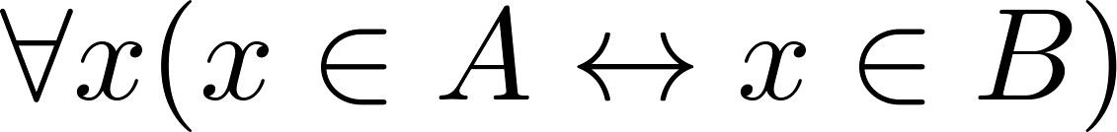
Set Equality
Two sets are equal if and only if they have the same elements.
  We write A = B if A and B are equal sets.
{1,3,5} = {3, 5, 1}
{1,5,5,5,3,3,1} = {1,3,5}
  if A and B are sets, then A and B are equal if and only if

Slide 26
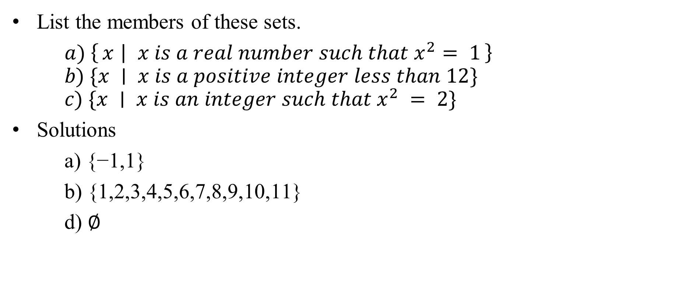
Quiz
List the members of these sets.
$a) \left\{x ∣ x is a real number such that x^{2}= 1\right\}$
$$b) \{x ∣ x is a positive integer less than 12\}$$
$$c) \{x ∣ x is an integer such that x^{2} = 2\}$$
Solutions
a) {−1,1}
b) {1,2,3,4,5,6,7,8,9,10,11}
d) ∅

Slide 27
Quiz
Which of the intervals
(0, 5), (0, 5], [0, 5), [0, 5], (1, 4], [2, 3], (2, 3)
contains 0?
Solution
[0, 5), [0, 5]

Slide 28
Quiz
Which of the intervals
(0, 5), (0, 5], [0, 5), [0, 5], (1, 4], [2, 3], (2, 3)
contains 1?
Solution
(0, 5), (0, 5],[0, 5), [0, 5]

Slide 29

Subsets
Definition: The set A is a subset of B, if and only if every element of A is also an element of B.
  The notation A ⊆ B is used to indicate that A is a subset of the set B.
  A ⊆ B holds if and only if is true.
      a ∈ ∅ is always false, ∅ ⊆ S ,for every set S.

Slide 30
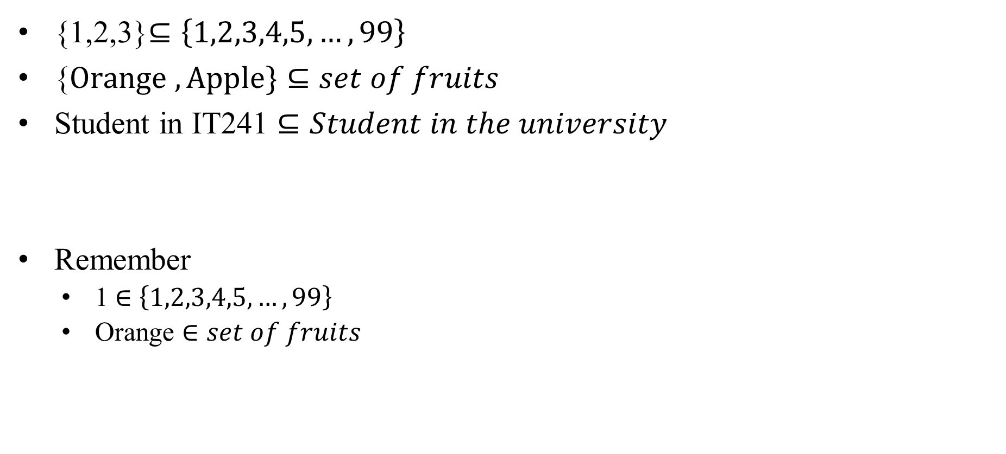
Subsets
{1,2,3}$⊆\left\{1,2,3,4,5,…,99\right\}$
{$Orange ,Apple\}⊆set of fruits$
Student in IT241 $⊆Student in the university$
Remember
  1 $∈$ $\left\{1,2,3,4,5,…,99\right\}$
  Orange $∈set of fruits$

Slide 31
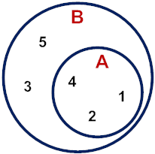
Quiz
A = {1, 2, 4} and B = {1, 2, 3, 4, 5}
A ⊆ B?
True

Slide 32
Quiz
A = {1, 2, 4} and B = {1, 2, 3, 4, 5}
A ⊆ B?
True

Slide 33
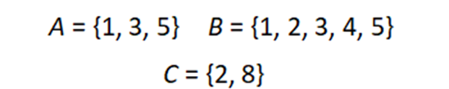
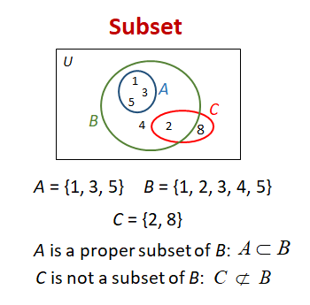
Quiz
A ⊆ B?
True
False
C ⊆ B?

Slide 34
Showing a Set is or is not a Subset of Another Set
Showing that A is a Subset of B: To show that A ⊆ B, show that if x belongs to A, then x also belongs to B.
Showing that A is not a Subset of B: To show that A is not a subset of B, A ⊈ B, find an element x ∈ A with x ∉ B. (Such an x is a counterexample to the claim that x ∈ A implies x ∈ B.)

Slide 35
Proper Subsets
Definition: If A ⊆ B, but A ≠B, then we say A is a proper subset of B, denoted by A ⊂ B. If A ⊂ B, then
is true.
Venn Diagram
U
B
A

Slide 36
Set Cardinality
Definition: If there are exactly n distinct elements in S where n is a nonnegative integer, we say that S is finite. Otherwise it is infinite.
Definition: The cardinality of a finite set A, denoted by |A|, is the number of (distinct) elements of A.
Examples:
  |ø| = 0
  Let S be the letters of the English alphabet. Then |S| = 26
  |{1,2,3}| = 3
  |{ø}| = 1
  The set of integers is infinite.

Slide 37
Power Sets
Definition: The set of all subsets of a set A, denoted P(A), is called the power set of A.
Example: If A = {a,b} then
P(A) = {ø, {a},{b},{a,b}}
Example: If A = {a,b,c} then
P(A) = {ø, {a},{b},{c},{a,b}, {a,c}, {b,c}, {a,b,c}}
If a set has n elements, then the cardinality of the power set is 2ⁿ.

Slide 38
Tuples
The ordered n-tuple (a₁,a₂,…..,a_{n}) is the ordered collection that has a₁ as its first element and a₂ as its second element and so on until a_{n} as its last element.
Two n-tuples are equal if and only if their corresponding elements are equal.
2-tuples are called ordered pairs.
The ordered pairs (a,b) and (c,d) are equal if and only if a = c and b = d.

Slide 39
Cartesian Product
Definition: The Cartesian Product of two sets A and B, denoted by
A × B is the set of ordered pairs (a,b) where a ∈ A and b ∈ B .
Example:
A = {a,b} B = {1,2,3}
A × B = {(a,1),(a,2),(a,3), (b,1),(b,2),(b,3)}

Slide 40
Cartesian Product
Definition: The Cartesian Product of two sets A and B, denoted by
A × B is the set of ordered pairs (a,b) where a ∈ A and b ∈ B .
Example:
A = {a,b} B = {1,2,3}
A × B = {(a,1),(a,2),(a,3), (b,1),(b,2),(b,3)}
B× A = {(1,a),(2,a),(3,a), (1,b),(2,b),(3,b)}

Slide 41

Quiz
Suppose that A = {1, 2}
A ×A
Solution
{1, 2} × {1, 2}
{(1,1), (1,2), (2,1), (2,2)}
$$A^{2}$$

Slide 42
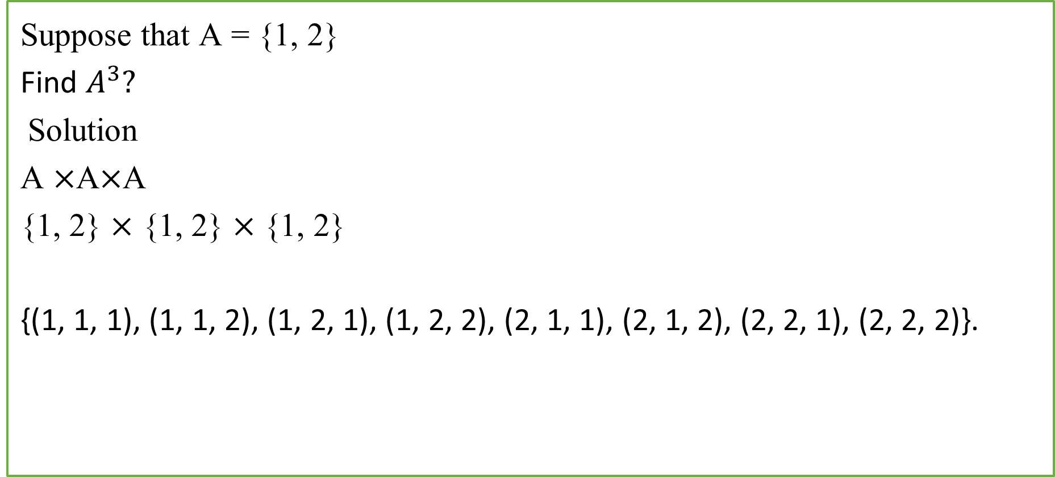
Quiz
Suppose that A = {1, 2}
Find $A^{3}?$
Solution
A ×A×A
{1, 2} × {1, 2} × {1, 2}
{(1, 1, 1), (1, 1, 2), (1, 2, 1), (1, 2, 2), (2, 1, 1), (2, 1, 2), (2, 2, 1), (2, 2, 2)}.

Slide 43
Quiz
Determine whether each of these pairs of sets are equal.
a) {1, 3, 3, 3, 5, 5, 5, 5, 5}, {5, 3, 1}
b) {{1}}, {1, {1}}
c) ∅, {∅}
Solution
Yes
No
No

Slide 44
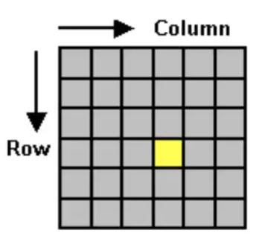
Tuple
Pixel Coordinates Application
  A digital image is made up of rows and columns of pixels. A pixel in such an image can be specified by saying which column and which row contains it. In terms of coordinates, a pixel can be identified by a pair of integers giving the column number and the row number.
https://www.cs.mtsu.edu/~xyang/3080/cartesian.html

Slide 45
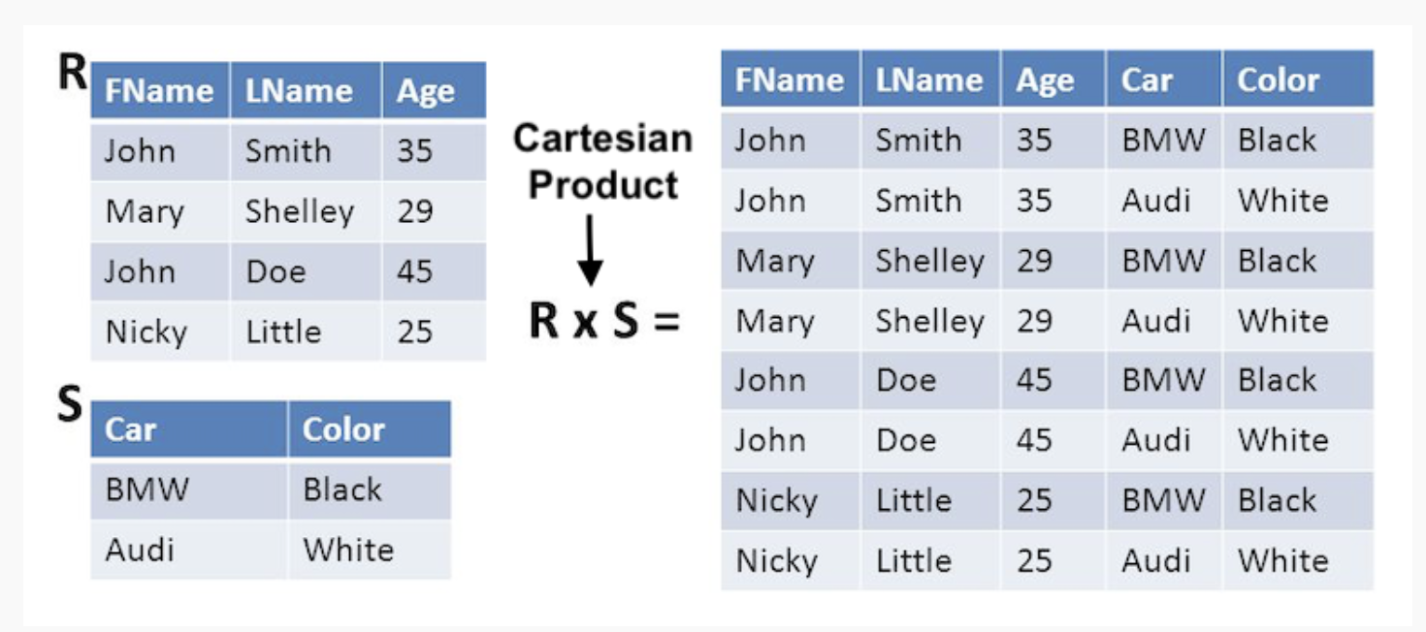
Cartesian Product
Database Application
https://www.cs.mtsu.edu/~xyang/3080/cartesian.html

Slide 46
Set Operations

Slide 47
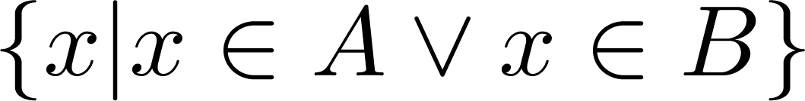
Union
Definition: Let A and B be sets. The union of the sets A and B, denoted by A ∪ B, is the set:
Example: What is {1,2,3} ∪ {3, 4, 5}?
Solution: {1,2,3,4,5}
Venn Diagram for A ∪ B
U
A
B

Slide 48
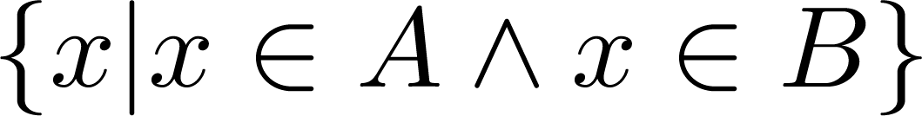
Intersection
Definition: The intersection of sets A and B, denoted by A ∩ B, is
Note if the intersection is empty, then A and B are said to be disjoint.
Example: What is? {1,2,3} ∩ {3,4,5} ?
Solution: {3}
Example: What is?
{1,2,3} ∩ {4,5,6} ?
Solution: ∅
Venn Diagram for A ∩B
U
A
B

Slide 49
Complement
Definition: If A is a set, then the complement of the A (with respect to U), denoted by Ā or A^{c} is the set U - A
Ā = {x ∈ U | x ∉ A}
Example: If U is the positive integers less than 100, what is the complement of {x | x > 70}
Solution: {x | x ≤ 70}
Venn Diagram for Complement
U
A
Ā

Slide 50
Difference
Definition: Let A and B be sets. The difference of A and B, denoted by
A – B, is the set containing the elements of A that are not in B.
The difference of A and B.
A – B = {x | x ∈ A ∧ x ∉ B} = A ∩‾B
Venn Diagram for A − B
U
A
B

Slide 51
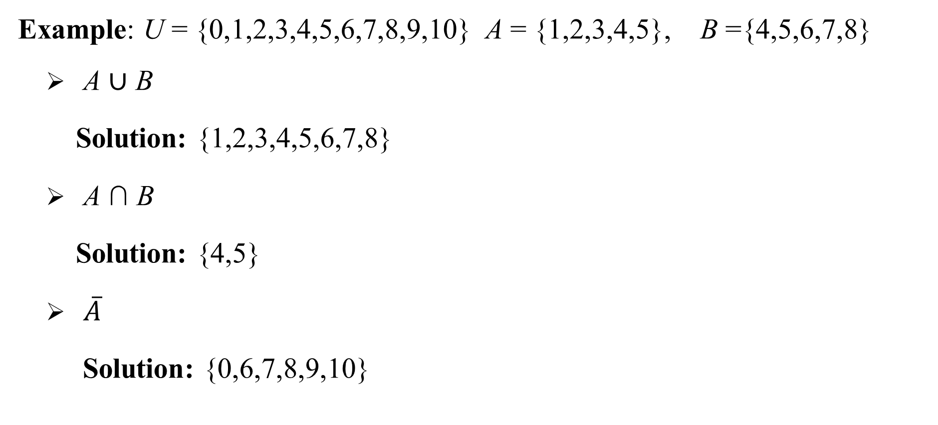
Quiz
Example: U = {0,1,2,3,4,5,6,7,8,9,10} A = {1,2,3,4,5}, B ={4,5,6,7,8}
  A ∪ B
    Solution: {1,2,3,4,5,6,7,8}
  A ∩ B
    Solution: {4,5}
  $\overline{A}$
    Solution: {0,6,7,8,9,10}

Slide 52
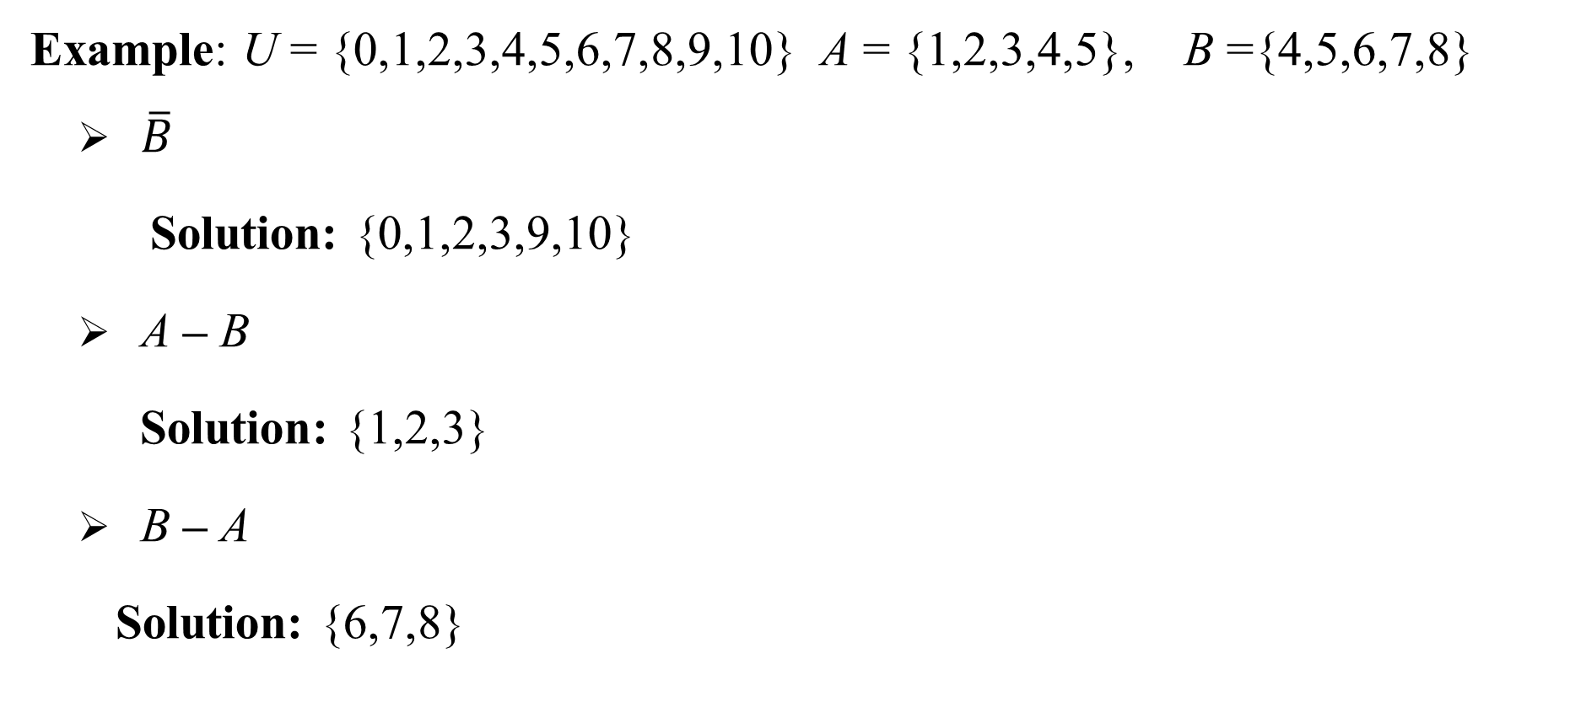
Quiz
Example: U = {0,1,2,3,4,5,6,7,8,9,10} A = {1,2,3,4,5}, B ={4,5,6,7,8}
  $\overline{B}$
    Solution: {0,1,2,3,9,10}
  A – B
    Solution: {1,2,3}
  B – A
    Solution: {6,7,8}

Slide 53

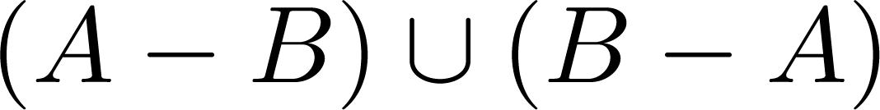
Symmetric Difference
Definition: The symmetric difference of A and B, denoted by is the set
Example:
  U = {0,1,2,3,4,5,6,7,8,9,10}
  A = {1,2,3,4,5} B ={4,5,6,7,8}
  What is
  Solution: {1,2,3,6,7,8}
U
A
B
Venn Diagram

Slide 54
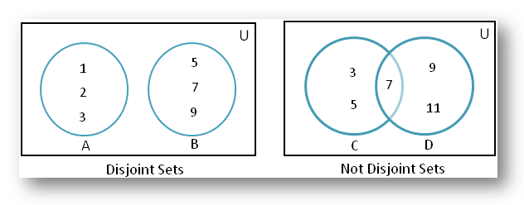
Cardinality of union of two set
|A ∪ B| = |A| + | B|
Inclusion-Exclusion
|A ∪ B| = |A| + | B| − |A ∩ B|

Slide 55



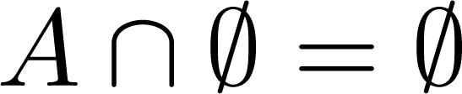


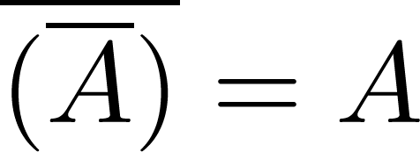
Set Identities
Identity laws
Domination laws
Idempotent laws
Complementation law

Slide 56


Set Identities
Commutative laws
Associative laws
Distributive laws

Slide 57


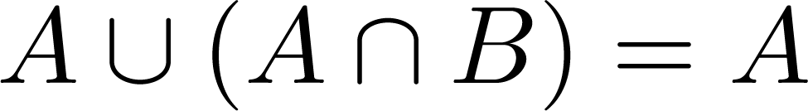
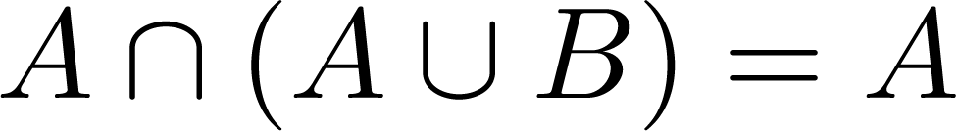

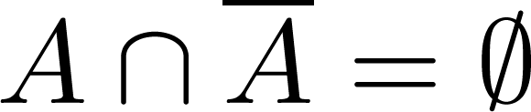
Set Identities
De Morgan’s laws
Absorption laws
Complement laws

Slide 58
Quiz
Let A = {1, 2, 3, 4, 5} and B = {0, 3, 6}. Find
  a) A ∪ B.
  b) A ∩ B.
  c) A − B.
  d) B − A.
Solution
  a) {0,1,2,3,4,5,6}
  b) {3}
  c) {1, 2, 4,5}
  d) {0, 6}

Slide 59
Quiz
Let A = {0, 2, 4, 6, 8, 10}, B = {0, 1, 2, 3, 4, 5, 6}, and C = {4, 5, 6, 7, 8, 9, 10}. Find
  a) A ∩ B ∩ C.
  b) A ∪ B ∪ C.
  c) (A ∪ B) ∩ C.
  d) (A ∩ B) ∪ C.
  Solution
  a) {4,6}
  b) {0,1,2,3,4,5,6,7,8,9,10}
  c) {4, 5, 6, 8, 10}
  d) {0,2,4,5,6,7,8,9,10}

Slide 60
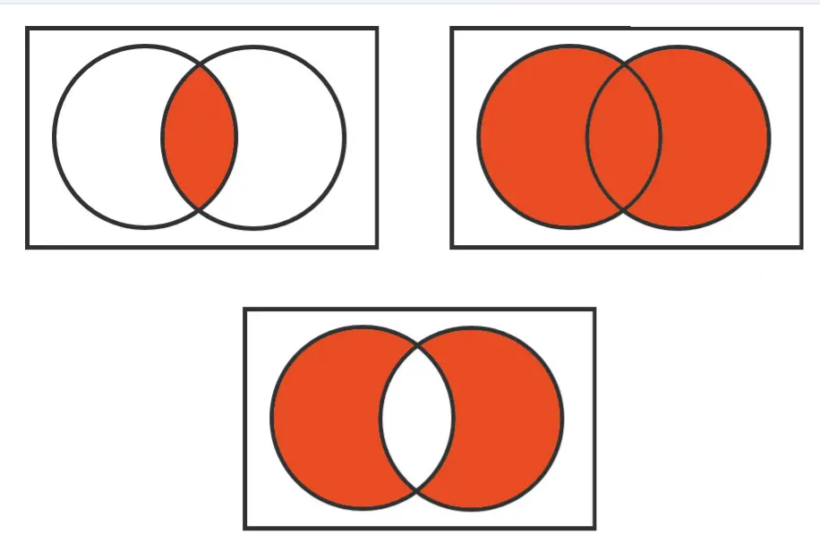
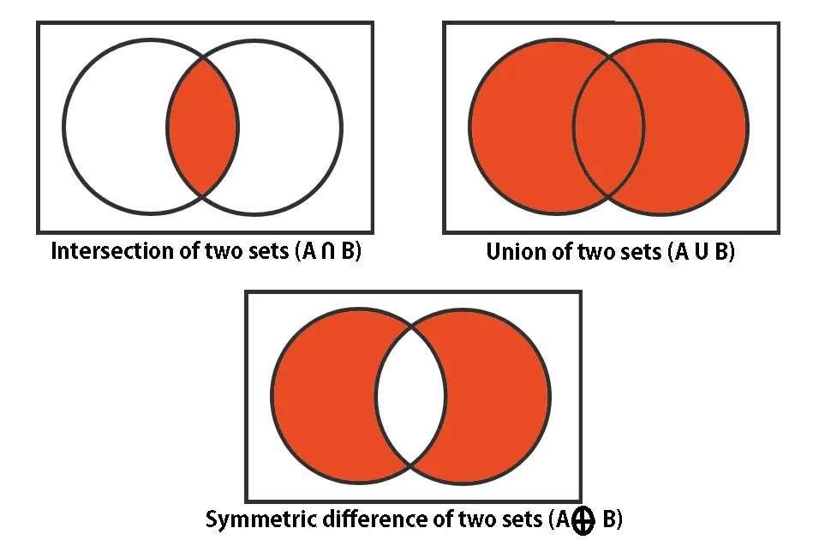
Quiz
Express set operation in the following venn diagram

Slide 61
Quiz
If A = {x, y} and B = {1, 2, 3, 4, 5}. Find cartesian product of A x B and B x A
Here, A = {x, y} and B = {1, 2, 3, 4, 5}
A x B = {(x, 1), (x, 2), (x, 3), (x, 4), (x, 5), (y, 1), (y, 2), (y, 3), (y, 4), (y, 5)}
B x A = {(1, x), (2, x), (3, x), (4, x), (5, x), (1, y), (2, y), (3, y), (4, y), (5, y))}
Here, we note that cartesian product of A x B ≠ B x A,

Slide 62
Quiz
If A and B are two sets such that |A| = 17 and |B| = 23 and | A ∪ B| = 38 then find | A ∩ B |.
Solution:
We know that | A ∪ B | = | A | + | B | – |A ∩ B |
⇒ 38 = 17 + 23 – |A ∩ B |
⇒ | A ∩ B | = 40 – 38 = 2

Slide 63
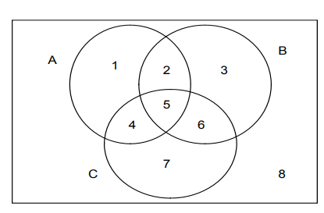
Quiz
Given the following Venn diagram
Find
• Set A
• Set B
• Set C
• A ∩ B ∩ C
• A ∩ C
• A ∩ B
B∩ C

Slide 64
Quiz
Given the following Venn diagram
Find
• Set A = {1,2,5,4}
• Set B = {2,3,5,6}
• Set C = {4,5,6,7}
• The set A ∩ B ∩ C ={5}
• The set A ∩ C ={4,5}
• The set A ∩ B={2,5}
• The set B ∩ C= {5,6}

Slide 65
Summary
Definition of sets
Describing Sets
Subsets and Set Equality
Cardinality of Sets
Tuples
Cartesian Product
Set Operations

