Slide 1


Financial Accounting
Prepared by Dr. Emad Zaher
Assistant Professor of Accounting
MGM611
Lecture 1
Accounting Equation & Analyzing Financial Transactions

Slide 2

Learning outcomes
Chapter (1) Introduction to Financial Accounting
LO 1 Identify the Basic Accounting Equation (Balance Sheet Equation)
LO 2 Explain the Building blocks of Accounting Equation.
LO 3 Describe the Revenues &Expenses Concepts. LO 4 State the different steps of Accounting cycle. LO 5 Analyzing the Financial transactions.
LO 6 Identify the golden rules of the double entry system.

Slide 3

BASIC ACCOUNTING EQUATION
Resources
Obligations
Capital
Assets
=
Liabilities
+ Owner’s Equity
100.000
40.000
60.000
Prepared by Dr. Emad Zaher

Slide 4
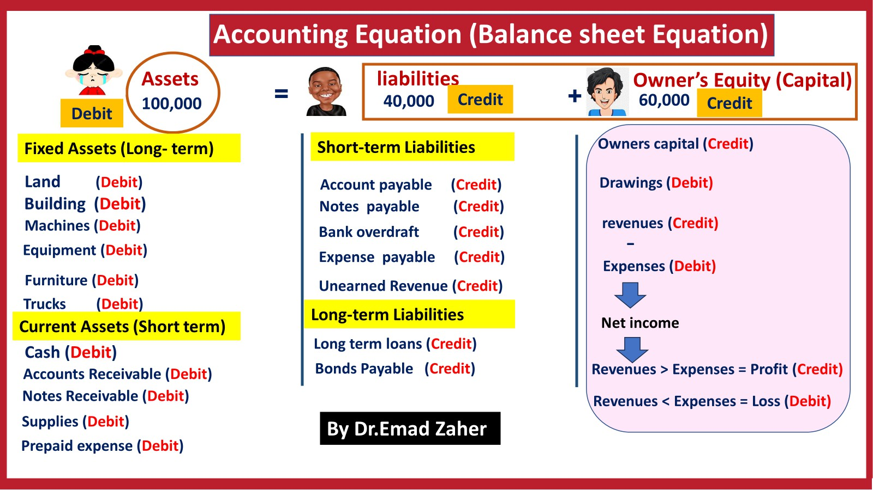

Slide 5


ASSETS AS A BUILDING BLOCK
Assets are resources owned by a business.
They are things of value used in carrying out such activities as production and exchange.
Prepared by Dr. Emad Zaher

Slide 6
Asset Accounts
2 - 6
Cash
Accounts
Receivable
Land
Asset Accounts
Notes
Receivable
Buildings
Prepaid Accounts
Equipment
Supplies

Slide 7

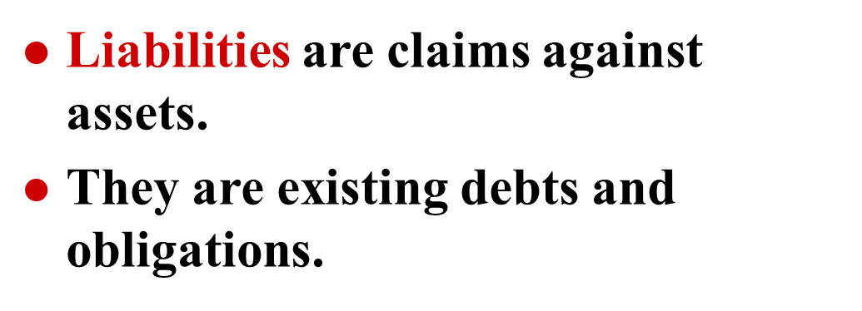



LIABILITIES AS A BUILDING BLOCK

Slide 8




Equity Accounts
Owner’s
Capital
Owner’s Withdrawals
Equity Accounts
Revenues
Expenses

Slide 9




OWNER’S EQUITY AS A BUILDING BLOCK
Owner’s Equity is equal to total assets minus total liabilities.
Owner’s Equity represents the ownership claim on total assets.
Subdivisions of Owner’s Equity:
  Capital
  Drawings
  Revenues
  Expenses

Slide 10


INVESTMENTS BY OWNERS AS A BUILDING BLOCK
Investments by owner are the assets put into the business by the owner.
These investments in the business increase owner’s equity.

Slide 11


DRAWINGS AS A BUILDING BLOCK
Drawings are withdrawals of cash or other assets by the owner for personal use.
Drawings decrease total owner’s equity.

Slide 12




Revenues VS. Expenses
Revenues (Credit) :
Sales Revenue
Service Revenue
Fees Earned
Commission Revenue
Dividends Revenue
Expenses (Debit):
Salary expenses
Wages expenses
Rent expenses
Utility expense
Repair expense
Insurance expense
Interest expense
Depreciation expense
Advertising expense
Supplies expense
Prepared by Dr. Emad Zaher

Slide 13











=
Double-Entry Accounting
+
Assets
Liabilities
Equity
ASSETS
LIABILITIES
EQUITIES
₋ Credit
+
Normal
- +
Normal
Debit
Credit
Debit
Credit
+ -
Debit
Normal

Slide 14














Double-Entry Accounting
Equity
_
_
Owner’s Capital
Owner's Withdrawals
+
Revenues
Expenses
Owner’s Capital
Owner's Withdrawals
Revenues
Expenses
De₋bit
Credit
Debit
Credit
Debit
Credit
Debit
Credit
+ - - + + -
+

Slide 15
Ex 1
Zaher Presented a selected information at December 31, 2023
Service revenue 36000 | Cash 8000 - Equipment 10000
Utilities expense 4000 | Account payable 2000
Notes payable 16500 | Rent expense 11000
Salaries and wages expense 7000 | Accounts receivable 9000
Determine the total assets at December 31,2023.
Determine the net income reported for December 2023.
Determine the owner’s equity at December 31,2023.
Answer
Required
Total assets = 8000 cash + 10000 equipment + 9000 accounts receivable
= 27000 LE
Net income =
revenue - expenses
= 36000 – 22000
= 14000 LE
Liabilities =
16500 Notes payable
+ 2000 Account payable
= 18500 LE
Total assets = Liabilities 27000 = 18500
owner`s eqity = 27000
Prepared by Dr. Emad Zaher
+ Owner`s equity
+ owner`s eqity
- 18500 = 8500 LE

Slide 16
The Accounting Cycle
Step1 :Identify and Analyze Transactions.
Step 2: Journal Entries by recording the Transactions.
Step 3: Post journals to ledgers (T-Account).
Step 4: Prepare an unadjusted trial balance.
Step 5: Journalize and post adjusting entries.
Step 6: Prepare an adjusted trial balance.
Step 7: Prepare financial statements.
Step 8: Journalize and post closing entries.

Slide 17



Accounting cycle
Analyze Transaction (Source Document)
General journal
Ledger (T-Account )
Trial balance
Closing Entries
Closing
Financial statements
Adjusting Entries
Prepared by Dr. Emad Zaher

Slide 18

Step1 :Identify and Analyze Transactions ((Source Documents)
Bills from Suppliers
Sales invoice
Checks
Purchase Orders
Bank Statements

Slide 19



Double-Entry System Illustration
1. Owners invest $40,000 cash to start a new business.
Assets
=
Liabilities
+
Equity
+ 40,000
+ 40,000
Prepared by Dr. Emad Zaher
3-19

Slide 20
Double-Entry System Illustration
2. Disburse (Paid) $600 cash for wages.
Assets
=
Liabilities
+
Equity
- 600
- 600
(expense)
3-20

Slide 21
Double-Entry System Illustration
3. Purchase office equipment priced at $5,200, giving a 10 percent promissory note in exchange.
Assets
=
Liabilities
+
Equity
+ 5,200
+ 5,200
3-21

Slide 22
4. Received $4,000 cash for services performed.
Assets
=
Liabilities
+
Equity
+ 4,000
+ 4,000
(revenue)
Prepared by Dr. Emad Zaher
3-22

Slide 23
5. Pay off a short-term liability of $7,000.
Assets
=
Liabilities
+
Equity
- 7,000
- 7,000
3-23

Slide 24
6 . Pay cash of $16,000 for a delivery van.
Assets
=
Liabilities
+
Equity
- 16,000
+ 16,000
Note that the accounting equation equality is maintained after recording each transaction.
3-24

Slide 25

Additional Examples
3-25

Slide 26
Step1 :Identify and Analyze Transactions.
Assets liabilities
+
Owner’s Equity
=
Analyze transaction
 | Assets = | Liabilities | + equity
investment by owner | Increase |  | Increase
Prepared by Dr. Emad Zaher

Slide 27
=
+
Assets
liabilities
Owner’s Equity
Analyze transactions
 | Assets = | Liabilities | + equity
Drawings by owners | Decrease |  | Decrease

Slide 28
Owner’s Equity
+
Assets
=
liabilities
Analyze transactions
 | Assets = | Liabilities | + equity
Borrowed cash from a bank | Increase | Increase

Slide 29
Owner’s Equity
Assets
=
liabilities
+
Analyze transactions
 | Assets = | Liabilities | + equity
Payment of bank loan | Decrease | Decrease

Slide 30
=
+
Assets
liabilities
Owners Equity
Analyze transactions
 | Assets = | Liabilities | + equity
Sold equipment for cash | Increase Decrease
 | Assets = | Liabilities | + equity
Sold equipment on account | Increase Decrease

Slide 31
=
+
Assets
liabilities
Owners Equity
Analyze transactions
 | Assets = | Liabilities | + equity
Performed services for cash | Increase |  | Increase
 | Assets = | Liabilities | + equity
Billed customers for services performed. | Increase |  | Increase
Prepared by Dr. Emad Zaher

Slide 32
Ex 2
 | Assets = | Liabilities | + equity
1- Made cash investment to start business | Increase |  | Increase
2- Borrowed cash from a bank on a note payable | Increase | Increase
3- Purchased supplies for cash | Increase Decrease
4- Purchased equipment on account | Increase | Increase
5- Payment of accounts payable | Decrease | Decrease
Prepared by Dr. Emad Zaher

Slide 33
 | Assets = | Liabilities | + equity
6- Received cash on accounts receivable | Increase Decrease
7- Withdrew cash for owner's personal use | Decrease |  | Decrease
8- Performed services for cash. | Increase |  | Increase
9- Billed customers for services performed. | Increase |  | Increase
10- Paid salaries expense for cash | Decrease |  | Decrease
11- Incurred advertising expense on account . |  | Increase | Decrease
Prepared by Dr. Emad Zaher

Slide 34
 | Ex 3
 |  |  | Assets = | Liabilities | + equity
1- Emad invested L.E 200,000 cash in the business |  |  | cash + 200000 |  | Capital + 200000
2- Paid L.E 3,000 cash for rent on storage space |  |  | Cash - 3000 |  | Expense -3000
3- Purchased equipment for L.E 15,000 from Al- shark company on account |  |  | + 15000 Equipment | + 15000 Account payable
4- Performed services for Magic Company for L.E 2,500 cash. |  |  | cash + 2500 |  | Revenue + 2500
5- Received a bill for L.E 1000 from Al-Akhbar for advertising expense. |  |  |  | Ex payable + 1000 | Expense - 1000
6- Paid Al-shark company for the equipment purchased in transaction (3) above |  |  | cash - 15000 | Account payable - 15000
Prepared by Dr. Emad Zaher

Slide 35
 | Assets = | Liabilities | + equity
7-Purchased supplies for L.E 500 cash | Supplies +500 Cash - 3000
8- Paid monthly expenses: salaries L.E 5000 and utilities L.E 400 | Cash - 5400 |  | Expense - 5400
9- Performed services for customer for L.E 1200 on account | Acc. receivable + 1200 |  | Revenue + 1200
10- Ahmed withdrew L.E 1000 cash for personal use. | Cash - 1000 |  | drawings - 1000

Slide 36
Choose the correct answer for each of the following
1. Which of the following events cannot be quantified into monetary units and recorded as an accounting transaction?
A | The hiring of employees | B | The Payment of expenses
C | The sale of equipment | D | The purchase of a new computer
2-When the owner invest cash in the business, the effect will be ::
A | Liabilities increase and owner’s equity increases. | B | Both assets and liabilities increase.
C | Both assets and owners’ equity increase. | D | None of the above
3- Performed services on account will affect :
A | Income statement only | B | Balance sheet only
C | Income statement and balance sheet. | D | None of the above

Slide 37
Double Entry System : Golden Rules
Account | Group | Normal | Trend | Entry
Assets (Debit)
Assets | A | Dr | + | Dr
 |  |  | - | Cr
Liabilities (Credit)
Liabilities | L | Cr | + | Cr
 |  |  | - | Dr
Owner's Equity (Credit)
Capital | O .E | Cr | + | Cr
 |  |  | - | Dr
Expenses |  | Dr | + | Dr
 |  |  | - | Cr
Revenue |  | Cr | + | Cr
 |  |  | - | Dr
Withdrawals |  | Dr | + | Dr
 |  |  | - | Cr
Prepared by Dr. Emad Zaher

Slide 38
Ex 1
For the accounts listed below, Determine if the normal balance of the account is
debit or credit:
1 ) assets Debit | 8) cash
2) liabilities Credit | 9) owner’s drawing
3) owner’s capital | 10) accounts receivable
4) revenues | 11) Accounts payable
5) expenses | 12) service revenue
6) equipment | 13) rent expense
7) buildings | 14) notes payable

Slide 39
Ex 2
*Determine how the entry in each statement is recorded in the journal by using debit or credit to indicate the increase or decrease in the affected account:
Debit
2. An increase in Salaries and Wages Expense
Credit
1. A decrease in Store Equipment.
Credit 3. A decrease in Accounts Receivable
5. An increase in Owner’s Drawings.
7. An increase in Service Revenue
9. An increase in Prepaid Insurance.
4. A decrease in Office Supplies.
Credit
6. A decrease in Accounts Payable.
8. An increase in Rent Expense
10. An increase in Owner’s Capital

Slide 40




Thank You

