Slide 1

Strategic and Operational Risk Management
Prepared by Dr. Nael Zabel
Lecture 10
PMG 630
The strategic nature
of corporate risk management

Slide 2

Lecture 10
RISK REVIEW and audit
The risk review examines both intended and documented results of the risk response and action plans in dealing with identified risks. Included in the risk review is an evaluation of the residual risk against established risk levels.
Residual risk assessment considers both the risks as previously identified and the resulting risk from the response mechanisms and the control activities implemented.

Slide 3
Lecture 10
RISK REVIEW and audit
The process evaluates the effectiveness, cost, and efficiency of the activities and its adequacy in providing reasonable assurance that the likelihood and impacts of the risk events are brought down to the established acceptable risk level (i.e., ALARP).

Slide 4
Lecture 10
RISK REVIEW and audit
It is critical that the risk review evaluates the significant risks that fall outside of the acceptable risk levels.
This may happen due to changing systems and policies or changing conditions and environments. These risks should be addressed with appropriate action plans to bring the risk within established levels.
Risk treatment and response plans should be updated accordingly.

Slide 5
Lecture 10
RISK REVIEW and audit
An important oversight role in confirming that management is monitoring and managing all known risks in accordance with established levels can be done through a risk audit.
When possible, the audit committee should consist of both internal and external members.
A risk audit is a more comprehensive evaluation of the entire risk management system and processes. Thus it is conducted less often than risk reviews.

Slide 6
Lecture 10
Effective Performance MONITORING
To be effective, it is emphasized that the performance monitoring processes should be treated as an integrated component in the system. There are two key elements in achieving an effective risk monitoring and review process.

Slide 7
Lecture 10
Effective Performance MONITORING
First, clear communication channels between the members of the system increase the level of awareness with regards to the implementation of risk treatment and controls.
All stakeholders in the system must know specifically why particular risk controls or safeguards have been implemented.

Slide 8
Lecture 10
Effective Performance MONITORING
Clear communication creates an environment where every member knows precisely his or her responsibilities toward addressing the risk. Communication is important especially in large systems that have a high level of interaction, ambiguity, emergence, huge data collection, and complexity.

Slide 9
Lecture 10
Effective Performance MONITORING
Second, it is necessary to establish a flexible monitoring process. The design of risk monitoring procedures should be flexible so that they can adapt and respond in a cost-effective manner to threats arising from emergence, turbulent environments, uncertainty, and contextual issues of a dynamic nature.

Slide 10
Lecture 10
Effective Performance MONITORING
Flexibility is the ability to add, adjust, or remove both physical components and functions.
The level of flexibility should not cause the monitoring process to lose its identity; rather, it should provide an environment of trust where members of the system can share their pro-posed changes and strategies.

Slide 11
Lecture 10
The nature of risk management
Risks are everywhere, as evidenced by many corporate events reported in the popular press, including major corporate scandals around once venerable companies.
We also witness a steady increase in man-made disasters around the world and even the emergence of mega-catastrophes caused by willful human actions that have both direct and indirect economic effects.

Slide 12
Lecture 10
The nature of risk management
These development shave intensified our focus on corporate and public risks and the risk management processes that may be needed to circumvent the adverse economic impacts from such events.
All the while, we have seen a public risk perception aimed at reducing system errors, operational malfunctions and uncontrolled human behaviors that affect the way in which we try to deal with corporate risks

Slide 13
Lecture 10
The significance of potential risk effects
Risk management as a professional discipline is nothing new. The insurance industry has operated for centuries on the basis of practices that allowed economic entities with specified risks to obtain cover by diversifying the exposures across many insured parties through the intermediation of professional insurance companies.

Slide 14
Lecture 10
The significance of potential risk effects
Similarly, there is really nothing new to the various risk events we see play out today as they affect individuals, institutions and societies.
The history is replete with examples of accidents, operational disruptions, fraud cases, political unrest and market collapses, which all constitute incidents with adverse effects on business and economic activity.

Slide 15
Lecture 10
The significance of potential risk effects
The sheer magnitude الحجم الهائلof potential economic repercussions has brought risk management to a new level of attention as the public has witnessed the (some-times) exorbitant personal gains derived from corporate fraud and excessive losses from extreme weather conditions, terrorist events and so forth.

Slide 16
Lecture 10
The significance of potential risk effects
The increased risk alertness اليقظه has also affected politicians and lawmakers in their capacity to impose new legislation and rules that public companies must abide الالتزام بها by as witnessed byte growth نموا ملحوظاin regulatory frameworks and corporate governance guidelines.

Slide 17
Lecture 10
The significance of potential risk effects
The frequency of earthquake events per se does not seem to increase, but the exposed economic infrastructure is extended. However, there seem to be other climatic changes that increase economic losses in exposed areas due to wind storms, hurricanes and flooding events.
The overwhelming consequence of these developments is that the insured losses from man-made disasters and natural catastrophes have been increasing dramatically (Figure 1.1).

Slide 18
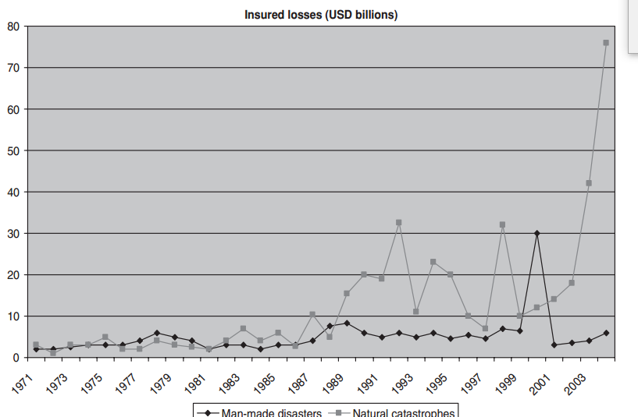

Slide 19
Lecture 10
The significance of potential risk effects
All in all, there is virtually no end to potential sources for economic disruption.
A conventional risk management focus has been concentrated on volatile financial markets, insurable casualties and macroeconomic conditions.

Slide 20
Lecture 10
The significance of potential risk effects
However, these risks have been extended to include many other factors beyond managerial control, including systemic disruptions, industry paradigm نموذج الصناعة changes, competitive initiatives, technological shifts, political incidents, mega-terrorist events and the like, many of which are hard to foresee and predict (Figure 1.2).

Slide 21
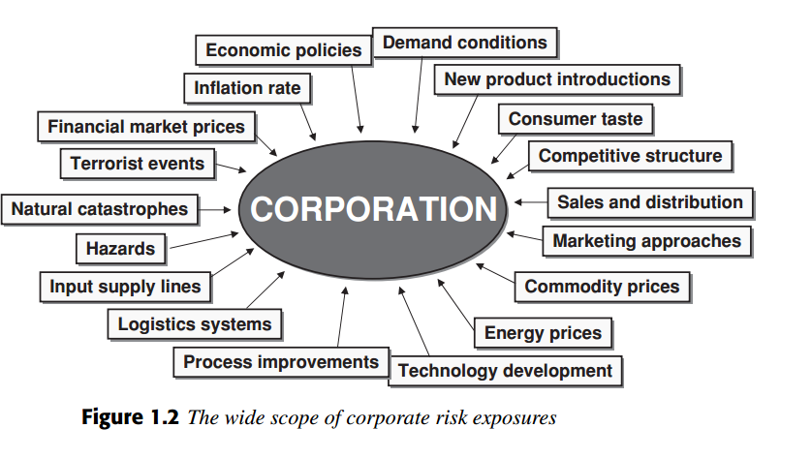

Slide 22
Lecture 10
Different approaches to risk management
The risk management challenge has been approached in many different ways depending on the assumed professional perspective.
The insurance profession looks upon risk management as a technique adopted to cover identifiable risks by diversifying exposures among many insurance takers through the active inter-mediation of insurance companies.

Slide 23
Lecture 10
Different approaches to risk management
The insurers charge a risk premium reflecting the expected risk of the events based on actuarial calculations plus a margin to cover administration and capital costs.

Slide 24
Lecture 10
Different approaches to risk management
While this approach works for many accidents and casualties where events are independent of each other, it becomes more complicated when risk events are related because the natural diversification across different insurance takers falls short.

Slide 25
Lecture 10
Different approaches to risk management
That is, if the hurricane runs through certain region, all of the insurance company’s customers in the vicinity are hit at the same time and the drain on capital reserves of local insurance companies becomes too large.

Slide 26
Lecture 10
Different approaches to risk management
Therefore, cover for these types of catastrophe risks requires more comprehensive risk-transfer solutions involving the global reinsurance and capital market intermediaries.

Slide 27
Lecture 10
Different approaches to risk management
Assuming a multinational financial management perspective, the emphasis changes more towards the foreign exchange rate exposures imposed on companies engaged in international trade and foreign direct investment.

Slide 28
Lecture 10
Different approaches to risk management
These exposures extend from short-term transactions to longer-term economic risks arising from volatile foreign exchange markets, while also considering the potential adverse effects from different political risks that arise in connection with overseas operations.

Slide 29
Lecture 10
Different approaches to risk management
As all of these risks relate to exposures that can be identified, quantified and assessed, they fit quite well with the cyclical activities described in the formal risk management process (see Box 1.11The formal risk management cycle).

Slide 30
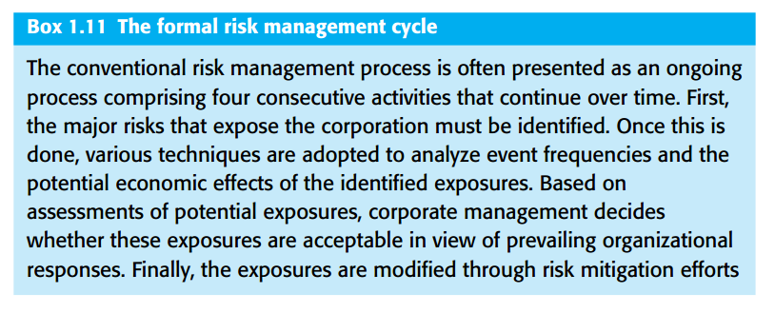
Lecture 10
Different approaches to risk management

Slide 31
Lecture 10
Different approaches to risk management
With the emerging emphasis on various operational risks, there has also been an increased focus on the potential for human errors and misconduct as well as technological breakdowns. Managing these types of exposures depends on effective corporate accounting systems to identify and measure the relevant exposures as well as internal control processes adopted to check whether exposures are kept within bounds and whether processes remain in line.

Slide 32
Lecture 10
Different approaches to risk management
All together, these perspectives on possible risk events are commensurate with the practices promoted by enterprise-wide risk management approaches that assume the formal elements of the risk management process.
They also resonate with contemporary public policy concerns where various legislative initiatives, regulation and supervision are imposed to reduce the adverse societal consequences of human error.

Slide 33
Lecture 10
Different approaches to risk management
Other disciplines seem to take slightly varied views on the risk phenomenon. While total quality management, six-sigma and lean management principles seem focused on improving operational efficiencies, they ideally also pay attention to emerging customer needs and process improvements through continuous learning.

Slide 34
Lecture 10
Different approaches to risk management
Similarly, risk assessments in project management see a need to balance advance planning with adaptive solutions that arise as the projects are implemented. We may even extend this perspective to corporate strategy formulation,

Slide 35
Lecture 10
Different approaches to risk management
which can be seen as the execution of a string of projects or strategic actions where the upside potential for improvements and uncovered opportunities should be exploited during implementation. Although the strategy-making process is rarely conceived this way, one might argue that strategic management, which incorporates analyses of institutional strengths, weaknesses, opportunities and threats (often epitomized as SWOT analysis), is de facto engaged in explicit analysis of strategic risks (Figure 1.3).

Slide 36
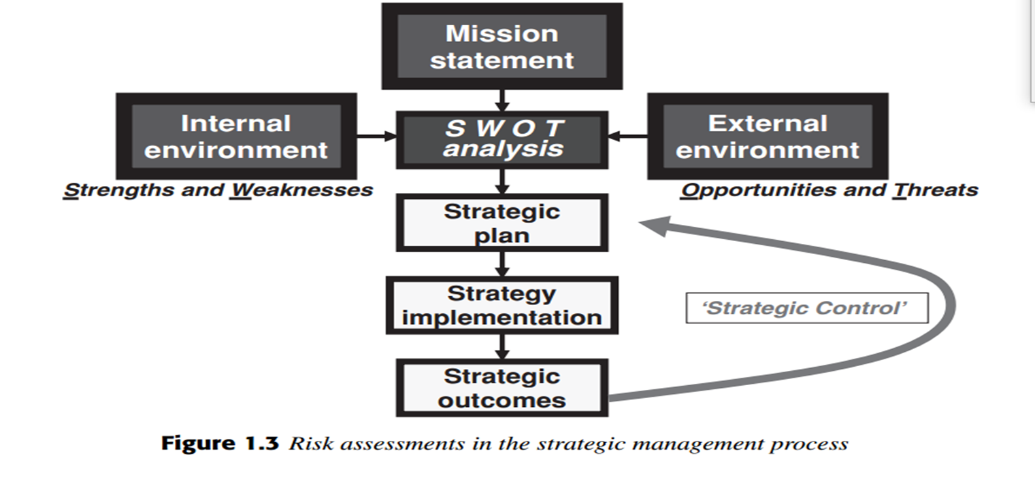
Lecture 10
Different approaches to risk management

Slide 37
Resources:
Operational Risk Management
C. Ariel Pinto
Luna Mylene Magpili
Raed M. Jaradat
Chapter 4

