Slide 1


College of Management
Project Communications
Lecturer: Dr. Raef Baraka
PMG 112
Lecture 04

Slide 2

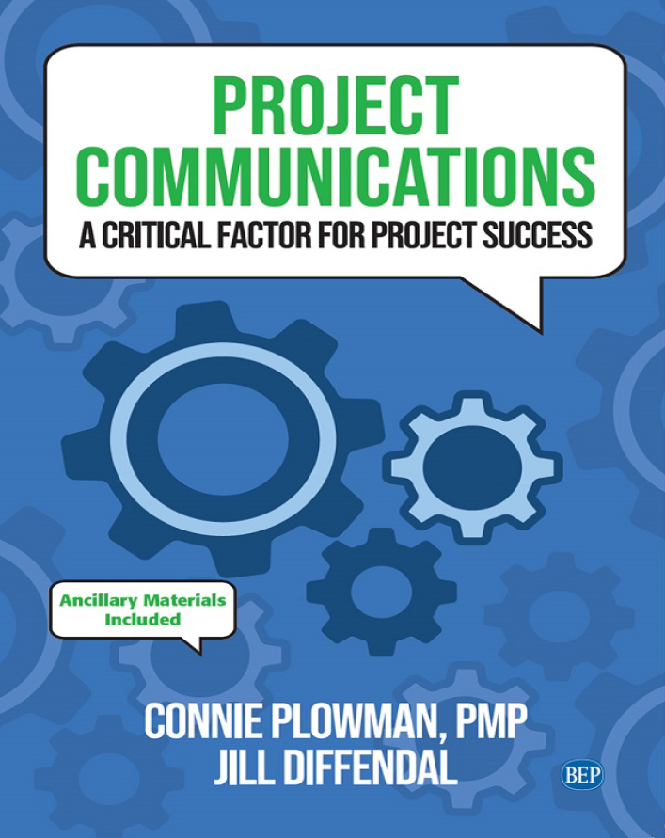
Reference Book:
Ch1: Introduction.
Ch2: Exploring Communication Theories.
Ch3: Knowing Your Audience.
Ch4: Starting with the Basics.
Ch5: Planning Project Communications.
Ch6: Managing and Monitoring Project Communications.
Ch7: Using Project Communication Tools.
Ch8: Communicating Change.
Ch9: Managing Conflict through Communication.
Ch10: Closing.

Slide 3

Chapter 4: Starting with the Basics
The purpose of this chapter is to help you:
Look at how high-performing organizations and project teams communicate.
Identify things to consider when communicating on projects, including the need for inclusive language.
Distinguish between formal and informal communications.
Examine the scalability of project communications

Slide 4
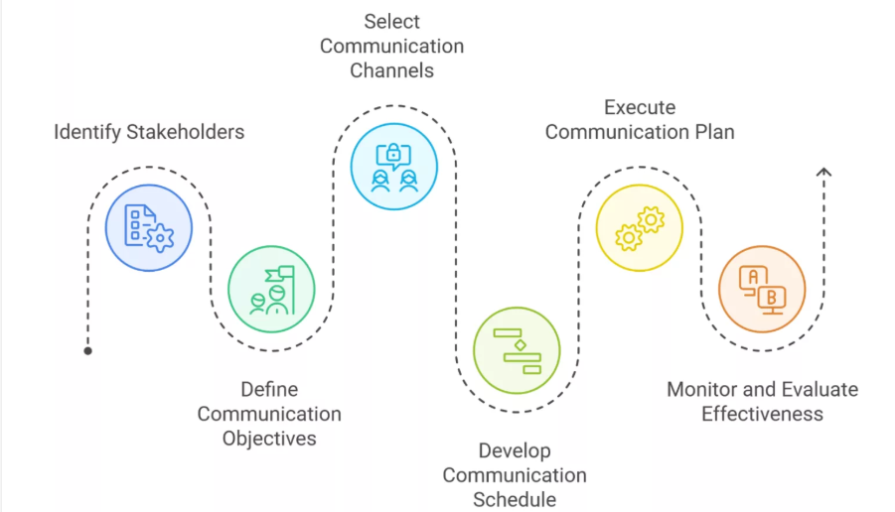
Starting with the Basics
Starting with the Basics
We have two ears and one mouth so that we can listen twice as much as we speak.
—Epictetus, Greek philosopher

Slide 5
Starting with the Basics
Starting with the Basics
Regarding communications, what do high-performing organizations do differently than other organizations?
Communicate key project topic areas better, including the objective of the project, its value for the business, and its outcomes, along with budget, scope, and schedule;
Are better at delivering clear, detailed communications about the project on time, through appropriate channels, with nontechnical language;
Use formal communications plans for nearly twice as many projects as low-performing organizations;
Create project communications management plans that are more than three times as effective as the plans of low-performing organizations.
Dr. Raef Baraka

Slide 6
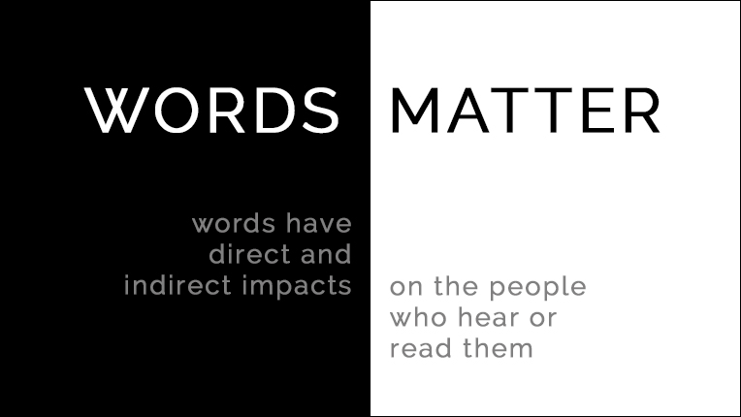
Starting with the Basics
Words Matter
In a leadership role—in projects, business, or other environments— people may hang on to every word you say.
Words have an impact. Your words may have a positive impact that encourages and inspires the project team, or your words may have a negative impact where team members “shut down” and resist getting tasks done.
Choose your words carefully, both in writing and orally. You never know what lasting impact, good or bad, your words may have.
Dr. Raef Baraka

Slide 7

Starting with the Basics
Verbal and Nonverbal Communication
Not all communication is verbal or written. There is also tone—the volume or inflection of the words being said. Most important, however, is what is not being said—the body language.
This includes facial expressions, eye contact, movement of hands, position of arms and legs, and other factors. Much research has been done (with varying results) on how much of our communication is done through body language.
Dr. Raef Baraka

Slide 8
Starting with the Basics
Verbal and Nonverbal Communication
Body language makes up a significant percentage of our communication. This makes it especially challenging to work with virtual teams because you are not able to see team members’ body language when you are having a conversation (without using video or a camera device).
You must rely mostly on the words being said. Understanding body language and the ability to “read” the nonverbal signals or movements are key skills for communicating on projects.
Dr. Raef Baraka

Slide 9
Starting with the Basics
Listen
Do you listen differently when you are communicating with external stakeholders versus internal project team members? Do you listen more intently when a customer is talking rather than when a colleague is speaking?
Listening differently often happens on project teams. Internally, most often the team member does not report to the project manager.
Usually, the team member reports directly to a supervisor or functional manager. So why should the team members listen to the project manager, if they don’t report to them? How do you get an executive stakeholder to listen to you when you have little or no authority?
Active listening is an important skill for everyone on the project.
Dr. Raef Baraka

Slide 10
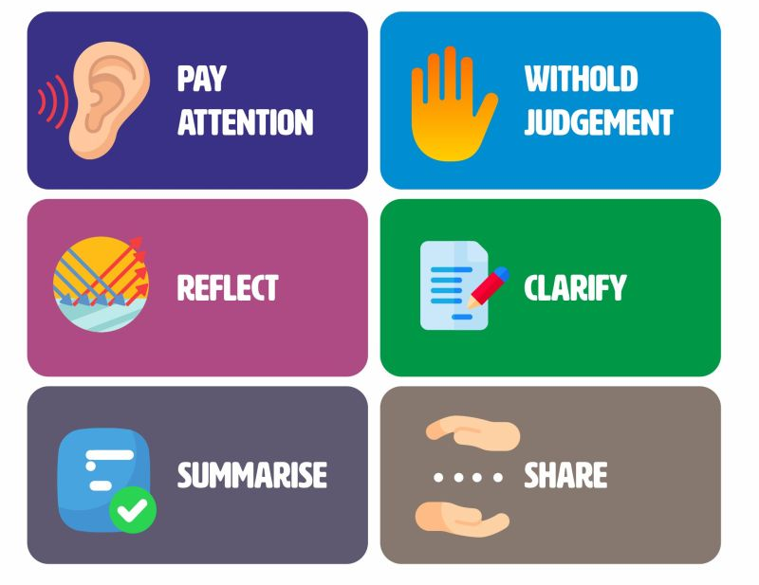
Starting with the Basics
Listen
There are six key active listening skills:
Be attentive.
Keep an open mind.
Be attuned to and reflect feelings.
Ask open-ended and probing questions.
Paraphrase.
Share your own thoughts and feelings.
Dr. Raef Baraka

Slide 11
Starting with the Basics
Give and Seek Feedback
While listening is important, receiving feedback is equally important. Bill Gates once said, We all need people who will give us feedback. That’s how we improve.
Feedback allows you to make necessary adjustments.
Feedback allows you to confirm that the communication methods you are using are working and adjust those methods that are not working.
Or, if a method is working for some but not others, remember that you don’t have to get rid of what you have. Rather, you can add a communication method that can support all stakeholders.
Dr. Raef Baraka

Slide 12

Starting with the Basics
Give and Seek Feedback
Feedback on communication processes helps identify potential communication breakdowns before or as soon as they occur. Look for opportunities where you can provide feedback—both as a way to recognize a job well done and areas where improvement is needed
Dr. Raef Baraka

Slide 13
Starting with the Basics
Deal with “Talkers”
Do you have people on your project team who love to hear themselves talk? These individuals are usually creating and sharing their thoughts at the same time, rather than formulating their thoughts first before speaking.
One technique to try is the talking spoon; or use any object that you can hold in your hand. A pencil, pen, or marker will also work. The object permits you to talk. As long as you are holding the object, it is your turn to speak. When you are done talking, you put the object down on the table, and another person picks up the object. It is now their turn to speak, and it is your turn to listen.
Dr. Raef Baraka

Slide 14
Starting with the Basics
Deal with “Talkers”
This exercise can be done informally without others even knowing it. Or it can be part of your team’s operating principles (discussed later in this chapter) on giving everyone the equal opportunity to verbally participate.
For virtual teams, the object can be something shown on the screen during your video conference calls. At the next opportunity when you experience a team member using too much airtime, give the talking spoon technique a try. As project managers, team members, and stakeholders, we need to be able to articulate our points and let others express theirs.
Dr. Raef Baraka

Slide 15
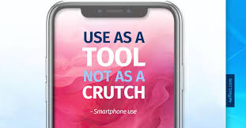
Starting with the Basics
Avoid Using Technology as a Crutch
Too often, people hide behind the keyboard rather than have conversations. They prefer to send an e-mail or text instead of engaging in a rich, interactive dialogue with another person or group. In having real-time conversations, you might gain valuable information, share new ideas, build relationships, and earn trust. However, meaningful interactions like these take time and effort.
The use of technology “encourages us to act as if speed and convenience are the most important criteria for how we communicate.”5 But they are not! Remember that every interaction is important. Step out from behind the keyboard and take advantage of opportunities to have meaningful interactions—either in person or virtually.
Dr. Raef Baraka

Slide 16
Starting with the Basics
Be Present
With so much happening in today’s dynamic project and working environments, it is easy to be distracted. Our minds are elsewhere. We are constantly interrupted by technology—phones, e-mails, and text messages.
When we attend project meetings or have project conversations; it is possible that our minds are thinking about other tasks we need to get done.
We might even be checking e-mail on our phones while another team member is speaking during a meeting. While we might be physically present, we are not mentally present. The project team needs you (and your mind) at your best on the topic at hand. It needs your active contribution and valuable ideas. Therefore, you need to be “there”—to be present—in every communication, conversation, and interaction.
Dr. Raef Baraka

Slide 17
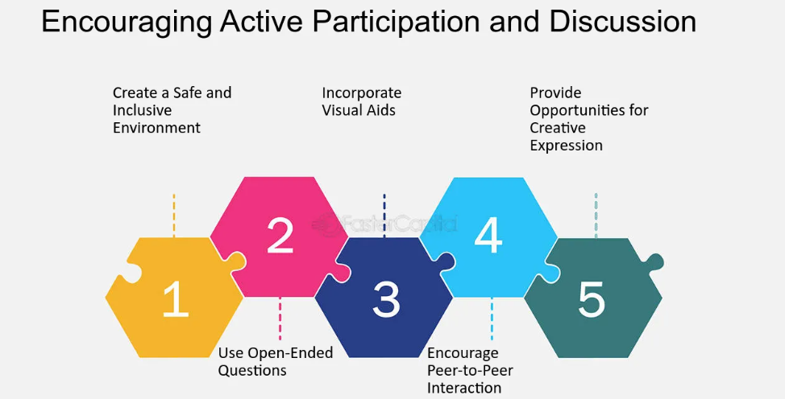
Starting with the Basics
Be Present
Dr. Raef Baraka

Slide 18
Starting with the Basics
Define Roles on the Team
For effective project communication, roles and responsibilities on the project need to be clearly defined.
This should be done at the project kickoff meeting.
To accelerate the process of establishing role definitions, start with roles that have been previously defined in other projects, for example, the project manager, project coordinator, team member, project sponsor, functional manager, etc.
Dr. Raef Baraka

Slide 19
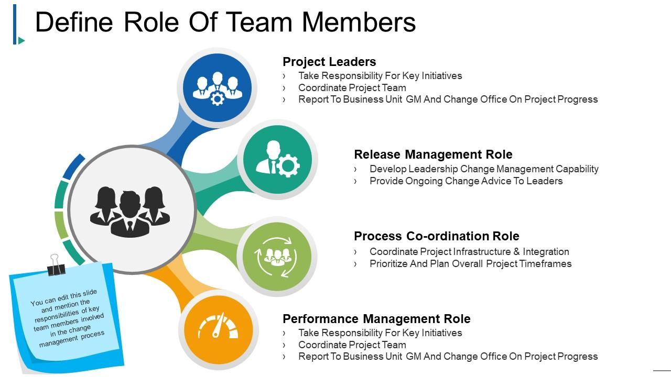
Starting with the Basics
Define Roles on the Team
Dr. Raef Baraka

Slide 20
Starting with the Basics
Define Roles on the Team
At the project kick-off meeting, review the sample roles together. Make adjustments specific to this project and this project team.
Make sure that responsibilities for project communication are clearly defined for each role.
Once the roles and responsibilities have been established and agreed upon, put the role definitions into your project plan.
Everyone should refer to them as needed throughout the project.
Dr. Raef Baraka

Slide 21
Starting with the Basics
Lead by Example
John Wooden, legendary American basketball player and coach, once said, “The most powerful leadership tool you have is your personal example.”
As a participant on the project team, you should be role modeling what you consider to be good communication practices and acceptable behaviors.
If you set good communication examples and actions, psychology indicates that others will follow. It starts with you.
Dr. Raef Baraka

Slide 22

Starting with the Basics
Lead by Example
Dr. Raef Baraka

Slide 23

Starting with the Basics
Lead by Example
Dr. Raef Baraka

Slide 24
Starting with the Basics
Avoid Silence
When project team members and stakeholders are not communicating, there is a risk that these groups will start having conversations among themselves.
This can create a foundation for even bigger problems, misunderstandings, and potential conflict.
A quick “check-in” is better than saying nothing at all. In some company cultures or project teams, silence means acceptance. In other words, if you do not respond, you are agreeing to the decision, action, or content.
Dr. Raef Baraka

Slide 25
Starting with the Basics
Use the Rule of Seven
The origin of the rule of seven started in marketing, where buyers needed to see and hear the same message seven different ways before they would make a purchase. The same concept can be applied to project communication. Aim to repeat the same message seven times, in seven different ways, to ensure everyone understands and receives the same message. What does the rule of seven look like in a project? Here is an example.
Susie is the project manager. She has created a lessons-learned document in the electronic project folder. At each status meeting, Susie communicates that no one has posted information in the lessons learned folder and asks everyone to write their lessons learned.
Dr. Raef Baraka

Slide 26

Starting with the Basics
Use the Rule of Seven
At the next team meeting, the lessons learned document (or log) is still empty. To set the example, Susie starts posting information in the lessons learned log and communicates that she has done so.
She tries the rule of seven approaches, using seven different ways to remind the team to take action. She uses a combination of formal and informal communication, as well as a mix of verbal and written communication.
Dr. Raef Baraka

Slide 27
Starting with the Basics
Use the Rule of Seven
Susie clearly states the reminder at each status meeting.
She includes a lessons learned category in status reports.
Susie adds a reminder in her e-mail signature.
She posts her own lessons learned each week and then shares the updates with each team member via e-mail.
Susie asks each member of the project team to share two lessons learned at the weekly stand-up meeting—one positive result and one negative result.
She sets up checkpoints throughout the project to capture lessons learned.
Susie creates and shares a short video about lessons learned with the project team.
Dr. Raef Baraka

Slide 28

Starting with the Basics
Use the Rule of Seven
As a result, she sees that each member of her project team is now actively participating in capturing lessons learned on the project. The rule of seven really does work! Consider doing a similar activity: Try delivering the same message in seven different ways and see the difference. Then share the results with your project team.
Dr. Raef Baraka

Slide 29
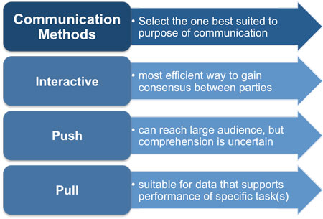
Starting with the Basics
Use Push, Pull, and Interactive Methods
On a project, there are numerous communication methods that the project team will use. Push communication methods require that the information be sent out. Pull communication methods require individuals to come to where the information is located, whether that location is physical or virtual. Interactive communication methods use an exchange of information.
Dr. Raef Baraka

Slide 30
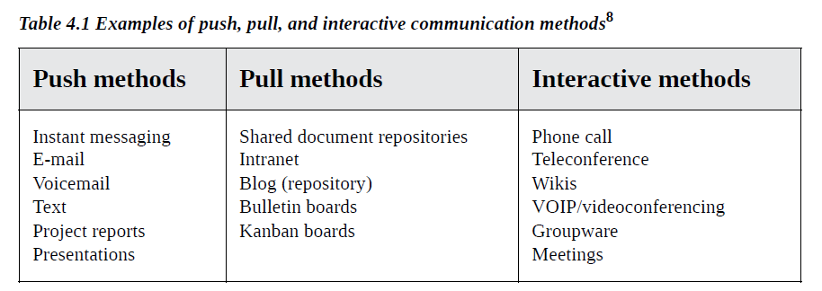
Starting with the Basics
Use Push, Pull, and Interactive Methods
Dr. Raef Baraka

Slide 31
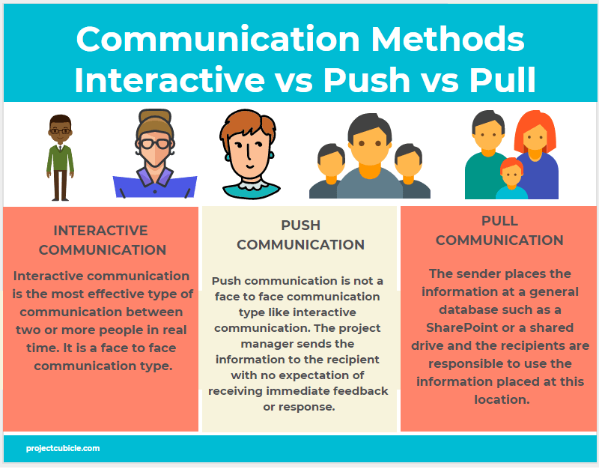
Starting with the Basics
Dr. Raef Baraka

Slide 32
Starting with the Basics
Utilize Training
Project management is both about knowledge (training) and experience. To qualify for many project management certifications, both project education hours and project experience hours may be required. Most project professionals have taken classes and studied project management. However, how much training have we done to learn about communicating?
If 90 percent of a project manager’s time is spent communicating, can we be really good at it just by experience? Probably not. Consider taking some communication classes. Read books on project communication— including this one! Follow blogs to learn more about effective communication.
Dr. Raef Baraka

Slide 33
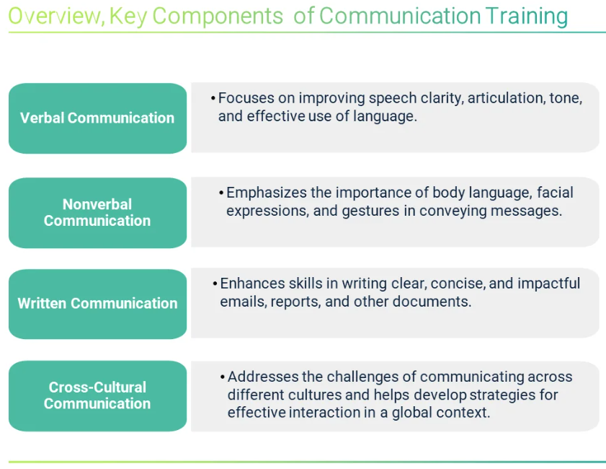
Starting with the Basics
Dr. Raef Baraka

Slide 34
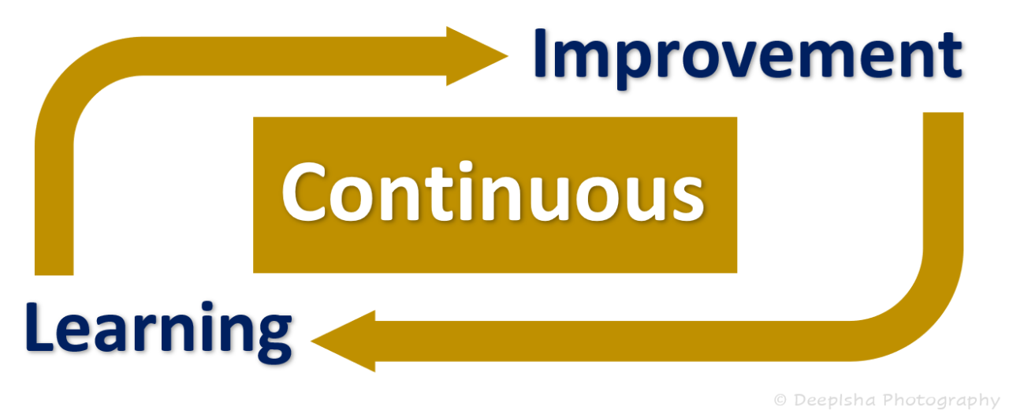
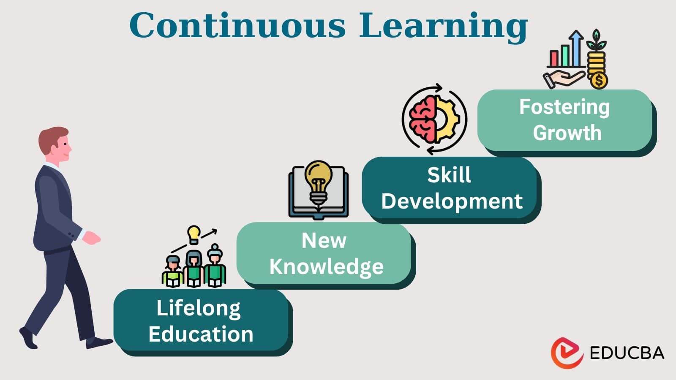
Starting with the Basics
Be a Continuous Learner
Look for opportunities to grow your communication skills, knowledge, and experience.
“To produce excellence, you must study excellence.”
Start doing both today—studying and producing project communication excellence.
Dr. Raef Baraka

Slide 35
Starting with the Basics
Implement Team Operating Principles
Team operating principles (or ground rules) outline the way communication is handled, what to expect, and who is responsible, along with many other aspects of working together. Some people call it a “team contract” or “team agreement.” Regardless of what it is called, it shows formally that all team members have committed to how they will work together—including communication protocols and expectations.
Dr. Raef Baraka

Slide 36
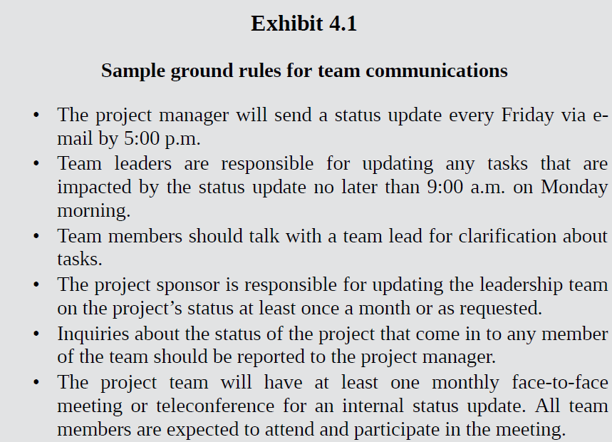
Starting with the Basics
Dr. Raef Baraka

Slide 37

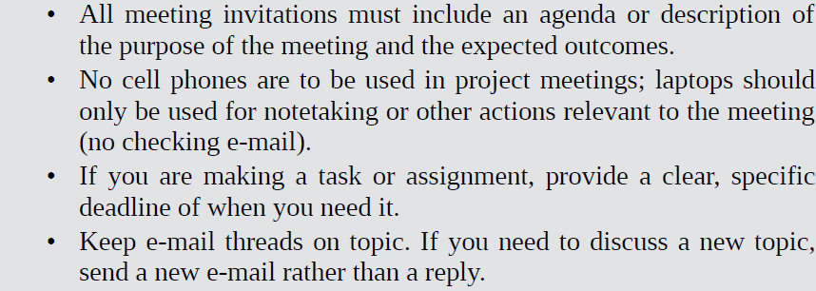
Starting with the Basics
Dr. Raef Baraka

Slide 38
Starting with the Basics
Use Inclusive Language—No Jargon
You may want to adjust the language you use when communicating with different levels in the organization as well, based on their interests. For example:
When communicating with executives and senior management, their interest may be the bottom-line impact and a high-level summary of the project.
When communicating with functional managers, their interest may be in the people and resources, specifically the team members they have assigned to work on the project.
When communicating with outside stakeholders, their interest may be in progress, status updates, and results achieved.
When communicating with the project team, their interest may be staying on schedule, completing tasks, addressing risks, and delivering project success.
Dr. Raef Baraka

Slide 39
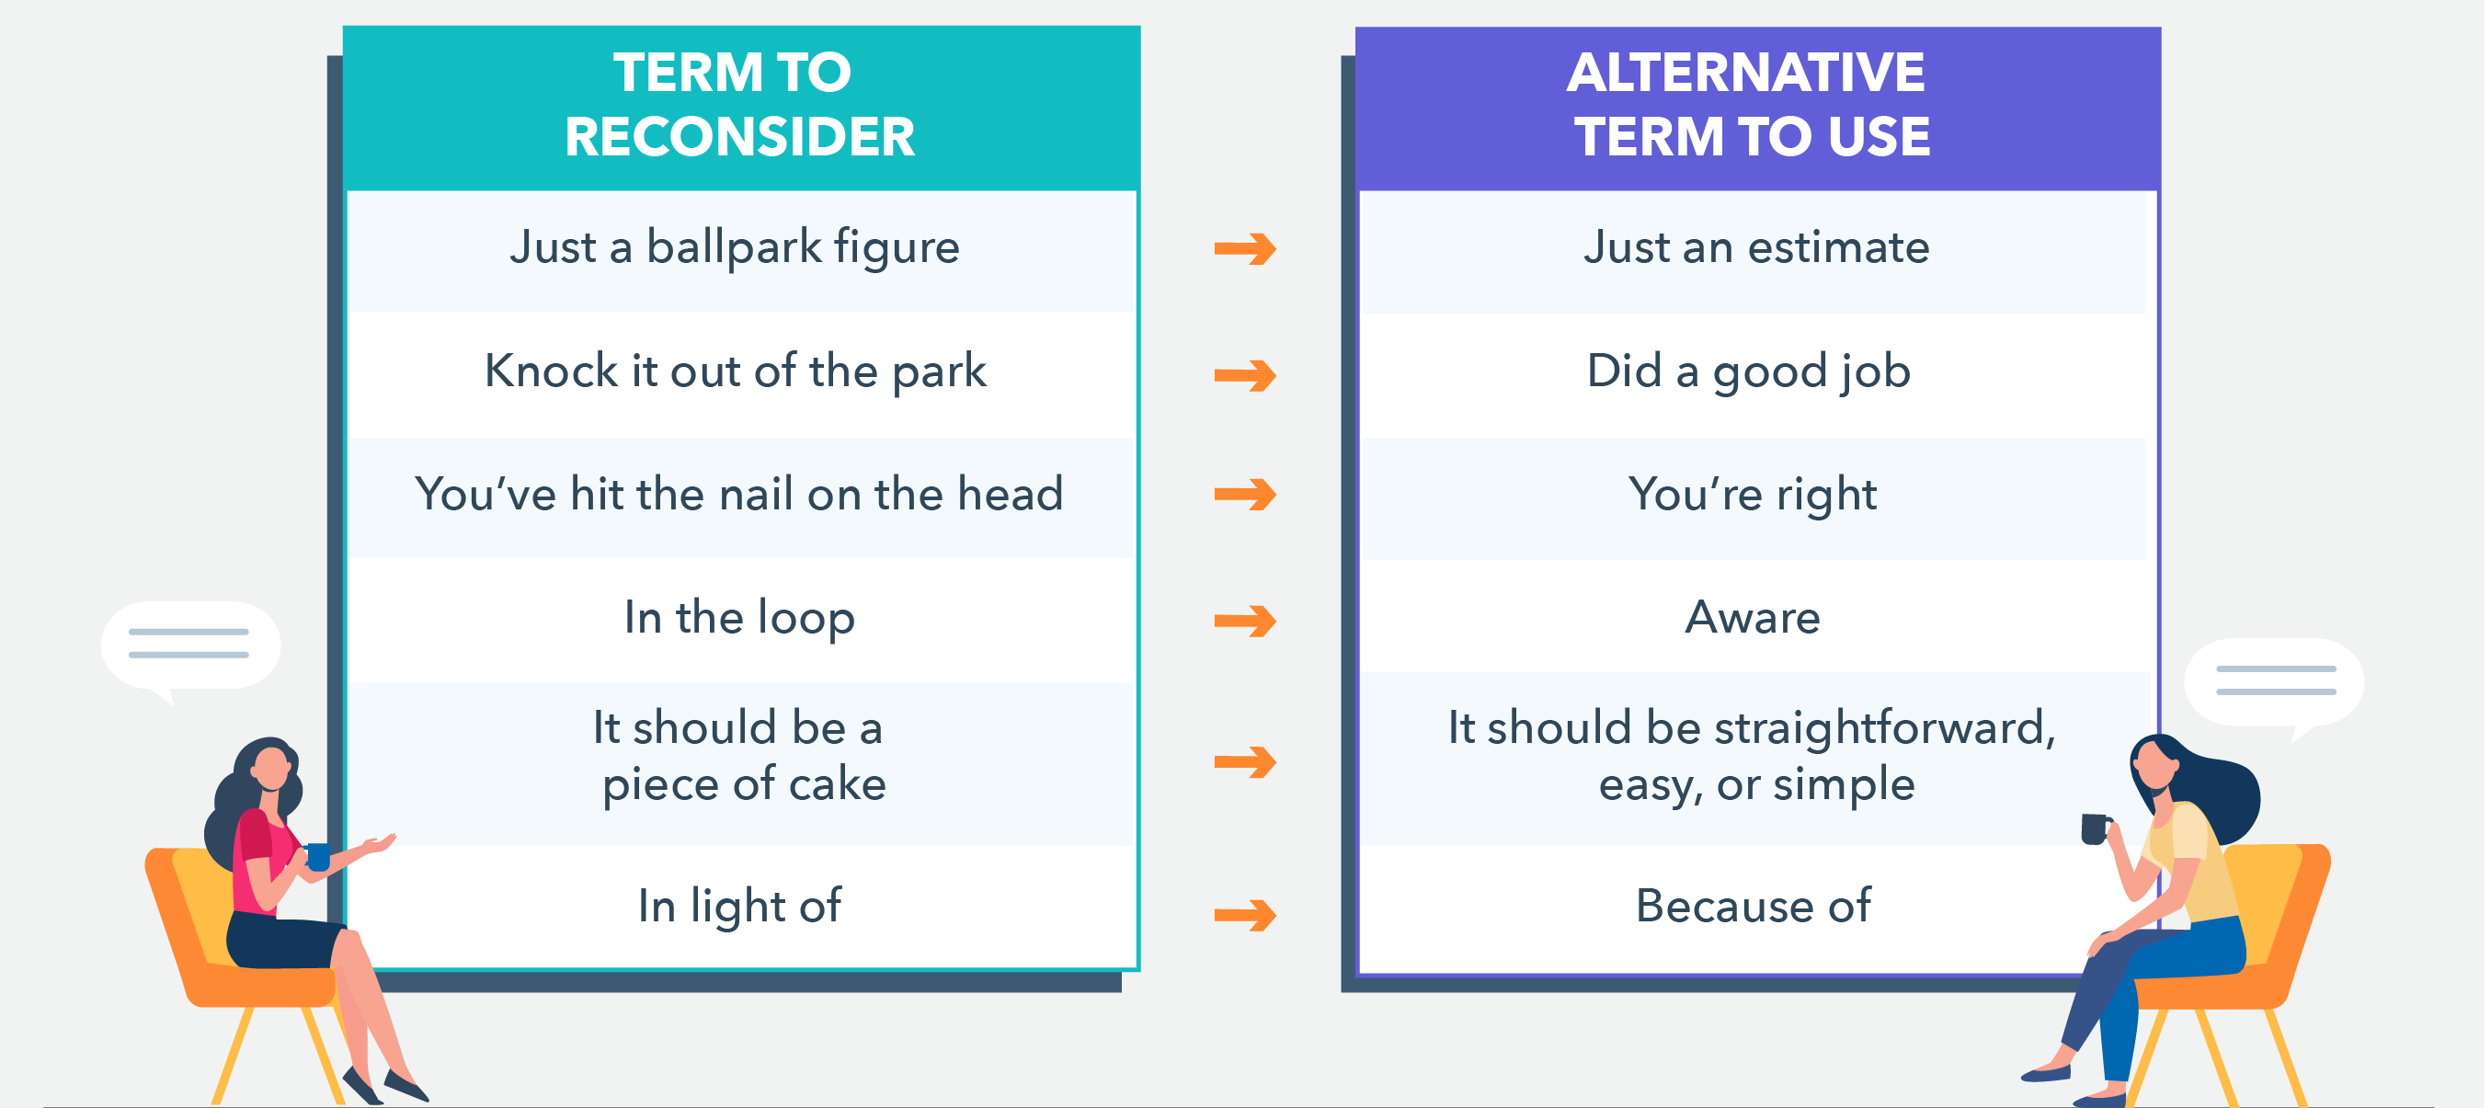
Starting with the Basics
Dr. Raef Baraka

Slide 40
Starting with the Basics
Lecture Summary
Whether you are communicating on a project, or communicating in general, it is important to start with the basics. Use practical techniques and sensible approaches for effectively delivering your message.
Research has shown that high-performing teams and organizations are better at communicating key project concepts, delivering their messages on time using inclusive language and the right methods, and effectively using formal project communications management plans.

Slide 41
Starting with the Basics
Lecture Summary
With the increase in the number of different ways to communicate, there are many things to consider in your project communications.
Scaling your project communications pertains to the amount of communication shared, the impact of the communication, the size and types of stakeholder groups, the various tools, and the diversity of the audience.
And don’t forget that words matter. Regardless of how they are delivered— formal, informal, written, or verbal—words have a lasting impact.

Slide 42



Thank You

