Slide 1



Object Oriented Programming
Prepared by Dr. Yasser Abdelhamid
IT223
Object Oriented Programming
Lecture 10

Slide 2

outline
Exceptions
Object Oriented design

Slide 3
exceptions

Slide 4
exception
An exception is an event that disrupts the normal flow of the program.

Slide 5
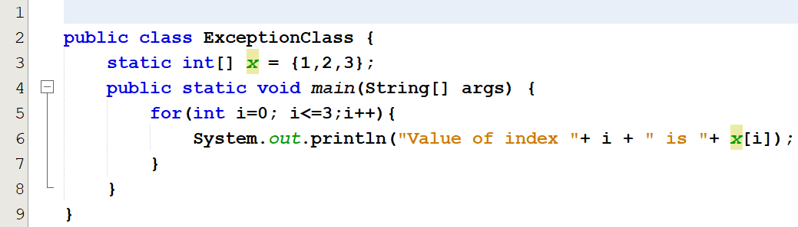
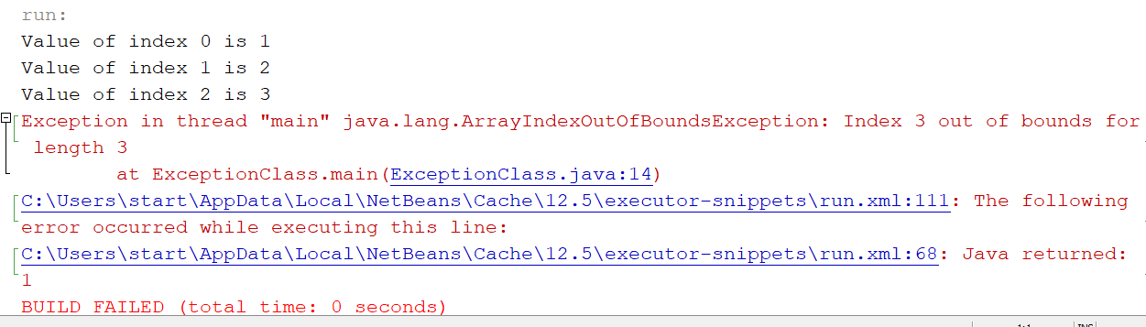
Example

Slide 6
What is an exception?
An Exception is an unwanted event that interrupts the normal flow of the program.
When an exception occurs program execution gets terminated.
In such cases we get a system generated error message.
By handling the exceptions we can provide a meaningful message to the user about the issue rather than a system generated message, which may not be understandable to a user.

Slide 7
Why an exception occurs?
There can be several reasons that can cause a program to throw exception.
For example:
  Opening a non-existing file in your program,
  Network connection problem,
  Bad input data provided by user etc.

Slide 8
Exception Handling
If an exception occurs, which has not been handled by programmer then program execution gets terminated and a system generated error message is shown to the user.
Example:
Instead of presenting this message, we can display a friendly message to the user specifying what went wrong, and giving him the chance to continue running the program without break.
Exception in thread "main" java.lang.ArithmeticException: / by zero at ExceptionDemo.main(ExceptionDemo.java:5)
ExceptionDemo : The class name
main : The method name
ExceptionDemo.java : The filename
java:5 : Line number

Slide 9
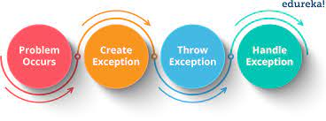
Exception handling mechanism
Exception Handling is a mechanism to handle runtime errors so that when an exception occurs, the program can still go back to the normal flow.

Slide 10
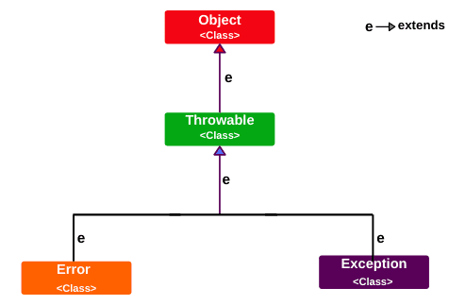
Hierarchy of Java Exception classes
java.lang.Throwable class is the root class of Java Exception hierarchy inherited by two subclasses:
  Exception and
  Error.

Slide 11
Difference between error and exception
Errors indicate that something severe enough has gone wrong, the application should crash rather than try to handle the error.
Exceptions are events that occurs in the code. A programmer can handle such conditions and take necessary corrective actions.

Slide 12
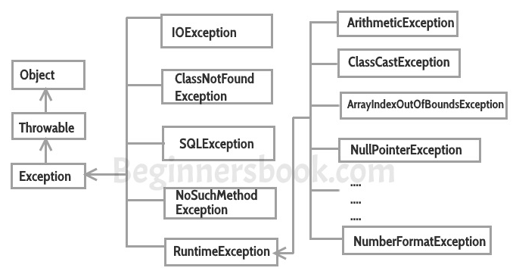
Types of java exceptions

Slide 13
Checked exceptions
All exceptions other than Runtime Exceptions are known as Checked exceptions.
The compiler checks them during compilation to see whether the programmer has handled them or not.
If these exceptions are not handled/declared in the program, you will get compilation error.
  For example:
    SQLException, IOException, ClassNotFoundException etc.

Slide 14
Unchecked Exceptions
Runtime Exceptions are also known as Unchecked Exceptions.
These exceptions are not checked at compile-time so compiler does not check whether the programmer has handled them or not but it’s the responsibility of the programmer to handle these exceptions and provide a safe exit.
  For example:
    ArithmeticException, NullPointerException, ArrayIndexOutOfBoundsException etc.

Slide 15
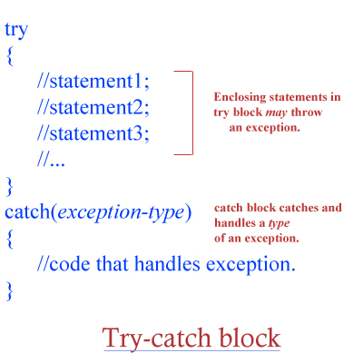
try catch block
Exceptions are handled in java using Try-Catch code blocks.

Slide 16
Try block
The try block contains set of statements where an exception might occur.
A try block is always followed by a catch block, which handles the exception that occurs in associated try block.
A try block must be followed by catch blocks or finally block or both.
  try{
  //statements that may cause an exception
  }

Slide 17
Catch block
A catch block is where you handle the exceptions.
This block must follow the try block.
A single try block can have several catch blocks associated with it.
When an exception occurs in try block, the corresponding catch block that handles that particular exception executes.
try
{
//statements that may cause an exception
}
catch (exception(type) e(object))‏
{
//error handling code
}

Slide 18
generic exception handler
The generic exception handler can handle all the exceptions but you should place it at the end of catch blocks.
If you place it before all the catch blocks then it will display its generic message. which may not be meaningful to the user.

Slide 19
class Example1 {
public static void main(String args[]) {
int num1, num2;
try {
/* We suspect that this block of statement can throw exception */
num2 = 62 / num1;
System.out.println(num2);
System.out.println("Hey I'm at the end of try block");
}
catch (ArithmeticException e) {
/* This block will only execute if any Arithmetic exception occurs in try block */
System.out.println("You should not divide a number by zero");
}
catch (Exception e) {
/* This is a generic Exception handler which means it can handle all the exceptions.
This will execute if the exception is not handled by previous catch blocks.*/
System.out.println("Exception occurred");
}
System.out.println("out of try-catch block");
}
}
Output:
You should not divide a number by zero
Out of try-catch block...

Slide 20
Catching multiple exceptions
class Example{
public static void main(String args[]){
try{
int arr[]=new int[7];
arr[4]=30/0; // divide by zero
System.out.println("Last Statement of try block");
}
catch(ArithmeticException e){
System.out.println("You should not divide a number by zero");
}
catch(ArrayIndexOutOfBoundsException e){
System.out.println("Accessing array elements outside of the limit");
}
catch(Exception e){
System.out.println("Some Other Exception");
}
System.out.println("Out of the try-catch block");
}
}
Output:
You should not divide a number by zero
Out of the try-catch block

Slide 21
Example:2
class Example{
public static void main(String args[]){
try{
int arr[]=new int[7];
arr[10]=10/5;
System.out.println("Last Statement of try block");
}
catch(ArithmeticException e){
System.out.println("You should not divide a number by zero");
}
catch(ArrayIndexOutOfBoundsException e){
System.out.println("Accessing array elements outside of the limit");
}
catch(Exception e){
System.out.println("Some Other Exception");
}
System.out.println("Out of the try-catch block");
}
}
Output:
Accessing array elements outside of the limit
Out of the try-catch block

Slide 22
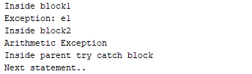
Nested try catch block in
Java – Exception handling
class Nest{
public static void main(String args[]){
//Parent try block
try{
//Child try block1
try{
System.out.println("Inside block1");
int b =45/0;
System.out.println(b);
}
catch(ArithmeticException e1){
System.out.println("Exception: e1");
}
//Child try block2
try{
System.out.println("Inside block2");
int b =45/0;
System.out.println(b);
}
catch(ArrayIndexOutOfBoundsException e2){
System.out.println("Exception: e2");
}
System.out.println("Just other statement");
}
…
catch(ArithmeticException e3){
System.out.println("Arithmetic Exception");
System.out.println("Inside parent try catch block");
}
catch(ArrayIndexOutOfBoundsException e4){
System.out.println("ArrayIndexOutOfBoundsException");
System.out.println("Inside parent try catch block");
}
catch(Exception e5){
System.out.println("Exception");
System.out.println("Inside parent try catch block");
}
System.out.println("Next statement..");
}
}

Slide 23
Java Finally block – Exception handling
A finally block contains all the crucial statements that must be executed whether exception occurs or not.
The statements present in this block will always execute regardless of whether exception occurs in try block or not such as closing a connection, stream, file, etc.

Slide 24
Java Finally block – Exception handling
class Example
{
public static void main(String args[]) {
try{
int num=121/0;
System.out.println(num);
}
catch(ArithmeticException e){
System.out.println("Number should not be divided by zero");
}
/* Finally block will always execute
* even if there is no exception in try block
*/
finally{
System.out.println("This is finally block");
}
System.out.println("Out of try-catch-finally");
}
}
Output:
Number should not be divided by zero
This is finally block
Out of try-catch-finally

Slide 25
Java Finally block – Exception handling
class JavaFinally
{
public static void main(String args[])
{
System.out.println(JavaFinally.myMethod());
}
public static int myMethod()
{
try {
return 112;
}
finally {
System.out.println("This is Finally block");
System.out.println("Finally block ran even after return statement");
}
}
}
Output:
This is Finally block
Finally block ran even after return statement
112

Slide 26
object oriented design

Slide 27
Understand the Requirements
Gain a thorough understanding of the project requirements and goals.
Identify the key functionalities, user interactions, and system constraints.
This understanding will guide your design decisions.

Slide 28
Identify Objects and Their Responsibilities
Identify the main objects or entities in the system based on the requirements.
Determine the responsibilities or behaviors that each object should have.
Consider what actions or operations objects need to perform to fulfill their roles.

Slide 29
Define Relationships Between Objects
Determine the relationships between objects.
Identify associations, aggregations, compositions, and generalizations (inheritance) between objects.
These relationships define how objects interact and collaborate to achieve system functionality.

Slide 30
Create Class Diagrams
Create class diagrams to visualize the objects, their attributes, and methods.
Use UML (Unified Modeling Language) notation to represent classes, relationships, and multiplicity.
Refine and iterate on the class diagrams as the design evolves.

Slide 31
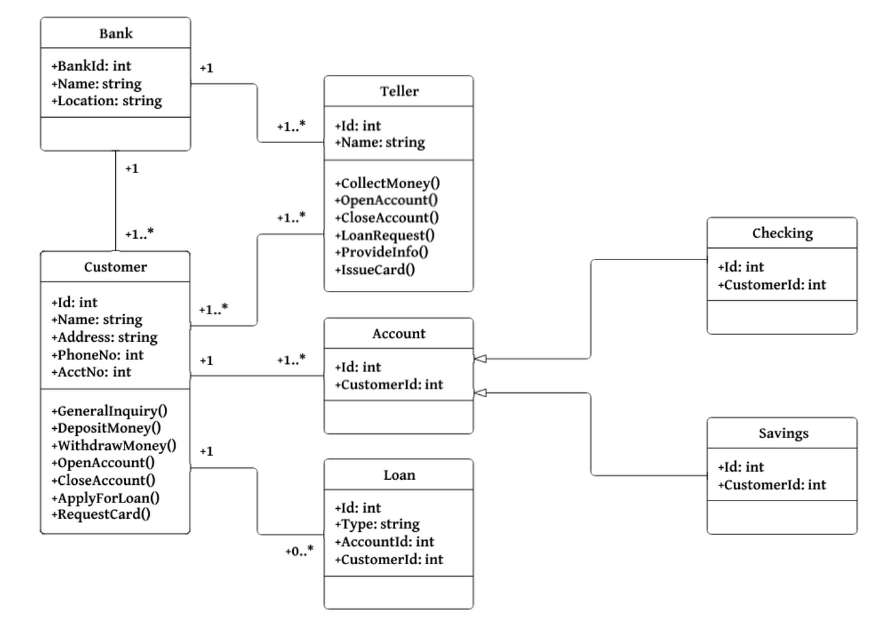
example

Slide 32
Encapsulate Data and Behavior
Encapsulate the data (attributes) and behavior (methods) within each class.
Define appropriate access modifiers (public, private, protected) for class members to ensure encapsulation and data integrity.
Consider applying principles such as information hiding and the single responsibility principle.

Slide 33
Apply Design Patterns
Consider applying design patterns to solve common design problems and improve the structure of your design.
Design patterns provide proven solutions and can enhance flexibility, maintainability, and extensibility.
Choose the appropriate patterns based on the system requirements and constraints.

Slide 34
Refine and Optimize the Design
Continuously refine and optimize the design.
Review the class relationships, responsibilities, and interactions to ensure cohesion and loose coupling.
Eliminate redundancy and ensure the design follows best practices and design principles.

Slide 35
Consider Design Trade-offs
Consider trade-offs between different design aspects, such as performance, maintainability, and scalability.
Evaluate the impact of design decisions on system performance, memory usage, and code complexity.
Seek a balance between the competing design considerations.

Slide 36
Validate the Design
Validate the design by reviewing it with stakeholders, domain experts, or fellow developers.
Seek feedback and incorporate necessary changes or improvements.
Use design reviews to catch potential issues early and ensure the design aligns with the project requirements.

Slide 37
Document the Design
Document the design using appropriate documentation techniques. Create clear and concise documentation that describes the design decisions, rationale, and key design elements.
Use diagrams, comments, and other supporting materials to enhance understanding and maintainability.

Slide 38
General
Remember that object-oriented design is an iterative process.
Refine the design as you gain more insights and feedback.
Keep the design flexible enough to accommodate changes and future enhancements.
Regularly review and refine the design as the project progresses to maintain a high-quality, scalable, and maintainable codebase.

Slide 39
SUmmary
Exceptions
Object Oriented design

Slide 40


Thank You

