Slide 1

Research Methods (RSC 701)
Prepared by
Dr. Mahitab ELrafii
Lecture No.3
Research Methods (RSC 701)

Slide 2

Content of Lecture
Lecture 3 Includes the following points:
Introduction
Reviewing the literature
What is a literature review?
How is a literature review different from an academic research paper?
Why do we write literature reviews?
Ask yourself questions like these:
What is the purpose of a literature review?
The key steps to writing a literature review.
Search for relevant sources.

Slide 3

Lecture 3
Introduction
The literature review is considered important steps in scientific research, and the basic steps associated with writing them must be reviewed.
Conducting a literature review helps you build your knowledge in your field. You’ll learn about important concepts, research methods, and experimental techniques that are used in your field. You’ll also gain insight into how researchers apply the concepts you’re learning in your unit to real-world problems.

Slide 4


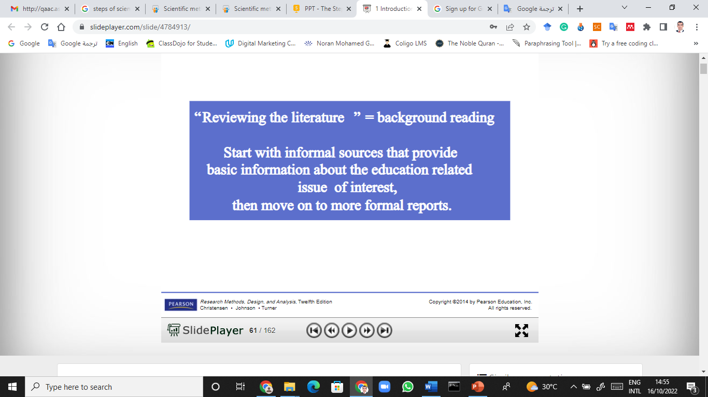
Lecture 3

Slide 5
Lecture 3
What is a literature review?
A literature review is a survey of scholarly sources (journal articles, and theses) related to a specific topic or research question. It is often written as part of a thesis, dissertation, or research paper, in order to situate your work in relation to existing knowledge, allowing you to identify relevant theories, methods, and gaps in the existing research.

Slide 6

Lecture 3
What is a literature review?
A literature review discusses published information in a particular subject area, and sometimes information in a particular subject area within a certain time period.
A literature review can be just a simple summary of the sources, but it usually has an organizational pattern and combines both summary and synthesis. A summary is a recap of the important information of the source, but a synthesis is a re-organization, or a reshuffling, of that information. It might give a new interpretation of old material or combine new with old interpretations. Or it might trace the intellectual progression of the field, including major debates. And depending on the situation, the literature review may evaluate the sources and advise the reader on the most pertinent or relevant

Slide 7

Lecture 3
How is a literature review different from an academic research paper?
The main focus of an academic research paper is to develop a new argument, and a research paper is likely to contain a literature review as one of its parts. In a research paper, you use the literature as a foundation and as support for a new insight that you contribute. The focus of a literature review, however, is to summarize and synthesize the arguments and ideas of others without adding new contribution

Slide 8

Lecture 3
Why do we write literature reviews?
Literature reviews provide you with a handy guide to a particular topic. If you have limited time to conduct research, literature reviews can give you an overview or act as a steppingstone. For professionals, they are useful reports that keep them up to date with what is current in the field. For scholars, the depth and breadth of the literature review emphasizes the credibility of the writer in his or her field. Literature reviews also provide a solid background for a research paper’s investigation. Comprehensive knowledge of the literature of the field is essential to most research papers

Slide 9
Lecture 3
Importance of literature review in research
Provides the interpretation of existing literature in light of updated developments in the field to help in establishing the consistency in knowledge and relevancy of existing materials
It helps in calculating the impact of the latest information in the field by mapping their progress of knowledge.
It brings out the dialects of contradictions between various thoughts within the field to establish facts
The research gaps scrutinized initially are further explored to establish the latest facts of theories to add value to the field
Indicates the current research place in the schema of a particular field
Provides information for relevancy and coherency to check the research
Apart from elucidating the continuance of knowledge, it also points out areas that require further investigation and thus aids as a starting point of any future research

Slide 10
Lecture 3
Importance of literature review in research
Justifies the research and sets up the research question
Sets up a theoretical framework comprising the concepts and theories of the research upon which its success can be judged
Helps to adopt a more appropriate methodology for the research by examining the strengths and weaknesses of existing research in the same field
Increases the significance of the results by comparing it with the existing literature

Slide 11
Lecture 3
Importance of literature review in research
Provides a point of reference by writing the findings in the scientific manuscript
Helps to get the due credit from the audience for having done the fact-finding and fact-checking mission in the scientific manuscripts
The more the reference of relevant sources of it could increase more of its trustworthiness with the readers
Helps to prevent plagiarism by tailoring and uniquely tweaking the scientific manuscript not to repeat other’s original idea

Slide 12

Lecture 3
Importance of literature review in research
By preventing plagiarism, it saves the scientific manuscript from rejection and thus also saves a lot of time and money
Helps to evaluate, condense and synthesize gist in the author’s own words to sharpen the research focus
Helps to compare and contrast to show the originality and uniqueness of the research than that of the existing other researches
Rationalizes the need for conducting the particular research in a specified field
Helps to collect data accurately for allowing any new methodology of research than the existing ones

Slide 13
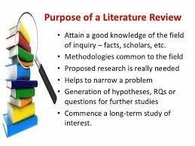
Lecture 3
What is the purpose of a literature review?
When you write a thesis, dissertation, or research paper, you will likely have to conduct a literature review to situate your research within existing knowledge. The literature review gives you a chance to:
Demonstrate your familiarity with the topic and its scholarly context
Develop a theoretical framework and methodology for your research
Position your work in relation to other researchers and theorists
Show how your research addresses a gap or contributes to a debate
Evaluate the current state of research and demonstrate your knowledge of the scholarly debates around your topic.
Writing literature reviews is a particularly important skill if you want to apply for graduate school or pursue a career in research.

Slide 14

Lecture 3
Ask yourself questions like these:
What is the specific thesis, problem, or research question that my literature review helps to define?
What type of literature review am I conducting? Am I looking at issues of theory? methodology? policy? quantitative research (e.g. on the effectiveness of a new procedure)? qualitative research (e.g., studies of loneliness among migrant workers)?
What is the scope of my literature review? What types of publications am I using (e.g., journals, books, government documents, popular media)? What discipline am I working in (e.g., nursing psychology, sociology, medicine)?

Slide 15

Lecture 3
Ask yourself questions like these:
4.How good was my information seeking? Has my search been wide enough to ensure I’ve found all the relevant material? Has it been narrow enough to exclude irrelevant material? Is the number of sources I’ve used appropriate for the length of my paper?
5.Have I critically analysed the literature I use? Do I follow through a set of concepts and questions, comparing items to each other in the ways they deal with them? Instead of just listing and summarizing items, do I assess them, discussing strengths and weaknesses?
6,Have I cited and discussed studies contrary to my perspective?
7.Will the reader find my literature review relevant, appropriate, and useful?

Slide 16
Lecture 3
Consider organization
You’ve got a focus, and you’ve stated it clearly and directly. Now what is the most effective way of presenting the information? What are the most important topics, subtopics, etc., that your review needs to include? And in what order should you present them? Develop an organization for your review at both a global and local level.
.

Slide 17

Lecture 3
The key steps to writing a literature review
There are five key steps to writing a literature review:
Search for relevant literature
Evaluate sources
Identify themes, debates, and gaps
Outline the structure
Write your literature review
A good literature review doesn’t just summarize sources—it analyzes, synthesizes, and critically evaluates to give a clear picture of the state of knowledge on the subject.

Slide 18
Lecture 3
Step 1 – Search for relevant literature
Before you begin searching for literature, you need a clearly defined topic.
If you are writing the literature review section of a dissertation or research paper, you will search for literature related to your research problem and questions.
Literature review research question example
What is the impact of social media on body image among Generation Z?

Slide 19


Lecture 3
Make a list of keywords
Make a list of keywords
Start by creating a list of keywords related to your research question. Include each of the key concepts or variables you’re interested in, and list any synonyms and related terms. You can add to this list as you discover new keywords in the process of your literature search.
Research Title
What is the impact of social media on body image among Generation Z?
Keywords example
Social media, Facebook, Instagram, Twitter, Snapchat, TikTok
Body image, self-perception, self-esteem, mental health
Generation Z, teenagers, adolescents, youth

Slide 20





Lecture 3
Search for relevant sources
Use your keywords to begin searching for sources. Some useful databases to search for journals and articles include:
Your university’s library catalogue
Google Scholar
ResearchGate
JSTOR
EBSCO
SAGE Journals

Slide 21





Lecture 3
Search for relevant sources
Use your keywords to begin searching for sources. Some useful databases to search for journals and articles include:
Science Direct
Elsevier journal
Springer journal
emerald
Taylor and Francis

Slide 22
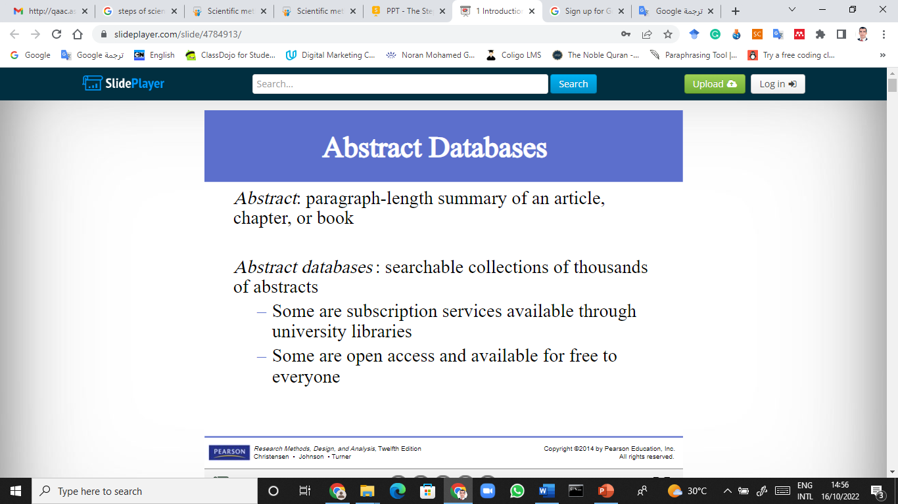

Lecture 3
Sources of literature review

Slide 23
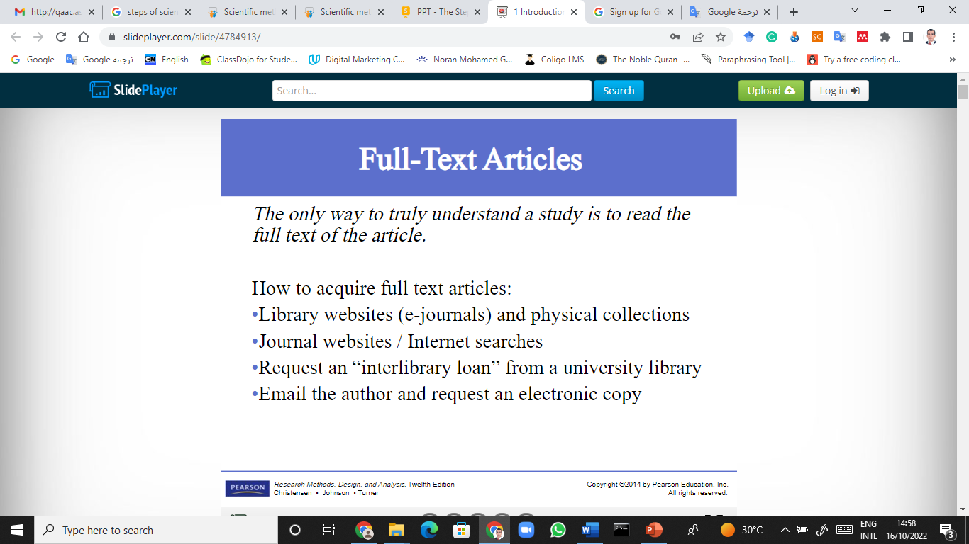
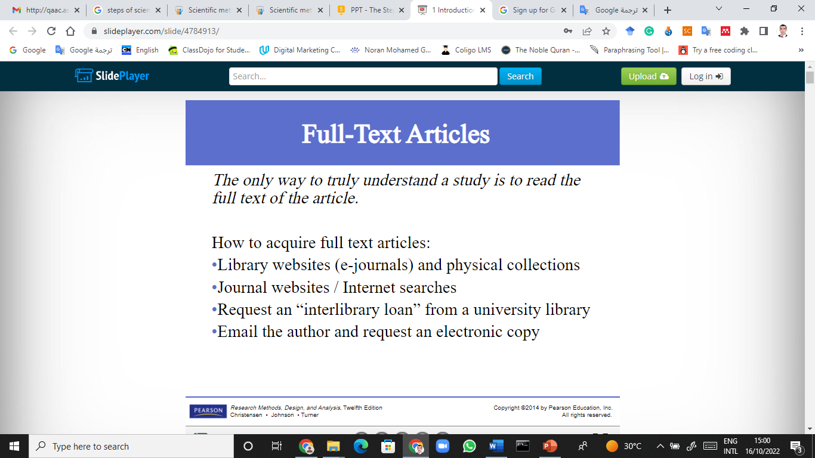

Lecture 3
Lecture 3
Sources of literature review

Slide 24
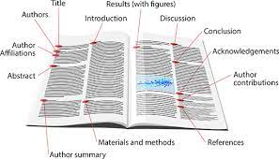

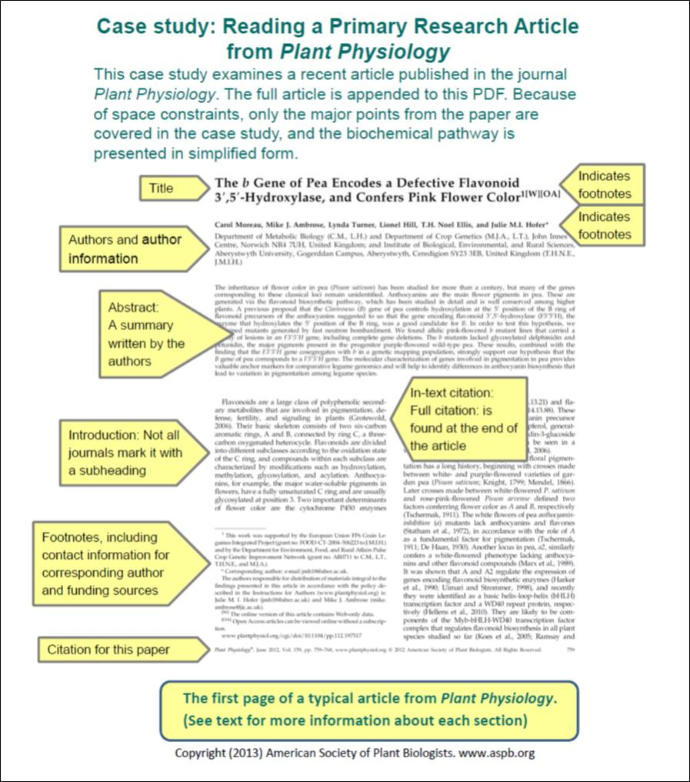
Lecture 3
Sources of literature review

Slide 25
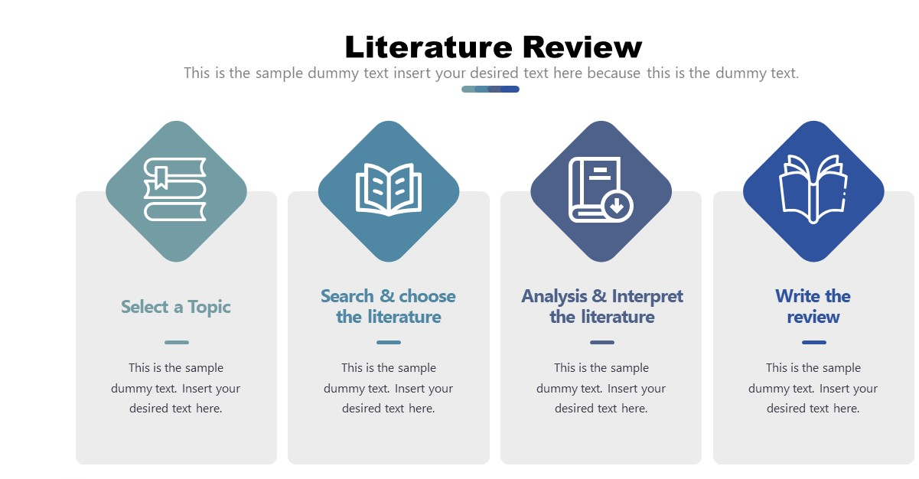
Lecture 3
literature review

Slide 26

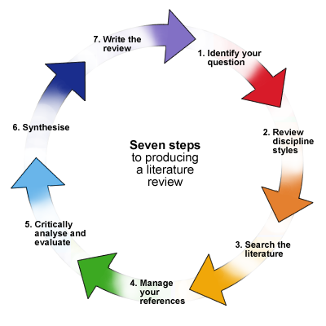
Lecture 3
Strategies for writing the literature review

Slide 27
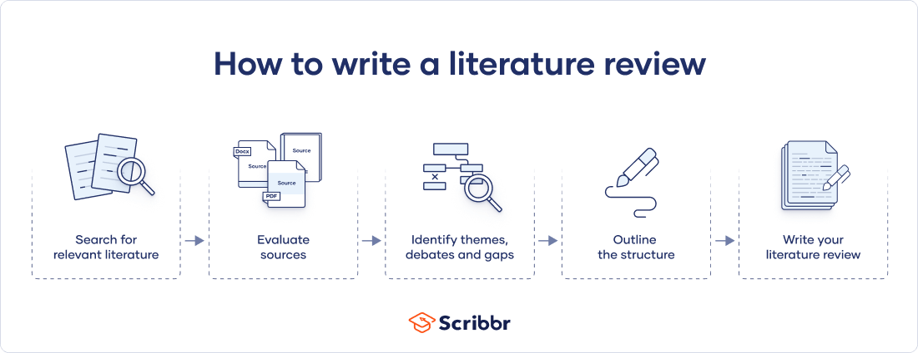
Lecture 3
How to Write a literature review?

Slide 28

Lecture 3
Step 2 – Evaluate and select sources
You likely won’t be able to read absolutely everything that has been written on your topic, so it will be necessary to evaluate which sources are most relevant to your research question.
For each publication, ask yourself:
What question or problem is the author addressing?
What are the key concepts and how are they defined?
What are the key theories, models, and methods?
s approach include:

Slide 29

Lecture 3
Step 2 – Evaluate and select sources
What are the results and conclusions of the study?
How does the publication relate to other literature in the field? Does it confirm, add to, or challenge established knowledge?
What are the strengths and weaknesses of the research?
Make sure the sources you use are credible and make sure you read any landmark studies and major theories in your field of research.
s approach include:

Slide 30

Lecture 3
Step 2 – Evaluate and select sources
Take notes and cite your sources
As you read, you should also begin the writing process.
Take notes that you can later incorporate into the text of your literature review.
It is important to keep track of your sources with citations to avoid plagiarism.
It can be helpful to make an annotated bibliography, where you compile full citation information and write a paragraph of summary and analysis for each source. This helps you remember what you read and saves time later in the process.
s approach include:

Slide 31
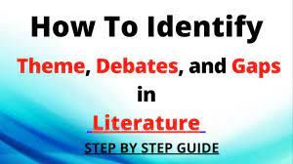
Lecture 3
Step 3 – Identify themes, debates, and gaps
To begin organizing your literature review’s argument and structure, be sure you understand the connections and relationships between the sources you’ve read. Based on your reading and notes, you can look for:
Trends and patterns (in theory, method or results): do certain approaches become more or less popular over time?
Themes: what questions or concepts recur across the literature?
Debates, conflicts and contradictions: where do sources disagree?
Pivotal publications: are there any influential theories or studies that changed the direction of the field?
Gaps: what is missing from the literature? Are there weaknesses that need to be addressed?
This step will help you work out the structure of your literature review and (if applicable) show how your own research will contribute to existing knowledge.
s approach include:

Slide 32
Lecture 3
Step 3 – Identify themes, debates, and gaps
Example of trends and gaps
In reviewing the literature on social media and body image, you note that:
Most research has focused on young women.
There is an increasing interest in the visual aspects of social media.
But there is still a lack of robust research on highly visual platforms like Instagram and Snapchat—this is a gap that you could address in your own research.
s approach include:

Slide 33

Lecture 3
Step 4 – Outline your literature review’s structure
There are various approaches to organizing the body of a literature review. Depending on the length of your literature review, you can combine several of these strategies (for example, your overall structure might be thematic, but each theme is discussed chronologically).
Chronological
The simplest approach is to trace the development of the topic over time. However, if you choose this strategy, be careful to avoid simply listing and summarizing sources in order.
Try to analyze patterns, turning points, and key debates that have shaped the direction of the field. Give your interpretation of how and why certain developments occurred.
s approach include:

Slide 34
Lecture 3
Step 4 – Outline your literature review’s structure
Thematic
If you have found some recurring central themes, you can organize your literature review into subsections that address different aspects of the topic.
For example, if you are reviewing literature about inequalities in migrant health outcomes, key themes might include healthcare policy, language barriers, cultural attitudes, legal status, and economic access.
s approach include:

Slide 35
Lecture 3
Step 4 – Outline your literature review’s structure
Methodological
If you draw your sources from different disciplines or fields that use a variety of research methods, you might want to compare the results and conclusions that emerge from different approaches. For example:
Look at what results have emerged in qualitative versus quantitative research
Discuss how the topic has been approached by empirical versus theoretical scholarship
Divide the literature into sociological, historical, and cultural source
Theoretical
A literature review is often the foundation for a theoretical framework. You can use it to discuss various theories, models, and definitions of key concepts.
s approach include:

Slide 36
Lecture 3
Step 5 – Write your literature review
Like any other academic text, your literature review should have an introduction, a main body, and a conclusion. What you include in each depends on the objective of your literature review.
Introduction
The introduction should clearly establish the focus and purpose of the literature review.
Tip
If you are writing the literature review as part of your dissertation or thesis, reiterate your central problem or research question and give a brief summary of the scholarly context. You can emphasize the timeliness of the topic (“many recent studies have focused on the problem of x”) or highlight a gap in the literature (“while there has been much research on x, few researchers have taken y into consideration”).h include:

Slide 37
Lecture 3
Step 5 – Write your literature review
Body
Depending on the length of your literature review, you might want to divide the body into subsections. You can use a subheading for each theme, time period, or methodological approach.
As you write, you can follow these tips:
Summarize and synthesize: give an overview of the main points of each source and combine them into a coherent whole
Analyze and interpret: don’t just paraphrase other researchers—add your own interpretations where possible, discussing the significance of findings in relation to the literature as a whole
Critically evaluate: mention the strengths and weaknesses of your sources
Write in well-structured paragraphs: use transition words and topic sentences to draw connections, comparisons and contrastsude:

Slide 38
Lecture 3
Step 5 – Write your literature review
Conclusion
In the conclusion, you should summarize the key findings you have taken from the literature and emphasize their significance.
Tip
Be sure to show how your research addresses gaps and contributes new knowledge, or discuss how you have drawn on existing theories and methods to build a framework for your research.
When you’ve finished writing and revising your literature review, don’t forget to proofread thoroughly before submitting. Not a language expert?

Slide 39
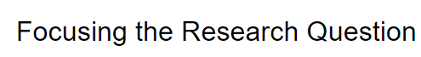

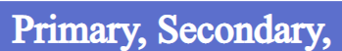
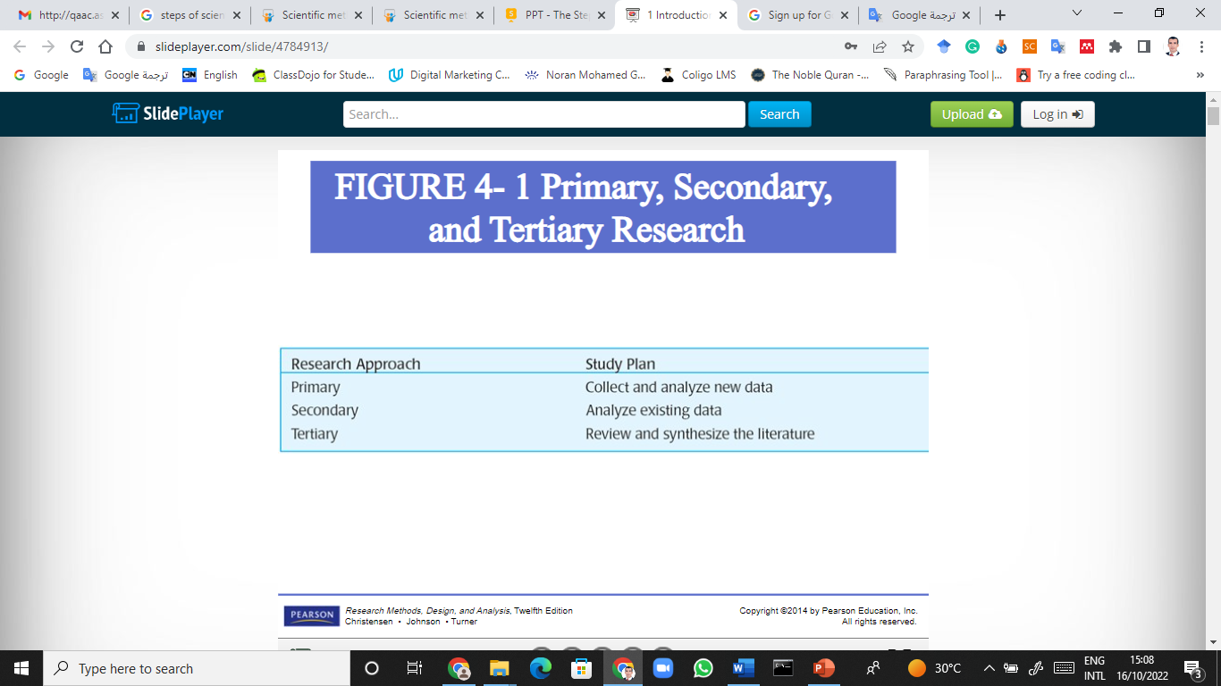
Lecture 3

Slide 40
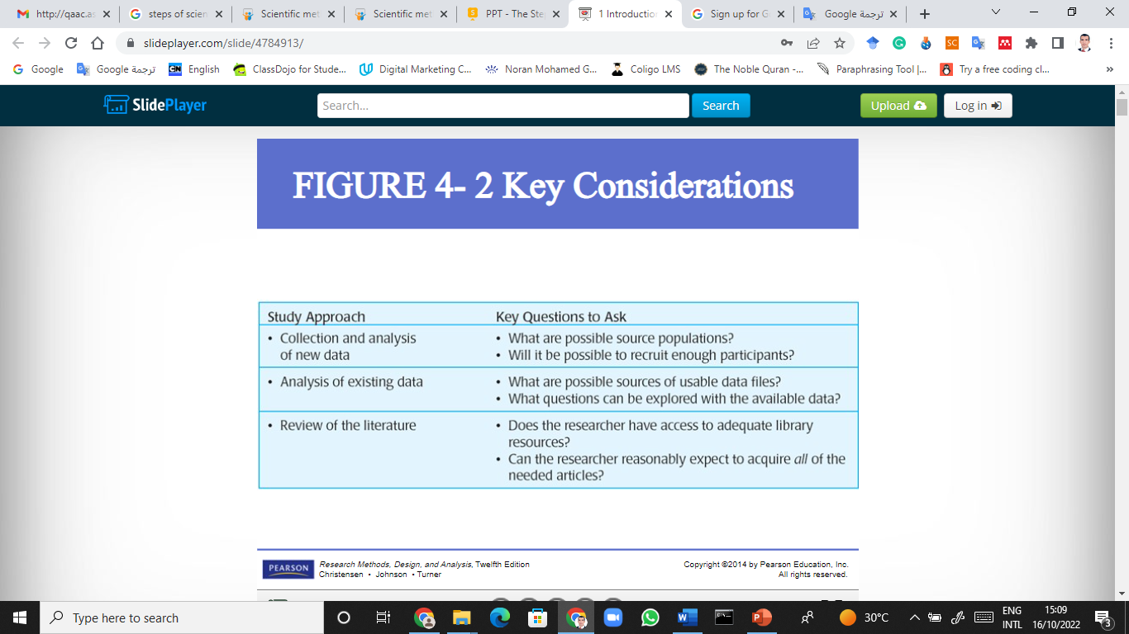
Lecture 3

Slide 41
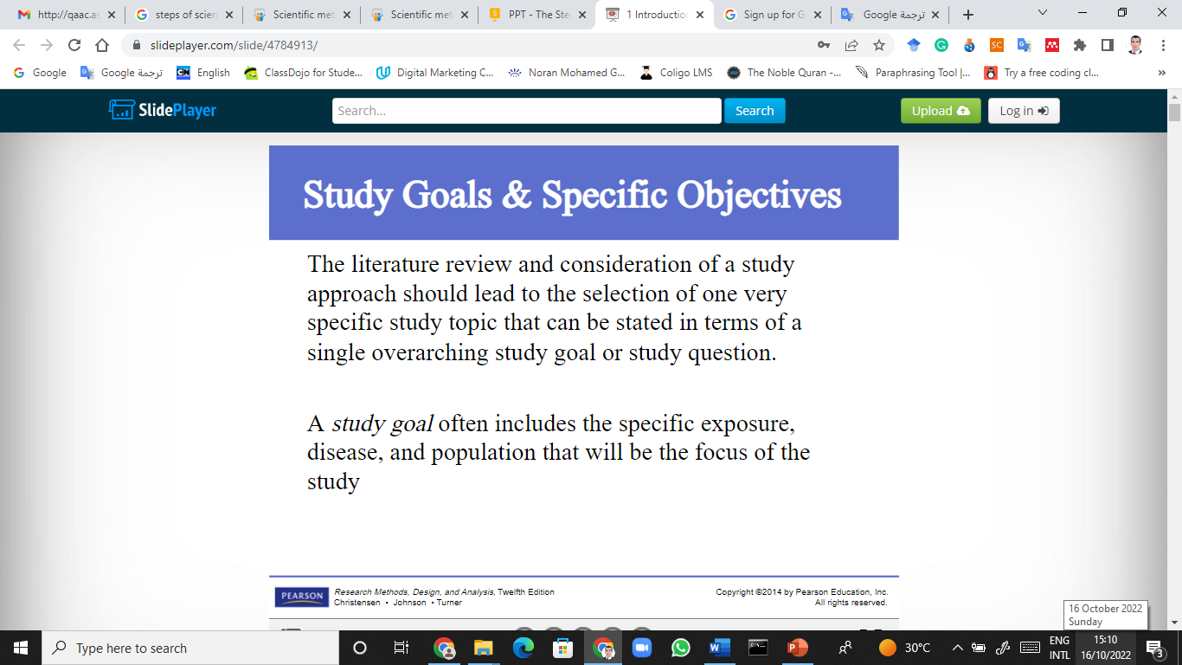

Lecture 3

Slide 42
Thank you

