Slide 1


Prepared by Eng. Eman Hamdy
Introduction to Information Systems – IT111
MS ACCESS DATABASE
Lecture 6 (Practical)

Slide 2

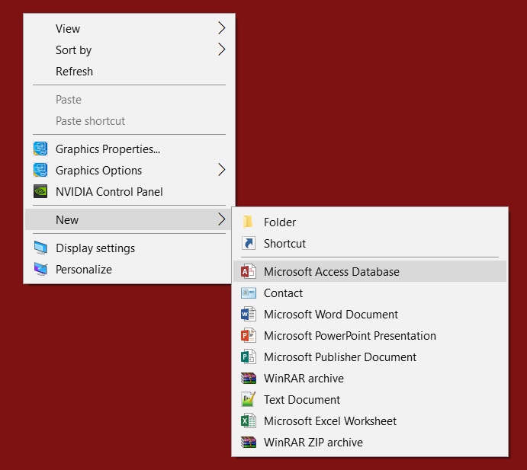
Lec
OPENING THE PROGRAM
06
1- Right Click anywhere on your Desktop
2- Choose New
3- Choose Microsoft Access Database

Slide 3
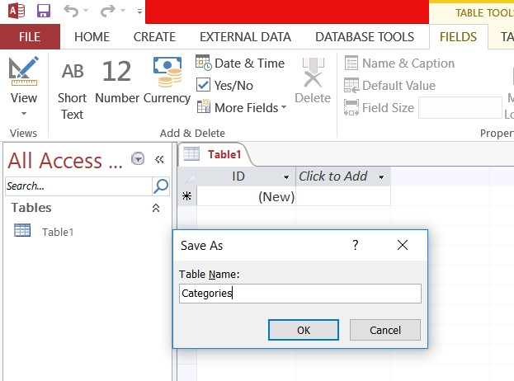
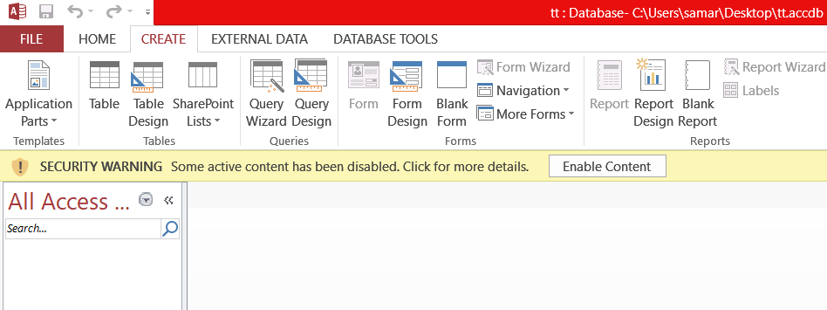
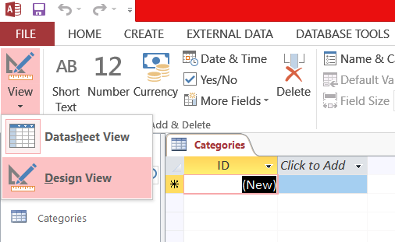
Lec
OPENING THE PROGRAM
06
1- Click on the CREATE tab then Choose Table 2- Press Ctrl+S to save the table and Name it.
3- Click on the View icon and Choose Design View

Slide 4
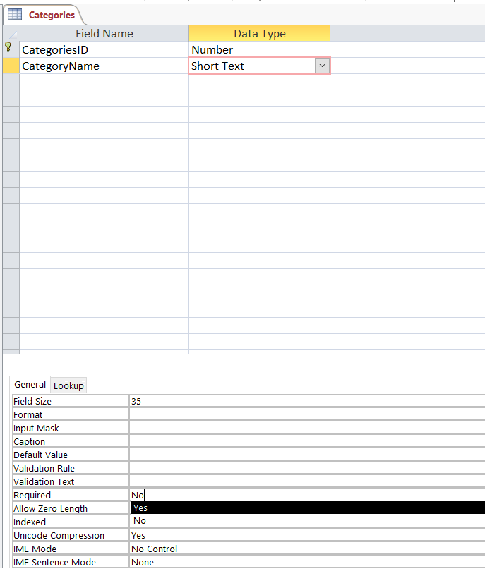
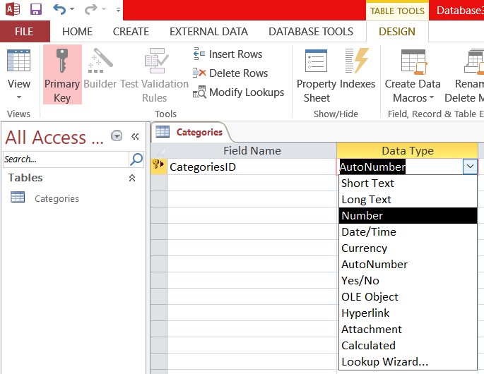
Lec
ADDING ATTRIBUTES
06
Name the attribute below Field Name Column
Choose its type below Data Type Column
Change the Field Size and Required from Field
Properties, the General tab below
1 2
3

Slide 5
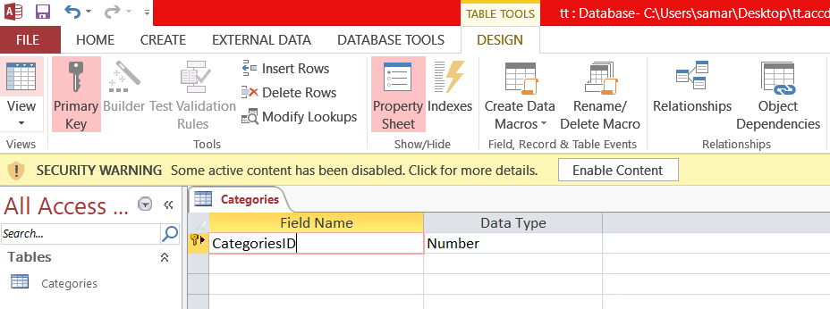
Lec
PRIMARY KEY
06
3- A small yellow key would appear beside thee chosen row
1- Choose the field
2- Click on the Primary Key under the DESIGN tab
2
1
3

Slide 6
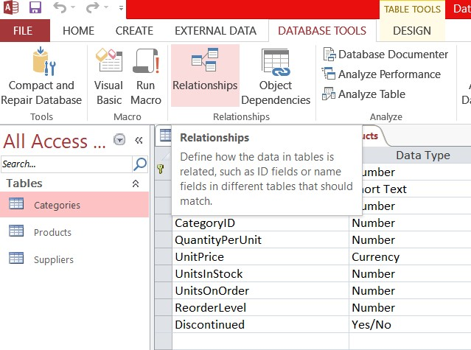
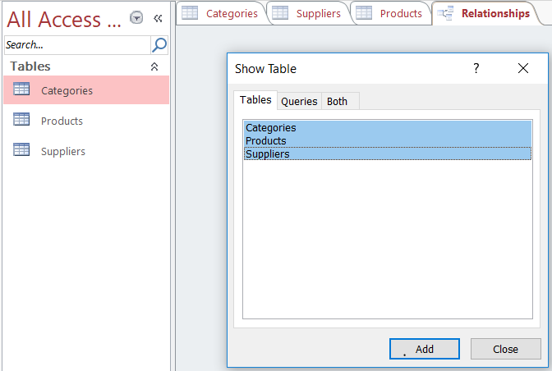
Lec
RELATIONSHIP CREATING
06
Click on DATABASE TOOLS tab then choose Relationships
Choose the tables you want to put in the relation then click Add
1
2

Slide 7
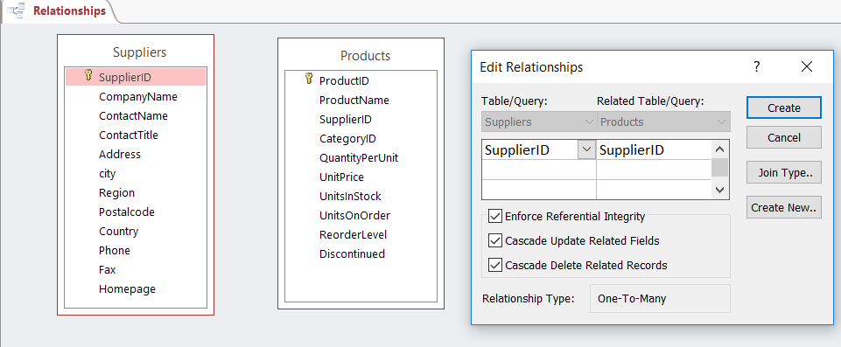
Lec
RELATIONSHIP CREATING
06
3
4
Match the Primary key in each table with its foreign one
Check the Integrity Boxes and then click Create

Slide 8
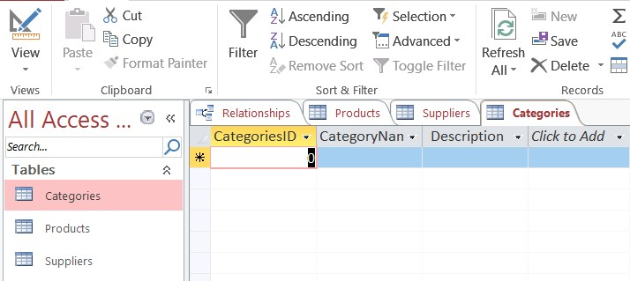
Lec
INSERTING DATA
06
1- Double Click on the table you want to insert data in. 2- Fill in the each row fields with the data of one record.
1
2

Slide 9
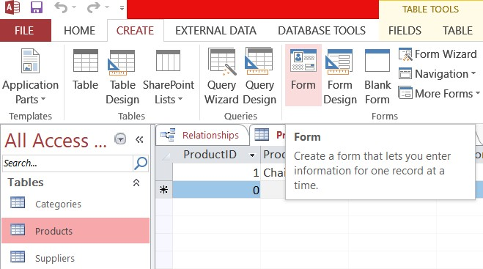
Lec
FORM CREATING
06
1- Choose the table you want to create a form for 2- Click on the CREATE tab
3- Choose Form

Slide 10
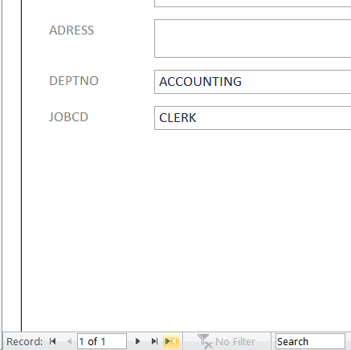
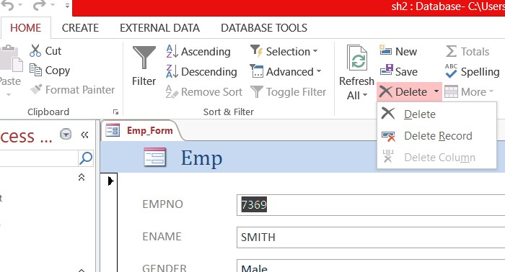
Lec
FORM USING
06
Choose Form View from View icon above:
1- Adding a New Record: Click on the yellow star below
2- Delete a Record: Click on HOME tab, click on the arrow beside and choose Delete Record 3- Update data: Just type the new values after choosing the record .
2
1

Slide 11
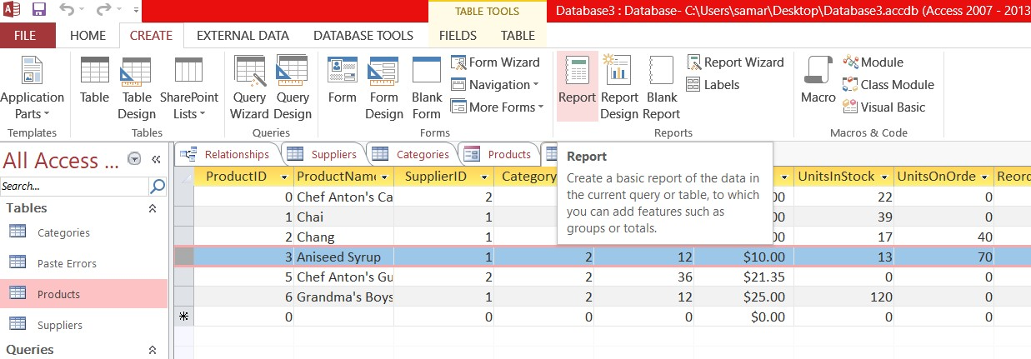
Lec
REPORT CREATING
06
Choose the table you want to report and make sure it’s on the Datasheet View
Click CREATE Report
2

Slide 12
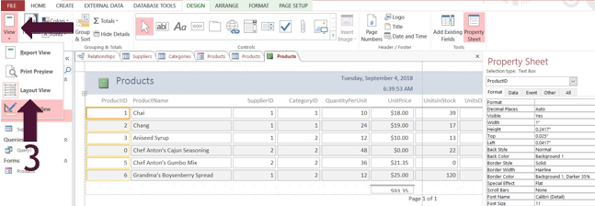
Lec
REPORT CREATING
06
3- A Suggested report would appear Click on View ->Layout View

Slide 13
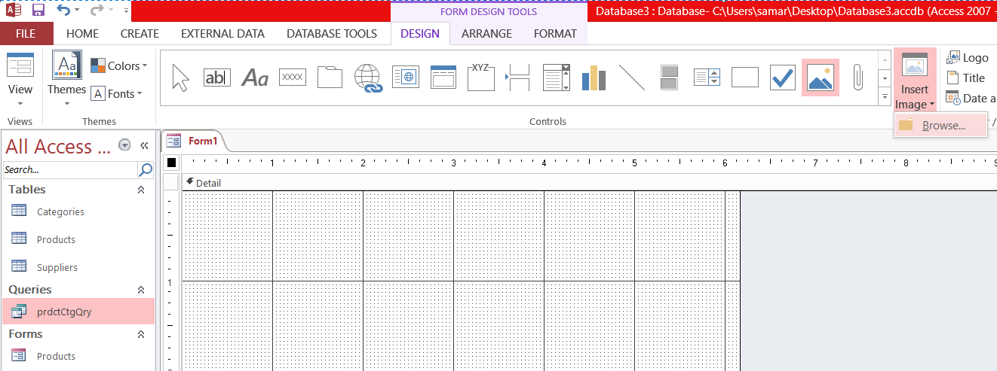
Lec
MAIN MENU
06
○ Main Menu is a simple form that you can create by clicking CREATE-> Form Design and then manipulate its element
1- To insert an image, click to Insert Image and then browse its location on your computer
2- To insert a label, click on Aa then resize it and write.
3- To insert a Button, click on the xxx icon ->Draw your button -> Close the wizard-> Double click on it t o name it
3
2
1

Slide 14



Thank You

