Slide 1



Discrete Mathematics
Dr. Shahira Ahmed
IT241
Lecture 8

Slide 2



Discrete Mathematics
Lecture 8
Number Theory and Cryptography
www.midocean.ae

Slide 3

Learning Outcomes
Understand the fundamental concepts of number theory.
Recognize the importance and applications of number theory in various fields.
Analyze and solve simple number theory s.
www.midocean.ae

Slide 4
Lecture Outline
Why Number theory?
Congruence
Greatest common divisor
Least Common Multiple
Some Examples on using number theory in cryptography
www.midocean.ae

Slide 5
Why?
Number theory is about integers and their properties.
Modern cryptography is based on Number Theory.
In order to understand how modern cryptographic techniques work, and to estimate the extent to which they are secure, it is important to understand the basics of number theory.
https://www2.rivier.edu/faculty/vriabov/cs572aweb/Slides/NumberTheory.ppt

Slide 6
Division
Definition: If a and b are integers with a ≠ 0, then
a divides b if there exists an integer c such that b = ac.
b
a
c

Slide 7
Division
Definition: If a and b are integers with a ≠ 0, then
a divides b if there exists an integer c such that b = ac.
b
a
c

Slide 8
Division
When a divides b we say that a is a factor or divisor of b and that b is a multiple of a.
The notation a | b denotes that a divides b.
If a does not divide b, we write a ∤ b.
b
a
c

Slide 9
Quiz
True or False
  4 | 12
  8 | 56
  3 | 7
Solution
  True, since 12 = 4(3).
  True, since 56 = 8(7).
  False, 3∤7,because 7∕3 is not an integer.

Slide 10
Division Algorithm
If b is an integer and d a positive integer, then there are unique integers q and r, with 0 ≤ r < d, such that b = dq + r.
    d is called the divisor.
    b is called the dividend.
    q is called the quotient.
    r is called the remainder.

Slide 11
Division Algorithm
If b is an integer and d a positive integer, then there are unique integers q and r, with 0 ≤ r < d, such that b = dq + r.
    d is called the divisor.
    b is called the dividend.
    q is called the quotient.
    r is called the remainder.

Slide 12
Quiz
What are the quotient and remainder when 10 is divided by 3?
What are the quotient and remainder when 12 is divided by 5?
What are the quotient and remainder when 10 is divided by 5?
What are the quotient and remainder when 101 is divided by 11?
  quotient =3 , remainder =1
  quotient =2 , remainder =2
  quotient =2 , remainder =0
  quotient =9 , remainder =2.

Slide 13
Quiz
What are the quotient and remainder when 10 is divided by 3?
  quotient =3 , remainder =1
  Quotient × Divisor + Remainder = Dividend
  3*3+1=10
What are the quotient and remainder when 12 is divided by 5?
  quotient =2 , remainder =2
  Quotient × Divisor + Remainder = Dividend
  2*5+2=12

Slide 14
Quiz
What are the quotient and remainder when 0 is divided by 3?
What are the quotient and remainder when 2 is divided by 3?
  q=0,r=0
  q=0,r=2

Slide 15
Divisibility Theorems
For integers a, b, and c it is true that
if a | b and a | c, then a | (b + c)
Example: 3 | 6 and 3 | 9, so 3 | 15.
if a | b, then a | bc for all integers c
Example: 5 | 10, so 5 | 20, 5 | 30, 5 | 40, …
if a | b and b | c, then a | c
Example: 4 | 8 and 8 | 24, so 4 | 24.

Slide 16
Primes
A positive integer p greater than 1 is called prime if the only positive factors of p are 1 and p.
A positive integer that is greater than 1 and is not prime is called composite.
Example:
The integer 7 is prime because its only positive factors are 1 and 7.
The integer 9 is composite because it is divisible by 3.

Slide 17
The Fundamental Theorem of Arithmetic
Theorem: Every positive integer greater than 1 can be written uniquely as a prime or as the product of two or more primes where the prime factors are written in order of nondecreasing size.
Examples:
  100 = 2 ∙ 2 ∙ 5 ∙ 5 = 2² ∙ 5²
  641 = 641
  999 = 3 ∙ 3 ∙ 3 ∙ 37 = 3³ ∙ 37
  1024 = 2 ∙ 2 ∙ 2 ∙ 2 ∙ 2 ∙ 2 ∙ 2 ∙ 2 ∙ 2 ∙ 2 = 2¹⁰

Slide 18
Primes
15 =
3·5
48 =
2·2·2·2·3 = 2⁴·3
17 =
17
100 =
2·2·5·5 = 2²·5²
512 =
2·2·2·2·2·2·2·2·2 = 2⁹
515 =
5·103
28 =
2·2·7

Slide 19
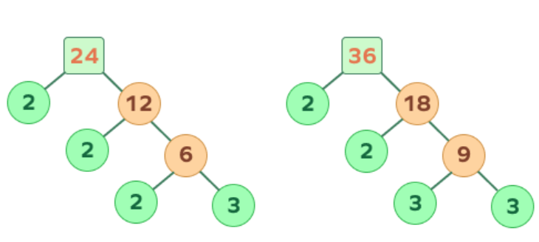
Greatest Common Divisors
Let a and b be integers, not both zero.
The largest integer d such that d | a and d | b is called the greatest common divisor of a and b.
The greatest common divisor of a and b is denoted by gcd(a, b).
  Example 1: What is gcd(24, 36) ?
  12

Slide 20
Greatest Common Divisors
Using prime factorizations:
a = p₁ª1 p₂ª2 … p_{n}ªn , b = p₁^{b}1 p₂^{b}2 … p_{n}^{b}n ,
where p₁ < p₂ < … < p_{n} and a_{i}, b_{i} ∈ N for 1 ≤ i ≤ n
gcd(a, b) = p₁^{min(a}1^{, b}1 ⁾ p₂^{min(a}2^{, b}2 ⁾ … p_{n}^{min(a}n^{, b}n ⁾
Example:
a = 60 =
2² 3¹ 5¹
b = 54 =
2¹ 3³ 5⁰
gcd(a, b) =
2¹ 3¹ 5⁰ = 6

Slide 21
Relatively Prime Integers
Two integers a and b are relatively prime if
gcd(a, b) = 1.
Examples:
  Are 15 and 28 relatively prime?
  Yes, gcd(15, 28) = 1.
  Are 55 and 28 relatively prime?
  Yes, gcd(55, 28) = 1.
  Are 35 and 28 relatively prime?
  No, gcd(35, 28) = 7.

Slide 22
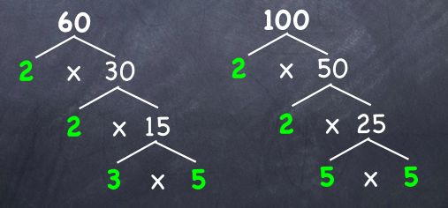
Least Common Multiples
The least common multiple of the positive integers a and b is the smallest positive integer that is divisible by both a and b.
We denote the least common multiple of a and b by lcm(a, b).
Examples:
  lcm(60,100)
  lcm of 60 and 100 = 2 * 2 * 3 * 5 * 5 = 300.

Slide 23
Least Common Multiples
Using prime factorizations:
a = p₁ª1 p₂ª2 … p_{n}ªn , b = p₁^{b}1 p₂^{b}2 … p_{n}^{b}n ,
where p₁ < p₂ < … < p_{n} and a_{i}, b_{i} ∈ N for 1 ≤ i ≤ n
lcm(a, b) = p₁^{max(a}1^{, b}1 ⁾ p₂^{max(a}2^{, b}2 ⁾ … p_{n}^{max(a}n^{, b}n ⁾
Example:
a = 60 =
2² 3¹ 5¹
b = 54 =
2¹ 3³ 5⁰
lcm(a, b) =
2² 3³ 5¹ = 4*27*5 = 540

Slide 24
GCD and LCM
a = 60 =
2² 3¹ 5¹
b = 54 =
2¹ 3³ 5⁰
gcd(a, b) =
2¹ 3¹ 5⁰ = 6
lcm(a, b) =
2² 3³ 5¹ = 540
Theorem: a*b =
gcd(a,b)*lcm(a,b)

Slide 25
Euclidean Algorithm
The Euclidian algorithm is an efficient method for computing the greatest common divisor of two integers.
It is based on the idea that gcd(a,b) is equal to gcd(a,c) when c is the remainder when a is divided by b.
Example: Find gcd(91, 287):
    287 = 91 ∙ 3 + 14
    91 = 14 ∙ 6 + 7
    14 = 7 ∙ 2 + 0
  gcd(287, 91) = gcd(91, 14) = gcd(14, 7) = 7
continued →

Slide 26
Congruences
Let a and b be integers and m be a positive integer. We say that a is congruent to b modulo m if m divides a – b.
We use the notation a ≡ b (mod m) to indicate that a is congruent to b modulo m.
In other words: a ≡ b (mod m) if and only if a mod m = b mod m.

Slide 27
Congruences
True or False
46 ≡ 68 (mod 11) ?
Yes, because 11 | (46 – 68).
46 ≡ 68 (mod 22)?
Yes, because 22 | (46 – 68).
For which integers z is it true that z ≡ 12 (mod 10)?
It is true for any z∈{…,-28, -18, -8, 2, 12, 22, 32, …}

Slide 28
Congruences
True or False
46 ≡ 68 (mod 11) ?
Yes, because 11 | (46 – 68).
46 ≡ 68 (mod 22)?
Yes, because 22 | (46 – 68).
For which integers z is it true that z ≡ 12 (mod 10)?
It is true for any z∈{…,-28, -18, -8, 2, 12, 22, 32, …}

Slide 29
Caesar Cipher
Julius Caesar created secret messages by shifting each letter three letters forward in the alphabet (sending the last three letters to the first three letters.)
For example, the letter B is replaced by E and the letter X is replaced by A. This process of making a message secret is an example of encryption.

Slide 30
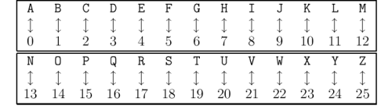
Caesar Cipher

Slide 31
Caesar Cipher
Here is how the encryption process works:
  Replace each letter by an integer from Z₂₆, that is an integer from 0 to 25 representing one less than its position in the alphabet.
  The encryption function is f(p) = (p + 3) mod 26. It replaces each integer p in the set {0,1,2,…,25} by f(p) in the set {0,1,2,…,25} .
  Replace each integer p by the letter with the position p in the alphabet.

Slide 32
Caesar Cipher
Example: Encrypt the message “MEET YOU IN THE PARK” using the Caesar cipher.
12 4 4 19 24 14 20 8 13 19 7 4 15 0 17 10.
Now replace each of these numbers p by f(p) = (p + 3) mod 26.
15 7 7 22 1 17 23 11 16 22 10 7 18 3 20 13.
Translating the numbers back to letters produces the encrypted message
“PHHW BRX LQ WKH SDUN.”

Slide 33

Caesar Cipher
Example: Encrypt the message “MEET YOU IN THE PARK” using the Caesar cipher.
12 4 4 19 24 14 20 8 13 19 7 4 15 0 17 10.
Now replace each of these numbers p by f(p) = (p + 3) mod 26.
15 7 7 22 1 17 23 11 16 22 10 7 18 3 20 13.
Translating the numbers back to letters produces the encrypted message
“PHHW BRX LQ WKH SDUN.”

Slide 34
Caesar Cipher
To recover the original message, use f⁻¹(p) = (p−3) mod 26. This process of recovering the original message from the encrypted message is called decryption.

Slide 35
Caesar Cipher
Example: decrypt the message ““PHHW BRX LQ WKH SDUN.”” using the Caesar cipher.
15 7 7 22 1 17 23 11 16 22 10 7 18 3 20 13.
Now replace each of these numbers p by f(p) = (p-3) mod 26.
12 4 4 19 24 14 20 8 13 19 7 4 15 0 17 10.
Translating the numbers back to letters produces the encrypted message
“MEET YOU IN THE PARK.”

Slide 36
Shift Cipher
Encrypt the message “STOP GLOBAL WARMING” using the shift cipher with k = 11.
Replace each letter with the corresponding element of Z₂₆.
18 19 14 15 6 11 14 1 0 11 22 0 17 12 8 13 6.
Apply the shift f(p) = (p + 11) mod 26, yielding
3 4 25 0 17 22 25 12 11 22 7 11 2 23 19 24 17.
Translating the numbers back to letters produces the ciphertext
“DEZA RWZMLW HLCXTYR.”

Slide 37
Shift Cipher
Decrypt the message “LEWLYPLUJL PZ H NYLHA ALHJOLY” that was encrypted using the shift cipher with k = 7.
Replace each letter with the corresponding element of Z₂₆.
11 4 22 11 24 15 11 20 9 11 15 25 7 13 24 11 7 0 0 11 7 9 14 11 24.
Shift each of the numbers by −k = −7 modulo 26, yielding
4 23 15 4 17 8 4 13 2 4 8 18 0 6 17 4 0 19 19 4 0 2 7 4 17.
Translating the numbers back to letters produces the decrypted message
“EXPERIENCE IS A GREAT TEACHER.”

Slide 38
Affine Ciphers
Shift ciphers are a special case of affine ciphers which use functions of the form
  f(p) = (ap + b) mod 26,
where a and b are integers, chosen so that f is a bijection.
The function is a bijection if and only if gcd(a,26) = 1.

Slide 39
Affine Ciphers
Example: What letter replaces the letter K when the function
f(p) = (7p + 3) mod 26 is used for encryption.
Since 10 represents K, f(10) = (7∙10 + 3) mod 26 =21, which is then replaced by V.

Slide 40
Cryptanalysis of Affine Ciphers
The process of recovering plaintext from ciphertext without knowledge both of the encryption method and the key is known as cryptanalysis or breaking codes.
An important tool for cryptanalyzing ciphertext produced with a affine ciphers is the relative frequencies of letters.
The nine most common letters in the English texts are E 13%, T 9%, A 8%, O 8%, I 7%, N 7%, S 7%, H 6%, and R 6%.

Slide 41
Cryptanalysis of Affine Ciphers
o analyze ciphertext:
  Find the frequency of the letters in the ciphertext.
  Hypothesize that the most frequent letter is produced by encrypting E.
  If the value of the shift from E to the most frequent letter is k, shift the ciphertext by −k and see if it makes sense.
  If not, try T as a hypothesis and continue.

Slide 42

Cryptanalysis of Affine Ciphers
Example: We intercepted the message “ZNK KGXRE HOXJ MKZY ZNK CUXS” that we know was produced by a shift cipher. Let’s try to cryptanalyze.jkm
The most common letter in the ciphertext is K. So perhaps the letters were shifted by 6 since this would then map E to K. Shifting the entire message by −6 gives us “THE EARLY BIRD GETS THE WORM.”

Slide 43
Group
A group is a mathematical structure consisting of a set of elements and an associated binary operation that satisfies four fundamental properties: closure, associativity, identity, and inverse.
Let G be a set, and let * be a binary operation defined on G. G is called a group if it satisfies the following properties:
  Closure: For any two elements a and b in G, the result of the operation a * b is also in G.
  Associativity: For any three elements a, b, and c in G, the operation is associative, i.e., (a * b) * c = a * (b * c).
  Identity: There exists an element e in G, called the identity element, such that for any element a in G, a * e = e * a = a.
  Inverse: For every element a in G, there exists an element b in G, called the inverse of a, such that a * b = b * a = e.

Slide 44
Group
(N,+) Form a group?
No, there is no inverse

Slide 45
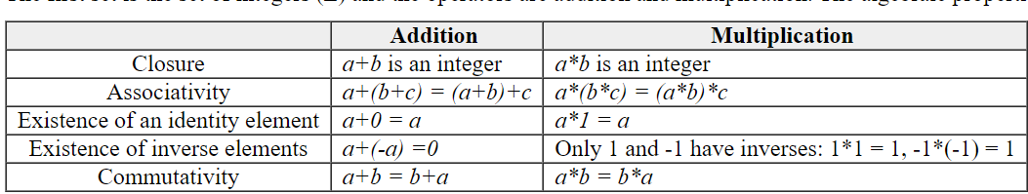
Group
(Z,+) Form a group?
Yes
(Z,*) Form a group?
No, There is no inverse

Slide 46
Group
(Z,-) Form a group?
No
(Z,/) Form a group?
No, Z is not closed under division

Slide 47
Group
An Abelian or Commutative Group is a Group with the additional condition
  Commutativity. For all a,b ∈ G, a*b=b*a

Slide 48
Fields
A Field is a set of elements F with binary operators * and + such that
  (F, +) is an abelian group
  (F \ I₊, *) is an abelian group
  the “multiplicative group”
  Distribution: a*(b+c) = a*b + a*c
  Cancellation: a*I₊ = I₊
The order of a field is the number of elements.
A field of finite order is a finite field.

Slide 49
Finite field Application للاطلاع فقط
Error Correction Codes: Finite fields are extensively used in coding theory and error correction codes. They form the foundation for constructing error correction codes such as Reed-Solomon codes, BCH codes, and LDPC codes. These codes are widely used in communication systems, storage devices, and data transmission to detect and correct errors.
Cryptography: Finite fields play a crucial role in modern cryptography. They are used in the design and implementation of symmetric key algorithms such as the Advanced Encryption Standard (AES) and block ciphers. Finite fields also form the basis for elliptic curve cryptography (ECC), which is widely used in public-key cryptography systems.
Combinatorics and Design Theory: Finite fields are used in combinatorics and design theory to construct combinatorial structures such as finite projective planes, block designs, and error-correcting codes. These structures have applications in coding theory, information theory, and experimental design.
Finite Field Arithmetic in Hardware: Finite field arithmetic is implemented in hardware for various applications. It is used in digital signal processors (DSPs), field-programmable gate arrays (FPGAs), and cryptographic hardware modules to perform efficient computations involving finite fields.

Slide 50
Recap

Slide 51
Quiz
Does 2 divide 68?
Does 15 divide 68?
Does 5 divide 25?
Does 5 divide 2?
Solution
  True , False , True , False

Slide 52
Quiz
Determine whether each of these integers is prime.
a) 21
b) 29
c) 71
d) 97
e) 111
f ) 143
Solution
  29, 71, 97 prime; 21, 111, 143 not prime

Slide 53
Quiz
Determine whether the integers in each of these sets are relatively prime.
a) 11, 15
b)11,19
c) 14, 15
d) 14, 21
e) 12, 18
f) 11,22
Solution
  a) Yes b) Yes c)Yes d) No e) No f) No

Slide 54
Quiz
Encrypt the message DO NOT PASS GO by translating the letters into numbers, applying the given encryption function
a) f (p) = (p + 3) mod 26 (the Caesar cipher)
b) f (p) = (p + 13) mod 26
c) f (p) = (3p + 7) mod 26
Solutions
GR QRW SDVV JR
QB ABG CNFF TB
QX UXM AHJJ ZX

Slide 55
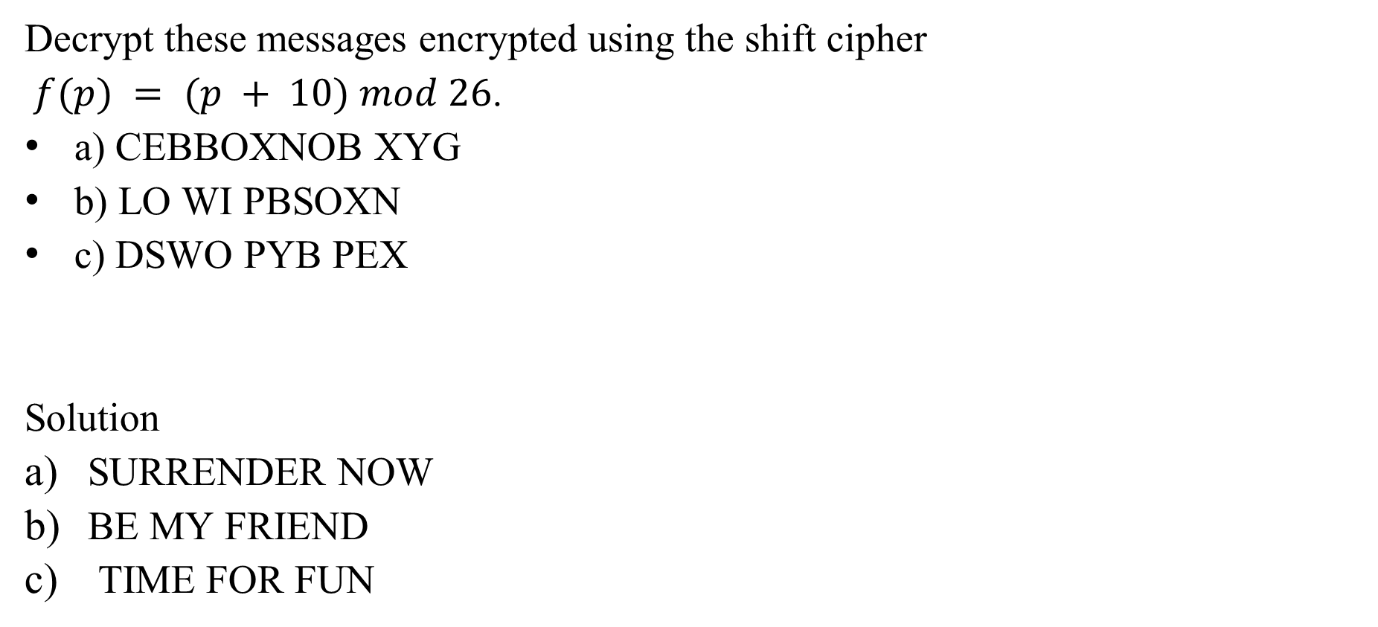
Quiz
Decrypt these messages encrypted using the shift cipher
$f(p) = (p + 10) mod 26$.
a) CEBBOXNOB XYG
b) LO WI PBSOXN
c) DSWO PYB PEX
Solution
SURRENDER NOW
BE MY FRIEND
TIME FOR FUN

Slide 56
Quiz
Find the GCD of 36 and 48.
Determine the positive integer that divides 72 and 120 with the greatest Common divisor.
Compute the GCD of 105 and 140.
What is the GCD of 54 and 81?
Find the common divisor of 63 and 105 with the greatest value.
Solution
  The GCD of 36 and 48 is 12.
  The GCD of 72 and 120 is 24.
  The GCD of 105 and 140 is 35.
  The GCD of 54 and 81 is 27.
  The GCD of 63 and 105 is 21.

Slide 57
Quiz
Determine the LCM of 15 and 20.
Find the LCM of 8 and 12.
Compute the LCM of 18 and 24
What is the LCM of 30 and 45?
Determine the LCM of 36 and 48
Solution:
  60
  24
  72
  90
  144

Slide 58
Lecture SuMmary
Number theory is a branch of mathematics that focuses on the properties and relationships of integers.
Prime numbers are integers greater than 1 that are divisible only by 1 and themselves, and they play a fundamental role in number theory. Prime factorization is the process of expressing a composite number as a product of prime factors.
Number theory has practical applications in cryptography
www.midocean.ae

