Slide 1



Overview of Project Management
Lecture 4
PMG 101
Foundations of Project Management
www.midocean.ae

Slide 2
Mission, Vision, Objectives and Culture of Organization
Chapter 4
www.midocean.ae

Slide 3
Learning Objectives
Define problem.
Understand mission, vision, goals and objectives.
Understand organizational culture and its impact on project management.
Understand dimensions of organizational culture.
Cultural dimensions of an Organization supportive to project management.
www.midocean.ae

Slide 4
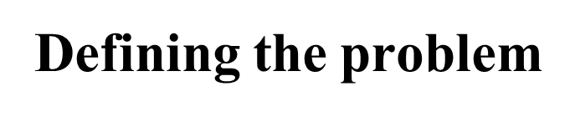
Every project solves a problem of some kind, but people are inclined to skip over the definition of the problem. This is a big mistake.
The way you define a problem determines how you will solve it, so it is critical that a proper definition be developed.
www.midocean.ae

Slide 5
Mission
A Mission Statement defines the company's business, its objectives and its approach to reach those objectives.
A mission statement describes an organization's purpose and answers the questions "What business are we in?" and "What is our business for?
www.midocean.ae

Slide 6
Vision
A Vision Statement describes the desired future position of the company.
A vision statement provides strategic direction and describes what the owner or founder wants the company to achieve in the future.
www.midocean.ae

Slide 7
Mission statements vs. Vision statements
Sometimes the terms “mission statement” and “vision statement” are used interchangeably or even combined into a single statement.
But they mean two very different things. Your mission statement is what your company is doing right now, while your vision statement is what you hope to achieve in the future – where you are in this moment versus where you’re going.
www.midocean.ae

Slide 8
Mission statements vs. vision statements
For example, if someone asks you, “So, what do you do?” you might say, “I’m a software developer at a mid-size software company”.
But, what if they asked you, “What do you want to be doing five or 10 years from now?” Your answer might be a bit different, right?
Maybe you’d say, “My goal is to move into a management position where I oversee all of the company’s developers”.
www.midocean.ae

Slide 9
Mission statement examples
We’ve put together a mini list of inspiration to help you get started. Below are some winning mission statements from a few well-known companies:
Sweetgreen: “Our mission is to inspire healthier communities by connecting people to real food.”
Nike: “Bring inspiration and innovation to every athlete* in the world. *If you have a body, you are an athlete.”
LinkedIn: “Connect the world’s professionals to make them more productive and successful.”
www.midocean.ae

Slide 10
How to write a mission statement
let’s just keep this simple for now. In its most basic form, your mission statement should capture:
What your company offers your customers (why do you exist?)
Who your company serves (who are your target customers?)
Why your company stands out (what makes you different from your competitors?
www.midocean.ae

Slide 11
How to write a mission statement
For example, imagine that you work for a software company that developed an app that uses highly tailored personality tests to match candidates with dream jobs. You might create something like this:
What your company offers your customers?
An easy solution to finding a dream job.
Who your company serves?
Young professionals who feel lost about their next career steps.
Why your company stands out?
Your personality assessments are patented and highly rated.
www.midocean.ae

Slide 12
Vision statement examples
Forecasting the future of your company – and with such bravado – makes creating a vision statement a strange (and somewhat braggy and therefore slightly uncomfortable) task. But, seriously, that’s what a vision is all about. See below for examples of companies who have taken this task and owned it.
Ford: “To become the world’s most trusted company.”
McDonald’s: “To be the best quick service restaurant experience. Being the best means providing outstanding quality, service, cleanliness and value, so that we make every customer in every restaurant smile.”
www.midocean.ae

Slide 13
A guide to write vision statement
Make it concise and easy to understand. It is best when your project vision statement is not only easy to understand, but also easy to remember. The shorter and clearer you make it, the less grey area there is for your team members to interpret in their own way. Also, if they can easily remember it, they are more likely to follow it.
Specify, but do not limit. Your vision statement should define the end goal and additional criteria that will make project a success. However, it should not be focused on one specific way to achieve this end goal. Instead, it should allow multiple paths to the desired result and encourage action from both stakeholders and the team.
Look into the future. When writing a project vision statement, your focus should be on what you aim to achieve in a certain time frame. Instead of focusing on what you want now, look 5, 10, 20 years ahead and set your goals on where you want to be. Thus, driving your operation forward and aiming to reach certain results in a certain time frame.
www.midocean.ae

Slide 14
A guide to write vision statement
4. Make it inspirational and challenging. Your vision statement should be about something that the whole team is excited to achieve. At the same time, this goal should be something of a challenge that would be possible long-term and not in the near future. This way your team is excited to work hard in order to get something that is possible along the way.
5. Don’t be too specific. When writing your vision, leave some space for changes. It is impossible to know what will happen in the next five years, thus keeping some vagueness to your goal means it won’t become inapplicable down the road.
6. Write about who you are. The best vision statements are about who you are as a company or team and who you wish to become.
www.midocean.ae

Slide 15
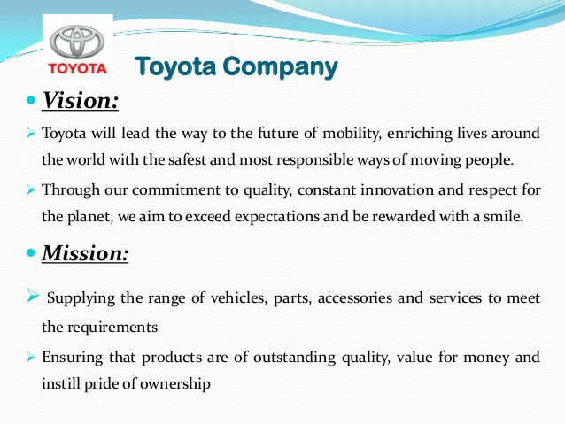
www.midocean.ae

Slide 16
Project’s Goals and Objectives
Projects are planned and implemented in terms of their goals and objectives set by the owners of the project.
Goals and objectives must be clearly defined and established at the outset.
Goals are outcomes of the project whilst objectives are activities that will result in the desired outcome.
www.midocean.ae

Slide 17

www.midocean.ae

Slide 18
Objectives help define the project in terms of its purpose.
Objectives need to be SMART:
Specific: clearly stated with specific outcomes.
Measurable: so, the end of each objective can be identified and measured against success criteria.
Achievable: attainable given the available resources, time, and technology, in accordance with required quality.
Relevant: ensure that your objectives are relevant to the company vision.
Timely bounded: planned and attained tasks according to base line and prioritization of hierarchy of needs.
www.midocean.ae

Slide 19
Developing Objectives
Objectives are developed within the limits set by the project triple constraints – also known as primary objectives - of time, resources, and scope, in accordance with required quality for project output.
Sometimes, satisfying all three primary objectives in full is almost impossible. Preferences must be applied in deciding the relative importance of each constraint in relation to goals.
www.midocean.ae

Slide 20
-Goals are desired outcomes whilst Objectives are a set of activities for achieving goals.
-They need to be developed and established at the outset and communicated to everyone involved.
-Project goals and objectives must be aligned with organizational goals and objectives in order to gain approval and contribute to overall organizational strategy.
-Objectives should be SMART and set within the limits of triple constraint.
-Goals are broad long-term outcomes and objectives are specific measurable short-term activities that will articulate project goals.
www.midocean.ae

Slide 21
MISSION and VISION ORGANIZING
-Facilitates strategy
-Defines roles and responsibilities
-Encourages coordinated efforts
-Creates and supports culture.
www.midocean.ae

Slide 22
What Went Wrong?
In a paper titled “A Study in Project Failure,” two researchers examined the success and failure of 214 IT projects over an eight-year period in several European countries.
The researchers found that only one in eight (12.5 percent) were considered successful in terms of meeting scope, time, and cost goals.
The authors said that the culture within many organizations is often to blame.
Among other things, people often do not discuss important leadership, stakeholder, and risk management issues.
www.midocean.ae

Slide 23
Organizational Culture
The unwritten rules of behavior, or norms that are used to shape and guide behavior, is shared by some subset of organization members and is taught to all new members of the company.
Key factors that affect culture development:
  -Technology
  -Environment
  -Geographical location
  -Reward system -Rules and procedures
  -Key organizational members -Critical incidents
www.midocean.ae

Slide 24
Organizational culture
Organizations have personalities, which are referred to as “cultures”.
Culture is One of three of the most important contextual issues for project management.
It helps to create concept of organizational culture and its roots and implications for effective project management.
Organizational culture is a system of shared meaning held by members that distinguishes the organization from other organizations.
Organizational cultures govern how that organization’s members behave.
www.midocean.ae

Slide 25
How An Organization’s Culture Is Established
An organization’s current customs, traditions and general way of doing things are largely due to what it has done before and the degree of success it has had with those endeavors. The original source of an organization’s culture usually reflects the vision, mission and values of the organization’s founder(s). Because they have the original idea, they usually have unique ways of carrying it out. Typically, they’re not usually constrained by old customs or approaches. Thus, they establish the early culture by projecting an image of what the organization should be. However, over time, many people will influence and shape an organization’s culture.
www.midocean.ae

Slide 26
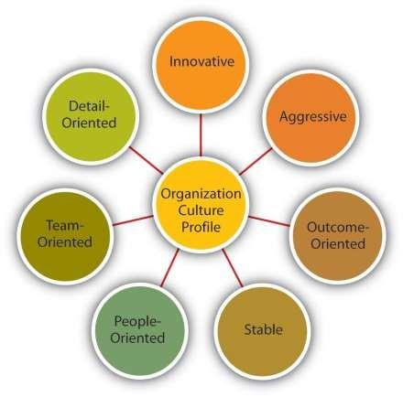
Characteristics of organization's culture
Seven characteristics that capture the essence of an organization's culture:
Innovation and Risk Taking;
Attention to Detail;
Outcome Orientation;
People Orientation;
Team Orientation;
Aggressiveness;
Stability.
www.midocean.ae

Slide 27
Characteristics of organization's culture
1. Innovation and Risk-taking: The degree to which employees are encouraged to be innovative and to take risks.
2. Attention to Detail: The degree to which employees are expected to exhibit precision, analysis and attention to detail.
3. Outcome Orientation: The degree to which managers focus on results or outcomes rather than on techniques and processes used to achieve these outcomes.
4. People Orientation: The degree to which management decisions take into consideration the effect of decisions on people within the organization.
www.midocean.ae

Slide 28
Functions and Liabilities of Organizational Culture
The Functions of Organizational Culture: Increasing organizational commitment and the consistency of employee behavior; aids employees by reducing ambiguity.
There are four basic functions of culture that help achieve these benefits:
Brings all the employees at a common platform.
Culture decides the way employees interact at their workplace
Creation of sense of identity.
Culture represents the predefined policies which guide the employees and give them a sense of direction at the workplace.
Culture as a Barrier. Because culture is difficult to change in the short run and defines proper behavior, it may create barriers in the organization:
a. Barrier to change
b.
c.
Barrier to Diversity;
Barrier to Acquisitions and Mergers
.
www.midocean.ae

Slide 29
Organizational Culture and Project Management
Culture can affect project management in at least four ways:
Departmental interaction;
Employee commitment to goals;
Project planning;
Performance evaluation.
A culture can powerfully affect the way in which departments within an organization view the process of project management.
The culture also influences the way in which employees commit themselves to the goals of their projects as opposed to other, potentially competing goals.
Through symbols, stories, and other signs, companies signal their commitment to project management.
www.midocean.ae

Slide 30
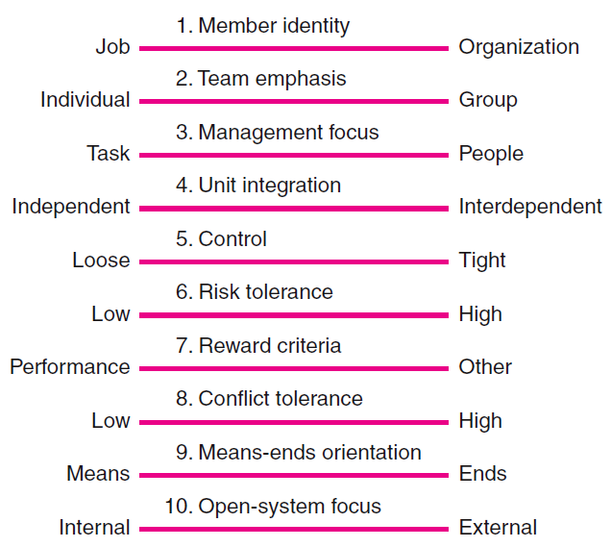
Key Dimensions Defining an Organization’s Culture
www.midocean.ae

Slide 31
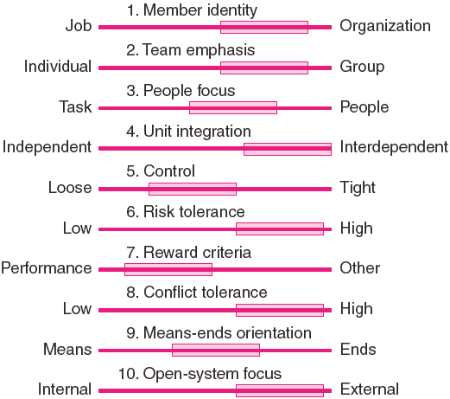
Cultural Dimensions of an Organization Supportive
of Project Management
www.midocean.ae

Slide 32
Challenges for Project Managers in Navigating Organizational Cultures:
- Interacting with the culture of the parent organization.
Interacting with the project’s clients or customer organizations.
Interacting with other organizations connected to the project.
Implications of Organizational Culture
for Organizing Projects
www.midocean.ae

Slide 33
Conclusion drawn at
last…..
Remember ,that the best culture makes all employees feel safe and welcome, never excluded or uncomfortable.
Focusing on "culture fit” alone makes it difficult to hire and welcome employees who are different than the prevailing culture, even if they’d be an asset and great counterbalance at your company.
www.midocean.ae

Slide 34



Thank You

