Slide 1

PMG 622
Agile Project Management
LECTURE 04: IMPLEMENTING AGILE: DELIVERING IN AN AGILE ENVIRONMENT [Part 1 of 2]
Everyone’s Smart
University
دكتور مهندس استشاري ادارة المشروعات
Eng. Dr. Akram Mustafa Suliman Ali,
PhD. AU, BEng. & MSc. AAST, CEng CMarEng MIMarEST, PE, PMP®,
ASQ CSSBB, ISO Lead Auditor, NDT Level II,

Slide 2
Quick Review and Introduction

Slide 3
The agile mindset
Agile is a mindset defined by values, guided by principles and manifested through many different practices.
Agile practitioners select practices based on their needs.
Notes:
It is worth noting that while the term “agile” became popularized after the Manifesto, the approaches and techniques being used by project teams today existed before the Agile Manifesto by many years and, in some cases, decades.

Slide 4
Agile Manifesto / “4 Values”
Working products
Customer collaboration
Over
Over
Process and tools
Comprehensive documentation
Responding to change
Individuals and interactions
Contract negotiation
Following and plan
Over
Over
We are uncovering better ways of developing software by doing it and helping others do it.
Through this work we have come to value:
That is, while there is value in the items on the right, we value the items on the left more.

Slide 6
Characteristics of Four Categories of Life Cycles

Slide 7
Attributes of Successful Agile Teams [1/2]
Attribute | Goal
Dedicated people | Increased focus and productivity Small team, fewer than ten people
Cross-functional team members | Develop and deliver often Deliver finished value as an independent team Integrate all the work activities to deliver finished work Provide feedback from inside the team and from others, such as the product owner
Colocation or ability to manage any location challenges | Better communication Improved team dynamics Knowledge sharing Reduced cost of learning Able to commit to working with each other

Slide 8
Attributes of Successful Agile Teams [2/2]
Attribute | Goal
Mixed team of generalists and specialists | Specialists provide dedicated expertise and generalists provide flexibility of who does what Team brings their specialist capabilities and often become generalizing specialists, with a focus specialty plus breadth of experience across multiple skills
Stable work environment | Depend on each other to deliver Agreed-upon approach to the work Simplified team cost calculations (run rate) Preservation and expansion of intellectual capital

Slide 9
Subject matter experts
Forum Topic: Subject Matter Experts
Why is it important to master the skill to benefitting form the utilization of Subject Matter Experts
What the key skills to master in order to effectively benefit from utilization of SME
What role can SMEs play in Agile Developments

Slide 10
Scrum roles, artifacts & ceremonies
SCRUM ARTIFICATS
  Product Backlog
  Sprint Backlog
  Increment
SCRUM CERMONIES
  Sprint Planning.
  Daily Scrum.
  Sprint Review.
  Sprint Retrospective.
SCRUM ROLES
  Product Owner
  Development Team Members
  Scrum Master

Slide 11
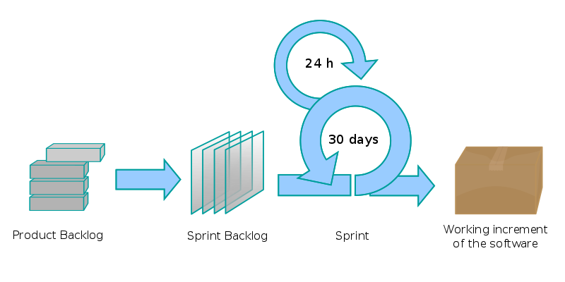

Slide 12
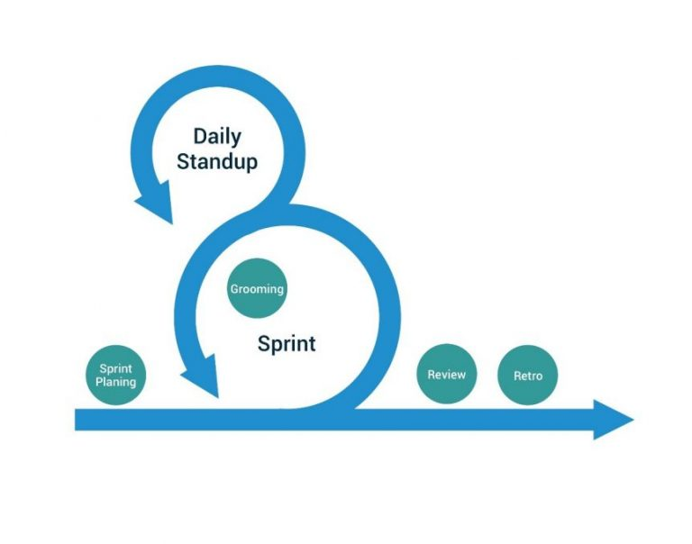

Slide 13
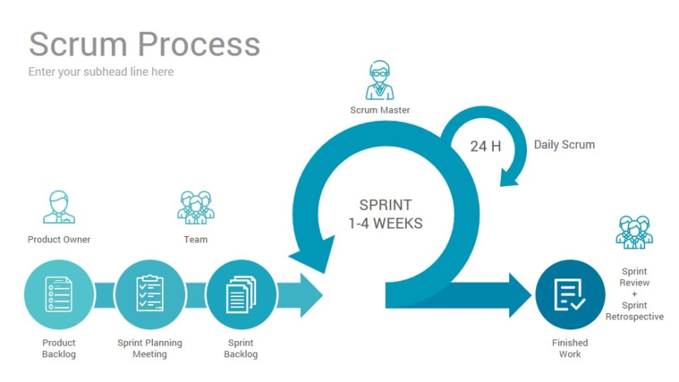

Slide 14


Slide 15
DELIVERING IN AN AGILE ENVIRONMENT

Slide 16
Current and last lecture overview
IMPLEMENTING AGILE: CREATING AN AGILE ENVIRONMENT
IMPLEMENTING AGILE: DELIVERING IN AN AGILE ENVIRONMENT

Slide 17
CHARTER THE PROJECT AND THE TEAM
Project Charter
Team Charter

Slide 18
PROJECT CHARTER
Why this project matters
Where the team is headed
What the project objective is
The WHY
The HOW
The WHAT
Why are we doing this project? This is the project vision.
Who benefits and how? This may be part of the project vision and/or project purpose.
What does done mean for the project? These are the project's release criteria.
How are we going to work together? This explains the intended flow of work.
Notes:
A servant leader may facilitate the chartering process

Slide 19
TEAM CHARTER
Team norms
Understanding of how to work together
Teams do not need a formal process for chartering as long as the teams understand how to work together.
Some teams benefit from a team chartering process.
  Team values, such as sustainable pace and core hours;
  Working agreements, such as what “ready” means so the team can take in work; what “done” means so the team can judge completeness consistently; respecting the time-box; or the use of work-in-process limits;
  Ground rules, such as one person talking in a meeting; and
  Group norms, such as how the team treats meeting times.
Notes:
The servant leader together with the team may decide to address other behaviors.
Remember that the team's social contract—its team charter—is how the team members interact with each other. The goal of the team charter is to create an agile environment in which team members can work to the best of their ability as a team.

Slide 20
COMMON AGILE PRACTICES

Slide 21
RETROSPECTIVES [1/2]
The single most important practice is the retrospective because it allows the team to learn about, improve, and adapt its process
Retrospectives help the team learn from its previous work on the product and its process
One of the principles behind the Agile Manifesto is: “At regular intervals, the team reflects on how to become more effective, then tunes and adjusts its behavior accordingly.”
Teams benefit from allocating enough time to learn, either from an interim retrospective or an end-of-the-project retrospective
Notes:
The HOW
Lessons Learnt
Continuous Improvement

Slide 22
RETROSPECTIVES [2/2]
Teams need to learn about their work product and work process.
First and foremost, a retrospective is not about blame;
The retrospective is about looking at the qualitative (people's feelings) and
quantitative (measurements) data, then using that data to find root causes, designing countermeasures, and developing action plans.
The project team may end up with many action items to remove impediments
A facilitator from the team leads them through an activity to rank the importance of each improvement item.
Once the improvement items are ranked by the team, the team chooses the appropriate number to work on for the next iteration (or adds work to the flow if flow-based).
Notes:
Acronyms and Definitions (glossary at the end of the book)

Slide 23
Team members may decide to retrospect at these key times:
Many teams use iterations—especially 2-week iterations—because the iteration prompts a demonstration and a retrospective at the end
  When the team completes a release or ships something. It does not have to be a monumental increment. It can be any release, no matter how small.
  When more than a few weeks have passed since the previous retrospective.
  When the team appears to be stuck and completed work is not flowing through the team.
  When the team reaches any other milestone.

Slide 24
BACKLOG PREPARATION
The backlog is the ordered list of all the work, presented in story form, for a team.
There is no need to create all of the stories for the entire project before the work starts—only enough to understand the first release in broad brushstrokes and then sufficient items for the next iteration.
Product owners might produce a product roadmap to show the anticipated sequence of deliverables over time. The product owner re-plans the roadmap based on what the team produces.
Notes:
Index cards or sticky notes
Rolling Wave

Slide 25


Slide 27
BACKLOG REFINEMENT
In iteration-based agile, the product owner often works with the team to prepare some stories for the upcoming iteration during one or more sessions in the middle of the iteration.
The purpose of these meetings is to refine enough stories so the team understands what the stories are and how large the stories are in relation to each other.
Allow the product owner to present story ideas to the team and for the team to learn about the potential challenges or problems in the stories.
If the product owner is unsure of the dependencies, the product owner can request the team to spike the feature in order to understand the risks.
Notes:
Small Medium Large

Slide 28
tip
Consider using impact mapping to see how the product fits together.
Under normal circumstances, the product owner leads this work. A servant leader can facilitate any necessary meetings as a way of serving the project.

Slide 29
how long the refinement should be
Many iteration-based agile teams use a time-boxed 1-hour discussion midway through a 2-week iteration.
Just-in-time refinement for flow-based agile. The team takes the next card off the to-do column and discusses it.
Multiple refinement discussions for iteration-based agile teams. Teams can use this when they are new to the product, the product area, or the problem domain.
Notes:
Teams often have a goal of spending not more than 1 hour per week refining stories for the next batch of work.
Teams want to maximize the time spent doing work as opposed to planning work.
If the team needs to spend more than 1 hour per week refining stories, the product owner could be over-preparing, or the team may be lacking some critical skills needed to evaluate and refine the work.

Slide 30
ways to conduct backlog preparation and refinement meetings
There are many ways for the product owner to conduct backlog preparation and refinement meetings, including for example:
Encourage the team to work as triads of developer, tester, business analyst/product owner to discuss and write the story.
Present the overall story concept to the team. The team discusses and refines it into as many stories as required.
Work with the team to find various ways to explore and write the stories together, making sure all of the stories are small enough so the team can produce a steady flow of completed work. Consider becoming able to complete a story at least once a day.
Notes:
Epic

Slide 31
DAILY STANDUPS
Teams use standups to micro-commit to each other, uncover problems, and ensure the work flows smoothly through the team.
Time-box the standup to no longer than 15 minutes. The team “walks” the Kanban or task board in some way, and anyone from the team can facilitate the standup.

Slide 32
iteration-based agile daily stand-up questions
What did I complete since the last standup?
What am I planning to complete between now and the next standup?
What are my impediments (or risks or problems)?
Notes:
Questions like these generate answers that allow the team to self-organize and
hold each other accountable for completing the work they committed to the day
before and throughout the iteration

Slide 33
flow-based agile daily stand-up questions
What do we need to do to advance this piece of work?
Is anyone working on anything that is not on the board?
What do we need to finish as a team?
Are there any bottlenecks or blockers to the flow of work?
Notes:
The team assesses the board from right to left.

Slide 34
Standup antipatterns
Standups become status meetings. Teams who have traditionally worked in a predictive environment may tend to fall into this antipattern since they are used to providing a status.
The team begins to solve problems as they become apparent. Standups are for realizing there are problems —not for solving them. Add the issues to a parking lot, and then create another meeting, which might be right after the standup, and solve problems there.
Standups can be very useful, provided the nature of the team's work requires intense collaboration.
Notes:
TIP
Encourage any team member to facilitate the standup instead of a project
manager or leader to ensure it does not turn into a status meeting, but
instead is used as a time for the team to self-organize and make
commitments to each other.

Slide 35
DEMONSTRATIONS/REVIEWS
As the team completes the features usually in the form of user stories, the team periodically demonstrates the working product.
The product owner sees the demonstration and accepts or declines stories.
In iteration-based agile, the team demonstrates all completed work items at the end of the iteration.
In flow-based agile, the team demonstrates completed work when it is time to do so, usually when enough features have accumulated into a set that is coherent.

Slide 36
gUIDELINES
A fundamental part of what makes a project agile is the frequent delivery of a working product.
Teams, including the product owner, need feedback to decide how early to ask for product feedback
Demonstrate whatever the team has as a working product at least once every 2 weeks
Notes:
That frequency is enough for most teams, so
team members can get feedback that prevents them from heading in a wrong
direction. That is also frequent enough so that the teams can keep the product
development clean enough to build a complete product as often as they want or
need to.

Slide 37
PLANNING FOR ITERATION-BASED AGILE
Teams consider their story size so they do not try to commit to more stories than there is team capacity to complete within one iteration.
When teams have a reduced capacity, they will only plan for work that meets that capacity.
Teams estimate what they can complete, which is a measure of capacity
Agile teams do not plan just once in one single chunk. Instead, agile teams plan a little, deliver, learn, and then replan a little more in an ongoing cycle.
Notes:
Each team's capacity is different. Each product owner's typical story size is different.

Slide 38
EXECUTION PRACTICES THAT HELP TEAMS DELIVER VALUE
If the team does not pay attention to quality, it will soon become impossible to release anything rapidly.
The following technical practices, many of which come from eXtreme Programming, may help the team to deliver at their maximum speed:
  Continuous integration
  Test at all levels
  Acceptance Test-Driven Development (ATDD)
  Test-Driven Development (TDD) and Behavior-Driven Development (BDD)
  Spikes (timeboxed research or experiments)

Slide 39
Continuous integration
Perform frequent incorporation of work into the whole, no matter the product, and then retest to determine that the entire product still works as intended.

Slide 40
Test at all levels
Employ system-level testing for end-to-end information and unit testing for the building blocks.
In between, understand if there is a need for integration testing and where.
Teams find smoke testing helpful as a first look at whether the work product is any good.
Teams have found that deciding when to run regression tests and which ones helps them maintain product quality with good build performance.
Agile teams have a strong preference for automated tests so they can build and maintain a momentum of delivery.
Notes:
Regression testing is testing existing software applications to make sure that a change or addition hasn't broken any existing functionality.

Slide 41
Acceptance Test-Driven Development (ATDD)
In ATDD, the entire team gets together and discusses the acceptance criteria for a work product.
Then the team creates the tests, which allows the team to write just enough code and automated tests to meet the criteria.
For non-software projects, consider how to test the work as the team completes chunks of value.

Slide 42
Test-Driven Development (TDD) and Behavior-Driven Development (BDD)
Writing automated tests before writing/creating the product actually helps people design and mistake-proof the product.
For non-software projects, consider how to “test-drive” the team's designs.
Hardware and mechanical projects often use simulations for interim tests of their designs.

Slide 43
Spikes (timeboxed research or Experiments)
Spikes are useful for learning and may be used in circumstances such as: estimation, acceptance criteria definition, and understanding the flow of a user's action through the product.
Spikes are helpful when the team needs to learn some critical technical or functional element.

Slide 44
HOW ITERATIONS AND INCREMENTS HELP DELIVER WORKING PRODUCT
Iterations help a team create a cadence for delivery and many kinds of feedback.
Teams produce increments of value for delivery and feedback.
The first part of this delivery is a demonstration.
Teams receive feedback about how the product looks and operates through a demo.
Team members retrospect to see how they can inspect and adapt their process to succeed.
Demonstrations or reviews are a necessary part of the agile project flow.
Schedule the demonstration as appropriate for the team's delivery cadence.

