Slide 1


Regression Analysis
Part II
Prepared by Dr. Hesham Mousli
MHA 613
Statistics in Healthcare
Lecture 10

Slide 2

Chapter
Intended Objectives
10
Understand the concepts of simple and multiple linear regression in healthcare settings.
Learn the steps involved in performing regression analysis, including preparing data and interpreting results.
Explore the applications of regression models, including assessing significant associations and making predictions.
Analyze case scenarios to apply regression models to real-world healthcare problems.

Slide 3

Chapter
10
Simple Linear Regression
Understanding Concepts and Interpreting Results

Slide 4
Chapter
Simple Linear Regression
10
Simple linear regression examines the relationship between two numerical variables.
Key assumptions:
  Data points should roughly align along a straight line.
  Random scatter around the line with no extreme outliers.

Slide 5
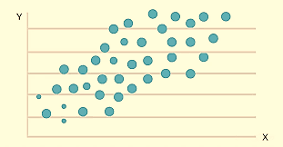
Steps in Performing Regression Analysis
Chapter
10
Prepare data: Two columns for X (independent) and Y (dependent).
Set variables: Assign roles for X and Y.

Slide 6
Steps in Performing Regression Analysis
Chapter
10
Use software to:
  Generate graphs and residual plots.
  Provide regression table and goodness-of-fit measures.

Slide 7
Chapter
Interpreting the Results
10
Scatter plot: Visual trend between X and Y.
  p-value for intercept & slope:
    < 0.05: Significant association between X and Y.
    ≥ 0.05: No conclusive evidence of association.
Goodness-of-fit: Evaluates how well the model fits the data.

Slide 8
Chapter
Predictive Model
10
Regression equation: Y = a + bX.
Use to predict Y based on X values.
Residual standard error: Measures prediction accuracy.

Slide 9
Case Example: Weight and Blood Pressure
Chapter
10
Hypothesis: Higher weight is associated with higher BP.
Observations:
  Low weight → Low BP (lower-left of scatter plot).
  High weight → High BP (upper-right of scatter plot).
Example regression equation: BP = 76.9 + 0.487 × Weight.

Slide 10
Case Scenario (1)
Chapter
10
An insurance company wants to estimate a patient's monthly healthcare costs based on the number of chronic conditions they have. Using patient data, they build a regression model where monthly healthcare cost (in dollars) is the dependent variable and the number of chronic conditions is the independent variable.

Slide 11
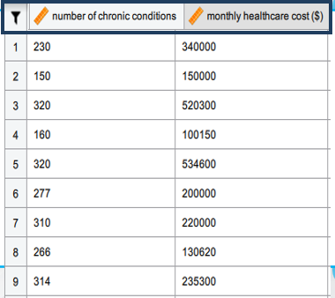

Slide 12
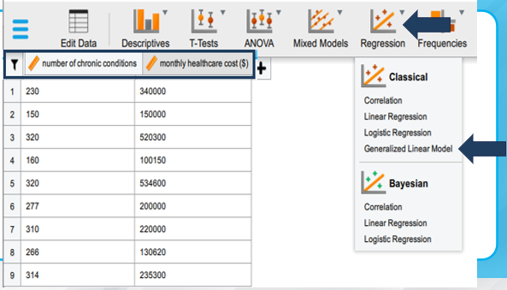

Slide 13
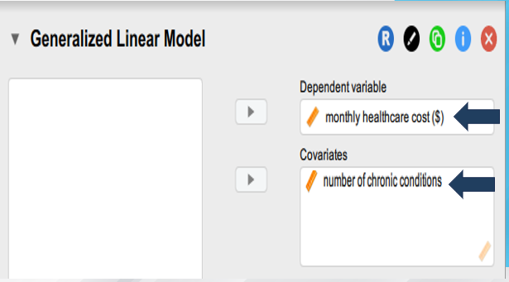

Slide 14
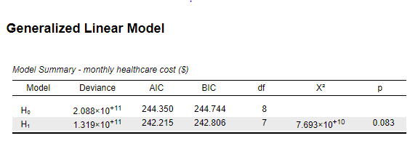

Slide 15
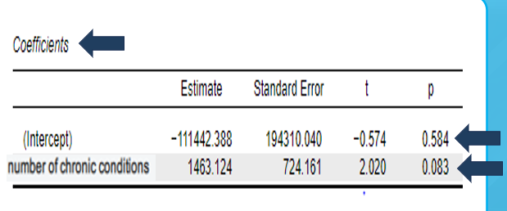

Slide 16
Case Scenario (1)
The regression model's p-values indicate the following:
  Model (p = 0.083): No significant overall relationship between the number of chronic patients and monthly healthcare costs.
  Intercept (p = 0.584): Baseline costs when chronic conditions are zero are not statistically reliable.

Slide 17
Case Scenario (1)
Number of Chronic Conditions (p = 0.083): It does not provide strong evidence of a meaningful relationship with monthly healthcare costs.
Implication:
  The model is not reliable for estimating monthly healthcare costs based solely on the number of chronic conditions.

Slide 18
Chapter
10
Multiple Linear Regression
Understanding Concepts and Interpreting Results

Slide 19
What is Multiple Linear Regression?
Chapter
10
A statistical method to model the relationship between a dependent variable and multiple predictors.
Used to predict an outcome variable based on multiple input variables.
Extends simple regression by incorporating multiple independent variables.

Slide 20
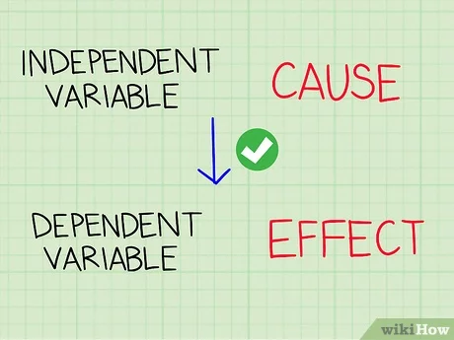
Chapter
Key Terms
10
Dependent Variable: The outcome variable being predicted.
Independent Variables: Predictors that influence the dependent variable.

Slide 21
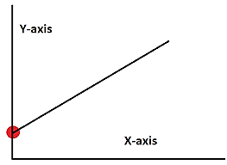
Chapter
Key Terms
10
Intercept: The predicted value when all predictors are zero.
Coefficients: Represent the change in the dependent variable for a one-unit change in a predictor, holding others constant.

Slide 22
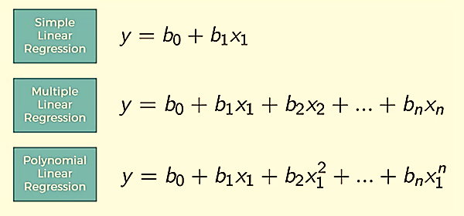

Slide 23
Chapter
Formulas and Interpretation
10
General Model: Y = β0 + β1X1 + β2X2 + ... + βnXn
Coefficients (β): Reflect the impact of each predictor.
Constant Term (β0): Baseline prediction (Intercept).
Example: Y = a + bX1 + cX2 predicts Y using X1 and X2.

Slide 24
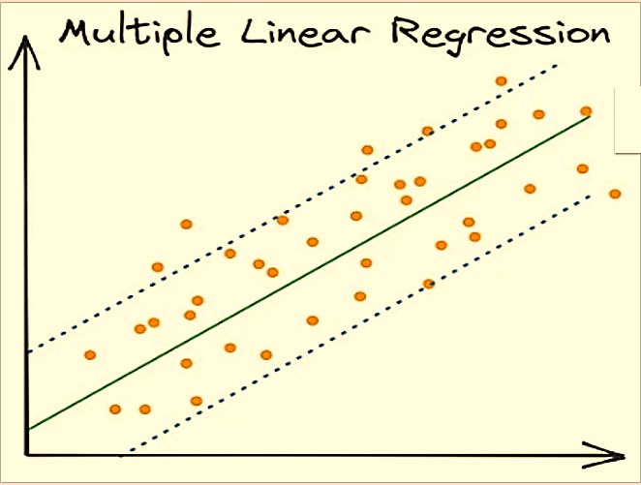
Patient satisfaction score
LOS
Age
Costs
INTERCEPTS

Slide 25
Chapter
Applications of Multiple Linear Regression
10
Assessing significant associations.
Making predictions and forecasting.
Deriving values of parameters with practical meanings.

Slide 26

Chapter
Interpreting the Results
10
  The P-value in the context of multiple linear regression results evaluates the statistical significance of the coefficients and the overall model.

Slide 27
Interpreting the Results
P-values
Chapter
10
R-squared:
  Role: The p-value is indirectly related to R² through the F-test, which tests the overall model fit.
  Interpretation: A small p-value for the F-test indicates that the model as a whole is significant, meaning at least one predictor explains a significant portion of the variance in the dependent variable.

Slide 28
Interpreting the Results
P-values
Chapter
10
Intercept:
  Role: Tests whether the intercept is significantly different from zero.
  Interpretation: A small p-value (<0.05) suggests that the intercept has a meaningful contribution, though its practical importance depends on the context of the predictors.

Slide 29
Interpreting the Results
R² & Coefficients
Chapter
10
R-squared (Coefficient of Determination):
  Definition: Represents the proportion of variance in the dependent variable explained by the predictors.
  Interpretation: Higher values (closer to 1) indicate a better fit of the model to the data.

Slide 30
Interpreting the Results
R² & Coefficients
Chapter
10
Intercept (Constant Term):
  Definition: The predicted value of the dependent variable when all predictors are zero.
  Interpretation: Serves as the baseline prediction; its relevance depends on whether a zero value for predictors is meaningful.

Slide 31
Interpreting the Results
R² & Coefficients
Chapter
10
Coefficients of Multiple Predictors:
  Definition: Measure the change in the dependent variable for a one-unit change in the predictor, holding other predictors constant.
  Interpretation: Positive coefficients indicate an increase, and negative coefficients indicate a decrease in the outcome variable with an increase in the predictor.

Slide 32
Case Scenario (2)
Chapter
10
A hospital administrator wants to predict the length of stay (LOS) of patients. Using historical data, the regression model includes the following predictors:
  Dependent Variable (Y): Patient’s length of stay (LOS)
  Independent Variables (X): Patient age, number of chronic conditions, and years of suffering comorbidities.
  Question: How can the results the guide number of assigned beds for each department?

Slide 33
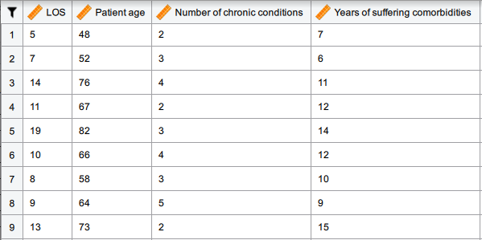

Slide 34
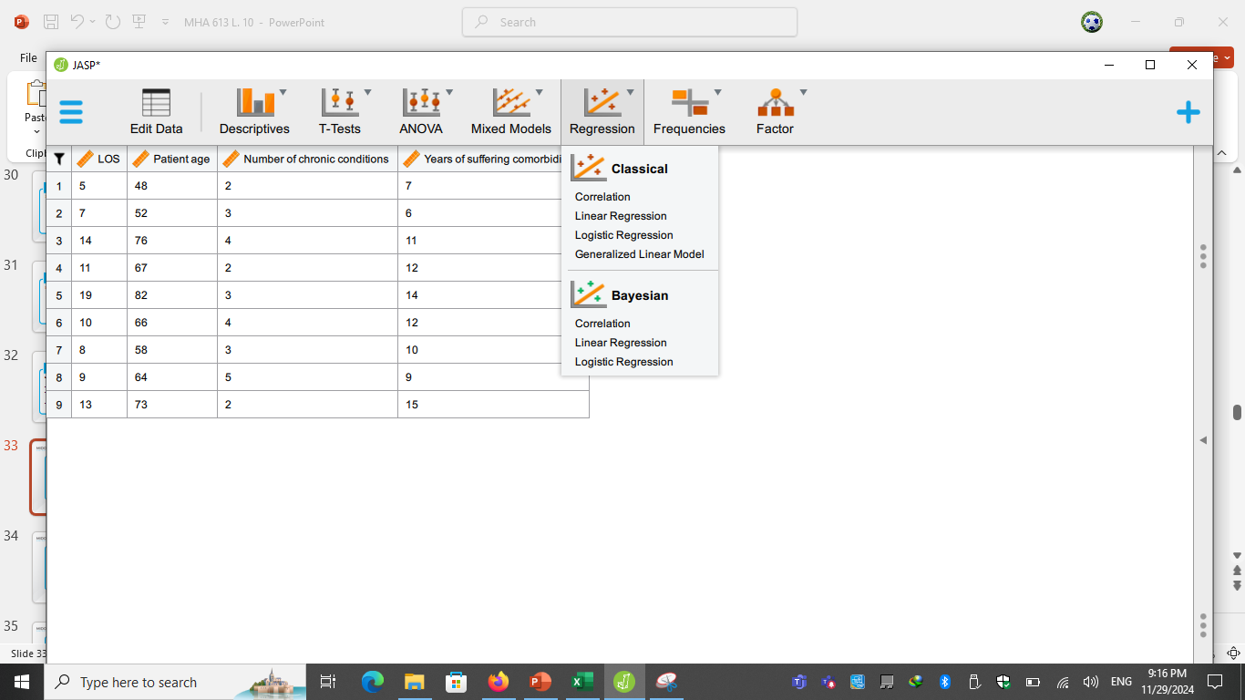

Slide 35
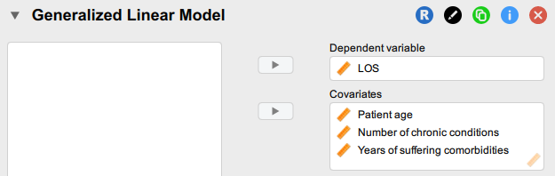

Slide 36
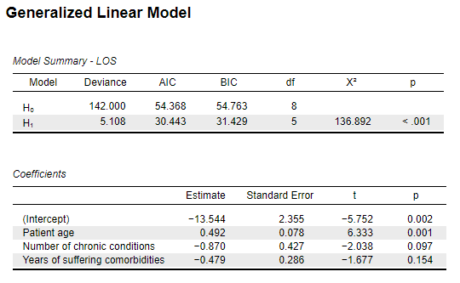

Slide 38
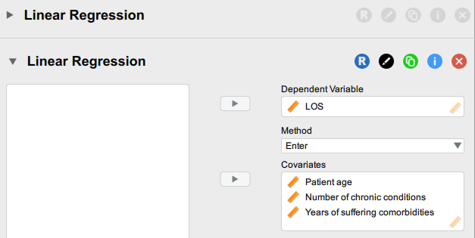

Slide 39
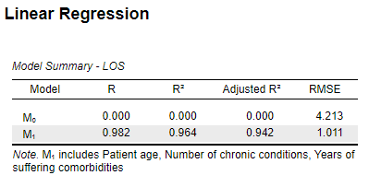

Slide 40
Case Scenario (2)
The regression model is statistically significant (p < 0.001) and explains a very high proportion of the variability in length of stay (LOS), (R² = 0.964).
Implication:
  Allocating resources efficiently, focusing on patients predicted to have the highest length of stay.

Slide 41
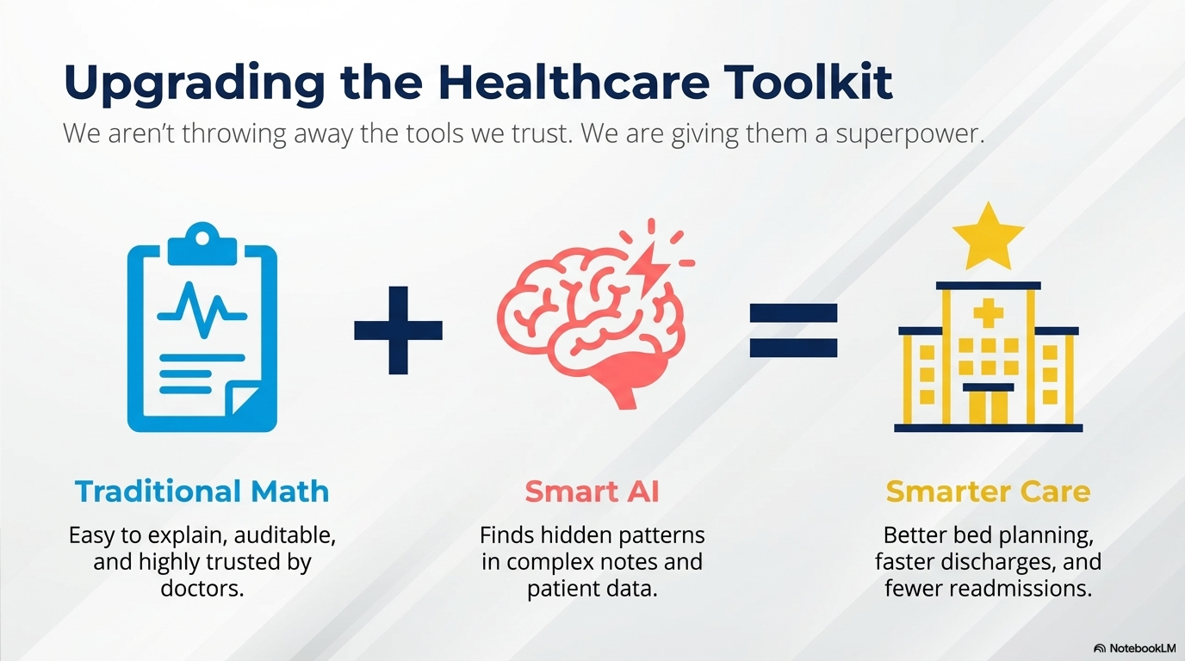

Slide 42
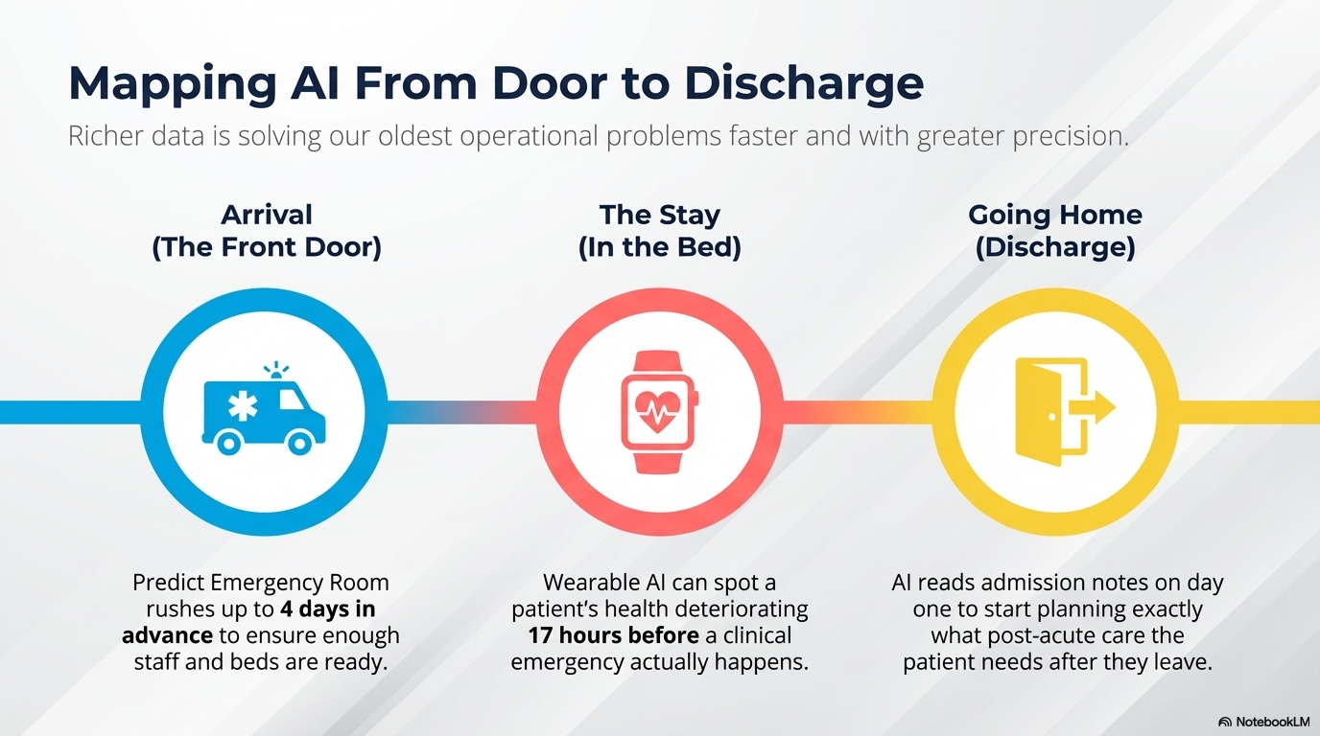

Slide 43
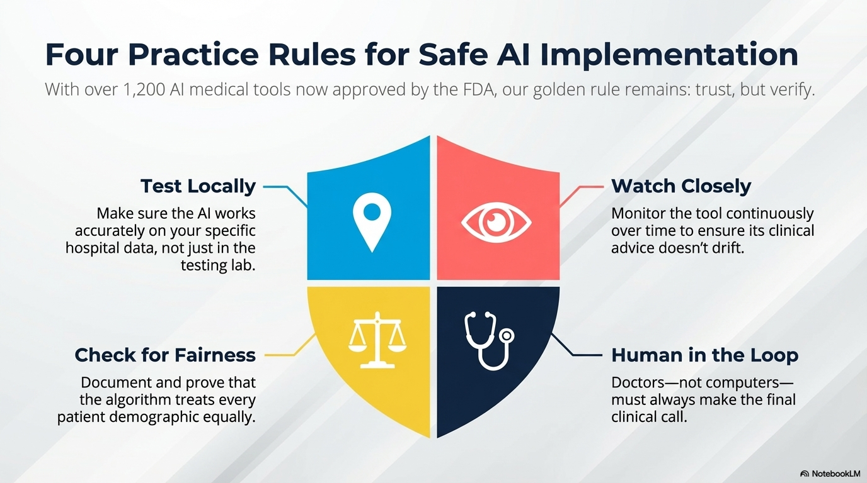

Slide 44




Thank You

