Slide 1

The Induction Session
Master of Entrepreneurship Program
Entrepreneurial Leadership & Organizational Behaviour
ENT 612
Dr Nahed Ahmed

Slide 2
Who am I?
I'm
Doctoral Researcher, York Business School, York St John University. UK
A Global Ambassador, Yorksj International Student Support Office. UK
One of the eight winners of the Civic Scholars Award. UK. 2021. 2022
One of two winners of the Guild-HE Doctoral Research. UK. 2020, 2021
One of the winners of the HESPAL Scholarship for the PhD by the British Council Palestine. 2019
More than 10 years of teaching administrative and financial courses.
More than 10 years of training in managerial, financial and entrepreneurial skills.
More than 10 years of senior administrative positions in Palestinian universities.

Slide 3
My Publications
2022 | "From Refugee to Entrepreneurship: Motivations factors and Challenges from the MENA Region" The chapter is expected to be a part of the book "Case Studies of Immigrant Entrepreneurship: Migrant Entrepreneurs in Contemporary Society - Palgrave Macmillan.
2022 | "Yemen Heaven: An ethnographic study of Yemeni female entrepreneurship in the United Kingdom: Concurrent marginalisation facilitating the reconstruction of individual identity" in the 15th Annual Ethnography Symposium 2022 of the University of Suffolk.
2022 | “From Refugee to Entrepreneurship: Motivations factors and Challenges of Three Women from the MENA Region” ON Research Journal of EU Business School Vol. 8. June.
2021 | “The Impact of Informal Social Capital on the Success of Female Entrepreneurship in the Gaza Strip” BAM conference. British Academy of Management. UK
2020 | “Female Entrepreneurship in Gaza Strip: Exploring the Role of Social Capital” BAM conference. British Academy of Management. UK
2018 | "Elements of women’s economic empowerment from the point of view of Palestinian female entrepreneurs” Sixth International Scientific Conference "The latest developments in administrative and economic sciences and their role in improving the performance of institutions". University of Jordan – Amman
2017 | “Women Entrepreneurs in the Gaza Strip: Success and Failure Factors “Journal of Al Isra’a University for Social Sciences and Humanities, Palestine.
2014 | “Women’s level of awareness of the role of self-employment in fighting poverty “, Al Aqsa University, Journal of Social Sciences, Palestine.
2012 | “Success of Family Projects in Severe Life Conditions - a case study “, Entrepreneurship & Small Business Management Conference, Faculty of Commerce, Islamic University of Gaza, Palestine.
2008 | “The Reality of Human Capital in the Small Projects”, administrative contemporary trends conference, Palestine.

Slide 4
This course will explore the theory and practice of Entrepreneurial leadership and Organizational behaviour
Credit Hours: 3 credit hours.

Slide 5
Introduction
This course focuses on building an Entrepreneurial Leadership Foundation where entrepreneurial leadership is a style that empowers individuals to take action and solve problems, navigate uncertainty, and embrace ambiguity.
This course will be the starting point in Organizational Behaviour where you will take a close look at global issues through an experiential entrepreneurial leadership lens, developing the ability to think strategically and systematically about different scenarios, and how to unpick them innovatively, creatively, and courageously.

Slide 6
The part of entrepreneurial leadership
Learning foundational entrepreneurial leadership skills.
Gaining techniques for encouraging collaboration, innovation, and creativity in different workplaces.
Understanding how to develop a growth-oriented leadership style.
Understanding Leadership principles for enhancing a collaborative work environment in which innovation succeeds.
Learning the leadership strategy.

Slide 7
The part organizational behaviour
Understanding the rationale of Organizational Behaviour and its characteristics.
Understanding theories and applications of personal attitudes, learning, perceptions and personality.
Understanding the concepts of group dynamics, motivation, communications and leadership.
Having a basic background in organizational culture.
Gaining the skills of conflict resolution.

Slide 8
The textbook:
Entrepreneurial Leadership: A practical Guide to Generating New Business by Angelo Mastrangelo 1st Edition.
Organizational Behaviour 14th Edition by Stephen P Robbins and Timothy A Judge

Slide 9
Lectures timetable for the first semester of 2023
The lecturer | The course | Course Code | The discussion session
Dr . Nahed Ahmed | Entrepreneurial Leadership & Organizational Behaviour | ENT612 | Monday 8:00 – 9:00 pm Saudi Arabia time

Slide 10

All sessions will be recorded, and each will have an online quiz

Slide 11
80% short exams during the semester
Exams
&
Marks
20% final exam

Slide 12

The final exam is only
60
minutes

Slide 13

All exams will be done through the educational platform (Model).

Slide 14
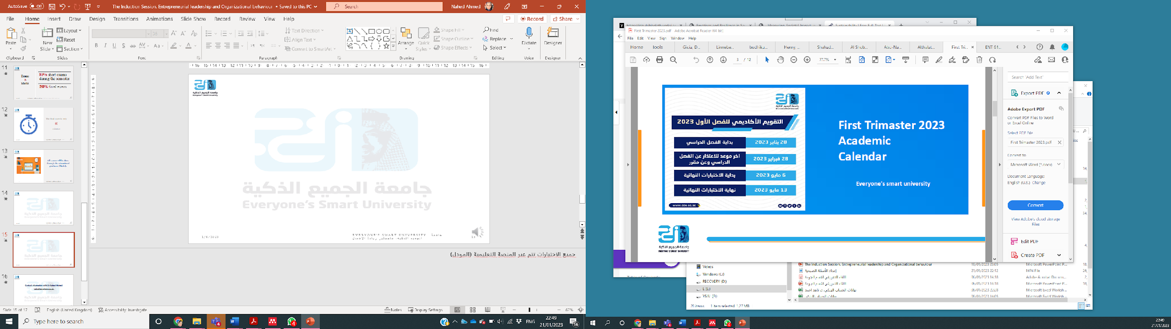

First Trimester 2023 Academic Calendar

Slide 15
Contact information with Dr Nahed Ahmed
nahed.kamal@esu.ac.ae

Slide 16

Wish you all the best

